Slide 1
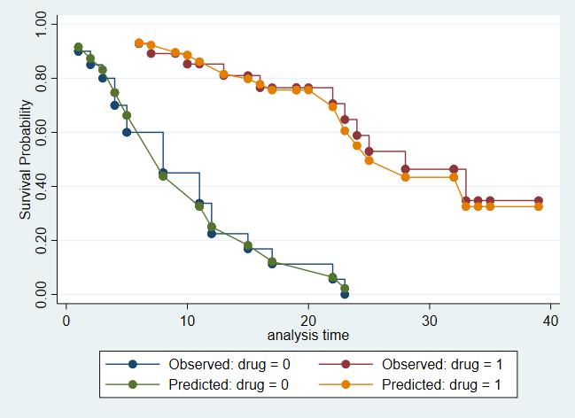
Survival analysis using Stata
Gabriela Ortiz

Slide 2
Overview
Introduction to survival-time data
Summary statistics
Exploratory graphs
Estimation
Semiparametric and parametric models
Predictions
Diagnostics
Goodness-of-fit plots
Testing assumptions

Slide 3
Introduction to survival data

Slide 4
Survival-time data
We measure time to an event of interest
The occurrence of the event is typically called a failure
An observation is censored if we don’t know the exact time of failure
Survival-time data is present in many fields
Health
Economics
Business
Criminology
Stata’s st suite of commands is designed for analyzing survival-time data
Notes:
Survival analysis has applications in many fields.
This might be time elapsed from a diagnosis to death; but failure isn’t always a bad thing, it can also be time from illness to recovery.
Time to employment, time to bankruptcy, or for criminology, you might be looking at time until relapse

Slide 5
A look at survival data
One record per patient
Patient ID | Sex | Days | Died
1 | Male | 89 | Yes
2 | Female | 91 | No
3 | Male | 90 | Yes
Notes:
Suppose we’re looking at time elapsed from a diagnosis to death.
The first and third patient died around 90 days after diagnosis.

Slide 6
A look at survival data
One record per patient
Patient ID | Sex | Days | Died
1 | Male | 89 | Yes
2 | Female | 91 | No
3 | Male | 90 | Yes
Diagnosis
Study ends
Died
The patient’s time of death is right-censored if they survive until the end of the study.
Notes:
Let’s say our study ended after 3 months.
If a patient survives until the end of a study, the patient’s time of death is right-censored.
We don’t know the time of failure, all we know is that at the end of the study, they hadn’t died.
Later we’ll discuss other types of censoring.

Slide 7
Single- vs. multiple-record data
One record per patient
Patient ID | Sex | Days | Died
1 | Male | 89 | Yes
2 | Female | 91 | No
3 | Male | 90 | Yes
Two records per patient
Patient ID | Sex | Days | Died
1 | Male | 33 | No
1 | Male | 89 | Yes
2 | Female | 33 | No
2 | Female | 91 | No
3 | Male | 32 | No
3 | Male | 90 | Yes
Notes:
We might have multiple records per subject. At 33 days, all patients have survived. One patient died 89 days after diagnosis, another 90 days after.
Also, note that time can be recorded in a number of ways. It might just be a number, for example we have the number of days, or it might be the patient’s age at the time, or calendar dates.

Slide 8
Final notes on survival data
There are other varieties
A subject might be diagnosed before the study starts, meaning they are at risk before we observe them (delayed entry).
There might be a gap between the time the subject entered the study and the time the study ended. Suppose the patient was traveling and unable to be reached for a month in the middle of the study but returned before the study ended.
You might have multiple-failure data.
We won’t be focusing on these types of complications, but Stata’s commands for analyzing survival-time data accommodate data with these features.
Notes:
A delayed entry is one example of left-truncation. We are able to observe this subject only because up until now they haven’t failed.
Some events can happen more than once, resulting in multiple-failure data. An example would be if we’re looking at time to a new cavity. So for each dental appointment we record if the patient has a new cavity.

Slide 9
A first example

Slide 10
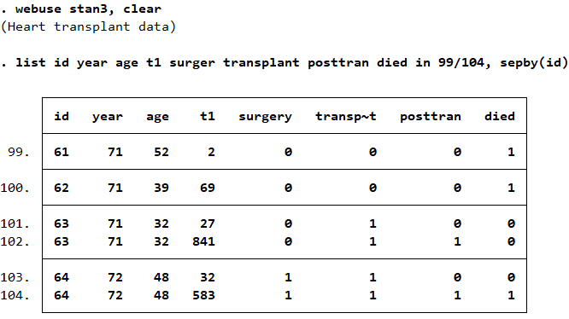
A look at survival-time data
Before using Stata’s st commands, we need to stset the data.
Notes:
Here we have patients admitted to the Stanford Heart Transplantation Program.
Patients waited for an available donor heart. Some died while waiting, others were transferred out of the program.
We have the YEAR the patient was accepted into the program along with the patient’s AGE, time in days since being admitted to the program, whether the patient had other heart surgery previously, and whether the patient received a transplant. Posttran is 0 and becomes 1 after the patient has received a transplant. We use –stset- to tell Stata the characteristics of our data, declaring our data to be survival data. We need to do this before using any –st- commands because Stata will use this information.
The exception being –stintreg-.

Slide 11
Declare data to be survival-time data
Notes:
Here we’ve specified the time variable t1, and failure is indicated by the variable died.
Died is binary; 0 means they didn’t die, 1 means they did. But you could also have a categorical failure variable; you would simply tell Stata which value represents failure.
Because we have multiple records per patient, we tell Stata that ID identifies each subject.
Exit refers to when we last observed the subject. This is usually when the failure occurred, but if one didn’t occur, it’s the end of the data for that subject.
Out of the 103 subjects, 75 died. The failure is death, so we have single-failure data.
Patients were admitted to the program because they need a transplant, so the number of days since they joined the program is the number of days they have been at risk; it’s the time they’ve been waiting for a transplant. With other data, you might have subjects join a program before they are at risk, so you would tell Stata when they become at risk, with –stset-.
Now that we’ve stset this data, we can use the –st- commands.

Slide 12
Describe survival-time data
Notes:
For example, with this command we see that all the subjects entered at time 0; this is when the subject is first under observation, so when they were admitted to the transplant program; some exited as early as time 1, but the median was 90 days
The max is 1799, as we saw from –stset-. That’s almost 5 years!
There are no gaps, and there were 75 failures. So about 73% of the subjects in this heart transplant program died.
Let’s take a look at the overall survivor function

Slide 13
Kaplan–Meier survivor function
. sts graph
S(t)=Pr(T>t)
Notes:
Here we have the probability of surviving beyond time t, which can also be said as
The probability that there is no failure event prior to t.
We see how quickly people pass in the first section of the graph
And the max survival time is between 1500 and 2000
If we take the area under this survivor function, we get the mean survival time.

Slide 14
Kaplan–Meier survivor function by group
. sts graph, by(surgery) risktable
Notes:
Here we plot the survivor functions separately for those who had other heart surgery previously, and those who didn’t. The green line represents individuals without previous heart surgeries, and they have a longer estimated survival time, but their probability of survival decreases more rapidly.
If we look around day 350, those with a history of surgery have about a 74% probability of surviving beyond that, and those
Without have about 26% probability of surviving beyond that.
I’ve also included a table with the number at risk. The numbers correspond to the analysis times on the x-axis.
At risk means the individual is at risk of the failure event occurring, which is death. By 5000 days, we only have 23 individuals left.

Slide 15
Confidence interval for median survival time
Notes:
I mentioned that if we take the area under the survivor function, we get the mean survival time.
Stci can compute this for us. We can also get the median survival time, or any other percentile we specify.
By default it will compute the median survival time, which is at 100 days
But this might differ across those who did and didn’t receive a transplant

Slide 16
Confidence interval by group
Notes:
So we use the by() option, and see that the median survival time is longer for those who received a transplant.
Recall that we will have two observations for individuals who do receive a transplant; everyone has posttran==0
And those who do receive one have a second observation, for posttran==1.
So out of the 103 subjects, 69 received a transplant.
We calculated the median survival time, but we can look at other statistics as well.

Slide 17
Summary statistics
Notes:
Here we see the total time at risk separately for individuals without a transplant, and for individuals that received one
And the incidence rate, which in this example, is the rate at which people pass away
This is calculated as the number of failures divided by the total time at risk for all the individuals in that group.
We also get percentiles of survival time; the 25th percentiles are very similar, but we see a big gap for the 75th percentiles.

Slide 18
Other statistics
Incidence rates
Obtain estimates and confidence intervals for the incidence-rate ratio (IRR) and incidence-rate difference. See [ST] stir.
Obtain person-time and incidence rate. Also, merge with standard-rate data to obtain SMRs. See [ST] stptime.
Failure rates
Tabulate failure rates by multiple categorical variables
Obtain stratified rate ratios
Carry out trend tests
See [ST] strate.
Life tables
Life, cumulative failure, and hazard tables
Graph survival rate and corresponding confidence interval
See [ST] ltable.
Notes:
--Those were just a couple of statistics you might look at, but there is more available.
You can obtain incidence-rate ratios and incidence-rate differences
If your data are stratified, you can obtain stratified IRRs with a test of homogeneity
In epidemiology, incidence rates are often presented per 1,000 person-years. You can obtain these type of rates with –stptime-.
Or if you have rates for a reference population, you can merge that data in and obtain standardized mortality ratios.
--If you’re interested in failure rates, you can tabulate the rate across levels of another variable.
So for example you could look at the failure rate across different age categories
And you can obtain the rate ratio for levels of another variable.
(And you can obtain rate ratios controlled for analysis time separately for each level of another variable.)
If you have a continuous variable, or an interval variable, you might also test for a trend of rates with these variables

Slide 19
Test equality of survivor functions
Notes:
In addition to summary statistics, there are several tests available as well.
For example, here we test whether the survivor functions are equal for the groups formed by posttran, which again is 0 if the individual hasn’t received a transplant, and becomes 1 when they do. 45 individuals who received a new heart passed away.
Here we fail to reject the hypothesis that the survivor functions are the same.
In this case we performed the log rank test, but there are 5 other tests that you can also perform with this command.

Slide 20
Cox proportional hazards model
Notes:
Now we’ve looked at some summary statistics and exploratory graphs.
Let’s move on to fitting regression models.
We’ll start with semiparametric models.

Slide 21
Single-observation survival-time data
Notes:
We’re going to change over to another dataset for the next example.
This dataset has information on a cancer drug trial
Some patients received a treatment, others received a placebo.
Our goal is to analyze time until death, which is measured in months
In this case, we have one observation per person, so there is no ID variable.
Studytime records the months to death, or the last month that they were known to be alive. Died indicates whether an individual passed away.
The patient’s age is also recorded.

Slide 22
Display survival-time settings
Notes:
These data have already been –stset-, so we can just type stset to take a look at those settings
This is the command that was typed; we see that there are 31 failures.
And the longest time of analysis is 39 months

Slide 23
Survivor and hazard functions
$$Probability of surviving$$
$$beyond time t$$
$$Hazard of failing at time t$$
. sts graph, surv saving(survival)
. sts graph, hazard nob saving(hazard)
. graph combine survival hazard
Notes:
Here we have the survivor function, and we see the that the probability of surviving decreases with time. We can also think of the data in terms of failure. So we have an estimate of the hazard function; the hazard function is the instantaneous rate of failure. This graph is based on a kernel smooth, and kernel- based estimators are biased near the boundaries. So by default, the smoothed hazards are adjusted near the boundaries. So I used the –noboundary- option to tell Stata not to make these adjustments. In the data we would see that one of the 4 individuals surviving up to 33 days died. After that, we don’t have any failures, so that’s where this graph ends. You can create graphs such as this one to explore the hazard function before fitting your model. Now that we have an intuition for hazard, let’s talk about modeling the hazard.

Slide 24
Cox proportional hazards model
$$h\left(t\right)= h_{0}\left(t\right)exp\left(β_{1}x_{1}+⋯+β_{k}x_{k}\right)$$
where $h_{0}\left(t\right)$ is the baseline hazard
The hazard depends on the covariates; we estimate their coefficients ($β_{k}$).
We assume the hazard ratio (exp($β_{k})$) is fixed over time.
Notes:
One model we can use with survival data is the Cox proportional hazards model
With this model, the hazard is assumed to follow this formula. But we make no assumptions about the baseline hazard.
This is the hazard when all the covariates are zero. Many times people will center the covariates so that the baseline corresponds to something meaningful.

Slide 25
Cox proportional hazards model
Notes:
We fit a Cox proportional hazards model in which the failure rate depends on age and whether the subject took the drug or a placebo. We see that the hazard ratio is about 1/10, meaning the drug results in a longer survival time than the placebo.
And, since the hazard ratio for age is > 1, older patients are more likely to die.
Let’s see what this model tells us about survivorship.
You may have noticed the comment on ties. Essentially, the proportional hazards model assumes that the hazard function is continuous, so there are no tied failures. But suppose two subjects have a failure recorded at the same time. There are a couple of different ways to handle this, but the default is to use the Breslow method. You can take a look at the documentation for other methods you can specify for handling tied failures.

Slide 26
Survivor function
. stcurve, survival
Notes:
Here we plot the survivor function; the default behavior is to set the covariates to their means. But the mean of “drug” doesn’t tell us anything, so let’s plot this function separately when we set drug=0 and when we set drug=1

Slide 27
Survivor function
. stcurve, survival
at1(drug=0 age=50)
at2(drug=0 age=60)
at3(drug=1 age=50)
at4(drug=1 age=60)
Notes:
Better yet, here I’ve set both drug and age to specific values.
Beginning with the bottom line, ORANGE, this is the survival function for a 65 year old who takes the placebo. For a 45 year old taking the placebo, GREEN, there is a big jump in the survivor function, at least for the first 20 months. There is a difference of around 0.6 in the probability if we look at 10 months. If we have a 45 year old taking the placebo, he or she has the same probability of surviving as a 65 year old receiving the treatment. This is the overlap you’re seeing between the green and purple lines. And the top line is for a 45 year old receiving treatment; so younger individuals receiving treatment have the highest probability of surviving, compared to their older counterparts and those who just take a placebo.
(I’ve omitted some graph formatting options here, but they will be in the do-file that we distribute.)

Slide 28
Hazard function
. stcurve, hazard
at1(drug=0) at2(drug=1)
Notes:
Here we plot the hazard function for those taking the placebo and those taking the treatment.
We see a drastic difference; receiving the treatment greatly reduces the hazard of death.

Slide 29
Assessing our model
Statistics
How well do our predictions agree with the outcomes?
Does the proportional-hazards assumption hold?
Diagnostic plots
Plot of residuals versus time
Log-log plots
Comparison of the observed survival curve and the Cox predicted curve
Notes:
Okay, we just saw the estimated hazard and survivor function, but
there are also some diagnostics available when fitting this type of model.
For example we can see if the outcome and predictions are in agreement.
We can assess whether the proportional hazards assumption is valid.
And, while graphical assessment is subjective, there are some diagnostic plots available as well.
All 3 of these graphs assess whether the proportional-hazards assumption has been violated

Slide 30
Concordance probability
Notes:
This command calculates the probability that predictions and outcomes are concordant, or in agreement.
The statistic that is computed by default is biased in the presence of censoring, so we requested
Gonen and Heller’s estimate of the concordance probability
What does it mean? we can correctly order survival times for pairs of patients about 78% of the
time on the basis of measurement of drug and age.
So it will compare patients, If the predicted survival time is larger for the
patient who lived longer, the predictions for the pair are said to be in agreement with the outcome.

Slide 31
Test the proportional hazards assumption
Notes:
We can also test the proportional hazards assumption with –estat phtest-
The detail option will test the assumption separately for each covariate
There is no evidence that the proportional-hazards assumption has been violated.
What this command is doing in the background is computing scaled residuals (Schoenfeld) for each covariate, and testing the null hypothesis that the slope is equal to zero when plotted against a function of time. And then it performs a global test. Again, we assume the hazard is fixed over time; a slope of zero is equivalent to saying the log hazard-ratio function is constant over time

Slide 32
Plotting Schoenfeld residuals versus time
. estat phtest, plot(drug)
Notes:
We can even plot these scaled residuals versus time.
Here I’ve plotted the residuals for the drug variable; and we have a flat line, a slope of 0

Slide 33
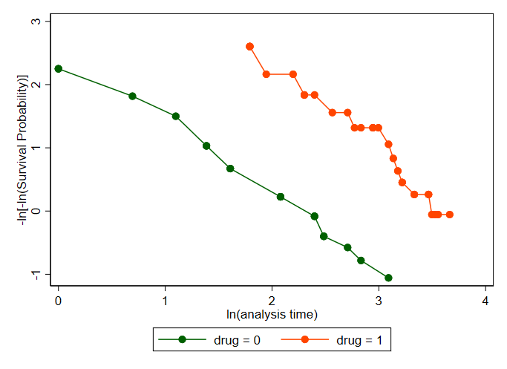
Log-log plot
. stphplot, by(drug)
Notes:
Here is another plot used to assess the validity of the proportional hazards assumption.
This plots the $−ln\left\{−ln(survival probability)\right\}$ against ln(analysis time) for levels of a categorical variable.
The proportional-hazards assumption is not violated when the curves are parallel.
And the curves for placebo and treatment look parallel.

Slide 34
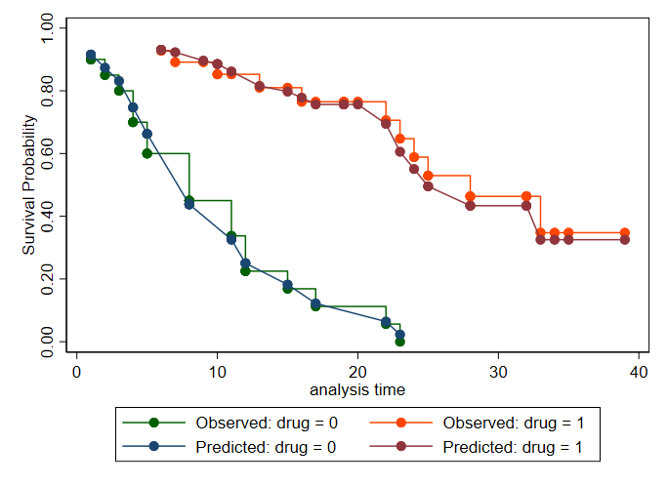
Kaplan–Meier and predicted survival plots
. stcoxkm, by(drug)
Notes:
With stcoxkm we can plot the Kaplan–Meier observed survival curves with the Cox predicted
curves for the same variable. The closer the observed values are to the predicted, the less likely it is
that the proportional-hazards assumption has been violated.
The blue and green lines are for the placebo group, the burgundy and orange ones are for the treatment group.
So all three graphs are in agreement, the proportional hazards assumption holds

Slide 35
More on the proportional-hazards assumption
Graphical assessment of the proportional-hazards assumption
Log-log plots
Adjust the estimates to average values of specified variables
Kaplan–Meier and predicted survival plots
Specify the method to handle tied failures
Test the proportional-hazards assumption
Test using Schoenfeld residuals
Choose from other time-scale functions or specify your own function of time
To learn more, see [ST]stcox PH-assumption tests.
Notes:
In addition to the graphs we’ve seen, you can also adjust ..
And specify …
And you can modify the look of either graph with any twoway_option.
For –estat phtest-, we performed the test using analysis time, but you can choose from other time scale functions, such as the rank of analysis time or the natural log of analysis time; and you can even specify your own function of time

Slide 36
Interaction between a covariate and analysis time
Notes:
Another thing we can do is interact a covariate with analysis time using the tvc() option. (time-varying covariate)
If the proportional hazards assumption holds for age, then the interaction should not be significant
Based on this p-value, it is not statistically significant.

Slide 37
Shared-frailty models
Notes:
If you want to fit a random-effects model, where observations within a group are correlated, you can fit a Cox regression with shared frailty.

Slide 38
Shared-frailty models
$h_{ij}\left(t\right)= h_{0}\left(t\right)exp\left(x_{ij}β+v_{i}\right)$
where $v_{i}$ is the effect of being in group i
Observations within a group share the same frailty and are thus correlated
Frailties are unobserved and can be predicted after fitting the model
Analogous to regression models with random effects
Notes:
A frailty is a latent random effect; here v_i is the log frailty for the group i
So observations within a group are correlated because they share the same frailty
If the within-group correlation is zero, then this reduces to the standard Cox model
Frailties are unobserved, and can be predicted after fitting the model.
(Note to self: frailties are not estimated within the model, they are predicted conditionally on the parameters and the data)

Slide 39
Shared-frailty data
Notes:
For an example of shared-frailties, we’re going to load a dataset on kidney dialysis patients.
We have two recurrence times in days measured for each patient.
For each recurrence of kidney failure, kidney dialysis is performed by inserting a catheter.
And we have an indicator for whether there was an infection at the catheter insertion point.
The time recorded is the time from initial insertion of the catether to either infection or censoring. We have the patient’s age and sex recorded as well. The group is defined by the patient, and the observations correspond to catheter insertions. So we think that recurrence of kidney failure is independent across individuals, but correlated within insertion points for the same patient.

Slide 40
Declare data to be survival-time data
Notes:
So we –stset- the data; the binary variable infect indicates failure
The time variable records the time from initial insertion of the catheter to either infection or censoring, so this is our time variable.
And we can now fit our Cox model, where we assume that the correlation of recurrence times between catheter insertions for the same individual is due to a patient-level frailty

Slide 41
Cox regression with shared frailty
Notes:
It’s as simple as specifying this shared() option.
A couple of things to note here, on the right you’ll see the observations per group.
But we already knew that we have exactly 2 observations per person. On the left, you see the group variable, and the frailties are assumed to be gamma distributed, with mean 1. Theta is the variance of the frailties, and its estimated from the data. If theta is zero, then all the frailties are equal, and the model reduces to a standard Cox model. But based on the likelihood ratio test, there is a significant frailty effect. Turning now to the hazard ratios, age doesn’t seem to have a statistically significant effect on the hazard for infection. But females face a much lower hazard than males, for infection.
(Theta measures the degree of within-group correlation)
We estimated the variance of the frailties, but not estimates of the frailties themselves; we can obtain those with –predict-
(!!goa omitted comment on degree of …)

Slide 42
Estimates of log frailties
Notes:
The effects option will give us the log frailties; here I’ve sorted the data based on these frailties, and listed the first and last patient.
What do these frailties tell us?

Slide 43
Estimates of log frailties
$h_{ij}\left(t\right)= h_{0}\left(t\right)×exp\left(x_{ij}β \right)$× $exp\left(v_{i}\right)$
Notes:
The smallest value represents the least frail patient. So that’s patient 21.
Here is the hazard function, and v_i represents the frailties
As you can see, they enter the hazard function multiplicatively
If we exponentiate these values, you’ll see that the smaller value results in a smaller hazard; while the larger value (0.5) results in a larger hazard.

Slide 44
Other variations of the Cox model
Stratified Cox regression
Group specific baseline hazard
. stcox x1 x2, strata(svar)
Select another method to handle tied failures
Efron, exact marginal-likelihood, or exact partial-likelihood
Learn more about fitting a Cox proportional hazards model in [ST]stcox.
Notes:
If you think the baseline hazard functions differs across groups in your data, you can fit a
stratified cox regression--the coefficients are assumed to be the same, regardless of group, but the baseline hazard can be group specific.
As mentioned, the default was to use the Breslow method to handle tied failures, but there are other methods available.

Slide 45
Competing risks regression models
Notes:
So far we’ve been talking only about our failure event of interest, but sometimes you’ll have one or more competing failure events that prevent your event of interest. In these cases, you’ll want to account for these other events.

Slide 46
Competing failure events
Consider patients in an ICU after having a heart attack
Model the time until a cardiac arrest
If a patient dies, they are no longer at risk for cardiac arrest
The event of death competes with our event of interest
With this type of data, we want to focus on the cumulative incidence function
Notes:
Just to clarify, if we observe death for a patient, he or she is not censored.
Censored means we don’t know the time of failure.
Death prevents the cardiac arrest from happening.

Slide 47
Cumulative incidence function
CIF(t)=Pr(T≤t and event of interest)
Notes:
The CIF is is the probability that you will observe the event of primary interest before a given time.
In the presence of competing failure events, when thinking about the probability of someone surviving, we would ask, for example
“what is the probability that the individual survives 50 days, and we observe cardiac arrest?”
Because they might survive 50 days and then die. But we won’t know until the event occurs, if it is death or cardiac arrest.
So this is why we look at the cumulative incidence function, so that we can ask something like “What is the probability of observing a cardiac arrest within 50 days?”

Slide 48
Hazards for competing risks
Hazard for a cardiac arrest: $h_{1}(t)$
Hazard for death: $h_{2}(t)$
Total hazard: $h(t)$= $h_{1}(t)$ + $h_{2}\left(t\right)$
Probability of the event being a cardiac arrest: $\frac{h_{1}(T)}{h_{1}(T)+h_{2}(T)}$
Subhazard for cardiac arrest: $\overline{h_{1}}\left(t\right)$
Notes:
Cardiac arrest → our event of interest
Death → competing event
So the probability of cardiac arrest depends on both hazards, and so we’ll be modeling
The subhazard of cardiac arrest.
--the subhazard allows us to look at the incidence of cardiac arrest, while taking into account that individuals are at risk of both cardiac arrest and death

Slide 49
Subhazard
Cumulative subhazard: $\overline{H_{1}} \left(t\right)=\int_{0}^{t}{\overline{h_{1}}\left(t\right)dt}$
$CIF1(t)$= 1- exp{-$\overline{H_{1}} (t)$}
This accounts for the fact that the cumulative incidence is a function of both hazards
Model: $\overline{h_{1}}\left(t|x\right)=$ $\overline{h_{1,0}}\left(t\right)×exp⁡(xβ)$
Notes:
If we integrate over the analysis time, we get the cumulative subhazard.
And we can use this to obtain the cumulative incidence function.
So when we fit a competing-risks regression, we’ll model the subhazard.
We have the subhazard, given the values of the covariates X.
This h_1,0 is the baseline subhazard; this is the subhazard when all the covariates are set to 0
We’ll be estimating the betas, which are subhazard ratios.
So let’s apply our knew terminology:
To measure the incidence of our event of interest, we use the cumulative incidence estimator.
Here we have the CIF for cardiac arrests. This is a function of
(Incidence is the number of new failures that occur during a specified period in a population at risk)

Slide 50
Data with competing failure events
Notes:
For each patient, we have an ID number, their age when admitted to the hospital for a heart attack.
And the number of days they have been in the intensive care unit.
A common hospital-acquired infection is pneumonia; so we have an indicator variable for this.
Patients who acquire pneumonia during their stay have two records, because pneumonia goes from 0 to 1
We also have indicators for death and cardiac arrest

Slide 51
Declare data to be survival-time data
Notes:
We stset the data; we specify id since we have multiple records for some individuals
The time variable is the number of days they have been in the ICU
And failure is cardiac arrest.

Slide 52
Competing risks regression
Notes:
We model the time to cardiac arrest as a function of the patient’s age and whether they have pneumonia
Some studies suggest that patients with pneumonia are at increased risk for cardiac arrest
And compete() indicates that death is the competing event. On the right-hand side you’ll see the breakdown of the patients that had the failure of interest, those that had the competing failure, and those that were censored. We get the results in form of subhazard ratios; interpretation is similar to hazard ratios with stcox
So increased age and contracting pneumonia are associated with an increased incidence of cardiac arrest in the ICU.

Slide 53
Graph of cumulative incidence function
. stcurve, cif at1(pneumonia=0) at2(pneumonia=1)
Notes:
Now we can take a look at the cumulative incidence function.
If we just type –stcurve, cif- we’ll get the function evaluated at the mean of age and mean of pneumonia.
So here I specify that we want the function for those without pneumonia, and those with pneumonia.
There is a dramatic difference; the incidence of cardiac arrest is 3 times higher for those with pneumonia.

Slide 54
Parametric survival models
Notes:
The Cox proportional hazards model and the competing risks regression models were semiparametric regression models
Now we’re going to move on to parametric survival models

Slide 55
Parametric survival models
With Stata, you can fit
Accelerated failure-time (AFT) models
$\log{t_{j}= x_{j}β+z_{j}}$
Change the time scale by a factor of $exp⁡(−x_{j}β)$
Notes:
AFT: the natural logarithm of the survival time, log t, is expressed as a linear function of the covariates
-zj is the error with density f(.)
-If we let this be the normal density, the lognormal regression model is obtained.
-Or, by letting this be the logistic density, the loglogistic regression is obtained.
The AFT model changes the time scale by a factor of – exp(-xjb)
Depending on whether this factor is greater or less than 1, time is either accelerated or decelerated
-Accelerated failure time means an increase in the expected waiting time for failure

Slide 56
Parametric survival models
With Stata, you can fit
Accelerated failure-time (AFT) models
$\log{t_{j}= x_{j}β+z_{j}}$
Change the time scale by a factor of $exp⁡(−x_{j}β)$
Proportional hazards (PH) models
$h({t_{j})= h_{0}(t)×g(x_{j})}$
Covariates have a multiplicative effect on the hazard function
Stata supports multiple parametric survival distributions when fitting either of these types of models.
Notes:
For proportional hazards models, the covariates have a multiplicative effect on the hazard function
-g(xj) is a nonnegative function of the covariates; if we use the exponential function, and leave the baseline hazard unspecified, this is equivalent to the Cox proportional hazards model
Let’s take a look at a couple.

Slide 57
Gompertz distribution
Suitable for data with monotone hazard rates
$h(t)=exp⁡(xβ)×exp⁡(γt)$
Used heavily to model mortality data
Gompertz models can only be fit in the proportional hazards metric
Notes:
This distribution is suitable when you are modeling data with hazard rates that either increase or decrease exponentially with time. For example, it is used heavily to model mortality data. Benjamin Gompertz was an actuary, and he introduced a formula to express mortality rates; that’s where this comes from.
Gamma is the ancillary parameter that is estimated from the data. When gamma is zero, the hazard function is the same for all time periods, so this just becomes an exponential model.
You can fit a Gompertz survival model only when using the proportional hazards metric

Slide 58
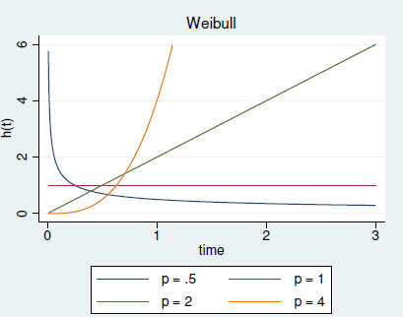
Weibull and exponential distributions
Weibull:
Suitable for data that exhibit monotone hazard rates
$h(t)=p×exp(xjβ)×t^{p−1}$
Exponential:
Suitable for data that exhibit a constant hazard
$h(t)=exp(xjβ)$
Notes:
This is another option if the hazard rate increases or decreases exponentially with time.
P is the shape parameter, and
On the right you see the hazard function for this distribution for different values of p
Another distribution that’s available is the exponential distribution. The exponential hazard is a special case of the Weibull hazard when the shape parameter p =1. p is the shape parameter and will be estimated from the data
Both of these distributions can be used to fit both accelerated failure time and proportional hazards models.

Slide 59
Loglogistic distribution
Suitable for modeling data with nonmonotonic hazard rates
$S(t)={\left\{1+{(λt)}^{1/γ}\right\}}^{−1}$
ln(t) follows a logistic distribution
Notes:
In our next example, we’ll be working with the loglogistic distribution. This distribution is specifically suitable for data in which the hazard rate increases and then decreases
Here you see the survivor function on the left, and a plot of the hazard function for this distribution on the right, for different values of the ancillary parameter, gamma. (try to keep this red curve in mind)
For this distribution, the natural logarithm of time follows a logistic distribution.

Slide 60
Fictional data from a drug trial
Notes:
For the next example we’ll be working with fictional data from a drug trial
Patients are given a placebo, or one of two drugs.
We’re recoding this variable so that 0 will indicate a placebo, and 1 will indicate either of the two drugs
The studytime variable records the months to death, or if they survived, the last month they were known to be alive
Died is an indicator variable. And we have the patients’ age at the start of the experiment

Slide 61
Declaring data to be survival-time data
Notes:
studytime is the time variable, and then failure is indicated by this binary variable died
We have 31 failures, and the longest time of analysis is 39 months

Slide 62
Parametric survival model
Notes:
We’re going to fit a model for the survival time, as a function of age and the type of drug the patient was taking. We need to specify the survival model we want to fit, so here we specify the loglogistic survival distribution. Here I’ve specified tratio, which exponentiates the coefficients to obtain time ratios
And noshow just suppresses the display of the key st variables, like died and studytime
A time ratio is a comparison of rates at which patients move along the survival curve.
For example, since the time ratio for age is 0.92, this means every one year increase in age
translates to a patient moving along the survival curve about 8% faster.
For the binary variable drug, 0 indicates placebo, 1 represents an actual drug.
Those taking a drug die at a much slower rate than those taking a placebo.
Also, look at the estimate for gamma, 0.43. So the distribution is pretty close to the red line we saw earlier.
We’ll take a look at some graphs to visualize these results.

Slide 63
Graph of the hazard function
. stcurve, hazard
Notes:
Here we look at the hazard function, and you see that same shape that we saw with the previous graph of the loglogistic distribution
We see the hazard rate increasing from 0 to 18 months, and then decreasing.

Slide 64
Graphs of survivor functions
. stcurve, survival at1(drug = 0) at2(drug=1) ylabels(0 0.5 1)
Notes:
Here we’ve graphed the survival function separately for those taking a placebo and those taking a drug
For those taking the placebo, about 50% will survive up to about 7 months
For those taking a drug, 50% will survive up to about 28 months.
Another thing we can do after fitting our model is take a look at the expected survival times.

Slide 65
Expected median survival time
Notes:
With –margins- we can obtain the expected median survival time, mean survival time, and the hazard ratios as well. Here we obtain the expected median survival time for individuals taking the placebo and those taking a drug, and we look at these expected values for a range of ages, from 50 to 65. (In our data, age ranges from late forties to late 60s.) we also get the confidence intervals for these expected median survival times. This is just a snippet, because we have 16 different values of age for three categories of drug, so it’ll be easier if we plot these results.

Slide 66
Plot of expected median survival times
. marginsplot
Notes:
Here we see that the expected median survival time drops from 47 to under 20 when we compare a 50 year old taking a drug to a 65 year old taking the drug. And that expected median varies greatly for younger individuals, but as we approach the late 60s, we get tighter confidence intervals.
For those taking the placebo, the expected median survival time looks grim. For this group, the expected median doesn’t vary quite as much.

Slide 67
Interval-censored survival-time data
Notes:
This brings me to our next section, Interval ….

Slide 68
Interval censoring
Diagnosis
Study ends
Right-censored
Study starts
Diagnosis
Study starts
Study ends
Left-censored
Diagnosis
Follow-up 1
Follow-up 2
Study ends
Interval-censored
Study starts
Notes:
We talked previously about right-censored subjects, but you might have guessed that there may also be left or interval censoring.
Suppose we’re studying the time from some diagnosis to death, and our study only runs a couple of months.
First, let’s say that anybody who is diagnosed is signed up for the study.
If a patient survives until the end of a study, the patient’s time of death is right-censored.
Then, suppose there is an individual that is diagnosed before the study was initiated, and they die before the study starts. If the failure occurred before we were able to observe them, the patient is left-censored. You may not come across this often, but it helps to understand the following case.
For the last case, suppose we follow up with patients multiple times.
During the first follow-up, they were fine. Then, they died, so they don’t make it to the second follow-up.
We don’t know when, we just know it happened after the first follow-up and before the second follow-up.
I kept things simple here, but this is the general idea.
The takeaway is that censored means we don’t know the time of failure; it might be after, or before, or sometime between two time points.

Slide 69
Interval-censored survival-time data
We fit models for these data with [ST]stintreg
Observations can be uncensored, right-censored, left-censored, or interval-censored
Like [ST]streg, we can fit both AFT and PH models
Unlike with other st commands, data do not need to be stset
This Photo by Unknown Author is licensed under CC BY-SA
Notes:
We can fit …
With this command, your data can be an assorted box of chocolates; you can have … and interval-censored.
accelerated failure-time (AFT) and proportional-hazards (PH) parameterizations are provided.
ST]stintreg ignores what we specified with [ST]stset

Slide 70
Interval-censored survival-time data
Notes:
Here we have data on breast retraction for breast cancer patients.
Patients had different visit times and durations between visits. At each visit, the
physician recorded a measure of breast retraction. The event of interest is breast retraction.
Because patients were observed at random follow-up times, the exact time of breast retraction was not observed
and was known only to fall in the interval between visits. The data consist of two interval variables,
ltime and rtime, that represent the last clinic visit time when breast retraction had not yet occurred
and the first clinic visit time when breast retraction was detected.

Slide 71
A look at our data
Notes:
The data are from a study that compared the cosmetic effects of two
cancer treatments: radiotherapy alone versus radiotherapy plus adjuvant chemotherapy

Slide 72
A look at our data
A left-censored observation is represented by a 0 or . in the lower endpoint
A right-censored observation is represented by a . in the upper endpoint
Notes:
The first two are left-censored; the last two are right-censored

Slide 73
Parametric model for interval-censored data
Notes:
We’re going to model the time to retraction simply as a function of the treatment the patient was under
And we specify the interval variables
Similar to –streg-, we need to specify the distribution.
On the right you’ll see the # of left-censored, right-censored, and interval-censored observations
On the left you’ll see that we’re using the proportional hazards metric– if you want the accelerated failure time metric you would use the –time- option
The hazard ratio for radiotherapy and chemotherapy is 2.5, meaning individuals who undergo both treatments
Are at a much higher risk than those who undergo radiotherapy alone
We also get an estimate of the shape parameter; since the coefficient for p is > 1, this indicates that the
Hazard of breast retraction increases with time.

Slide 74
Goodness-of-fit plot
. estat gofplot
Notes:
If we’d like to check how well our model fit the data, we can use this command, which
Plots the estimated cumulative hazards against the Cox–Snell residuals.
When you plot the residuals against themselves you get this 45 degree line.
When the model fits the data well, the plot of the estimated cumulative hazards will be close to the reference line, as it is in our case
* let them know you can also use stcurve after stintreg

Slide 75
Obtaining predictions
Notes:
We can also obtain predictions after fitting models with –stintreg-,
such as median and mean survival times, hazards, hazard ratios, linear predictions, standard errors, probabilities, and Cox–Snell and martingale-like residuals.
Here we obtain the mean survival time; and with tabulate we display those means along with the group size for each treatment

Slide 76
Review
Exploratory graphs
Kaplan–Meier survivor function
Summary statistics and tests
Median survival time and incidence rates
Test for equality of survivor functions
Model fitting
Cox proportional hazards model
Cox regression with shared frailty
Competing-risks regression
Regression for interval-censored data
Diagnostics
Concordance probability
Test of proportional-hazards assumption
Kaplan-Meier and predicted survival plot
Log-log plot
Goodness-of-fit plot
Explanatory graphs
Survivor, hazard, and cumulative incidence functions
Plot of predicted median survival time

Slide 77
What else can Stata do with survival data?

Slide 78
Data transformations
Convert
Count-time data to survival-time data; see [ST] cttost
Snapshot data to time-span data; see [ST] snapspan
Survival-time data to case-control data; see [ST] sttocc
Survival-time data to count-time data; see [ST] sttoct
Manipulate
Generate variables reflecting entire histories; see [ST] stgen
Split or join time-span records; see [ST] stsplit
Report variables that vary over time; see [ST] stvary
Notes:
If your data are in another format, count-time or snapshot, you can use these
commands to convert them to survival data
Or, you can convert your survival data to ..
Additionally, there is a convenience command that allows you to create variables based on functions of the time span. And to convert between single and multiple record data, you can split or join records. And you can also verify which variables vary over time

Slide 79
Other models with survival data
Models with multilevel/panel data
Random-effects parametric survival models; see [XT] xtstreg
Multilevel mixed-effects parametric survival models; see [ME] mestreg
Finite mixtures of parametric survival models; see [FMM] fmm: streg
Bayesian analysis
See [BAYES] bayes: streg
See [BAYES] bayes: mestreg
Structural equation models with survival data; see [SEM] Intro 5
Treatment-effects estimation; see [TE] stteffects

Slide 80
Designing a study for survival analysis
Sample size, power, and effect size for the Cox proportional hazards model; see [PSS] power cox
Sample size and power for the exponential test; see [PSS] power exponential
Sample size, power, and effect size for the log-rank test; see [PSS] power logrank
Notes:
If you’re designing a study for survival analysis, you can perform power analysis
To estimate the sample size required to detect say a hazard ratio of 0.5 with specified power
Or if your study will be comparing exponential survivor functions,
You can compute the required number of events to detect a specified effect size with given power.
Or compute power of the prospective study, given the sample size and effectsize
And similarly if you’ll be comparing survivor functions using a log-rank test

Slide 81
Where to learn more
Overview of Stata’s survival analysis features
Video tutorials on working with survival-time data in Stata
FAQs on working with survival-time models in Stata

Slide 82
References
Sun, J. 2006. The Statistical Analysis of Interval-Censored Failure Time Data. New York: Springer
Finkelstein, D. M., and R. A. Wolfe. 1985. A semiparametric model for regression analysis of interval-censored failure time data. Biometrics 41: 933–945.
McGilchrist, C. A., and C. W. Aisbett. 1991. Regression with frailty in survival analysis. Biometrics 47: 461–466.

Slide 83
Thank you

