Slide 1
Fitting Models and
Interpreting Results
Chuck Huber
StataCorp
chuber@stata.com
Stata Webinar
September 16, 2020

Slide 2
Download Website
You can download the slides, datasets, and do-files here:
https://tinyurl.com/statareg

Slide 3
Outline
The dataset
Linear regression with one covariate
  Continuous covariates
  Binary covariates
  Categorical covariates
Linear regression with multiple covariates
Linear regression with interactions
Linear regression with log-transformations

Slide 6
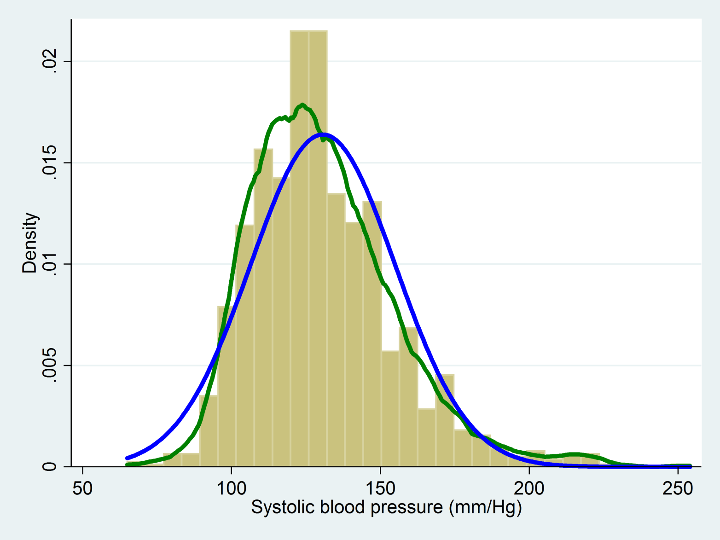
histogram sbp, normal normopts(lcolor(blue) lwidth(thick)) ///
kdensity kdenopts(lcolor(green) lwidth(thick))

Slide 7
Outline
The dataset
Linear regression with one covariate
  Continuous covariates
  Binary covariates
  Categorical covariates
Linear regression with multiple covariates
Linear regression with interactions
Linear regression with log-transformations

Slide 8
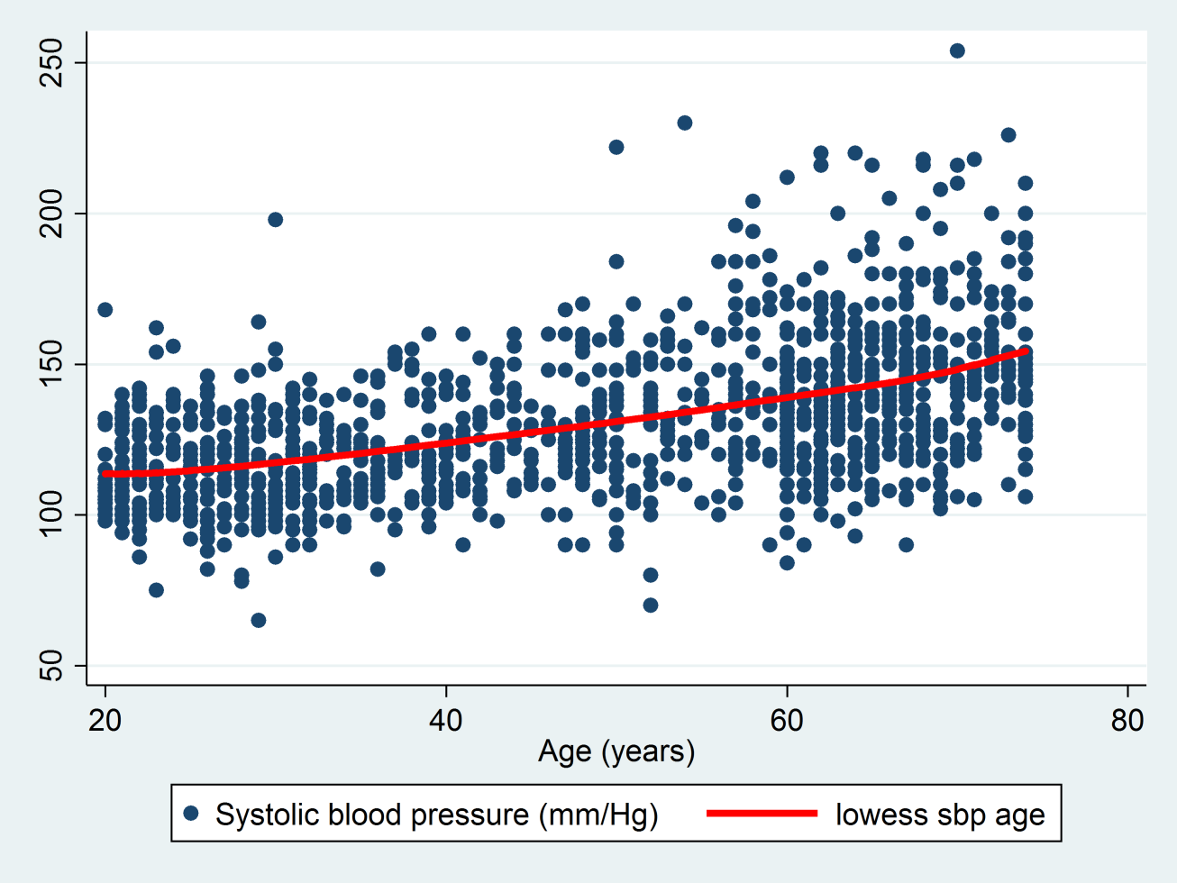
Scatterplot for SBP by Age
twoway (scatter sbp age) ///
(lowess sbp age, lcolor(red) lwidth(thick))

Slide 9
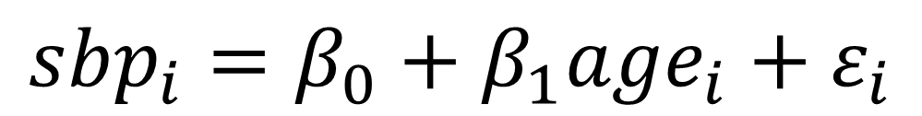
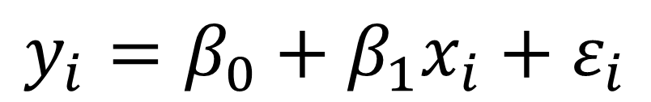
Linear Regression
Linear regression allows us to estimate the relationship between an outcome variable, y, and one or more predictor variables, x_{i}.
$$y_{i}=β_{0}+β_{1}x_{i}+ε_{i}$$
$${sbp}_{i}=β_{0}+β_{1}{age}_{i}+ε_{i}$$

Slide 10
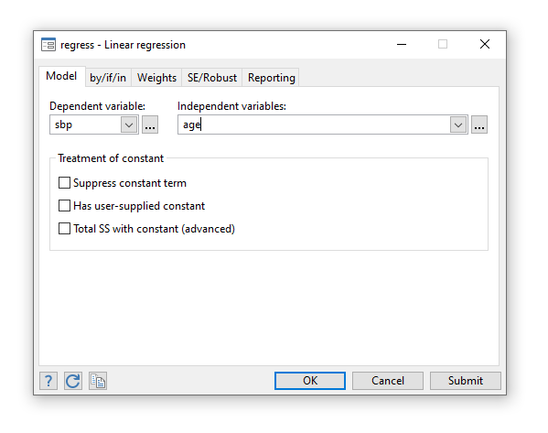
Statistics > Linear models and related > Linear regression

Slide 11
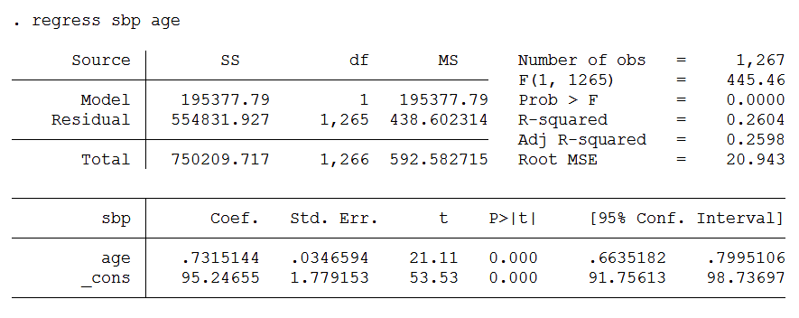
Linear Regression for Age
On average, SBP is 0.73 mm/Hg higher for each additional
year of age.

Slide 12
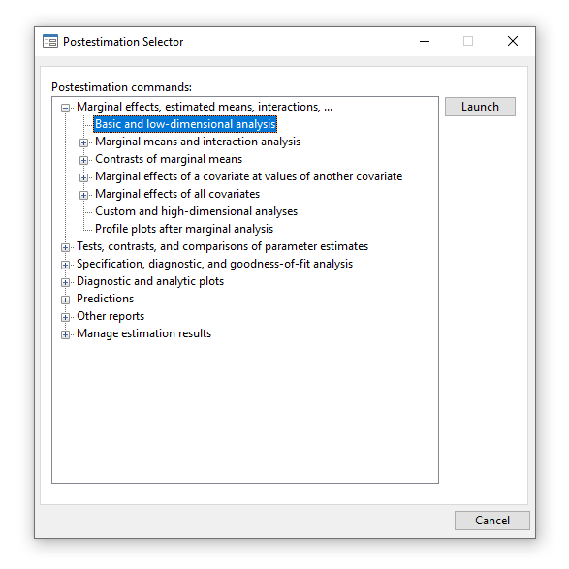
Statistics > Postestimation

Slide 13
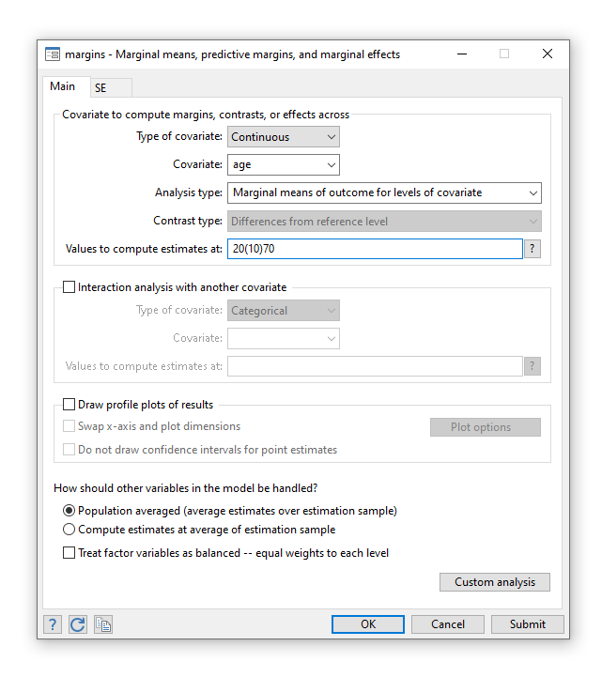
Margins

Slide 14
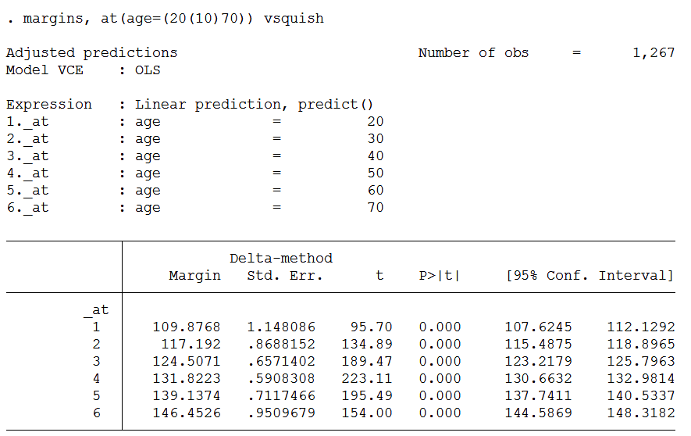
Margins for Age
Our regression model predicts that the average SBP is 109.9 mm/Hg at age 20, 117.192 at
age 30, 124.5 at age 40, 131.8 at age 50, 139.1 at age 60 and 146.5 at age 70.

Slide 15
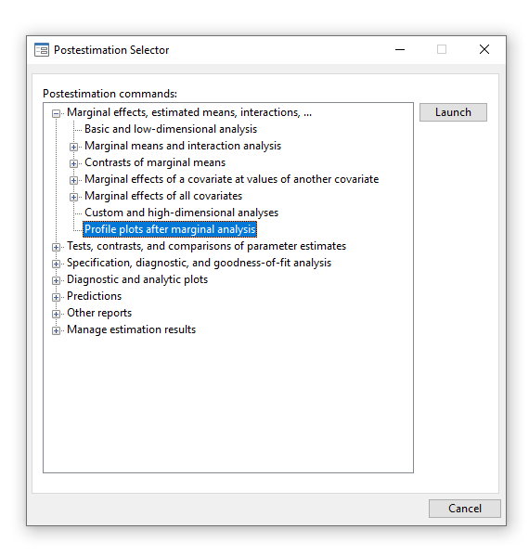
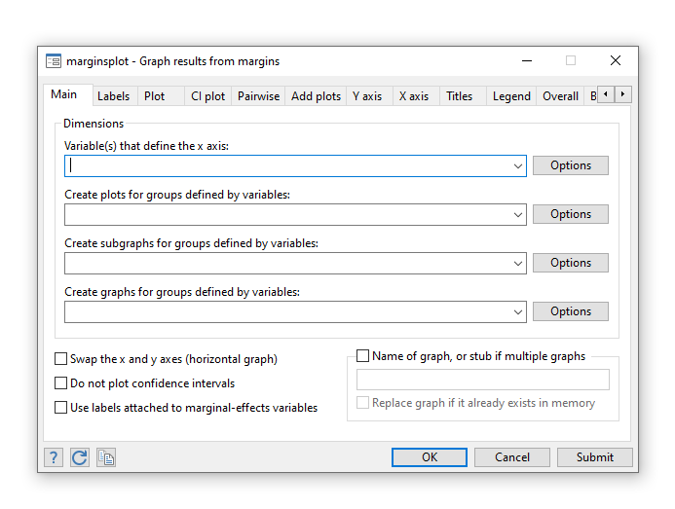
Marginsplot

Slide 16
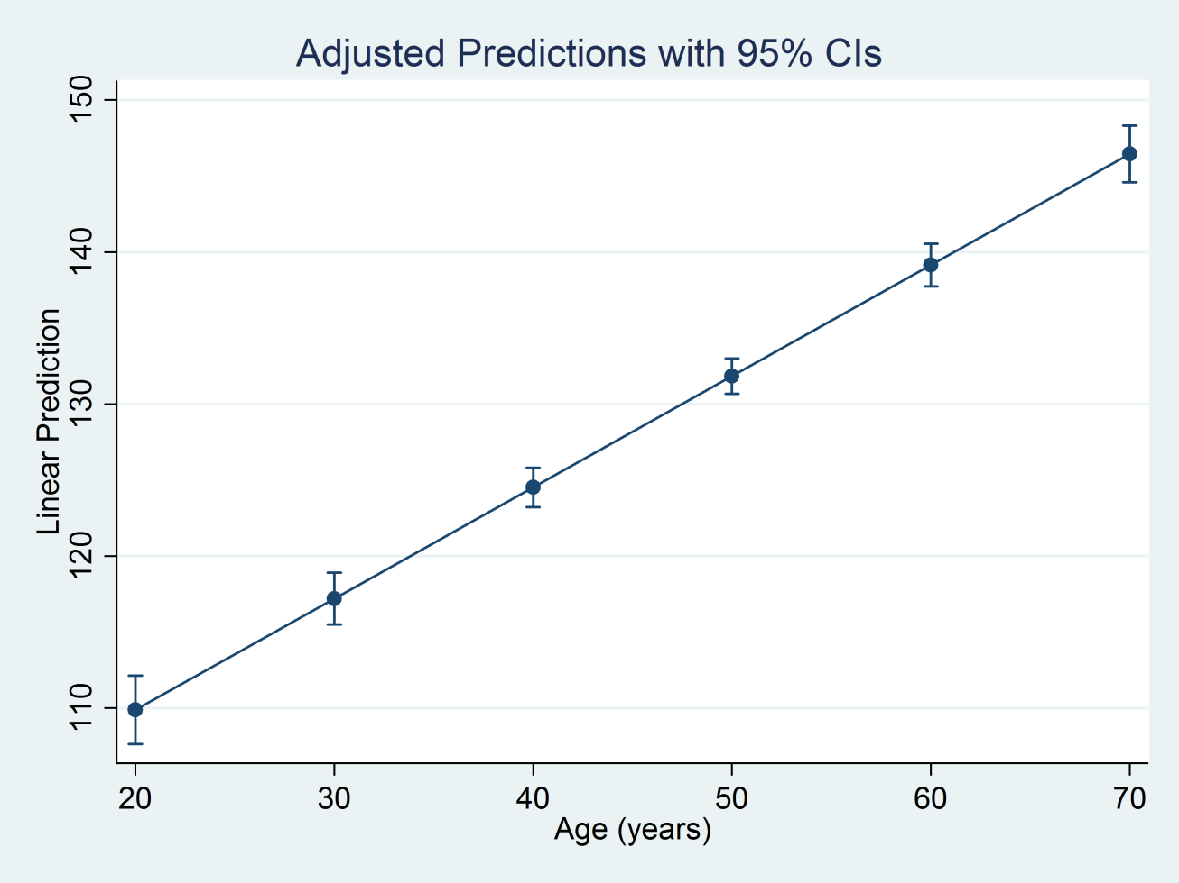
Marginsplot for Age
marginsplot

Slide 17
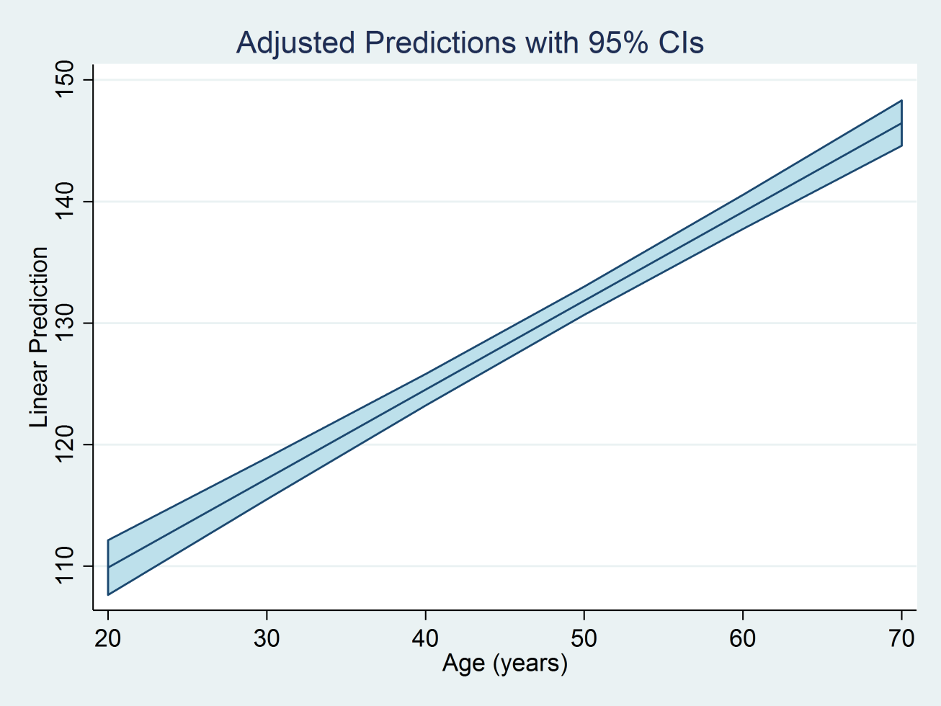
Marginsplot for Age
marginsplot, recast(line) recastci(rarea) ciopts(fcolor(ltblue))

Slide 18
Outline
The dataset
Linear regression with one covariate
  Continuous covariates
  Binary covariates
  Categorical covariates
Linear regression with multiple covariates
Linear regression with interactions
Linear regression with log-transformations

Slide 19
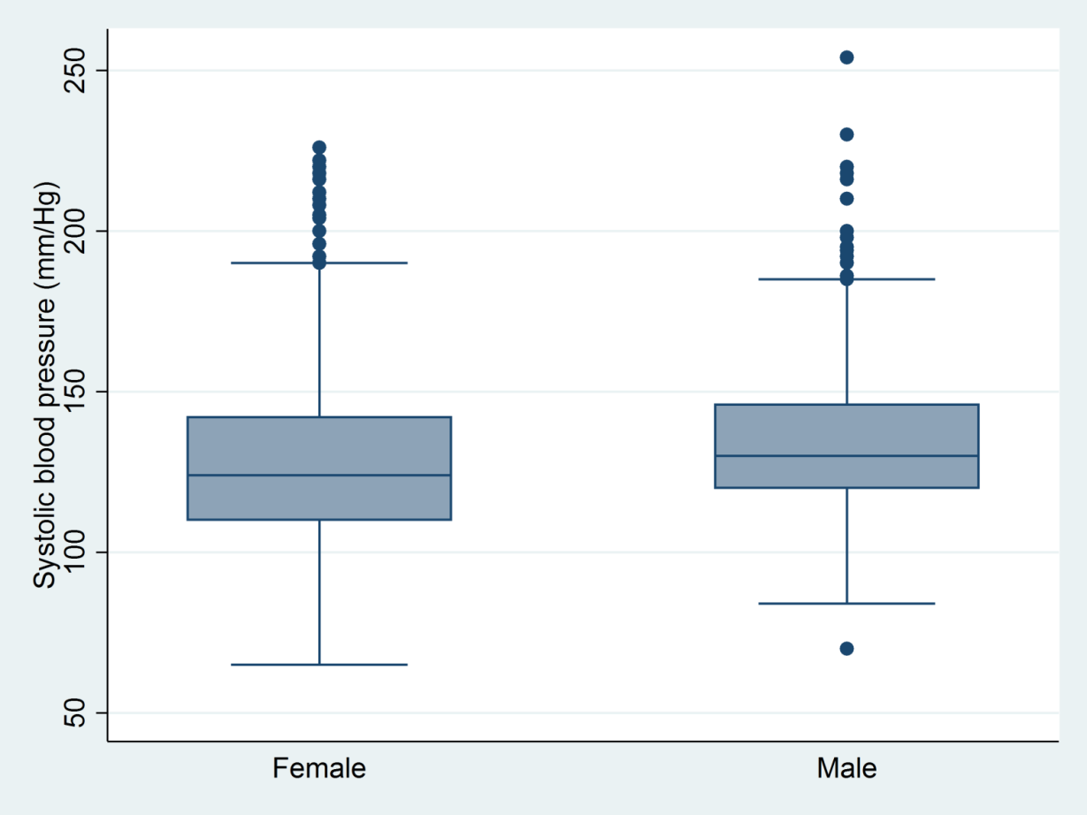
Boxplots for SBP by Sex
graph box sbp, over(sex)

Slide 20
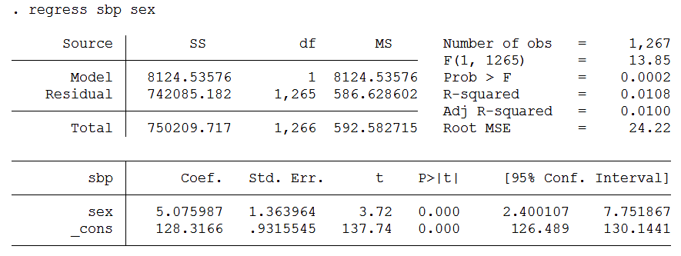
Linear Regression for SBP and Sex
Females are coded “0” and males are coded “1” so the average sbp for females
is 128.3 mm/Hg and the sbp for males is 5.1 mm/Hg higher than females.

Slide 21
Factor Variable Notation
Stata assumes that covariates are continuous unless you tell it otherwise
We can use the “i.” prefix to tell Stata that a covariate is a categorical variable
regress sbp i.sex
We can use the “c.” prefix to tell Stata explicitly that a covariate is continuous
regress sbp c.age

Slide 22
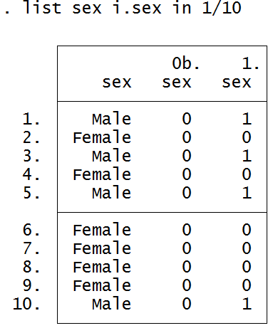
Factor Variable Notation
The “i.” operator in front of the variable sex specifies that sex is a categorical variable.
Stata will automatically create indicator variables for sex and label them in the output.

Slide 23
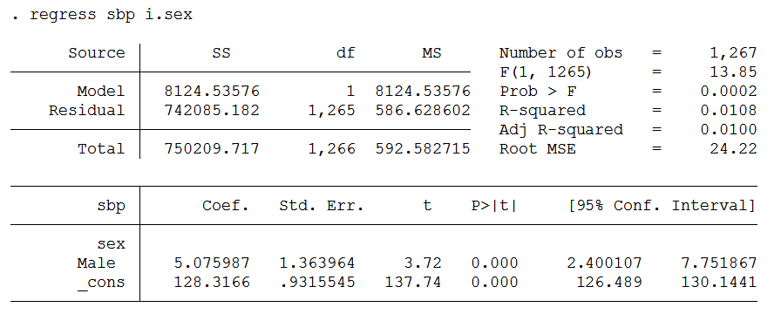
Factor Variable Notation
The “i.” operator in front of the variable sex specifies that sex is a categorical variable.
Stata will automatically create indicator variables for sex and label them in the output.

Slide 24
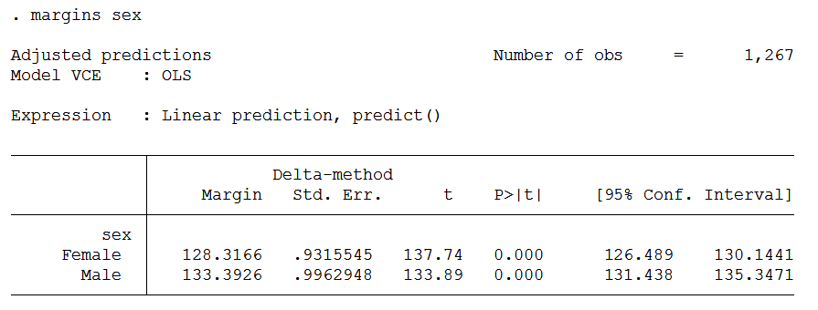
The Margins Command
Our regression model predicts that the average sbp for females
is 128.3 and the average sbp for males is 133.4.

Slide 25
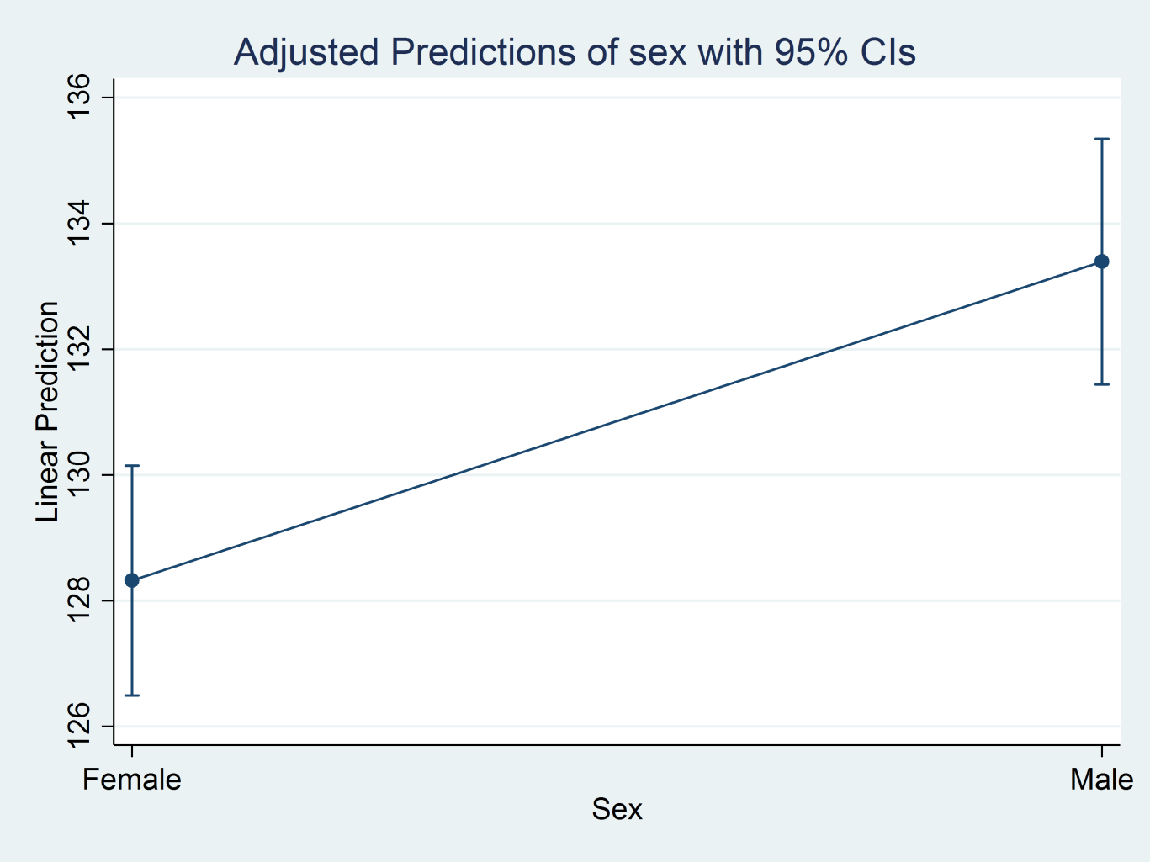
The Marginsplot Command
marginsplot

Slide 26
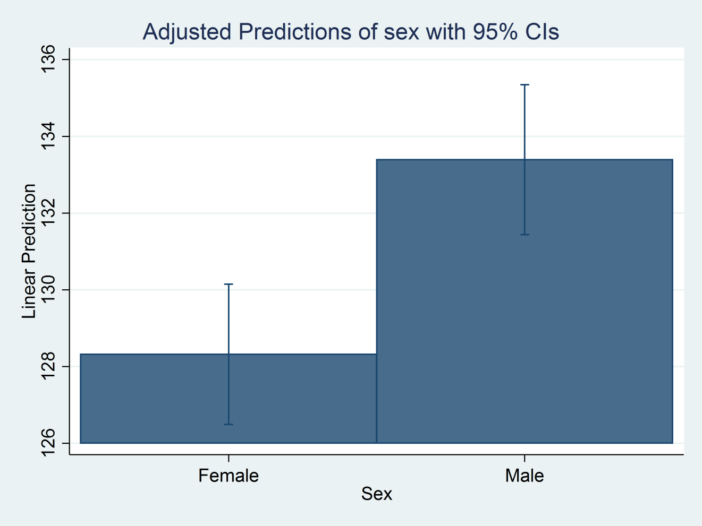
The Marginsplot Command
marginsplot, recast(bar)

Slide 27
Outline
The dataset
Linear regression with one covariate
  Continuous covariates
  Binary covariates
  Categorical covariates
Linear regression with multiple covariates
Linear regression with interactions
Linear regression with log-transformations

Slide 28
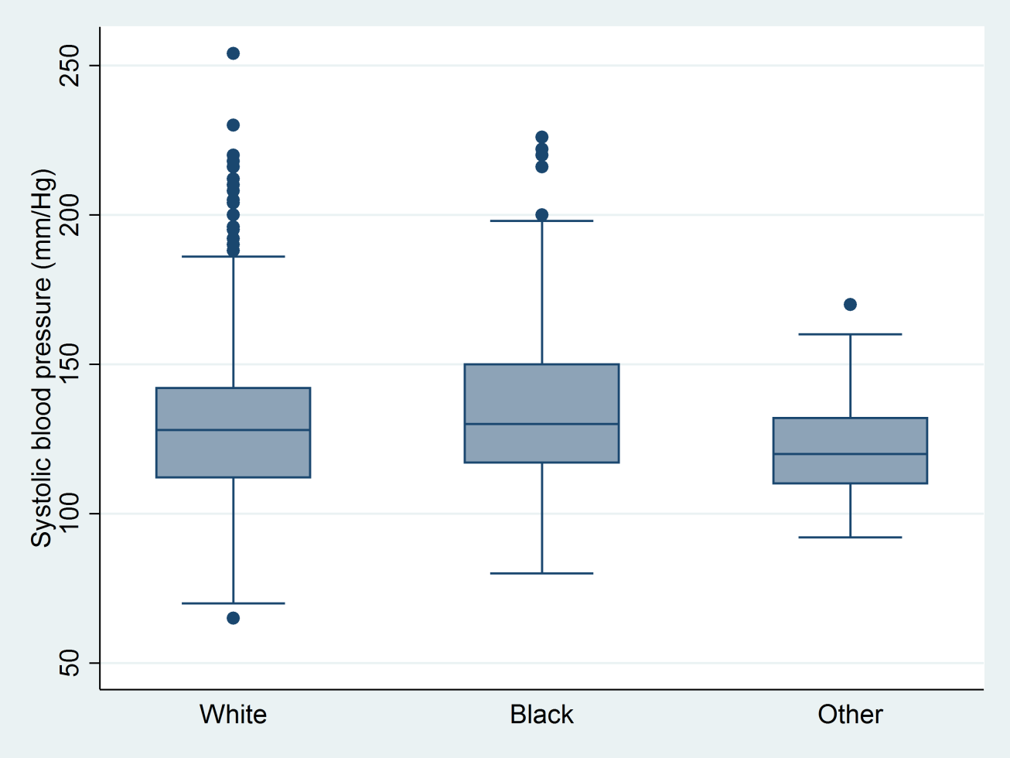
Boxplot for Race
graph box sbp, over(race)

Slide 29
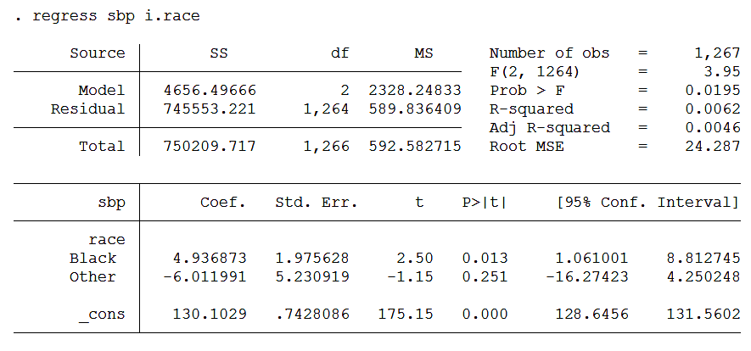
Linear Regression for SBP and Race
The average sbp for the referent category “White” is 130.1. The average sbp for the
category “Black” is 4.9 mm/Hg higher than the category “White”. The average sbp
for the category “Other” is 6.0 mm/Hg lower than the category “White”.

Slide 30
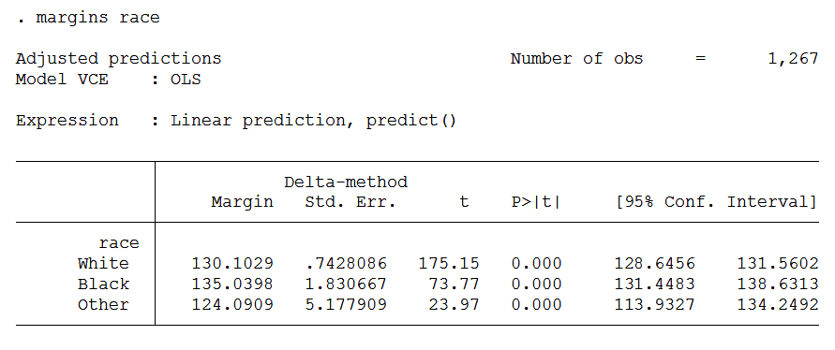
Margins for Race
Our model predicts that the average sbp is 130.1 for the “White” category, 135.0 for
the “Black” category, and 124.1 for the “Other” category.

Slide 31
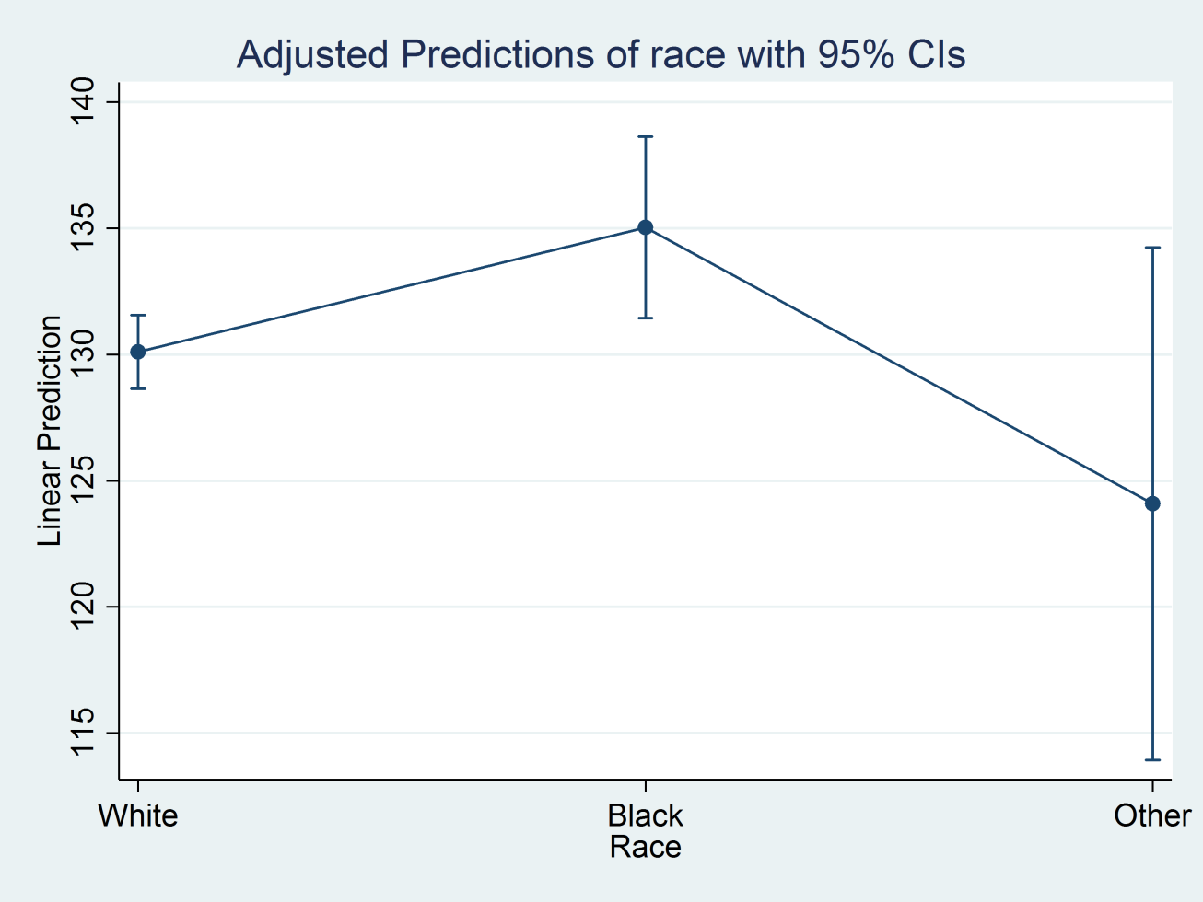
Marginsplot for Race
marginsplot

Slide 32
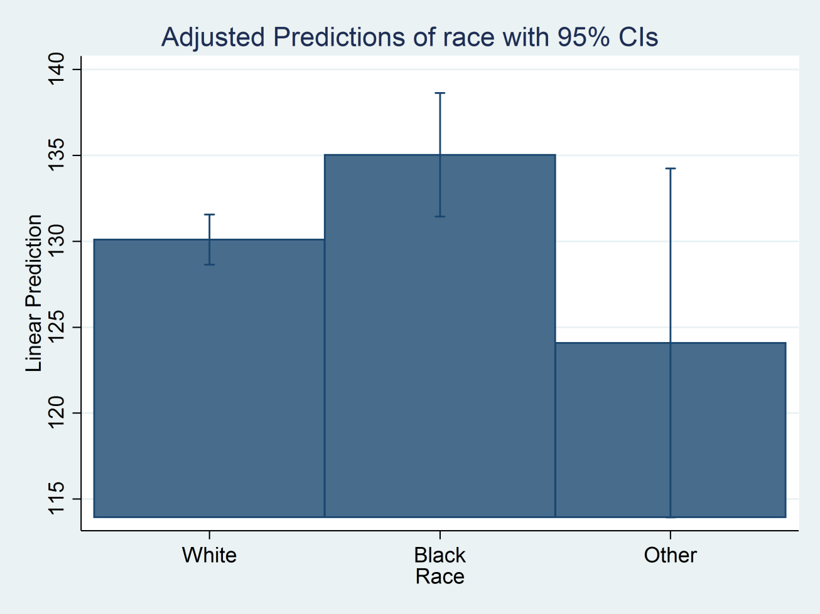
Marginsplot for Race
marginsplot, recast(bar)

Slide 33
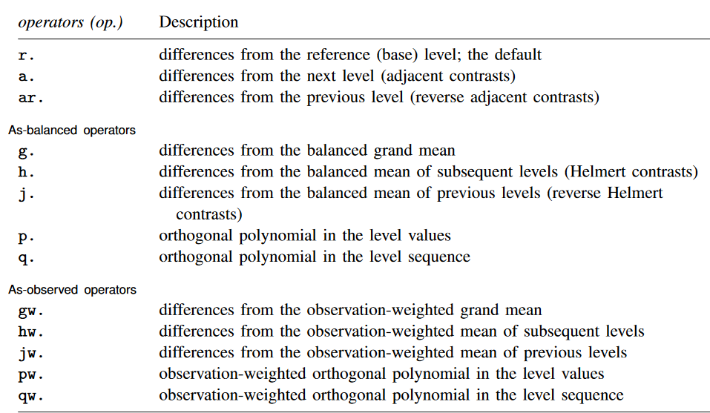
Contrast Operators

Slide 34
Contrasts of Margins

Slide 35
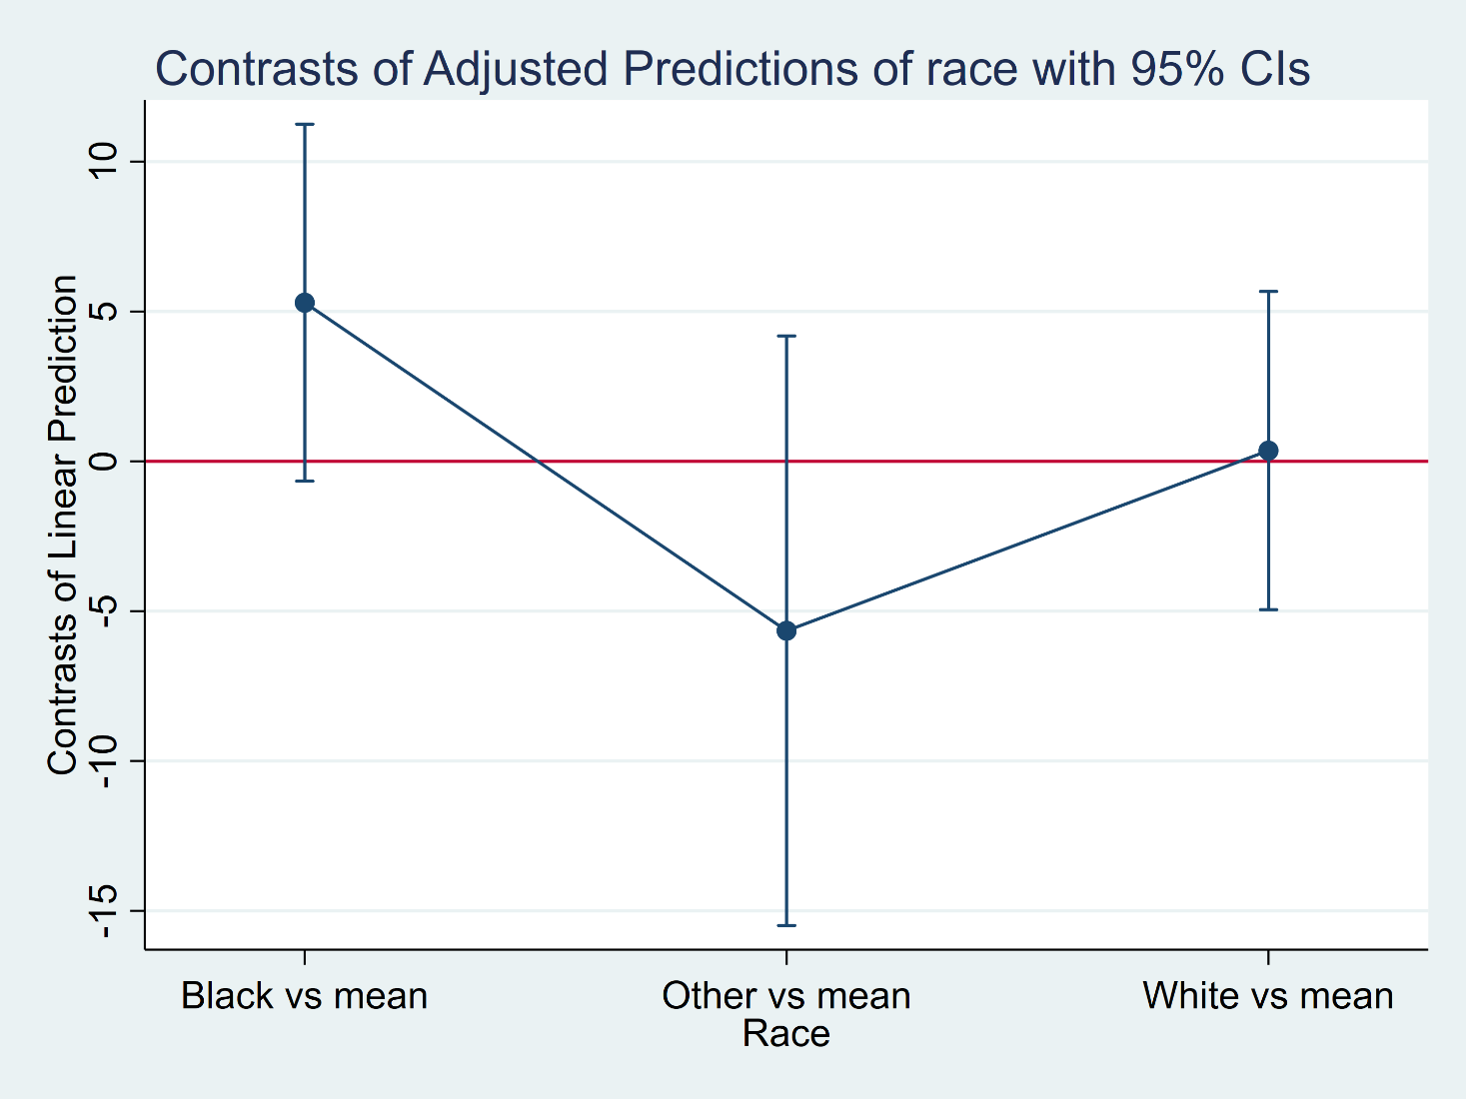
Contrasts of Margins
marginsplot, yline(0) plotregion(margin(l=15 r=15))

Slide 36
Pairwise Comparisons of Margins

Slide 37
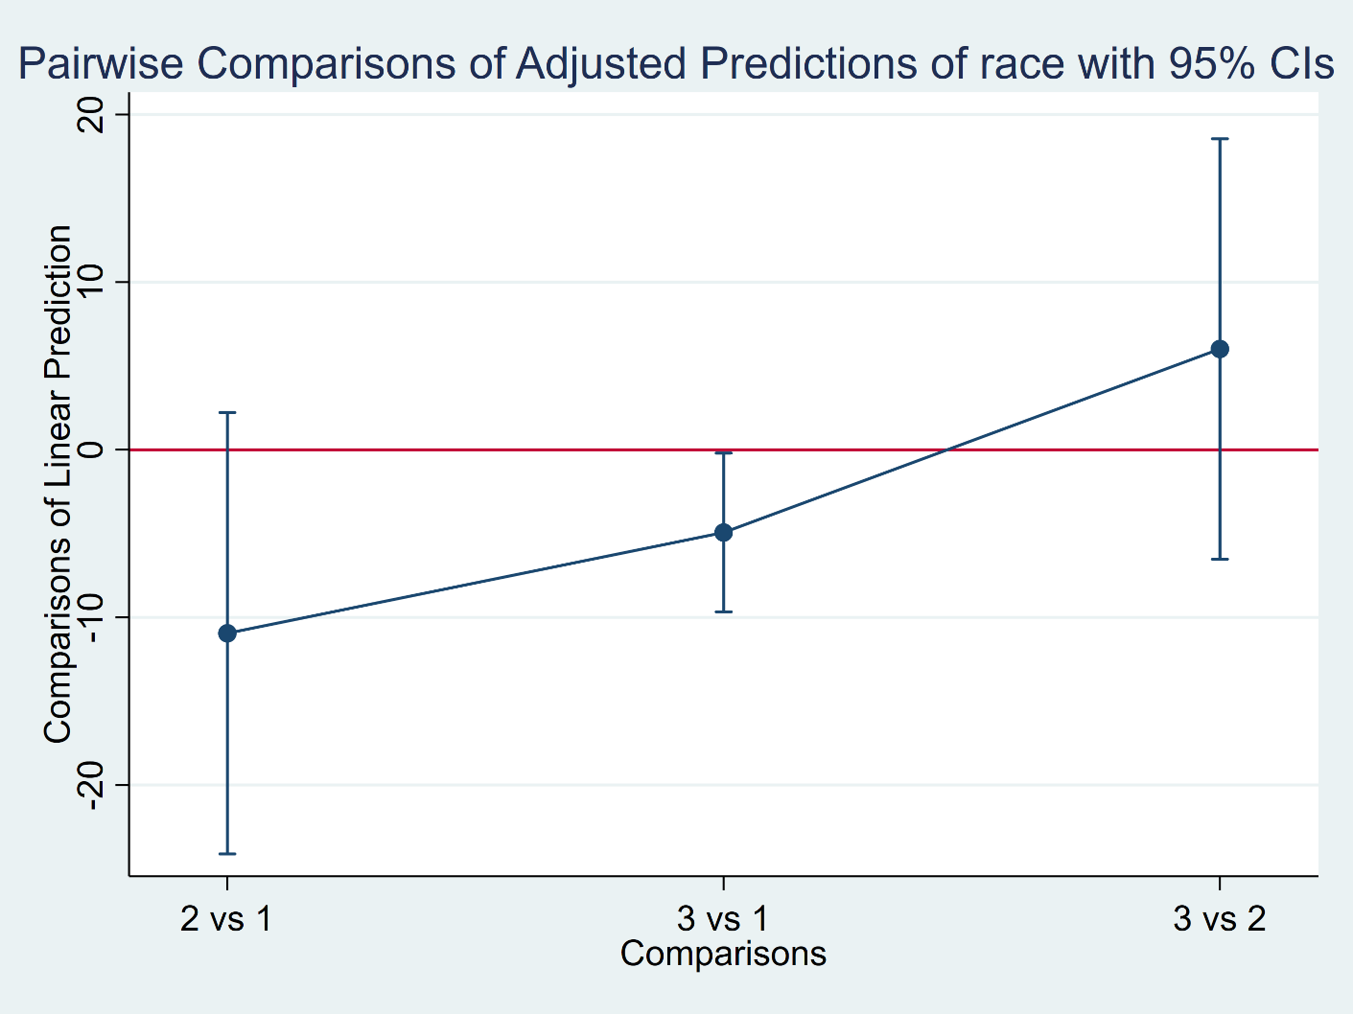
Pairwise Comparisons of Margins
marginsplot, xdimension(_pw) unique yline(0) ///
plotregion(margin(l=10 r=10))

Slide 38
Outline
The dataset
Linear regression with one covariate
  Continuous covariates
  Binary covariates
  Categorical covariates
Linear regression with multiple covariates
Linear regression with interactions
Linear regression with log-transformations

Slide 39
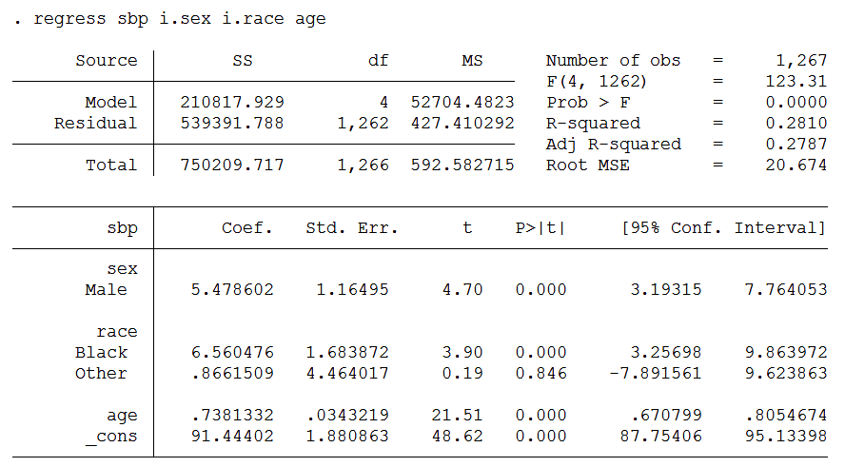
Multiple Regression

Slide 40
Margins for Age and Sex
The predictions for each combination of age and sex are averaged over race.

Slide 41
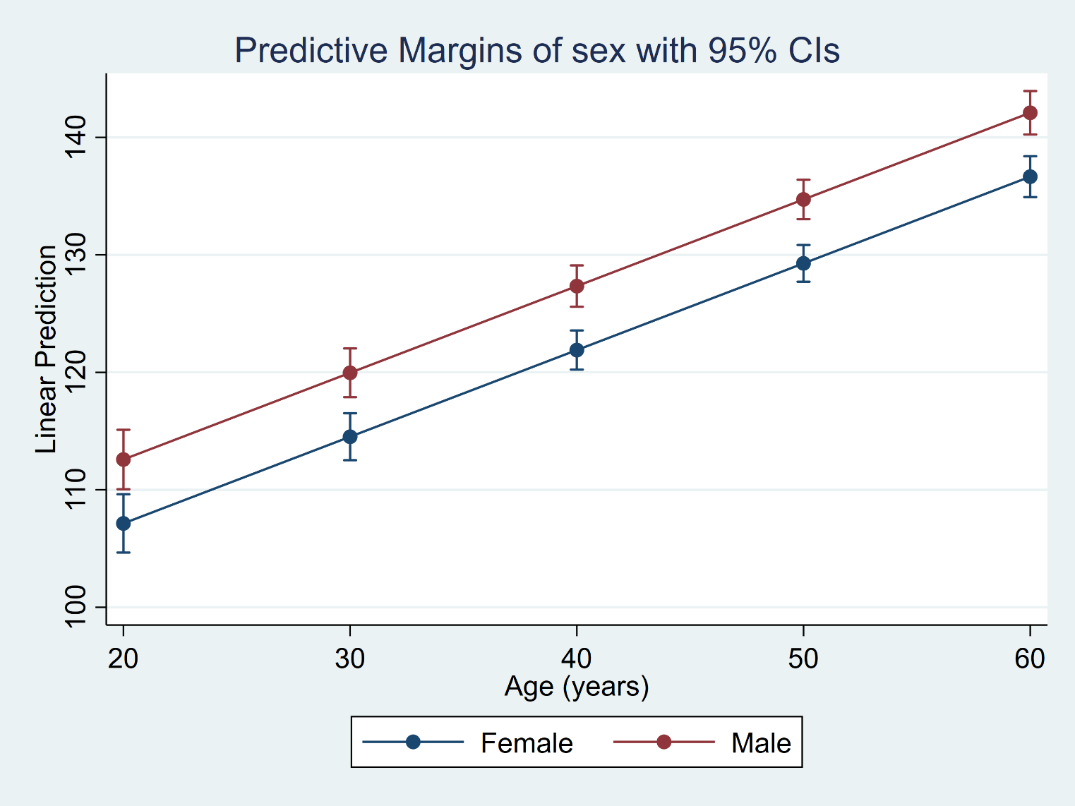
Marginsplot for Age and Sex
marginsplot

Slide 42
Margins for Age and Race
The predictions for each combination of age and race are averaged over sex.

Slide 43
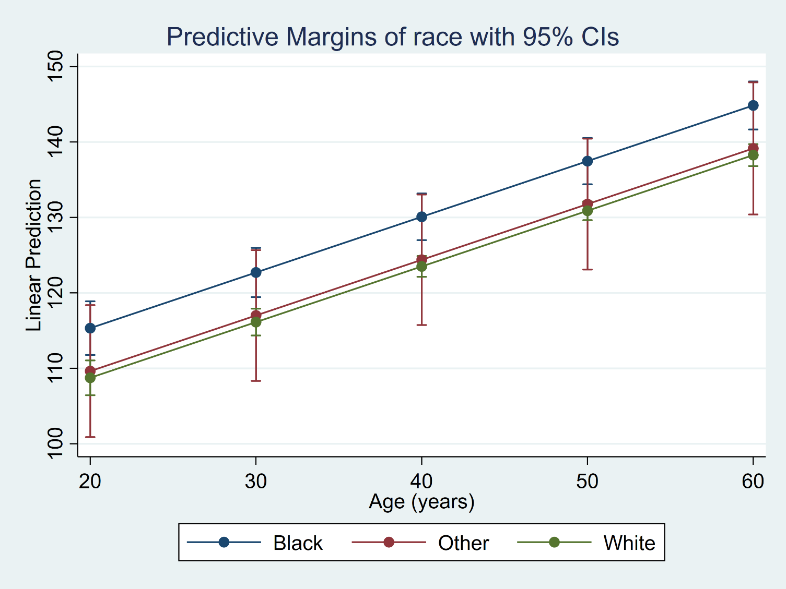
Marginsplot for Age and Race
marginsplot

Slide 44
Outline
The dataset
Linear regression with one covariate
  Continuous covariates
  Binary covariates
  Categorical covariates
Linear regression with multiple covariates
Linear regression with interactions
Linear regression with log-transformations

Slide 45
What is Moderation?
M
X
Y
“The effect of X on some variable Y is moderated by M if its size,
sign, or strength depends on or can be predicted by M. In that case,
M is said to be a moderator of X’s effect on Y, predicted by M.”
(Hayes, 2013, pg 208).

Slide 46
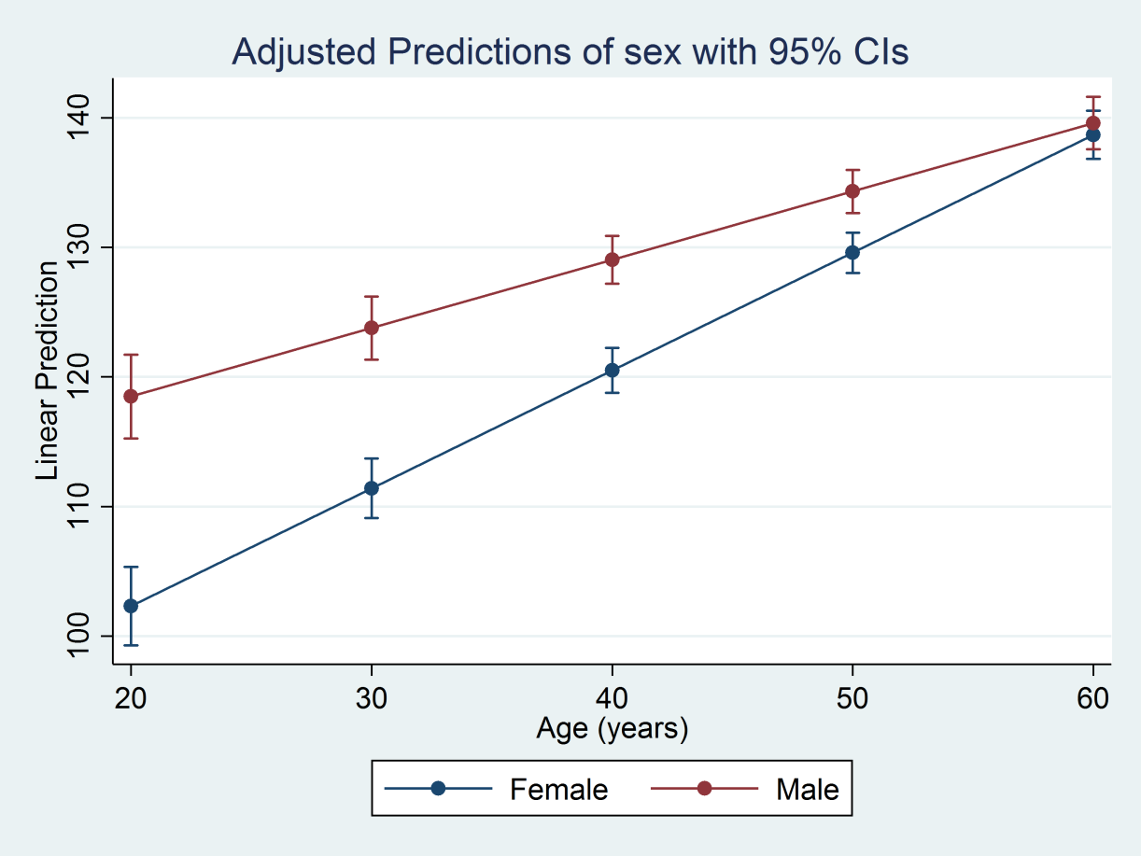
Example: Age (X), SBP (Y) and Sex (M)
The effect of age (X) on SBP (Y) is not the same for males and females.
Thus sex is a moderator for the relationship between age and SBP.

Slide 47
Factor Variable Notation
We can use the “#” operator to create an interaction term for two covariates
regress sbp c.age i.sex c.age#i.sex
Or we can use the “##” operator to include both main effects and the interaction term
regress sbp c.age##i.sex

Slide 48
Factor Variable Notation

Slide 49
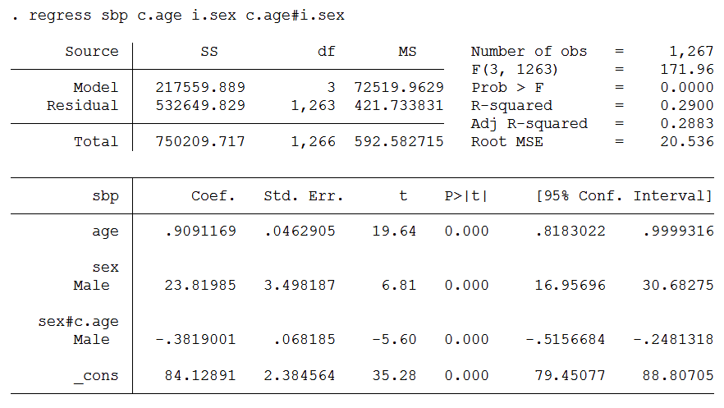
Regression for Age (X) and Sex (M)

Slide 50
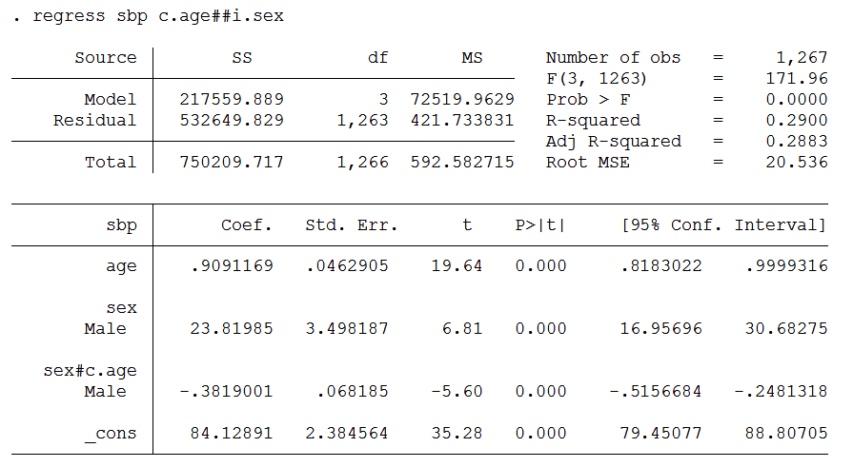
Regression for Age (X) and Sex (M)

Slide 51
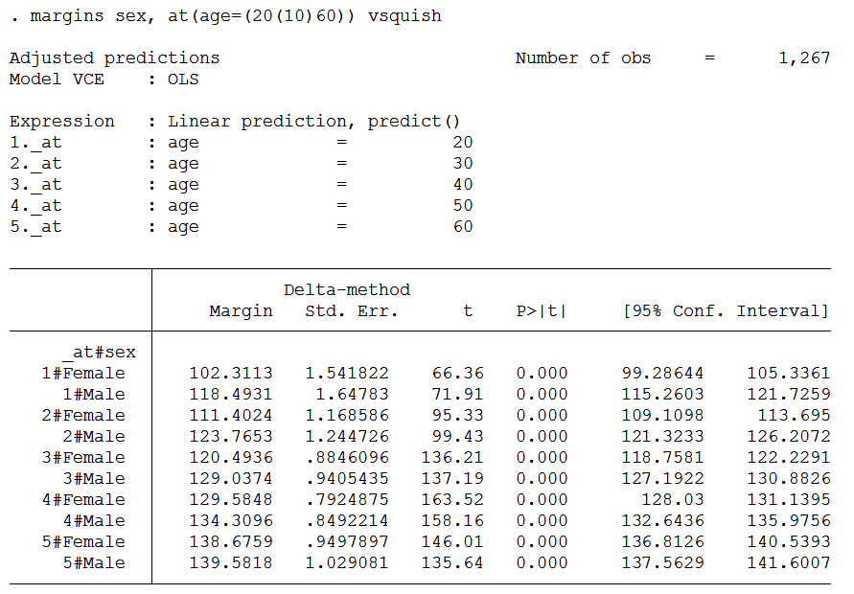
Margins for Age (X) and Sex (M)

Slide 52

Marginsplot for Age (X) and Sex (M)
marginsplot

Slide 53
Regression for Age (X) and Race (M)

Slide 54
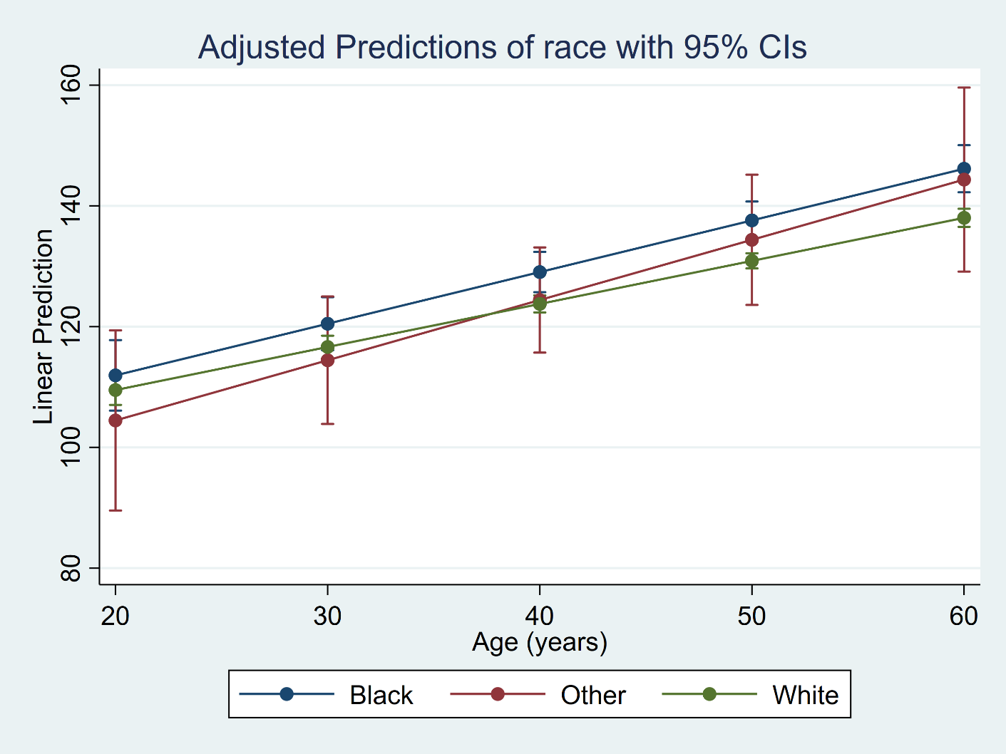
Marginsplot for Age (X) and Race (M)
margins race, at(age=(20(10)60)) vsquish
marginsplot, legend(rows(1))

Slide 55
F-test for Interaction

Slide 56
Likelihood Ratio Test for Interaction

Slide 57
Continuous-by-Continuous Interactions

Slide 58
Continuous-by-Continuous Interactions

Slide 59
Continuous-by-Continuous Interactions

Slide 60
Continuous-by-Continuous Interactions

Slide 61
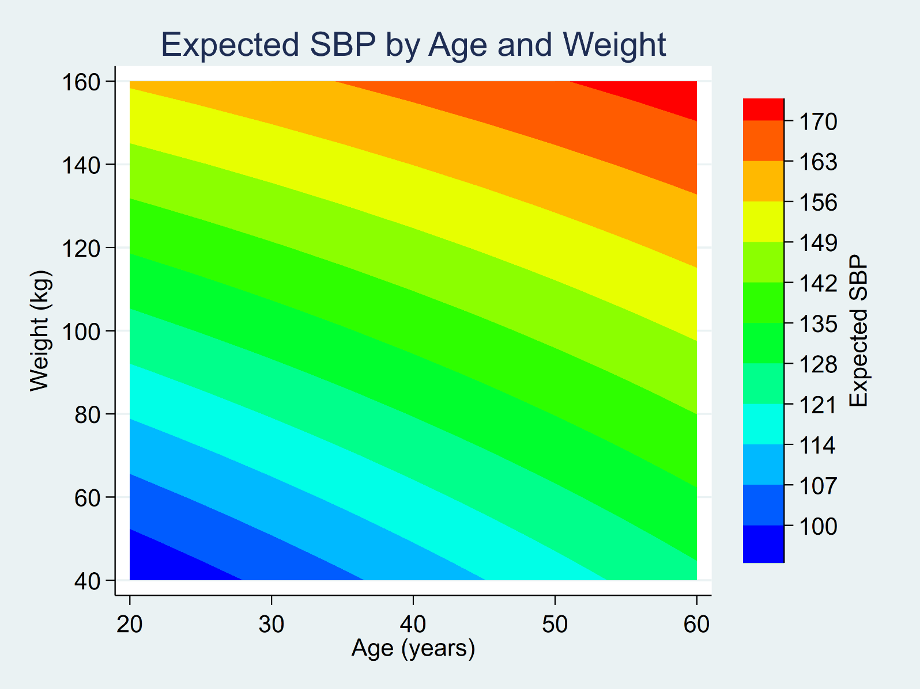
Continuous-by-Continuous Interactions

Slide 62
Outline
The dataset
Linear regression with one covariate
  Continuous covariates
  Binary covariates
  Categorical covariates
Linear regression with multiple covariates
Linear regression with interactions
Linear regression with log-transformations

Slide 63
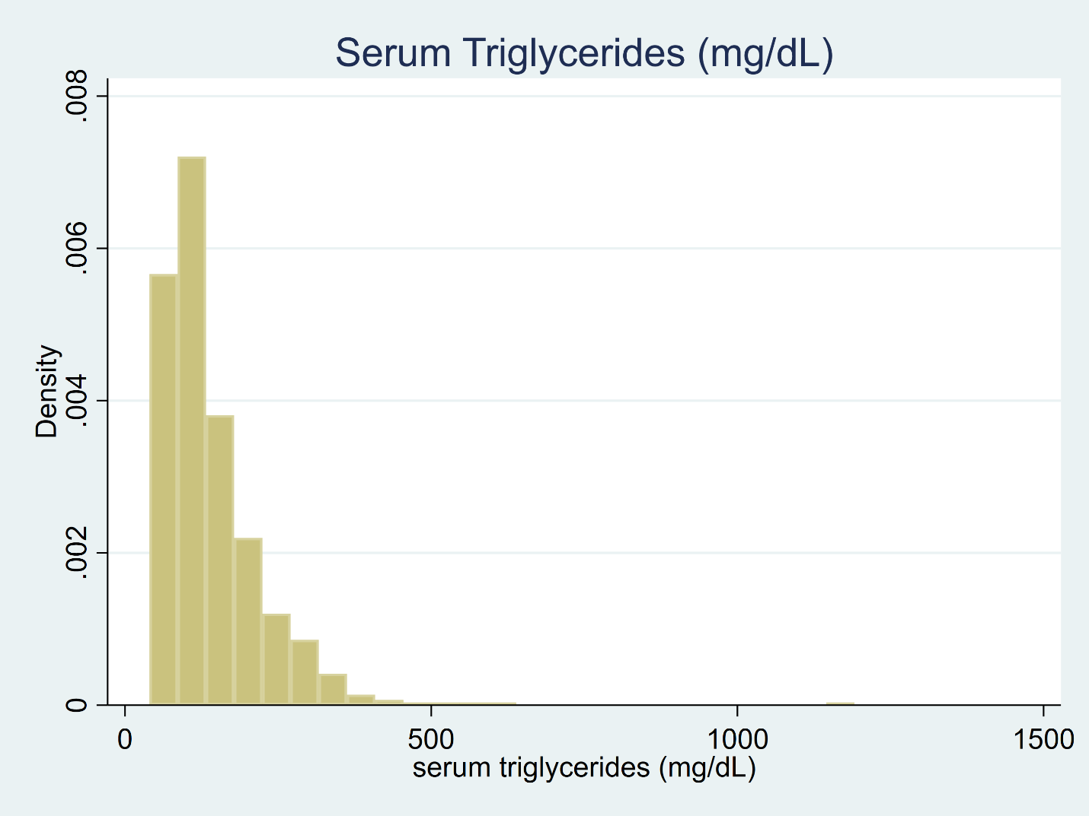
Log-Transformations
histogram triglycerides, title("Serum Triglycerides (mg/dL)")

Slide 64
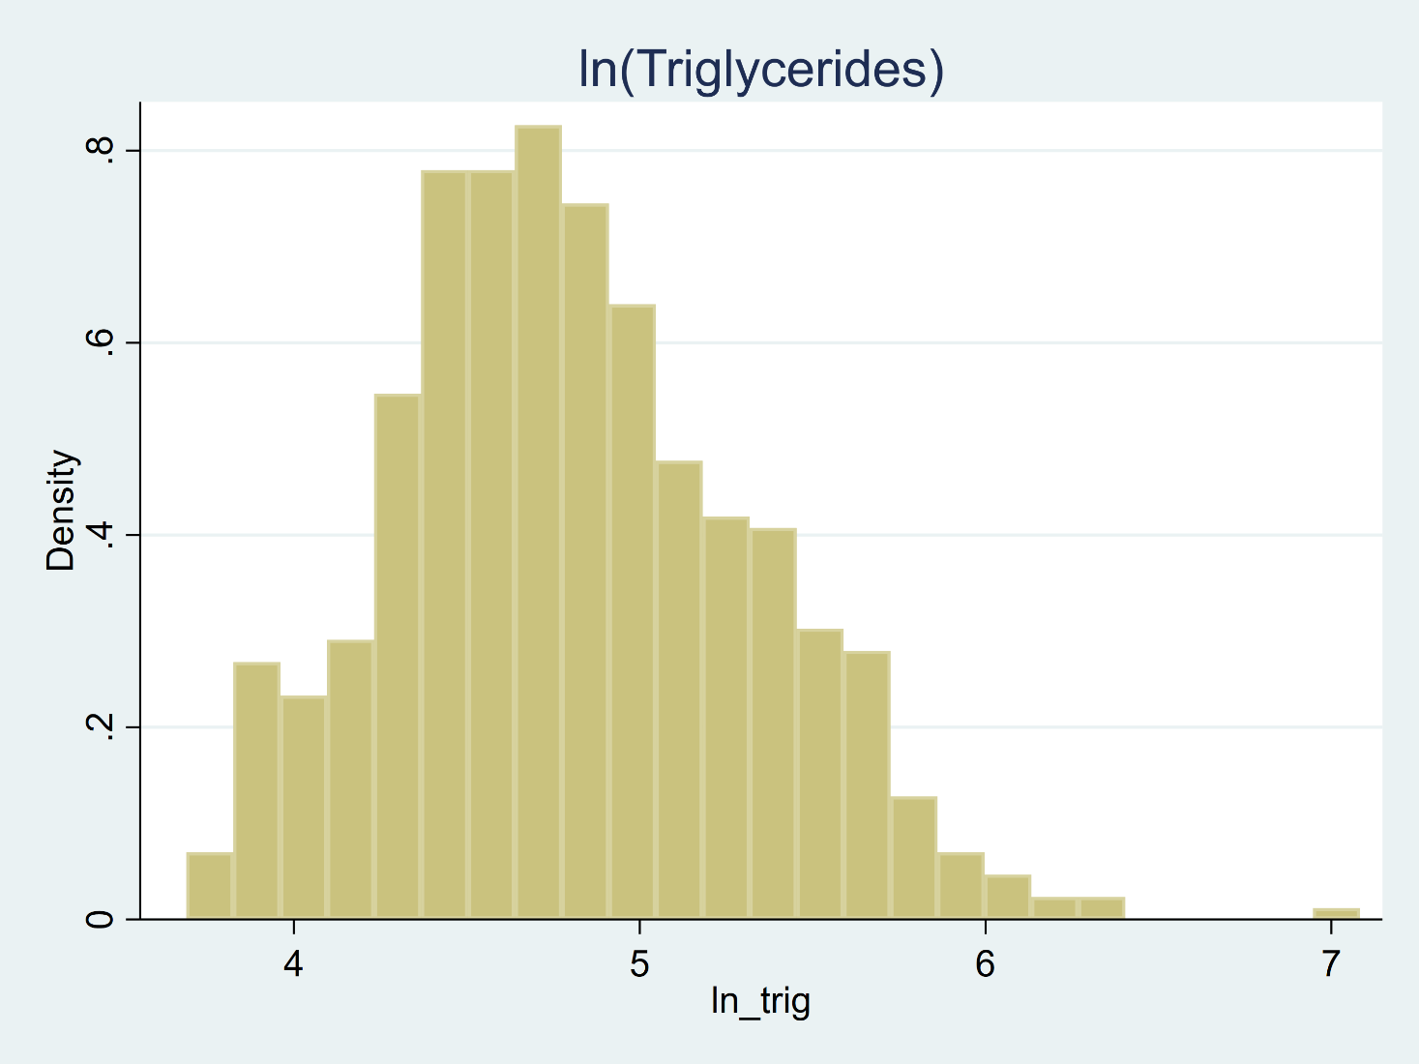
Log-Transformations
generate ln_trig = ln(triglycerides)
histogram ln_trig, title("ln(Triglycerides)")

Slide 65
Log-Transformations
How do we interpret the coefficient for age?

Slide 66
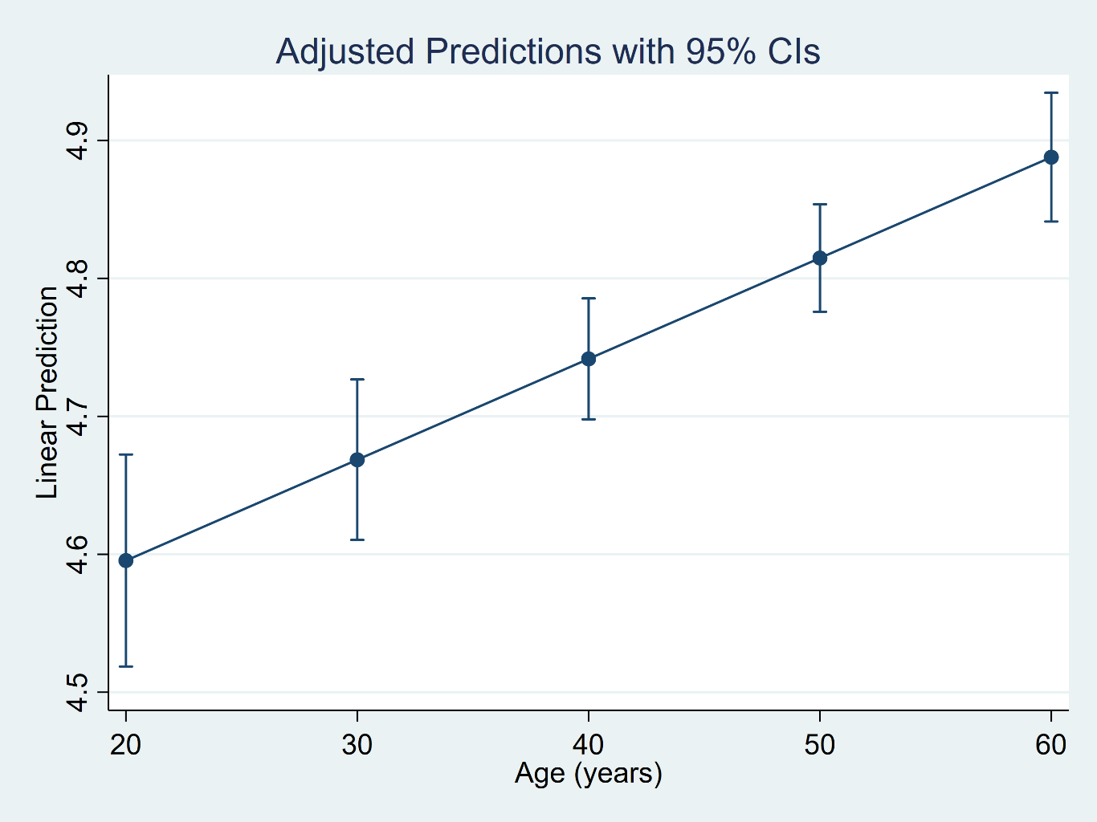
Log-Transformations
margins, at(age=(20(10)60))
marginsplot

Slide 67
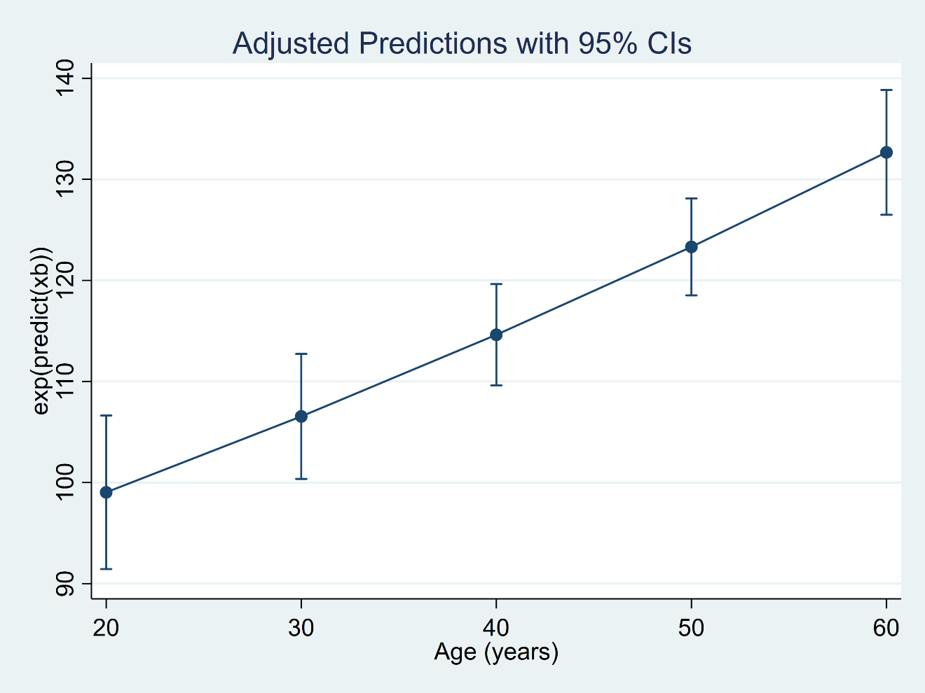
Log-Transformations
BIASED!
margins, expression(exp(predict(xb))) at(age=(20(10)60))
marginsplot

Slide 68
Log-Transformations
Use poisson rather than regress; tell a friend

Slide 69
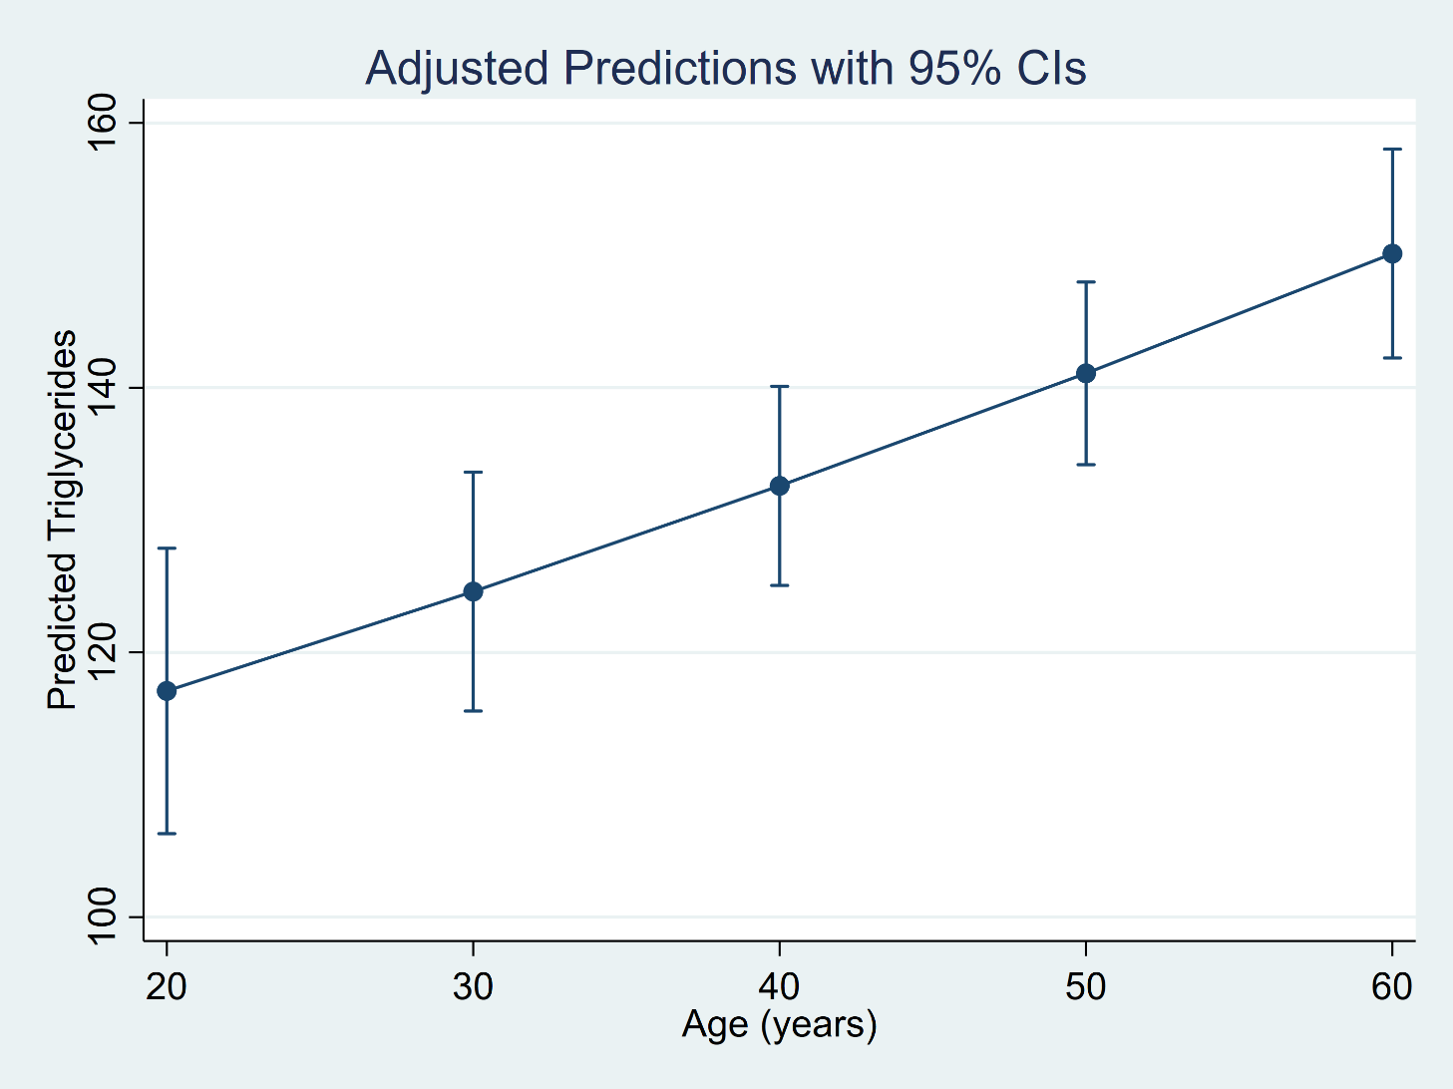
Log-Transformations
margins, at(age=(20(10)60))
marginsplot

Slide 70
Outline
The dataset
Linear regression with one covariate
  Continuous covariates
  Binary covariates
  Categorical covariates
Linear regression with multiple covariates
Linear regression with interactions
Linear regression with log-transformations

Slide 71
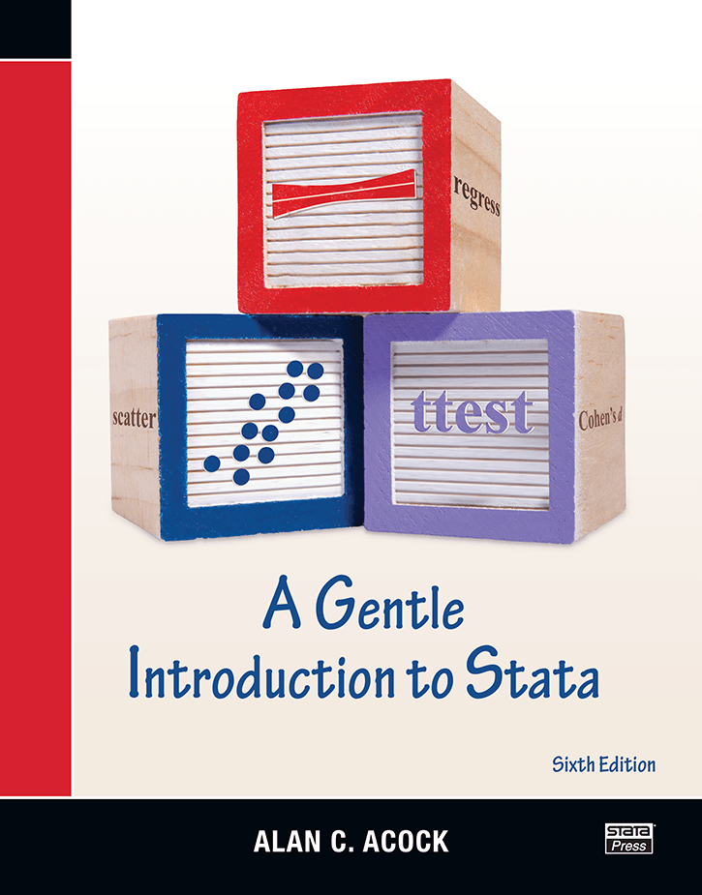
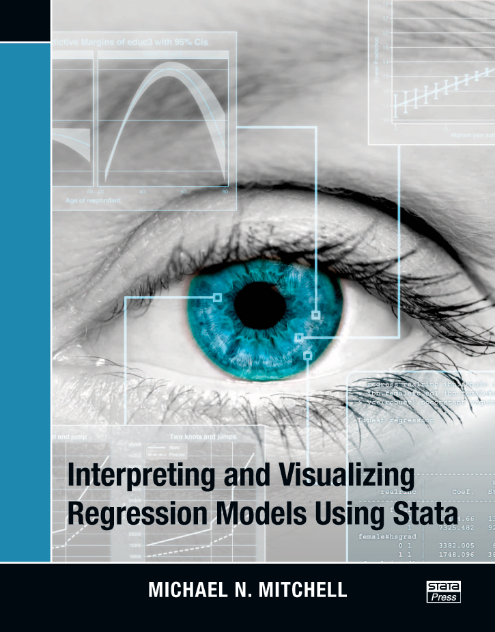
Other Resources
https://www.stata.com/bookstore/gentle-introduction-to-stata/
https://www.stata.com/bookstore/interpreting-visualizing-regression-models/

Slide 72
Other Resources
Stata Manual: margins
Stata Manual: marginsplot
Stata Manual: margins, contrast
Stata Manual: margins, pwcompare
Stata Manual: graph twoway contour
Stata Blog: Use poisson rather than regress; Tell a friend
In the spotlight: Interpreting models for log-transformed outcomes
In the spotlight: Visualizing continuous-by-continuous interactions with margins and twoway contour
YouTube: Factor Variables Playlist
YouTube: Margins Playlist
YouTube: Profile Plots and Interaction Plots Playlist

Slide 73
Thanks for coming!
Questions?
chuber@stata.com
You can download the slides, datasets, and do-files here:
https://tinyurl.com/statareg

