Slide 1
Latent Class Analysis Using Stata
Chuck Huber
StataCorp
chuber@stata.com
Stata Webinar
March 27, 2018

Slide 2
Outline
Latent class analysis (LCA)
Estimation and postestimation options
margins and marginsplot
Latent class analysis with covariates
Latent class analysis by groups
Latent profile analysis

Slide 3
Latent Class Analysis
A latent class model is characterized by having a categorical latent variable and categorical observed variables.
The levels of the categorical latent variable represent groups in the population and are called classes.
We are interested in identifying and understanding these unobserved classes.
Class 3
Class 1
Class 2

Slide 4
Latent Class Analysis
Behavioral Research
Classify people who are more likely to exhibit specific behaviors
Different kinds of social phobias
Categories of eating disorders
Medicine and Health
Identify patients with different disease risk profiles
Marketing Research
Differentiate subsets of customers and their buying habits
And many, many more…

Slide 5
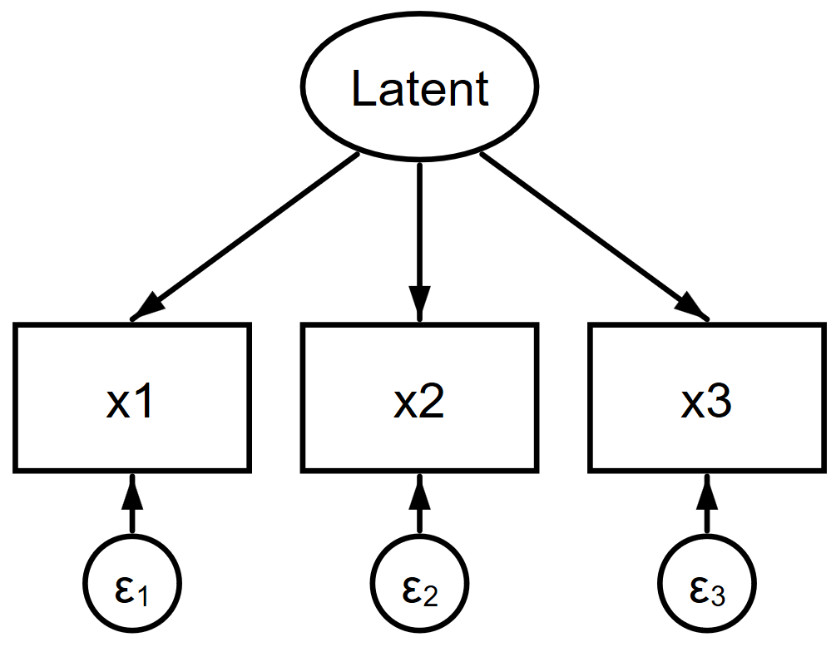
Latent and Observed Variables
Latent variables are hypothetical constructs that we cannot measure directly (e.g. “intelligence” or “depression”)
Observed variables are variables that we observe (e.g. “SAT scores” or “Feel sad”)

Slide 6
Latent and Observed Variables
 | Continuous Latent | Categorical Latent
Continuous Observed | Factor analysis | Latent Profile Analysis
Categorical Observed | Latent trait analysis or Item Response Theory | Latent Class Analysis
Reproduced from Table 1.1 in Collins and Lanza (2010)

Slide 7
Example Data

Slide 8
Example Data
Class 1
“Possible rule breaking and norm violations”
May include underage drinking
Class 2
“More actively delinquent”
Occasional drug use, skipping school, and non-violent crime
Class 3
“Highly delinquent”
Regular drug use, theft, and violent crime

Slide 9
Example Data
Note that we do not have a variable for class membership.

Slide 10
Example Data

Slide 11
Conceptual Path Diagram
Class 3
Class 1
Class 2
alcohol
truant
vandalism
theft
weapon

Slide 12
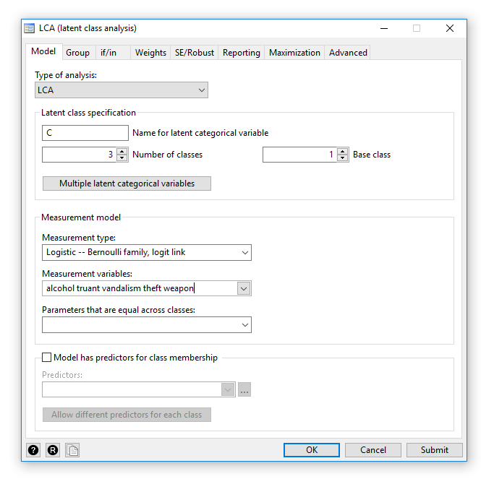
Statistics > LCA (latent class analysis)
gsem (alcohol truant vandalism theft weapon <- _cons) ///
, family(bernoulli) link(logit) lclass(C 3)

Slide 13
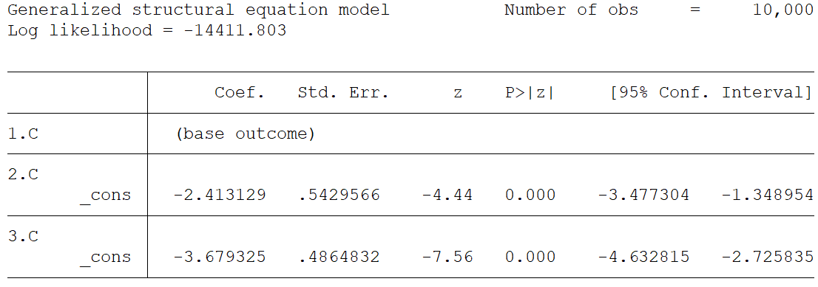
The coefficients for class

Slide 14
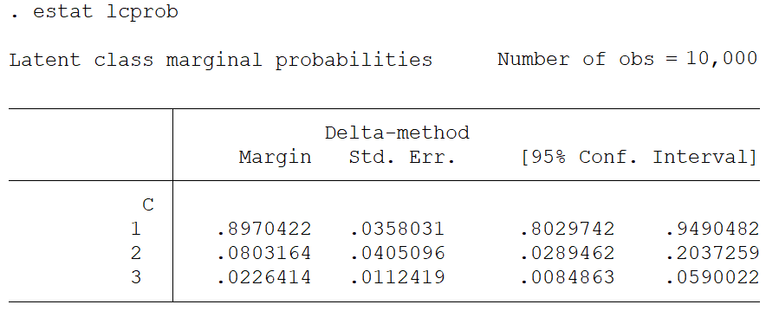
LCA Postestimation

Slide 15
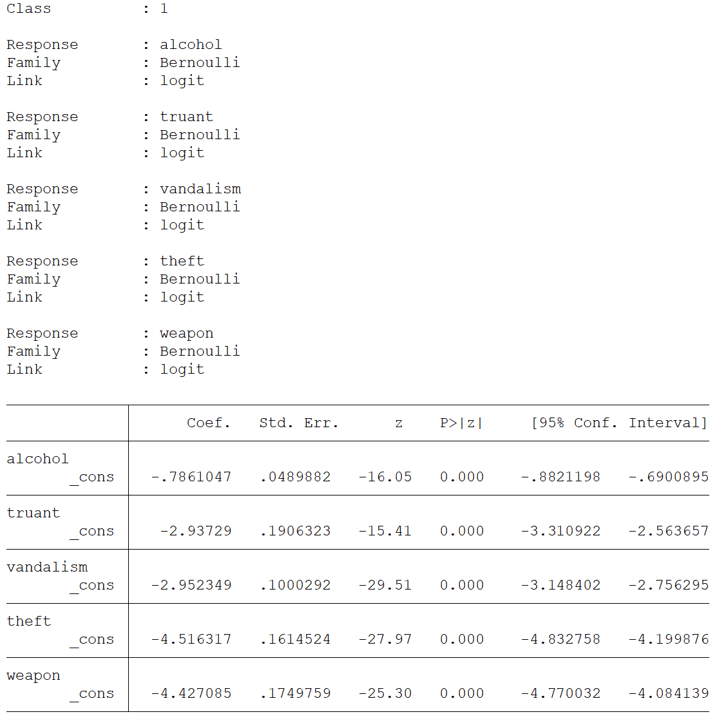

Slide 16
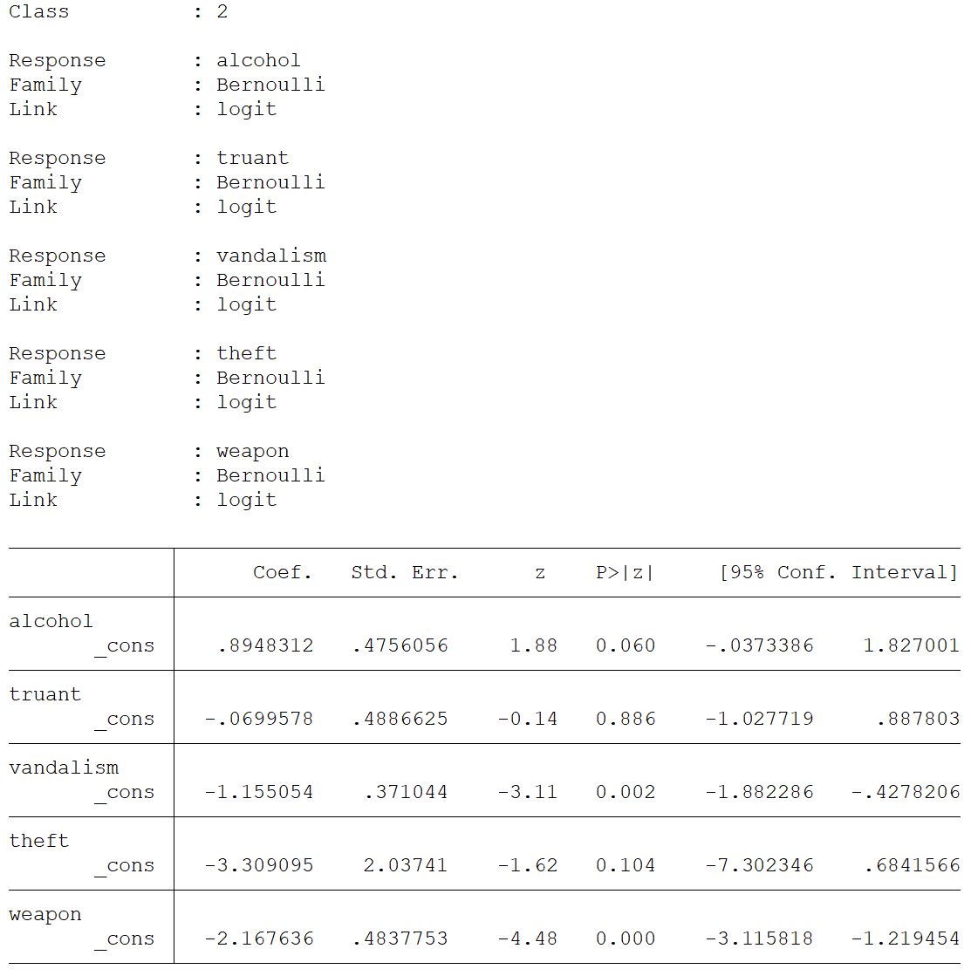

Slide 17
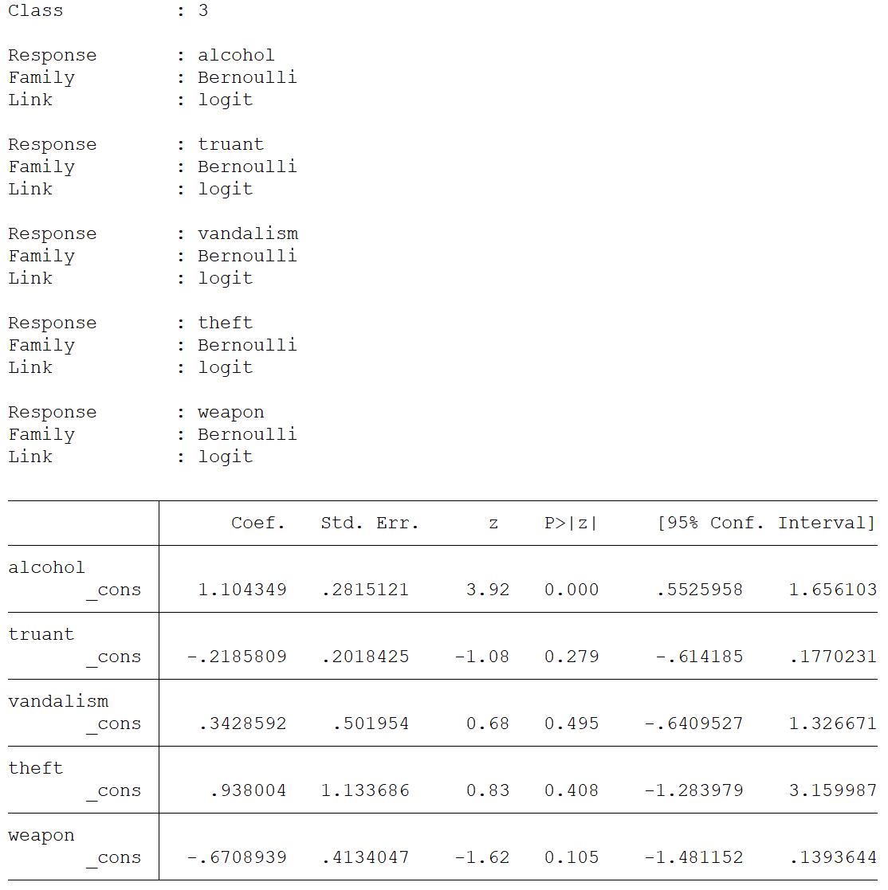

Slide 18
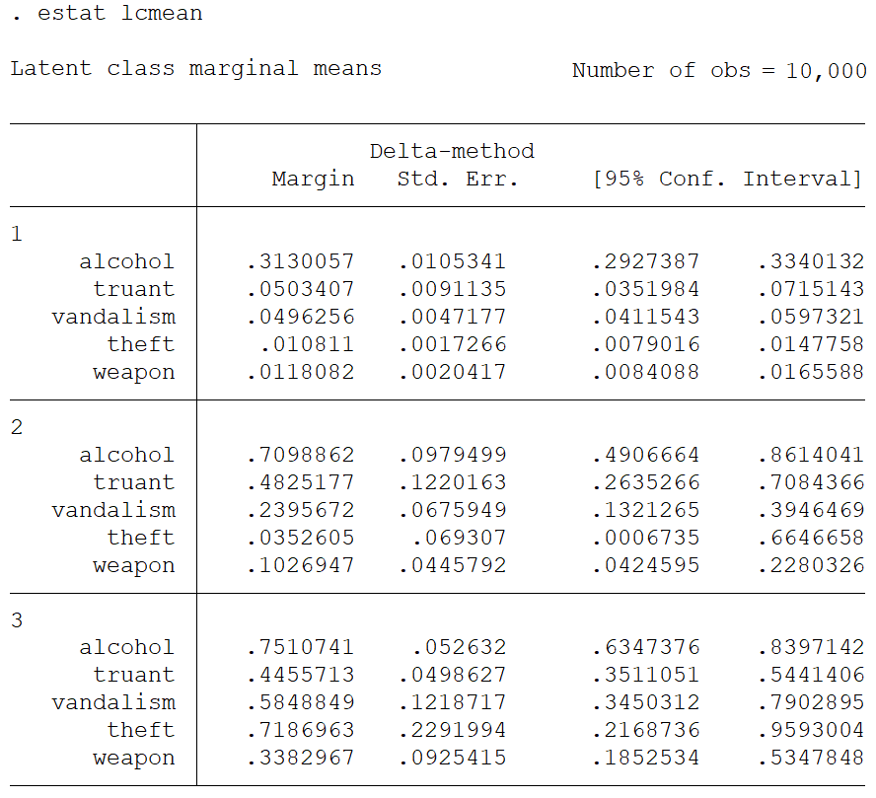
LCA Postestimation

Slide 19
Estimation and Postestimation
First you estimate the parameters (fit the model)
gsem (alcohol truant vandalism theft weapon <- _cons) ///
, family(bernoulli) link(logit) lclass(C 3)
Then you calculate quantities such as goodness-of-fit statistics, model predictions, residuals, etc
estat lcmean
estat lcprob

Slide 20
margins and marginsplot
You can use margins to calculate marginal predictions after you fit almost any kind of model in Stata.
You can use marginsplot to graph those marginal predictions.

Slide 21
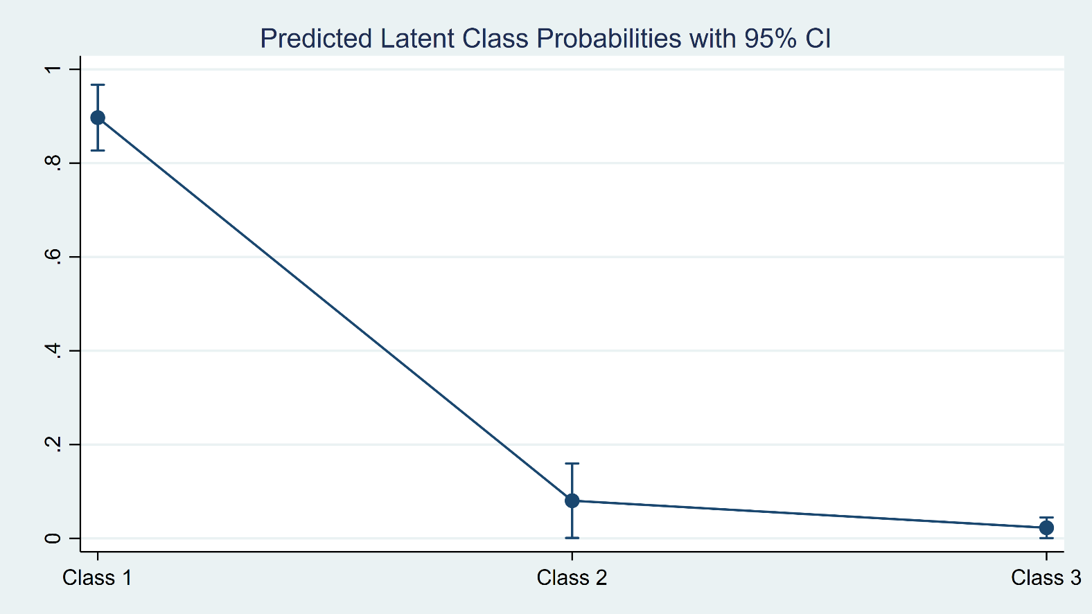
margins and marginsplot
margins, predict(classpr class(1)) ///
predict(classpr class(2)) ///
predict(classpr class(3))
marginsplot, xtitle("") ytitle("") ///
xlabel(1 "Class 1" 2 "Class 2" 3 "Class 3") ///
title("Predicted Latent Class Probabilities with 95% CI")

Slide 22
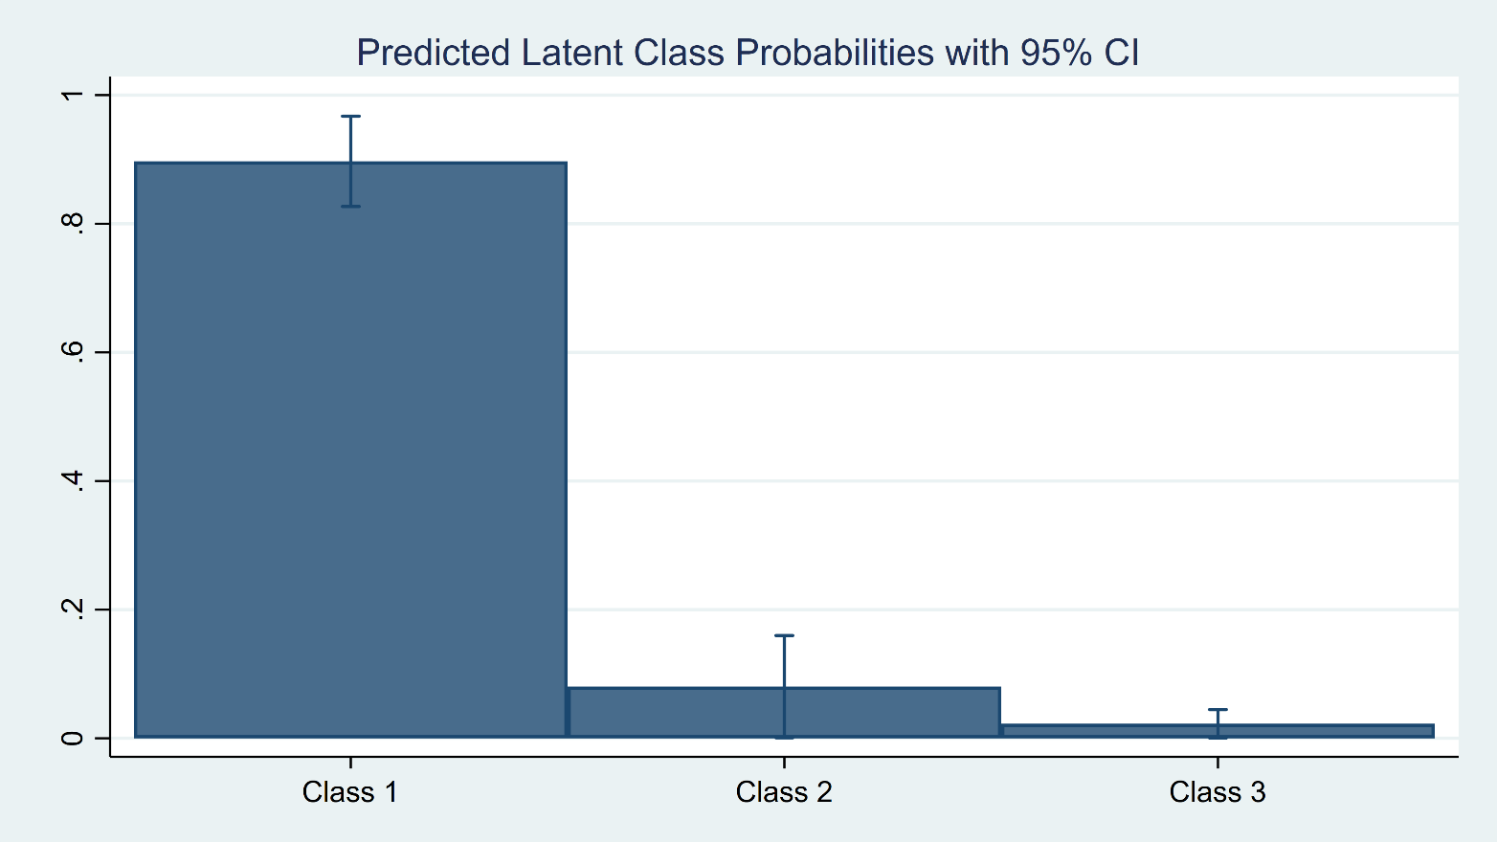
margins and marginsplot
margins, predict(classpr class(1)) ///
predict(classpr class(2)) ///
predict(classpr class(3))
marginsplot, recast(bar) xtitle("") ytitle("") ///
xlabel(1 "Class 1" 2 "Class 2" 3 "Class 3") ///
title("Predicted Latent Class Probabilities with 95% CI")

Slide 23
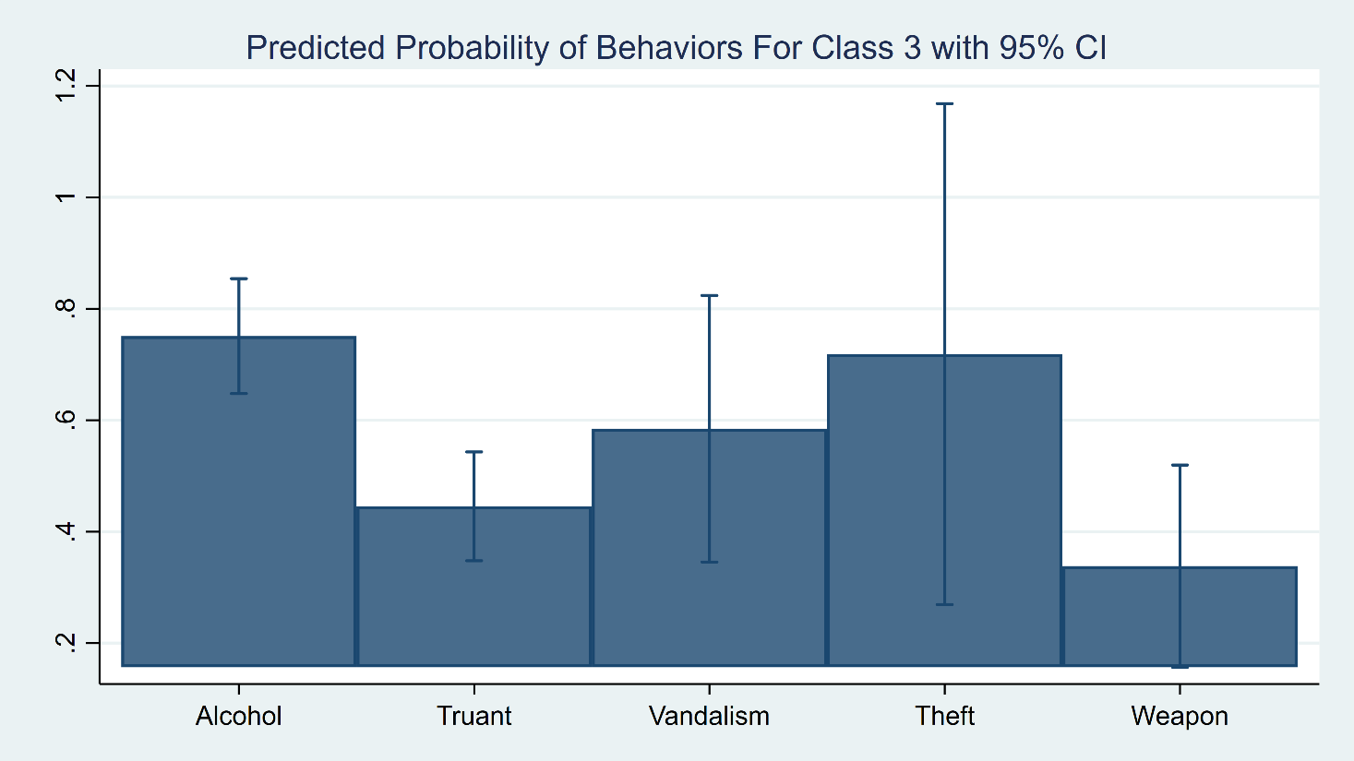
margins and marginsplot
margins, predict(outcome(alcohol) class(3)) ///
predict(outcome(truant) class(3)) ///
predict(outcome(vandalism) class(3)) ///
predict(outcome(theft) class(3)) ///
predict(outcome(weapon) class(3))
marginsplot, recast(bar) xtitle("") ytitle("") ///
xlabel(1 "Alcohol" 2 "Truant" 3 "Vandalism" 4 "Theft" 5 "Weapon") ///
title("Predicted Probability of Behaviors For Class 3 with 95% CI")

Slide 24
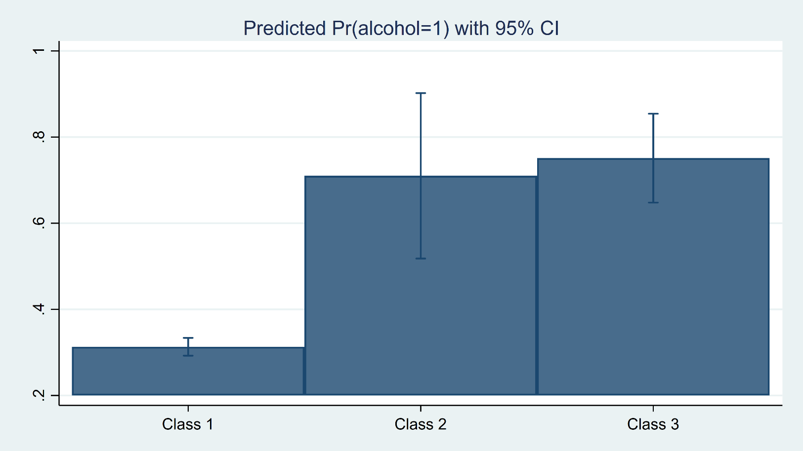
margins and marginsplot
margins, predict(outcome(alcohol) class(1)) ///
predict(outcome(alcohol) class(2)) ///
predict(outcome(alcohol) class(3))
marginsplot, recast(bar) xtitle("") ytitle("") ///
xlabel(1 "Class 1" 2 "Class 2" 3 "Class 3") ///
title("Predicted Pr(alcohol=1) with 95% CI")

Slide 25
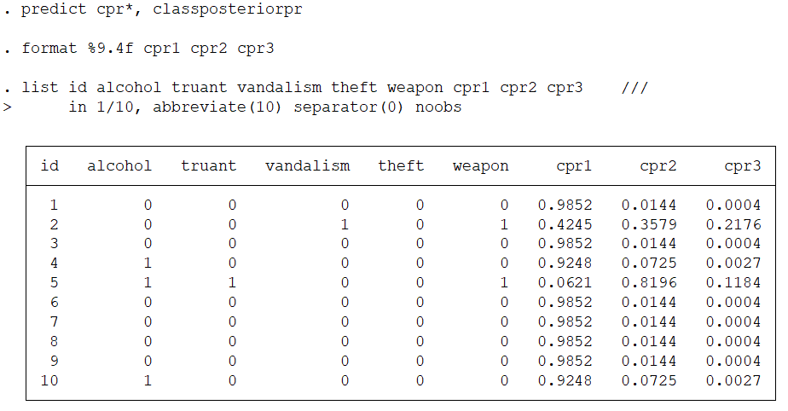
LCA Postestimation

Slide 26
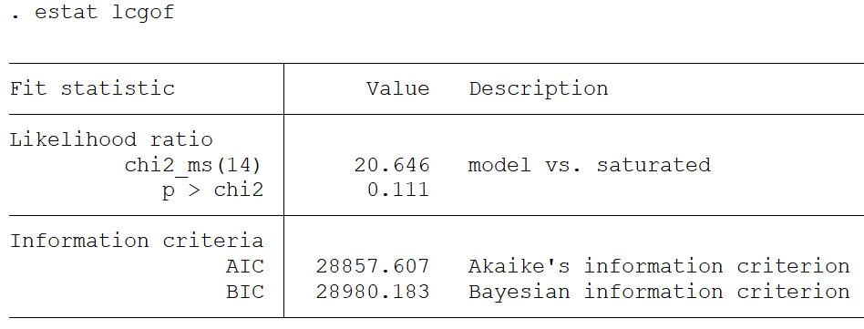
LCA Postestimation

Slide 27
How many classes?
quietly gsem (alcohol truant vandalism theft weapon <- ), logit lclass(C 1)
estimates store oneclass
quietly gsem (alcohol truant vandalism theft weapon <- ), logit lclass(C 2)
estimates store twoclass
quietly gsem (alcohol truant vandalism theft weapon <- ), logit lclass(C 3)
estimates store threeclass

Slide 28
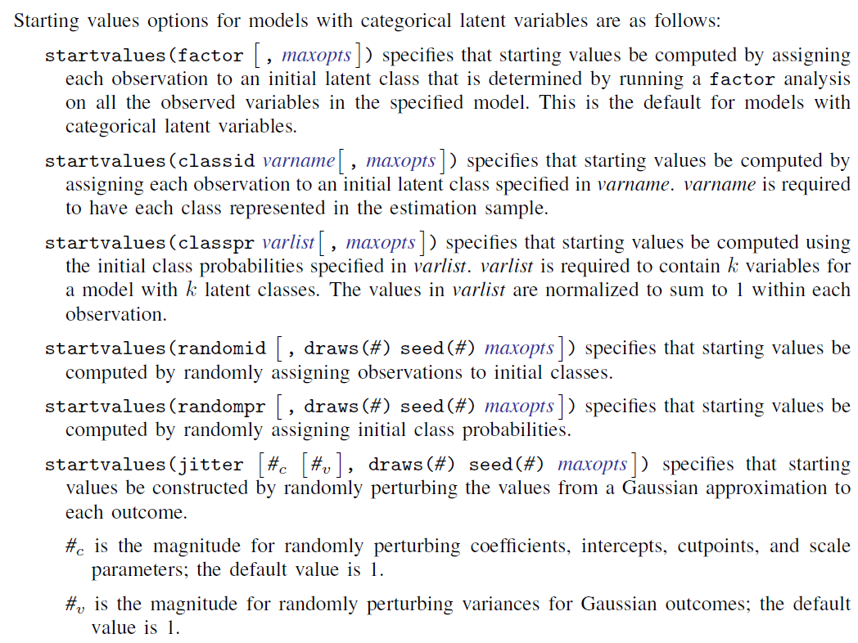
Options for Starting Values

Slide 29
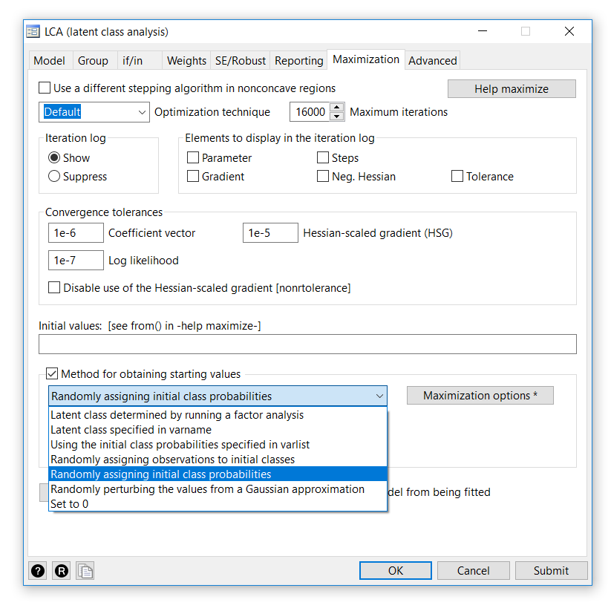
Options for Starting Values
gsem (alcohol truant vandalism theft weapon <- _cons) ///
, logit lclass(C 3) ///
startvalues(randompr, draws(20) seed(15))

Slide 30
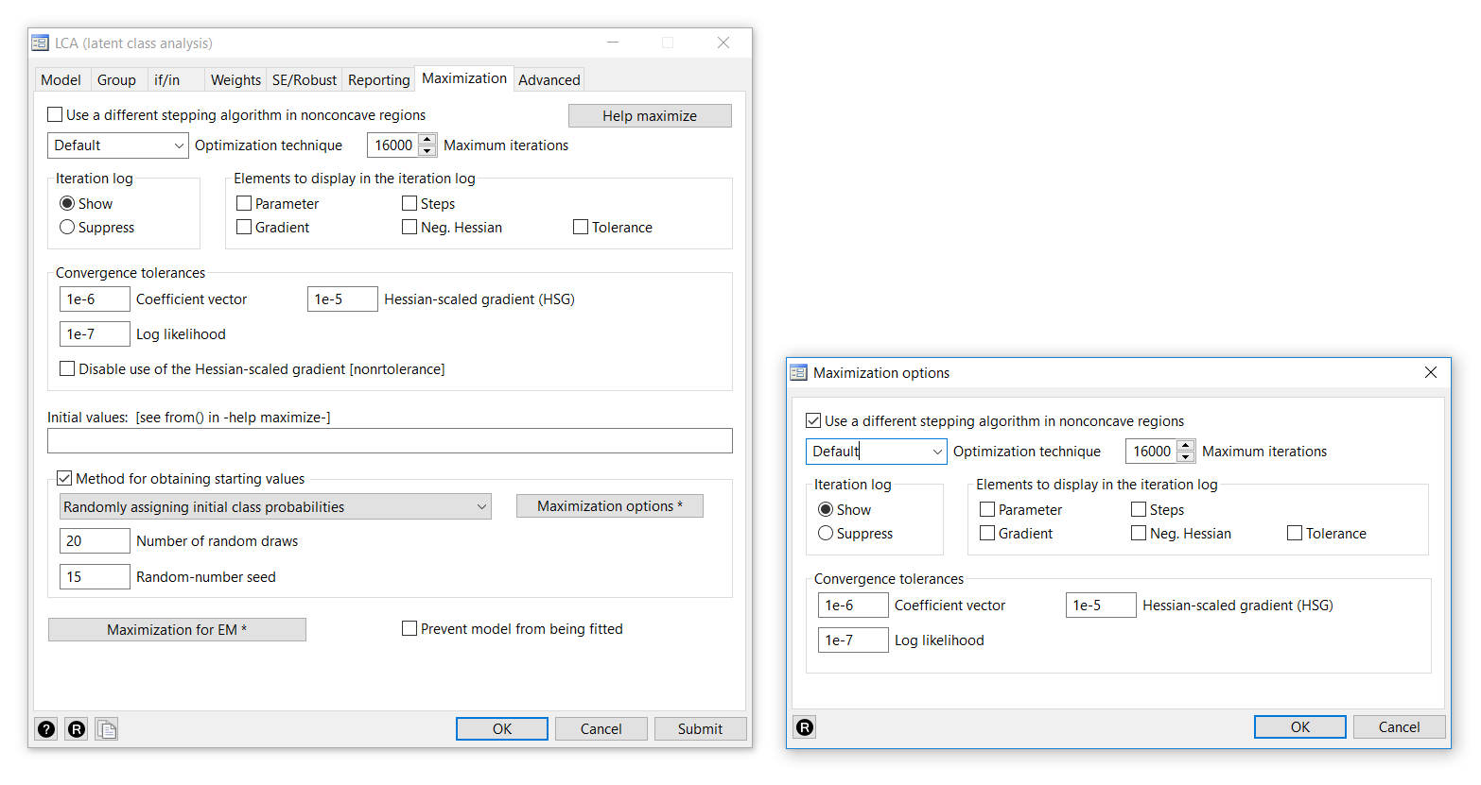
Options for Starting Values
gsem (alcohol truant vandalism theft weapon <- _cons) ///
, logit lclass(C 3) ///
startvalues(randompr, draws(20) seed(15) difficult)

Slide 31
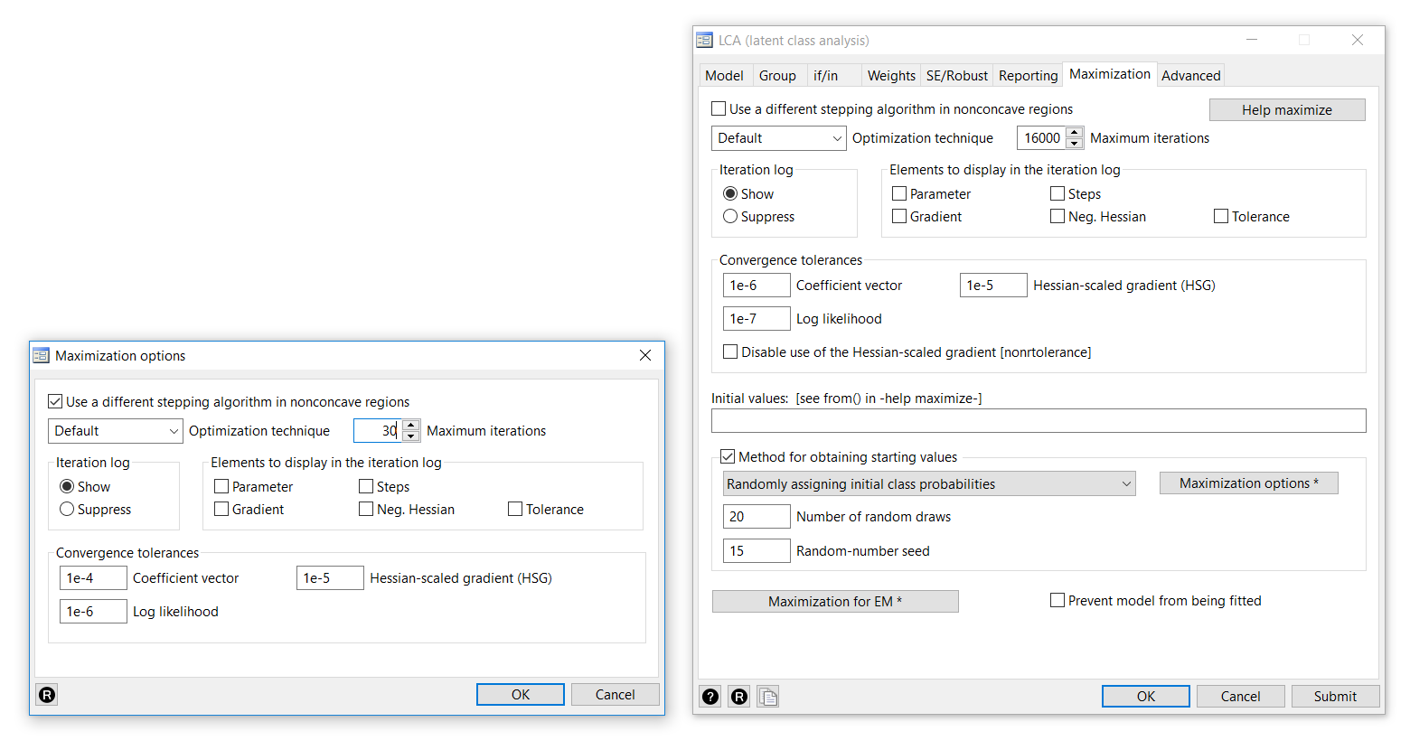
Options for the EM Algorithm
gsem (alcohol truant vandalism theft weapon <- _cons) ///
, logit lclass(C 3) ///
startvalues(randompr, draws(20) seed(15) difficult) ///
emopts(iterate(30) difficult)

Slide 32
Outline
Latent class analysis (LCA)
Estimation and postestimation options
margins and marginsplot
Latent class analysis with covariates
Latent class analysis by groups
Latent profile analysis

Slide 33
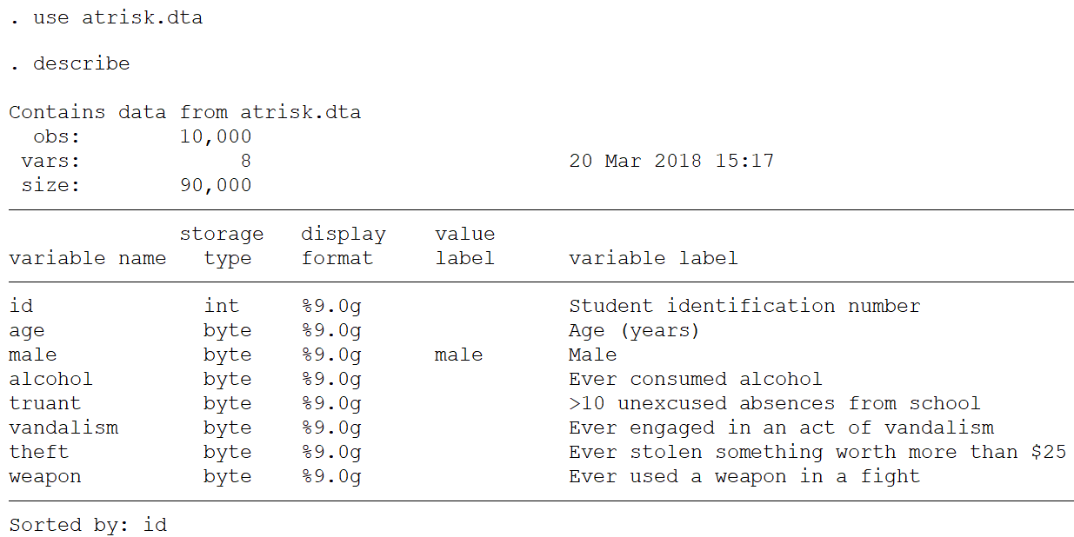
LCA With Covariates

Slide 34
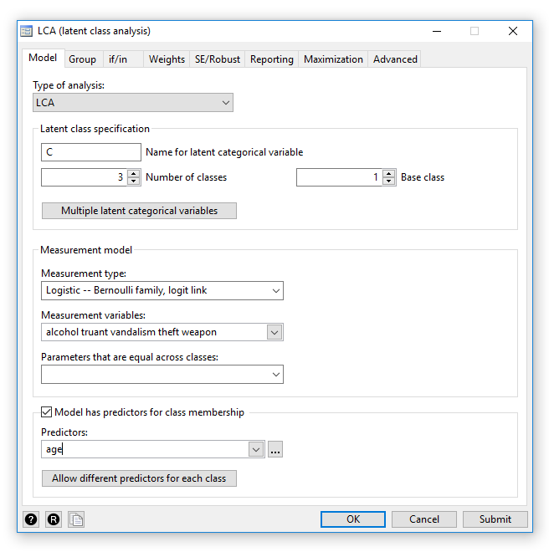
LCA With Covariates
gsem (alcohol truant vandalism theft weapon <- _cons) ///
(C <- age), family(bernoulli) link(logit) ///
lclass(C 3)

Slide 35
LCA With Covariates

Slide 36
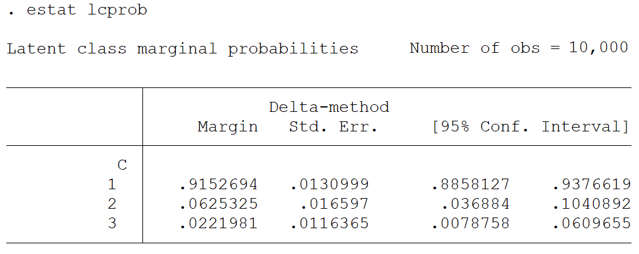
LCA With Covariates

Slide 37
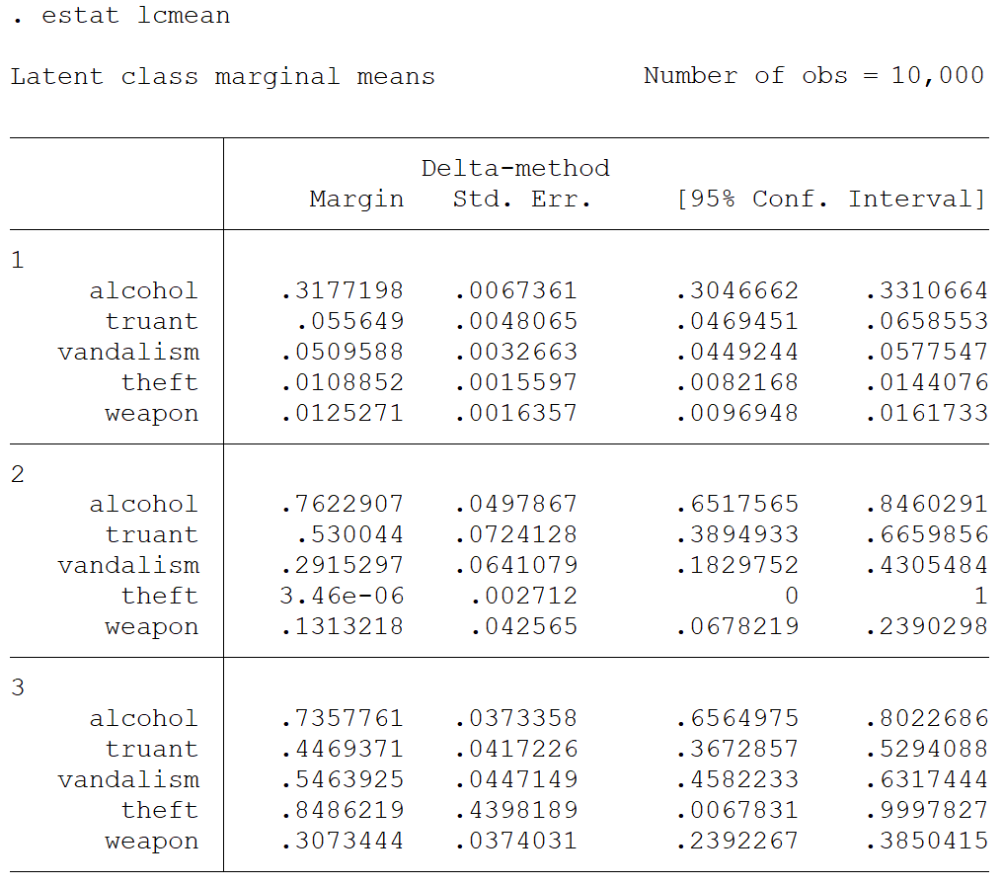
LCA With Covariates

Slide 38
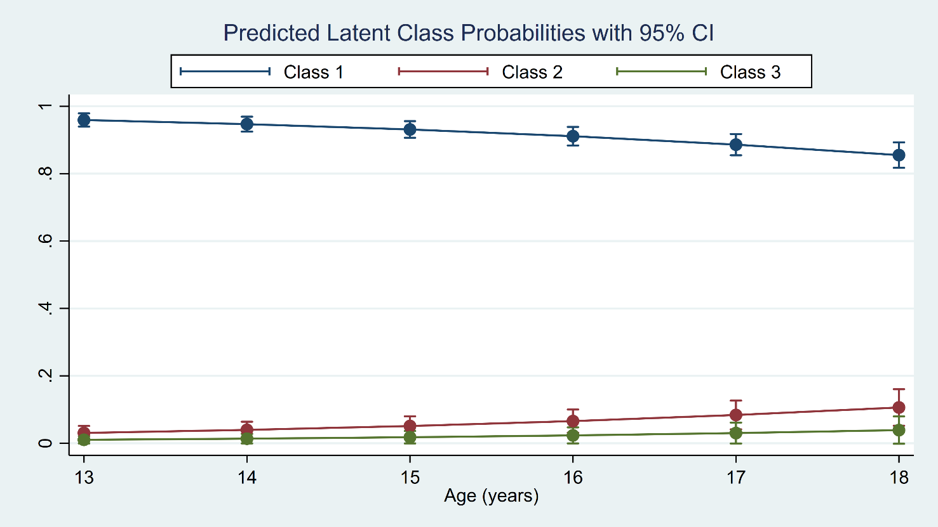
margins and marginsplot
margins, predict(classpr class(1)) ///
predict(classpr class(2)) ///
predict(classpr class(3)) ///
at(age=(13(1)18))
marginsplot, title("Predicted Latent Class Probabilities with 95% CI") ///
legend(order(1 "Class 1" 2 "Class 2" 3 "Class 3") ///
rows(1) position(12) ring(1)) ytitle("")

Slide 39
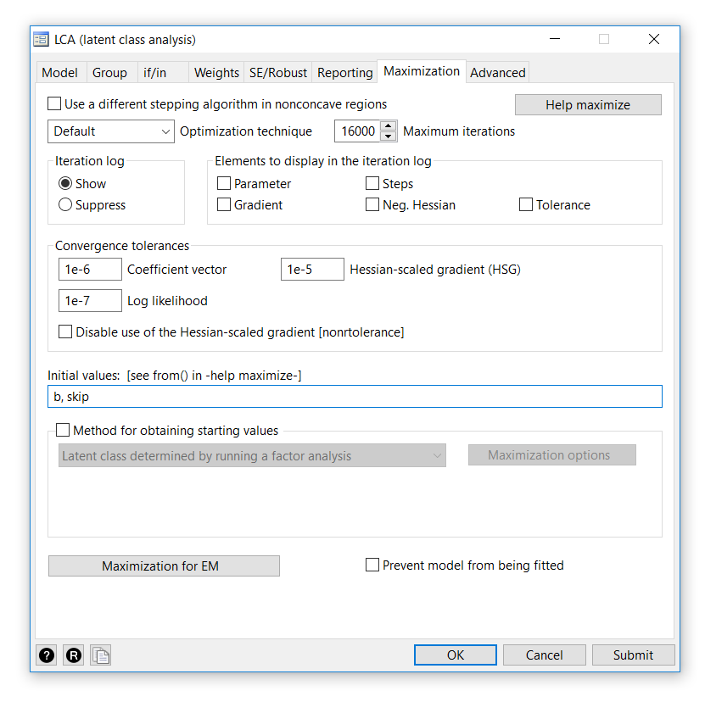
Initial Values with the from()Option
gsem (alcohol truant vandalism theft weapon <- _cons) ///
(C <- age), family(bernoulli) link(logit) ///
lclass(C 3) from(b, skip)

Slide 40
Initial Values with the from()Option
// Fit a model without age
gsem (alcohol truant vandalism theft weapon <- _cons) ///
, family(bernoulli) link(logit) ///
lclass(C 3)
// Store the parameter estimates in a matrix named b
matrix b = e(b)
// Fit a model including age using matrix b for the starting values
gsem (alcohol truant vandalism theft weapon <- _cons) ///
(C <- age), family(bernoulli) link(logit) ///
lclass(C 3) ///
from(b, skip)

Slide 41
Outline
Latent class analysis (LCA)
Estimation and postestimation options
margins and marginsplot
Latent class analysis with covariates
Latent class analysis by groups
Latent profile analysis

Slide 42
LCA By Groups

Slide 43
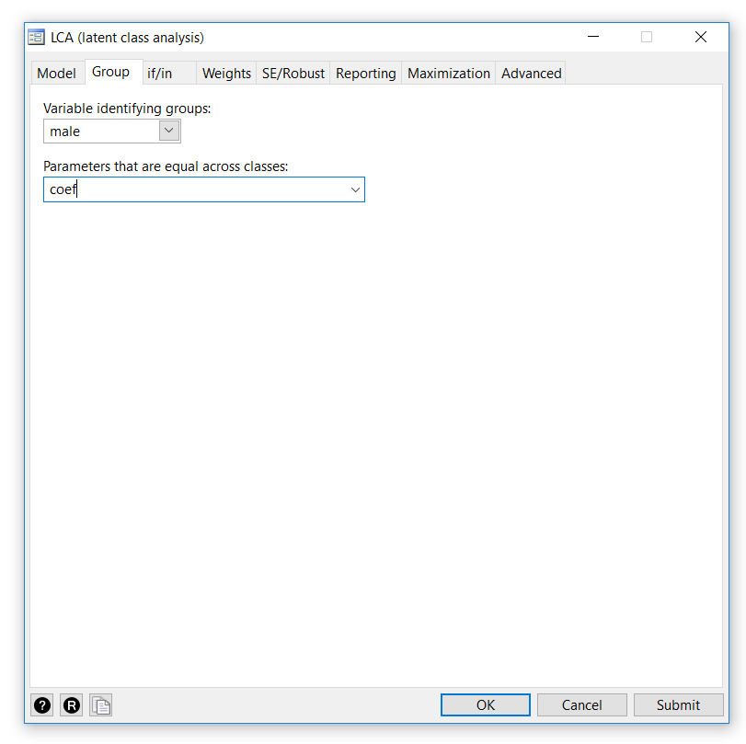
LCA By Groups
gsem (alcohol truant vandalism theft weapon <- _cons) ///
(C <- age), family(bernoulli) link(logit) ///
lclass(C 3) group(male) ginvariant(coef)

Slide 44
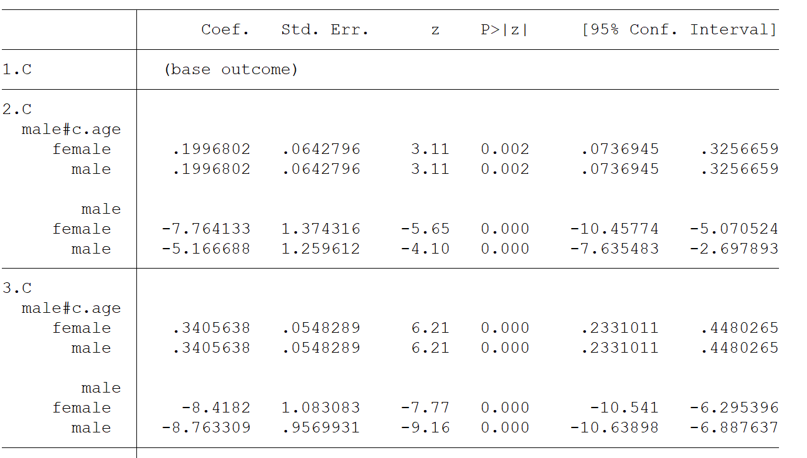
LCA By Groups

Slide 45
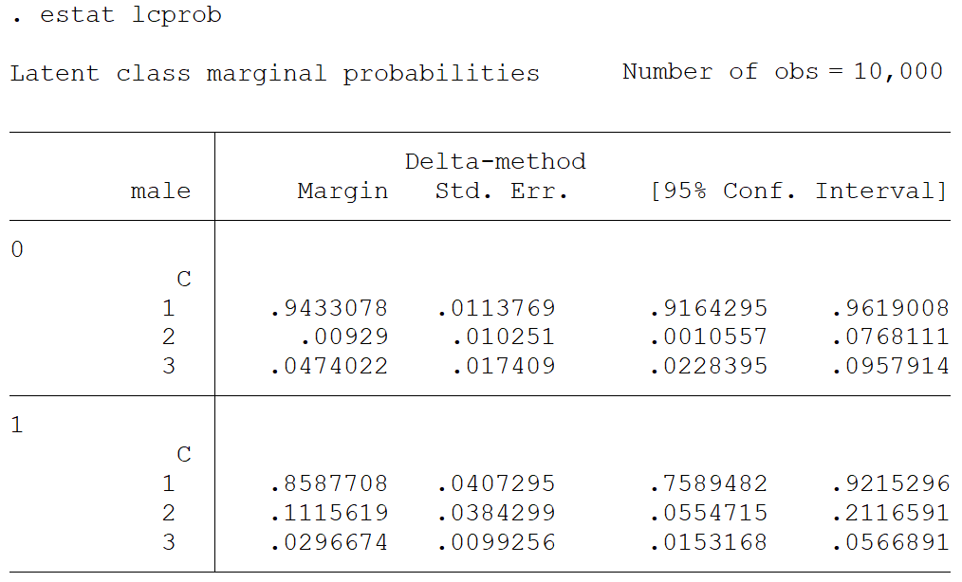
LCA By Groups

Slide 46
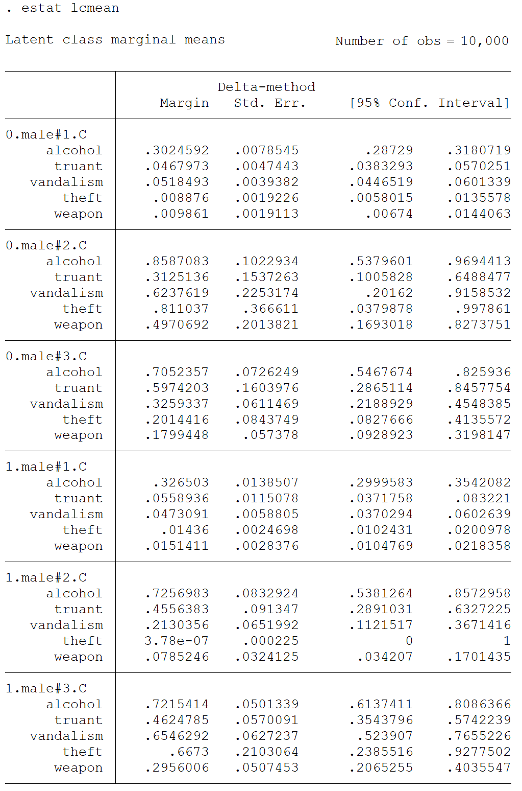

Slide 47
Outline
Latent class analysis (LCA)
Estimation and postestimation options
margins and marginsplot
Latent class analysis with covariates
Latent class analysis by groups
Latent profile analysis

Slide 48
Latent and Observed Variables
 | Continuous Latent | Categorical Latent
Continuous Observed | Factor analysis | Latent Profile Analysis
Categorical Observed | Latent trait analysis or Item Response Theory | Latent Class Analysis
Reproduced from Table 1.1 in Collins and Lanza (2010)

Slide 49
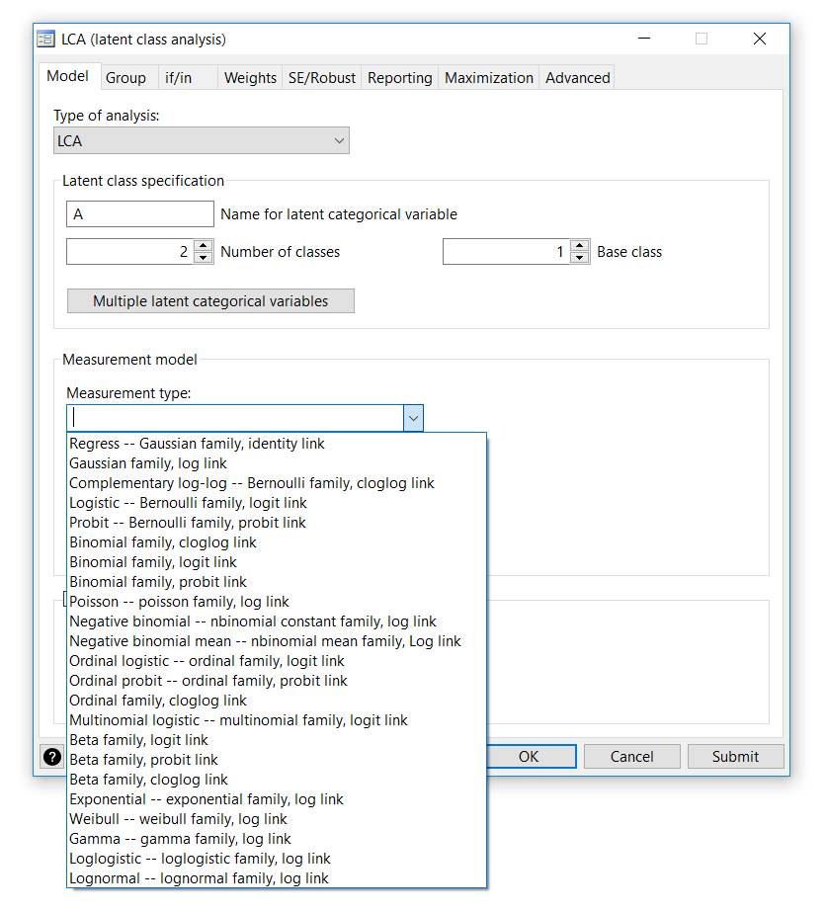
Latent Profile Analysis

Slide 50
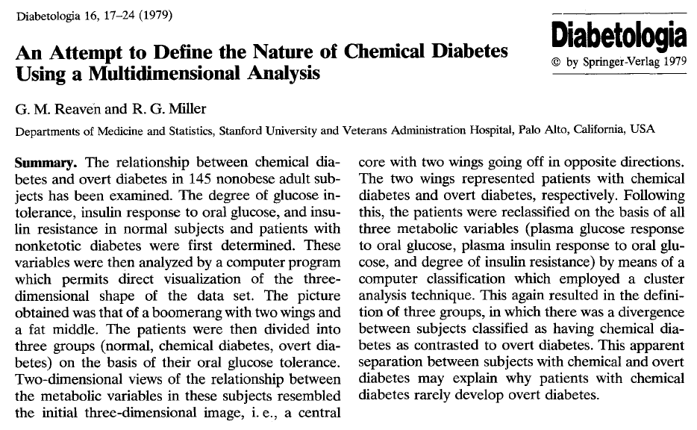
Latent Profile Analysis

Slide 51
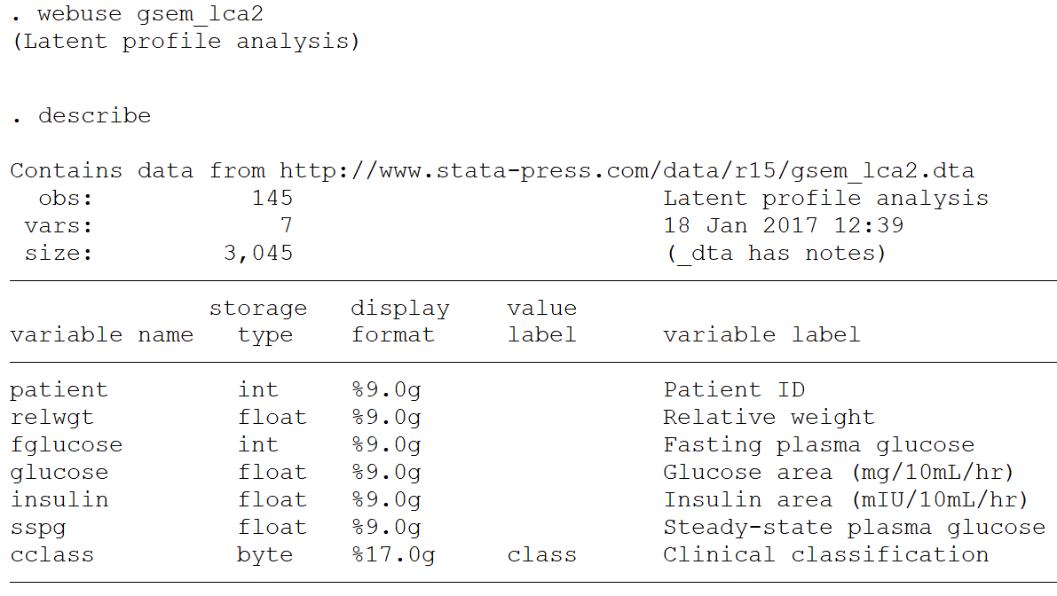
Latent Profile Analysis

Slide 52
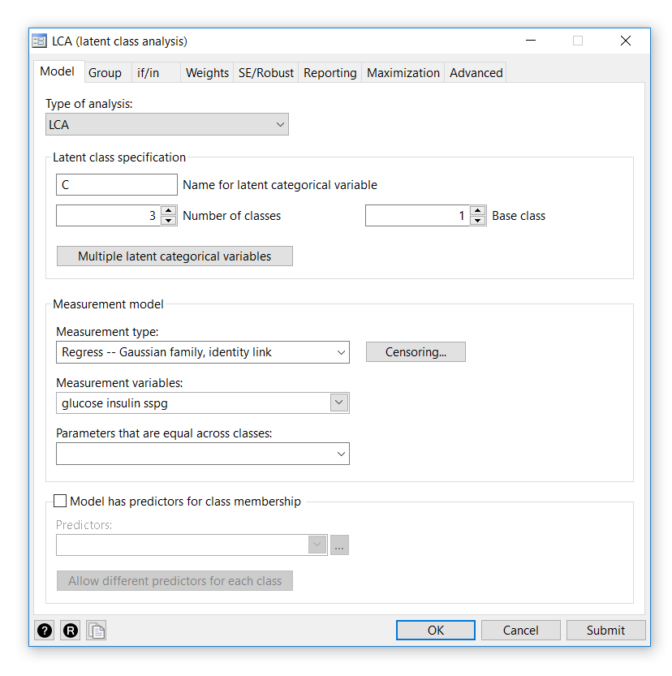
Latent Profile Analysis
gsem (glucose insulin sspg <- _cons), ///
family(gaussian) link(identity) ///
lclass(C 3)

Slide 53
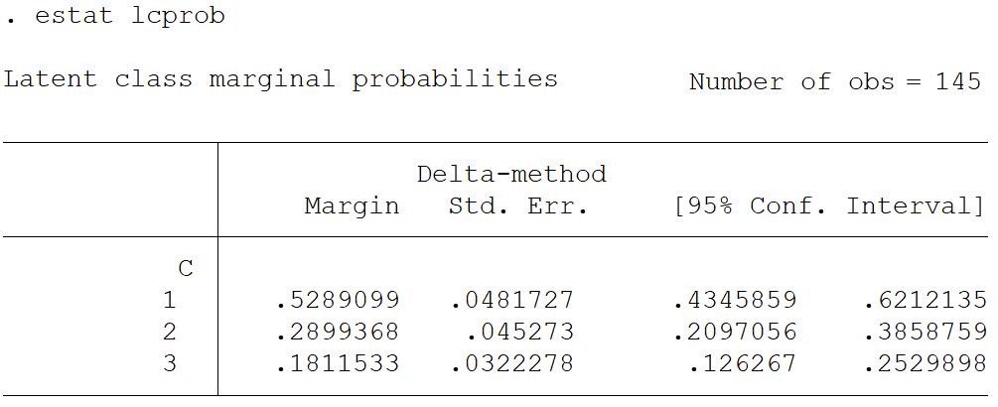
Latent Profile Analysis

Slide 54
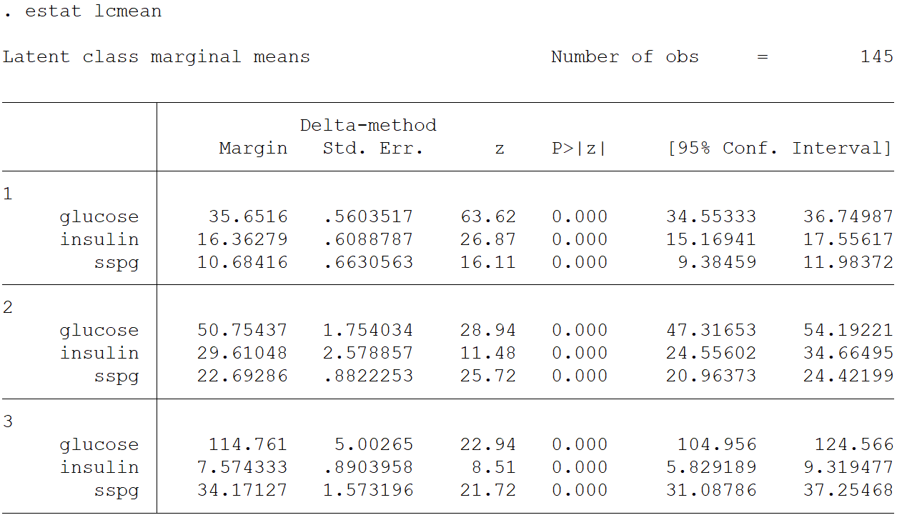
Latent Profile Analysis

Slide 55
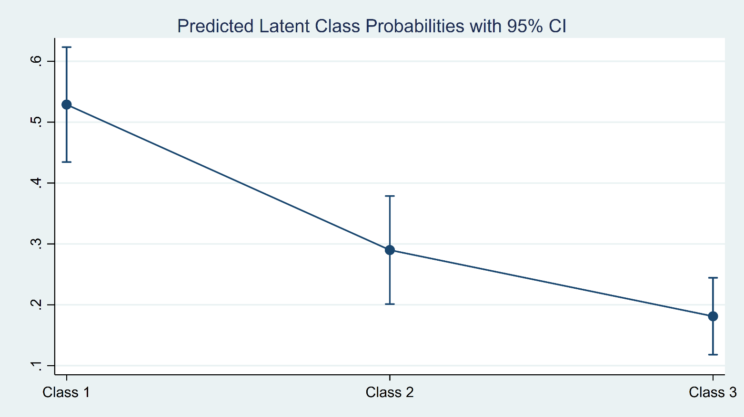
Latent Profile Analysis
margins, predict(classpr class(1)) ///
predict(classpr class(2)) ///
predict(classpr class(3))
marginsplot, xtitle("") ytitle("") ///
xlabel(1 "Class 1" 2 "Class 2" 3 "Class 3") ///
title("Predicted Latent Class Probabilities with 95% CI")

Slide 56
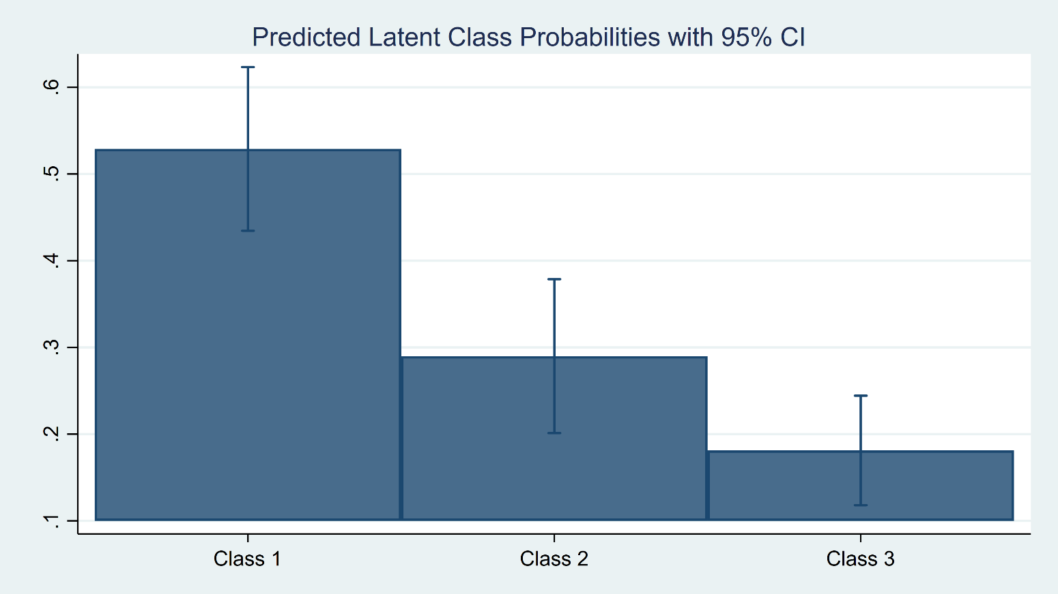
Latent Profile Analysis
margins, predict(classpr class(1)) ///
predict(classpr class(2)) ///
predict(classpr class(3))
marginsplot, recast(bar) xtitle("") ytitle("") ///
xlabel(1 "Class 1" 2 "Class 2" 3 "Class 3") ///
title("Predicted Latent Class Probabilities with 95% CI")

Slide 57
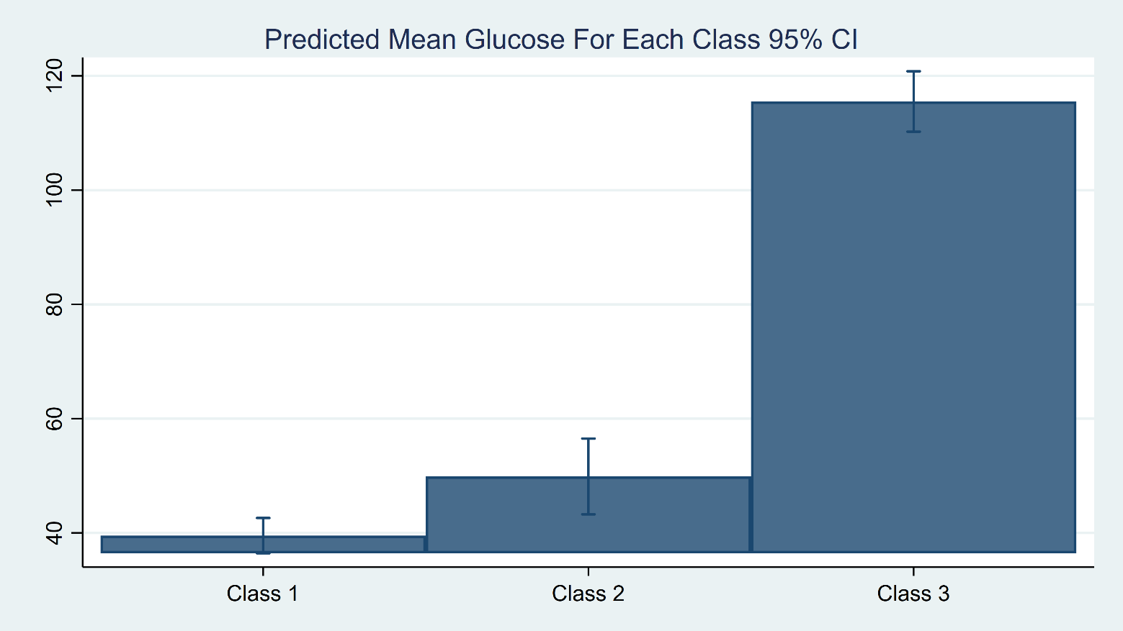
Latent Profile Analysis
margins, predict(outcome(glucose) class(1)) ///
predict(outcome(glucose) class(2)) ///
predict(outcome(glucose) class(3))
marginsplot, recast(bar) xtitle("") ytitle("") ///
xlabel(1 "Class 1" 2 "Class 2" 3 "Class 3") ///
title("Predicted Mean Glucose For Each Class 95% CI")

Slide 58
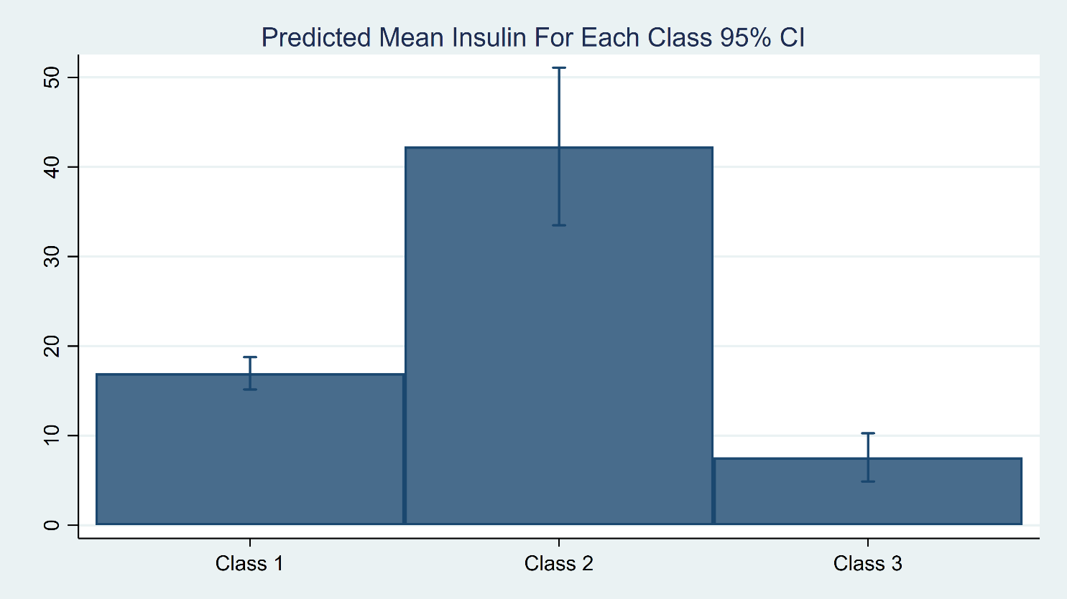
Latent Profile Analysis
margins, predict(outcome(insulin) class(1)) ///
predict(outcome(insulin) class(2)) ///
predict(outcome(insulin) class(3))
marginsplot, recast(bar) xtitle("") ytitle("") ///
xlabel(1 "Class 1" 2 "Class 2" 3 "Class 3") ///
title("Predicted Mean Insulin For Each Class 95% CI")

Slide 59
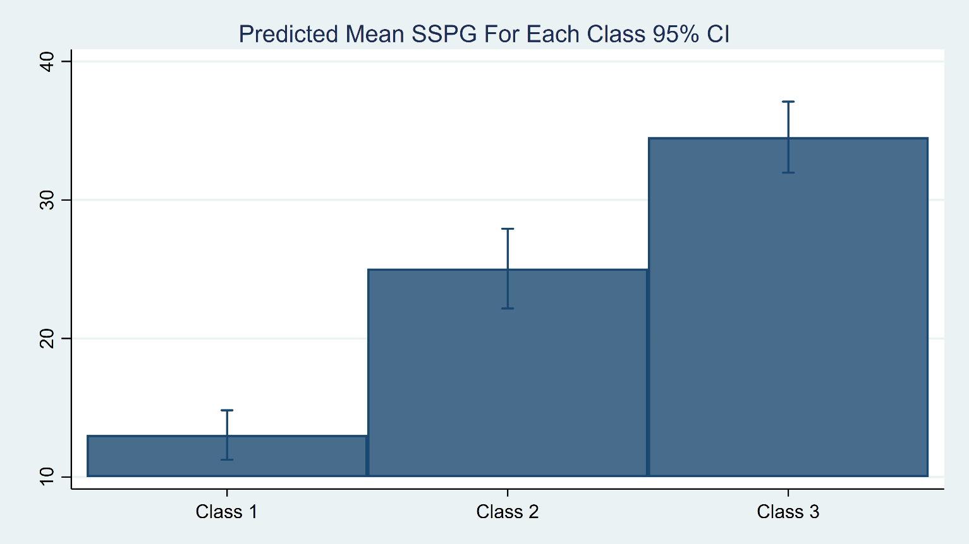
Latent Profile Analysis
margins, predict(outcome(sspg) class(1)) ///
predict(outcome(sspg) class(2)) ///
predict(outcome(sspg) class(3))
marginsplot, recast(bar) xtitle("") ytitle("") ///
xlabel(1 "Class 1" 2 "Class 2" 3 "Class 3") ///
title("Predicted Mean SSPG For Each Class 95% CI")

Slide 60
Summary
Latent class analysis (LCA)
Estimation and postestimation options
margins and marginsplot
Latent class analysis with covariates
Latent class analysis by groups
Latent profile analysis

Slide 61
Thanks for Coming!
Questions?

