Slide 1
How To Create Basic
Stata Estimation Commands
Chuck Huber
StataCorp
chuber@stata.com
Stata Webinar
March 14, 2023

Slide 2
Download Website
You can download all of the slides, datasets and do-files here:
https://tinyurl.com/StataProgramming2

Slide 3
Why Create Your Own
Estimation Commands?
You develop a new statistical estimator
You read about a new estimator in the literature

Slide 4
Basic Parts Of An Estimation Program
program myprogram
// DEFINE THE INPUT SYNTAX
// FIT MODEL, ESTIMATE PARAMETERS
// DISPLAY AND RETURN RESULTS
end

Slide 5
Outline
Least Squares Estimation
  Convert variables to matrices
  Linear Regression Command Using Least Squares
Maximum Likelihood Estimation
  Maximum Likelihood Estimation With mlexp
  Linear Regression With ml
  Logistic Regression With ml
  Maximizing Your Own Likelihood Functions With ml
  Estimation Options With ml

Slide 6
Convert Data To Matrices

Slide 7
Convert Data To Matrices
mkmat age bmi female, matrix(X)
numeric
variables
new
matrix

Slide 8
Convert Data To Matrices
Data
Convert data to matrix
Matrix

Slide 9
Convert Data To Matrices
Data
Convert data to matrix
Matrix

Slide 10
Convert Data To Matrices
y
X

Slide 11
Calculate b

Slide 12
Compare b to regress

Slide 13
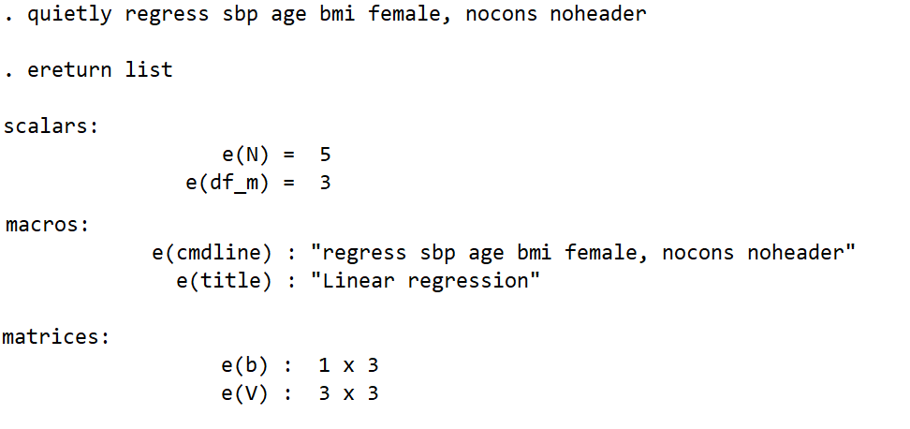
ereturn list
matrix of beta coefficients
variance/covariance matrix

Slide 14
Compare b to e(b)
b
e(b)
Note that there are more efficient ways to estimate b. Type ‘help matrix accum’

Slide 15
Calculate The Error Matrix

Slide 16
Calculate The Variance/Covariance Matrix
V

Slide 17
Compare V to e(V)
V
e(V)

Slide 18

Outline
Least Squares Estimation
  Convert variables to matrices
  Linear Regression Command Using Least Squares
Maximum Likelihood Estimation
  Maximum Likelihood Estimation with mlexp
  Linear Regression With ml
  Logistic Regression With ml
  Maximizing Your Own Likelihood Functions With ml
  Estimation Options With ml

Slide 19
Define a command named regressmat
program regressmat
version 16
syntax varlist(min=2 numeric) [if] [in]
marksample touse
end
Run regressmat

Slide 20
Define a command named regressmat
capture program drop regressmat
program regressmat
version 16
syntax varlist(min=2 numeric) [if] [in]
marksample touse
gettoken depvar indepvars : varlist
display "depvar = `depvar'"
display "indepvars = `indepvars'"
end
Run regressmat

Slide 21
Define a command named regressmat
capture program drop regressmat
program regressmat
version 16
syntax varlist(min=2 numeric) [if] [in]
marksample touse
gettoken depvar indepvars : varlist
tempvar intercept
generate `intercept' = 1
end
Run regressmat

Slide 22
Define a command named regressmat
capture program drop regressmat
program regressmat
version 16
syntax varlist(min=1 numeric) [if] [in]
marksample touse
gettoken depvar indepvars : varlist
tempvar intercept
generate `intercept' = 1
mkmat `depvar' if `touse', matrix(y)
mkmat `indepvars' `intercept' if `touse', matrix(X)
matlist y
matlist X
end
Run regressmat
(see next slide)

Slide 23
Redefine a command named regressmat
(see previous slide)
Run regressmat
y
X

Slide 24
Define a command named regressmat
capture program drop regressmat
program regressmat
version 16
syntax varlist(min=1 numeric)
marksample touse
gettoken depvar indepvars : varlist
tempvar intercept
generate `intercept' = 1
mkmat `depvar' if `touse', matrix(y)
mkmat `indepvars' `intercept' if `touse', matrix(X)
matrix b = invsym(X'*X)*X'*y
matrix e = y - X*b
scalar k = colsof(X)
scalar N = rowsof(X)
matrix s = (e'*e)/(N-k)
matrix V = invsym(X'*X)*s
matlist b
matlist V
end
(see next slide)

Slide 25
Redefine a command named regressmat
(see previous slide)
Run regressmat
b
V

Slide 26
Define a command named regressmat
capture program drop regressmat
program regressmat, eclass
version 16
syntax varlist(min=1 numeric) [if] [in]
gettoken depvar indepvars : varlist
marksample touse
tempvar intercept
generate `intercept' = 1
mkmat `depvar' if `touse', matrix(y)
mkmat `indepvars' `intercept' if `touse', matrix(X)
matrix b = invsym(X'*X)*X'*y
matrix e = y - X*b
scalar k = colsof(X)
scalar N = rowsof(X)
matrix s = (e'*e)/(N-k)
matrix V = invsym(X'*X)*s
matrix b = b'
ereturn post b V
ereturn display
end

Slide 27
Redefine a command named regressmat
(see previous slide)
Run regressmat

Slide 28
Redefine a command named regressmat
(see previous slide)
Run regressmat

Slide 29
Define a command named regressmat
capture program drop regressmat
program regressmat, eclass
version 16
syntax varlist(min=1 numeric) [if] [in]
gettoken depvar indepvars : varlist
marksample touse
tempvar intercept
generate `intercept' = 1
mkmat `depvar' if `touse', matrix(y)
mkmat `indepvars' `intercept' if `touse', matrix(X)
matrix b = invsym(X'*X)*X'*y
matrix e = y - X*b
scalar k = colsof(X)
scalar N = rowsof(X)
matrix s = (e'*e)/(N-k)
matrix V = invsym(X'*X)*s
matrix b = b'
matrix colnames b = `indepvars‘ "_cons"
matrix rownames V = `indepvars‘ "_cons"
matrix colnames V = `indepvars‘ "_cons"
ereturn post b V
ereturn display
end

Slide 30
Redefine a command named regressmat
(see previous slide)
Run regressmat

Slide 31
c:\ado\personal\regressmat.ado
program regressmat, eclass
version 16
syntax varlist(min=1 numeric) [if] [in]
gettoken depvar indepvars : varlist
marksample touse
tempvar intercept
generate `intercept' = 1
mkmat `depvar' if `touse', matrix(y)
mkmat `indepvars' `intercept' if `touse', matrix(X)
matrix b = invsym(X'*X)*X'*y
matrix e = y - X*b
scalar k = colsof(X)
scalar N = rowsof(X)
matrix s = (e'*e)/(N-k)
matrix V = invsym(X'*X)*s
matrix b = b'
matrix colnames b = `indepvars‘ "_cons"
matrix rownames V = `indepvars‘ "_cons"
matrix colnames V = `indepvars‘ "_cons"
ereturn post b V
ereturn display
end

Slide 32
Outline
Least Squares Estimation
  Convert variables to matrices
  Linear Regression Command Using Least Squares
Maximum Likelihood Estimation
  Maximum Likelihood Estimation with mlexp
  Linear Regression With ml
  Logistic Regression With ml
  Maximizing Your Own Likelihood Functions With ml
  Estimation Options With ml

Slide 33
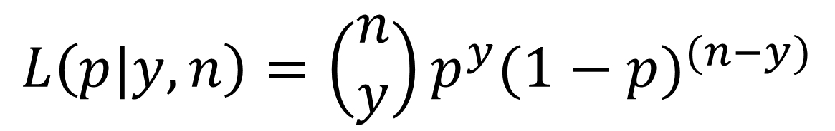
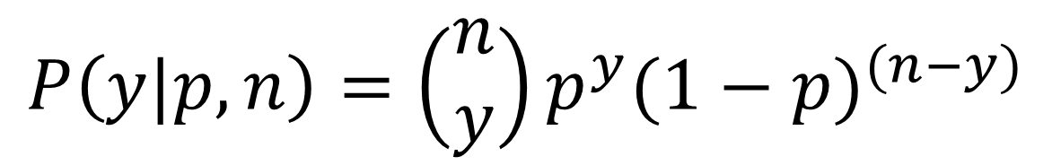
Likelihood Functions
$$P\left(y|p,n\right)=\left(\begin{matrix}n \\ y\end{matrix}\right)p^{y}{(1−p)}^{(n−y)}$$
$$L\left(p|y,n\right)=\left(\begin{matrix}n \\ y\end{matrix}\right)p^{y}{(1−p)}^{(n−y)}$$

Slide 34
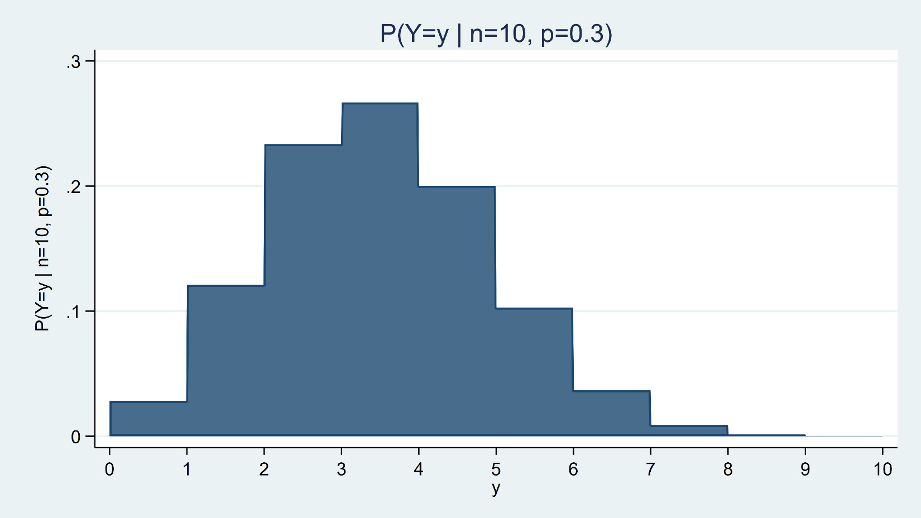
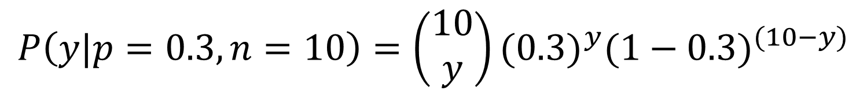
Binomial Probability Distribution Function
$$P\left(y|p=0.3,n=10\right)=\left(\begin{matrix}10 \\ y\end{matrix}\right){(0.3)}^{y}{(1−0.3)}^{(10−y)}$$

Slide 35
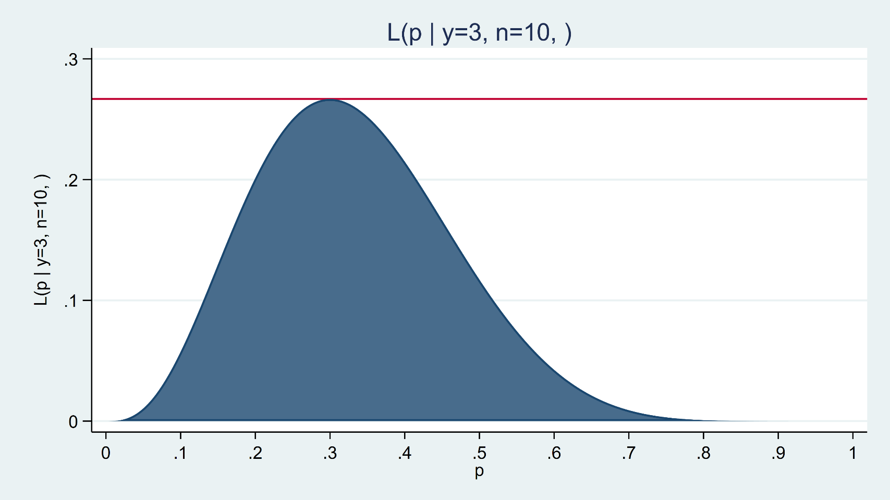
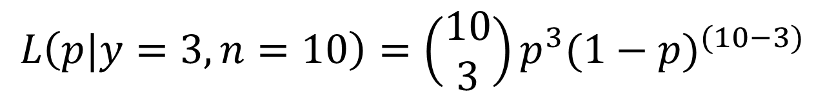
Binomial Likelihood Function
$$L\left(p|y=3,n=10\right)=\left(\begin{matrix}10 \\ 3\end{matrix}\right)p^{3}{(1−p)}^{(10−3)}$$

Slide 36
Estimate the MLE Using mlexp
mlexp (binomialp(10,3,{p}))
Note that mlexp expects a log-likelihood so the standard errors are incorrect

Slide 37
Estimate the MLE Using mlexp
mlexp (ln(binomialp(10,3,{p})))

Slide 38
Stata’s Distribution Functions
Beta and noncentral beta distributions
Binomial distribution
Cauchy distribution
Chi-squared and noncentral chi-squared distributions
Dunnett's multiple range distribution
Exponential distribution
F and noncentral F distributions
Gamma distribution
Hypergeometric distribution
Inverse Gaussian distribution
Laplace distribution
Logistic distribution
Negative binomial distribution
Normal (Gaussian), binormal, and multivariate normal distributions
Poisson distribution
Student's t and noncentral Student's t distributions
Tukey's Studentized range distribution
Weibull distribution
Weibull (proportional hazards) distribution
Wishart distribution

Slide 39
Outline
Least Squares Estimation
  Convert variables to matrices
  Linear Regression Command Using Least Squares
Maximum Likelihood Estimation
  Maximum Likelihood Estimation with mlexp
  Linear Regression With ml
  Logistic Regression With ml
  Maximizing Your Own Likelihood Functions With ml
  Estimation Options With ml

Slide 40
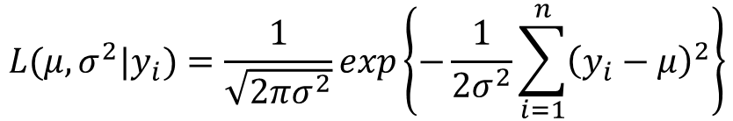
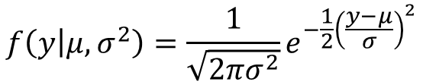
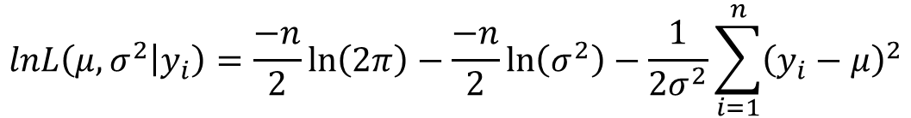
Maximum Likelihood Estimation
Gaussian (Normal) Density Function
$$f\left(y | μ,σ^{2}\right)=\frac{1}{\sqrt{2πσ^{2}}}e^{−\frac{1}{2}{\left(\frac{y−μ}{σ}\right)}^{2}}$$
Gaussian (Normal) Likelihood Function
$$L(μ,σ^{2}|y_{i})=\frac{1}{\sqrt{2πσ^{2}}}exp\left\{−\frac{1}{2σ^{2}}\sum_{i=1}^{n}{{\left(y_{i}−μ\right)}^{2}}\right\}$$
Gaussian (Normal) Log-likelihood Function
$$lnL\left(μ,σ^{2} | y_{i}\right)=\frac{−n}{2}\ln\left(2π\right)−\frac{−n}{2}\ln\left(σ^{2}\right)−\frac{1}{2σ^{2}}\sum_{i=1}^{n}{{\left(y_{i}−μ\right)}^{2}}$$

Slide 41
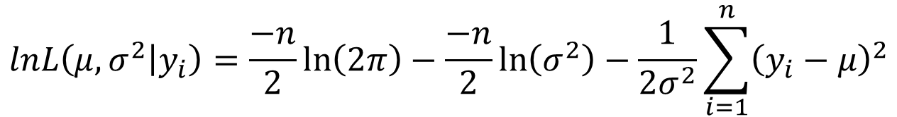
Maximum Likelihood Estimation
Gaussian (Normal) Log-likelihood Function
$$lnL\left(μ,σ^{2} | y_{i}\right)=\frac{−n}{2}\ln\left(2π\right)−\frac{−n}{2}\ln\left(σ^{2}\right)−\frac{1}{2σ^{2}}\sum_{i=1}^{n}{{\left(y_{i}−μ\right)}^{2}}$$
$lnL\left(μ,σ^{2} | y_{i}\right)$ = ln(normalden(y,mu,sigma))

Slide 42
The ml command
ml model
ml maximize
ml clear
ml query
ml check
ml search
ml plot
ml init
ml report
ml trace
ml count
ml graph
ml display
ml footnote
ml score

Slide 43
Define an “evaluator program” named mynormal_lf
capture program drop mynormal_lf
program mynormal_lf
version 16
args lnf mu sigma
quietly replace `lnf' = ln(normalden($ML_y1,`mu',`sigma'))
end
$ML_y1 is the dependent variable (e.g. sbp)
`mu'is the mean
`sigma' is the standard deviation

Slide 44
Define an “evaluator program” named mynormal_lf
capture program drop mynormal_lf
program mynormal_lf
version 16
args lnf mu sigma
quietly replace `lnf' = ln(normalden($ML_y1,`mu',`sigma'))
end
Define a model with ml model
ml model lf mynormal_lf (mu: sbp = age bmi i.female) (sigma:)

Slide 45
Define an “evaluator program” named mynormal_lf
capture program drop mynormal_lf
program mynormal_lf
version 16
args lnf mu sigma
quietly replace `lnf' = ln(normalden($ML_y1,`mu',`sigma'))
end
Define a model with ml model
ml model lf mynormal_lf (mu: sbp = age bmi i.female) (sigma:)

Slide 46
Fit the model with ml maximize

Slide 47
Evaluator
Program
Define model
Fit model
Results

Slide 48
ml model lf mynormal_lf (mu: sbp = age bmi i.female) ///
(sigma:), vce(robust)

Slide 49
MLE With Survey Weights

Slide 50
ml model lf mynormal_lf (mu: sbp = age bmi i.female) ///
(sigma:), svy

Slide 51
Define a program named regressml
program regressml, eclass
syntax varlist(min=1 numeric fv)
gettoken depvar indepvars : varlist
ml model lf mynormal_lf (mu: `depvar' = `indepvars') ///
(sigma:)
ml maximize, nolog
end
Run regressml
(results on next slide)

Slide 52
Run regressml

Slide 53
ml postestimation
predict and predictnl
margins and marginsplot
lincom and nlcom
contrast and pwcompare
test and testnl
The svy option allows svy postestimation commands

Slide 54
You can run margins after regressml

Slide 55
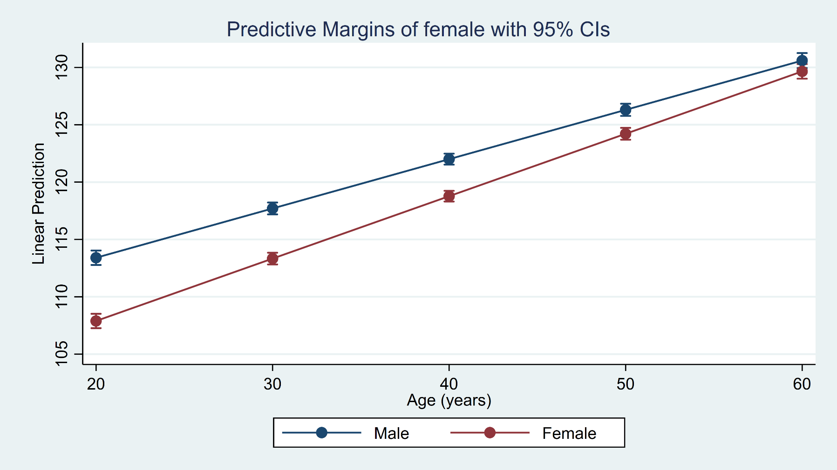
You can run marginsplot after regressml and margins
. marginsplot

Slide 56
c:\ado\personal\mynormal_lf.ado
program mynormal_lf
version 16
args lnf mu sigma
quietly replace `lnf' = ln(normalden($ML_y1,`mu',`sigma'))
end
c:\ado\personal\regressml.ado
program regressml, eclass
syntax varlist(min=1 numeric fv)
gettoken depvar indepvars : varlist
ml model lf mynormal_lf (mu: `depvar' = `indepvars') ///
(sigma:)
ml maximize, nolog
end

Slide 57
Outline
Least Squares Estimation
  Convert variables to matrices
  Linear Regression Command Using Least Squares
Maximum Likelihood Estimation
  Maximum Likelihood Estimation with mlexp
  Linear Regression With ml
  Logistic Regression With ml
  Maximizing Your Own Likelihood Functions With ml
  Estimation Options With ml

Slide 58
Define an “evaluator program” named mylogit_lf
capture program drop mylogit_lf
program mylogit_lf
version 16
args lnf mu
quietly replace `lnf' = ln(invlogit( `mu')) if $ML_y1 == 1
quietly replace `lnf' = ln(invlogit(-`mu')) if $ML_y1 == 0
end
$ML_y1 is the dependent variable (e.g. diabetes)
`mu'is the mean

Slide 59
Define a program named logitml
program logitml, eclass
version 16
syntax varlist(min=1 numeric fv)
gettoken depvar indepvars : varlist
ml model lf mylogit_lf (mu: `depvar' = `indepvars')
ml maximize, nolog eform("OR")
end
Run logitml
(results on next slide)

Slide 60
Run logitml

Slide 61
You can run margins after logitml

Slide 62
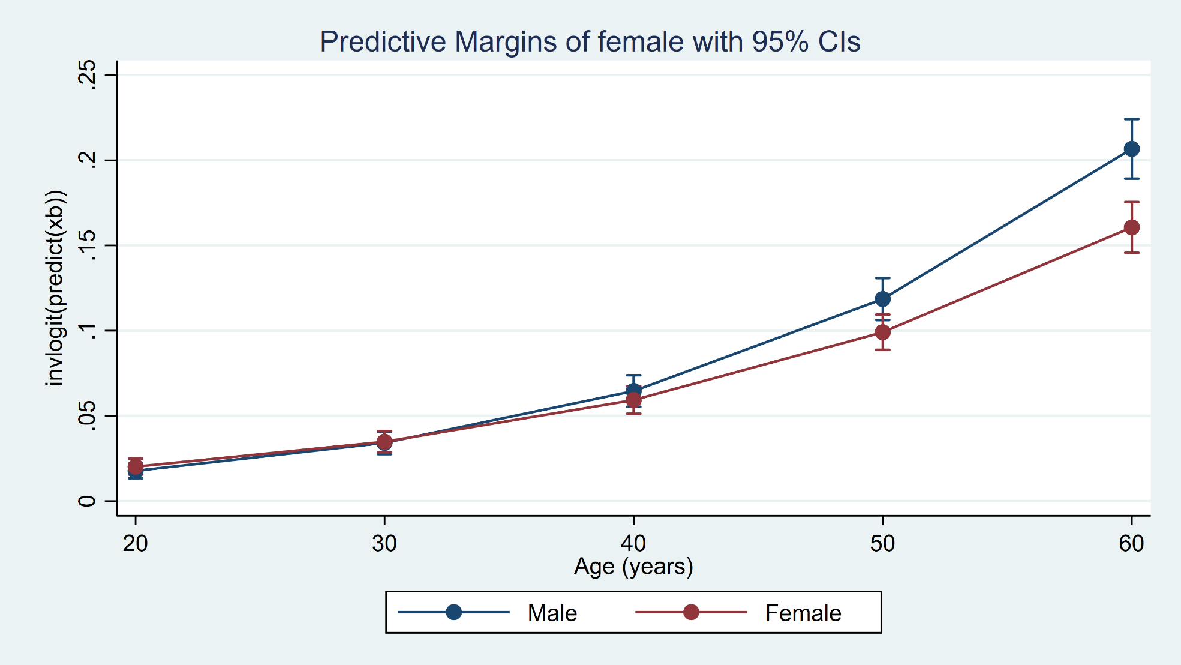
You can run marginsplot after logitml and margins
. marginsplot

Slide 63
c:\ado\personal\mylogit_lf.ado
program mylogit_lf
version 16
args lnf mu
quietly replace `lnf' = ln(invlogit( `mu')) if $ML_y1 == 1
quietly replace `lnf' = ln(invlogit(-`mu')) if $ML_y1 == 0
end
c:\ado\personal\logitml.ado
program logitml, eclass
version 16
syntax varlist(min=1 numeric fv)
gettoken depvar indepvars : varlist
ml model lf mylogit_lf (mu: `depvar' = `indepvars')
ml maximize, nolog eform("OR")
end

Slide 64
Outline
Least Squares Estimation
  Convert variables to matrices
  Linear Regression Command Using Least Squares
Maximum Likelihood Estimation
  Maximum Likelihood Estimation with mlexp
  Linear Regression With ml
  Logistic Regression With ml
  Maximizing Your Own Likelihood Functions With ml
  Estimation Options With ml

Slide 65
What if we want to maximize an
unfamiliar likelihood function?
Log-likelihood Function
$$lnL\left(a,μ | y_{i}\right)=\sum_{i=1}^{n}{ln\left(Γ\left(y_{i}+a\right)\right)−\sum_{i=1}^{n}{ln\left(y_{i}!\right)−Nln\left(Γ\left(a\right)\right)+\sum_{i=1}^{n}{y_{i}ln\left(μ\right)+Naln\left(1−μ\right)}}}$$
c:\ado\personal\mynb_lf.ado
capture program drop mynb_lf
program mynb_lf
version 16
args lnf theta1 a
local y "$ML_y1"
tempvar mu
generate double `mu' = exp(`theta1')
quietly replace `lnf' = lngamma(`y'+ (1/`a'))-lngamma((1/`a')) ///
- lnfactorial(`y') - (`y'+(1/`a'))*ln(1+`a'*`mu') ///
+ `y'*ln(`a') + `y'*ln(`mu')
end
Notes:
https://stats.idre.ucla.edu/stata/code/imple-linear-and-nonlinear-models-using-statas-ml-command/
The code for poisson and negative binomial regression came from “Microeconometrics Using Stata,” by A. Colin Cameron and Pravin K. Trivedi.

Slide 66
c:\ado\personal\mynb_lf.ado
program mynb_lf
version 16
args lnf theta1 a
local y "$ML_y1"
tempvar mu
generate double `mu' = exp(`theta1')
quietly replace `lnf' = lngamma(`y'+ (1/`a'))-lngamma((1/`a')) ///
- lnfactorial(`y') - (`y'+(1/`a'))*ln(1+`a'*`mu') ///
+ `y'*ln(`a') + `y'*ln(`mu')
end
c:\ado\personal\nbml.ado
program nbml, eclass
version 16
syntax varlist(min=1 numeric fv)
gettoken depvar indepvars : varlist
ml model lf mynb_lf (`depvar' = `indepvars') (a:)
ml maximize, nolog eform("OR")
end

Slide 67
Run nbml

Slide 68
You can run margins after nbml

Slide 69
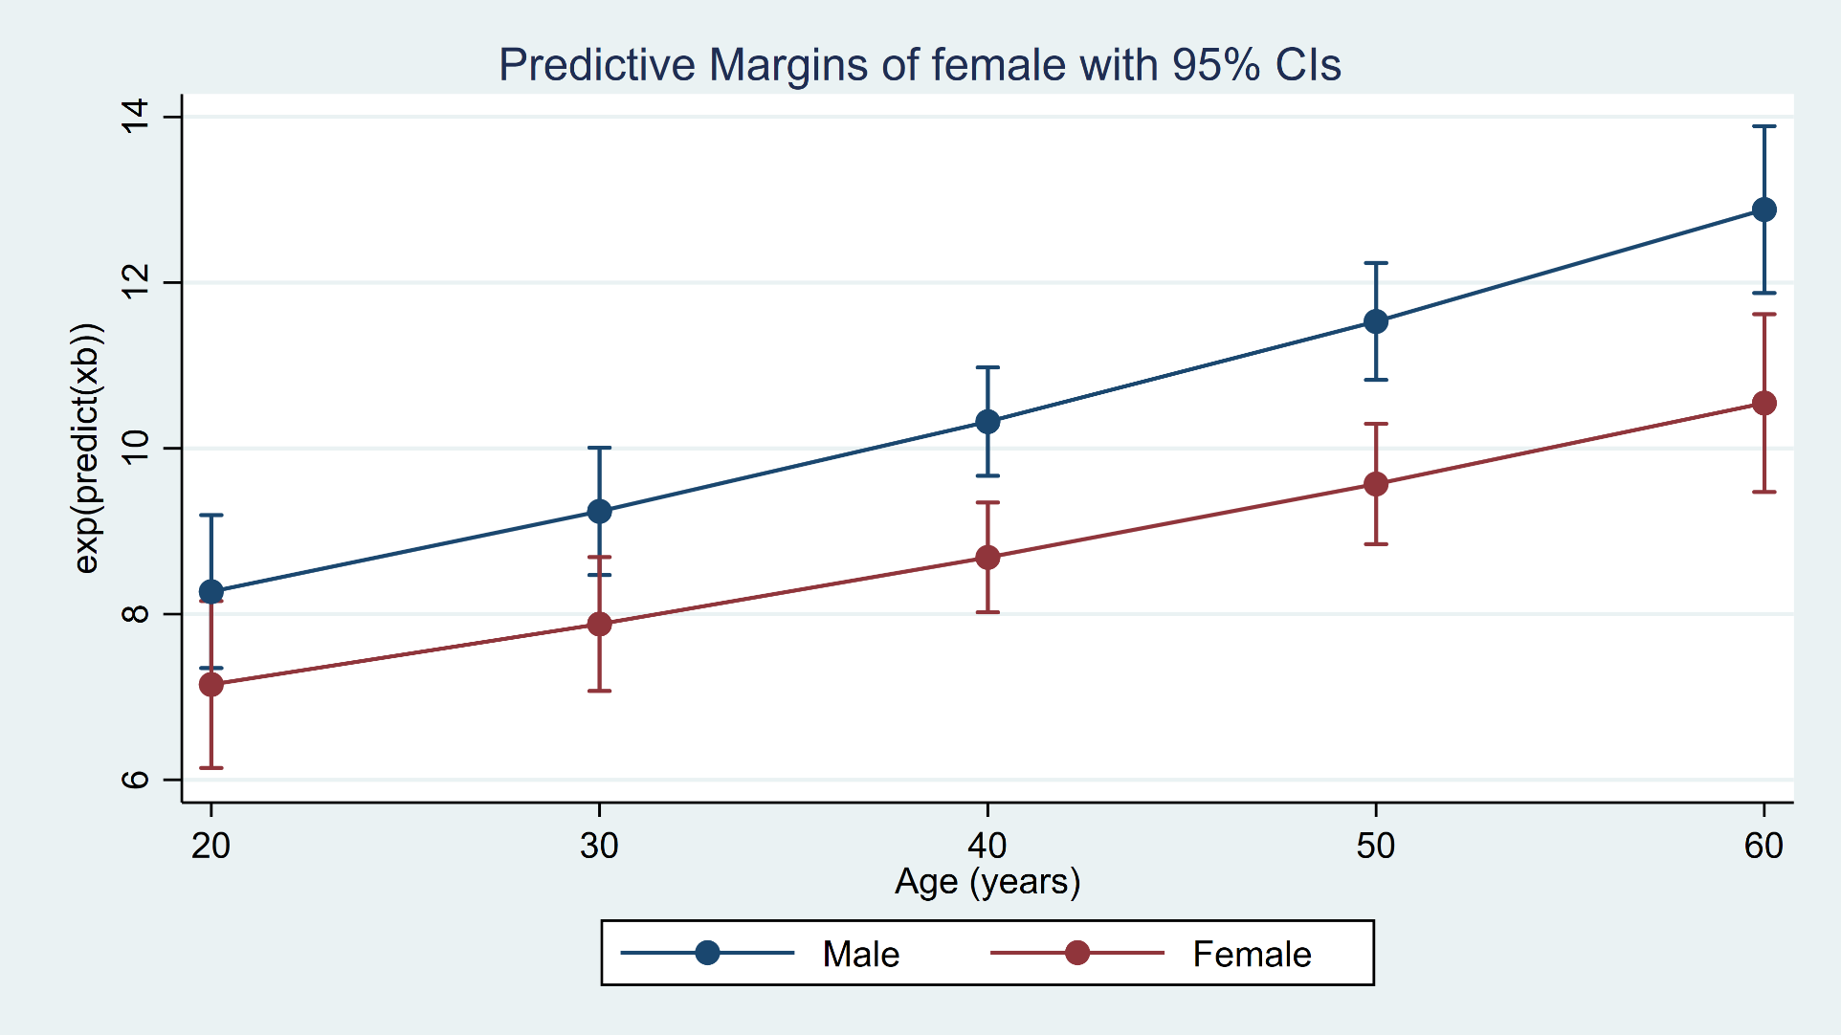
You can run marginsplot after nbml and margins
. marginsplot

Slide 70
Outline
Least Squares Estimation
  Convert variables to matrices
  Linear Regression Command Using Least Squares
Maximum Likelihood Estimation
  Maximum Likelihood Estimation with mlexp
  Linear Regression With ml
  Logistic Regression With ml
  Maximizing Your Own Likelihood Functions With ml
  Estimation Options With ml

Slide 71
The ml commands
ml clear
ml query
ml check
ml search
ml plot
ml init
ml report
ml trace
ml count
ml maximize
ml model
ml graph
ml display
ml footnote
ml score

Slide 72
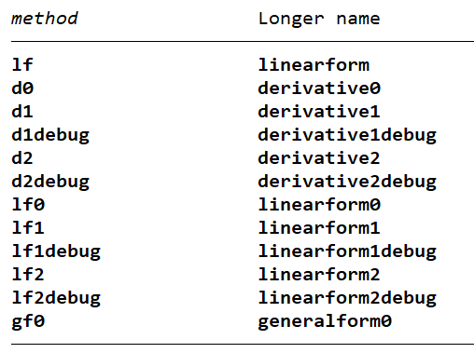
ml model method

Slide 73
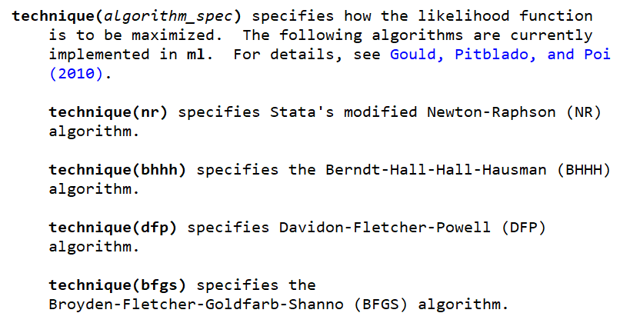
ml model,technique()

Slide 74
Outline
Least Squares Estimation
  Convert variables to matrices
  Linear Regression Command Using Least Squares
Maximum Likelihood Estimation
  Maximum Likelihood Estimation with mlexp
  Linear Regression With ml
  Logistic Regression With ml
  Maximizing Your Own Likelihood Functions With ml
  Estimation Options With ml

Slide 75
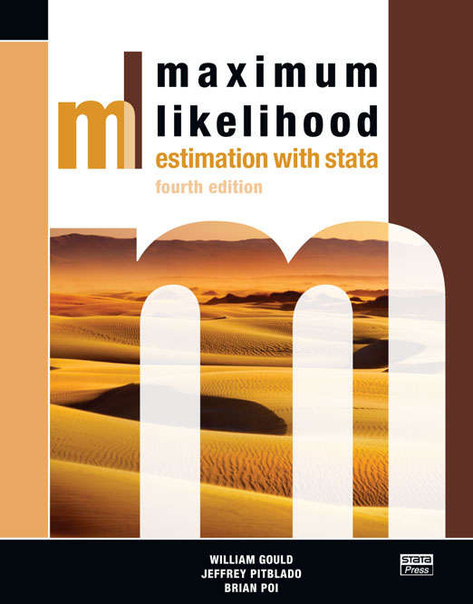
Other Resources
https://www.stata.com/bookstore/maximum-likelihood-estimation-stata/

Slide 76

Other Resources
https://www.stata.com/bookstore/mata-book/

Slide 77
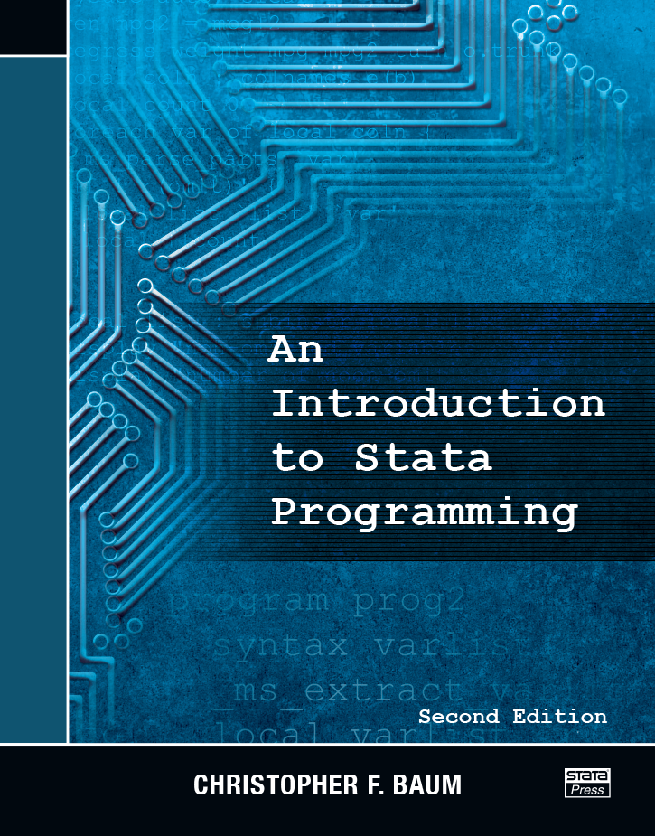
Other Resources
https://www.stata.com/bookstore/introduction-stata-programming/

Slide 78
Other Resources
Stata Blog: Programming An Estimation Command
https://blog.stata.com/2016/01/15/programming-an-estimation-command-in-stata-a-map-to-posted-entries/
UCLA Statistical Consulting Group
https://stats.idre.ucla.edu/stata/code/imple-linear-and-nonlinear-models-using-statas-ml-command/
The log-likelihood on Slide 63 is modified from the UCLA website and
“Microeconometrics Using Stata,” by A. Colin Cameron and Pravin K. Trivedi

Slide 79
Questions?
You can download the slides, dataset, and do-file here:
https://tinyurl.com/StataProgramming2
My email address is:
chuber@stata.com

