Slide 1
Summarizing data from continuous glucose monitoring using the cgmstats package
Natalie Daya Malek, PhD, MPH

Slide 2
Adults worldwide are living with diabetes
589
million
By 2050
853
million

Slide 3
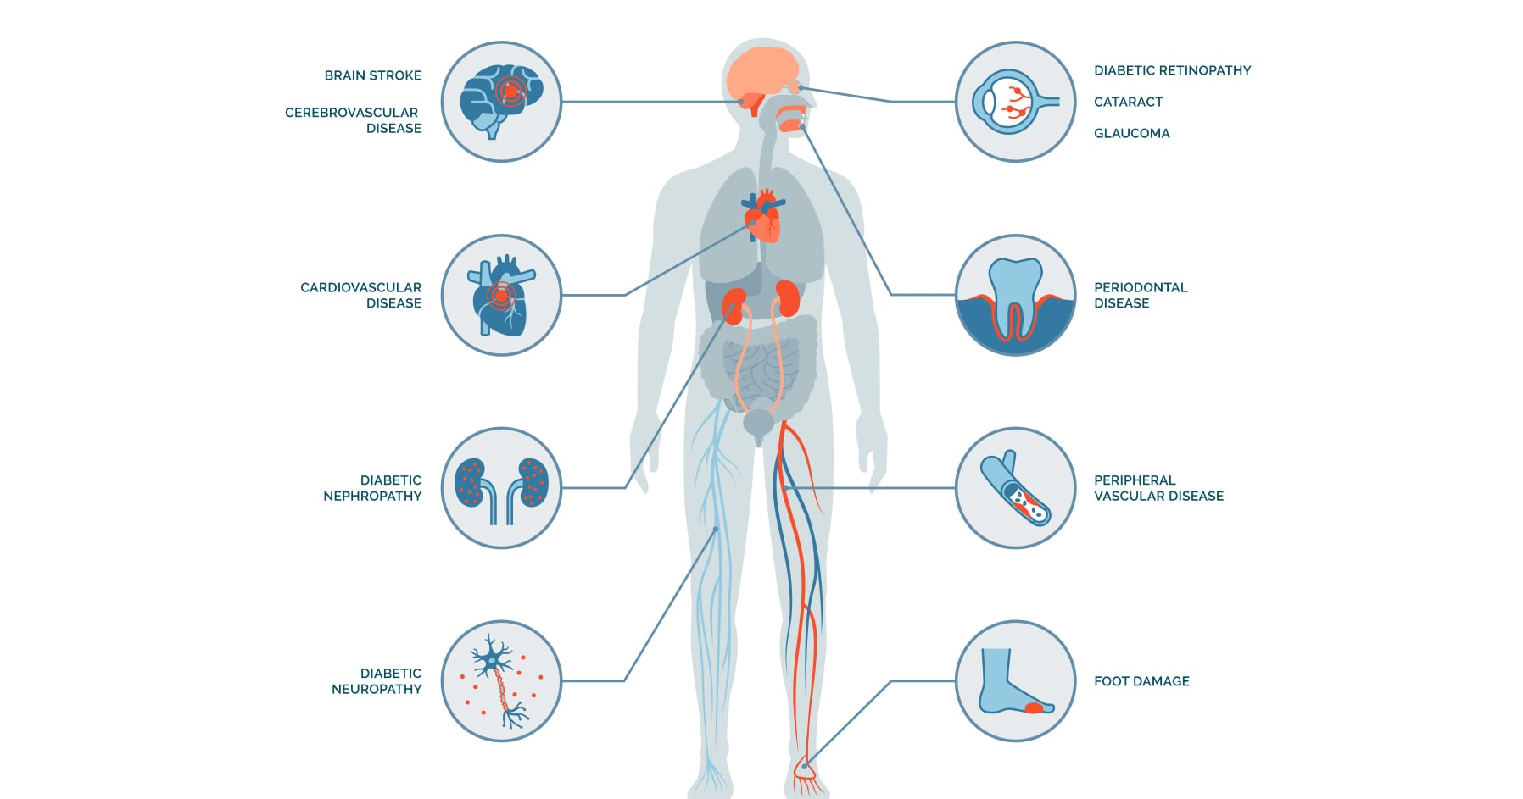
Diabetes complications
Adapted from https://www.endocrine.org/patient-engagement/endocrine-library/diabetes-complications

Slide 4
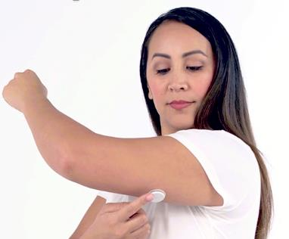
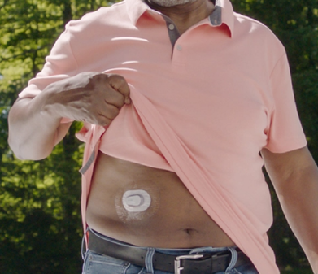
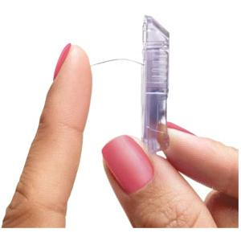
Continuous glucose monitoring widely used among persons with diabetes
Measures interstitial glucose at set increments throughout the day and night
Provides insight into glucose patterns (i.e., hypoglycemia, hyperglycemia) and variability
Typically worn for 1-2 weeks
Can help inform immediate therapy decisions and lifestyle modifications
Side view of CGM

Slide 5

American Diabetes Association Standards of Care 2026
7.15 Use of CGM is recommended at diabetes onset and anytime thereafter for children, adolescents, and adults with diabetes who are on insulin therapy, A on noninsulin therapies that can cause hypoglycemia, C and on any diabetes treatment where CGM helps in management. C The specific CGM device and method for use should be made based on the individual’s circumstances, preferences, and needs. E

Slide 6
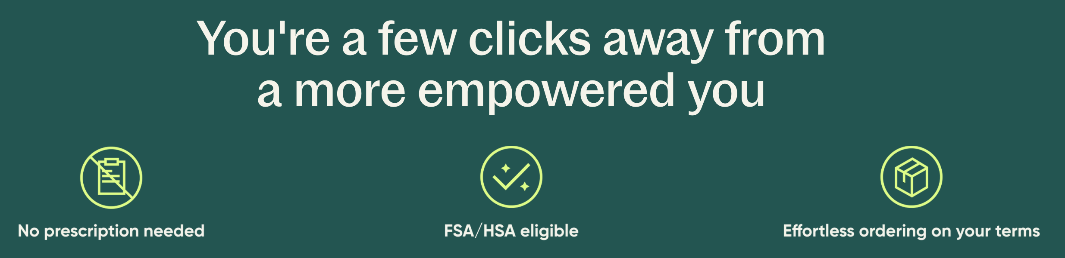
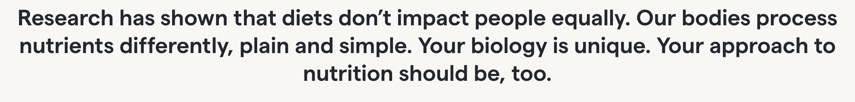

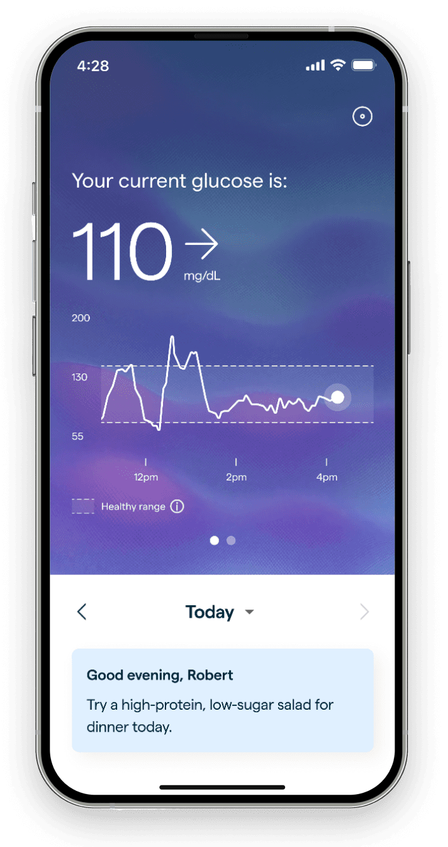


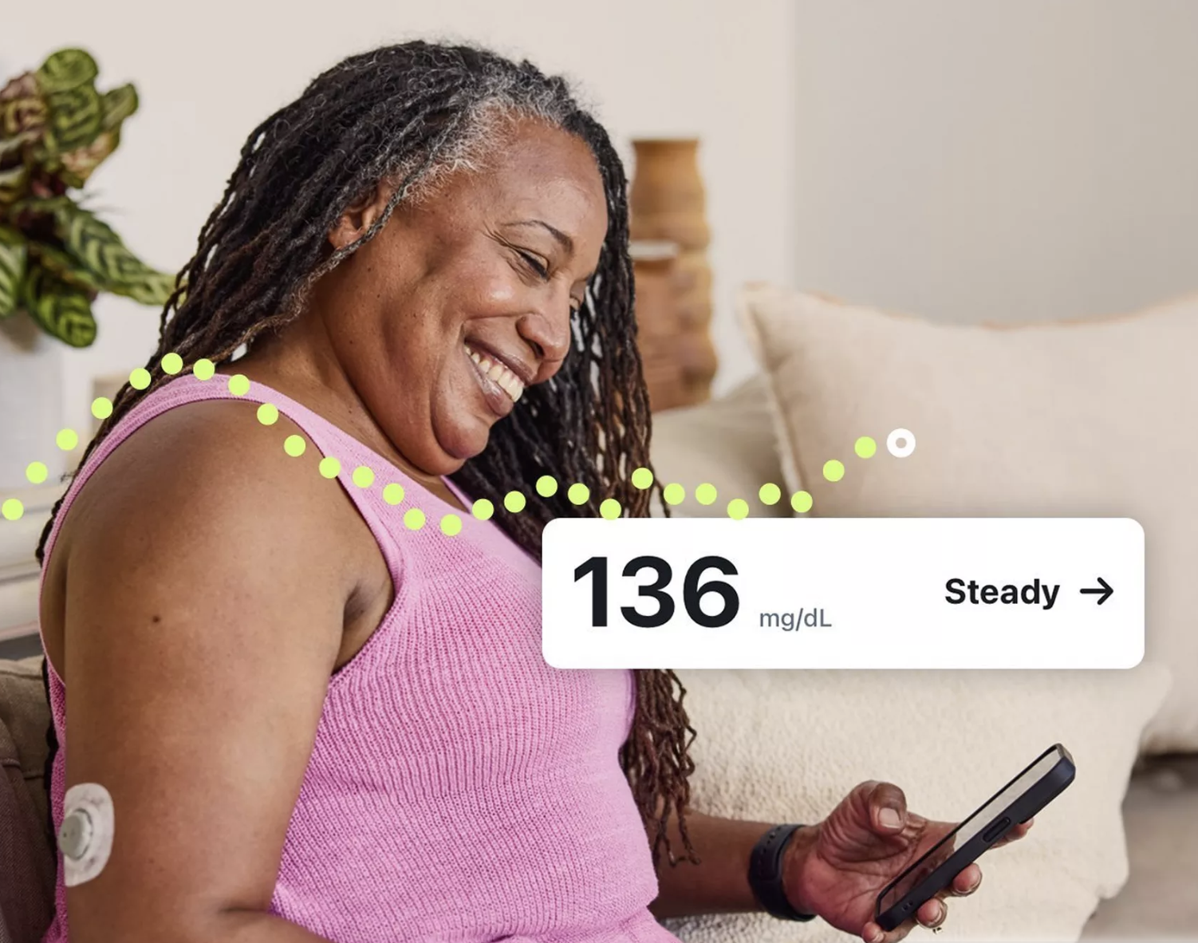
Availability of over-the-counter CGMs – March 2024

Slide 7
Expanding role of continuous glucose monitoring in research
🧪
Clinical trials
Real-world evidence (claims/EHR)
Observational cohorts
Metabolic and lifestyle studies
Glycemic control/variability
📊
CGM Metrics
📈
Long-term clinical outcomes
🍽️

Slide 8
The use of CGMs is increasing – produces a large amount of data
For one participant:
CGM recording frequency (in minutes) | Total # of readings per 2 weeks
15 | 1,344
5 | 4,032
1 | 20,160

Slide 9
The use of CGMs is increasing – produces a large amount of data
CGM recording frequency (in minutes) | Total # of readings per 2 weeks
 | 1 participant | Cohort study of 1,000 participants
15 | 1,344 | 1,344,000
5 | 4,032 | 4,032,000
1 | 20,160 | 20,160,000

Slide 10
FDA-approved CGM systems
Device-specific export formats
Abbott FreeStyle Libre 2 | Medtronic Guardian Connect
Abbott FreeStyle Libre 2 Plus | Eversense 365 CGM System
Abbott FreeStyle Libre 14 | Dexcom G6 Pro
Abbott FreeStyle Libre 3 | Dexcom G6
Abbott FreeStyle Libre 3 Plus | Dexcom G7
Lingo by Abbott* | Stelo by Dexcom*
Libre Rio by Abbott*
 | * over-the-counter

Slide 11
Lack of standardized statistical and methodological approaches to analyze CGM data
Increasingly used in epidemiologic studies and clinical trials
!
Variability in data processing methods
Inconsistent statistical approaches
Differences in data reporting
Manually

Slide 12
We need tools that provide a flexible and automated approach to process and comprehensively analyze CGM data.
No such tool previously existed in Stata.

Slide 13
Introducing the first Stata package to process and analyze CGM data – cgmstats
Processes, summarizes and visualizes data from CGM systems
Raw CGM data → Stata dataset with a variety of summary metrics
Summary metrics use definitions recommended in the international consensus statement on CGM in clinical trials

Slide 14
Syntax of cgmstats
cgmstats, id(varname) glucose(varname) time(varname) dtadir(string) [freq(#) unit(string) hyper(numlist) hypo(numlist) hyper_exc_lngth(#) hypo_exc_lngth(#) daystart(string) dayend(string) firsthours(#) lasthours(#) by(string) keep(string) timebefore(string) timeafter(string) auc hist(varlist, [freq bw(#)]) plot(numlist, [nostats fill]) savecombdta(string) savecombdir(string) savesumdta(string) savesumdir(string) saveplotdir(string)]

Slide 15
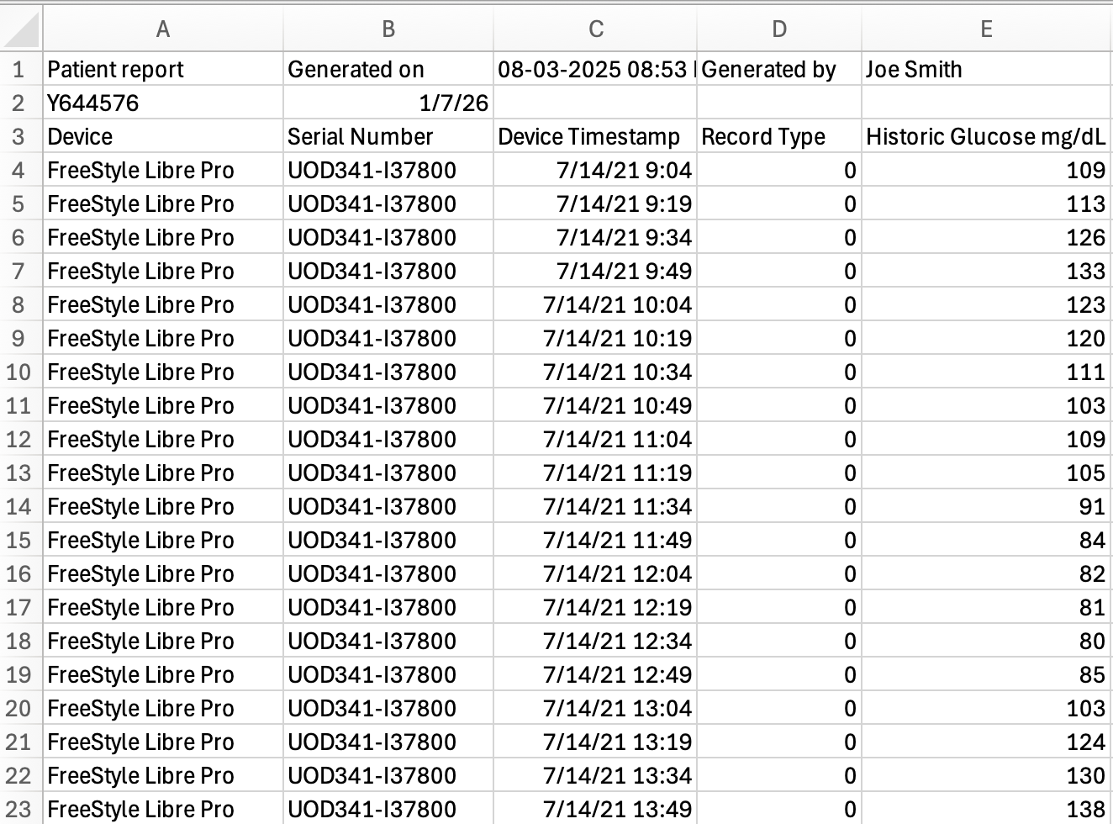
Raw CGM data (.csv)
(1) ID
(2) Timestamp
(3) Glucose value

Slide 16
Automated warnings
If the timestamp is in the incorrect format, the user will receive an error that says, for example:
Timestamp is not in the correct format %tcCCYY/NN/DD_HH:MM.
Current format: %tcCCYY-NN-DD_HH:MM:SS
If duplicate timestamps are found, the user will receive the following error:
Duplicate timestamps detected!
If the directory containing the input dta files is not specified, the user will receive the following error:
You must specify the directory with the input dta-files

Slide 17
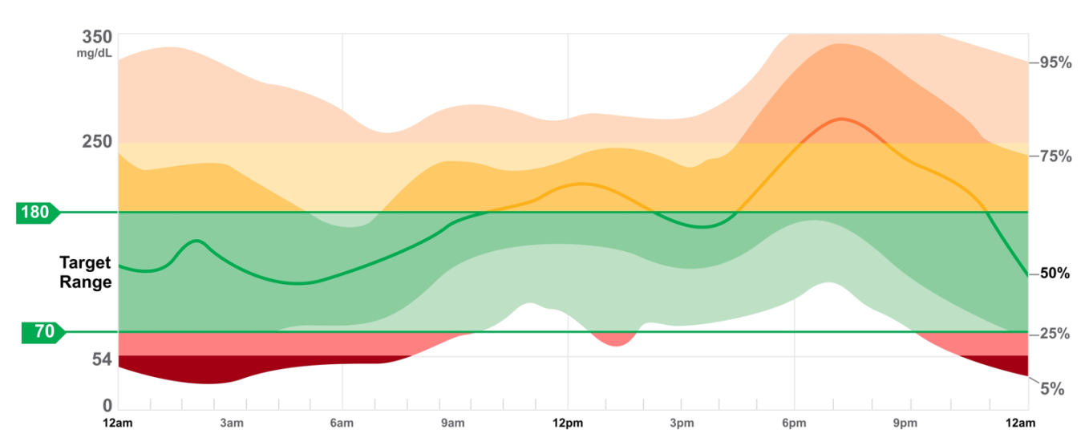
Ambulatory Glucose Profile (a single 24-hour period)
Hyperglycemia
Hypoglycemia

Slide 18
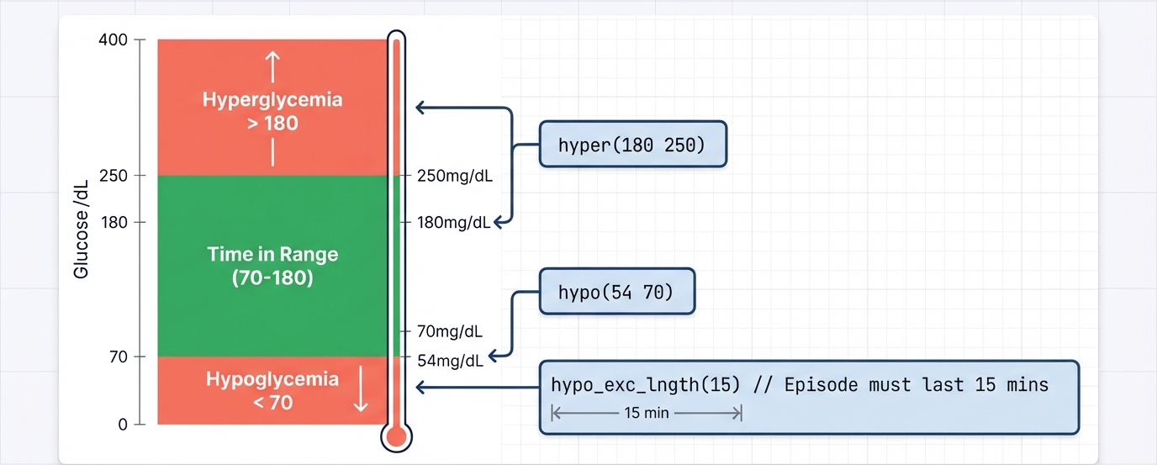
Flexibility: Define Your Own Ranges
cgmstats, id(varname) glucose(varname) time(varname) dtadir(string) [hyper(numlist) hypo(numlist) hyper_exc_lngth(#) hypo_exc_lngth(#)]
Time above range (>180 mg/dL)
Time >250 mg/dL
Time 70-250 mg/dL
Time 54-180 mg/dL
Time 54-250 mg/dL
Time <54 mg/dL
Glucose (mg/dL)
Time in range (70-180 mg/dL)
54
Time below range (<70 mg/dL)

Slide 19

Summary metrics produced by cgmstats
Output
first_glucose_reading | The timestamp of the first CGM reading
ndayswear | Number of days CGM sensor was worn
total_sensor_readings | Total number of CGM sensor readings
percent_cgm_wear | The number of sensor readings as a percentage of possible obtained readings by the CGM (given time worn)
mean_sensor | Mean of sensor glucose values
median_sensor | Median sensor glucose value
q1_sensor | First quartile sensor glucose value
q3_sensor | Third quartile sensor glucose value
min_sensor | Minimum of sensor glucose values
max_sensor | Maximum of sensor glucose values
sd_sensor | Standard deviation of sensor glucose values
cv_sensor | Coefficient of variation (%) of sensor glucose values (100*SD/mean glucose)
$≥$70% ←

Slide 20
Summary in range and hypoglycemic metrics produced by cgmstats
Output
min_spent_X_{i}_Y_{i} | Minutes spent in the target blood glucose range (X-Y)
percent_time_X_{i}_Y_{i} | Minutes spent in the target blood glucose range (X-Y), as a percentage of the total time CGM was worn
min_spent_under_X_{i} | Total number of minutes spent below cut point(s) X (i.e., 54 and 70 mg/dL; option "hypo")
percent_time_under_X_{i} | Minutes spent below cut point(s) X (i.e., 54 and 70 mg/dL), as a percentage of the total time CGM was worn
episodes_under_X_{i} | The count of glucose episodes below cut point(s) X (i.e., 54 and 70 mg/dL; option "hypo"), for user-defined time (i.e., default at least 30 minutes; option “hypo_exc_lngth”)
avg_hypo_lngth_X_{i} | The mean length (in minutes) of episodes below cut point(s) X (i.e., 54 and 70 mg/dL; option "hypo"). Minimum length to be considered an episode defined by option "hypo_exc_lngth" (default 30 minutes).

Slide 21
Summary hyperglycemic metrics produced by cgmstats
Output
min_spent_over_X_{i} | Total number of minutes spent above cut point(s) X (i.e., 180 and 250 mg/dL; option "hyper")
percent_time_over_X_{i} | Minutes spent above cut point(s) X (i.e., 180 and 250 mg/dL), as a percentage of the total time CGM was worn
episodes_over_X_{i} | The count of glucose episodes above cut point(s) X (i.e., 180 and 250 mg/dL; option "hyper"), for user-defined time (i.e., default at least 30 minutes; option “hyper_exc_lngth”)
avg_hyper_lngth_X_{i} | The mean length (in minutes) of episodes above cut point(s) X (i.e., 180 and 250 mg/dL; option "hyper"). Minimum length to be considered an episode defined by option "hyper_exc_lngth" (default 30 minutes).
auc_over_X_{i} | Area under the sensor glucose curve over cut point(s) X (i.e., 180 and 250 mg/dL; option “hyper”), calculated using the trapezoidal rule

Slide 22
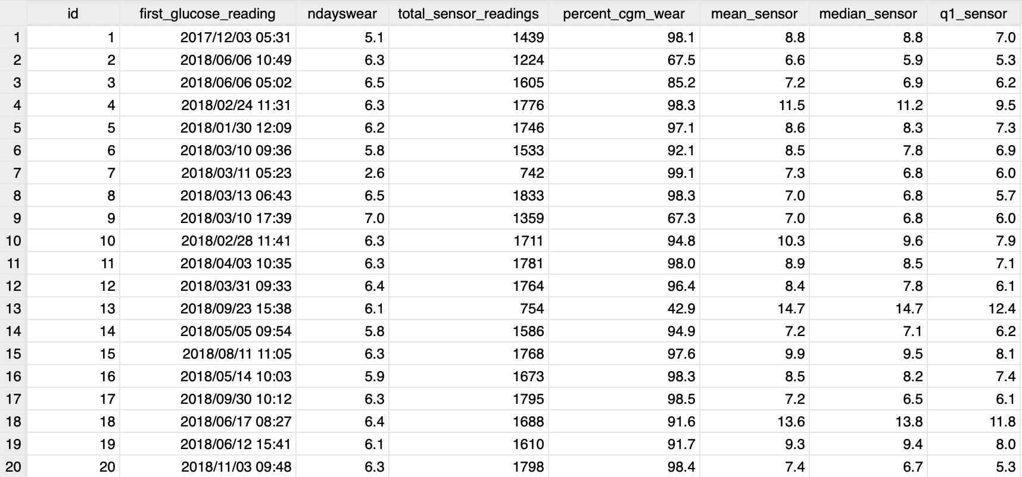
Output – cgmstats

Slide 23
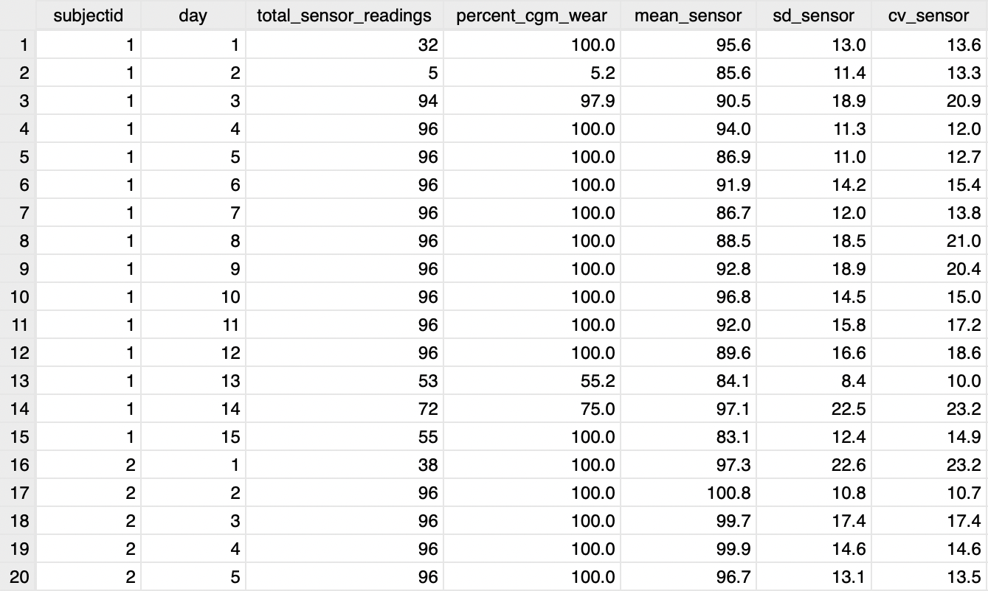
cgmstats, id(varname) glucose(varname) time(varname) dtadir(string) [by(subjectid day)]

Slide 24


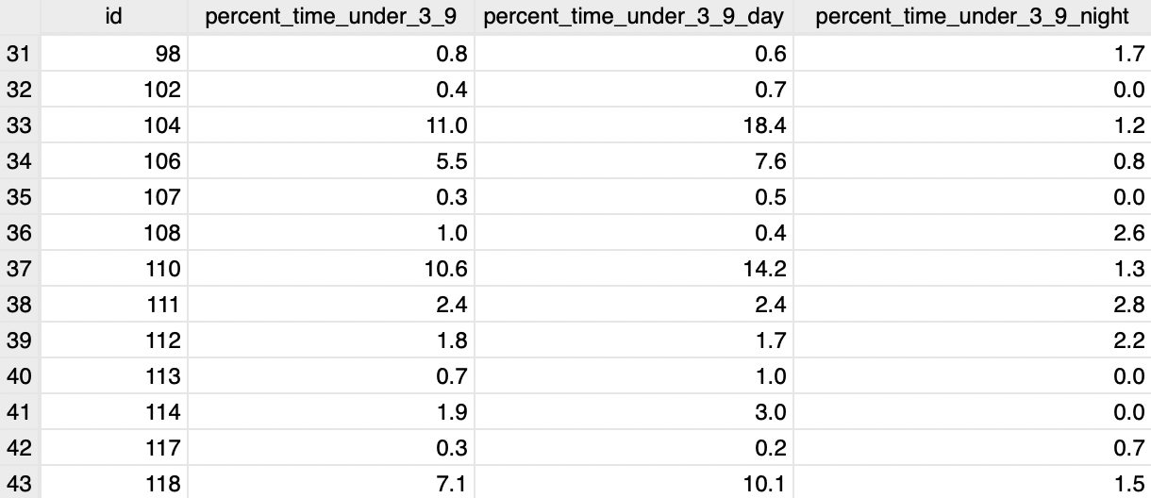
Daytime vs. nighttime
cgmstats, id(varname) glucose(varname) time(varname) dtadir(string) [daystart(string) dayend(string)]
* Default defines nighttime as 10pm – 6am

Slide 25
Optional histograms of CGM summary metrics
cgmstats, id(varname) glucose(varname) time(varname) dtadir(string) [hist(varlist, [freq bw(#)])]

Slide 26
CGM tracings – option to fill gaps
cgmstats, id(varname) glucose(varname) time(varname) dtadir(string) [plot(numlist, [nostats fill])]

Slide 27

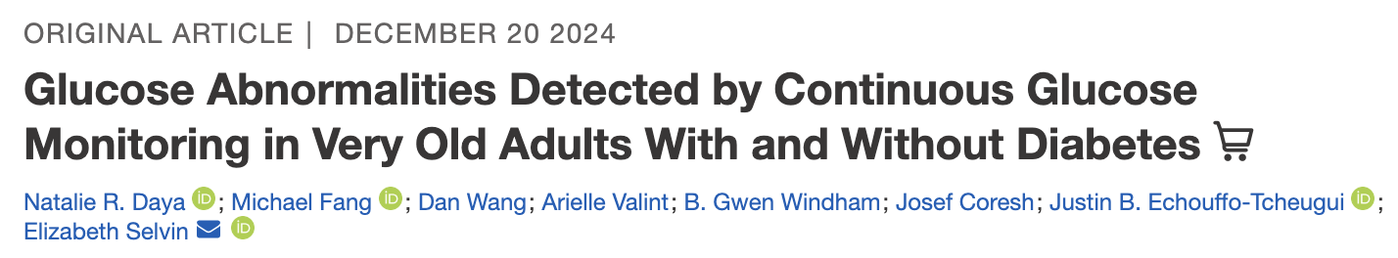
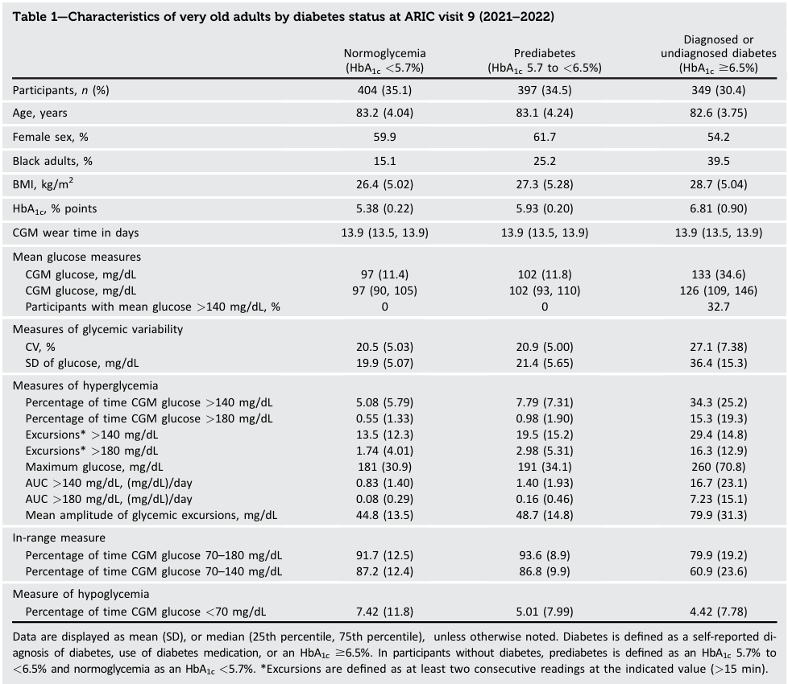

Slide 28
Conclusions and Key Takeaways
CGM data are increasingly used in epidemiologic research
Efficient and reproducible analysis tools are needed
cgmstats provides a standardized solution in Stata
Enables reproducible epidemiologic research

Slide 29
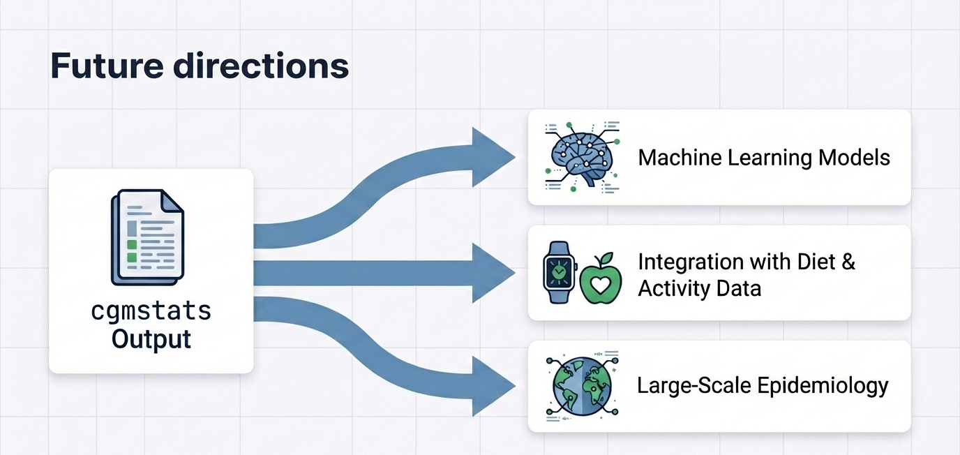
Future directions

Slide 30
Acknowledgements
Elizabeth Selvin, PhD, MPH
Dan Wang, MS
Sui Zhang, MS
Michael Fang, PhD, MHS
Amelia Wallace, PhD, MS
Scott Zeger, PhD, MS
Dr. Selvin’s Diabetes Data Group

Slide 31

Thank you!
Natalie Daya Malek, PhD, MPH
ndaya1@jh.edu
Download cgmstats today (ssc install cgmstats)
Feedback on the package is welcome
Daya Malek, N., Wang, D., Zhang, S., Fang, M., Wallace, A., Zeger, S., and Selvin, E. Summarizing data from continuous glucose monitors using the cgmstats package. Stata Journal. (In press).

