Slide 1
Advances in non-standard sample size calculations: the ART suite
Ian White
MRC Clinical Trials Unit at UCL
Stata Biostatistics and Epidemiology Virtual Symposium
18 Feb 2021
Notes:
25 minutes talk + 5 minutes discussion
~250 participants worldwide

Slide 2
Plan
Sample size calculation in clinical trials
Stata tools: art and power
Binary outcome: improving artbin
Categorical outcome: developing artcat
Software testing

Slide 3
Acknowledgements
Sophie Barthel
Patrick Royston
Abdel Babiker
Ella Marley-Zagar
Tim Morris
Max Parmar
Babak Choodari-Oskooei
all from MRC CTU

Slide 4
Why calculate sample size?
Sample size calculations arise in planning a study
We’re going out to collect new data. How much data should we collect to answer our research question?
  especially important for funding applications
Sometimes researchers can’t change their sample size
  e.g. re-analysing existing data
  e.g. collecting new data but sample is fixed
  even so, they may need to show in advance that the analysis is likely to answer their research question (“power”)
This talk is about calculations either way: power ↔ sample size
All motivated by randomised trials but applicable to observational studies with little confounding

Slide 5
Why is it important to get it right?
Increasing sample size is expensive, time-consuming, even painful
  don’t want to do it if unnecessary
Too small a sample size makes it more likely to fail to answer the research question
  and can cast doubt on the whole study
As trials progress, it’s very common to need to modify the sample size calculation due to
  slow recruitment
  new evidence about likely effect / nuisance parameters / target population
Forms key part of discussions with funders

Slide 6

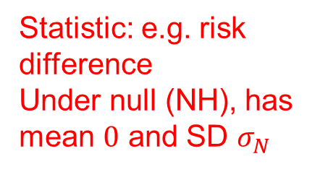
Theory of sample size calculations
Statistic: e.g. risk difference
Under null (NH), has mean $0$ and SD $σ_{N}$
$$z_{α}σ_{N}$$

Slide 7
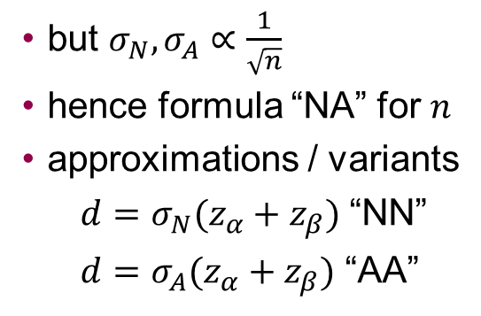
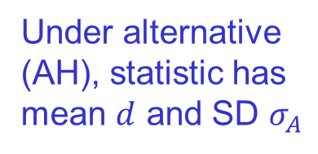



Theory of sample size calculations
$$d$$
Statistic: e.g. risk difference
Under null (NH), has mean $0$ and SD $σ_{N}$
$$z_{α}σ_{N}$$
$$z_{β}σ_{A}$$
Under alternative (AH), statistic has mean $d$ and SD $σ_{A}$
so $d=z_{α}σ_{N}+z_{β}σ_{A}$
but $σ_{N},σ_{A}∝\frac{1}{\sqrt{n}}$
hence formula “NA” for $n$
approximations / variants
  $d=σ_{N}(z_{α}+z_{β})$ “NN”
  $d=σ_{A}(z_{α}+z_{β})$ “AA”

Slide 8
Sample size calculations in Stata
ART: Assessment of Resources for Trials
Royston P, Babiker A. A menu-driven facility for complex sample size calculation in randomized controlled trials with a survival or a binary outcome. Stata J 2002;2:151–63.
Barthel FM-S, Royston P, Babiker A. A menu-driven facility for complex sample size calculation in randomized controlled trials with a survival or a binary outcome: Update. Stata J 2005;5:123–9.
Royston P, Barthel FM-S. Projection of power and events in clinical trials with a time-to-event outcome. Stata J 2010;10:386–94.
power suite in Stata 13 (2013)
Notes:
https://www.stata.com/support/faqs/statistics/power-by-simulation/

Slide 9
Why do we still need ART?
artsurv for time-to-event outcome: allows >2 groups, staggered entry, non-constant hazard, non-proportional hazards, withdrawal from allocated treatment, treatment cross-over (switching)
artbin for binary outcome: allows >2 groups, method options, non-inferiority trial
Notes:
9.5 mins to here

Slide 10
New work on artbin
Providing clear description of methods used
Simpler syntax
More options and better syntax for non-inferiority methods
Coherent output

Slide 11
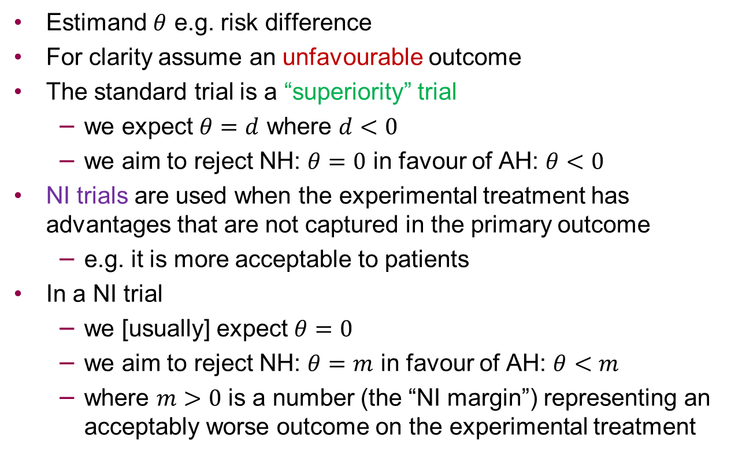
Non-inferiority (NI) trials
Estimand $θ$ e.g. risk difference
For clarity assume an unfavourable outcome
The standard trial is a “superiority” trial
  we expect $θ=d$ where $d<0$
  we aim to reject NH: $θ=0$ in favour of AH: $θ<0$
NI trials are used when the experimental treatment has advantages that are not captured in the primary outcome
  e.g. it is more acceptable to patients
In a NI trial
  we [usually] expect $θ=0$
  we aim to reject NH: $θ=m$ in favour of AH: $θ<m$
  where $m>0$ is a number (the “NI margin”) representing an acceptably worse outcome on the experimental treatment

Slide 12
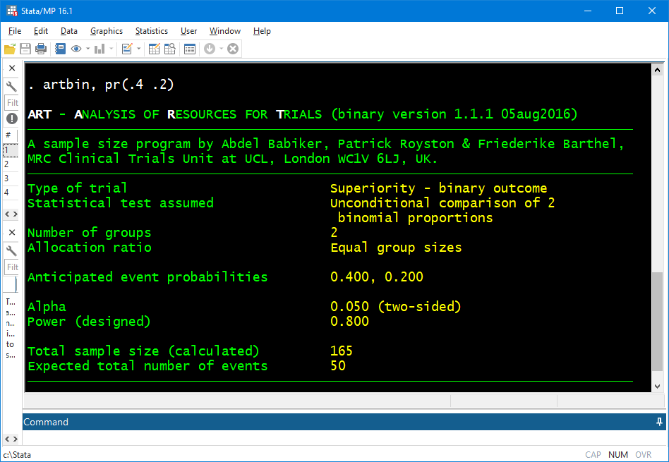
Superiority: artbin, pr(.4 .2)
Answer
Notes:
artbin, pr(.4 .2)

Slide 13
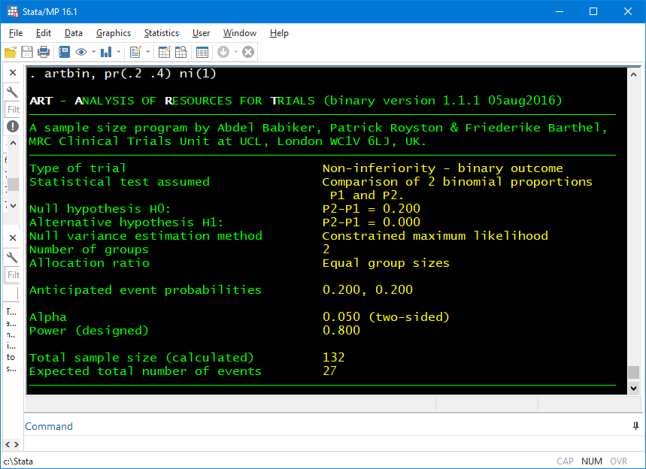
Non-inferiority: old syntax artbin, pr(.2 .4) ni(1)
Answer
Notes:
artbin, pr(.2 .4) ni(1)

Slide 14
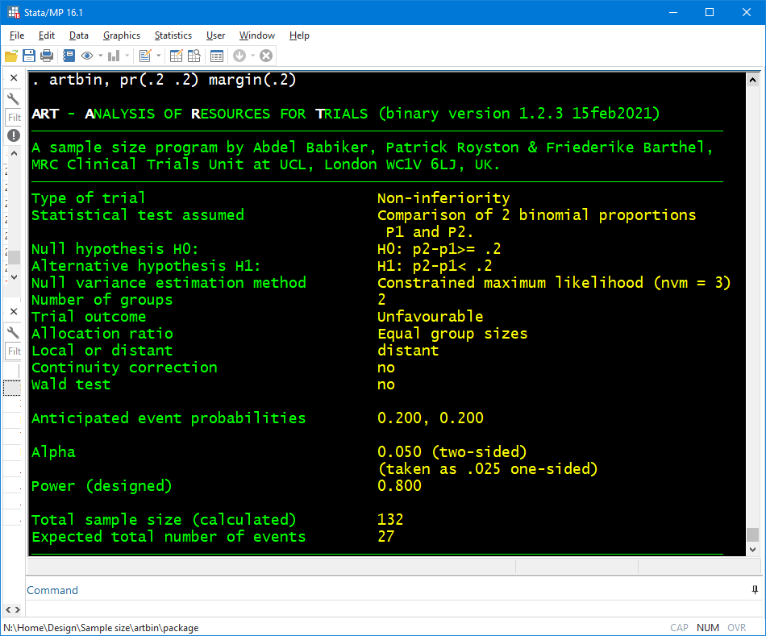
Non-inferiority: new syntax artbin, pr(.2 .2) margin(.2)
Clear NH, AH
Outcome type inferred
Answer
Notes:
artbin, pr(.2 .2) margin(.2)

Slide 15
Advantages of this NI approach
clarity
can infer & report whether outcome is favourable or unfavourable
can design a NI trial with a non-null expected treatment effect
  e.g. STREAM trial in drug-resistant TB with favourable outcome:
    artbin, pr(.7 .75) margin(-.1) aratio(1 2)

Slide 16
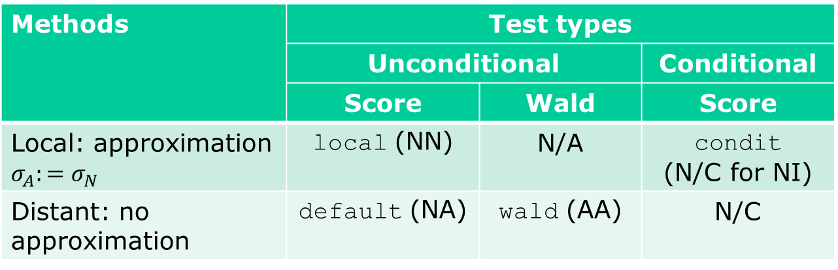
Being methodical about calculation options
Settings |  | Options
2 arms | superiority | continuity correction
 | non-inferiority
>2 arms | heterogeneity
 | trend
Methods | Test types
 | Unconditional |  | Conditional
 | Score | Wald | Score
Local: approximation $σ_{A}:=σ_{N}$ | local (NN) | N/A | condit (N/C for NI)
Distant: no approximation | default (NA) | wald (AA) | N/C
NN, NA, AA: formula types.
N/A: not applicable. N/C: not coded.
Notes:
16 mins to here

Slide 17
New program: artcat

Slide 18
Motivation
In 2020, I was involved in designing a trial of treatments for COVID-19 that could be used in an African outpatient setting
  thanks to the team incl. Debbie Ford, Hanif Esmail, Di Gibb, Anna Turkova, Annabelle South
We considered a 3-level ordered categorical outcome: death; in hospital; or alive and not in hospital
Other COVID-19 trials have used other ordered categorical outcomes, typically with 6-8 levels
We needed sample size calculations for an ordered categorical outcome, and they were not available in Stata
Ideas apply beyond COVID-19

Slide 19
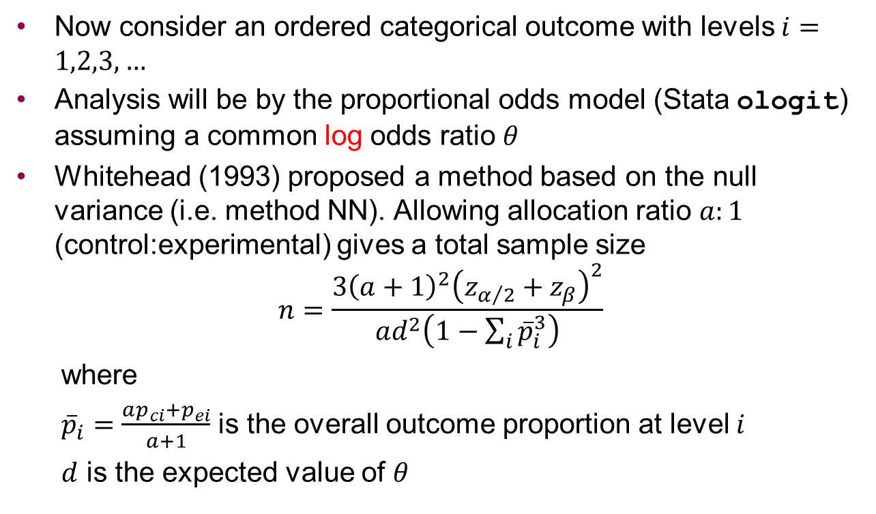
Whitehead’s method
Now consider an ordered categorical outcome with levels $i=1,2,3,…$
Analysis will be by the proportional odds model (Stata ologit) assuming a common log odds ratio $θ$
Whitehead (1993) proposed a method based on the null variance (i.e. method NN). Allowing allocation ratio $a:1$ (control:experimental) gives a total sample size
$$n=\frac{3{\left(a+1\right)}^{2}{\left(z_{α/2}+z_{β}\right)}^{2}}{ad^{2}\left(1−\sum_{i}{{\overline{p}}_{i}^{3}}\right)}$$
  where
  ${\overline{p}}_{i}=\frac{ap_{ci}+p_{ei}}{a+1}$ is the overall outcome proportion at level $i$
  $d$ is the expected value of $θ$

Slide 20
Limitations of Whitehead’s method
It requires a common odds ratio at the design stage.
But e.g. in the COVID-19 trial, we considered a 3-level outcome of death / hospitalisation / OK, and assumed a common risk ratio of 0.75 for the 2 adverse outcomes.
It uses the NN method, so may be inaccurate
It doesn’t allow for non-inferiority trials

Slide 21
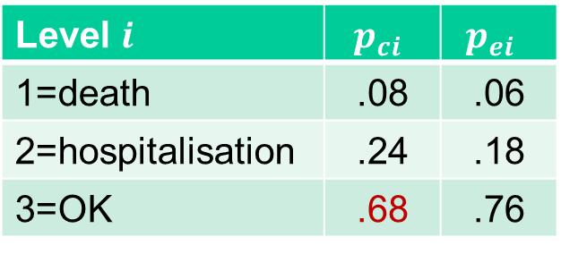
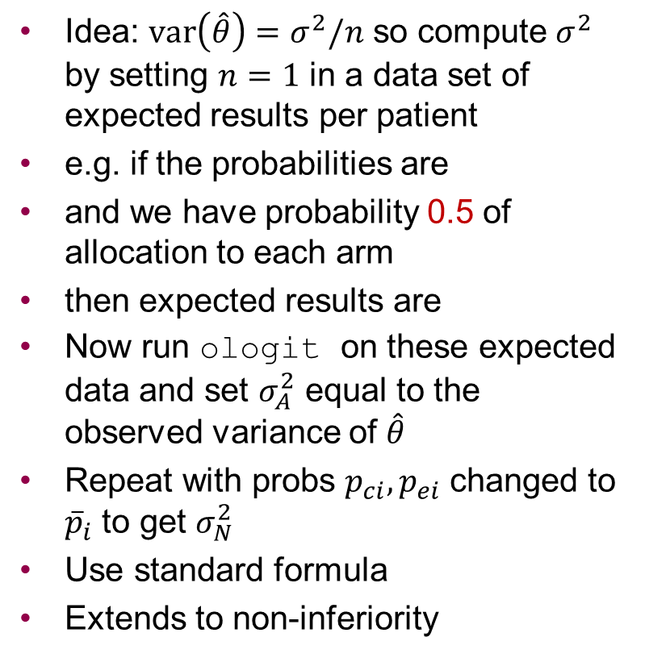
New proposal – “ologit” method
Idea: $var\left(\hat{θ}\right)=σ^{2}/n$ so compute $σ^{2}$ by setting $n=1$ in a data set of expected results per patient
e.g. if the probabilities are
and we have probability 0.5 of allocation to each arm
then expected results are
Now run ologit on these expected data and set $σ_{A}^{2}$ equal to the observed variance of $\hat{θ}$
Repeat with probs $p_{ci}, p_{ei}$ changed to ${\overline{p}}_{i}$ to get $σ_{N}^{2}$
Use standard formula
Extends to non-inferiority
Level $i$ | $$p_{ci}$$ | $$p_{ei}$$
1=death | .08 | .06
2=hospitalisation | .24 | .18
3=OK | .68 | .76
Outcome | Rand | Prob
1 | c | .04
2 | c | .12
3 | c | .34
1 | e | .03
2 | e | .09
3 | e | .38

Slide 22
artcat – outline of syntax
Immediate command, like artbin, artsurv, power
User specifies:
The outcome probabilities in the control arm
  directly: pc(0.08 0.24)
  or as cumulative probabilities: pc(0.08 0.32) cum
The probabilities in the experimental arm
  directly: pe(0.06 0.18)
  as cumulative probabilities: pe(0.06 0.24) cum
  via a common OR or RR: or(0.7) or rr(0.75)
Either power() or n()
Various options e.g. allocation ratio aratio(2 1)
or for NI trial margin(1.2)
Effects are expressed as odds ratios (not log odds ratios).
The syntax restricts to a two-arm trial.

Slide 23
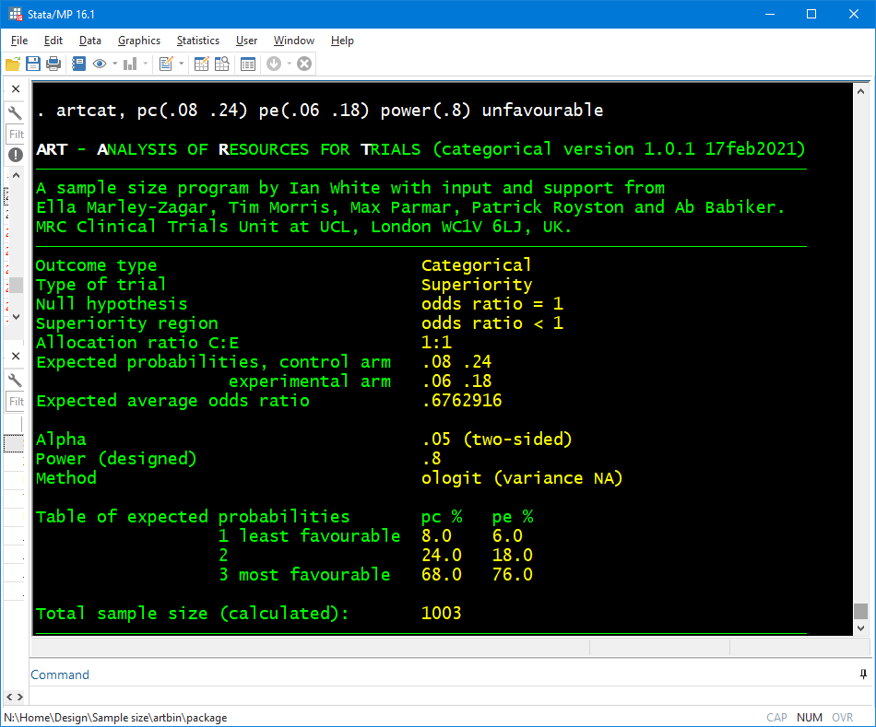
Let’s be sure we have specified the probabilities correctly
Answer
Notes:
artcat, pc(.08 .24) pe(.06 .18) power(.8)
US spelling is allowed

Slide 24
FLU-IVIG example
We reproduce the sample size calculation for the FLU-IVIG trial (Davey et al. 2019).
The control arm is expected to have a 1.8% probability of the worst outcome (death), a 3.6% probability of the next worst outcome (admission to an intensive care unit), and so on.
The trial is designed to have 80% power if the intervention achieves an odds ratio of 1.77 for a favourable outcome.
We invert this odds ratio because artcat is designed to focus on unfavourable outcomes.
artcat, pc(.018 .036 .156 .141 .39) or(1/1.77) power(.8) whitehead unfavourable

Slide 25
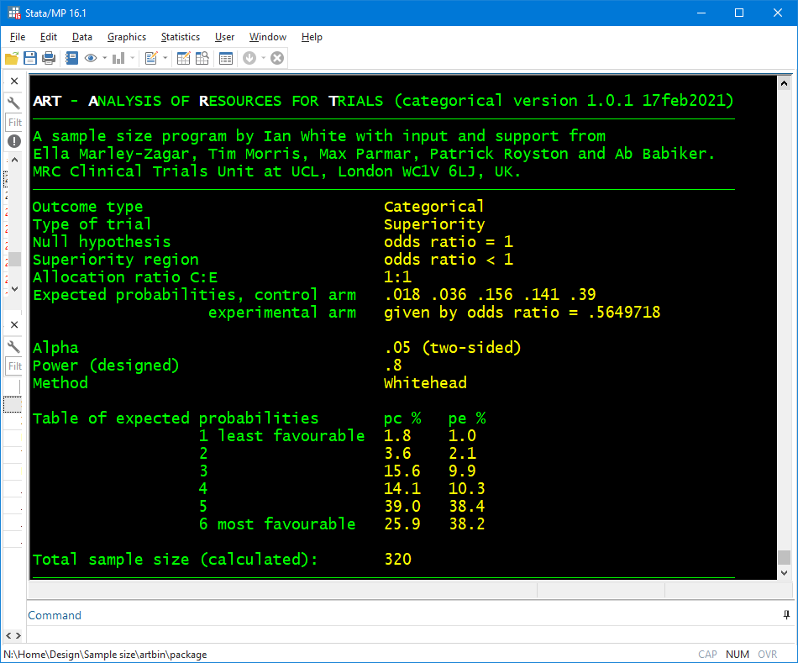
Answer
Notes:
artcat, pc(.018 .036 .156 .141 .39) or(1/1.77) power(.8) whitehead unfavourable

Slide 26
FLU-IVIG example (ctd)
The calculated sample size is 320 using the Whitehead method
Using the new (NA) method instead gives a very similar sample size of 322

Slide 27
Evaluation
Consider 6-level outcome like FLU-IVIG
Compare methods by computing the sample size by each method
Evaluate methods by fixing the sample size and computing power by each method and by simulation
Simulation outline:
  simulate control data as specified and experimental data with assumed odds ratio
  test H0 using ologit + Wald test (sometimes fails due to perfect prediction) or LRT
  repeat 100000 times & compute power
  all Monte Carlo errors are about 0.1%

Slide 28
Comparison (6-level outcome)
Odds ratio | Sample size for 90% power, calculated from sample size formula
 | Whitehead | New NN | New NA | New AA
0.2 | 56 | 56 | 60 | 67
0.3 | 98 | 98 | 102 | 109
0.4 | 168 | 168 | 172 | 178
0.5 | 291 | 291 | 295 | 302
0.6 | 534 | 534 | 538 | 544
0.7 | 1090 | 1090 | 1094 | 1101
0.8 | 2777 | 2777 | 2781 | 2787
Difference between methods up to 10
Whitehead = New NN (always)
Differences unimportant for moderate odds ratios (>=0.5)
Differences important for extreme odds ratios (<=0.4)

Slide 29
Evaluation (6-level outcome)
Odds Ratio | Sample size by NN | Power %, from sample size formula or simulation
 |  | New NN | New NA | New AA | Simulation
0.2 | 56 | 90.1 | 88.1 | 84.5 | 88.4
0.3 | 98 | 90.1 | 88.9 | 86.9 | 89.2
0.4 | 168 | 90.1 | 89.4 | 88.3 | 89.5
0.5 | 291 | 90.0 | 89.6 | 89.0 | 89.6
0.6 | 534 | 90.0 | 89.8 | 89.5 | 89.7
0.7 | 1090 | 90.0 | 89.9 | 89.7 | 90.1
0.8 | 2777 | 90.0 | 90.0 | 89.9 | 90.1
All methods are accurate for moderate odds ratios (>=0.5)
New NA performs best for extreme odds ratios (<=0.4).
NN (Whitehead) method is slightly anti-conservative.

Slide 30
Software testing
We have started a programme of testing our unit’s software
This program may be used to design randomised trials so it is crucial to get it right
We’ve decided to report how we’ve tested
so…

Slide 31
Software testing for artbin and artcat
Compared with published results
  artbin: publications e.g. Pocock 2003
  artcat: Whitehead 1993
Compared with other software
  artbin: Sealed Envelope; Stata ssi; niss; sampsi; power
  artcat: R package dani (Quartagno 2019)
Checked error messages in a number of impossible cases, for example negative odds ratio
Checked every combination of calculation options
Run simulations
Notes:
why not compare artcat with -power twoprop, or-?

Slide 32
Discussion
ART suite provides user-friendly functionality that’s not available in power
artcat paper is submitted to SJ & program available on github; artbin paper & program in preparation
Data sets of expected outcomes can be used more broadly for sample size calculations (e.g. covariate adjustment)
Should we / how should we report software testing?

Slide 33
Extra slides

Slide 34
Comparison 2: binary outcome
Control probability 0.2, power 0.9
Again all methods agree for moderate odds ratios
power and artbin agree for all odds ratios
but artcat disagrees for extreme odds ratios
OR | Sample size calculated by
 | power | artbin |  | artcat
 |  | local | distant | New NN | New NA | New AA
0.2 | 194 | 197 | 192 | 150 | 180 | 230
0.3 | 286 | 290 | 285 | 249 | 274 | 314
0.4 | 436 | 439 | 436 | 403 | 425 | 460
0.5 | 696 | 699 | 694 | 666 | 686 | 717
0.6 | 1194 | 1198 | 1198 | 1168 | 1186 | 1214
0.7 | 2318 | 2322 | 2322 | 2294 | 2311 | 2336
0.8 | 5660 | 5664 | 5664 | 5638 | 5654 | 5677

Slide 35
Evaluation 2: binary outcome
Odds Ratio | Sample size | Power %, from sample size formula or simulation
 |  | artbin |  | artcat |  |  | Simulation
 |  | local | dist. | NN | NA | AA | Wald | LRT
0.2 | 197 | 90.1 | 90.7 | 96.1 | 92.2 | 85.1 | 91.8 | 92.9
0.3 | 290 | 90.1 | 90.5 | 93.8 | 91.5 | 87.6 | 91.0 | 91.7
0.4 | 439 | 90.0 | 90.3 | 92.3 | 90.9 | 88.7 | 90.7 | 91.1
0.5 | 699 | 90.0 | 90.2 | 91.3 | 90.5 | 89.3 | 90.4 | 90.5
0.6 | 1198 | 90.0 | 90.1 | 90.7 | 90.3 | 89.6 | 90.3 | 90.3
0.7 | 2322 | 90.0 | 90.1 | 90.3 | 90.1 | 89.8 | 90.2 | 90.2
0.8 | 5664 | 90.0 | 90.0 | 90.1 | 90.1 | 89.9 | 90.0 | 90.0
All methods remain accurate for moderate odds ratios
For extreme odds ratios, new NA performs
  best of the artcat methods
  better than artbin / power?
Notes:
Wald NA (output b=se=0): 0.8% (OR=0.2), 0.002% (OR=0.3)

