Slide 1
Peer Code Review:
Streamlining, Standardizing, and
Improving Stata Code
2025 Stata Conference
Ankriti Singh

Slide 2
Context
The Nature of Research at the Development Impact Group

Slide 3
Research at the Development Impact Group
Over 200 studies across more than 60 countries
Most are empirical projects, relying on data and statistical analysis
All papers are verified for computational reproducibility at publication, in line with leading economics journals
Notes:
End: But code isn’t just for the final stage

Slide 4


Code is Central to Nearly Every Stage: from Design to Final Publication
Design
Acquisition
Processing
Analysis
Publication
Lead researchers can't review all the code files in detail
Notes:
But code isn’t just for the final stage—it’s central at every step
Given the nature of work – span over multiple years – impractical for researchers to review
Next: When code isn’t reviewed early

Slide 5

Errors Often Surface at Publication
Design
Acquisition
Processing
Analysis
Publication
Notes:
-When code isn’t reviewed early, problems tend to surface at the worst possible moment—during publication.
- Teams are under pressure to trace the error through months/years of work
-And the truth is, a single unnoticed error at any stage can undo years of effort.
Next: This is the challenge we face

Slide 6
Key Challenge
How do we ensure that the final publication or reproducibility package can reliably reproduce all key steps
…years later?

Slide 7

We Need Checks,
But Not Just at the End
Think of it as preventive maintenance for your research pipeline.
Notes:
Not enough to check at the end
Build checks throughout research lifesycle

Slide 8



Our Solution
Peer Code Reviews

Slide 9




What is
Peer Code Review?
Researcher writes code
Researcher revises and learns
Peer reviews code
Peer gives feedback
Notes:
resulting in a continuous cycle of learning and improvement.

Slide 10
Peer Code Review as a Quality Checkpoint
Enhances Research Quality
Encourages good practices from the start, not just at publication
Helps catch errors or ambiguity early, when they’re easier to fix
Promotes Reproducibility
Makes final verification faster, cheaper, and more reliable
Fosters Collaboration and Learning:
Builds a culture of shared responsibility for code quality
Early Detection of Issues

Slide 11
Why Peer Code Review in Stata

Slide 12
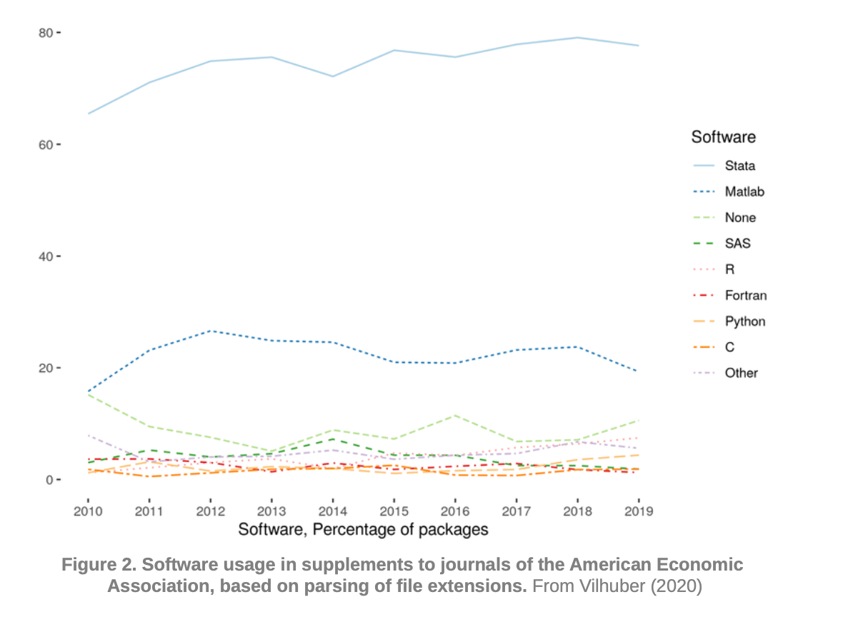
Stata Remains Dominant in Economics/Development
Source: Vilhuber, L. (2020). Reproducibility and Replicability in Economics . Harvard Data Science Review, 2(4). https://doi.org/10.1162/99608f92.4f6b9e67

Slide 13
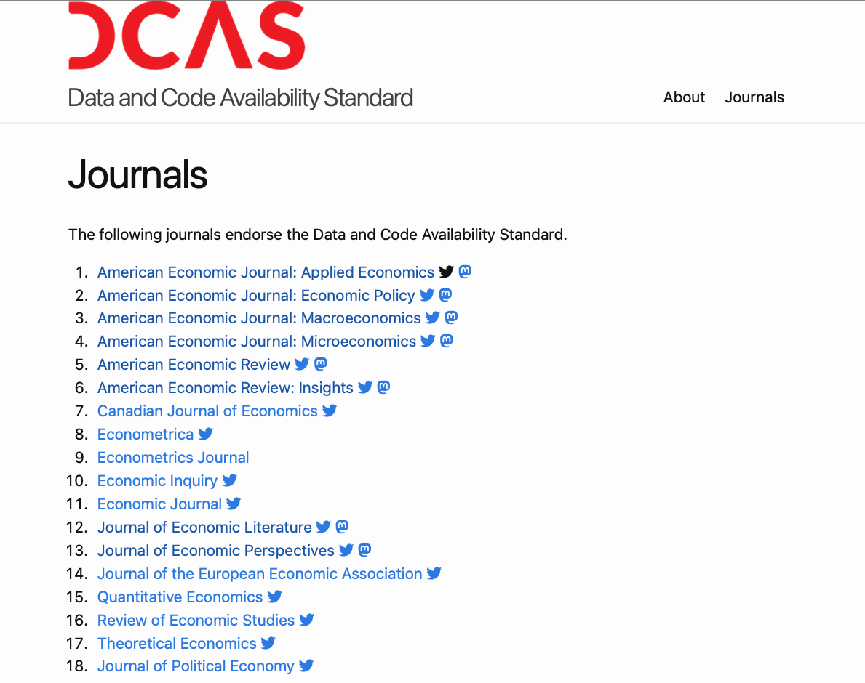
More Journals Demand Full Access to Data and Code for Reproducibility
Source: Data and Code Availability Standard. Version 1.0 (December 15, 2022). https://datacodestandard.org. DOI: 10.5281/zenodo.7436134.

Slide 14
Reproducibility Gaps in Stata-Based Packages
Based on our review of ~350 reproducibility packages and the publication of 250+ packages on the Reproducible Research Repository (RRR)
80% of the packages are in Stata
50% of Stata packages fail to run on the first attempt.

Slide 15

Most Issues are Code-Related
All of these can be caught early with peer code review.
Broken file paths
Missing dependencies
Unstable results
Missing or mismatched data files
… and more

Slide 16
How we did it?
Peer Code Review in Practice

Slide 17
Quarterly Peer Code Review
Quarterly peer code reviews held for the past 5 years
Open to RAs and economists
15 registrations (people/projects) per quarter on average

Slide 18
In Practice…
Prepare & Submit Code Package
Exchange Code & Review
Provide Feedback

Slide 19
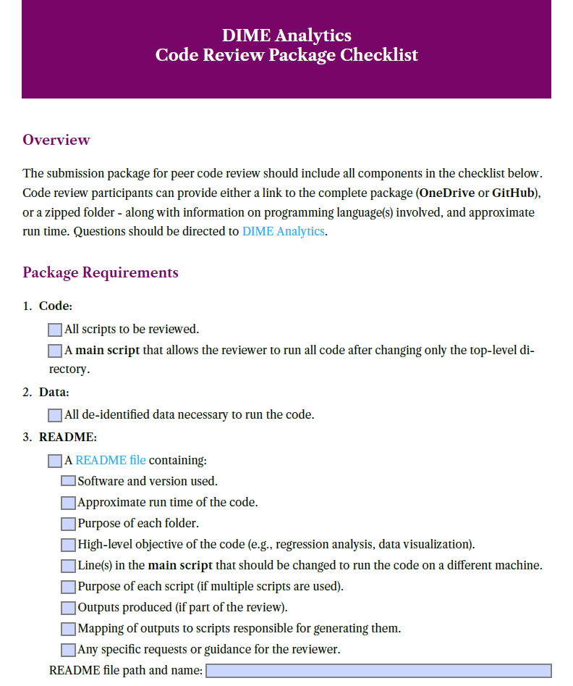
Prepare and Submit Code
Participants start by preparing the code review package using a checklist. The package must include:
  Code and outputs
  Data
  Documentation: README
Submission of code still in progress (up to 1000 lines) is encouraged
Available here.
Notes:
- So they can get early feedback on any structural or conceptual issues

Slide 20
Exchange Code and Review
Packages are reviewed using three types of checklists:
1. Task-specific checklists
  Focused on steps like cleaning and analysis; language-neutral
2. Best-practice checklist (Stata)
  Covers reproducibility and coding standards in Stata
3. Feedback checklist
  High-level impressions: structure, clarity, ease of use

Slide 21
Task Specific Checklists
Cleaning
Construction
Create and transform variables, group-level calculations, and save outputs.
Analysis
Organize code, document decisions, and generate final outputs.
High-frequency Checks
Survey-specific checks to assess data quality and consistency.
Randomization and Sampling
Set parameters and assign units to treatment or control.
Check duplicates, data types, labels, missing values, merges, and save cleaned data.

Slide 22
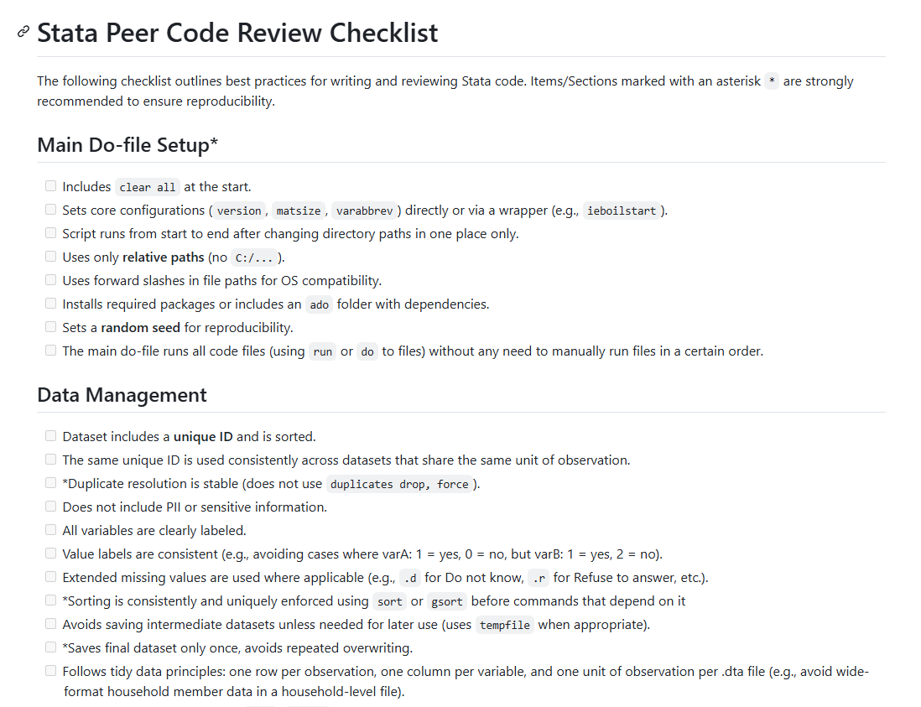
Stata Checklist
General best practices:
Main do-file set up
Data Management
Code Readability & Style
Available here
Notes:
- These two checklists serve as a guide for reviewers
- They help ensure that even without deep subject-matter knowledge, reviewers can still perform basic but important checks for good coding practices and reproducibility.

Slide 23
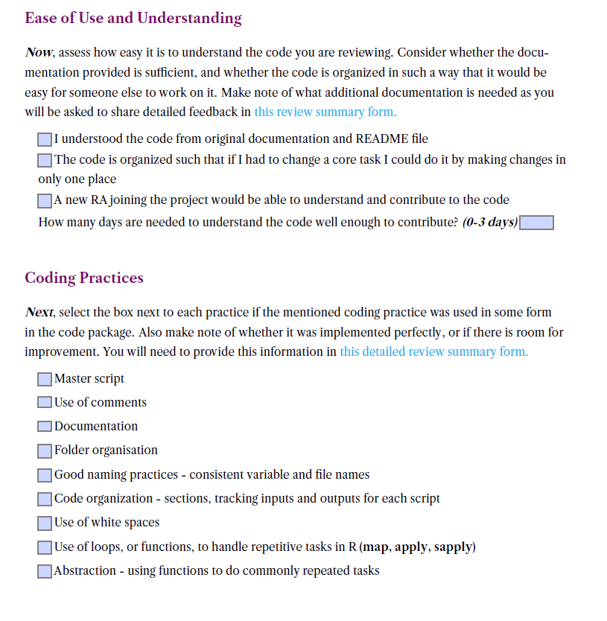
General Feedback Checklist: Key Areas
Structure
Reproducibility
Clarity
Coding Practices
Feedback and suggestions

Slide 24
Why These Checks Specifically?
Reflect common issues we've seen in our work with researchers
Based on experience reviewing hundreds of reproducibility packages

Slide 25
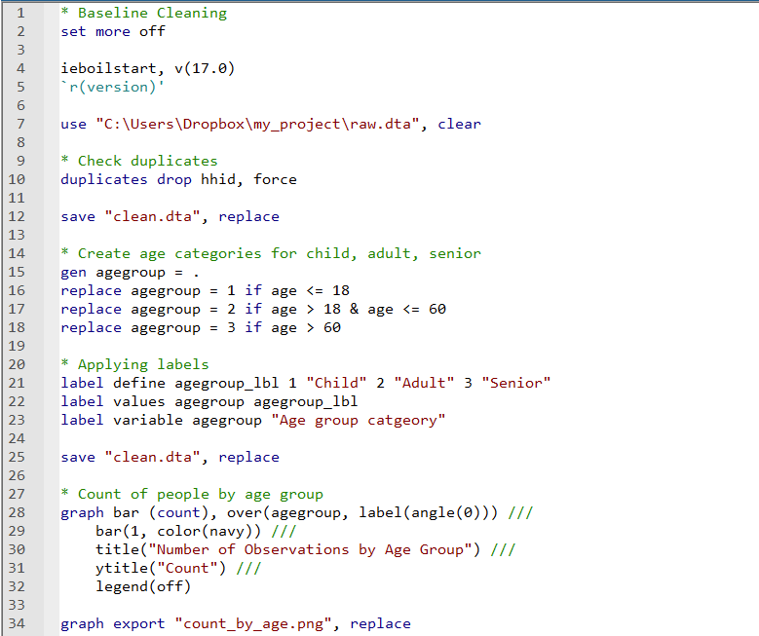

Review Snapshot
Sets core configuration
Uses absolute path
Duplicate resolution is not stable
No global/local directory used
Labels assigned, comment utilized.
Data is overwritten
Uses line breaks
Output not saved in a dedicated folder

Slide 26
What Happens After the Review?
Feedback is submitted via a form and assessed
Summary is shared with the coder and their team leads
Coder revises the code based on the feedback

Slide 27
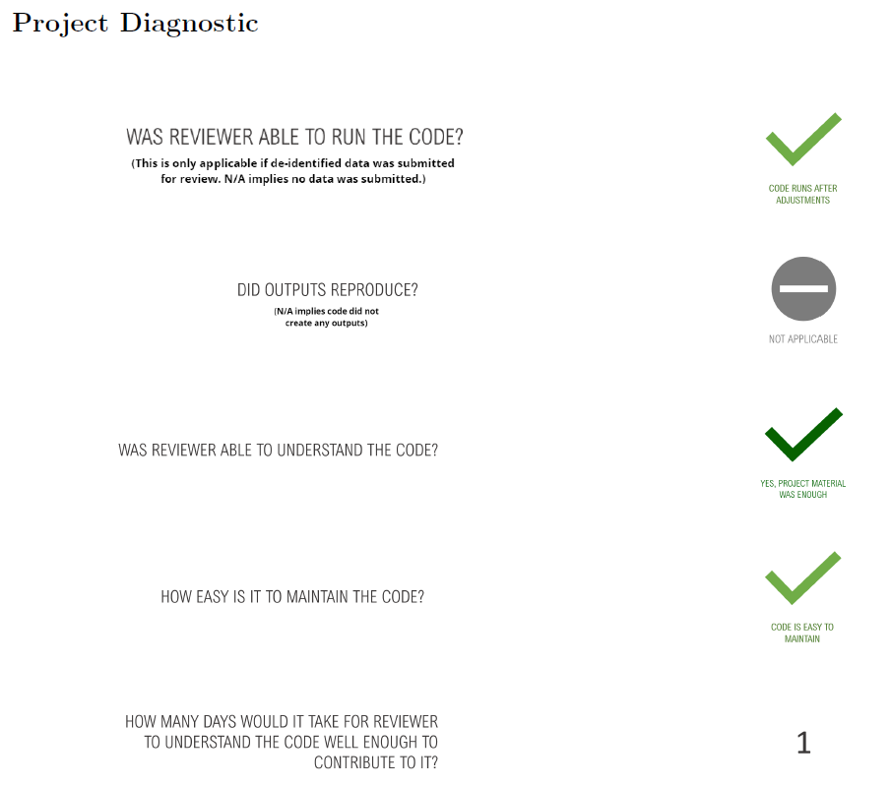
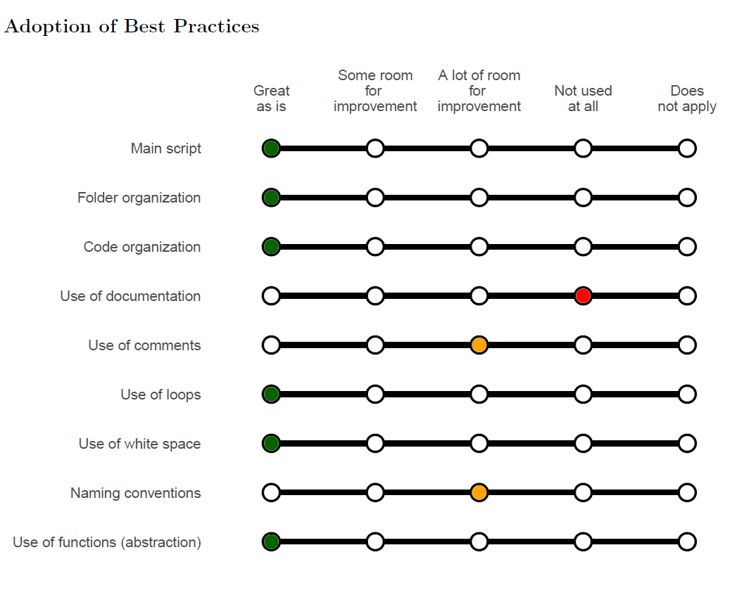
Feedback from Code Review

Slide 28
How the Feedback Helps the Research Team?
Highlights strengths and gaps across projects
Guides us in designing relevant trainings
Helps team leads assess and support team members effectively

Slide 29
Participant Learnings
Coding practices
Commands and tools discovery
Reproducibility & Project Organization
Review Mindset & Learning from Peers
  Improved code organization (e.g., folder structure, main do-files, modular scripts)
  Better use of comments and documentation
  Efficient use of loops, and functions
  Avoid modifying raw data directly
  Discovered: ieboilstart, iebaltab, collect, collapse2, addoc, winsorize, gtools
  Setting up environment for reproducible code execution
  Creating README files for transparency
  Installing user-written packages at the top of scripts
  Realizing the importance of external readability in code
  Getting inspiration from others’ project organization
  Reinforcing the habit of rerunning code from scratch
Notes:
How to organize code better
Understand what it means to write reproducible code
They gain perspective by seeing how others work

Slide 30
Why Do We Still Need Peer Reviews
Even with AI tools?

Slide 31
AI Can Assist,
But Can’t Replace Judgment
Context matters
AI tools don’t always understand project-specific logic, file structures, or intent

Slide 32
What AI Can’t Easily Catch
“According to the HFCs checklist, there is space for improvement. For instance, I was not able to find any code specifically tracking survey progress, like checks/summary stats for the number/share of surveys attempted, completed, and declined...”
“If the code will be run on a weekly basis, the coder could focus on preparing a function that takes as inputs the existing dataset and new data, checks which listings are not in the existing data, appends new entries to the table and saves a new master dataset with the name of the week (better not to overwrite the same file).”
Notes:
Contextual understanding
In-depth reviews

Slide 33
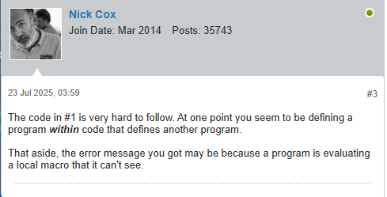
And Finally…
Peer code review isn’t just about the code…
It promotes collaboration, shared practices, and mutual growth
AI can’t replace Human Feedback
Notes:
More than the code
Growing together as a research community

Slide 34
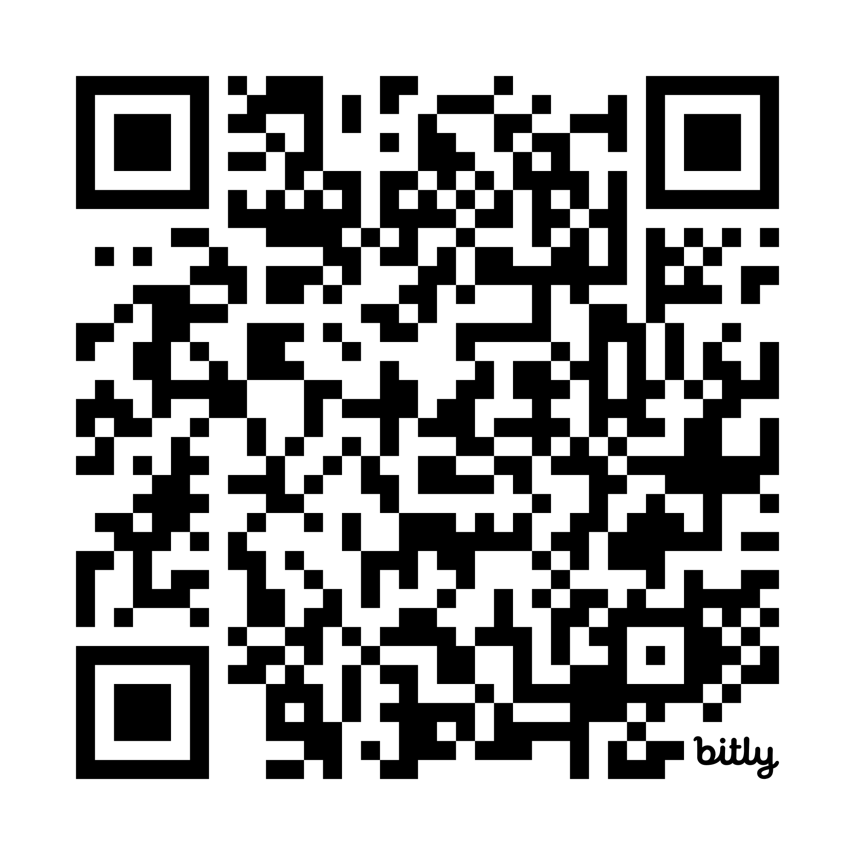
For more details or to adapt this model to your team, please don’t hesitate to reach out.
dimeanalytics@worldbank.org
asingh43@worldbank.org
https://bit.ly/peer-code-review
Thank You!

