Slide 1
Creating pre- and posttest visualizations using Stata, Excel, and Tableau
By: Sergio Cervantes
Date: July 31st, 2025
Nashville, TN

Slide 2
Part 1: Clean your Stata data
Have your ordinal and dichotomous variables ready.
  Check their construct validity (e.g. “About the same” should be a 3 in a variable with values 1-5) beforehand.
  They require numeric ranges like [1,5] or [0,1].
Append all group datasets to gather separate aggregate findings.
  I recommend creating a “total” dataset with every respondent, then appending all other groups.

Slide 3
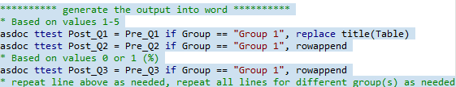
Part 2: Run asdoc ttest Stata syntax, then move the Word output into Excel
First, run the Stata syntax below to generate Word output (repeat lines using rowappend at the end).
Second, copy every row of the Word output table below “Table.”
Third, paste all the Word output into Excel using the left-hand corner.

Slide 4

Part 2: Run asdoc ttest Stata syntax, then move the Word output into Excel
First, run the Stata syntax below to generate Word output (repeat lines using rowappend at the end).
Second, copy every row of the Word output table below “Table.”
Third, paste all the Word output into Excel using the left-hand corner.

Slide 5
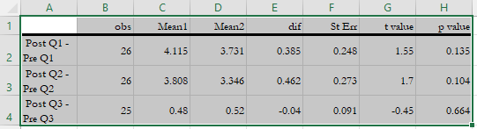


Part 2: Run asdoc ttest Stata syntax, then move the Word output into Excel
First, run the Stata syntax below to generate Word output (repeat lines using rowappend at the end).
Second, copy every row of the Word output table below “Table.”
Third, paste all the Word output into Excel using the left-hand corner.

Slide 6
Part 3: Modify and save the Excel file
Remove St Err and t value columns, along with Column D below.
Rename – obs → n / Mean1 → Post / Mean2 → Pre / dif → Diff
Add Table Number, Group and Question variables.
  Table Number depends on # of visualizations, Group depends on # of groups analyzed, and Question depends on the evaluation item desired to study.

Slide 7
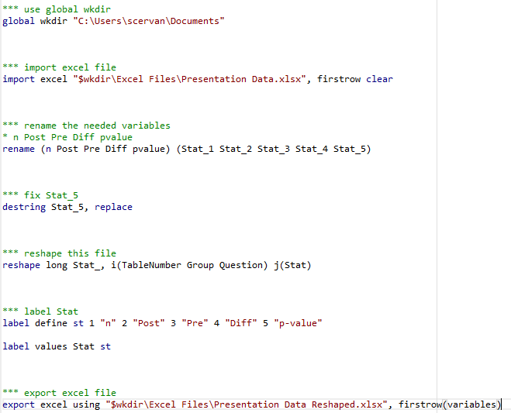
Part 4: Import the Excel file back into Stata and reshape the file

Slide 8
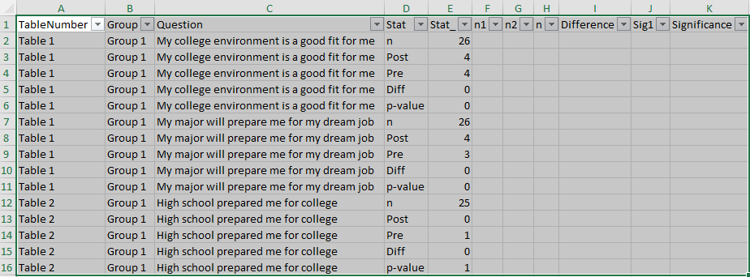
Parts 5-7: Modify your reshaped Excel file to replicate the following view (Add Columns F-K) and add a filter (CTRL+SHIFT+L) for all cells

Slide 9
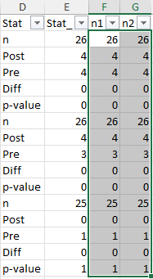
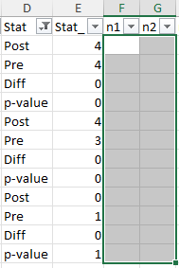
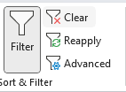
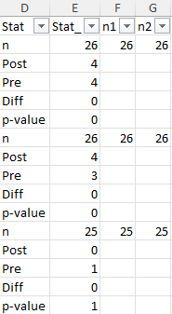
Part 5: Prepare the n column
First, copy and paste all Column E values into F and G, clear out all values not tied to “n” rows from Column D with filtering, then clear the filter.

Slide 10
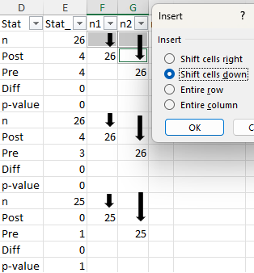
Part 5: Prepare the n column
Second, shift down Column F and G values toward Post and Pre rows respectively and separately using Insert (CTRL+SHIFT+PLUS).

Slide 11
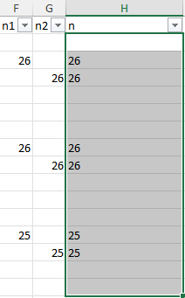
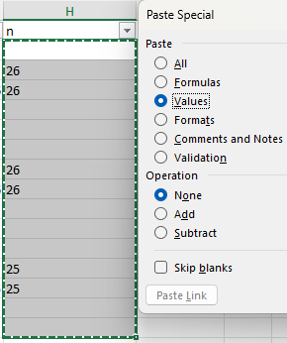

Part 5: Prepare the n column
Third, Concatenate from the top (H2), Autofill, then Copy and Paste Special with Values for all Column n values. Remove Columns n1 and n2.

Slide 12
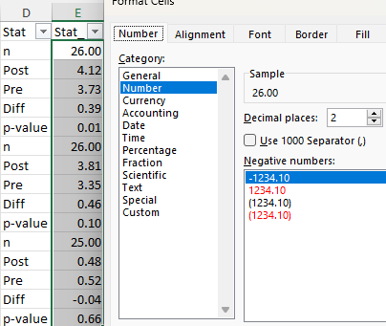
Part 6: Prepare the Difference column
First, Format all Column E values so they have two decimal places.

Slide 13
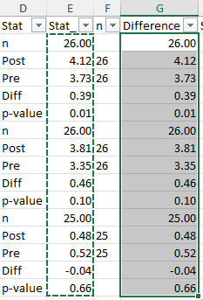
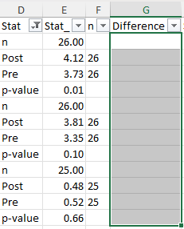
Part 6: Prepare the Difference column
Second, copy and paste all Column E values into G, clear out all values not tied to “Diff” rows from Column D using filtering, then clear the filter.

Slide 14
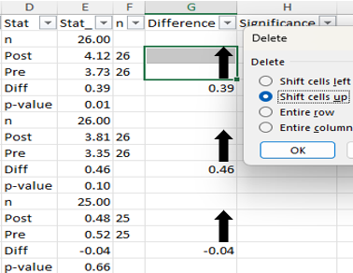
Part 6: Prepare the Difference column
Third, Shift up the Difference values from the “Diff” rows in Column D towards the Post rows using Delete (CTRL + MINUS).

Slide 15
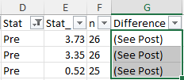
Part 6: Prepare the Difference column
Fourthly, using filtering, attach “(See Post)” on each “Pre” row in Column D into the Difference column by dragging the first cell down, then clear the Stat filter.

Slide 16
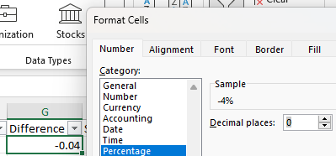
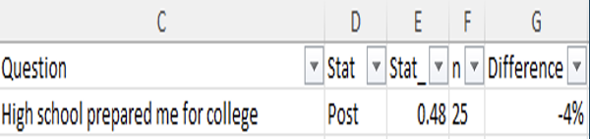
Part 6: Prepare the Difference column
For percentage items, you can filter with Question (Column C) and Stat (filter out Pre values using Column D), format, then clear the filter.

Slide 17
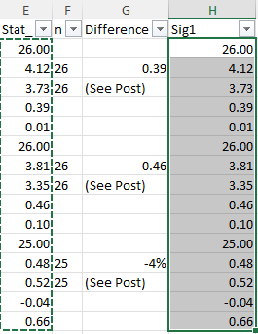
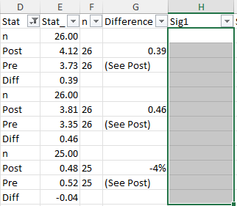
Part 7: Prepare the Significance column
First, copy and paste all Column E values into H, clear out all values not tied to “p-value” rows in Column D using filtering, then clear the filter.

Slide 18
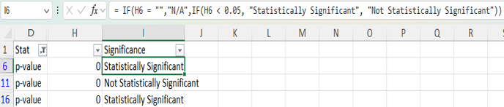
Part 7: Prepare the Significance column
Second, filter out all rows from Column D except for “p-value” rows, calculate statistical significance from Column H values with a nested if-then formula, and drag the formula down with the bottom right-hand corner of first cell (I6).

Slide 19
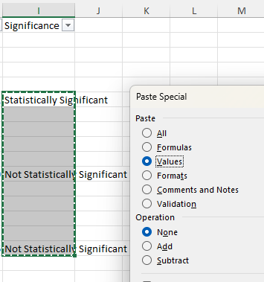
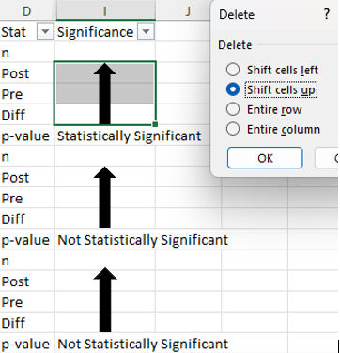
Part 7: Prepare the Significance column
Third, Copy then Paste Special with Values on the Significance column, then shift up the Significance values towards the Post rows from Column D using Delete (CTRL + MINUS).

Slide 20
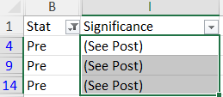

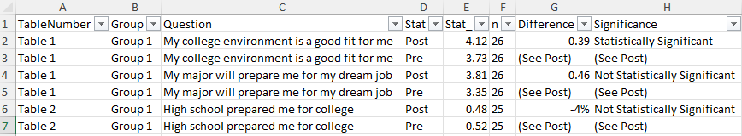
Part 7: Prepare the Significance column
Fourthly, attach “(See Post)” to each “Pre” Column D row into the Significance column (dragging works best) using filtering, clear the filter, eliminate all rows except the Pre and Post rows from Column D, and replicate the file below.

Slide 21
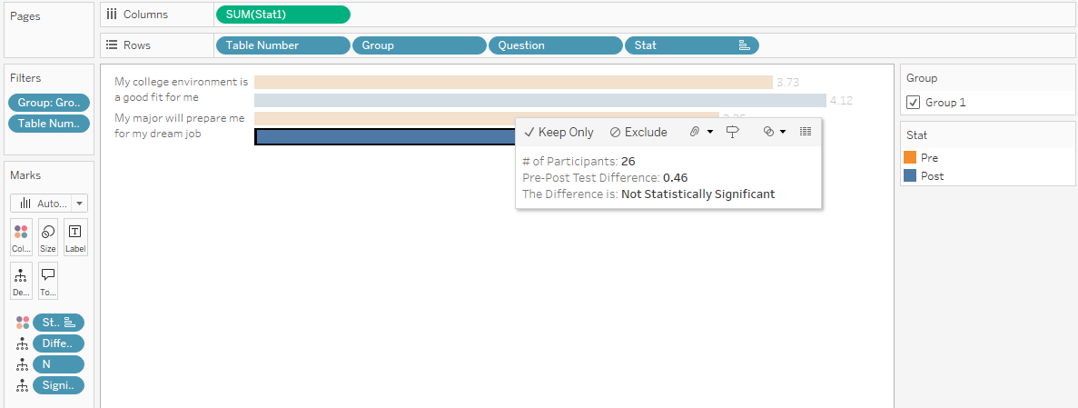
Part 8-10: Create the pre- and posttest visualizations in Tableau (percentage and decimal visuals must be done separately, modify Table Number filter if needed)

Slide 22
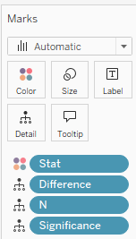
Part 8: Open the newly created Excel file in Tableau and set-up the Tableau Interface
Columns and Rows
Marks (Non-Tooltip)

Slide 23
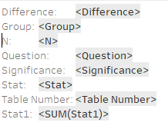



Part 8: Open the newly created Excel file in Tableau and set-up the Tableau Interface
Marks (Tooltip)
Color Key

Slide 24
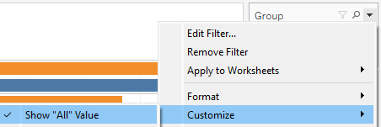
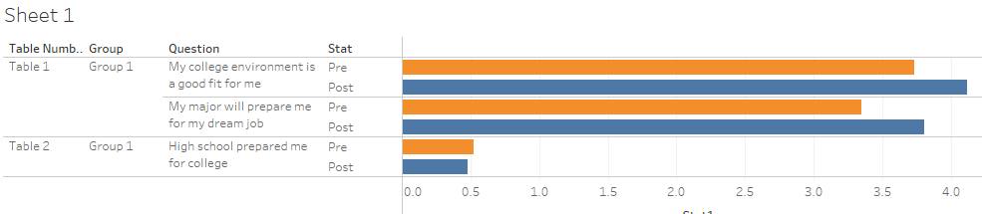
Part 8: Open the newly created Excel file in Tableau and set-up the Tableau Interface
Under the Group Variable dropdown, uncheck Show “All” Value
Interface Set-Up So Far (Remove borders & lines, modify title if needed)

Slide 25
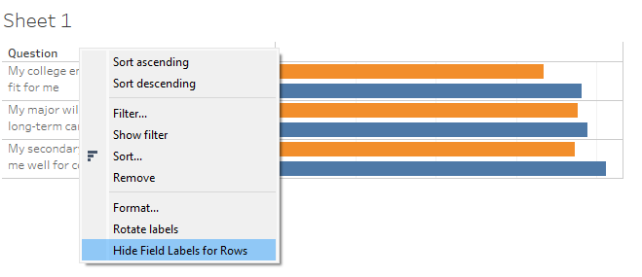
Part 9: Add Modifications to Tableau Interface
Hide Field Labels for Question and Stat separately by right-clicking on them.

Slide 26
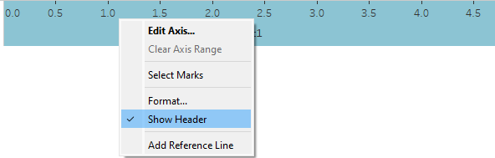
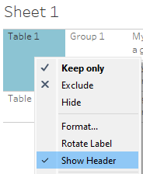
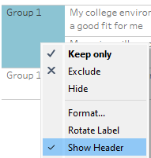
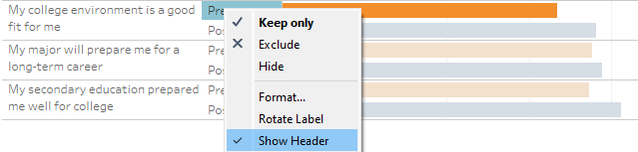
Part 9: Add Modifications to Tableau Interface
Uncheck Show Header
  after right-clicking on Table and Group
  after right-clicking on x-axis
  for Pre and Post Rows

Slide 27

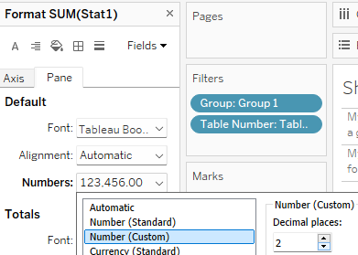
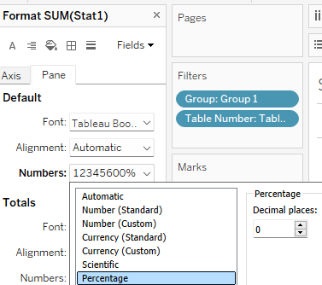
Part 10: Ensure that numbers show up properly in the Tableau interface
Show mark labels
Format values from Fields under Pane for SUM(Stat1), Stat1 being the variable with all numeric values

Slide 28
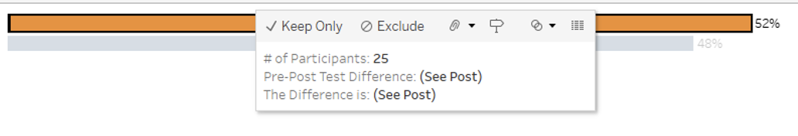

Final Product

Slide 29

Any Questions?
Feel free to connect with me if you have any questions or inquiries regarding the presentation! ☺

