Slide 1

Prompt-based programming:
Easing the Stata learning curve
Zhenghao (Vincent) Jin, MHS, Abimereki Muzaale, MD MPH
Johns Hopkins University
Notes:
Reduce the credit part and proceed with only the title – Use we to shortening the scripts all the time

Slide 2
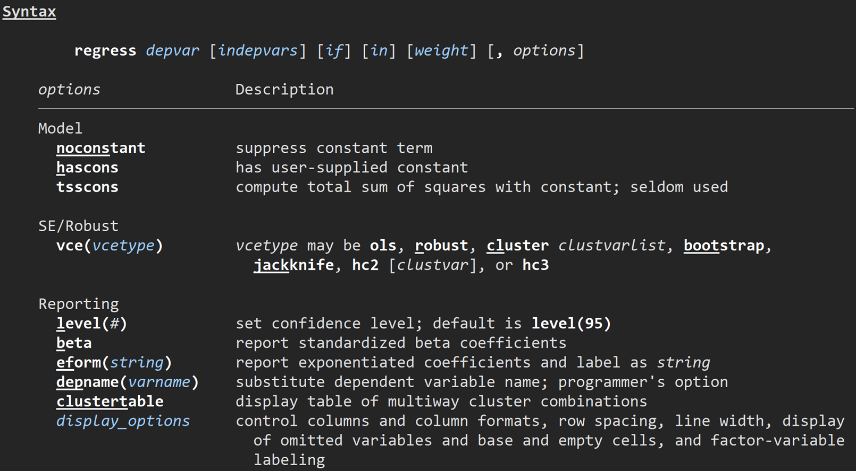
Program name

Slide 3
Required syntax

Slide 4
Optional Syntax

Slide 5
Available options

Slide 6
Traditional Syntax Based

Slide 7
Background and Hypothesis
Prompt based
Traditional syntax
Multiple parameter intakes
Mandatory, self-explanatory intake
Check points and Modifications without termination
One time intake for parameters
Needs to study the syntax
Hard to identify/fix errors

Slide 8
Background and Hypothesis
Prompt based
Traditional syntax
Multiple parameter intakes
Mandatory, self-explanatory intake
Check points and Modifications without termination
One time intake for parameters
Needs to study the syntax
Hard to identify/fix errors

Slide 9
Background and Hypothesis
Prompt based
Traditional syntax
Multiple parameter intakes
Mandatory, self-explanatory intake
Check points and Modifications without termination
One time intake for parameters
Needs to study the syntax
Hard to identify/fix errors

Slide 10
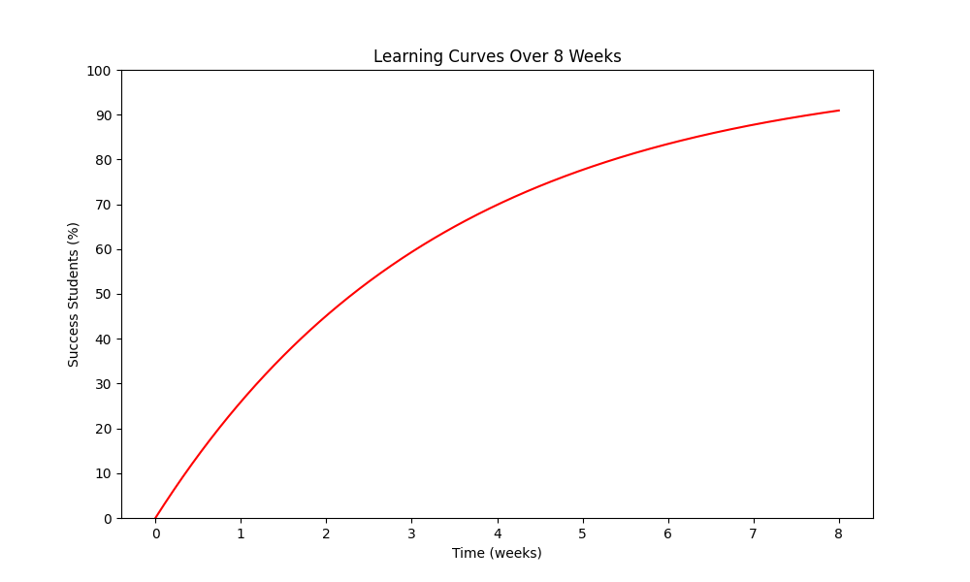
Syntax Based
Difficulties in achieving research goals reported due to lacking skills in operating Stata programs

Slide 11
Syntax Based
Time for 50% of students succeed on automating table 1 production or regression analysis

Slide 12
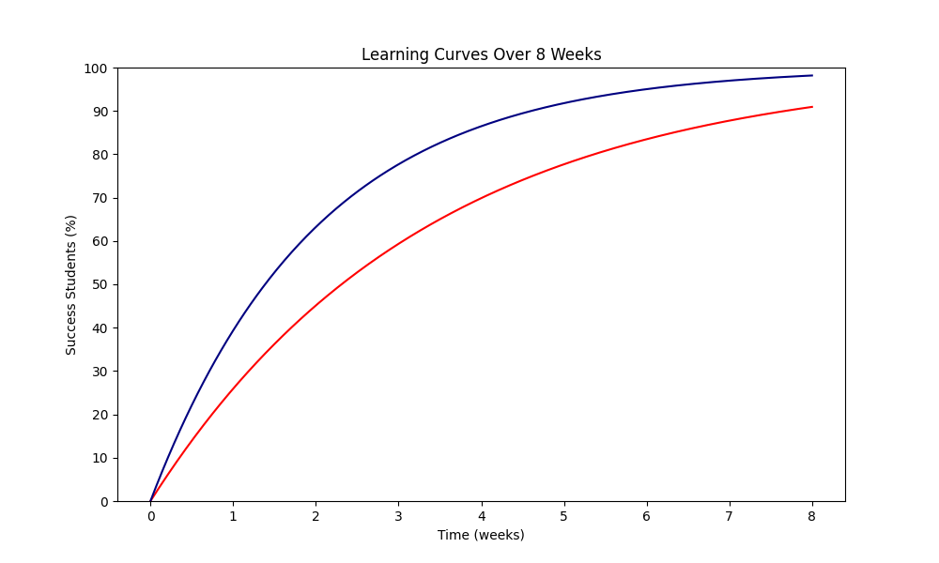
Prompt Based
Syntax Based
Time for 50% of students succeed on automating table 1 production or regression analysis

Slide 13
Background and Hypothesis
Prompt based
Traditional syntax
Multiple parameter intakes
Mandatory, self-explanatory intake
Check points and Modifications without termination
One time intake for parameters
Needs to study the syntax
Hard to identify/fix errors

Slide 14
Background and Hypothesis
Prompt based
Traditional syntax
Multiple parameter intakes
Mandatory, self-explanatory intake
Check points and Modifications without termination
One time intake for parameters
Needs to study the syntax
Hard to identify/fix errors

Slide 15
Background and Hypothesis
Prompt based
Traditional syntax
Multiple parameter intakes
Mandatory, self-explanatory intake
Check points and Modifications without termination
One time intake for parameters
Needs to study the syntax
Hard to identify/fix errors

Slide 16
Prompt Based Programming
Integrating the user input into program executions.
The function:
  _request() option under Stata’s display command
  display “Information to request user input”, _request(macro_name)

Slide 17
Prompt Based Programming
Integrating the user input into program executions.
The function:
  _request() option under Stata’s display command
  display “Information to request user input”, _request(macro_name)

Slide 18
Prompt Based Programming
Integrating the user input into program executions.
The function:
  _request() option under Stata’s display command
  display “Information to request user input”, _request(macro_name)

Slide 19
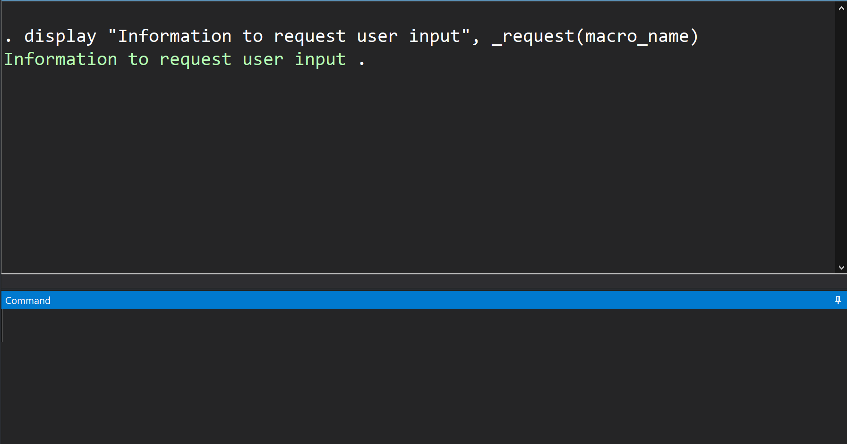
Request option tells Stata to throw out a prompt here

Slide 20
Displaying the string (prompt question)
Pause the program and wait for input

Slide 21
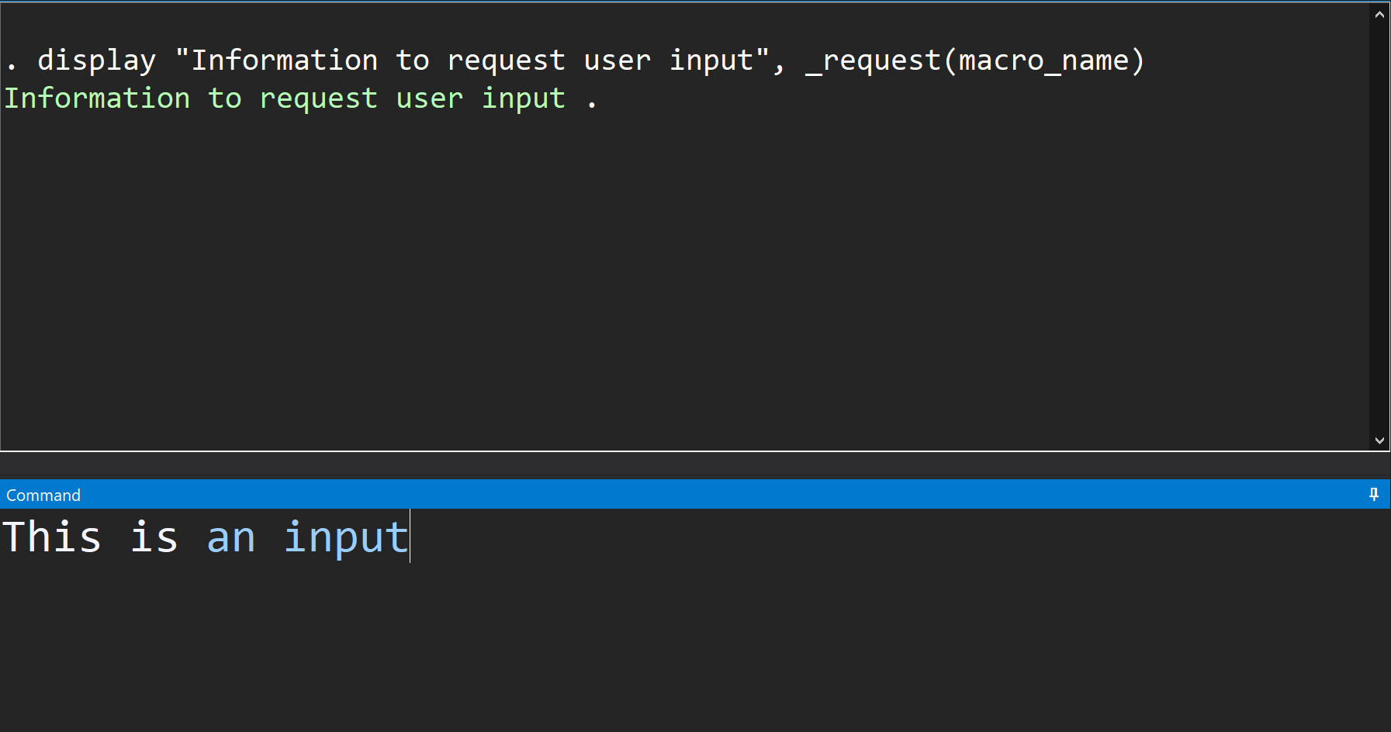
User enter input from the Command window
and hit enter

Slide 22
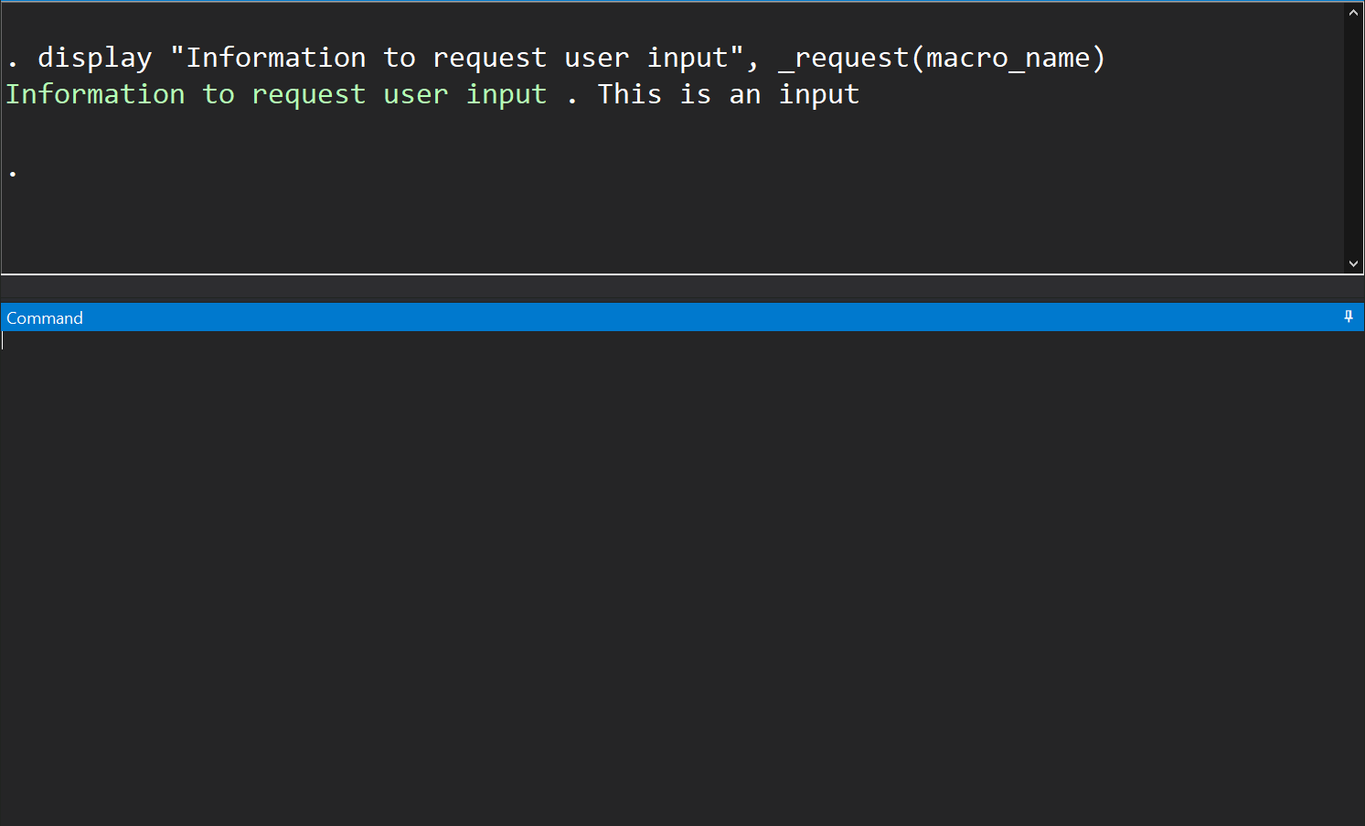
Information is taken in and prompt is completed

Slide 23
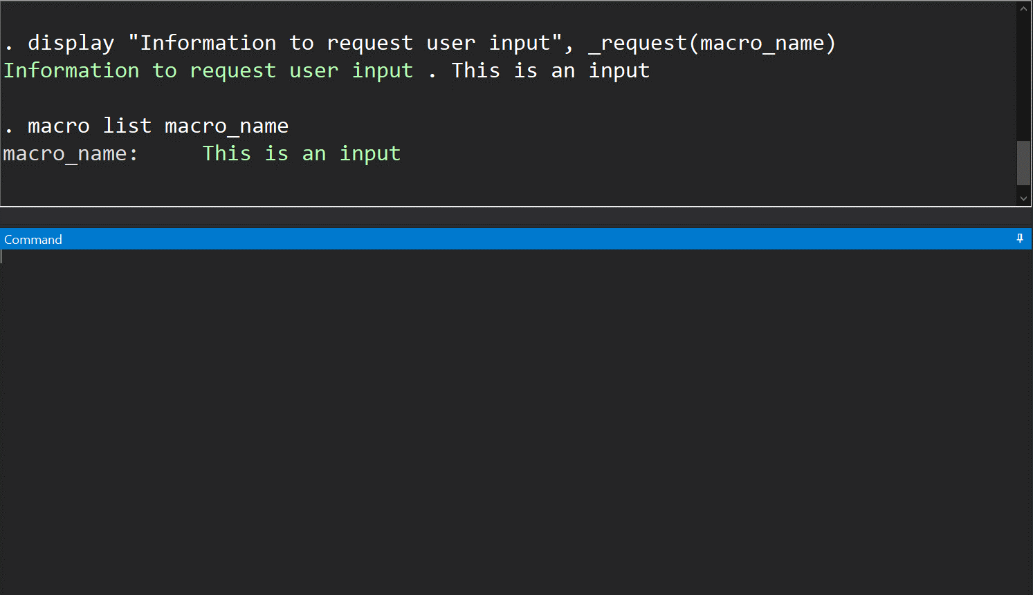
Information will be stored in a global macro
with a name specified by the code

Slide 24
Utilizing User Input
The user input can be modified and used for different purposes:
  Confirmation
  Parameter intake

Slide 25
Confirmation-program check points
Prompts can set critical points for user to check program settings before actual executions

Slide 26
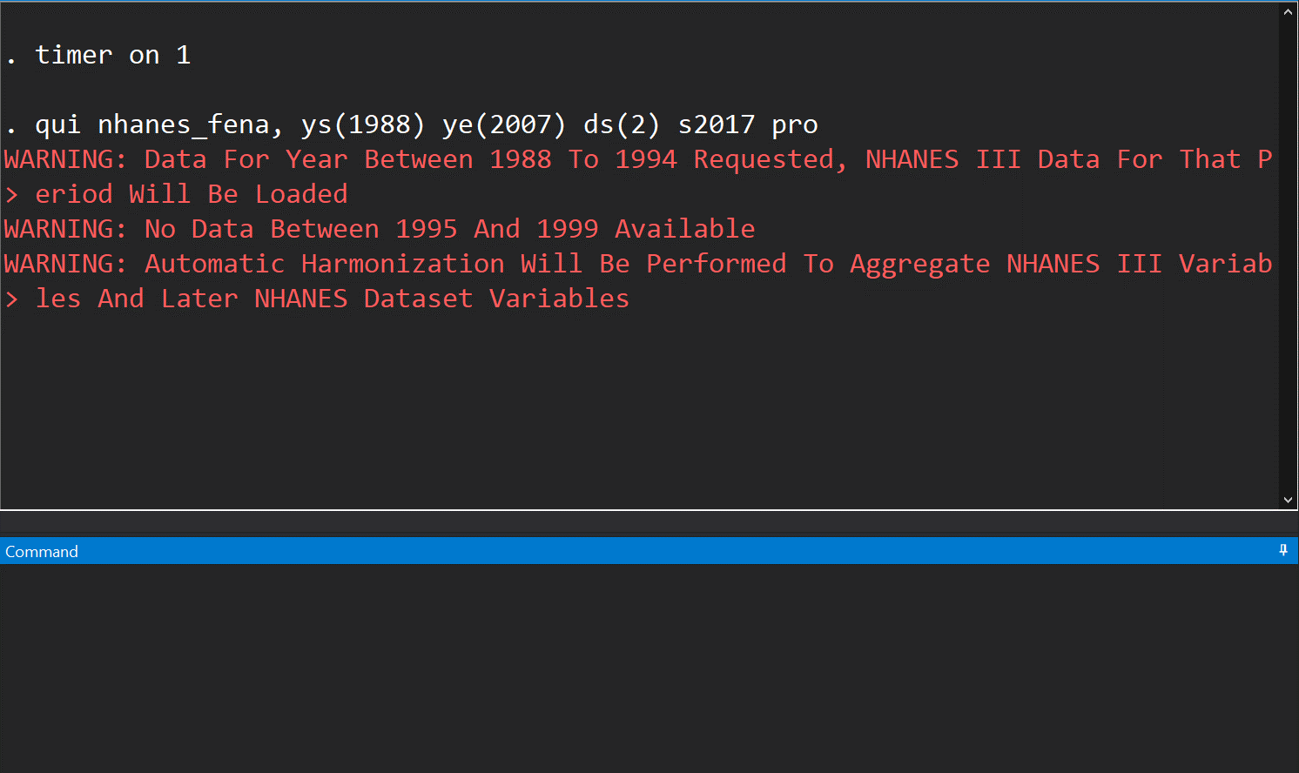
Desired parameter values:
ys – 1988 ye – 2017 ds - 2

Slide 27
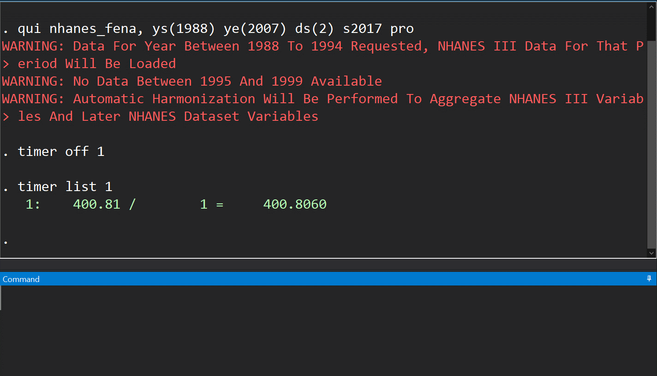
This is the error!
But we won’t know and find the error until at least 400 seconds after

Slide 28
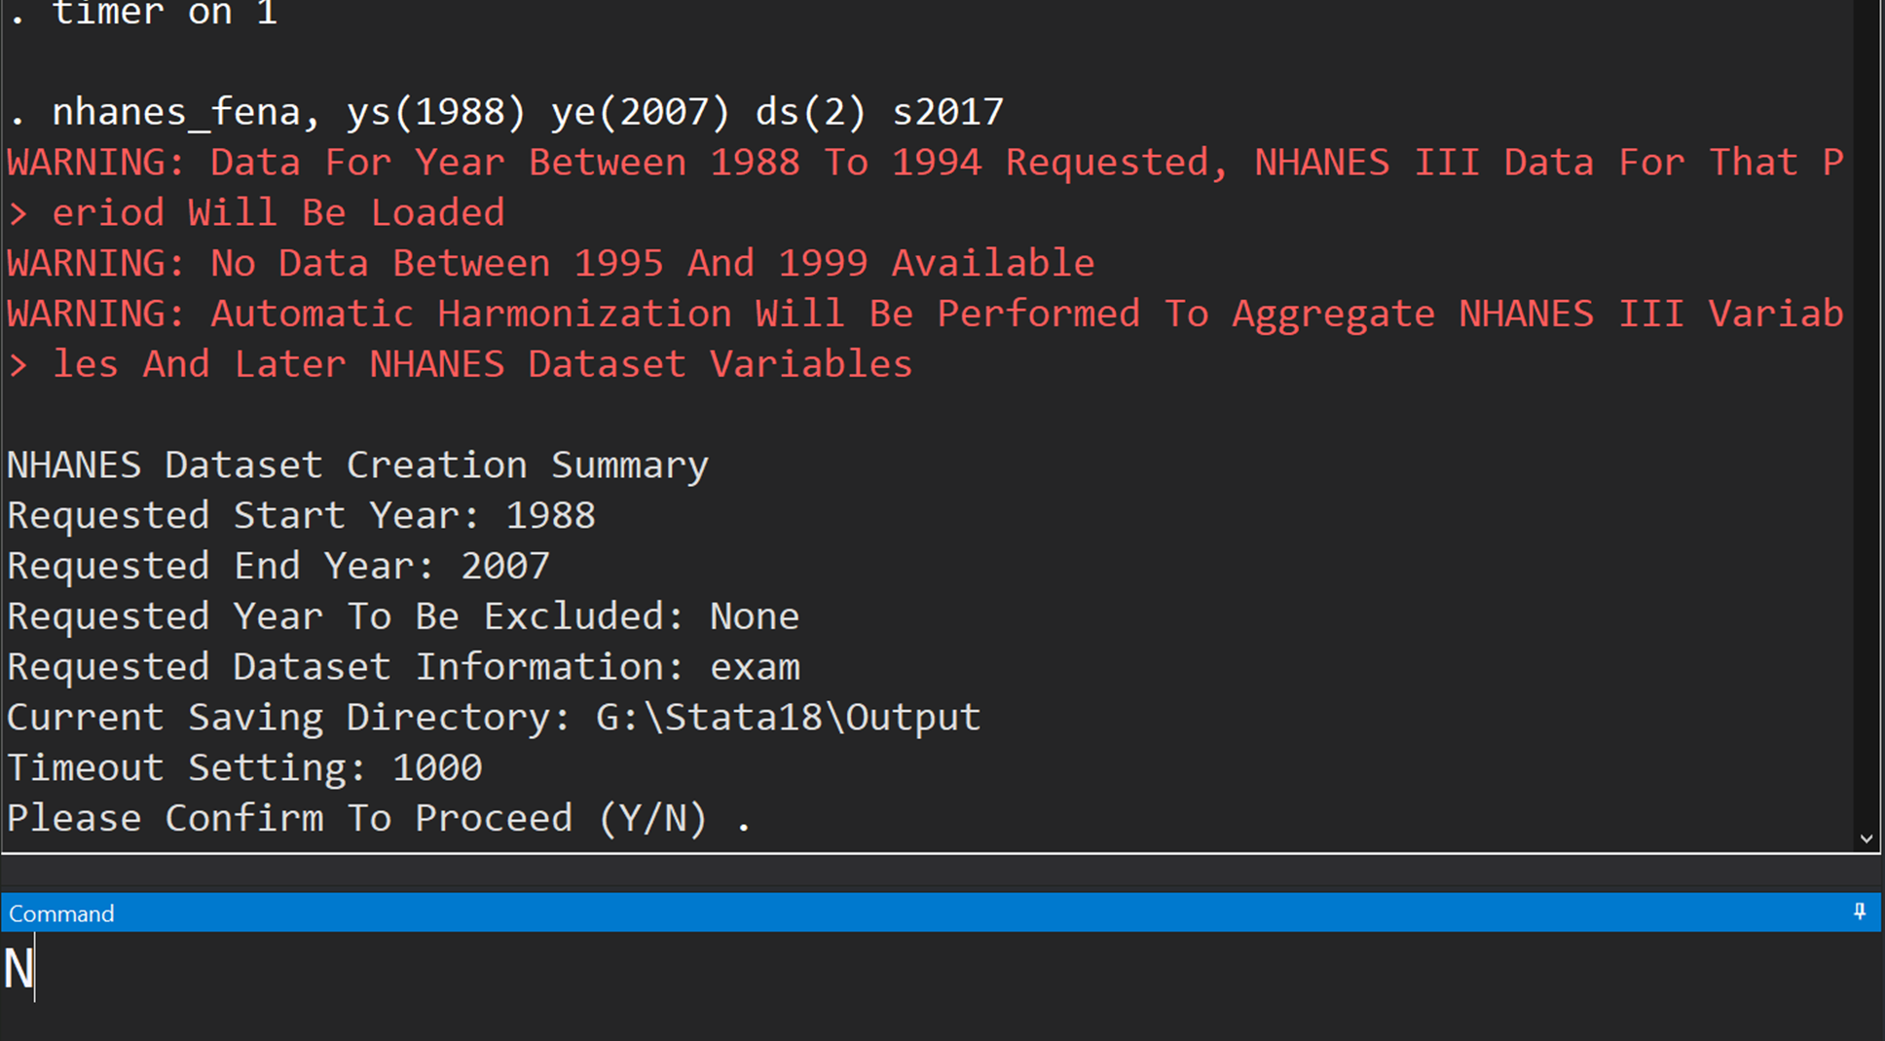
This is a check point before actual execution
This is the confirmation prompt
There is an error, so entering N to deny proceeding

Slide 29
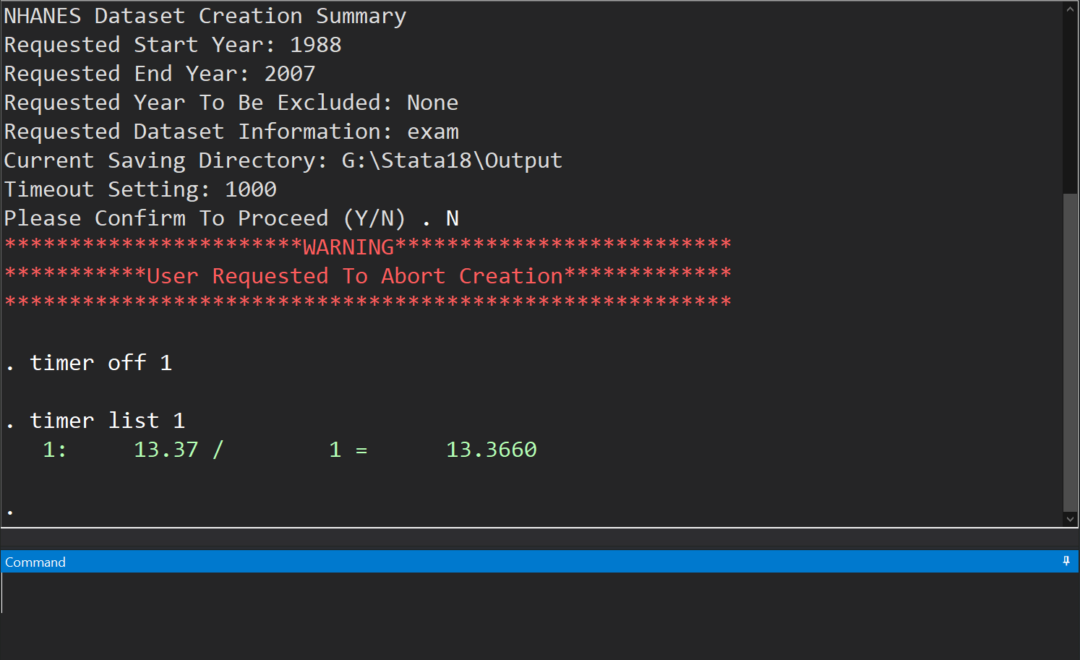
With check-points from prompt, it only takes 13s!

Slide 30
Background and Hypothesis
Prompt based
Traditional syntax
Multiple parameter intakes
Mandatory, self-explanatory intake
Check points and Modifications without termination
One time intake for parameters
Needs to study the syntax
Hard to identify/fix errors

Slide 31
Utilizing User Input
The user input can be modified and used for different purposes:
  Confirmation
  Parameter intake

Slide 32
Parameter Intake – cleaner fashion
Prompts can take in parameters in cleaner fashion.
  Avoid potential error in constructing lists
  Easy to understand and follow

Slide 33
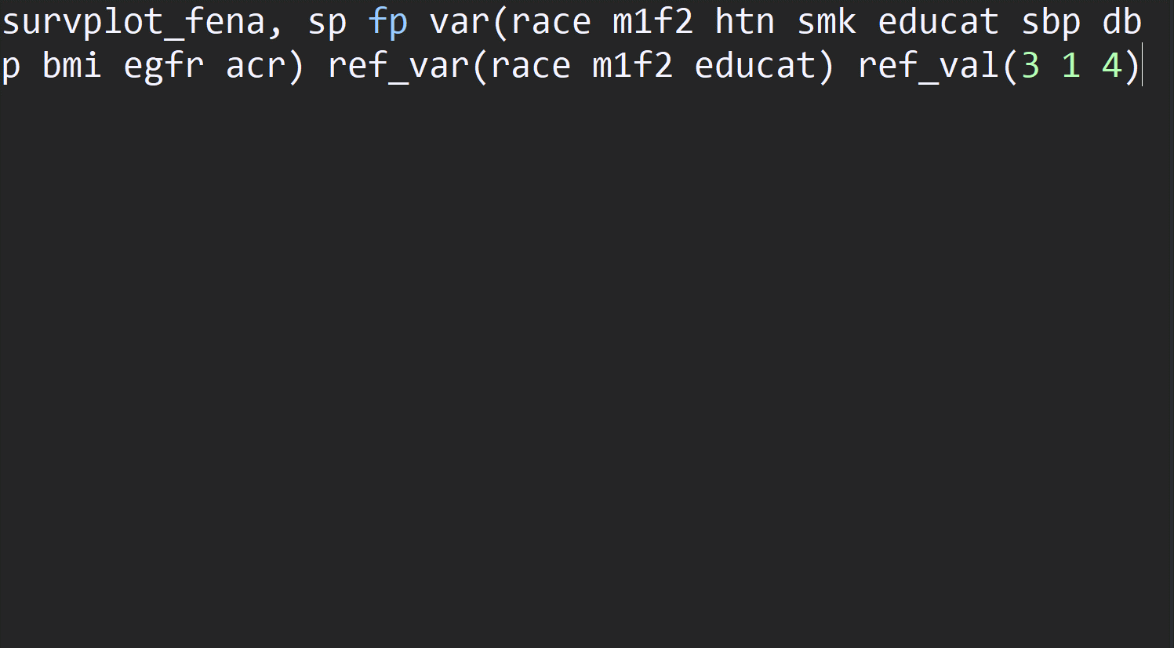
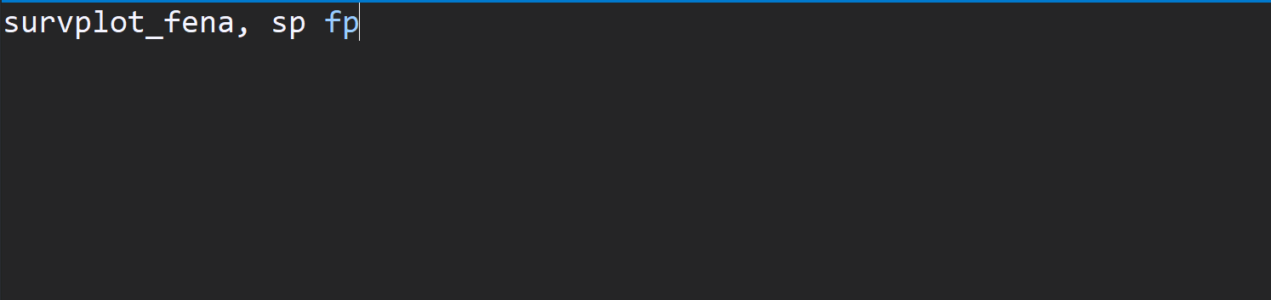
Include everything at program call –
long lists leave spaces for human errors
Traditional Syntax
Prompt Based
No more long lists, less errors!

Slide 34
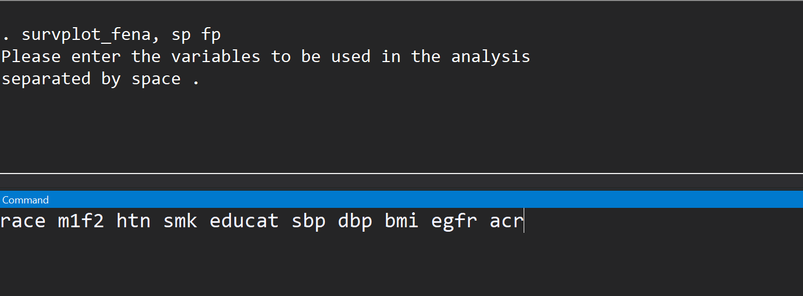
Transforming long option lists to prompts one-at-a-time

Slide 35
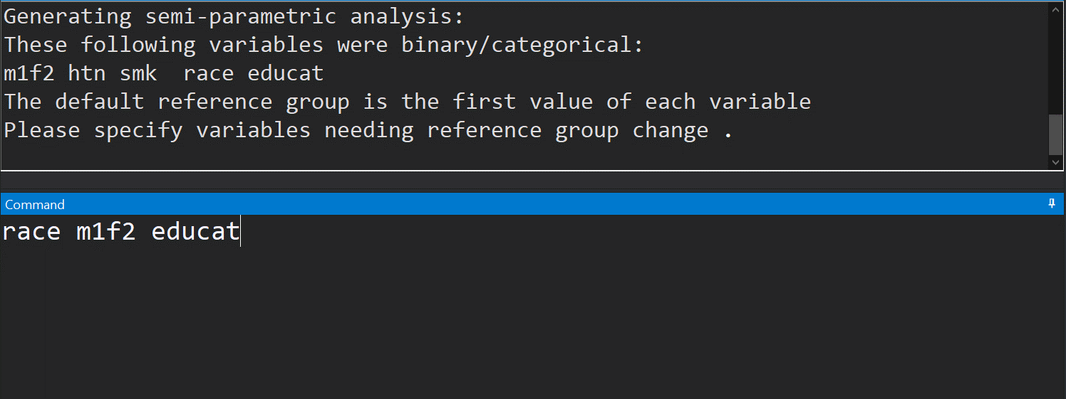

Slide 36
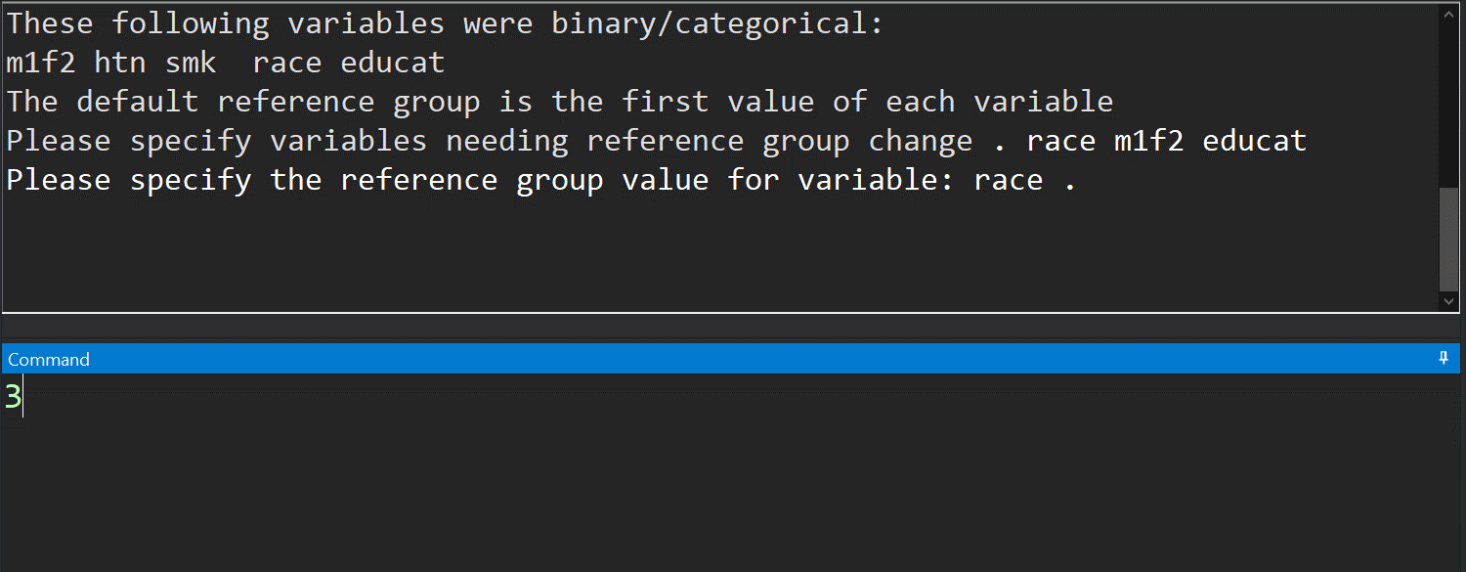

Slide 37
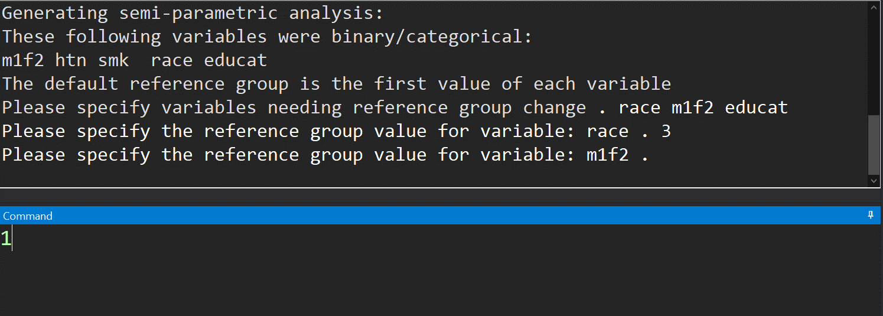

Slide 38
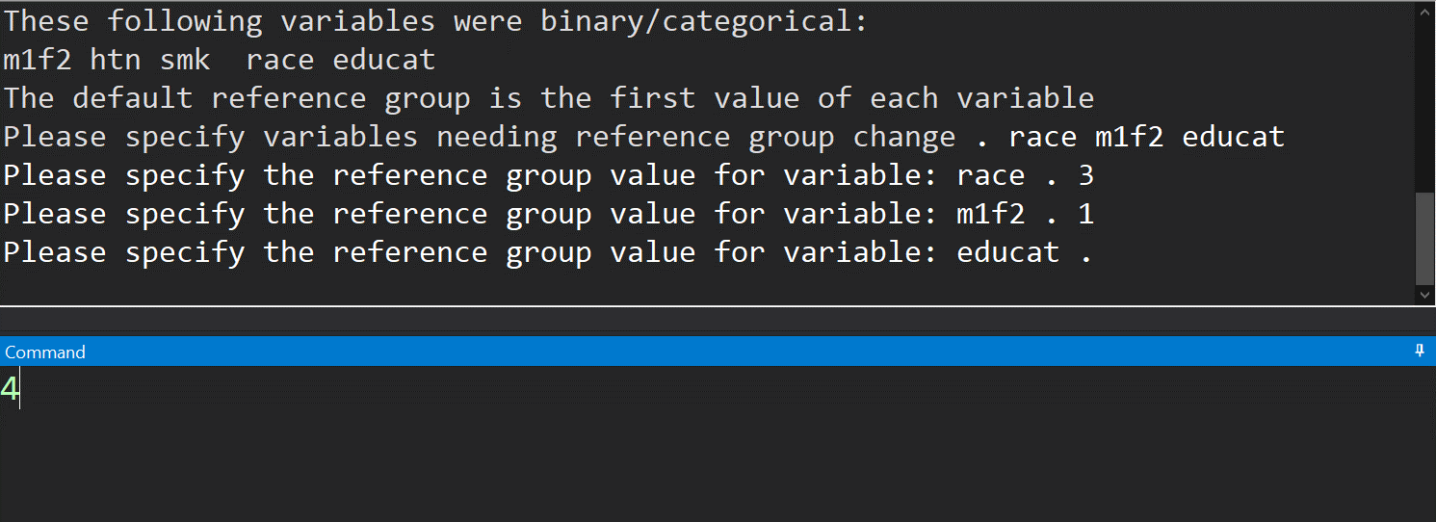

Slide 39
Background and Hypothesis
Prompt based
Traditional syntax
Multiple parameter intakes
Mandatory, self-explanatory intake
Check points and Modifications without termination
One time intake for parameters
Needs to study the syntax
Hard to identify/fix errors

Slide 40
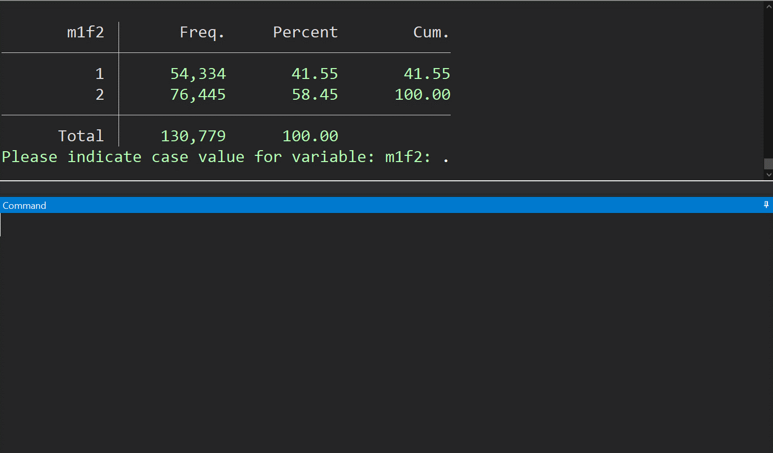
Helpful statistics to help user recall

Slide 41
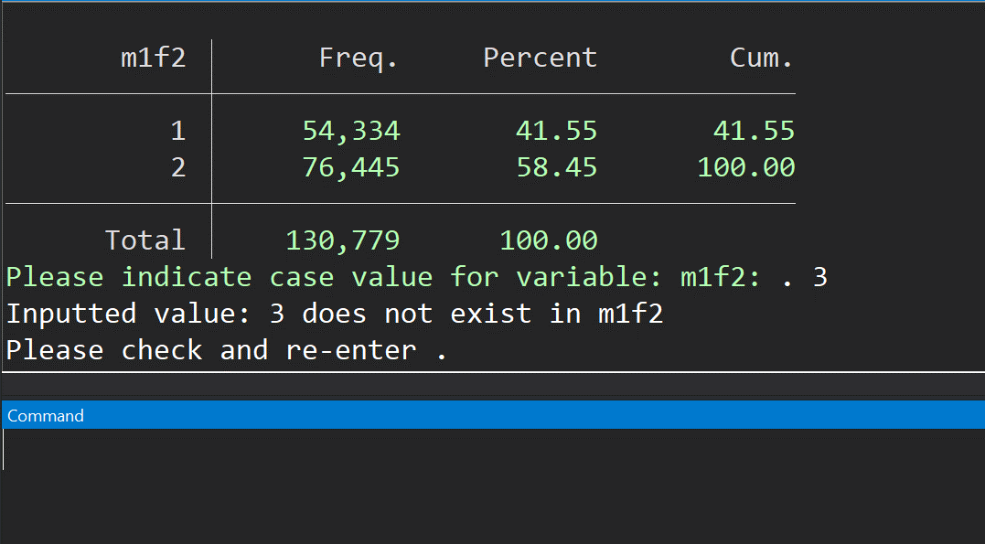
Only 1 or 2, 3 is NOT valid
Can check input after intake

Slide 42
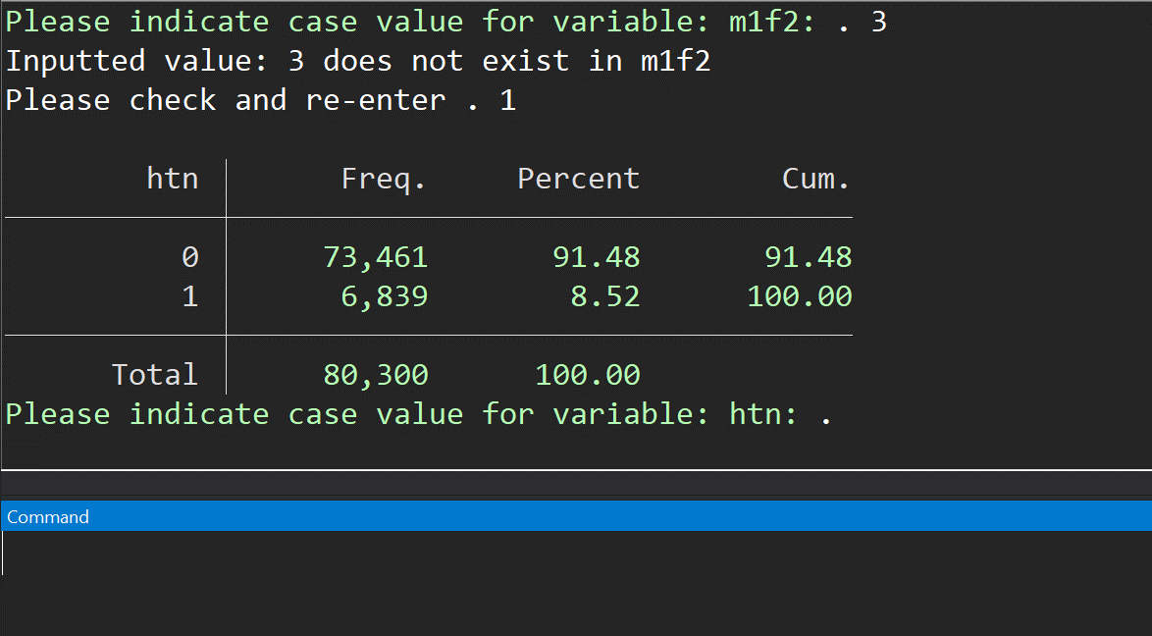
Modification without termination

Slide 43
Background and Hypothesis
Prompt based
Traditional syntax
Multiple parameter intakes
Mandatory, self-explanatory intake
Check points and Modifications without termination
One time intake for parameters
Needs to study the syntax
Hard to identify/fix errors

Slide 44
Thank you!

Slide 45
Issues and Limitation
Prompts are mandatory
  hard to automate
  hard to integrate into other program or codes
Hard to compile
  Multiple inputs require for one test

Slide 46
Issues and Limitation
Prompts are mandatory
  hard to automate
  hard to integrate into other program or codes
Hard to compile
  Multiple inputs require for one test

Slide 47
Possible Solution
Prespecify the global macro requested to bypass the request
FROM THIS:
program define test
noi di “This is a request”, _request(content)
noi di “Your input is: ${content}”
end

Slide 48
Possible Solution
Prespecify the global macro requested to bypass the request
FROM THIS:
program define test
noi di “This is a request”, _request(content)
noi di “Your input is: ${content}”
end

Slide 49
Possible Solution
TO THIS:
global content : di “Example input.”
program define test
syntax, [pro]
if (“`pro’” != “pro”) {
noi di “This is a request”, _request(content)
}
noi di “Your input is: ${content}”
end

Slide 50
Lesson Learned
All approaches are useful for programs.
The key issue is to identify targeting user population
  more user focused and acts independent
    prompt based may be better
  Collaborating/integrating with other program/complicated scripts
    syntax approach may be better
It is always important to think about the actual goal of the program
  how it will be used? where it will be placed?

Slide 51
Lesson Learned
All approaches are useful for programs.
The key issue is to identify targeting user population
  more user focused and acts independent
    prompt based may be better
  Collaborating/integrating with other program/complicated scripts
    syntax approach may be better
It is always important to think about the actual goal of the program
  how it will be used? where it will be placed?

Slide 52
Lesson Learned
All approaches are useful for programs.
The key issue is to identify targeting user population
  more user focused and acts independent
    prompt based may be better
  Collaborating/integrating with other program/complicated scripts
    syntax approach may be better
It is always important to think about the actual goal of the program
  how it will be used? where it will be placed?

Slide 53
Lesson Learned
All approaches are useful for programs.
The key issue is to identify targeting user population
  more user focused and acts independent
    prompt based may be better
  Collaborating/integrating with other program/complicated scripts
    syntax approach may be better
It is always important to think about the actual goal of the program
  how it will be used? where it will be placed?

Slide 54
Lesson Learned
All approaches are useful for programs.
The key issue is to identify targeting user population
  more user focused and acts independent
    prompt based may be better
  Collaborating/integrating with other program/complicated scripts
    syntax approach may be better
It is always important to think about the actual goal of the program
  how it will be used? where it will be placed?

