Slide 1
How to Analyze Public Opinion Data in Ten Easy Steps:
A Beginner’s Guide Using Stata
Lindsay J. Benstead
Professor of Politics and Global Affairs
Director, Middle East Studies Center (MESC)
Portland State University

Slide 2
The Genesis of the Book
Open Educational Resource (OER)
  “…learning, teaching and research materials in any format and medium that reside in the public domain or are under copyright that have been released under an open license, that permit no- cost access, re-use, re-purpose, adaptation and redistribution by others” (UNESCO, 2024).
  “freely licensed, remixable learning materials, from single lessons to full textbooks” (Liberal Education, 2022).

Slide 3
The Genesis of the Book
Textbook costs and equity
  “Research shows that [when] … educators provide OER, student performance gaps shrink and withdrawal rates decline.”
  High cost of textbooks and student retention.

Slide 4
The Basis Approach of the Book
To walk students step-by-step through a simple research article focusing on how the research question was formulated and answered using publicly-available public opinion data and STATA.
Learning objectives:
  To be able to replicate the results of a published research article
  To be able to formulate an original research question and answer it with publicly-available data and STATA.

Slide 5
Outline of the Book
Introduction to conducting empirical social science research
Research ethics
Steps in answering and answering a research question (With the steps used in Stata)
Final exam

Slide 6
Example Chapter: Chapter 1
Box 1.1 Building Blocks of Empirical Social Science Research
Empirical research - A type of study that uses observable evidence to gain knowledge.
Research question - A research question should be about the relationship between two concepts/variables (that is, be explanatory, rather than simply descriptive).
Descriptive research - Research into how something is, often describing a single concept/variable.
Explanatory research - Research into why something is, especially that seeks to explain the relationship between two concepts/variables (i.e., an independent and dependent variable).
Concept - An abstract idea.
Variable- A concrete idea that takes on different values.
Theory - A statement about why the change in an independent variable explains the change in the dependent variable.

Slide 7
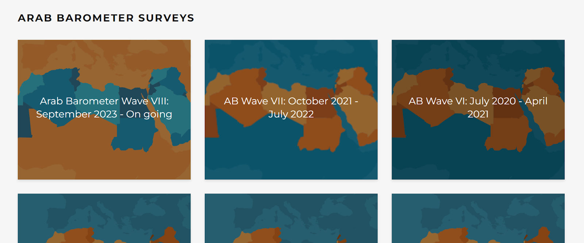
Example Chapter: Chapter 1 (Where to Find Data)

Slide 8
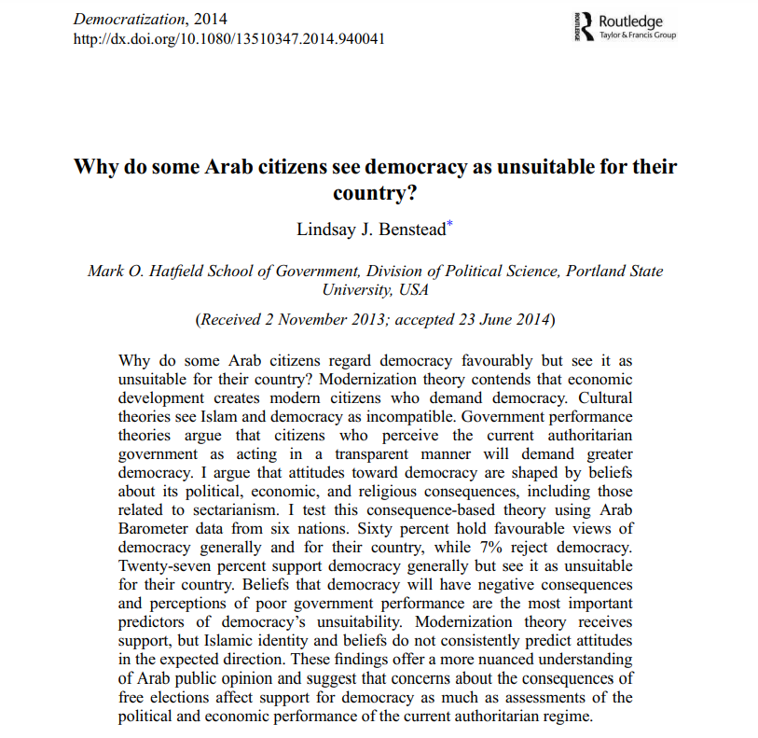
The Sample Research Paper
Lindsay J. Benstead. 2014. “Why Do Some Arab Citizens See Democracy as Unsuitable for Their Country?” Democratization. First published online September 3, 2014. doi: 10.1080/13510347.2014.940041.

Slide 9
Arab Barometer, Wave I (2006-2008)
Do Arab citizens support democracy?
“Democracy may have its problems, but it’s the best form of government.”
  Prior to Arab uprisings, 80% or more in national samples agreed or strongly agreed

Slide 11
Argument: Consequence Based Theory
Consequence Based Theory
The reasons citizens see democracy as unsuitable stem not from religion or economic modernization – the focus of many studies of Arab public opinion – but from concerns about economic problems and political instability that could accompany free elections.

Slide 12
Findings: Democracy’s Consequences
When citizens worry about economic upheaval, violence, or negative cultural ramifications as a result of free elections, demand for democracy diminishes.

Slide 13
Findings: Religion
While religiosity does not affect attitudes toward democracy, sectarian identity does have an effect.
Effects of sect depend on context.
In Lebanon, for example, Shiite Muslims are more likely to see democracy as suitable than Christians. This may be because Christians, who make up an estimated 41 percent of the population, expect to lose from freer elections, while Shiite Muslims could gain more influence.
Notes:
(Shiite Muslims make up about 27 percent of the population, Sunni Muslims 26 percent. Together, Muslims make up a larger proportion of the country than Christians.)

Slide 14
Example Chapter (Creating a Scale)
corr q2011 q2012 q2013 q2014 q2015 if q2011>0 & q2011<5 & q2012>0 & q2012<5 & q2013>0 & q2013<5 & q2014>0 & q2014<5 & q2015>0 & q2015<5
(obs=5751)
| q2011 q2012 q2013 q2014 q2015
-------------+---------------------------------------------
q2011 | 1.0000
q2012 | 0.5655 1.0000
q2013 | 0.5527 0.5177 1.0000
q2014 | 0.4259 0.5672 0.3849 1.0000
q2015 | 0.3769 0.3877 0.5031 0.3271 1.0000

Slide 15

Tessler, Mark A. Social Science Research in the Arab World and Beyond: A Guide for Students, Instructors and Researchers. Cham: Springer, 2023. doi:10.1007/978-3-031-13838-6.

Slide 16
Conclusion
The potential of OER to support student success and teach research skills.
OER textbook to be completed in the fall 2024.

Slide 17
Back Up

Slide 18
Arab Public Opinion after the Uprisings:
Why Do Some Arab Citizens See Democracy as Unsuitable?
Lindsay Benstead
Mark O. Hatfield School of Government
Portland State University

Slide 19
Outline
Part I
  Multivariate statistical analysis of Arab Barometer data (2006-2008) explaining lagging support for democracy.
Part II
  Transitional Governance Project (Benstead, Lust, Malouche, and Wichmann) data from Tunisia.

Slide 20
Arab Barometer, Wave I (2006-2008)
Do Arab citizens support democracy?
“Democracy may have its problems, but it’s the best form of government.”
  Prior to Arab uprisings, 80% or more in national samples agreed or strongly agreed

Slide 21
Arab Barometer, Wave I (2006-2008)

Slide 23
Research Questions
Why do many Arab citizens see democracy as unsuitable?

Slide 24
Argument: Consequence Based Theory
Consequence Based Theory
The reasons citizens see democracy as unsuitable stem not from religion or economic modernization – the focus of many studies of Arab public opinion – but from concerns about economic problems and political instability that could accompany free elections.

Slide 25
Motivation for Explaining Popular Support for Democracy
Scholars have long suggested that public support for democracy is a key driver of democratization.
Conditions that appear to threaten public confidence in democracy in the Arab world – instability, violence and upheaval – are an unfortunate byproduct of the transitions taking place in the region. And, this appears to be hampering citizen confidence in democracy.

Slide 26
Theoretical explanations

Slide 27
Explanations for Lagging Support for Democracy
Islam and sectarianism
  Wants Shari’a. “The government should implement only the laws of Shari’a. Strongly agree[=4]/agree[=3]/disagree[=2]/strongly disagree[=1].”

Slide 28
Explanations for Lagging Support for Democracy
Modernization theory
  Lower education. Illiterate[=7]/elementary[=6]/primary[=5]/secondary[=4]/some college[=3]/BA[=2]/MA or higher[=1].
  Lower support for gender equality. “A university education is more important for a boy than a girl. Strongly agree[=4]/agree[=3]/disagree[=2]/strongly disagree[=1].”
  Does not follow media. “How often do you follow news about politics and government in [country]? Very often[=1]/often[=2]/sometimes[=3]/never[=4]”
  Lower income. Ten-point scale, where 10 is lowest.

Slide 29
Explanations for Lagging Support for Democracy
Political economic
  Higher economic satisfaction. “How would you rate the economic situation of your family today? Very Good[=4]/good[=3]/bad[=2]/very bad[=1].”
Social capital
  Lower interpersonal trust. “Generally speaking, would you say: most people can be trusted[=0]/you must be very careful in dealing with people[=1].”
  Not associational membership. “Are you a member of any organization or formal groups? Yes[=0]/No[=1].”

Slide 30
Explanations for Lagging Support for Democracy
Government performance
  Lower government satisfaction. “Using a similar 10-point scale, where 1 means very unsatisfied and 10 means very satisfied, indicate how satisfied you are with the performance of the current [country name] government.” Recoded, where low satisfaction is 10.
  Lower institutional trust. “I’m going to name a number of institutions. For each one, please tell me how much trust you have in them. Is it a great deal of trust[=1]/quite a lot of trust[=2]/not very much trust[=3]/not at all[=4]?” Prime minister, the courts, parliament, the police, political parties. Mean of non-missing responses. Cronbach’s alpha .81.

Slide 31
Explanations for Lagging Support for Democracy
Democracy’s consequences
  Security concerns. “Democracies are not good at maintaining order: Strongly agree[=4]/agree[=3]/disagree[=2]/strongly disagree[=1].”
  Cultural concerns. “The culture of U.S. and other Western countries has many positive attributes: Agree[=0]/Disagree[=1].”
  Democracies run economies well. “In a democracy, the economy runs badly: Strongly agree[=4]/agree[=3]/disagree[=2]/strongly disagree[=1].”

Slide 34
Findings: Democracy’s Consequences
When citizens worry about economic upheaval, violence, or negative cultural ramifications as a result of free elections, demand for democracy diminishes.

Slide 35
Findings: Government Performance
Perceptions of poor government performance (including the belief that the government lacks transparency and effectiveness) degrade government legitimacy and decrease confidence that democracy in suitable.

Slide 36
Findings: Economic Modernization
Lower levels of economic modernization (such as not following the news or having lower levels of education) matter in Morocco and Yemen.

Slide 37
Findings: Religion
While religiosity does not affect attitudes toward democracy, sectarian identity does have an effect.
Effects of sect depend on context.
In Lebanon, for example, Shiite Muslims are more likely to see democracy as suitable than Christians. This may be because Christians, who make up an estimated 41 percent of the population, expect to lose from freer elections, while Shiite Muslims could gain more influence.
Notes:
(Shiite Muslims make up about 27 percent of the population, Sunni Muslims 26 percent. Together, Muslims make up a larger proportion of the country than Christians.)

Slide 38
Tunisia’s democratic transition

Slide 39
Research Question
Is democracy possible in the Arab world? To what extent do Tunisians support democracy and why is that support waning since 2011?
Development
Challenges
The Transitional Governance Project, a survey research and party capacity-building project I am a part of with Ellen Lust, Dhafer Malouche, Gamal Soltan and Jakob Wichmann.

Slide 40
Developments
2011 Constituent Assembly Elections (35% Ennhada)
January 2014 passage of constitution after inclusive process (compromise)
2014 Parliamentary Elections (Nida Tounes)
  Ennahda low approval rating/desire for “Homme politique”
  Economic problems and insecurity
2014 Presidential Elections (Essebsi, Nida Tounes)

Slide 41
Challenges
Economic growth, strengthening political institutions needed to strengthen government legitimacy and build demand for democracy
Avoiding polarization between Islamists and old guard
Transitional justice
  Political exclusion law
  Committee on Truth and Dignity
Local elections

Slide 42
Argument: Consequence Based Theory
The reasons citizens see democracy as unsuitable stem not from religion or economic modernization – the focus of many studies of Arab public opinion – but from concerns about economic problems and political instability that could accompany free elections.
2012 and 2014 surveys from Tunisia

Slide 43
Support for democracy declined in Tunisia from 2012 to 2014
To what extent do you agree with the following statement: “Democracy may have its problems but it is better than any other form of government”?
1.097
1.031
100%
Strongly agree
Agree
Disagree
Strongly disagree
2012
2014

Slide 44
Current Situation and Attitudes Towards Democracy
What is the most important task that Tunisia is facing today?
1.036
100%
Fight unemployment
Terrorism
Restore economic growth
Reduce poverty and social inequality
Rising prices
Other

Slide 45
The current government is perceived as being ineffective in addressing a variety of problems.
How effective is the current government in addressing each of the following problems?
1.105
1.123
1.131
1.137
1.111
Very effective
2%
1%
1%
1%
1%
100%
Effective
Not effective
Not effective at all
Terrorism
Corruption
Unemployment
Rising prices
Poverty

Slide 46
Tunisians’ Assessments of Democracy’s Consequences (2014)
To what extent to you agree or disagree on the following statements: “Democracy, in Tunisia…
Undermines social and ethnical values.” (27% agree)
Creates instability.” (36% agree)
Negatively impacts your economic interests.” (19% agree)

Slide 47
Conclusion
Is Arab democracy possible? Yes, Tunisia shows it is. But it will take time for citizens to develop confidence in democracy as best for them.
  Requires government performance
  Requires democracy perform

Slide 48
BackUp

Slide 49
Current Situation and Attitudes Towards Democracy
People often differ in their views on the characteristics that are essential to democracy. If you have to choose only one thing, what would you choose as the most important characteristic?
A small income gap between rich and poor
Other
5%
0%
Economic opportunities for the middle class
10%
Basic necessities like food,
clothing and shelter for everyone
41%
Freedom to criticize the
government/those in power
17%
27%
Protection of human rights and individual freedoms

