Slide 1
A worked example of matching-adjusted indirect comparison using Stata
Eric Barrette, Tim Hanson
August 1, 2024
Eric Barrette, PhD

Slide 2
Background
Motivation
Industry, regulators, and payers have growing interest in comparing treatments that have not been directly compared in trials (e.g., trials of drugs B vs A and C vs A but B vs C)
  Method of indirect comparison using aggregate data and results from both trials are available (Bucher et al. 1997)
  Related to approaches used in network meta-analysis
What if individual patient data (IPD) was available?
  Likely IPD is available for one of the treatments - unlikely IPD is available for both
  If IPD is available for both trials other observational methods can be applied
Matched Adjusted Indirect Comparison (Signorovitch et al. 2010) uses available IPD
  Re-weight IPD so average (and higher moment) characteristics match the aggregate characteristics of other treatment and then compare outcomes between balanced populations
  Intuition: Assume re-weighting patients in the trial with IPD by their odds of having been enrolled in the trial without IPD
  Numerous assessments, advances, applications, have been published since

Slide 3
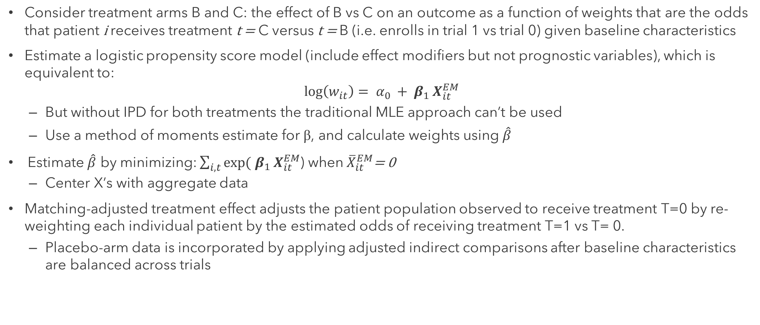
Background
Methods overview
Consider treatment arms B and C: the effect of B vs C on an outcome as a function of weights that are the odds that patient i receives treatment t = C versus t = B (i.e. enrolls in trial 1 vs trial 0) given baseline characteristics
Estimate a logistic propensity score model (include effect modifiers but not prognostic variables), which is equivalent to:
$$\log\left(w_{it}\right)= α_{0 }+ β_{1 }X_{it}^{EM}$$
    But without IPD for both treatments the traditional MLE approach can’t be used
    Use a method of moments estimate for β, and calculate weights using $\hat{β}$
Estimate $\hat{β}$ by minimizing: $\sum_{i,t}{exp⁡(}$ $β_{1 }X_{it}^{EM}$) when${ \overline{X}}_{it}^{EM}$= 0
    Center X’s with aggregate data
Matching-adjusted treatment effect adjusts the patient population observed to receive treatment T=0 by re-weighting each individual patient by the estimated odds of receiving treatment T=1 vs T= 0.
    Placebo-arm data is incorporated by applying adjusted indirect comparisons after baseline characteristics are balanced across trials

Slide 4
Background
Applications
Indirect comparisons are a key component of drug development plans and support defining product “value” because they enable therapies used in clinical practice and new therapies to be compared indirectly when there is a lack of head-to-head randomized controlled trials
Acceptance by regulatory and HTA bodies varies but inclusion of MAIC in submissions is increasing
  A 2019 search of NICE website found 21 appraisals including MAIC between 2014–2019 – 17 from 2017 or later
  Source: https://ispor.confex.com/ispor/euro2019/meetingapp.cgi/Paper/97251
  Review of CADTH technology assessments found 22 MAIC analyses between 2016 and 2022
  Source: https://www.valueinhealthjournal.com/article/S1098-3015%2821%2902789-3/fulltext
As a Stata user, how can I perform MAIC analyses?
  Likely to come up in my role in Health Economics and Outcomes Research for HTA submissions and possibly other types of regulatory submissions
  Need to be able QC other work – can review code and parallel code

Slide 5
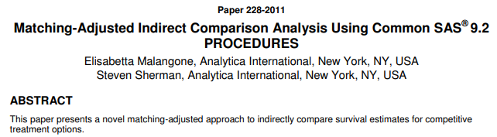
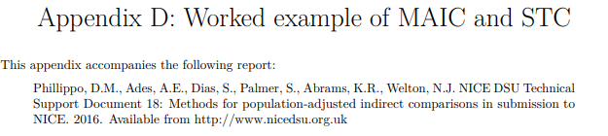
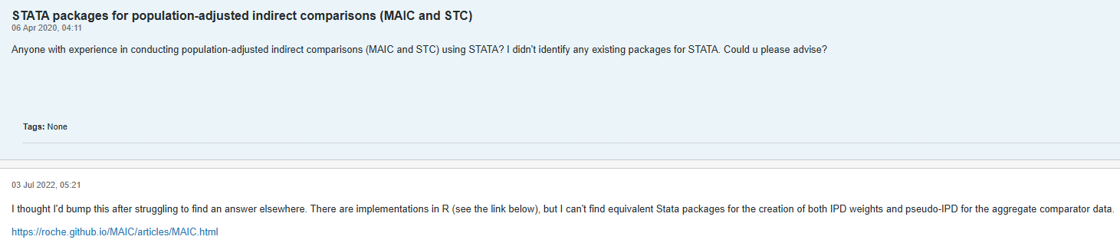
MAIC in statistical software
Example SAS code (2011):
Source: https://support.sas.com/resources/papers/proceedings11/228-2011.pdf
Worked example in R (2016):
Source: https://research-information.bris.ac.uk/ws/portalfiles/portal/94868465/Appendix_D_Worked_example_of_MAIC_and_STC.pdf
Where is the Stata package?
(2020)
(2022)
Source: https://www.statalist.org/forums/forum/general-stata-discussion/general/1544952-stata-packages-for-population-adjusted-indirect-comparisons-maic-and-stc

Slide 6
Worked example
Data
Simulate data for two trials – A vs B and A vs C:
  2 variables: age and gender - age is an effect modifier and gender a prognostic variable
  The AB trial (N(AB) = 500): ages 45 to 75, 64% females
  The AC trial (N(AC) = 300): ages 45 to 55, 80% females
  Data for the AC trial is aggregated (as if it were reported in a publication)
The MAIC uses IPD of AB trial and aggregate AC data to compare B to C
  Mean (SD) age = 49.80667 (3.082363)
Generate simulated data from Phillippo et al. (2016) using R code provided in appendix
  R code includes the seed value allowing for exact replication of data for a direct test of Stata vs R
  Can simulated data with the same parameters in Stata but not the exact same data
Source: Phillippo, D.M., Ades, A.E., Dias, S., Palmer, S., Abrams, K.R., Welton, N.J. NICE DSU Technical Support Document 18: Methods for population-adjusted indirect comparisons in submission to NICE. Appendix D. 2016. Available from http://www.nicedsu.org.uk

Slide 7
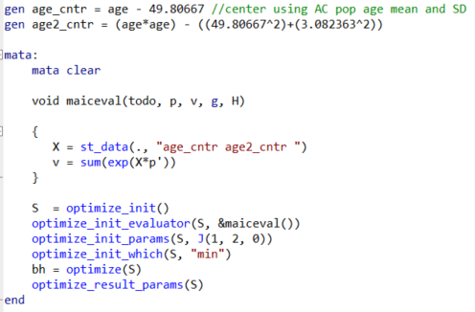
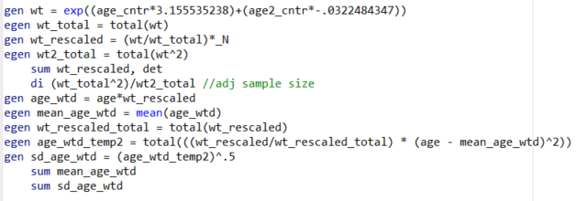

Solving the optimization problem using MATA
objfn <- function(a1, X){
sum(exp(X %*% a1))
}
gradfn <- function(a1, X){
colSums(sweep(X, 1, exp(X %*% a1), "*"))
}
X.EM.0 <- sweep(with(AB.IPD, cbind(age, age^2)), 2,
with(AC.AgD, c(age.mean, age.mean^2 + age.sd^2)), '-’)
print(opt1 <- optim(par = c(0,0), fn = objfn, gr = gradfn,
X = X.EM.0, method = "BFGS"))
a1 <- opt1$par
wt <- exp(X.EM.0 %*% a1)
wt.rs <- (wt / sum(wt)) * N_AB # rescaled weight
sum(wt)^2/sum(wt^2)
AB.IPD %>%
mutate(wt) %>%
summarise(age.mean = weighted.mean(age, wt),
age.sd = sqrt(sum(wt / sum(wt) * (age - age.mean)^2))
)
AC.AgD[, c("age.mean", "age.sd")]
Source: Phillippo, D.M., Ades, A.E., Dias, S., Palmer, S., Abrams, K.R., Welton, N.J. NICE DSU Technical Support Document 18: Methods for population-adjusted indirect comparisons in submission to NICE. Appendix D. 2016. Available from http://www.nicedsu.org.uk

Slide 8
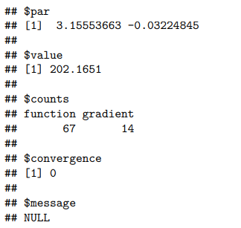
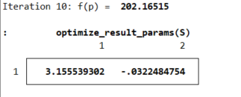
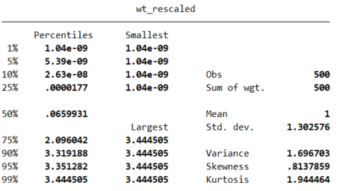
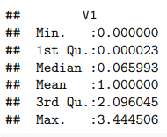




Comparing R and Stata results
Outputs
R
Stata
2)
1. Parameter estimates
1)
2. Objective function value at minimum
2)
1)
3a)
3b)
3a)
3c)
3. Distribution of rescaled weights
3b)
3c)
4. Adjusted sample size
4)
4)
5. Weighed population summary stats
5)
5)
Source: Phillippo, D.M., Ades, A.E., Dias, S., Palmer, S., Abrams, K.R., Welton, N.J. NICE DSU Technical Support Document 18: Methods for population-adjusted indirect comparisons in submission to NICE. Appendix D. 2016. Available from http://www.nicedsu.org.uk

Slide 9

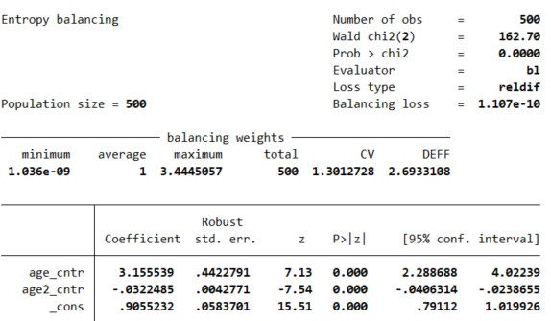
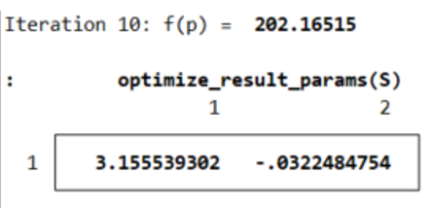
An aside
Balancing population characteristics sounds like entropy balancing?
Yes. In fact, entropy balancing is another approach that yields same weights: Phillippo DM, Dias S, Ades AE, Welton NJ. Equivalence of entropy balancing and the method of moments for matching-adjusted indirect comparison. Res Synth Methods. 2020 Jul;11(4):568-572.
Stata has entropy balancing (ebalfit or ebalance) commands, and they can be adapted to MAIC:
    Use centered population characteristics as targets

Slide 10
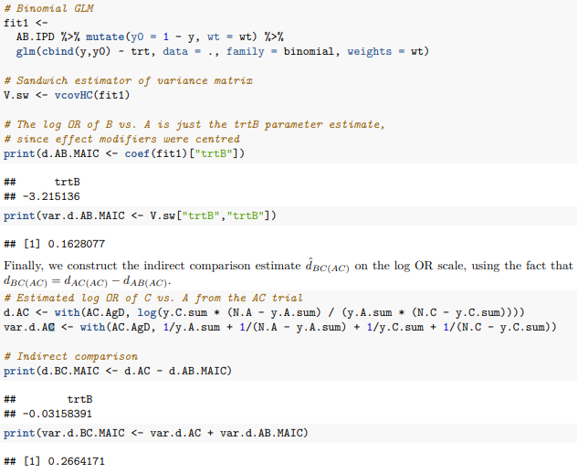
Indirect comparison: the relative effect of B vs A and B vs C in the AC population
R example
Source: Phillippo, D.M., Ades, A.E., Dias, S., Palmer, S., Abrams, K.R., Welton, N.J. NICE DSU Technical Support Document 18: Methods for population-adjusted indirect comparisons in submission to NICE. Appendix D. 2016. Available from http://www.nicedsu.org.uk

Slide 11

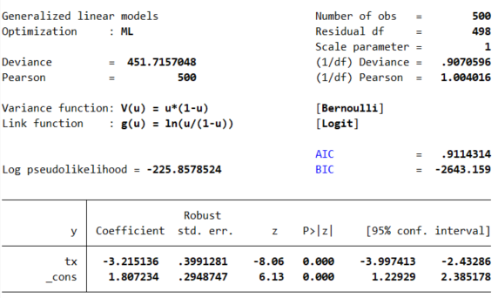
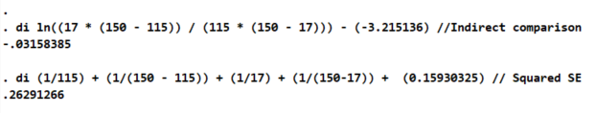
Indirect comparison: the relative effect of B vs A and B vs C in the AC population
Stata version

Slide 12
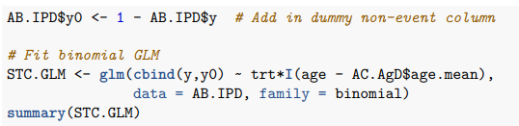

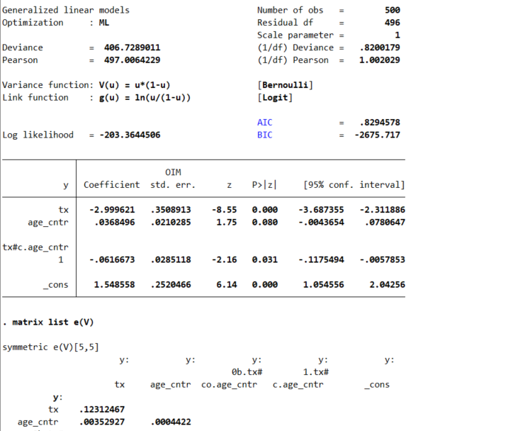
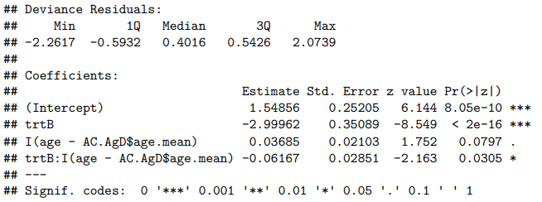
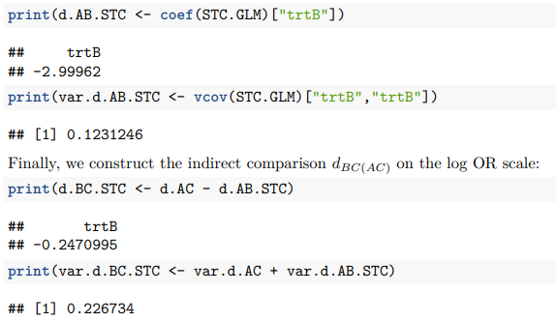

Another Aside: simulated treatment comparison worked example
An alternative approach to MAIC
Source: Phillippo, D.M., Ades, A.E., Dias, S., Palmer, S., Abrams, K.R., Welton, N.J. NICE DSU Technical Support Document 18: Methods for population-adjusted indirect comparisons in submission to NICE. Appendix D. 2016. Available from http://www.nicedsu.org.uk

Slide 13
Comparison of indirect effect estimates
Indirect comparison estimates (95% CIs) by method and software
 | R | Stata
B vs A: MAIC | -3.215 (-4.006, -2.424) | -3.215 (-3.997, -2.433)
B vs A: STC | -3.000 (-3.687, -2.312) | -3.000 (-3.687, -2.312)
B vs C: MAIC | -0.032 (-1.043, 0.980) | -0.032 (-1.037, 0.973)
B vs C: STC | -0.247 (-1.180, 0.686) | -0.247 (-1.180, 0.686)
Note: the true effect size of B vs A is -2.885 and the true effect size of C vs B is -0.400
Source: Phillippo, D.M., Ades, A.E., Dias, S., Palmer, S., Abrams, K.R., Welton, N.J. NICE DSU Technical Support Document 18: Methods for population-adjusted indirect comparisons in submission to NICE. Appendix D. 2016. Available from http://www.nicedsu.org.uk

Slide 14
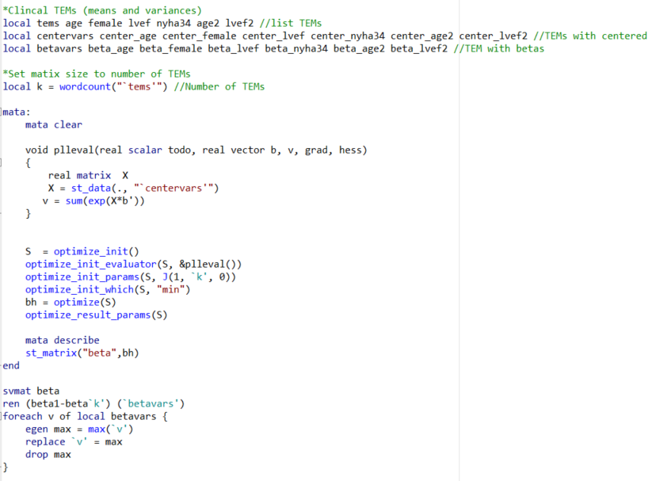
An application of MAIC
Using MATA approach in practice

Slide 15

Where is the MAIC Stata command?
Do we need one?
Stata has the functionality to estimate the parameters needed for MAIC calculations in multiple ways with commands/packages that already exist (e.g., MATA, ebalfit, ebalance)
An MAIC specific command could help with the arithmetic of calculating weights and the indirect comparison of hazard ratios, odds ratios, etc. which was tedious and potentially error prone
Maybe a Stata command will be available soon?
    From a 2023 Northern European Stata Conference presentation:
Source: https://www.stata.com/meeting/northern-european23/slides/Northern_Europe23_Crowther.pdf

Slide 16
Thank you
Eric Barrette, PhD
Senior Director, Health Economics and Outcomes Research
Medtronic
eric.barrette@medtronic.com

