Slide 1
Creating Likert-Scale Visualizations: An Approach Using Stata and Tableau
By: Sergio Cervantes, M.A.

Slide 2
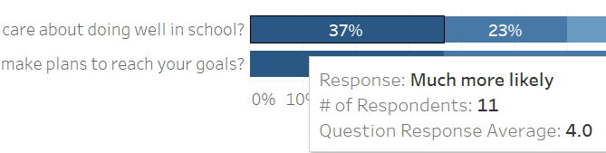
Goal: Likert-Scale Visualization (Done with 10-Step Process)

Slide 3
Be sure to take note of what numeric values are tied to responses!
Example #1: Strongly Disagree → Disagree → Neither Agree nor Disagree → Agree → Strongly Agree
(Strongly Disagree typically takes a value of 1, while Strongly Agree typically takes a value of 5)
Example #2: None of the Time → Some of the Time → Most of the Time → All of the Time
(None of the Time typically takes a value of 1, while All of the Time typically takes a value of 4)

Slide 4
Be sure to take note of what numeric values are tied to responses!
Example #1: Strongly Disagree → Disagree → Neither Agree nor Disagree → Agree → Strongly Agree
(Strongly Disagree typically takes a value of 1, while Strongly Agree typically takes a value of 5)
Example #2: None of the Time → Some of the Time → Most of the Time → All of the Time
(None of the Time typically takes a value of 1, while All of the Time typically takes a value of 4)

Slide 5
Step 1 – export your cleaned data using Stata
syntax line: export excel using “file path”, firstrow(variables)
If you have categorical labeled variables with a numeric basis from your .dta file, Stata keeps the variable labels and gets rid of the numeric components
If there are some variables that retain their numeric type after exporting, it can be handled using import

Slide 6
Step 1 – export your cleaned data using Stata
syntax line: export excel using “file path”, firstrow(variables)
If you have categorical labeled variables with a numeric basis from your .dta file, Stata keeps the variable labels and gets rid of the numeric components
If there are some variables that retain their numeric type after exporting, it can be handled using import

Slide 7
Step 1 – export your cleaned data using Stata
syntax line: export excel using “file path”, firstrow(variables)
If you have categorical labeled variables with a numeric basis from your .dta file, Stata keeps the variable labels and gets rid of the numeric components
If there are some variables that retain their numeric type after exporting, it can be handled using import

Slide 8
Step 2 – import the data using Stata
syntax line: import excel “file path”, firstrow allstring clear
The allstring component is helpful to ensure that all your variables are treated as strings
The purpose of using import for the same excel file we export is to facilitate the reshaping we will need to do to obtain a simplified structure so we can use reshape

Slide 9
Step 2 – import the data using Stata
syntax line: import excel “file path”, firstrow allstring clear
The allstring component is helpful to ensure that all your variables are treated as strings
The purpose of using import for the same excel file we export is to facilitate the reshaping we will need to do to obtain a simplified structure so we can use reshape

Slide 10
Step 2 – import the data using Stata
syntax line: import excel “file path”, firstrow allstring clear
The allstring component is helpful to ensure that all your variables are treated as strings
The purpose of using import for the same excel file we export is to facilitate the reshaping we will need to do to obtain a simplified structure so we can use reshape

Slide 11
Step 3 – do a wide-to-long reshape
syntax line: reshape long Question_, i(ID) j(Question)
We will reshape variables Question_1, Question_2, … Question_#
We mainly need to keep our unique ID variable, our group variable(s), and the item variables we’d like to include in our visualization
It’s good to make tabulations of all the variables needing reshaping to identify possible values and any potential spelling deviations

Slide 12
Step 3 – do a wide-to-long reshape
syntax line: reshape long Question_, i(ID) j(Question)
We will reshape variables Question_1, Question_2, … Question_#
We mainly need to keep our unique ID variable, our group variable(s), and the item variables we’d like to include in our visualization
It’s good to make tabulations of all the variables needing reshaping to identify possible values and any potential spelling deviations

Slide 13
Step 3 – do a wide-to-long reshape
syntax line: reshape long Question_, i(ID) j(Question)
We will reshape variables Question_1, Question_2, … Question_#
We mainly need to keep our unique ID variable, our group variable(s), and the item variables we’d like to include in our visualization
It’s good to make tabulations of all the variables needing reshaping to identify possible values and any potential spelling deviations

Slide 14
Step 3 – do a wide-to-long reshape
syntax line: reshape long Question_, i(ID) j(Question)
We will reshape variables Question_1, Question_2, … Question_#
We mainly need to keep our unique ID variable, our group variable(s), and the item variables we’d like to include in our visualization
It’s good to make tabulations of all the variables needing reshaping to identify possible values and any potential spelling deviations

Slide 15

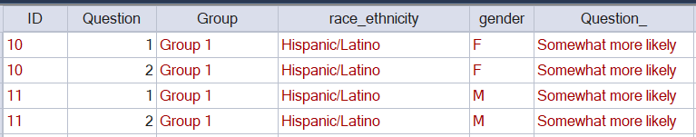
Before and After Reshaping
Before Reshaping
After Reshaping

Slide 16
Step 4 – export an excel file to open in Tableau
Double sort (syntax line: sort ID Question) to organize the data
Using the Question variable, label each value with its corresponding question
From the string value column, we can drop blanks which represent non-responses
Tabulate the string value column to determine all possible string values and generate a numeric variable version of it (i.e. “Agree” → 4)

Slide 17
Step 4 – export an excel file to open in Tableau
Double sort (syntax line: sort ID Question) to organize the data
Using the Question variable, label each value with its corresponding question
From the string value column, we can drop blanks which represent non-responses
Tabulate the string value column to determine all possible string values and generate a numeric variable version of it (i.e. “Agree” → 4)

Slide 18
Step 4 – export an excel file to open in Tableau
Double sort (syntax line: sort ID Question) to organize the data
Using the Question variable, label each value with its corresponding question
From the string value column, we can drop blanks which represent non-responses
Tabulate the string value column to determine all possible string values and generate a numeric variable version of it (i.e. “Agree” → 4)

Slide 19
Step 4 – export an excel file to open in Tableau
Double sort (syntax line: sort ID Question) to organize the data
Using the Question variable, label each value with its corresponding question
From the string value column, we can drop blanks which represent non-responses
Tabulate the string value column to determine all possible string values and generate a numeric variable version of it (i.e. “Agree” → 4)

Slide 20
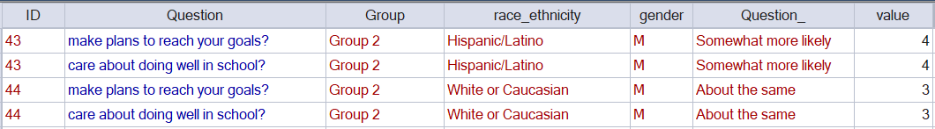
Structure of Excel File to open in Tableau

Slide 21
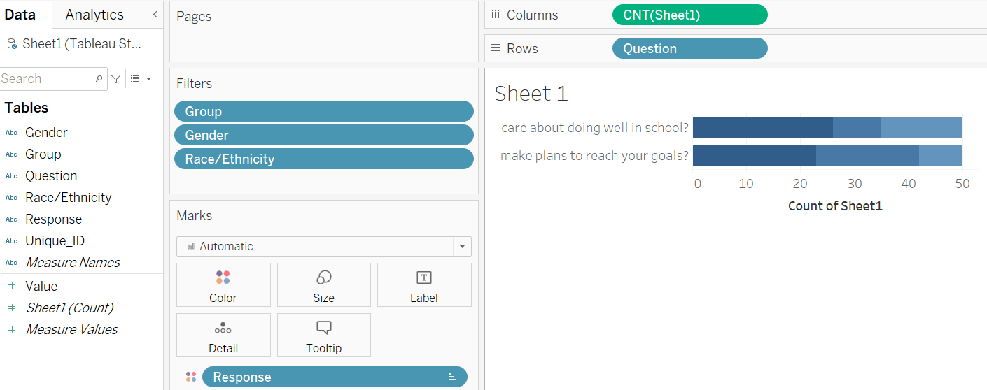
Step 5 – Click and Drag the Key Variable Pills into Tableau

Slide 22
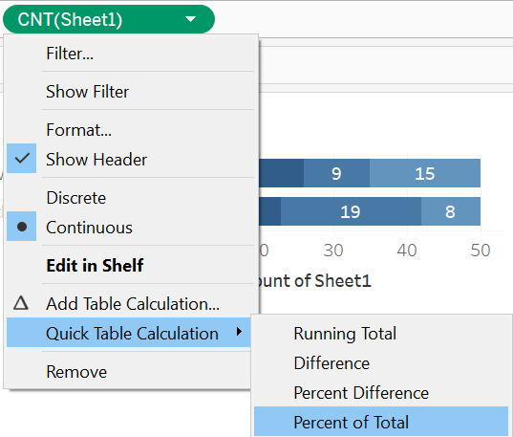
Step 6 – Modify the Table Calculation Column Variable
First, Right-click the Column Pill, and make it a Percent of Total Quick Table Calculation
Right-click the Column Pill again, click Compute Using, then select the Response variable
Next, Click Analysis on the top, then click Show Mark Labels to see Percentages

Slide 23
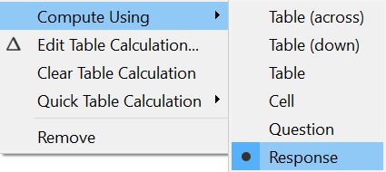
Step 6 – Modify the Table Calculation Column Variable
First, Right-click the Column Pill, and make it a Percent of Total Quick Table Calculation
Right-click the Column Pill again, click Compute Using, then select the Response variable
Next, Click Analysis on the top, then click Show Mark Labels to see Percentages

Slide 24
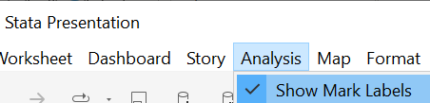
Step 6 – Modify the Table Calculation Column Variable
First, Right-click the Column Pill, and make it a Percent of Total Quick Table Calculation
Right-click the Column Pill again, click Compute Using, then select the Response variable
Next, Click Analysis on the top, then click Show Mark Labels to show Percentages

Slide 25
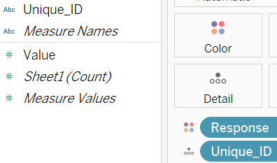
Step 7 – Generate Counts for Respondents
First, drag the ID variable into the Detail box
Then, right-click the ID variable, click Measure, then select Count (Distinct)

Slide 26
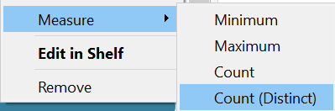

Step 7 – Generate Counts for Respondents
First, drag the ID variable into the Detail box
Then, right-click the ID variable, click Measure, then select Count (Distinct)

Slide 27
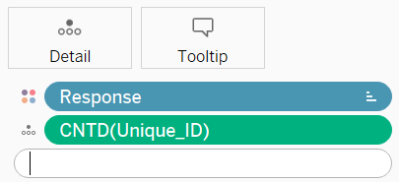
Step 8 – Generate Question Response Averages
We will need to type in an Exclude LOD (Level of Detail) Expression
At the automatic level, Tableau will give the averages by Response (i.e. the average for “About the same” will be 3 for each question)
With the LOD expression, we will gather Question Response Averages instead of Averages for the individual Responses
Type {EXCLUDE [Response]: AVG([Value])}, right-click the green pill, then change the ATTR into a Sum Measure

Slide 28
Step 8 – Generate Question Response Averages
We will need to type in an Exclude LOD (Level of Detail) Expression
At the automatic level, Tableau will give the averages by Response (i.e. the average for “About the same” will be 3 for each question)
With the LOD expression, we will gather Question Response Averages instead of Averages for the individual Responses
Type {EXCLUDE [Response]: AVG([Value])}, right-click the green pill, then change the ATTR into a Sum Measure

Slide 29
Step 8 – Generate Question Response Averages
We will need to type in an Exclude LOD (Level of Detail) Expression
At the automatic level, Tableau will give the averages by Response (i.e. the average for “About the same” will be 3 for each question)
With the LOD expression, we will gather Question Response Averages instead of Averages for the Individual Responses
Type {EXCLUDE [Response]: AVG([Value])}, right-click the green pill, then change the ATTR into a Sum Measure

Slide 30
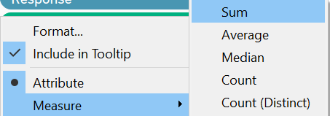
Step 8 – Generate Question Response Averages
We will need to type in an Exclude LOD (Level of Detail) Expression
At the automatic level, Tableau will give the averages by Response (i.e. the average for “About the same” will be 3 for each question)
With the LOD expression, we will gather Question Response Averages instead of Averages for the individual Responses
Type {EXCLUDE [Response]: AVG([Value])}, right-click the green pill, then change the ATTR into a Sum Measure

Slide 31

Step 9 – Modify the Tooltip to Include Key Information
First, click on Tooltip in the Marks box
Second, go to Insert and click any item you’d like inside the tooltip
Now, modify whatever written portions of the tooltip except the highlighted dark terms which represent the variables and/or calculations
Click OK

Slide 32

Step 9 – Modify the Tooltip to Include Key Information
First, click on the Tooltip box
Second, click Insert and click any item you’d like inside the tooltip
Now, modify whatever written portions of the tooltip except the highlighted dark terms which represent the variables and/or calculations
Click OK

Slide 33

Step 9 – Modify the Tooltip to Include Key Information
First, click on the Tooltip box
Second, go to Insert and click any item you’d like inside the tooltip
Now, modify whatever written portions of the tooltip except the highlighted dark terms which represent the variables and/or calculations
Click OK

Slide 34
Step 9 – Modify the Tooltip to Include Key Information
First, click on the Tooltip box
Second, go to Insert and click any item you’d like inside the tooltip
Now, modify whatever written portions of the tooltip except the highlighted dark terms which represent the variables and/or calculations
Click OK

Slide 35

Step 10 – Modify the Visual as Needed
To fix the sheet title, simply double-click on it and you can edit it
To format any part of the visual, you just need to right-click anywhere on the visual and click Format
Now, to modify Calculations in Format, go to Fields, then select a Field – most calculations can be fixed at the Pane level - Default option
To modify the axis, right click the percentage area and click Edit Axis

Slide 36
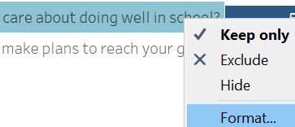
Step 10 – Modify the Visual as Needed
To fix the sheet title, simply double-click on it and you can edit it
To format any part of the visual, you just need to right-click anywhere on the visual and click Format
Now, to modify Calculations in Format, go to Fields, then select a Field – most calculations can be fixed at the Pane level - Default option
To modify the axis, right click the percentage area and click Edit Axis

Slide 37
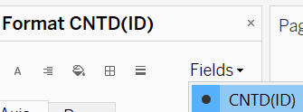
Step 10 – Modify the Visual as Needed
To fix the sheet title, simply double-click on it and you can edit it
To format any part of the visual, you just need to right-click anywhere on the visual and click Format
Now, to modify Calculations in Format, go to Fields, then select a Field – most calculations can be fixed at the Pane level - Default option
To modify the axis, right click the percentage area and click Edit Axis

Slide 38

Step 10 – Modify the Visual as Needed
To fix the sheet title, simply double-click on it and you can edit it
To format any part of the visual, you just need to right-click anywhere on the visual and click Format
Now, to modify Calculations in Format, go to Fields, then select a Field – most calculations can be fixed at the Pane level - Default option
To modify the axis, right click the percentage area and click Edit Axis

Slide 39
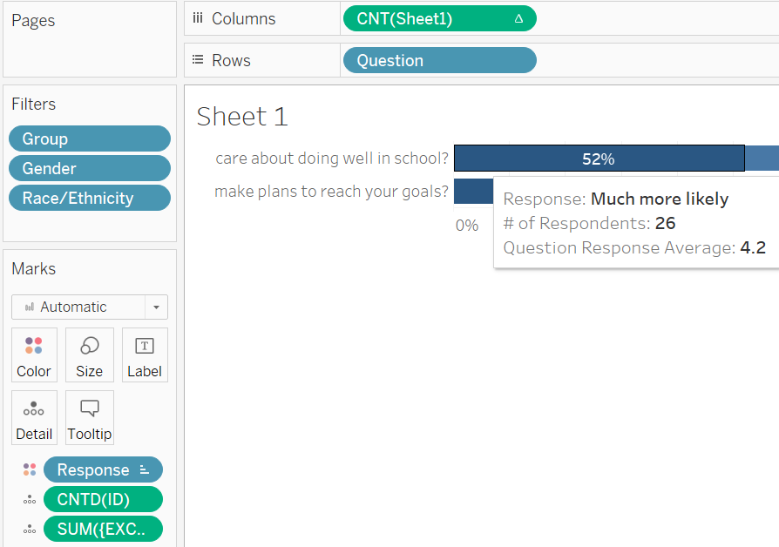
Final Result – You can use this as a sheet in a dashboard!

Slide 40

Questions?

