Slide 1
Program monitoring of educational tablet-based interventions using topic modeling in Stata
Abraham Bahlibi, Imagine Worldwide
Stata Conference
July 21st, 2023

Slide 2
Table of Contents
Introduction
Background
Pilot Context and Methodology
Process is Stata
Results
Takeaways and Challenges
References

Slide 3
Introduction
The Context
Following a phase of rigorous efficacy research, Imagine Worldwide is working with partners to scale a tablet-based education intervention in several Sub-Saharan African countries. The program is expanding from dozens to hundreds and soon thousands of schools in these locations.
The Problem
Program monitoring is critical for maintaining the quality of implementation and outcomes for the educational tablet-based intervention as we scale.
During program monitoring, we collect large amounts of qualitative data and need a method for analyzing it quickly to make it actionable.
Pilot Purpose
To test using topic modeling to support program monitoring by summarizing key topics in large datasets of text observations that were logged during the implementation of the tablet program.
To identify implementation issues by using the “LDAgibbs” Stata package, which runs the topic modeling algorithm, while also testing to see how well the Stata package generates topics to assist monitoring.

Slide 4
THE LEARNING CRISIS
Talent is universal, but opportunity is not
Over 500M children do not attain
basic literacy and numeracy skills globally
ENORMOUS NEED FOR SCALABLE SOLUTIONS
LOW PERFORMANCE OF SCHOOLS
89%
450M
of children in Sub-Saharan Africa are unable to read and understand a simple text by the age of 10*
children will be born in Africa in the 2020s** and by 2030 young Africans will be 42% of global youth***
Notes:
*World Bank The State of Global Learning Poverty: 2022 Update
** UN Population Projections
*** World Economic Forum

Slide 5
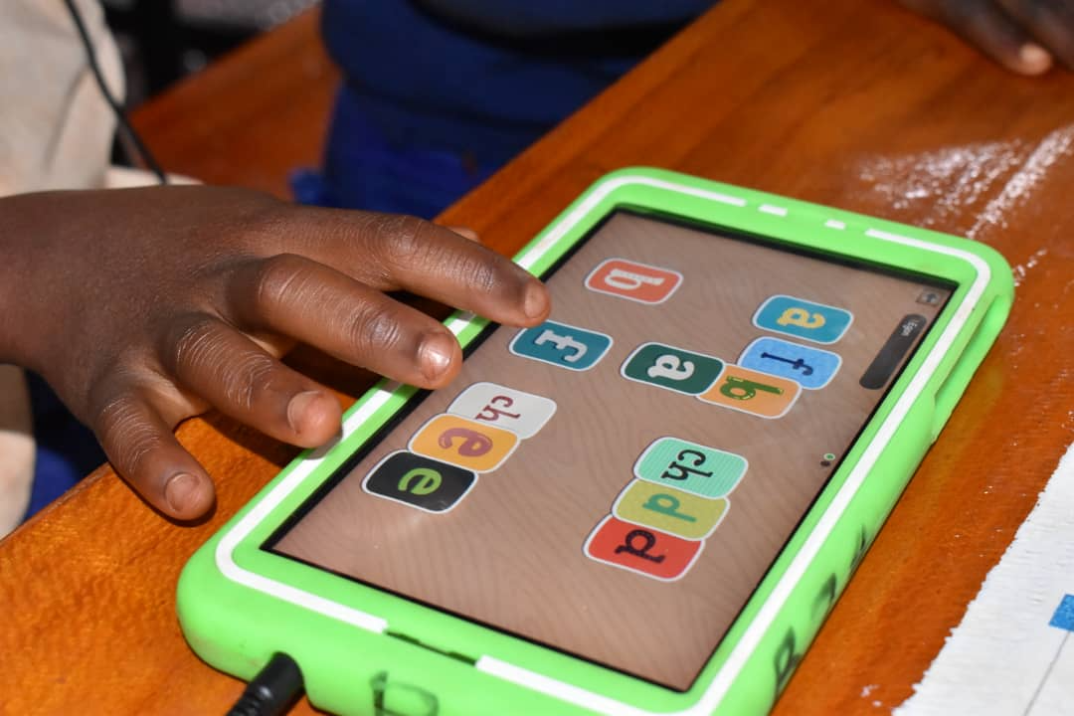
Description of the Tablet Program
Research-based, award-winning software by onebillion
Child centered, personalized learning
Provides instruction in foundational literacy and numeracy
Available so far in Chichewa, Kiswahili, English, and French
For use primarily with Grades 1-4
Supplemental to normal school instruction
Tablet sessions run 30-60 min daily; 4-5 sessions per day are possible
Adults play a facilitative role
Tablets are charged using solar power
There are local variations in how the program is implemented

Slide 6
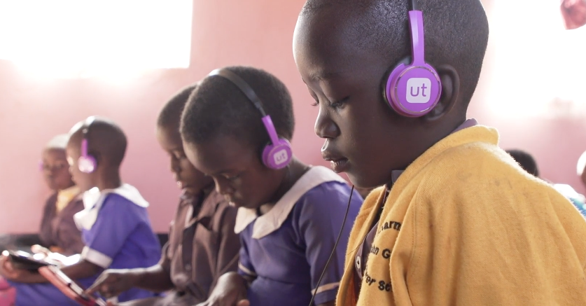
THE RESULTS
Our rigorous research* on the tablet program has shown strong gains in literacy and numeracy, plus stakeholders report increased student enrollment and improved attendance, engagement, and confidence as learners
4.2
72%
Gender
Equity
50%
months of additional literacy learning after 13 months of disrupted learning due to COVID
attained emergent or fluent mathematics status after 13 months
boys and girls had similarly positive results
more children advanced on national literacy benchmarks
* Find research studies on our website: https://www.imagineworldwide.org/resources/

Slide 7
Pilot Context
Setting and implementation
19 schools in Liberia and 13 schools in Ghana
Average learners per tablet session
Ghana: ~28 learners (min= 3 and max =62)
Liberia: ~25 learners (min=3 and max =89)
Learners are given their own tablet to work on for the session
Teachers are trained by our implementation partners on how to run the program
Program monitoring activities
Each of the schools has a dedicated field officer
The field officer performs weekly visits to observe the implementation of the tablet program
The field officer also is tasked with weekly submission of a tablet program monitoring survey
Data from the tablet program monitoring survey is what is used for our analysis
Date range for the pilot monitoring survey data: October 11th, 2021 - ongoing

Slide 8
Monitoring Methodology
Program monitoring survey
Purpose: For field officers to log observations from their site visits. Field officers observe the classroom session of the tablet program, fill out the program monitoring survey, and uploads the surveys to the internet. Field officers are prompted to make comments about 6 types of observations:
Tablet use by learners
Session setup
Environment of the classroom
Closing the session
Technical issues
Other issues
Data collection: Field officers use a mobile data collection application on a mobile device to log survey responses.
After the mobile device uploads the data to the internet, it is then downloaded as an excel file.
The excel file contains field officer name, country name, school name, timestamps, and open-ended responses from field officers’ observations.

Slide 9
Topic Modeling Methodology
What is topic modeling/Latent Dirichlet Allocation (LDA)?
LDA is a natural language processing and machine learning technique that aims to discover main themes or “topics” within a collection of documents. In this case, the documents are comments that were logged by field officers.
LDA groups words from the comments into topics based on how frequently certain words appear together.
LDA helps us understand a large collection of comments without having to read each one.
Assumptions and limitations
LDA assumes that the collection of comments contains a mixture of topics.
LDA also assumes that the order of words in a comment does not matter and only considers the frequency of words.
Topic modeling does not possess semantic understanding.

Slide 10
Procedure in Stata
Step 1: Import the tablet monitoring survey excel file into Stata.
Step 2: Make sure comments are in one column.
Step 3: Use “stritrim” command on the comments variable to get rid of additional spaces. Also, use the “lower” command to make all words in lowercase.
Step 4: Use the “txttool” command to remove punctuations.
Step 5: Drop comments that have no context. For example, comments that only have “N/A” or “OK” were dropped.
Step 6: Load in a stopwords.txt file that contains stop words. Stop words are articles, prepositions, pronouns, conjunctions, and common verbs. We then use the txttool command to load in the .txt file to exclude the stop words from the analysis.
Step 7: Run the LDAgibbs command.
Before running the command, we must specify how many topics we think there are in the data. We selected for LDAgibbs to identify 5 topics for our analysis.
LDAgibbs first randomly assigns each word to a topic. It then makes many iterations and updates the probability a word belongs to each of the topics.

Slide 11
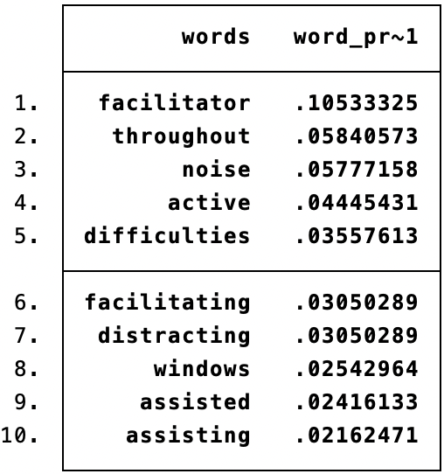
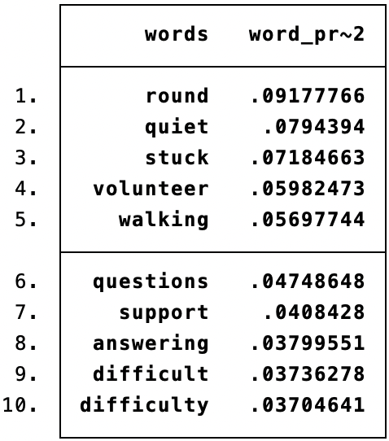
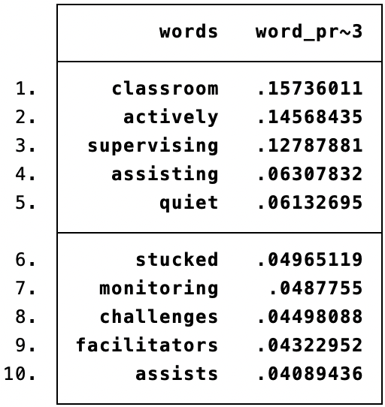
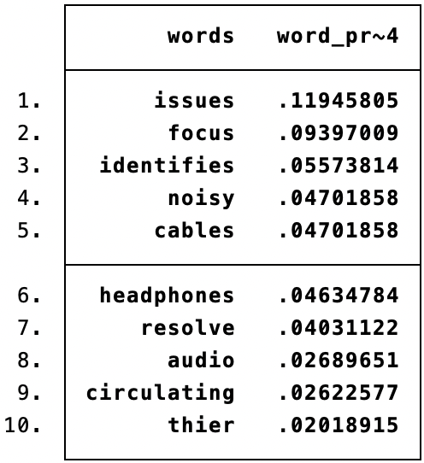
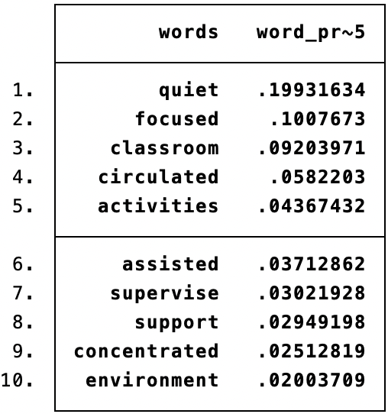
Results
Top 10 words associated with each of the 5 topics
The results are from 524 tablet use observations from Ghana
Overall program performance
Topic 2, topic 3, topic 5: support, assisting, and supervise
Program issues
Topic 1: Windows and noise
Topic 4: Issues, noisy, cables, and headphones

Slide 12
Results
Top comments from topic 1: Learners near the windows were making noise
“Students from the JHS were standing by windows talking which was a bit distracting the tablets sessions. The facilitator was present and supervision the tablet session.”
“Noise from others students, students standing by the windows.”
Top comments from topic 2: Teachers actively supervising learners on the tablets
“Teacher and volunteer walking round to observe and give assistance to students who are stuck in answering questions or challenge in hearing.”
“Very quiet and concentrated class with teacher and volunteer walking round to support interns hearing and stuck in answering questions .”
Top comments for topic 4: Faulty audio cables led to headphones not working. This led to many tablets producing sound from their speakers, which made the classrooms noisy
“As a result of audio cables being faulty, session was noisy”
“The session continued to be noisy due to faulty audio cables”

Slide 13
Takeaways and Challenges
Takeaways
Topic modeling worked as expected
We made inferences from the topic modeling results and identified program performance and issues that were reported in the field officers
We followed up with the monitoring team and shared the results from topic modeling
Challenges
Not enough data yet
Pilot data was limited to 524 observations. Topic modeling groups words into topics more clearly with more observations
Comments are not long enough
It is recommended that comments are at least 50–100. We are considering feasible methods for obtaining meaningful longer comments.

Slide 14
References
Schwarz, C. (2018). ldagibbs: A command for topic modeling in Stata using latent Dirichlet
allocation. The Stata Journal, 18(1), 101-117.
Levesque, K., Bardack, S., Chigeda. A. (2020). Tablet-based learning for foundational literacy and math: An
8-month RCT in Malawi. Research report prepared for Imagine Worldwide. Retrieved from:
https://www.imagineworldwide.org/wp-content/uploads/An-8-month-RTC-in-Malawi_Final-Report_
Jan-2020.pdf
Pitchford, N. J., Hubber, P. J., & Chigeda, A. (2017). Unlocking Talent: Improving Learning Outcomes of
Primary School Children in Malawi. Unpublished report.
Wencker, T. (2019). Policy Brief: Text Mining. German Institute for Development Evaluation. Retrieved from
https://www.deval.org/fileadmin/Redaktion/PDF/05-Publikationen/Policy_Briefs/2019_1_Text_Min
ing/DEval_Policy_Brief_Text_Mining_2019_EN.pdf

Slide 15
Stay connected with Imagine
Follow us on social media or sign up for our newsletter
imagineworldwide.org

