Slide 1
Using Stata for Q-methodology Studies
Noori Akhtar-Danesh, PhD
McMaster University
Hamilton, Canada
E-mail: daneshn@mcmaster.ca

Slide 2
Outline
Introduction: what is Q-methodology & how it works?
Stata programs for Q-methodology analysis
  qconvert
  qfactor
  qpair

Slide 3
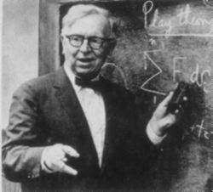
Q-methodology (QM): History
QM was introduced by William Stephenson in 1935 in a letter to Nature
He defined it as the “objective study of subjectivity” or a person's point of view on any matter of personal or social importance (McKeown and Thomas, 1988)

Slide 4
Goals in a Q-methodology study
To identify different patterns of thought (not necessarily their numerical distribution among the larger population)
The research emphasis is to understand how and why people think the way they do; not how many people think in a certain way

Slide 5
Four steps in a Q-study
A Q-study involves four steps:
    Developing the concourse
    Identifying a sample of representative statements from the concourse (Q-sample) and developing a Q-sort table
    Q-sorting activities (Data collection)
    Analysis and interpretation

Slide 6
QM: The Concourse
Concourse: Includes all statements related to ideas, feelings, concerns, and preferences about the topic of study
A concourse can be collected from
  Interviews, focus groups
  Commentaries from newspapers
  Literature review
  ??????

Slide 7
QM: Q-sample
Q-sample (Q-set) is a representative set of statements including all the major viewpoints, feelings, and preferences in the concourse
The statements in the Q-sample are numbered randomly
Then each statement is typed on a piece of paper (e.g., 3X5 cards) or used online!

Slide 8
Example 1:
Marijuana Legalization (ML)
Objective: To explore the salient viewpoints of the participants attending several QM workshops on marijuana legalization

Slide 9
Example 1:
Marijuana Legalization
Marijuana (Latin name of Cannabis sativa) is known to most people as grass, pot, or weed, mainly when referring to its recreational use
It may have great potential for the development of new drugs
On the other hand, cannabis smoke can
  induce unpleasant effects such as panic, paranoia, and hallucinations
  increase heart rate and lower blood pressure
  lead to amotivational syndrome
  adversely affect short-term memory and cognitive abilities in long-term users

Slide 10
Example1 :
Marijuana Legalization
Its growth, possession and consumption have been outlawed in most countries because of its negative aspects, mainly the risk of addiction
We searched WWW. to find positive and negative statements about the ML
Found > 50 statements (Concourse)
19 representative statements were selected (Q-sample) and used in the workshops

Slide 11
Example1: List of statements
The harms associated with marijuana are less than those associated with tobacco and alcohol, and they are not sufficient reason to justify making marijuana illegal
By legalizing marijuana, doctors may become part of the black market by handing out prescriptions to those who want it rather than those who need it
The reason that marijuana poses a health threat is because most people smoke it, and smoking anything is hazardous to your health
Taxpayers are forced to pay billions of dollars to prosecute and lock up people for having marijuana. If marijuana were legal, this money, plus tax revenues from marijuana sales, could be used for other purposes such as education or health care
Marijuana does not cause violence. In fact, people who are high on marijuana tend to be relaxed, mellow, and too happy to want to fight.
.
.
.

Slide 12
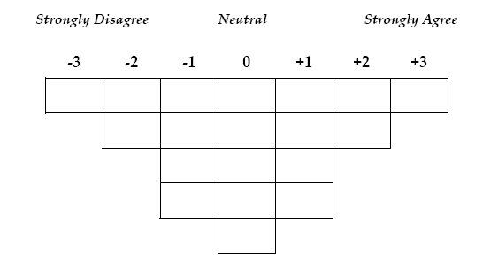
Q-Sort table (scale)
When the Q-sample is identified a quasi-normal grid (scale) is developed for data collection..
The scale is spread across the top of a flat area which may range from -3 to +3,
-4 to +4, .., or -6 to +6
This table (Q-sort table) is used for data collection

Slide 13
A Completed Q-Sort

Slide 14
Analysis & Interpretation
A by-person factor analysis (FA) is used for analysis
In by-person FA, the analysis is not performed by variable, trait, or statement, but rather by person
As a result, participants with similar opinions (Q-sorts) correlate with each other to form a factor
Because each completed Q-sort represents one point of view, a group of similar Q-sorts, a factor, ultimately represent a common viewpoint

Slide 15
Analysis & Interpretation
Factors are usually named based on their distinguishing statements
A distinguishing statement for a factor is a statement that its score for the factor is significantly different from its scores from the other factors
Consensus statement: A statements with similar scores between all factors

Slide 16
Factor Interpretation
To interpret a factor a synthetic Q-sort is created based on its factor scores
Each synthetic Q-sort is then interpreted to reveal the viewpoint represented by the factor
Particular attention is given to the distinguishing statements and to those that receive extreme scores

Slide 17
ML dataset: Participants & data organization
P-set: 40 participants from different Q-methodology workshops sorted the statements
The raw data were entered into Stata and qconvert was used to convert raw data to usable data for analysis by qfactor

Slide 18
A Completed Q-Sort

Slide 19
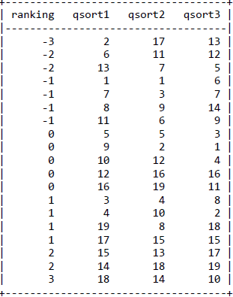
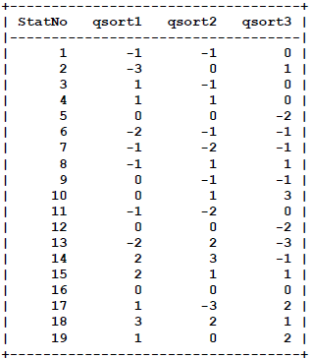
qconvert
qconvert qsort*, save(newdata)

Slide 20
Step 4:
Analysis & Interpretation
There are several programs available for analysis: PCQ, PQMethod, and KADE
However, these programs have limited options for factor extraction and factor rotation
Their options include only PCA and centroid factor extractions and varimax and manual factor rotations

Slide 21
qfactor

Slide 22
qfactor

Slide 23
qfactor: Results

Slide 24
Stored files
qfactor stores two matrices that can be retrieved and used in subsequent analysis:
r(fctrldngs): its columns includes variables such as Q-sort number, unrotated and rotated factor loadings, uniqueness and communality of each Q-sort, and Factor which indicates which Q-sort was loaded on what factor
r(fctrscrs): it stores factor scores for all statements. This matrix contains z-scores and ranked scores for the extracted factors

Slide 25
Example 2: Evaluation of an interprofessional education (IPE) program in anatomy

Slide 26
Example 2: Evaluation of an interprofessional education program in anatomy
An IPE program in anatomy started at McMaster University in 2009
The 10-week program involved lectures, hands on gross anatomy dissection, and focus group (feedback)
The students were from different disciplines including:
  Doctor of Medicine (MD), Midwifery (MW), Occupational Therapy (OT), Physician’s Assistant (PA), Physiotherapy (PT), and Registered Nurse (RN)

Slide 27
Background
The students evaluated the effectiveness of the program since 2011
Traditionally, using a Likert scale survey, the results were extremely positive, providing no specific hint for improvement
Purpose: we used a Q study to understand the spectrum of student perceptions/beliefs about the course and their interprofessional experience

Slide 28
Methods
Q-sample
Statements derived from qualitative feedback of previous years
43 statements reflected three themes:
  Interprofessional education
  Course structure
  Course content

Slide 29
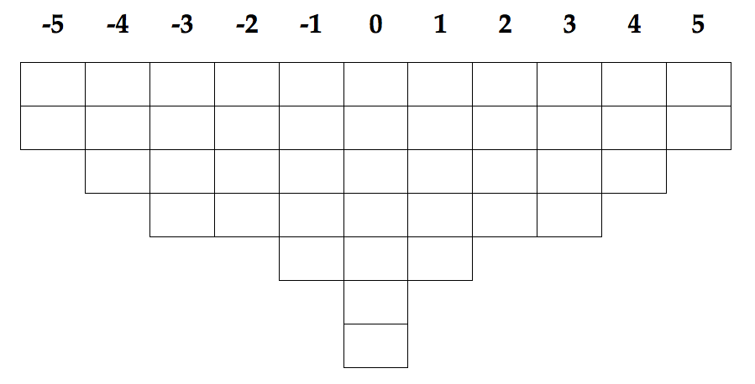
Methods
Q-Sort table
Least Agree
Neutral
Most Agree

Slide 30
Methods
Analysis
Analysis using qfactor:
qfactor qsort*, nfa(3) ext(pcf) es(0.8) min

Slide 31
Results
Anatomy
IPE Enthusiasts
Skeptical IPE Anatomists
n=2
Study Group
(N = 26)
Group 1
n=18
Group 3
Group 2
n=6
Practical
IPE Advocates
Notes:
Visual of how Q methodology breaks up the opinions and views of everyone in the study group
Discuss the GOAL of Q methodology, which is to gain an understanding of all of the viewpoints that exist within a population, not to understand the proportion of a population who believes each
Q methodology identifies all the unique viewpoints within a group.

Slide 32
Factor 1: Anatomy IPE enthusiasts
Distinguishing Statements
# | Statement | Anatomy IPE enthusiasts | Practical IPE advocates | Skeptical IPE anatomists
12 | Different members of my team brought different anatomical knowledge and they guided me through the material I was not comfortable with | 4 | 1 | -5
43 | Because of this course, I think I will be a much stronger advocate for interprofessional teams in the future | 2 | 5 | 0
9 | My interprofessional group integrated everyone’s profession, as much as possible, into each case | 1 | -3 | 4
20 | Sometimes I thought it was hard to learn from a cadaver with seven or eight people | -1 | 4 | 3
25 | I think a lot of the benefits of working with the interprofessional team would still occur if I had worked in a group of students from my program only. Working as part of a team is the important part – it does not matter if it is an interprofessional team or not | -2 | -5 | 3
4 | I did not get a fair chance at the cadaver during the dissections | -4 | 1 | 3
37 | I felt that certain students dominated the dissection and prevented my learning | -4 | 2 | 2

Slide 33
Factor 3: Skeptical IPE Anatomists
Distinguishing Statements
# | Statement | Anatomy IPE enthusiasts | Practical IPE advocates | Skeptical IPE anatomists
14 | I found the presentations about the different professions really valuable | 0 | 0 | 5
11 | I found that interdisciplinary collaboration was not important for some cases | -2 | 0 | 4
9 | My interprofessional group integrated everyone’s profession, as much as possible, into each case | 1 | -3 | 4
25 | I think a lot of the benefits of working with the interprofessional team would still occur if I had worked in a group of students from my program only. Working as part of a team is the important part – it does not matter if it is an interprofessional team or not | -2 | -5 | 3
30 | Learning with students from different disciplines helped me gain a solid understanding of my role in the context of other health care professionals | 1 | 2 | -3
40 | I better understand the limitations of my scope of practice as a result of working with other members of my interprofessional group | 0 | -1 | -5
12 | Different members of my team brought different anatomical knowledge and they guided me through the material I was not comfortable with | 4 | 1 | -5

Slide 34
Consensus Statements
# | Statement | Anatomy IPE enthusiasts | Practical IPE advocates | Skeptical IPE anatomists
31 | I felt that certain students dominated the dissection and prevented my learning | 2 | 2 | 2
7 | Informal conversations with my group members helped me build an understanding of the different professional roles | 3 | 3 | 2
41 | As a result of this course, I will collaborate more in the workplace | 1 | 0 | 0
27 | I felt that I was a burden to certain student’s learning when I tried to involve the rest of the interdisciplinary team | -4 | -2 | -2
26 | I felt that doing dissection was a waste of time | -5 | -5 | -4

Slide 35
Qpair for the analysis of paired Q-sorts

Slide 36
Qpair for the analysis of paired Q-sorts

Slide 37
Qpair: An example
Person-Organization (P-O) fit
This study included 50 Information technology (IT) professionals with their views on person-organization (P-O) fit regarding training and development priorities
The Q-sample included 27 short statements on the topics, venues, and resources relevant to IT professional’s training & development
A Q-sort table with 27 cells was used for data collection

Slide 38
Qpair: An example
Q-sort table with 27 cells

Slide 39
Qpair: An example
Paired Q-sort: Participants provided their views regarding training & development priorities based on their own P-O fit priorities (Time 1) and their understanding of their organization’s priorities (Time 2)
qpair program was used for analysis
We used the data from Time 1 as the baseline (approach II)
qpair, first(qsort*_1) second(qsort*_2) nfactor(3) ext(pcf) approach(II) es(0.8) min

Slide 40
Qpair: An example
Factor 1

Slide 41
Qpair: An example
Factor 2

Slide 42
Qpair: An example
Factor 3

Slide 43
Qpair: An example
Consensus statements at baseline

Slide 44
Qpair: An example

Slide 45
References
Akhtar-Danesh, N. Using Cohen's Effect Size to Identify Distinguishing Statements in Q-methodology. Open Journal of Applied Sciences, 8(2), 73-79 (2018).
Akhtar-Danesh, N. qfactor: A command for Q-methodology analysis. The Stata Journal 18, 432-446 (2018).
Akhtar-Danesh, N. & Wingreen, S. C. qpair: A command for analyzing paired Q-sorts in Q-methodology. The Stata Journal 22, 884-907 (2022).
Mackinnon, C., Akhtar-Danesh, N., Palombella, A. & Wainman, B. C. Using Q-methodology to determine students perceptions of interprofessional anatomy education. Anat Sci Educ 15, 877-885 (2022).
McKeown, B. & Thomas, D. B. Q Methodology. 2 edn, (Sage Publication, 2013).

Slide 46
Thank you
Questions?

