Slide 1
mlmeval: Complementary Tools for an Integrated Approach to Multilevel Model Selection
Anthony J. Gambino, PhD
Sarah D. Newton, PhD
D. Betsy McCoach, PhD
University of Connecticut

Slide 2
Introduction
mlmeval is a postestimation command to be used after running mixed to aid users in assessing the fit and adequacy of their multilevel models.
Model fit in the form of extensive information criteria options.
Model adequacy in the form of R² measures defined for multilevel models (Rights & Sterba, 2019a), the focus of this presentation due to it being a relatively new approach.

Slide 3
Background
McCoach, D. B., Newton, S., & Gambino, A. J. (2022). Evaluation of model fit and adequacy. In A. A. O’Connell, D. B. McCoach, & B. A. Bell (Eds.), Multilevel modeling methods with introductory and advanced applications (pp. 51–94). Information Age Publishing.
Chapter included explanations and example code to calculate IC and R² measures in R, but the code is cumbersome, especially for the R² measures.

Slide 4
Multilevel Model Adequacy: R² Measures
For decades, the only available R² measures for MLM were limited in terms of what they could accurately describe, how completely they could partition the outcome variance, the models they could be applied to, and their accessibility via literature and software implementation.

Slide 5
Multilevel Model Adequacy: R² Measures
Rights & Sterba (2019a, 2022) proposed a general framework for defining R² measures for MLM based on a full decomposition of the outcome variance.

Slide 6
Multilevel Model Adequacy: R² Measures
For simplicity, we’ll just focus on 2-level models.
It’s straightforward to extend it to more than two levels (Rights & Sterba, 2022).
The framework can theoretically accommodate any number of levels.

Slide 7

Two-Level Linear Mixed Model
$$y_{ij}=x_{ij}^{′}γ+w_{ij}^{′}u_{j}+e_{ij}$$
$$e_{ij}\sim N\left(0,σ^{2}\right)$$
$$u_{j}\sim MVN(0,Τ)$$

Slide 8
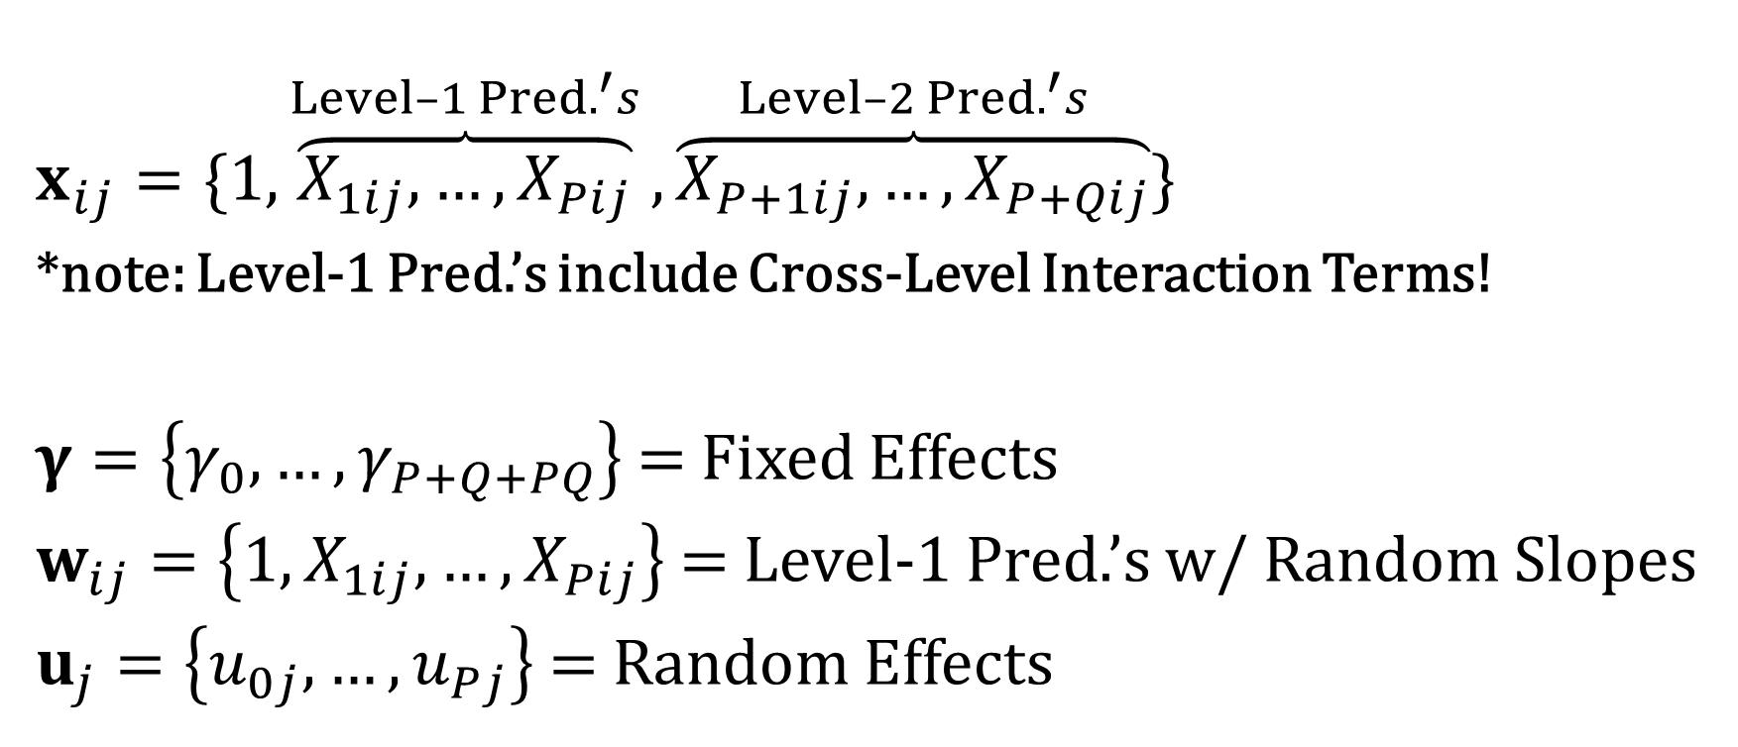

$$y_{ij}=x_{ij}^{′}γ+w_{ij}^{′}u_{j}+e_{ij}$$
$$x_{ij}=\{1,\overset{Level–1 Pred.^{′}s}{\overbrace{X_{1ij},…,X_{Pij}}},\overset{Level–2 Pred.^{′}s}{\overbrace{X_{P+1ij},…,X_{P+Qij}}}\}$$
*note: Level-1 Pred.’s include Cross-Level Interaction Terms!
$γ=\left\{γ_{0},…,γ_{P+Q+PQ}\right\}$ = Fixed Effects
$w_{ij}=\left\{1,X_{1ij},…,X_{Pij}\right\}$ = Level-1 Pred.’s w/ Random Slopes
$u_{j}=\left\{u_{0j},…,u_{Pj}\right\}$ = Random Effects

Slide 9
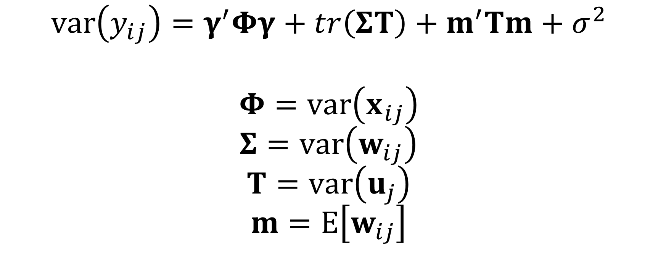
Two-Level Variance Decomposition (Rights & Sterba, 2019a)
$$var\left(y_{ij}\right)=γ^{′}Φγ+tr\left(ΣΤ\right)+m^{′}Τm+σ^{2}$$
$$Φ=var\left(x_{ij}\right)$$
$$Σ=var\left(w_{ij}\right)$$
$$Τ=var\left(u_{j}\right)$$
$$m=E\left[w_{ij}\right]$$

Slide 10
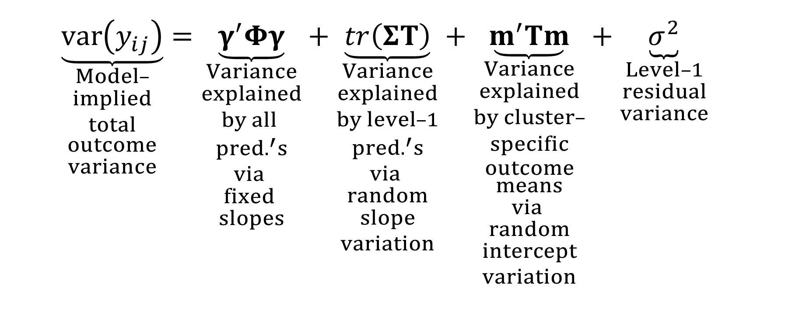
Two-Level Variance Decomposition
$$\underset{\begin{aligned}Model– \\ implied \\ total \\ outcome \\ variance\end{aligned}}{\underbrace{var\left(y_{ij}\right)}}=\underset{\begin{aligned}Variance \\ explained \\ by all \\ pred.^{′}s \\ via \\ fixed \\ slopes\end{aligned}}{\underbrace{γ^{′}Φγ}}+\underset{\begin{aligned}Variance \\ explained \\ by level–1 \\ pred.^{′}s \\ via \\ random \\ slope \\ variation\end{aligned}}{\underbrace{tr\left(ΣΤ\right)}}+\underset{\begin{aligned}Variance \\ explained \\ by cluster– \\ specific \\ outcome \\ means \\ via \\ random \\ intercept \\ variation\end{aligned}}{\underbrace{m^{′}Τm}}+\underset{\begin{aligned}Level–1 \\ residual \\ variance\end{aligned}}{\underbrace{σ^{2}}}$$

Slide 11
Full Variance Decomposition (cwc)
It’s possible to compute total R² measures with these components.
However, the outcome variance can be further decomposed if we cluster-mean center our data (often called centering-within-cluster, or cwc).
Doing so allows us to compute both total and level-specific R² measures.

Slide 12
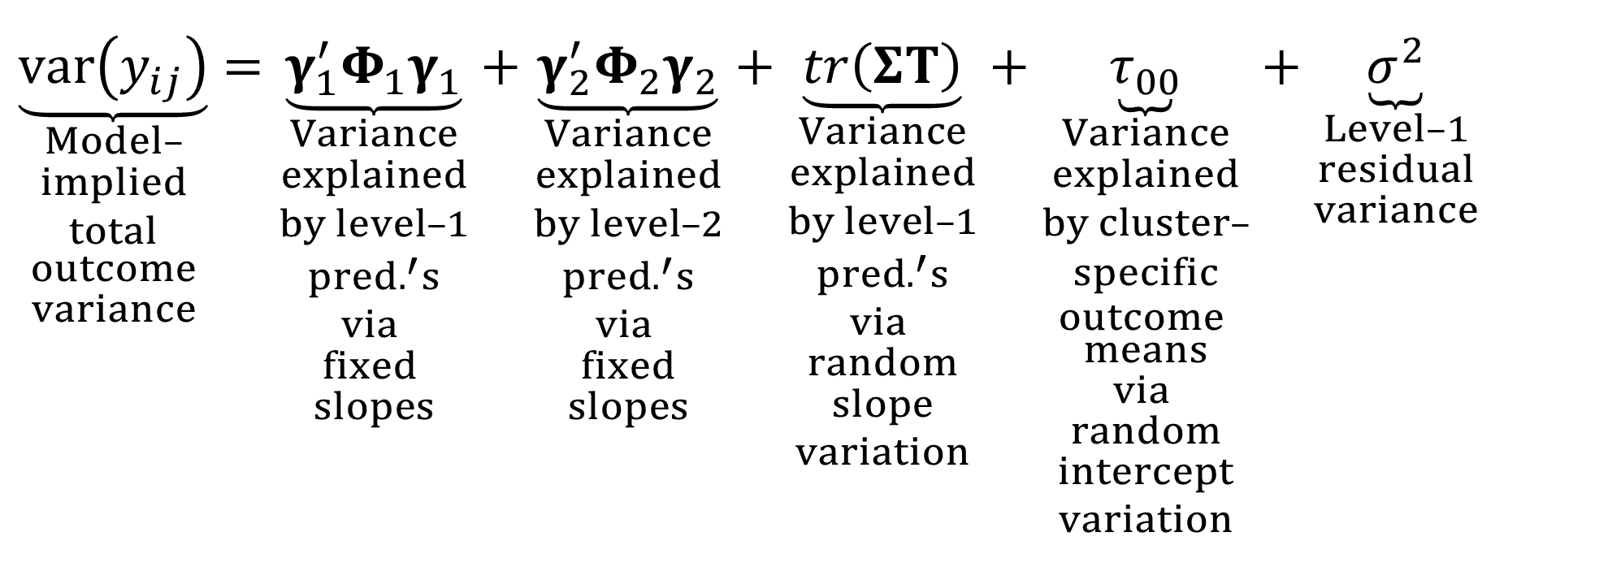
Full Two-Level Variance Decomposition (cwc)
$$\underset{\begin{aligned}Model– \\ implied \\ total \\ outcome \\ variance\end{aligned}}{\underbrace{var\left(y_{ij}\right)}}=\underset{\begin{aligned}Variance \\ explained \\ by level–1 \\ pred.^{′}s \\ via \\ fixed \\ slopes\end{aligned}}{\underbrace{γ_{1}^{′}Φ_{1}γ_{1}}}+\underset{\begin{aligned}Variance \\ explained \\ by level–2 \\ pred.^{′}s \\ via \\ fixed \\ slopes\end{aligned}}{\underbrace{γ_{2}^{′}Φ_{2}γ_{2}}}+\underset{\begin{aligned}Variance \\ explained \\ by level–1 \\ pred.^{′}s \\ via \\ random \\ slope \\ variation\end{aligned}}{\underbrace{tr\left(ΣΤ\right)}}+\underset{\begin{aligned}Variance \\ explained \\ by cluster– \\ specific \\ outcome \\ means \\ via \\ random \\ intercept \\ variation\end{aligned}}{\underbrace{τ_{00}}}+\underset{\begin{aligned}Level–1 \\ residual \\ variance\end{aligned}}{\underbrace{σ^{2}}}$$

Slide 13
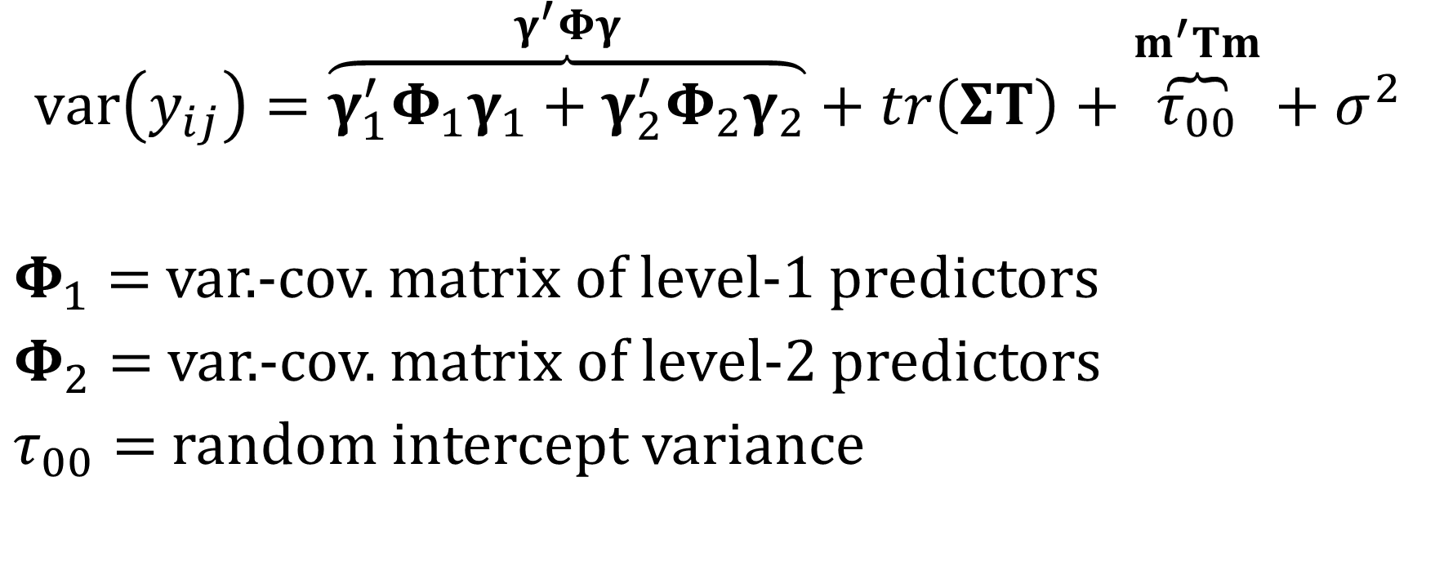
Full Two-Level Variance Decomposition (cwc)
$$var\left(y_{ij}\right)=\overset{γ^{′}Φγ}{\overbrace{γ_{1}^{′}Φ_{1}γ_{1}+γ_{2}^{′}Φ_{2}γ_{2}}}+tr\left(ΣΤ\right)+\overset{m^{′}Τm}{\overbrace{τ_{00}}}+σ^{2}$$
$Φ_{1}=$ var.-cov. matrix of level-1 predictors
$Φ_{2}=$ var.-cov. matrix of level-2 predictors
$τ_{00}=$ random intercept variance

Slide 14
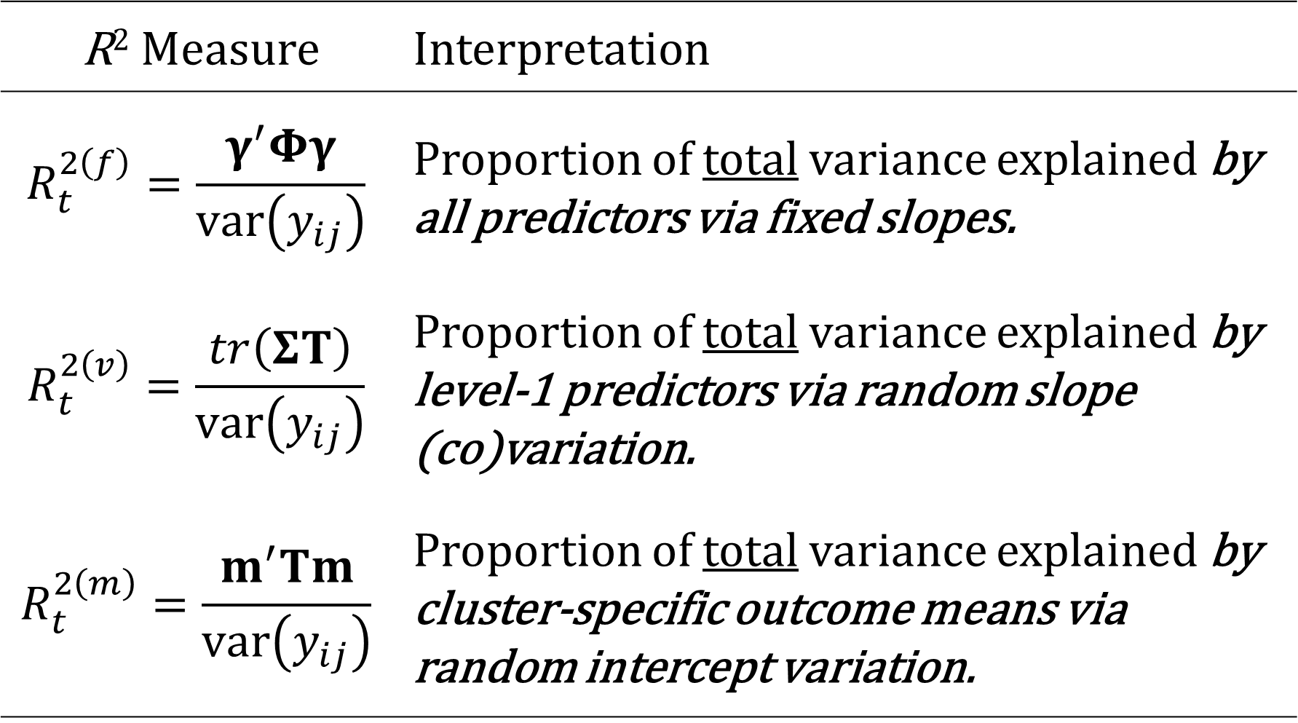
R² Measure | Interpretation
$$R_{t}^{2\left(f\right)}=\frac{γ^{′}Φγ}{var\left(y_{ij}\right)}$$ | Proportion of total variance explained by all predictors via fixed slopes.
$$R_{t}^{2\left(v\right)}=\frac{tr\left(ΣΤ\right)}{var\left(y_{ij}\right)}$$ | Proportion of total variance explained by level-1 predictors via random slope (co)variation.
$$R_{t}^{2\left(m\right)}=\frac{m^{′}Τm}{var\left(y_{ij}\right)}$$ | Proportion of total variance explained by cluster-specific outcome means via random intercept variation.

Slide 15
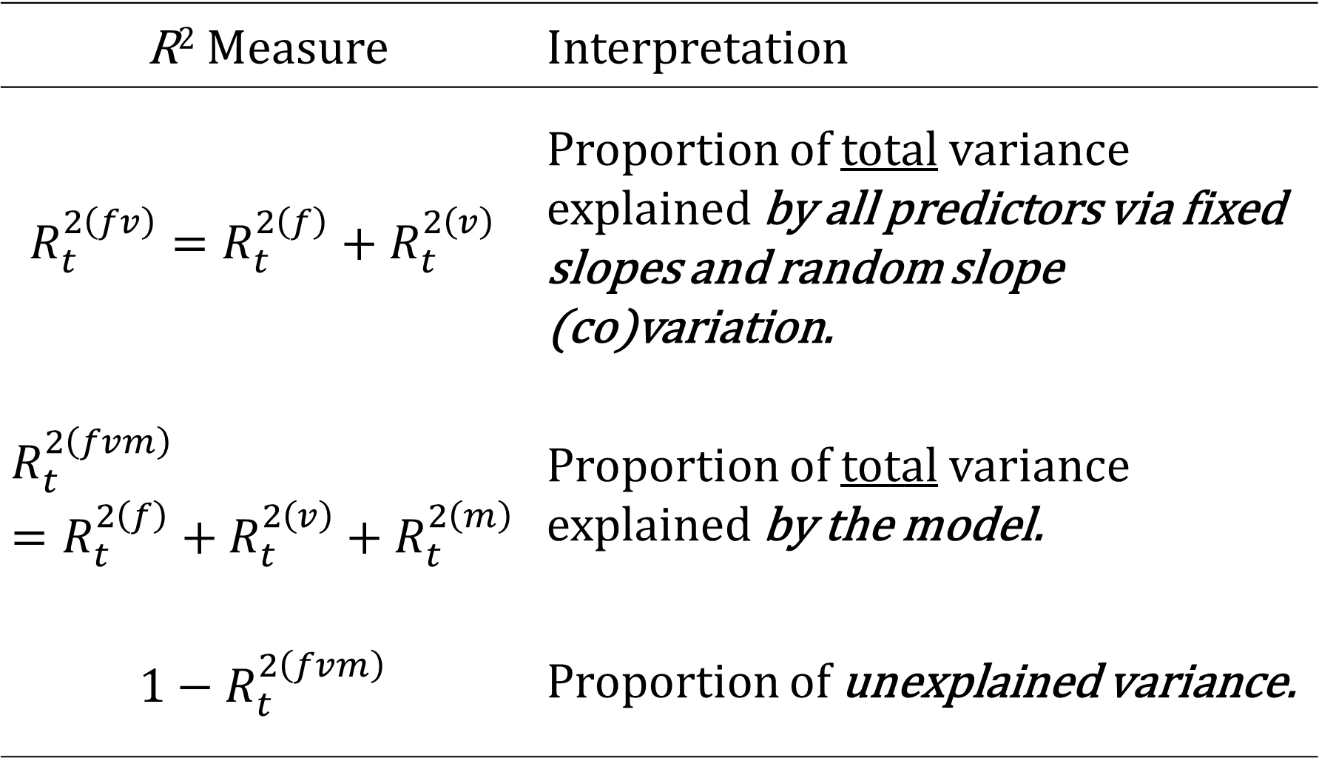
R² Measure | Interpretation
$$R_{t}^{2\left(fv\right)}=R_{t}^{2\left(f\right)}+R_{t}^{2\left(v\right)}$$ | Proportion of total variance explained by all predictors via fixed slopes and random slope (co)variation.
$$R_{t}^{2\left(fvm\right)}=R_{t}^{2\left(f\right)}+R_{t}^{2\left(v\right)}+R_{t}^{2\left(m\right)}$$ | Proportion of total variance explained by the model.
$${1−R}_{t}^{2\left(fvm\right)}$$ | Proportion of unexplained variance.

Slide 16
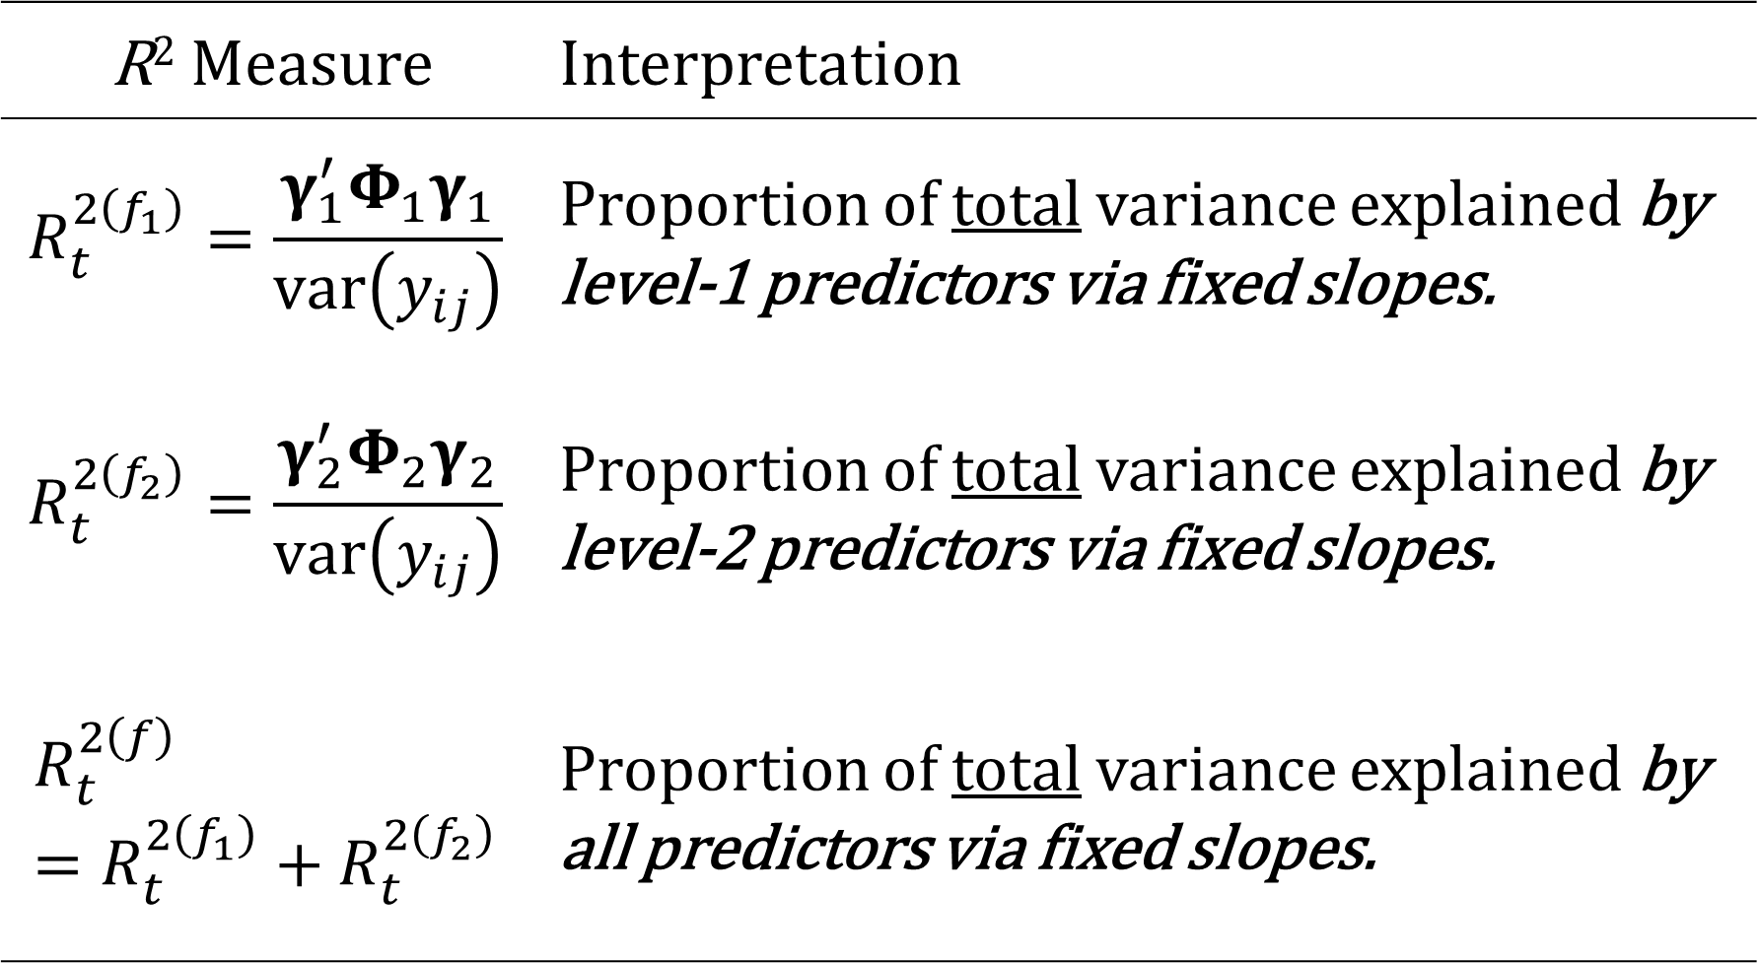
R² Measure | Interpretation
$$R_{t}^{2\left(f_{1}\right)}=\frac{γ_{1}^{′}Φ_{1}γ_{1}}{var\left(y_{ij}\right)}$$ | Proportion of total variance explained by level-1 predictors via fixed slopes.
$$R_{t}^{2\left(f_{2}\right)}=\frac{γ_{2}^{′}Φ_{2}γ_{2}}{var\left(y_{ij}\right)}$$ | Proportion of total variance explained by level-2 predictors via fixed slopes.
$$R_{t}^{2\left(f\right)}=R_{t}^{2\left(f_{1}\right)}+R_{t}^{2\left(f_{2}\right)}$$ | Proportion of total variance explained by all predictors via fixed slopes.

Slide 17
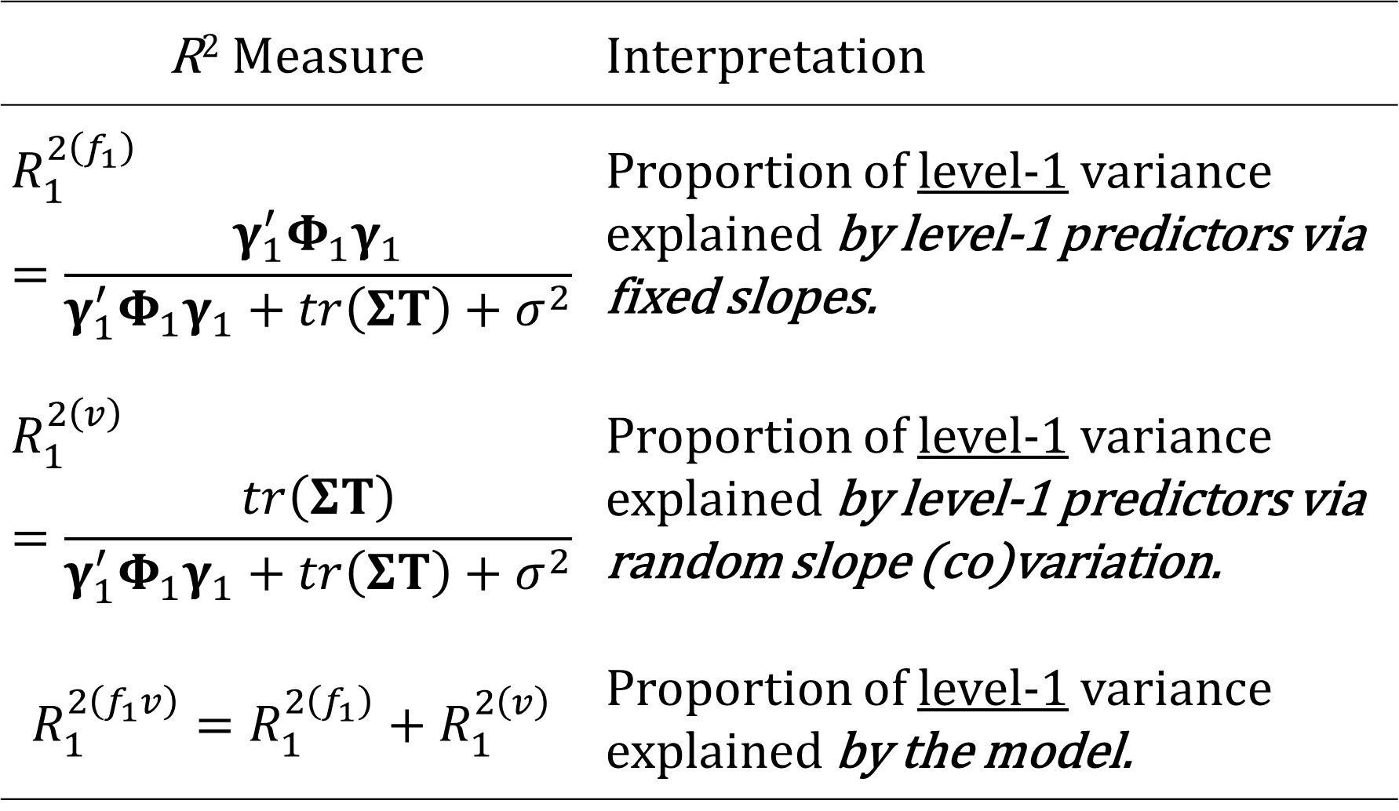
R² Measure | Interpretation
$$R_{1}^{2\left(f_{1}\right)}=\frac{γ_{1}^{′}Φ_{1}γ_{1}}{γ_{1}^{′}Φ_{1}γ_{1}+tr\left(ΣΤ\right)+σ^{2}}$$ | Proportion of level-1 variance explained by level-1 predictors via fixed slopes.
$$R_{1}^{2\left(v\right)}=\frac{tr\left(ΣΤ\right)}{γ_{1}^{′}Φ_{1}γ_{1}+tr\left(ΣΤ\right)+σ^{2}}$$ | Proportion of level-1 variance explained by level-1 predictors via random slope (co)variation.
$$R_{1}^{2\left(f_{1}v\right)}=R_{1}^{2\left(f_{1}\right)}+R_{1}^{2\left(v\right)}$$ | Proportion of level-1 variance explained by the model.

Slide 18
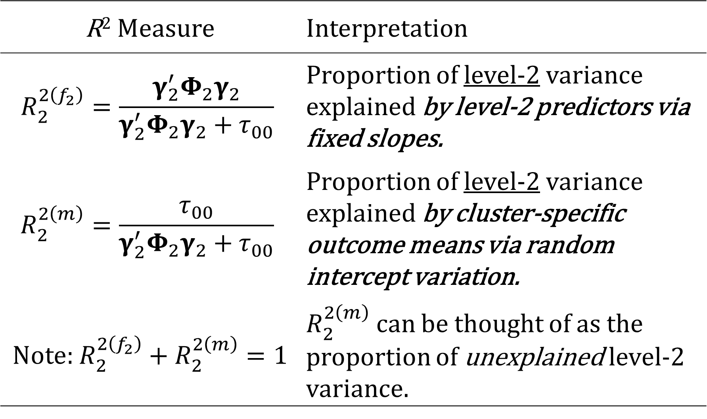
R² Measure | Interpretation
$$R_{2}^{2\left(f_{2}\right)}=\frac{γ_{2}^{′}Φ_{2}γ_{2}}{γ_{2}^{′}Φ_{2}γ_{2}+τ_{00}}$$ | Proportion of level-2 variance explained by level-2 predictors via fixed slopes.
$$R_{2}^{2\left(m\right)}=\frac{τ_{00}}{γ_{2}^{′}Φ_{2}γ_{2}+τ_{00}}$$ | Proportion of level-2 variance explained by cluster-specific outcome means via random intercept variation.
Note: $R_{2}^{2\left(f_{2}\right)}+R_{2}^{2\left(m\right)}=1$ | $R_{2}^{2\left(m\right)}$ can be thought of as the proportion of unexplained level-2 variance.

Slide 19
R² Measures: Software Implementation
Shaw et al. (2022) contributed an R package (r2mlm) that can implement the framework.
This package can automatically fill in the necessary information for the user based on an lme4/nlme model object, but it currently can only do this for limited cases.
Outside of those specific cases, this package requires the user to plug in model estimates and information about the predictors used in the model like which ones had random effects and which levels they exist on.

Slide 20
mlmeval implementation of R² Framework
mlmeval does not require the user to provide any information.
Simply run it after a completed mixed command and it will find the necessary information from the stored estimates and the ereturn list macros/matrices.
mlmeval allows up to 5-level models.

Slide 21
Syntax
mlmeval [, options]
options Description
Main
cwc use full variance decomposition
r2 only compute R^2 measures
ic only compute information criteria

Slide 22
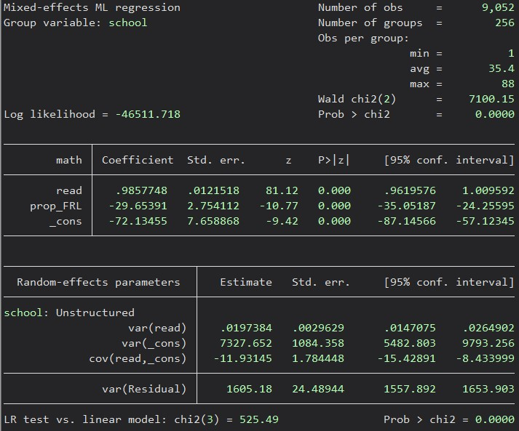

Slide 23
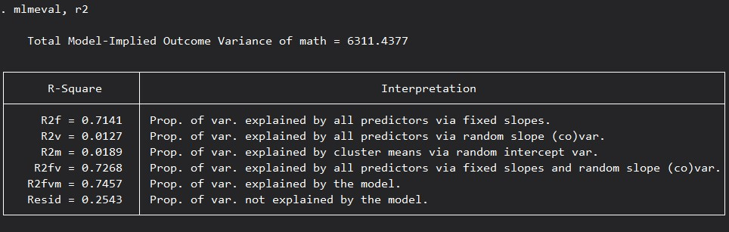

Slide 24
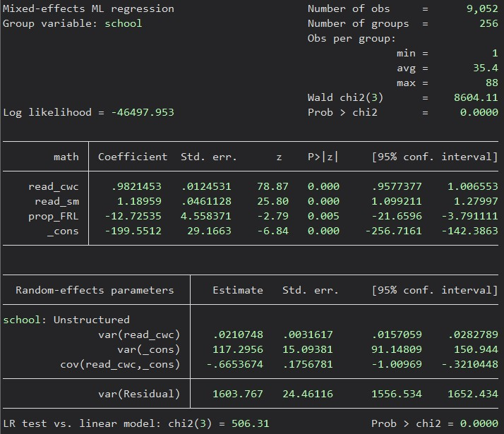

Slide 25
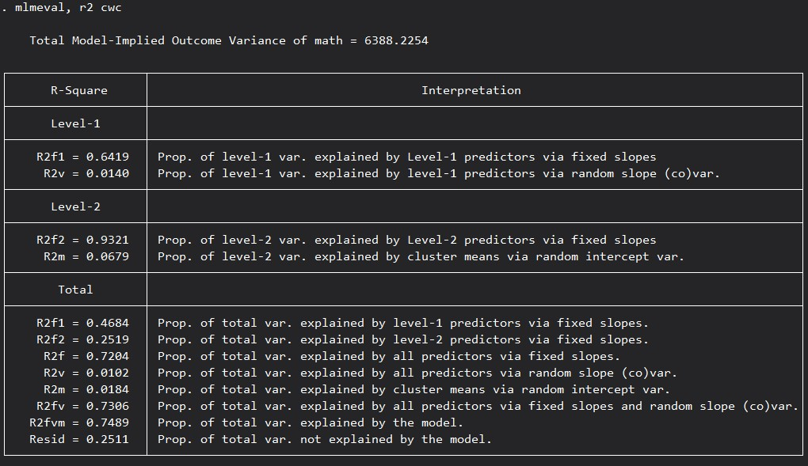

Slide 26
Future Directions
Allowing factor variables in model equation
Model Comparisons (Rights & Sterba, 2019b)
  mlmeval mod1 mod2
R² Extensions including measures for:
  Longitudinal Growth models (Rights & Sterba, 2021)
  Mixed-Effects Location Scale models (Zhang & Hedeker, 2022)
  Generalized Linear Mixed Models (in development)
  Cross-Classified Models (in development)

Slide 27
Thank you! Email us at:
anthony.gambino@uconn.edu
sarah.newton@uconn.edu
betsy@uconn.edu

Slide 28
References
Akaike, H. (1973). Information theory and an extension of the maximum likelihood principle. In B. N. Petrov & B. F. Csaki (Eds.), Second International Symposium on Information Theory, (pp. 267-281). Academiai Kiado.
Boekee D.E., Buss H.H. (1981). Order estimation of autoregressive models. In Proceedings of the 4th Aachen colloquium: Theory and application of signal processing (pp. 126-130).
Bozdogan, H. (1987). Model selection and Akaike’s Information Criterion (AIC): The general theory and its analytical extensions. Psychometrika, 52(3), 345-270. https://doi.org/10.1007/BF02294361
Haughton, D. M. A. (1988). On the choice of a model to fit data from an exponential family. The Annals of Statistics, 16(1), 342–355.
Hannan, E. J. & Quinn, B. G. (1979). The determination of the order of an autoregression. Journal of the Royal Statistical Society Series B (Methodological), 41(2), 190-195. https://doi.org/10.1111/j.2517-6161.1979.tb01072.x
Hurvich, C. M. & Tsai, C. (1989). Regression and time series model selection in small samples. Biometrika, 76(2), 297-307. https://doi.org/10.1093/biomet/76.2.297
McCoach, D. B., Newton, S., & Gambino, A. J. (2022). Evaluation of model fit and adequacy. In A. A. O’Connell, D. B. McCoach, & B. A. Bell (Eds.), Multilevel modeling methods with introductory and advanced applications (pp. 51-94). Information Age Publishing.

Slide 29
References (cont.’d)
Rights, J. D., & Sterba, S. K. (2019a). Quantifying explained variance in multilevel models: An integrative framework for defining R-squared measures. Psychological Methods, 24(3), 309-338. http://dx.doi.org/10.1037/met0000184
Rights, J. D., & Sterba, S. K. (2019b). New recommendations on the use of R-squared differences in multilevel model comparisons. Multivariate Behavioral Research, 55(4), 568-599. https://doi.org/10.1080/00273171.2019.1660605
Rights, J. D., & Sterba, S. K. (2021). Effect size measures for longitudinal growth analyses: Extending a framework of multilevel model R-squareds to accommodate heteroscedasticity, autocorrelation, nonlinearity, and alternative centering strategies. Child and Adolescent Development, 65-110. https://doi.org/10.1002/cad.20387
Rights, J. D., & Sterba, S. K. (2022). R-squared measures for multilevel models with three or more levels. Multivariate Behavioral Research. https://doi.org/10.1080/00273171.2021.1985948
Schwarz, G. (1978). Estimating the dimension of a model. The Annals of Statistics, 6(2), 461–464.
Sclove, S. L. (1987). Application of model-selection criteria to some problems in multivariate analysis. Psychometrika, 52(3), 333-343.
Shaw, M., Rights, J. D., Sterba, S. K., & Flake, J. K. (2022). R2mlm: An R package calculating R-squared measures for multilevel models. Behavior Research Methods. https://doi.org/10.3758/s13428-022-01841-4
Zhang, X., & Hedeker, D. (2022). Defining R-squared measures for mixed-effects location scale models. Statistics in Medicine, 1-17. https://doi.org/10.1002/sim.9521

Slide 30
Appendix: Model Fit: Information Criteria
mlmeval provides the deviance, AIC, and AIC3, as well as:
AICC BB1A BIC
CAIC HBIC HQIC SABIC
For each possible sample size, including the effective sample size (N_{eff}).

