Slide 1
Violence in Peru during pandemic times: The dynamic relationship between COVID19, intimate partner violence, and risk factors
Stata Conference
DC, August 2022
Angelo Cozzubo, NORC
Wilson Hernández, GRADE
Jorge Agüero, University of Connecticut
Denise Legard, PNUD Perú
José Carlos Aguilar, PUCP
José Mendoza, PUCP

Slide 2
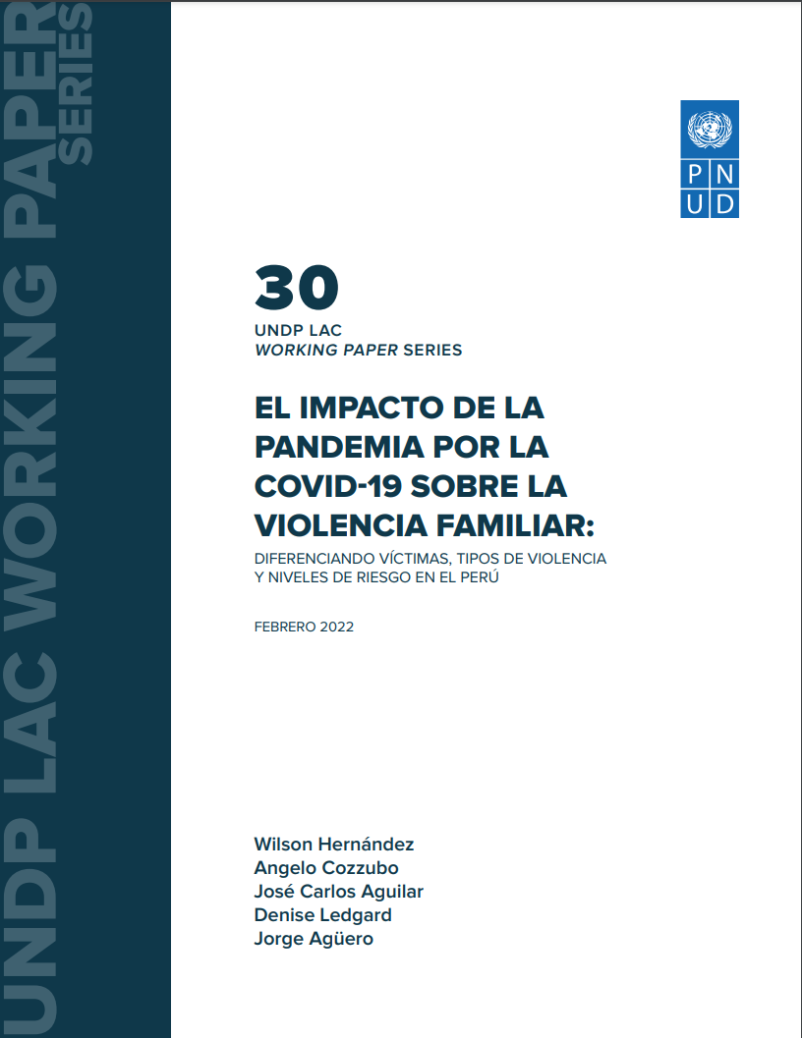
Summary
Worldwide evidence shows IPV increased during COVID19
  Usually short-term analysis. No explanation of mechanisms
Our study → calls received during the complete 2020 year
by domestic violence hotline in Peru
Objectives
  Analyze the dynamics of effects
  Differentiate effects by type IPV
  Identify mechanisms
Results
  Non-linear increase of calls
  Psychological IPV showed the greatest increase, followed by physical one. No effects for sexual violence.
Mechanisms → previous violence, alcohol consumption
Policy efforts → Understand IPV as a heterogeneous phenomenon
Risk factors to predict and prevent severe IPV
Notes:
This is an overall summary of the paper
Published as WP by UNDP. Process sending to journal
In case you need to leave, this is all you need to know

Slide 3
IPV in Peru
Intimate Partner Violence in Peru, 2019
3 out of 5
2%
168
Women have been victims of IPV
Victims access Ministry of Women services to combat IPV
Femicides Record value in the last decade
Notes:
Some numbers about IPV in Peru
Very worrying situation
High increase in the last decade
Source DHS and Police reports

Slide 4


Violence Helpline in Peru
National Domestic Violence Hotline: Línea 100
  Free phone service, Ministry of Women. 24/7 attention
  Handles all types of violence cases
    43% against women, 35% against children
  Orientation for safety and reporting
  For severe IPV, broker between victims and other services
  198 call center operatros
    80% women
    60% psychologists
  Nationwide service, but calls come mostly from
    55% Lima
    50% from 24 districts nationwide
Notes:
L100 is part of the Ministry of Women, particularly program called Aurora
One of the emblematic strategies to reduce IPV in the country
Created in 2006 Digital admin registry since 2017 (very messy)

Slide 5
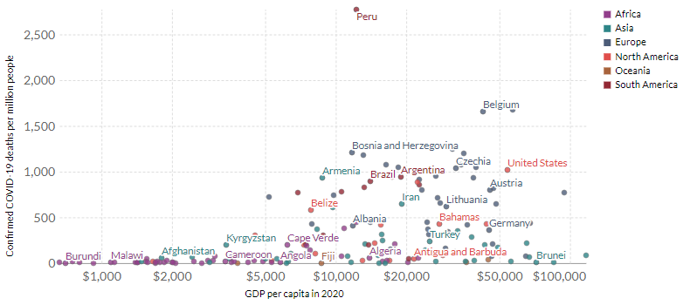
Covid19 deaths in peru
Peru: one countries hit hardest by COVID19 worldwide
Source: Our World in Data. Johns Hopkins University CSSE COVID-19 Data, World Bank.
Notes:
Peru was one of the countries that first applied lockdowns and border closing as recommended by WHO
Health system was precarious. Informality as high as 70% (no health coverage)
Dichotomy between saving the economy and saving lives
Peru lost both ↑ 10 pp poverty, ↓ 11pp GDP

Slide 6
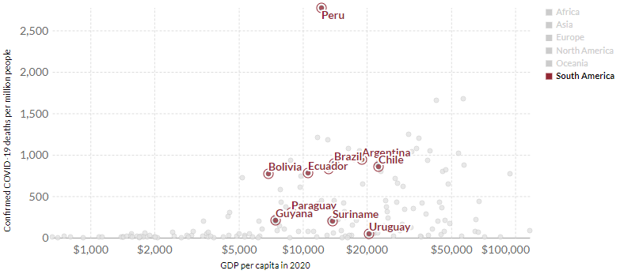
Covid19 deaths in peru
Peru: also an outlier in the LAC region
Source: Our World in Data. Johns Hopkins University CSSE COVID-19 Data, World Bank.

Slide 7
Covid context in peru
Syndemic
Pandemic officialy declared on March 15th, 2020
Very strict and prolonged measures
National general lockdown
  Night curfew
  More restrictions for elders and children
  Complete lockdown on Sunday
  7 extensions for lockdown
  Every 14 or 30 days.
  International borders remained closed
  Only change: 30-min walked allowed
Severe economic consequences (INEI)
  Poverty rate increased in 10 percentage points
  Employment rate fell in 39 percentage points in the first three months of quarantine
  Closure of non-essential services
  Police stations open but…
  No services for IPV victims besides L100
  Centros de Emergencia Mujer
Notes:
Few reasons for being in street: medical emergency, medical attention, drugstore, groceries, bank, etc.
Police and military on the streets. Jail time for defiers

Slide 8
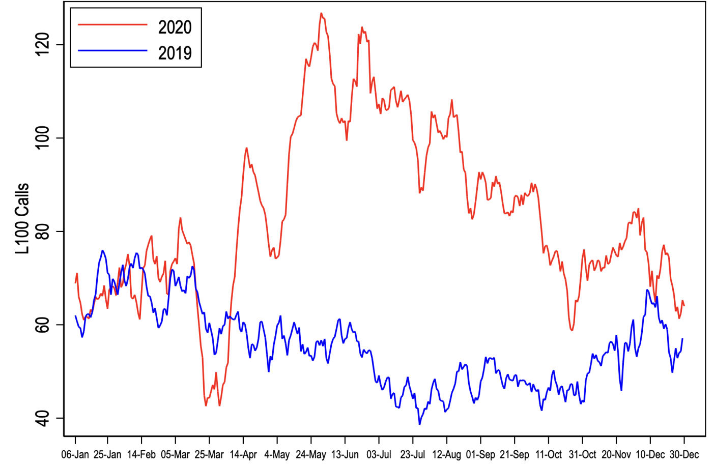
calls before and during covid19
Number of calls peaked during COVID19 lockdown
  Average number of calls similar between Jan – March 2019 & 20
    60-80 daily calls nationwide
  May 2020: 120 daily calls.
    Non-linear decrease in rest year
  Police stations never closed but IPV reports dropped significantly
  L100 played an essential role
    Primary source of help for IPV
    Unstopped 24/7 free service
  March 16th
Source: Administrative records for Línea 100.

Slide 9
Theories IPV during COVID
COVID & IPV: Why would violence increase?
Routine activity theory (Cohen & Felson, 1979)
Opportunity to engage in violent behaviors
Exposure effect and emotional cues (Card & Dahl, 2011)
Violence as a control tool (Dobash & Dobash, 1979;
Tauschen et al., 1991)
Reduction of social surveillance (Beland et al., 2020)
Bargaining model
Relative positions: advantages and disadvantages
Affected by pandemic (cash transfers, care tasks, job loss)
Notes:
Routine activity theory: crimen theory, event occurs because combo of likely offender + suitable target + absence of capable guardian
Card & Dahl, 2011: Family Violence and Football
Control tool: Physical violence is viewed as both a source of direct gratification and as an instrument for controlling the victim's behavior. Our model is a Stackleberg type model in which the assailant maximizes expected utility subject to the stochastic reaction function of the victim.

Slide 10






International evidence
Indeed, evidence shows IPV increased during COVID19
Arenas-Arroyo et al., 2020
Beland et al., 2020
J. L. Payne & Morgan, 2020
Silverio-Murillo & Balmori de la Miyar, 2020
Perez-Vincent et al., 2020
Ashby, 2020;
Bullinger et al., 2020; Campedelli et al., 2020; Leslie & Wilson, 2020; McCrary & Sanga, 2020;
Mohler et al., 2020; J. Payne et al., 2020; Piquero et al., 2020
  Impact mechanisms not clear
    Mobility
    Stressors: economic and length.
  Evidence for Peru: Agüero (2020), ↑48% calls to L100
  Gaps in the literature
    Linear effect? Long-term effects?
    Effect by type of violence?
    Effect due to risk of violence?

Slide 11
objectives
Objectives: Evaluate the impact of lockdown policies on IPV against women
1.
2.
3.
Differentiate effects by types of violence: psychological, physical and sexual
Evaluate mechanisms: prior violence, isolation, and substance use
Analyze the dynamics of the effects in a longer term: 11 months period

Slide 12
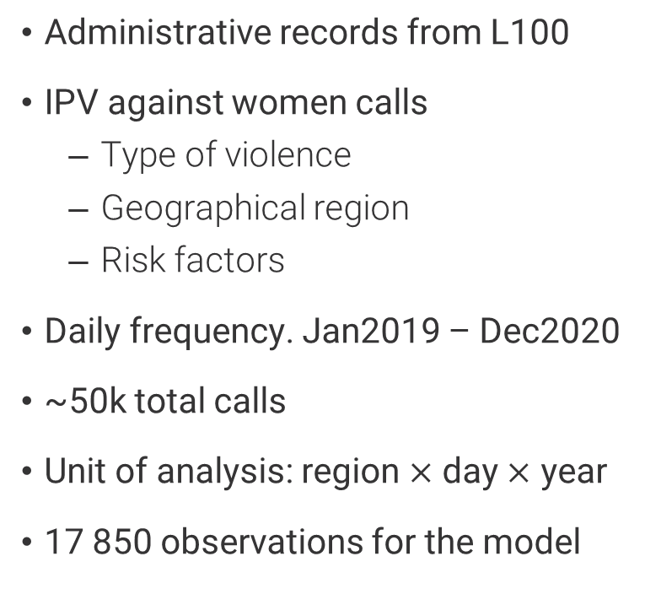
Data
Data and analysis sample
IPV calls, by type of violence | Panel (A). 2019 | Column Table Name | Panel (B). 2020 | Column Table Name
Jan - Dec | Number of calls | % | Number of calls | %
Psychological | 6835 | 34.5 | 14266 | 47.6
Physical | 12371 | 62.4 | 15086 | 50.3
Sexual | 616 | 3.1 | 637 | 2.1
Total | 19822 | 100 | 29989 | 100
  Administrative records from L100
  IPV against women calls
    Type of violence
    Geographical region
    Risk factors
  Daily frequency. Jan2019 – Dec2020
  ~50k total calls
  Unit of analysis: region $×$ day $×$ year
  17 850 observations for the model

Slide 13
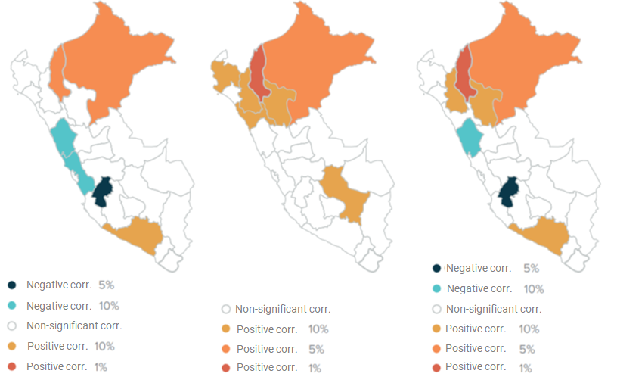
Spatial clusters of ipv
Geographical clusters of violence against women
Regions from where each call was made
Global spatial correlation (Moran index) positive and significant at the 1%
Local Moran index. Identify IPV spatial clusters
New and significant hotspots after pandemic
Psychological
Physical
Sexual
Notes:
Global Moran 0.35-0.42. Increase during quarantine.

Slide 14
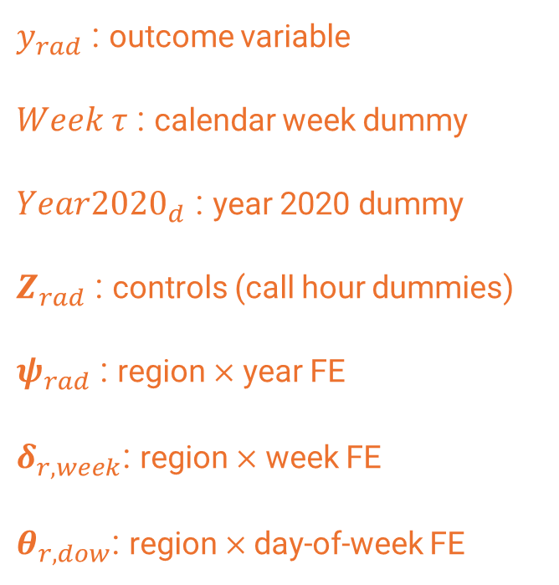
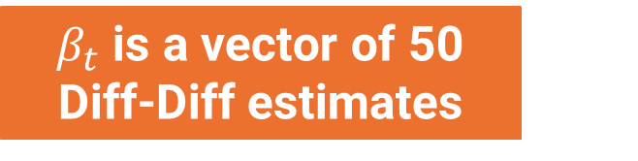
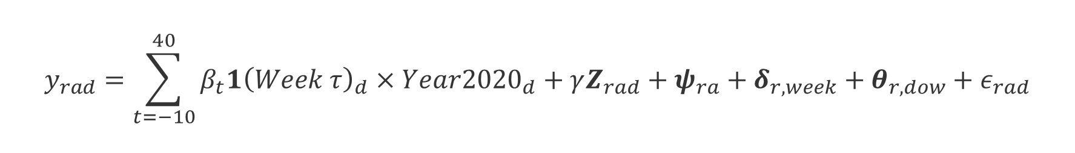
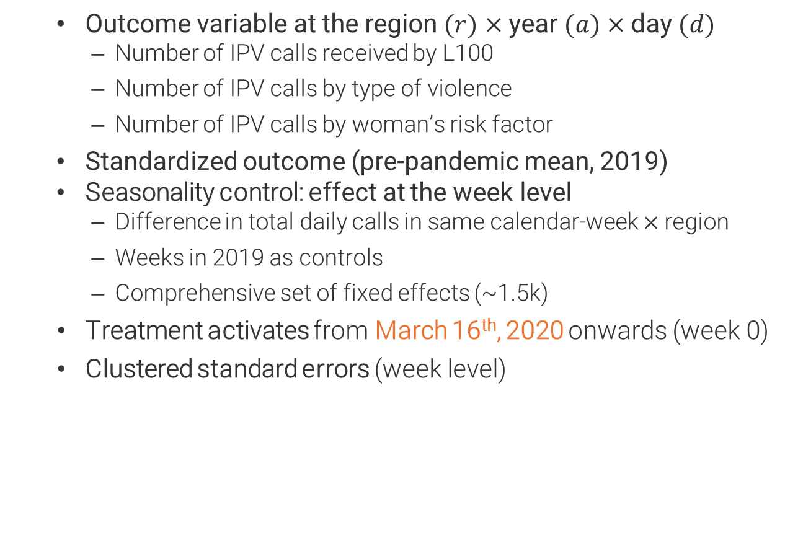
Methodology
Methodology – Event Study Model
$β_{t}$ is a vector of 50 Diff-Diff estimates
$$y_{rad}=\sum_{t=−10}^{40}{β_{t}1{\left(Week τ\right)}_{d}×Year{2020}_{d}+γZ_{rad}+ψ_{ra}+δ_{r,week}}+θ_{r,dow}+ε_{rad}$$
$y_{rad}$ : outcome variable
$Week τ$ : calendar week dummy
$Year{2020}_{d}$ : year 2020 dummy
$Z_{rad}$ : controls (call hour dummies)
$ψ_{rad}$ : region $×$ year FE
$δ_{r,week}$: region $×$ week FE
$θ_{r,dow}$: region $×$day-of-week FE
  Outcome variable at the region $(r)$ $×$year $(a)$ $×$day $(d)$
      Number of IPV calls received by L100
      Number of IPV calls by type of violence
      Number of IPV calls by woman’s risk factor
  Standardized outcome (pre-pandemic mean, 2019)
  Seasonality control: effect at the week level
      Difference in total daily calls in same calendar-week $×$region
      Weeks in 2019 as controls
      Comprehensive set of fixed effects (~1.5k)
      Treatment activates from March 16th, 2020 onwards (week 0)
      Clustered standard errors (week level)

Slide 15
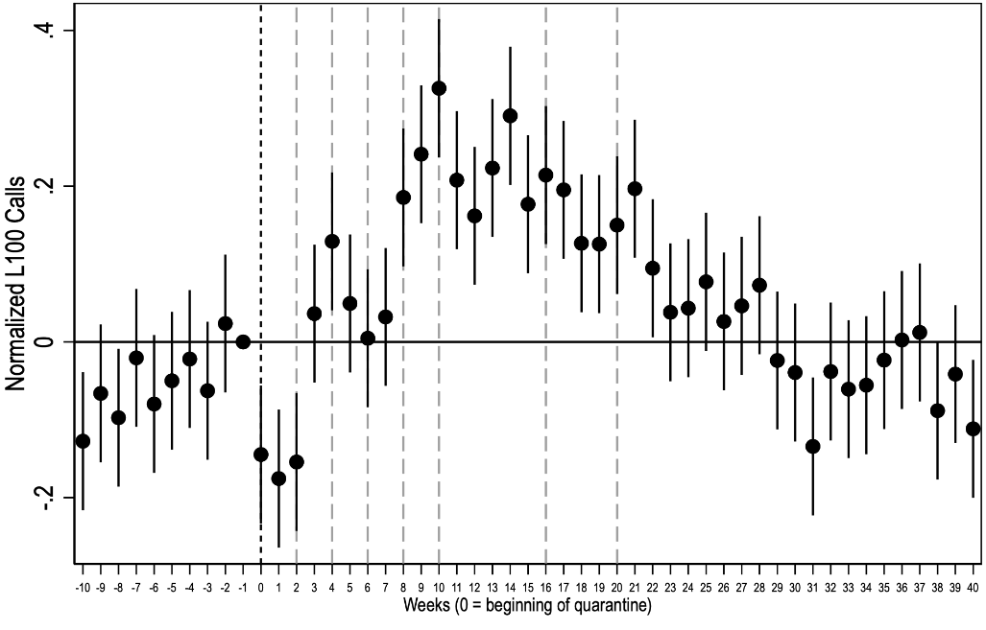
Overall effects
Event Study - Daily IPV calls in 2020, relative to 2019
Overall effect total calls to L100
No significant pre-trends
Nonlinear Dynamic
  Inverted U-shape
Duration effect
Drop in the first 3-weeks:
  Productivity of operators?
  ‘Honeymoon’, saving ourselves
Reversion to 2019 level of call matches last lockdown extension (1-31 Aug)
Note: Event study estimates and 95% confidence intervals. The black dotted line indicates the starting weeks of the lockdown (Mar16, 2020) and the gray dotted lines indicate its extensions. The regression includes region-year, region-week, and region-day fixed effects. Four additional dummies indicating the hour the call was made are included as controls. To account for years starting on different days of the week, we encode the first week as starting on January 1st and finishing on the first Sunday, so since the second calendar week, each week will run from Monday through Sunday.
Notes:
- DD results: along these almost eleven months, the estimate accounts for a 10.5% increase in calls for IPV compared to the standardized mean of the pre-pandemic period. This overall effect hides the different effects observed when differentiating violence by type
Beta% more calls in 2020 than in 2019 for the same calendarweek-region
No pre-trends argue in favor of the PT assumption for ES
Nonlinear effect. Inverted U shape. There is an initial (and significant) drop in calls during the first three weeks, which then transforms into increases compared to previous years at least until week 22 of lockdown. Since then, calls tend to increase at a lower rate
Week 30 (Oct2020), variation no significant
The short tem drop in the first three weeks is attributed to the calls for physical violence
Because the immediate drop observed during the first three weeks of the pandemic does not affect all types of violence, but is rather restricted to the physical one, we can discard that this increase is the result of changes in the productivity of operators during the first weeks of confinement

Slide 16
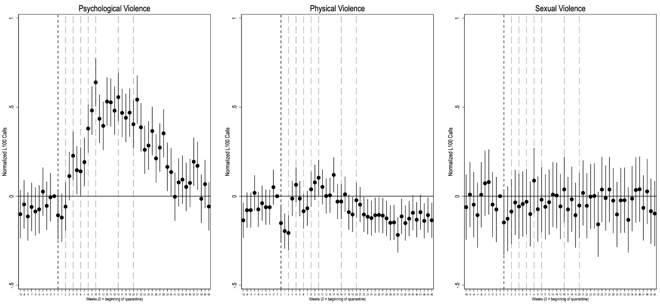
Event Study: Daily IPV calls by type of violence
Psychological
Physical
Sexual
Notes:
Also nonlinear
Physcological IPV higher effects
Calls for psycho violence follows a pattern similar to the total calls. An initial (non significant) dorp during the first 3 weeks is followed by (significant) increase since week 3 and a peak in week 10
Physical IPV explains the reduction in first 3 weeks
Though there is a couple of significant results afterwards, there is no clear change until week 22 when the weekly effects are mostly negative and significant
No effect for sexual IPV across the entire period
Harder for women in more severe context of violence to make the call

Slide 17
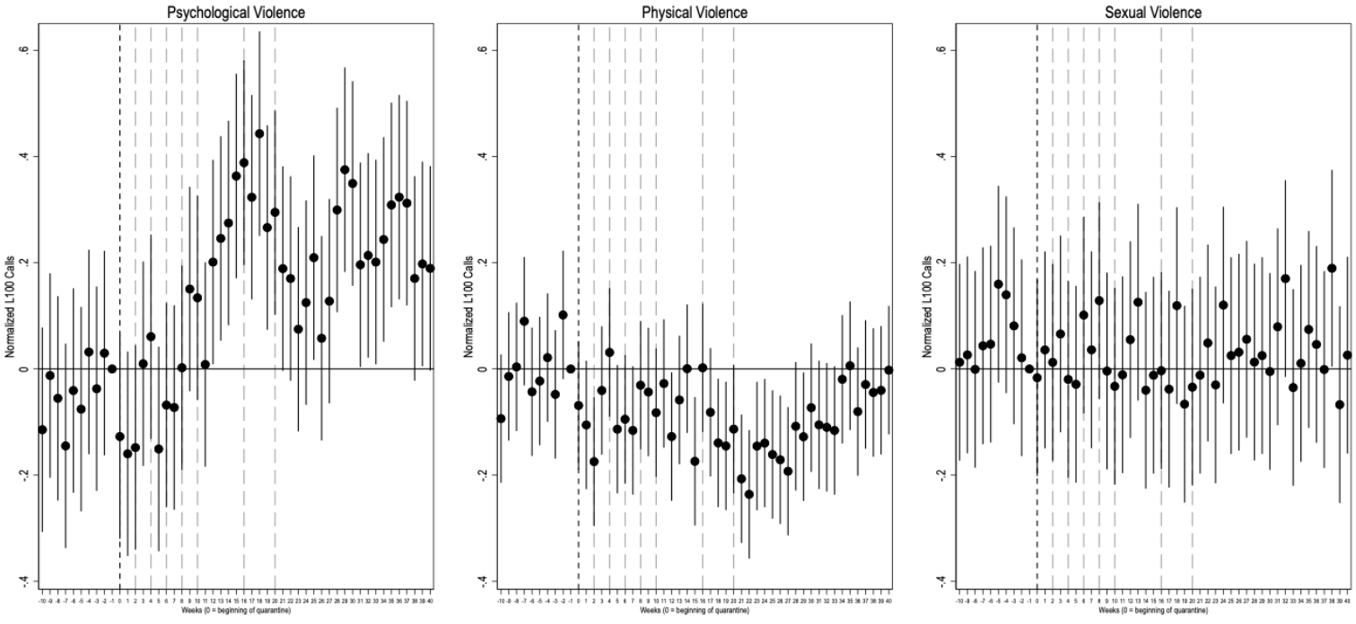
Mechanism 1: Women who reported previous violence
Psychological
Physical
Sexual
Notes:
In line with previous literature, women that were victims of IPV were at higher risk as can be seen in the calls to L100
This effect did not appear immediately after the lockdown nor was stable during the first 11 weeks evaluated
Calls for psycho IPV increased since week 10. Effect DIDN’T FADE AWAY for the whole year
However, variation of physical IPV was less crear except at the end of the period evaluated.
Further research is needed to understand if psycho and physical violence interact as subtitutues. Or women in more severe context of IPV
No effects on sexual IPV

Slide 18
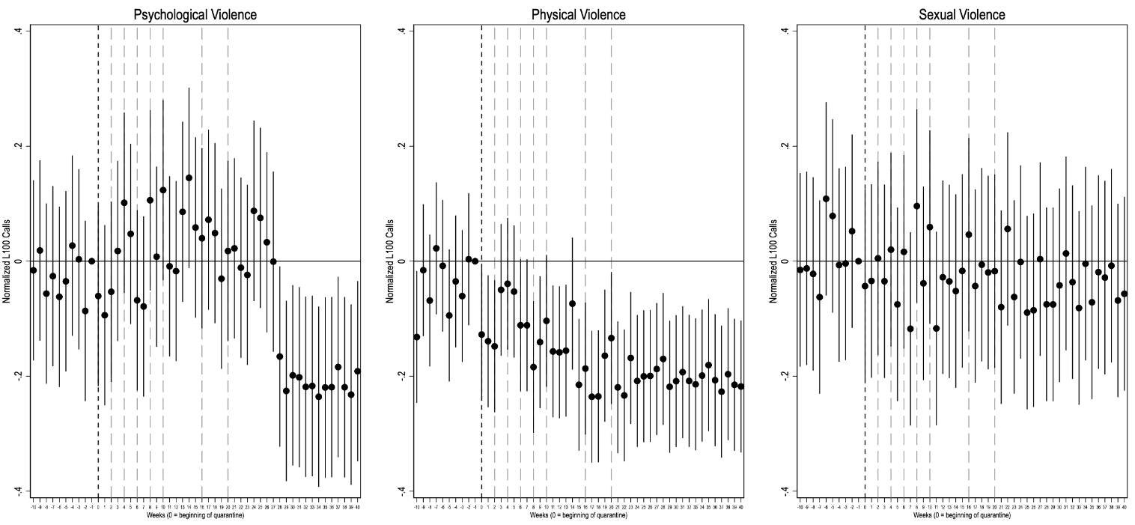
Mechanism 2: Women lacking a network of family and friends
Psychological
Physical
Sexual
Notes:
Two different mechanisms tested to address isolation
Lack of network for 17% sample
Psycho IPV decrease significantly only after week 28
In terms of physical violence, the relationship is clearer. Women with no networks called les frequently tan pre COVID19
There are no effects on sexual violence

Slide 19
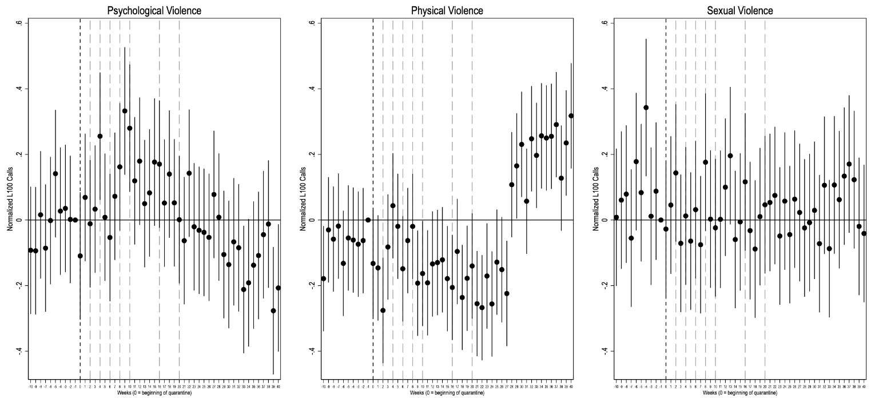
Mechanism 2: Women isolated by their partner
Psychological
Physical
Sexual
Notes:
Isolation (10% sample): explicit limitation of social contacts by partner
No effects for psycho or sexual IPV
Since week 33, end of lockdown,L100 received more calls from isolated women for physical v. ↑20%
This sudden change may be related to how the conditions of the lockdown changed dramatically during those weeks
This suggest that isolation as a consequence of partners behavior may be more durable and riskier to the extent of limiting reaching out to services for IPV

Slide 20
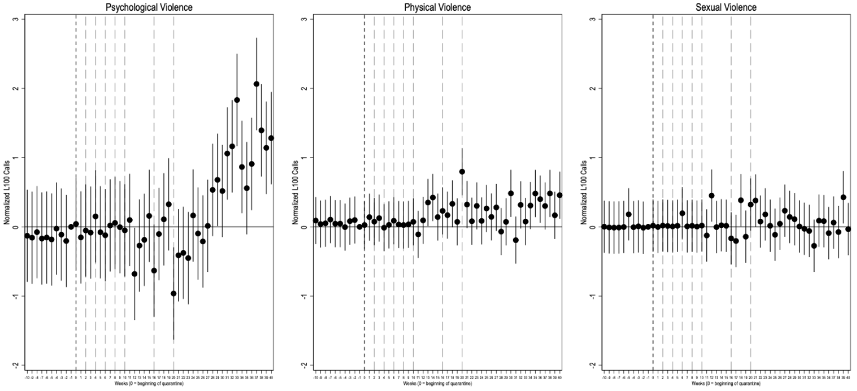
Mechanism 3: Women whose partner consumes alcohol or drugs
Psychological
Physical
Sexual
Notes:
Alcohol picks up cumulative effects of stress
During the pandemic, stressful situations may have led to greated alcohol consumption at home, acting as a trigger for violence (Chaflin et al)
Present in the narratives of victims searching for help during the pandemic (Hernandez, Lyons & Brewer)
Calls for psycho v. begin to increase from week 28. Associated with re-opening of markets
Attention to the magnitude of Beta = [1,2]. X5 bigger than overall results
Increase of calls for physical is smaller and irregular. It becomes clearer in the last weeks of the year
No effect for sexual IPV

Slide 21
Qualitative Approach
In-depth interviews
IPV survivors
L100 call center operators
Police officers overseeing family affairs

Slide 22
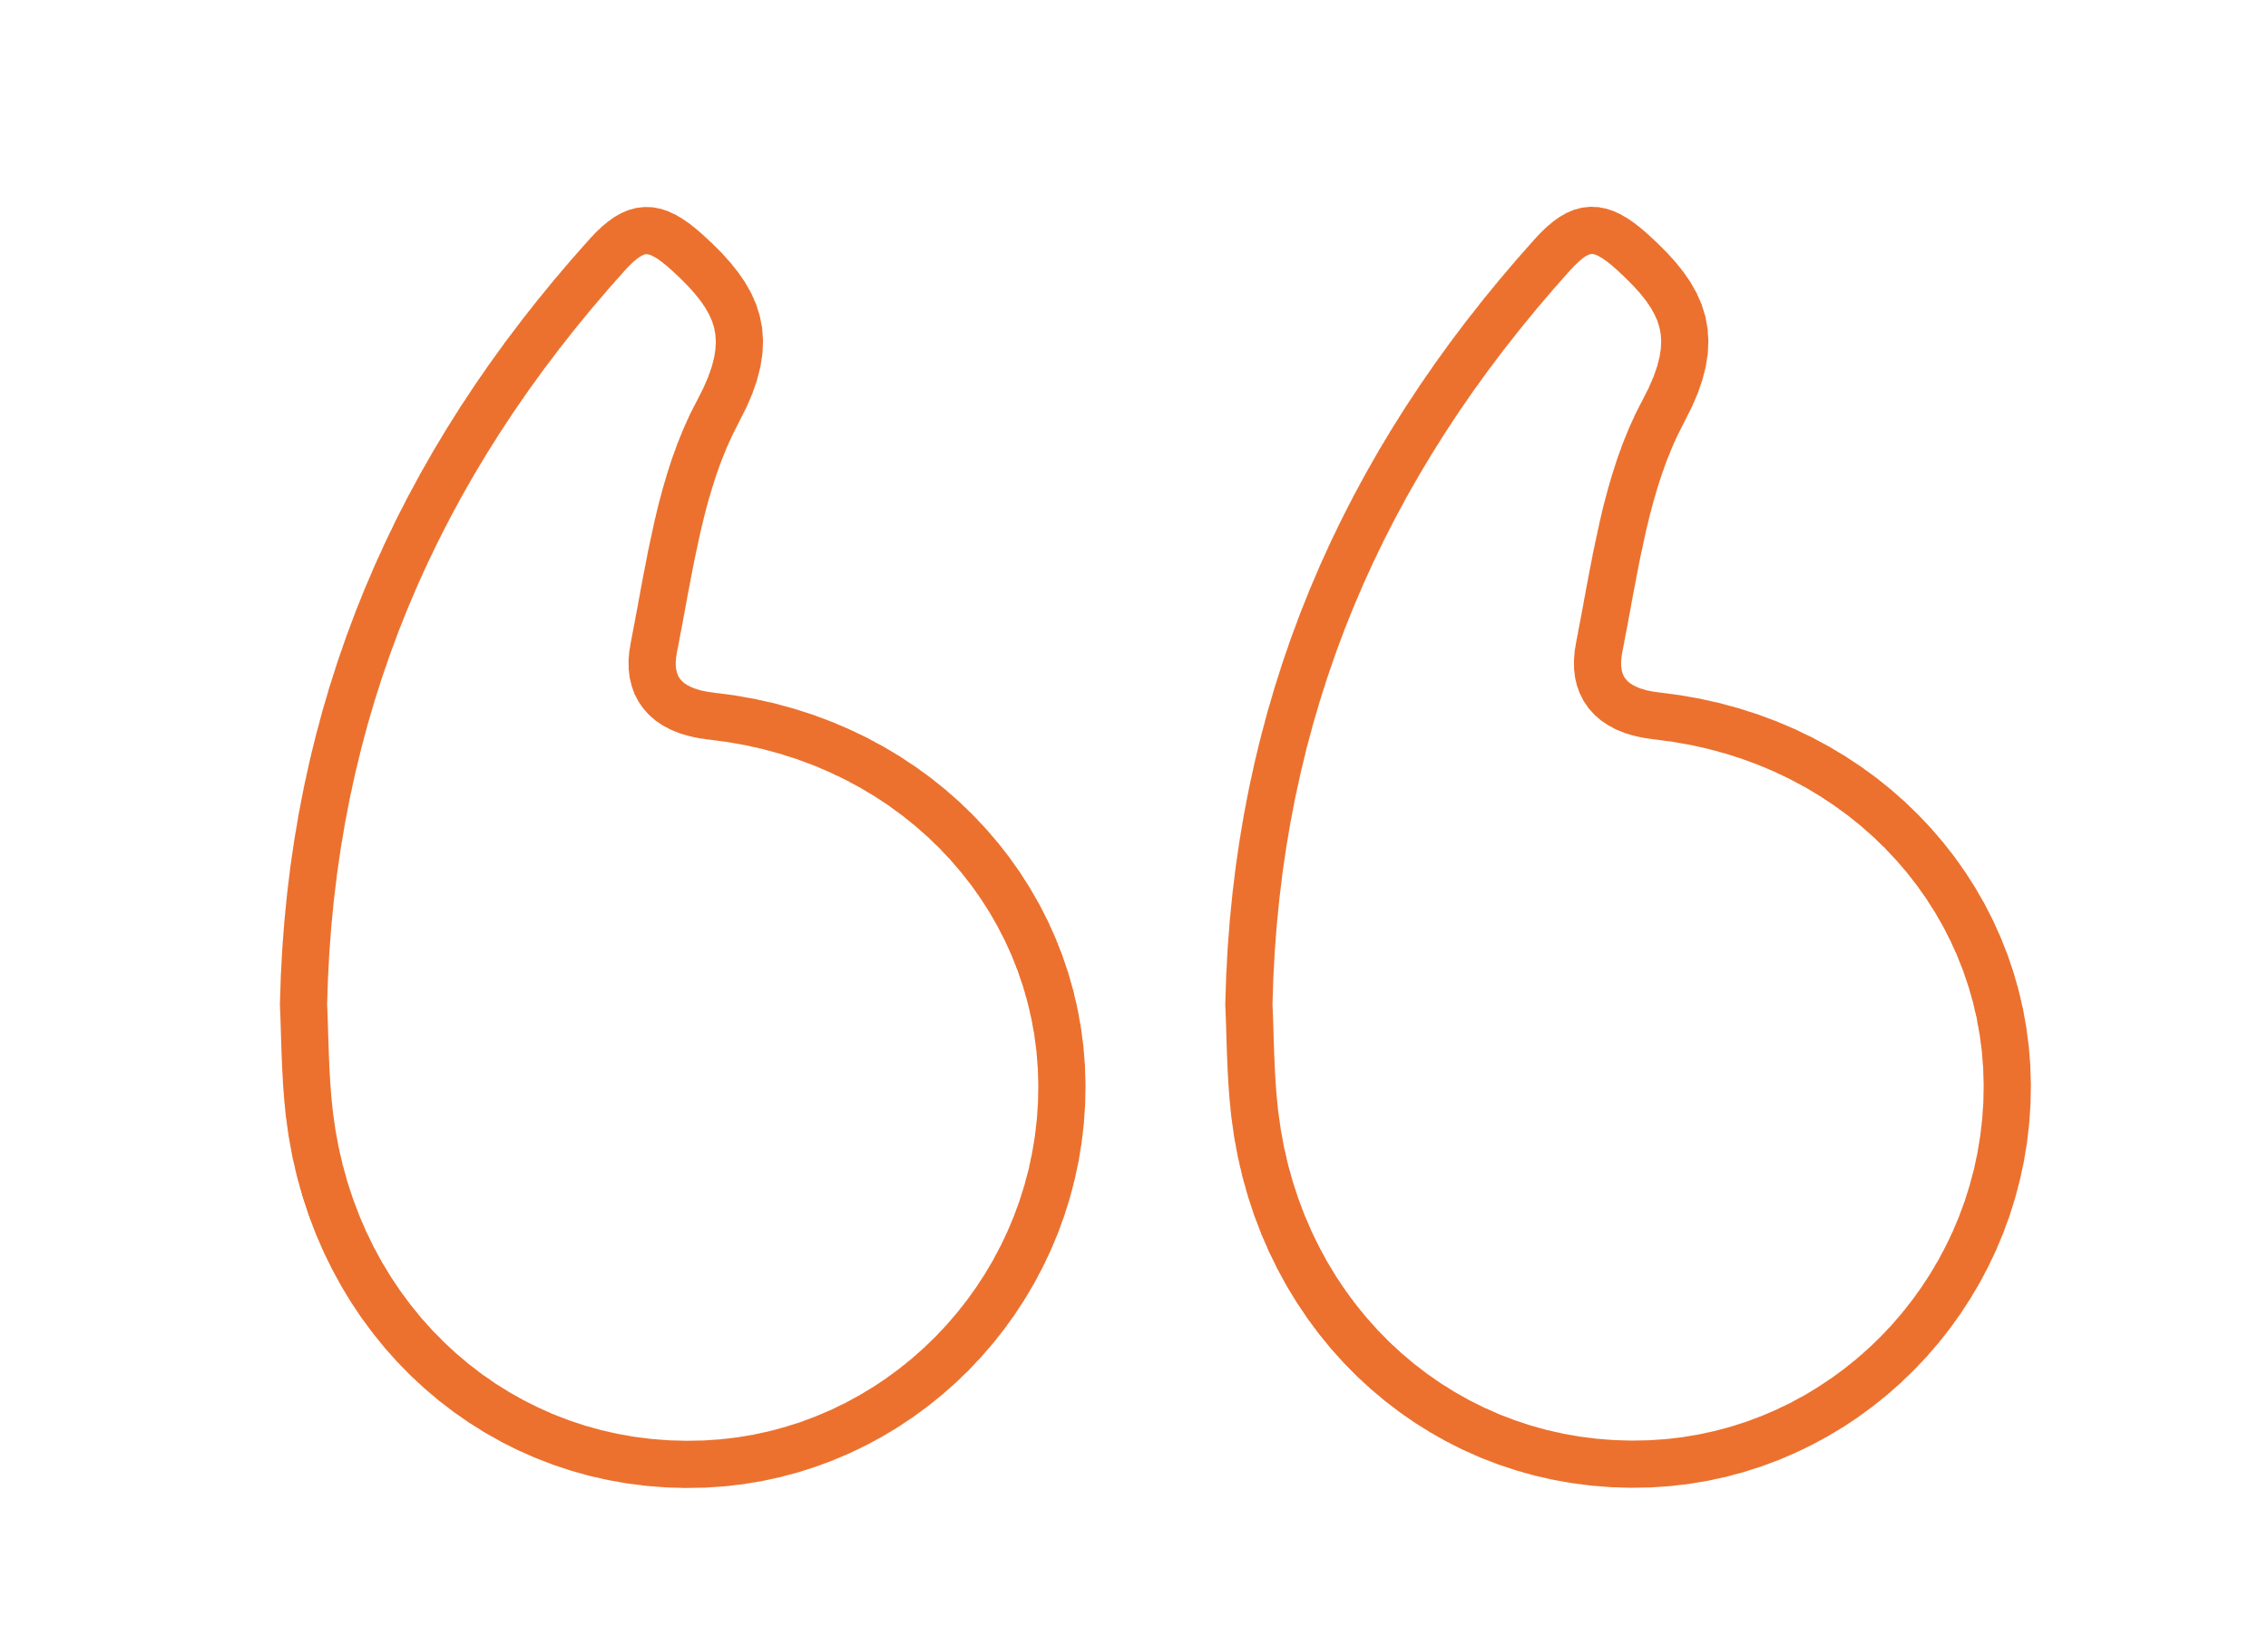
Qualitative approach
IPV survivors mentioned that alimony was a stronger source of conflict
Emergency cash transfers by the government became a new source of conflict
Operators noted a rise in number of calls “gender-based lockdown” was decreed
Victims contacted L100 when assailants were away from home
Cuando se hizo más fuerte la cuarentena [es decir, cuando se extendió y aumentó el toque de queda], él ya no venía.
Se olvidaba de nosotros, ni había quién iba a comprar. No se aparecía, teníamos que estar llamándole, como si nosotros estuviéramos por suplicarle.
- --////- Survivor of IPV N° 1
Notes:
Q1 (conflict regarding money) → When the quarantine became stronger [the curfew extended and more restrictive], he (assailant) no longer came. He forgot about us, and there was no one to do the (grocery) shopping. He didn't show up, we had to call him constantly, almost as begging him.

Slide 23
Qualitative approach
En Lima, no tiene a nadie que la apoye, solo llama a su familia que está en Huánuco pero su relación es mala. Después de la última pelea con su expareja ella no podia hacer la denuncia porque la familia del agressor vigilaba que no saliera.
Por eso mintió y dijo que se iba a hacer un control en la posta y con esa excusa salió para denunciar. Después de realizar la denuncia, las discusiones y agresiones se volvieron peores. ‘Después de denunciarme a mí sigues viviendo en mi casa’, pero ya no le hacía caso, hasta que entro en labor y dio a luz por cesárea.
Ella se quedó en la casa de él y es ahí cuando el agresor borra el contacto de la posta. ‘Tu recuperándote te vas a largar, pero me dejas a mis hijos’.
– L100 call center operator
Notes:
In Lima, she has no one to support her, she only calls her family who is in Huánuco but their relationship is bad.
After the last fight with her ex-partner, she couldn't make the police report because the aggressor’s family was watching that she didn't leave the house.
That's why she lied and said that she was going to get a check-up at the local health center and with that excuse she went out to do the police report. After that, the arguments and aggressions became worse. "After reporting me, you continue to live in my house," but she no longer paid any attention to him, until she went into labor and gave birth by cesarean section.
She stayed at his house and that's when the aggressor erase the phone contact from the health center (point of contact for the L100). ‘When you recover, you are going to leave, but you are leave me my children’.

Slide 24
Are women the only ones affected?

Slide 25
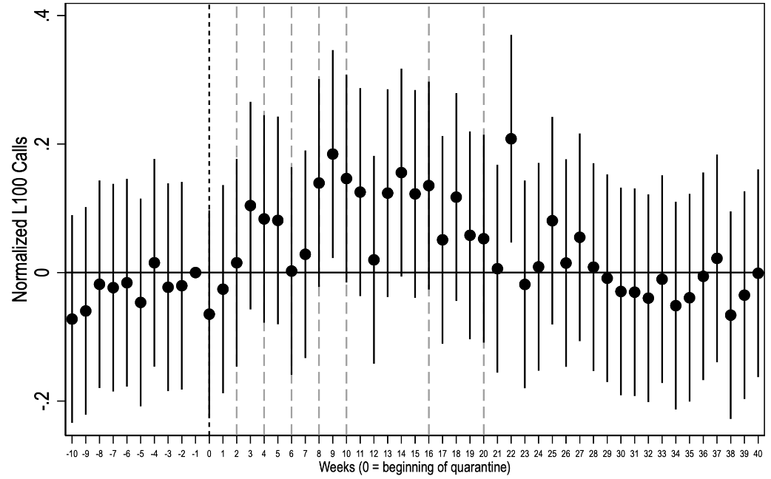
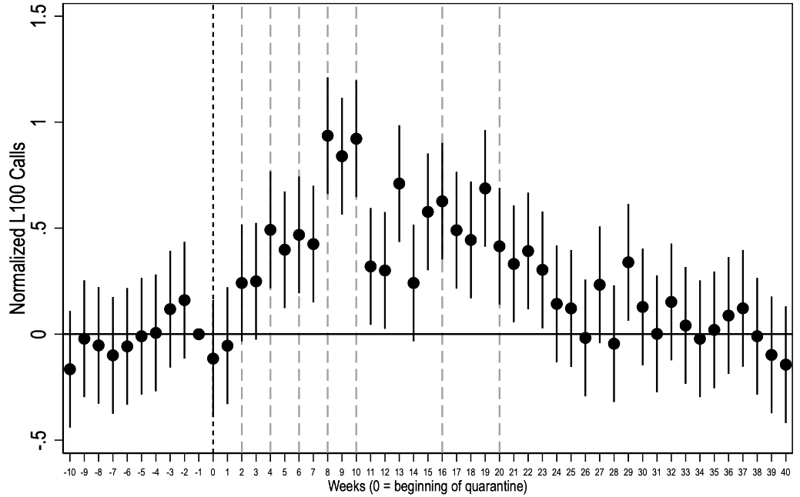
Effects on males
Event Study - Daily IPV calls by men in 2020, relative to 2019
Are women the only ones affected?
Event study for IPV cases against men
No significant effects in number of calls made by men victims of IPV along the 40 weeks evaluated
But significant effects for IPV of same-sex couples
Similar dynamic to effects of women with heterosexual partners: nonlinear effect, peak increase week 10
Next steps: IPV against minors
Event Study - Daily IPV calls (same sex couples) 2020, relative to 2019
Note: Event study estimates and 95% confidence intervals. The black dotted line indicates the starting weeks of the lockdown (Mar16, 2020) and the gray dotted lines indicate its extensions. The regression includes region-year, region-week, and region-day fixed effects. Four additional dummies indicating the hour the call was made are included as controls. To account for years starting on different days of the week, we encode the first week as starting on January 1st and finishing on the first Sunday, so since the second calendar week, each week will run from Monday through Sunday.
Notes:
- A valid question around IPV during pandemic must address if only women were more prone to suffer IPV by their male counterparts

Slide 26
6 takeaways
Takeaways
Nonlinear dynamic effects in IPV
Forced confinement created IPV conditions
Increase of IPV calls different by type of violence.
Sexual violence requires other reporting channels and services.
Assessment of three mechanisms
No free lunch between lockdowns & IPV.
Notes:
More calls or more violence? First-time or repeated victims?
Increased time at home, stress and aggression. In line with theories of routine activities and control
Inverted-U shape effects led by psychological IPV. Initial call drop attributed to physical IPV.
Qualitative and int. evidence suggests it has not decreased
Prior violence, isolation, and drugs. May be driving the results.
Need for evidence on consequences, to inform debates. Future crises

Slide 27
6 takeaways
Takeaways
Forced confinement created conditions for increased time at home, stress and aggression
in line with theories of routine activities and control
Nonlinear dynamic effects in IPV
More calls or more violence?
First-time or repeated victims?
Increase of IPV calls different by type of violence.
Inverted-U shape effects led by psychological IPV. Initial call drop attributed to physical IPV.
Sexual violence requires other reporting channels and services. Qualitative and int. evidence suggests it has not decreased
Assessment of three mechanisms that may drive the results.
Prior violence, isolation, and drugs
No free lunch of health-related lockdown measures on IPV.
Need for evidence on consequences, to inform debates. Future crises
Notes:
Peru has been one of the countries hardest hit by COVID-19 and is a country with high rates of intimate partner violence.
The objective of this study was to evaluate the impact of pandemic-related lockdowns on intimate partner violence in Peru and identify the mechanisms behind these effects.
Analysis uses administrative records of calls received by L100, the only telephone service for victims of violence in the country.
Unlike previous studies, the effects of confinement measures on intimate partner violence are differentiated according to the types of violence (psychological, physical, and sexual).
As far as we are concerned, this work is the first to identify dynamic effects over almost one year of the pandemic for intimate partner violence using national-level data.
Limitations. Although the records from Línea 100 are valuable, it is important to note that they do not represent the prevalence of IPV in the general population. certain forms of violence may be underrepresented, self selection

Slide 28
Questions?

Slide 29
Thank you.
Angelo Cozzubo
  Senior Research Associate II
  cozzubo-angelo@norc.org

