Slide 1
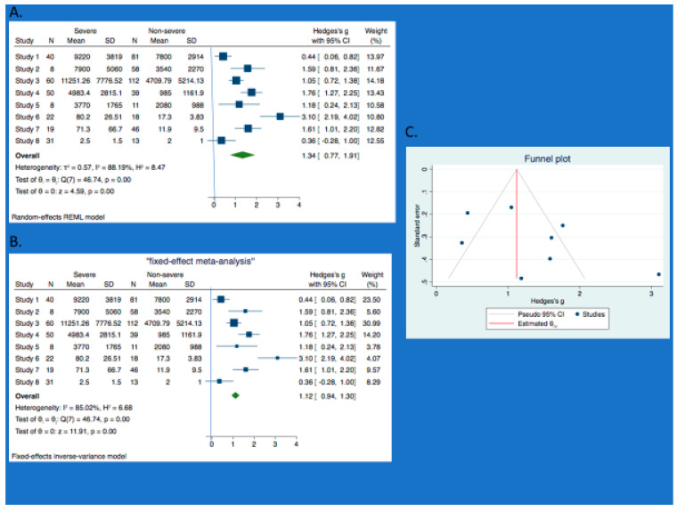
Calprotectin Metadata in COVID-19
Dr Raphael Udeh
School of Medicine & Public Health
The University of Newcastle, Australia [Alumni]
2021 Stata Conference
August 5, 2021

Slide 2
Calprotectin Metadata in COVID-19 | Contents
Research Questions
Rationale / Recent Evidence
What is Calprotectin?
Hypothesis / Aims
Search & Selection criteria / Statistical Analysis
Study characteristics / Summary of main findings
Meta-analysis using Stata
Strength & Limitations
Conclusion / Significance

Slide 3
Calprotectin Metadata in COVID-19 | Research Questions
What is the difference in Calprotectin level between
patients with and without severe COVID-19?
Role as a marker of disease progression and as an
outcome predictor?

Slide 4
Calprotectin Metadata in COVID-19 | Rationale
Varied clinical course
- Mild / moderate cases [Often recovers]
- Severe cases [May end up in ICU or die]
Need for a more specific diagnostic tool – to identify and predict outcomes in COVID-19

Slide 5
Calprotectin Metadata in COVID-19 | Recent Evidence
1. Elevated calprotectin and abnormal myeloid cell subsets discriminate severe from mild COVID-19
A Silvin, N Chapuis, G Dunsmore, AG Goubet… - Cell, 2020
…… we performed high-dimensional flow cytometry and single-cell RNA sequencing of COVID-19 patient peripheral blood …… release of massive amounts of calprotectin (S100A8/S100A9) in severe cases.
2. S100A8/A9 in Inflammation
S Wang, R Song, Z Wang, Z Jing, S Wang.. - Frontiers in immu… 2018 - frontiersin.org
……. S100A8 and S100A9 …….. often exist in the form of heterodimer, while
homodimer exists very little because of the stability. S100A8/A9 is constitutively expressed in

Slide 6
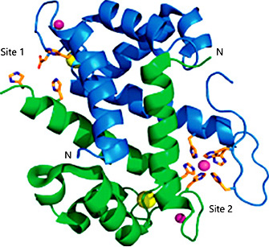
Calprotectin Metadata in COVID-19 | What is Calprotectin?
Calcium and Zinc-binding protein
- Heterodimer of S100A8 [Green] and S100A9 [Blue]
Fundamentally expressed by neutrophils and macrophages
Predominant protein in neutrophils
- Accounts for 45-60% of all cytosolic proteins in neutrophils
Non-covalent bonding between these blood cells and Calprotectin
- via its main receptor, Toll-like receptor 4 [TLR4]
Postulated functions include
- acute-phase reactant in neutrophil migration in infection etc
- involved in cell maturation, arachidonic acid metabolism, predictive roles etc.

Slide 7
Calprotectin Metadata in COVID-19 | Our Hypothesis
Calprotectin is significantly higher in severe cases of
COVID-19 compared to the non-severe forms
Raised calprotectin level in severe COVID-19 has
diagnostic, prognostic and therapeutic value

Slide 8
Calprotectin Metadata in COVID-19 | Aims
To carefully evaluate the levels of calprotectin in
severe and non-severe COVID-19
To identify the implication of raised levels
of calprotectin

Slide 9
Calprotectin Metadata in COVID-19 | Search & Quality Check
Systematic search [Dec 1, 2019 – Dec 5, 2020] in
- MEDLINE
- EMBASE
- The Cochrane Library
- Web of Science
- MedRxiv
Quality assessment of included studies
- Newcastle-Ottawa Scale [NOS]: 3 main parameters for cohort/cc
- National Institute of Health [NIH]: 9 parameters for case series

Slide 10
Calprotectin Metadata in COVID-19 | Selection criteria
Table 1. Eligibility criteria.
PICOS | Inclusion | Exclusion
Participants | Adults ≥ 18 years with confirmed COVID-19 infection | Adolescents < 18 years
Intervention | Calprotectin level measured | Other diagnostic parameters used
Comparison | Severe and non-severe COVID-19 infections | -
Outcome | -Difference in calprotectin levels between the groups -Association between calprotectin level and clinical/laboratory assessment of disease activity -Association with risk of disease progress/therapeutic response | -
Study design | -Observational clinical studies -Randomized controlled trial (RCTs) -Case reports-Editorials | -Opinion papers, correspondents, review papers, healthcare guidelines, protocol -Non-human studies -Animal model and in-vitro studies

Slide 11
Calprotectin Metadata in COVID-19 | PRISMA
*98 published records retrieved
*61 after duplicate removal
*41 initially excluded
*20 further excluded
*10 finally included [8:2]

Slide 12
Calprotectin Metadata in COVID-19 | Statistical Analysis
Narrative synthesis of the results of the included studies
Relevant data extraction from the findings of each study
Categorized by reported outcome measure as
- either Serum / Faecal calprotectin
- Standardized Mean Difference [SMD] in the mean values for severe and
non-severe evaluated
- metan in Stata v 16.1 employed to get the pooled estimate
- Substantial heterogeneity was defined by ꓲ₂ more than 50%

Slide 13
Calprotectin Metadata in COVID-19 | Study Characteristics

Slide 14
Calprotectin Metadata in COVID-19 | Summary table [Main results]
* Chen L. et al 2020 Cellular & Molecular Immunology
- Elevated serum levels of S100A8/A9 and HMGB1 at hospital admission are
correlated with inferior clinical outcomes inCOVID-19 patients.
* Effenberger et al 2020 gut.bmj
- Faecal calprotectin indicates intestinal inflammation in COVID-19
Calprotectin circulating level strongly correlated with mean oxygen score and is significantly raised in COVID-19 patients who died..
FC levels were significantly higher in COVID-19 patients with diarrhea and correlated positively with serum IL-6 but not with CRP and ferritin.

Slide 15
Calprotectin Metadata in COVID-19 |Meta-analysis using Stata
Core commands:
- meta esize n1 m1 sd1, n2 m2 sd2
- meta summarize, random – for descriptive
statistics
- meta forestplot, random title(‘’Random-
effect meta-analysis’’)
- Steps 2 & 3 repeated for the fixed-effect model
- meta funnelplot
- meta bias, egger

Slide 16
Calprotectin Metadata in COVID-19 |Metaanalysis
Meta-analysis (Total cohort).
Forest plot (REM) and
Forest plot (FEM) comparing the mean differences in calprotectin level between severe and non-severe COVID-19. Studies 1–8 are respectively—Chen et al [14]; De Guadiana et al [25]; Shi et al [26]; Silvin et al [12]; Bauer et al [27]; Effenberger et al [16]; Ojetti et al [28]; Britton et al [29].
C. Funnel plot showing some publication bias.

Slide 17
Calprotectin Metadata in COVID-19 | Subgroup analysis/Pub. Bias
Figure 4: Meta-analysis (sensitivity analysis excluding three studies).
Forest plot (REM) and
Forest plot (FEM) comparing the mean differences in calprotectin level between severe and non-severe COVID-19. Studies 1-5 are respectively: De Guadiana et al²⁵; Shi et al²³; Silvin et al¹²; Bauer et al²⁴; Ojetti et al²⁶.
Funnel plot (for the sensitivity analysis excluding three studies) shows no publication bias, an improvement from the total cohort funnel plot shown in figure 3c.
Funnel plot (Subgroup analysis - Serum group) shows no publication bias.
Funnel plot (Subgroup analysis - faecal group) shows some evidence of publication bias with much asymmetry.

Slide 18
Calprotectin Metadata in COVID-19 | Strength & Limitations
Strengths
- First comprehensive systematic review and meta-analysis
- Overall pooled estimate presents the data with enhanced accuracy
- Most studies are of good quality
- Included studies overlapped fairly
Limitations
- Some of the included studies were underpowered
- Huge heterogeneity owing to huge variation in clinical attributes
- Variation in calprotectin kits in different studies
- Lack of adequate data demands some caution in generalizing our findings

Slide 19
Calprotectin Metadata in COVID-19 | Conclusions / Significance
Circulating calprotectin is elevated in COVID-19
Higher levels in severe cases of COVID-19 for risk stratification and outcome prediction
Opportunity as a druggable target - potential therapeutic strategy in severe COVID-19

Slide 20
Calprotectin Metadata in COVID-19 | Acknowledgement [Co-authors]
Co-authors:
Shailesh Advani¹ Luis García De Guadiana Romualdo² & Xenia Dolje-gore³
* ¹Terasaki Institute of Biomedical Innovation, Los Angeles, CA 90024,
USA
* ²Hospital Universitario Santa Lucía, Calle Minarete, s/n, 30202,
Cartagena, Murcia, Spain
* ³School of Medicine & Public Health, University of Newcastle,
Australia.

Slide 21
Calprotectin Metadata in COVID-19 | References
* References
- Silvin et al. Cell, 182(6), 1401-1418.
- Wang S. et al. Frontiers in immunology,
11(9), 1298.
- Udeh R. et al. Journal of clin med 10(4), 775
https://doi.org/10.3390/jcm10040775/
[See the paper for the full reference list]

Slide 22
Calprotectin Metadata in COVID-19

Slide 23
Calprotectin Metadata in COVID-19 | Correspondence/collaboration
Contact/Correspondence:
Dr Ralph Udeh
Raphael.Udeh@uon.edu.au
+61449735329
Twitter: @DrUdeh2021
LinkedIn: https://www.linkedin.com/in/raphael-udeh-
1a4a2276/

