Slide 1



compmed: A new command for estimating causal mediation effects with non-adherence to treatment allocation
Anca Chis Ster, Sabine Landau, Richard Emsley
Department of Biostatistics and Health Informatics, King’s College London, United Kingdom
Thursday 12rd September 2024
2024 UK Stata Conference

Slide 2
Motivation for handling nonadherence in mediation
Trials in mental health often evaluate complex interventions, such as therapy or psychotherapy
One guideline for evaluating complex interventions is to understand the treatment mechanism, i.e., understand how the treatment works in practice
Trials in mental health are faced with the challenge of nonadherence to treatment allocation
It’s currently unclear how to account for nonadherence in a mechanism evaluation, or how to practically implement this within a statistical package, e.g.,
Anca Chis Ster
King’s College London anca.m.chis_ster@kcl.ac.uk

Slide 3
Background: The challenge of non-adherence in trials
ITT
= NDE + NIE
Mediator
(M)
Baseline covariates
(X)
U,X
U
NIE = a*b
Treatment receipt
(D)
Randomisation
(R)
Outcome
(Y)
NDE = c’
NDE
NIE
ITT
a
c’
b
X, U = measured or unmeasured variables
ITT = Intention-to-treat
CACE = Complier Average Causal Effect
NDE = Natural Direct Effect
NIE = Natural Indirect Effect
Anca Chis Ster
King’s College London anca.m.chis_ster@kcl.ac.uk
CACE

Slide 4
Background: The challenge of non-adherence in trials
ITT
= NDE + NIE
Mediator
(M)
Baseline covariates
(X)
U,X
U
NIE = a*b
Randomisation
(R)
Treatment receipt
(D)
Outcome
(Y)
NDE = c’
a
NDE
NIE
c’
b
X, U = measured or unmeasured variables
ITT = Intention-to-treat
CACE = Complier Average Causal Effect
NDE = Natural Direct Effect
NIE = Natural Indirect Effect
Anca Chis Ster
King’s College London anca.m.chis_ster@kcl.ac.uk
ITT
CACE

Slide 5
Background: The challenge of non-adherence in trials
Baseline covariates
(X)
ITT
= NDE + NIE
Mediator
(M)
Baseline covariates
(X)
U,X
U
NIE = a*b
Randomisation
(R)
Treatment receipt
(D)
Outcome
(Y)
NDE = c’
NDE
NIE
CACE
a
c’
b
X, U = measured or unmeasured variables
ITT = Intention-to-treat
CACE = Complier Average Causal Effect
NDE = Natural Direct Effect
NIE = Natural Indirect Effect
Anca Chis Ster
King’s College London anca.m.chis_ster@kcl.ac.uk
ITT

Slide 6
Background: Mechanism evaluation
U
Baseline covariates
(X)
ITT
= NDE + NIE
Mediator
(M)
Baseline covariates
(X)
U,X
U1
NIE = a*b
Randomisation
(R)
Outcome
(Y)
ITT
Treatment receipt
(D)
NDE = c’
a
NDE
NIE
U2
c’
b
= NDE + NIE
X, U = measured or unmeasured variables
ITT = Intention-to-treat
CACE = Complier Average Causal Effect
NDE = Natural Direct Effect
NIE = Natural Indirect Effect
Anca Chis Ster
King’s College London anca.m.chis_ster@kcl.ac.uk
CACE

Slide 7
Background: Mechanism evaluation
U
Baseline covariates
(X)
ITT
= NDE + NIE
Mediator
(M)
NIE = a*b
Baseline covariates
(X)
U,X
U1
a
b
Randomisation
(R)
c’
Outcome
(Y)
Treatment receipt
(D)
ITT
= NDE + NIE
NDE
NIE
U2
NDE = c’
X, U = measured or unmeasured variables
ITT = Intention-to-treat
CACE = Complier Average Causal Effect
NDE = Natural Direct Effect
NIE = Natural Indirect Effect
Anca Chis Ster
King’s College London anca.m.chis_ster@kcl.ac.uk
CACE

Slide 8
Background: Mechanism evaluation
U
a
NIE = a*b
b
Baseline covariates
(X)
ITT
= NDE + NIE
Mediator
(M)
Baseline covariates
(X)
U,X
U1
ITT
= NDE + NIE
Randomisation
(R)
Treatment receipt
(D)
Outcome
(Y)
NDE
NIE
U2
X, U = measured or unmeasured variables
ITT = Intention-to-treat
CACE = Complier Average Causal Effect
NDE = Natural Direct Effect
NIE = Natural Indirect Effect
Anca Chis Ster
King’s College London anca.m.chis_ster@kcl.ac.uk
NDE = c’
CACE
c’

Slide 9
Background: Mechanism evaluation
U
a
NIE = a*b
b
Baseline covariates
(X)
ITT
= NDE + NIE
Mediator
(M)
Baseline covariates
(X)
U,X
U1
ITT
= NDE + NIE
Randomisation
(R)
Treatment receipt
(D)
Outcome
(Y)
NDE
NIE
U2
X, U = measured or unmeasured variables
ITT = Intention-to-treat
CACE = Complier Average Causal Effect
NDE = Natural Direct Effect
NIE = Natural Indirect Effect
Anca Chis Ster
King’s College London anca.m.chis_ster@kcl.ac.uk
NDE = c’
CACE
c’

Slide 10
Combining mediation and non-adherence: Identification
U
a
NIE = a*b
b
Baseline covariates
(X)
ITT
= NDE + NIE
Mediator
(M)
Baseline covariates
(X)
U,X
U1
ITT
= NDE + NIE
Randomisation
(R)
Treatment receipt
(D)
Outcome
(Y)
NDE
NIE
U2
CACE
X, U = measured or unmeasured variables
ITT = Intention-to-treat
CACE = Complier Average Causal Effect
NDE = Natural Direct Effect
NIE = Natural Indirect Effect
Anca Chis Ster
King’s College London anca.m.chis_ster@kcl.ac.uk
NDE = c’
CACE
c’

Slide 11
Combining mediation and non-adherence: Identification
U
a
NIE = a*b
b
Baseline covariates
(X)
The CACE can be partitioned into a:
Complier-Average Causal Mediated Effect (CACME)
Complier-Average Natural Direct Effect (CANDE)
ITT
= NDE + NIE
Mediator
(M)
Baseline covariates
(X)
U,X
U1
ITT
= NDE + NIE
Randomisation
(R)
Treatment receipt
(D)
Outcome
(Y)
NDE
NIE
U2
CACE
= CACME + CANDE
X, U = measured or unmeasured variables
ITT = Intention-to-treat
CACE = Complier Average Causal Effect
NDE = Natural Direct Effect
NIE = Natural Indirect Effect
Anca Chis Ster
King’s College London anca.m.chis_ster@kcl.ac.uk
NDE = c’
CACE
c’

Slide 12
Combining mediation and non-adherence: Assumptions
The CACME and CANDE can be identified under:
Conditionally ignorable treatment assignment
  No variables that influence the randomisation variable
Monotonicity
  No individuals who would receive the opposite intervention to the one offered
Exclusion restriction for non-compliers
  Randomisation cannot directly influence the mediator or outcome variables
Conditionally ignorable observed mediator among compliers
  No unmeasured confounding between the mediator and outcome
Anca Chis Ster
King’s College London anca.m.chis_ster@kcl.ac.uk
CACE = Complier Average Causal Effect
CANDE = Complier Average Natural Direct Effect
CACME = Complier Average Causal Mediated Effect

Slide 13
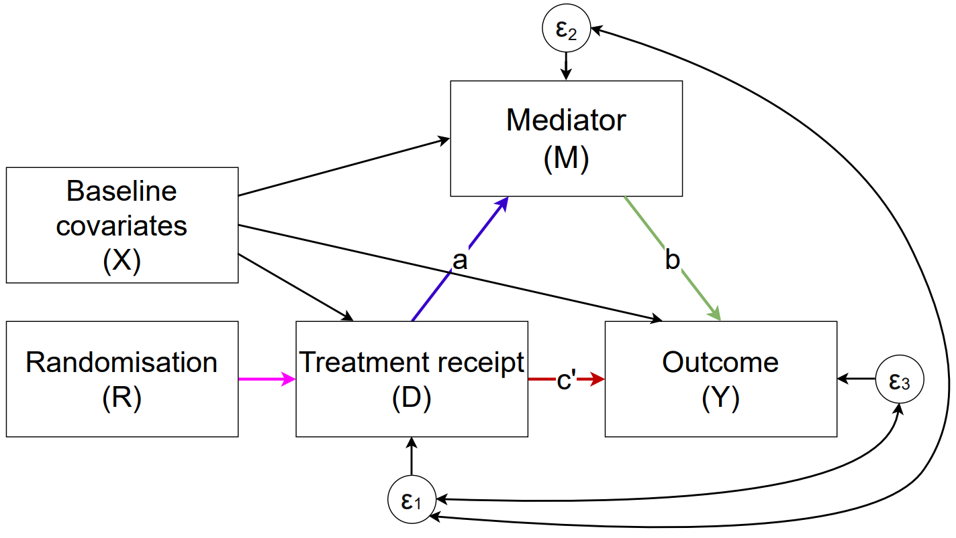



Combining mediation and non-adherence: Estimation
Figure: Path diagram for Structural Equation Model combining mediation and non-adherence
Pathways estimated using Structural Equation Modelling with maximum likelihood
  $$E\left[M|D,X\right]$$
  $$E\left[Y|M,D,X\right]$$
  $$E\left[D|R,X\right]$$
CACME = a * b
CANDE = c’
Anca Chis Ster
King’s College London anca.m.chis_ster@kcl.ac.uk
CACE = Complier Average Causal Effect
CANDE = Complier Average Natural Direct Effect
CACME = Complier Average Causal Mediated Effect
^{α} Complier Average Causal Effect (total)
^{Ω} Complier Average Natural Direct Effect (direct)
^{δ} Complier Average Causal Mediated Effect (mediated)

Slide 14
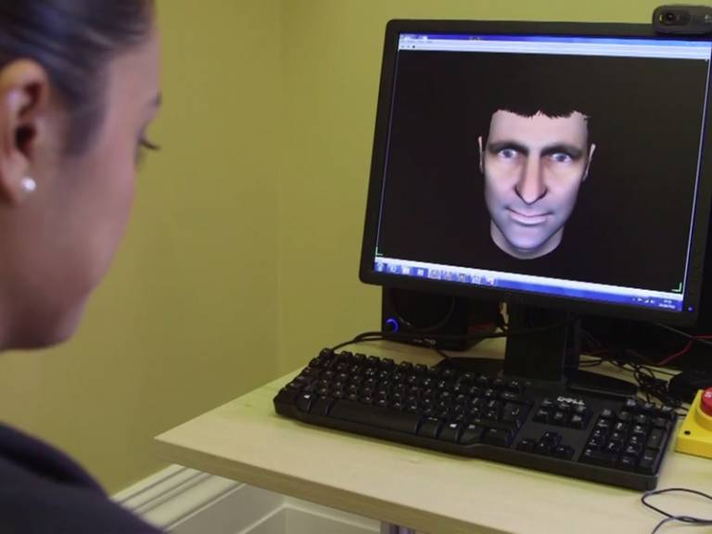
Illustrating example: The AVATAR study
150 participants randomised 1:1 to receive AVATAR therapy or supportive counselling for psychosis related symptoms
The primary outcome was the total score on the Psychotic Symptom Rating Scales at 12 weeks and was analysed with the ITT principle
84% compliance (attended ≥3 of 6 sessions)
Mediator of interest is the participants acceptance-based attitudes in relation to their auditory hallucinations
Craig, T. K. J., Rus-Calafell, M., Ward, T., Leff, J. P., Huckvale, M., Howarth, E., . . . Garety, P. A. (2018). AVATAR therapy for auditory verbal hallucinations in people with psychosis: a single-blind, randomised controlled trial. The Lancet Psychiatry, 5(1), 31-40. doi:10.1016/S2215-0366(17)30427-3

Slide 15
Estimation via –sem–
sem (R -> D) (D -> M) (D M -> Y), cov(e.D*e.M) cov(e.D*e.Y)
The path (R -> D) implements IV theory and accounts for the endogeneity in D
The covariances cov(e.D*e.M) and cov(e.D*e.Y) are essential as they allow for unmeasured confounding between D-M and D-Y
estat teffects
Produces many results and paths – many are not relevant
Can be difficult to identify which paths correspond to the CACME and CANDE

Slide 16
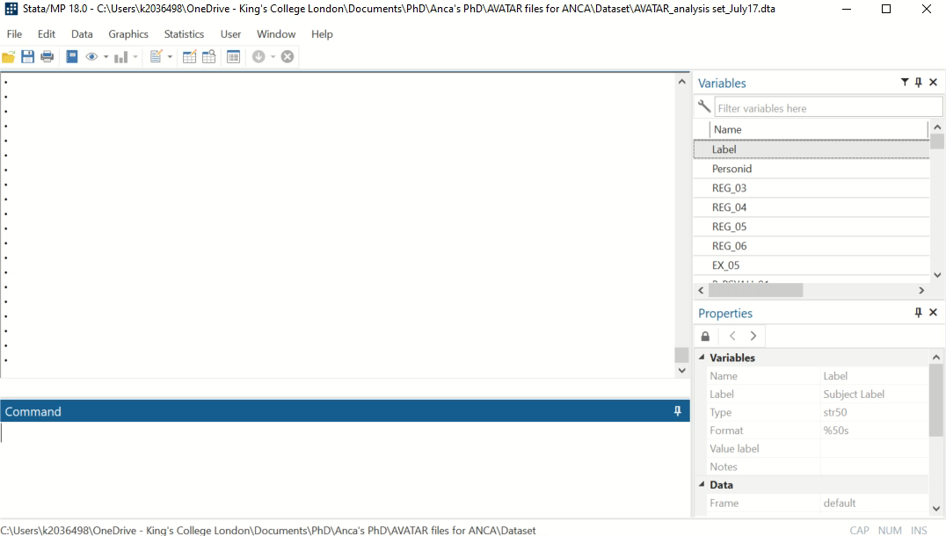
Estimation via the –sem– command

Slide 17
The –compmed- command: Motivation
Estimating the CACME and CANDE requires
  Knowledge of SEMs and the SEM Stata package
  Fitting the correct Structural Equation Model
  Identifying the correct pathways that correspond to the CACME and CANDE
compmed offers a standardised approach for estimating the CACME and CANDE in Stata using a single, more intuitive, and user-friendly programme.
Anca Chis Ster
King’s College London anca.m.chis_ster@kcl.ac.uk

Slide 18
The –compmed- command: Syntax
compmed Y, mvar(M) dvar(D) rvar(R) cvars(varlist) [, vce(vcetype) FULLoutput]
cvars(varlist) determines the list of covariates that are included in the outcome and mediator models.
vce(vcetype)calculates the standard error of the estimator. vcetype can be oim (observed information matrix), robust (Huber/White/sandwich estimator), bootstrap, or cluster (generalized Huber/White/sandwich estimator). If the option is not specified, the default is oim.
FULLoutput reports the full decomposition of effects into total, direct, and indirect effects, along with standard errors obtained by the delta method (Sobel, 1987). This option is equivalent to the ‘estat teffects’ command that is for use after running an the sem command in Stata.
Anca Chis Ster
King’s College London anca.m.chis_ster@kcl.ac.uk

Slide 19
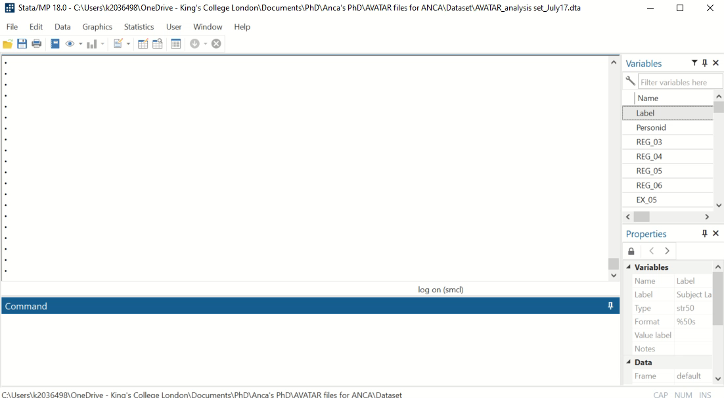
The –compmed- command: Demonstration
Anca Chis Ster
King’s College London anca.m.chis_ster@kcl.ac.uk

Slide 20
Missing data consideration
Both -sem- and -compmed- undertake a complete-case analysis, i.e., observations with missing values are dropped from the analysis
The analysis is therefore valid provided the missing data are MCAR, or MAR (provided all variables that drive missingness are in the analysis model)
  Information on non-adherence, a common predictor of missingness, is already included in the analysis model
A Monte Carlo simulation study demonstrates that unbiased estimates of CACME, CANDE, and CACE can be obtained under the MCAR and MAR scenarios explored (full results and details not described here)

Slide 21
Final remarks
The CACE can be partitioned into a CACME and CANDE under a given set of assumptions and can be estimated with linear SEMs
A new Stata program, compmed, provides a practical tool for undertaking causal mediation analysis with non-adherence
  Fits the correct SEM model
  Automatically identifies the paths that correspond to the CACME and CANDE
  Outputs a nice and simple table with these estimates
Anca Chis Ster
King’s College London anca.m.chis_ster@kcl.ac.uk

Slide 22

Questions
anca.m.chis_ster@kcl.ac.uk
@anca_chisster

