Slide 1
Visualisations to evaluate and communicate adverse event data in randomised controlled trials:
Application of the user written Stata commands aedot and aevolcano
Rachel Phillips
Senior Lecturer in Medical Statistics and Clinical Trials
Imperial College London

Slide 2
Outline
Overview of current practice for communication of adverse events in RCTs
Demonstrate how graphics provide an improvement on current practice
Demonstrate two user written Stata commands to produce example graphics

Slide 3
Background
RCTs are typically designed around a primary efficacy outcome e.g. does drug A improve survival compared to drug B (standard care)
Might also have known safety outcomes (or harms) as secondary outcomes
Plus adverse events (AEs) that emerge during the trial
How we analyse and report AE outcomes needs improvements
Methods used to analyse these outcomes are less established and data is underutilised

Slide 4
Evaluating harm
Prespecified events of interest + many emerging AEs
We don’t know what or how many AEs will be reported
Outcome measurement considerations:
      Variable type: single occurrence and repeated AEs, time to event, continuous
      Duration of each AE
      Severity of each AE
      Timing of each AE
Often low event rates
…current practice underutilises this data

Slide 5
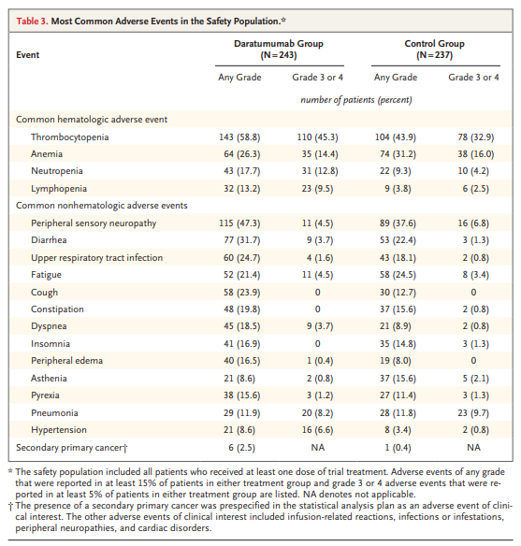
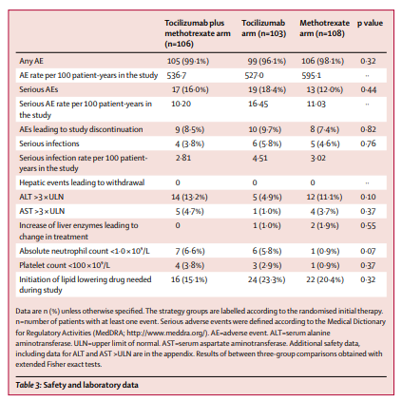
Typically we find AE data presented in tables

Slide 6
State of play
We’ve got complex, multifaceted data that we simplify and present in contingency tables, sometimes accompanied with inappropriate hypothesis tests or alternatively undertaking no analysis at all!
We are missing a valuable opportunity for early evaluation of harm

Slide 7

What are we trying to do when analysing AE data?
We’re looking for signals of adverse reactions
Reporting all AE data in tables can be overwhelming and incomprehensible
We need summaries that are more digestible and allow a clearer, more informative profile to be presented

Slide 8

Could visualisations offer a solution?

Slide 9
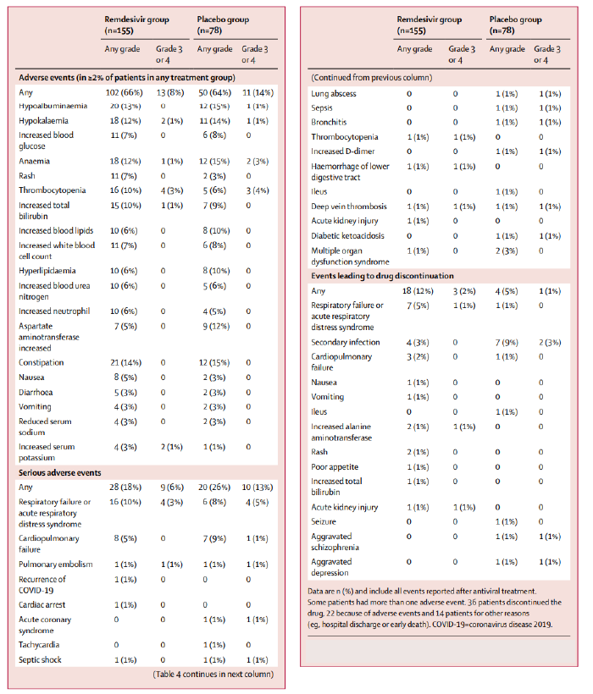
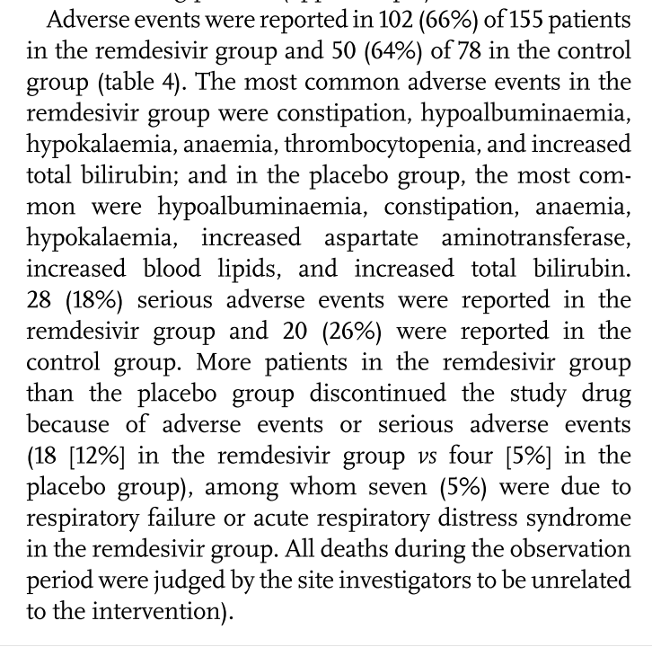
Case study: Remdesivir in adults with severe COVID-19
How useful is this information?
Are they clinically important?
Is there a numerical imbalance?
Could they in fact relate to the underlying infection or participant comorbidity?
Wang, Y., et al. (2020). "Remdesivir in adults with severe COVID-19: a randomised, double-blind, placebo-controlled, multicentre trial." The Lancet 395(10236): 1569-1578.

Slide 10
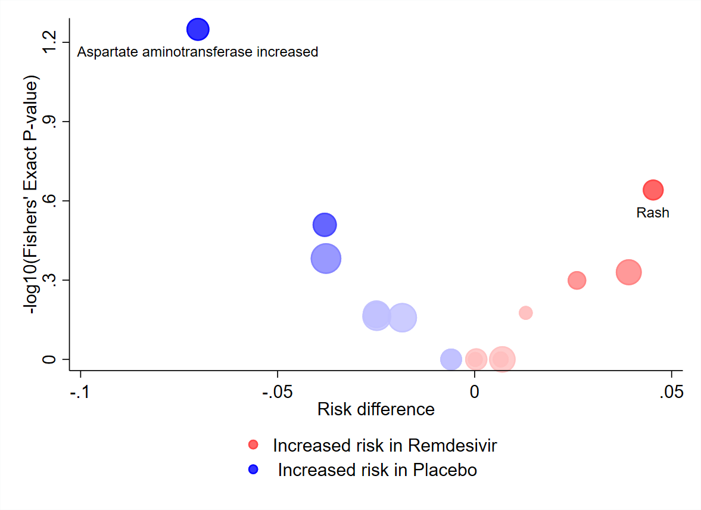
Volcano plot
AEs that occurred ≥ 2% of participants

Slide 11
Volcano plot
Individual participant data
Install: ssc install aevolcano or https://ideas.repec.org/c/boc/bocode/s458736.html#download
Syntax: aevolcano varname , treat(varname) id(varname) n1(integer) n2(integer) [options]
aevolcano: requires data in long format with one row per event per participant, where varname indicates the variable that contains the event name/identifier. varname may be a numeric or a string variable.
Options
* treat(varname): variable indicating treatment group assignment in the existing dataset (must be numeric)
* id(varname): variable identifying unique participants in the existing dataset, multiple events (rows) per id acceptable (must be numeric)
* n1(#): the total number of unique participants in the first treatment group (must be an integer value)
* n2(#): the total number of unique participants in the second treatment group (must be an integer value)
Various [options] to edit the graph

Slide 12
Volcano plot
Summary level data
Install: part of the aevolcano package
Syntax: aevolcs varname , n1(varname) n2(varname) tot1(varname) tot2(varname) [options]
aevolcs: requires summary data in long format with one row per event, where varname indicates the variable that contains the event name/identifier. varname may be a numeric or a string variable.
Options
* n1(varname):variable indicating the number of participants in the first treatment group with the event specified in varname (must be numeric)
* n2(varname): variable indicating the number of participants in the second treatment group with the event specified in varname (must be numeric)
* tot1(varname): variable indicating the total number of unique participants in the first treatment group (must be numeric)
* tot2(varname): variable indicating the total number of unique participants in the second treatment group (must be numeric)
Various [options] to edit the graph

Slide 13
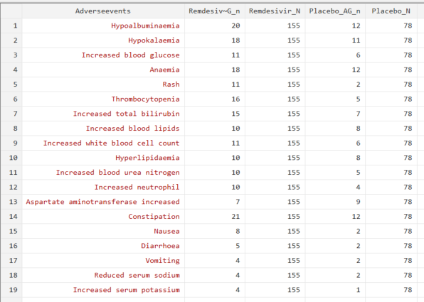
Volcano plot
Summary level data

Slide 14
Volcano plot
Summary level data
Basic syntax:
aevolcs Adverseevents, n1(Remdesivir_AG_n) n2( Placebo_AG_n) tot1(Remdesivir_N) tot2(Placebo_N)

Slide 15
Volcano plot
Summary level data
Assigns legend label
for second treatment group
Specify bubble
label position
Syntax with added options:
aevolcs Adverseevents , n1(Remdesivir_AG_n) n2(Placebo_AG_n) tot1(Remdesivir_N) tot2(Placebo_N)
legendyn(1) legend1(Remdesivir) legend2(Placebo) labelyn(1) labang(0) labpos(6) labgap(2)
Assigns legend label
for first treatment group
Turns bubble
labels on
Specify label
distance
from bubble
Turns legend on
Specify bubble
label angle/orientation

Slide 16
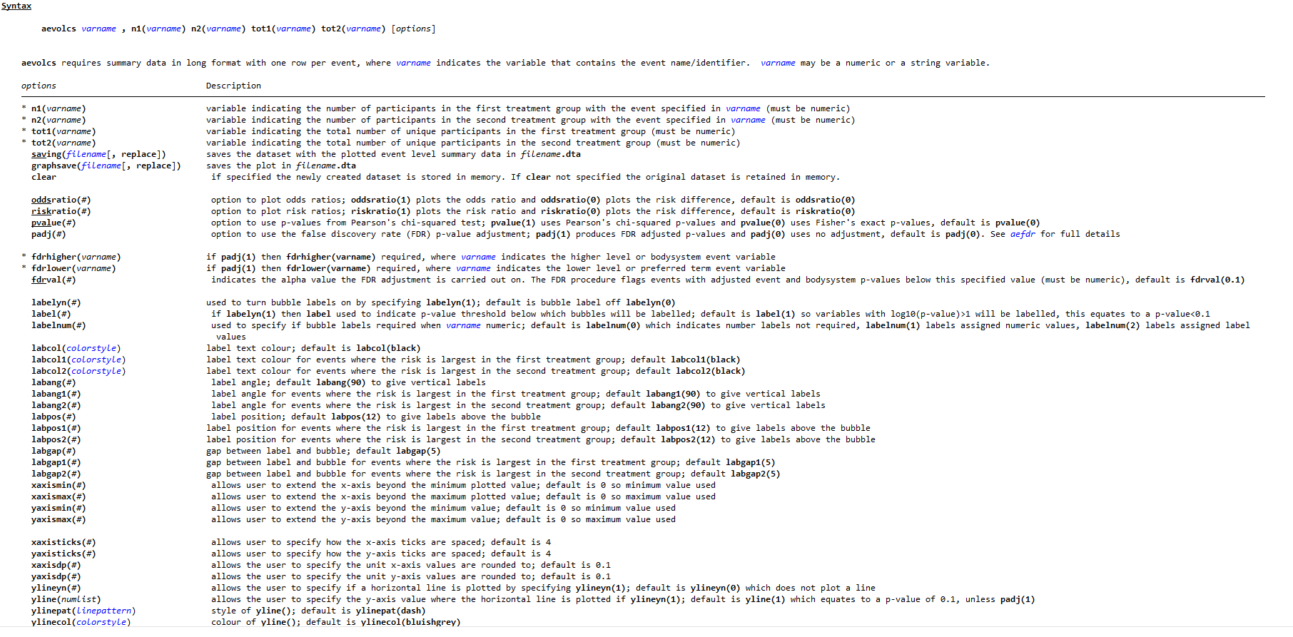
Volcano plot
Summary level data
All [options] detailed in the help file

Slide 17
Volcano plot
Pros
Immediate communication of extreme differences in AE - any asymmetry in the plot
Effective way to communicate signals for adverse reactions
Cons/cautions
Less effective when there are few AEs in total, or where several AEs share the same frequency
      Useful when ≈ 10 events or more and not dominated by low frequency counts, e.g. 0 and 1
Precision of the estimate not transparent
      Possible to give a misleading impression when the event numbers are small
Still need to check if it communicates a fair representation of the raw data
Presentation of more detailed information in a table is still needed

Slide 18
Dot plot
AEs that occurred ≥ 2% of participants

Slide 19
Dot plot
Individual participant data
Install: ssc install aedot or https://ideas.repec.org/c/boc/bocode/s458735.html
Syntax: aedot varname , treat(varname) id(varname) n1(integer) n2(integer) [options]
aedot: requires data in long format with one row per event per participant, where varname indicates the variable that contains the event name/identifier. varname may be a numeric or a string variable.
Options
* treat(varname): variable indicating treatment group assignment in the existing dataset (must be numeric)
* id(varname): variable identifying unique participants in the existing dataset, multiple events (rows) per id acceptable (must be numeric)
* n1(#): the total number of unique participants in the first treatment group (must be an integer value)
* n2(#): the total number of unique participants in the second treatment group (must be an integer value)
Various [options] to edit the graph

Slide 20
Dot plot
Summary level data
Install: part of the aedot package
Syntax: aedots varname , n1(varname) n2(varname) tot1(varname) tot2(varname) [options]
aedots: requires summary data in long format with one row per event, where varname indicates the variable that contains the event name/identifier. varname may be a numeric or a string variable.
Options
* n1(varname): variable indicating the number of participants in the first treatment group with the event specified in varname (must be numeric)
* n2(varname): variable indicating the number of participants in the second treatment group with the event specified in varname (must be numeric)
* tot1(varname): variable indicating the total number of unique participants in the first treatment group (must be numeric)
* tot2(varname): variable indicating the total number of unique participants in the second treatment group (must be numeric)
Various [options] to edit the graph

Slide 21
Dot plot
Summary level data
Basic syntax:
aedots Adverseevents, n1(Remdesivir_AG_n) n2(Placebo_AG_n) tot1(Remdesivir_N) tot2(Placebo_N)

Slide 22
Dot plot
Changes marker symbol
Summary level data
Changes marker colour
Syntax with added options:
aedots Adverseevents , n1(Remdesivir_AG_n) n2(Placebo_AG_n) tot1(Remdesivir_N) tot2(Placebo_N)
logoff(1) leftcolor1(red) leftcolor2(green) leftsymb1(triangle) legendleft1(Remdesivir (N=155)) legendleft2(Placebo (N=78)) brightmargin(3.5) leftlabsize(1.3) rightxline(1) rightxlabel(0.2 0.5 1 2 6 20) nummargin(1) margin(30) event1pos(35) event2pos(90) event1name(Remdesivir) event2name(Placebo) marginpos(r)
Specify the position of the data table
Includes the data table
Specify the labels for the columns of the data table
Specify position of data table columns relative to x-axis

Slide 23
Dot plot
Individual participant data

Slide 24
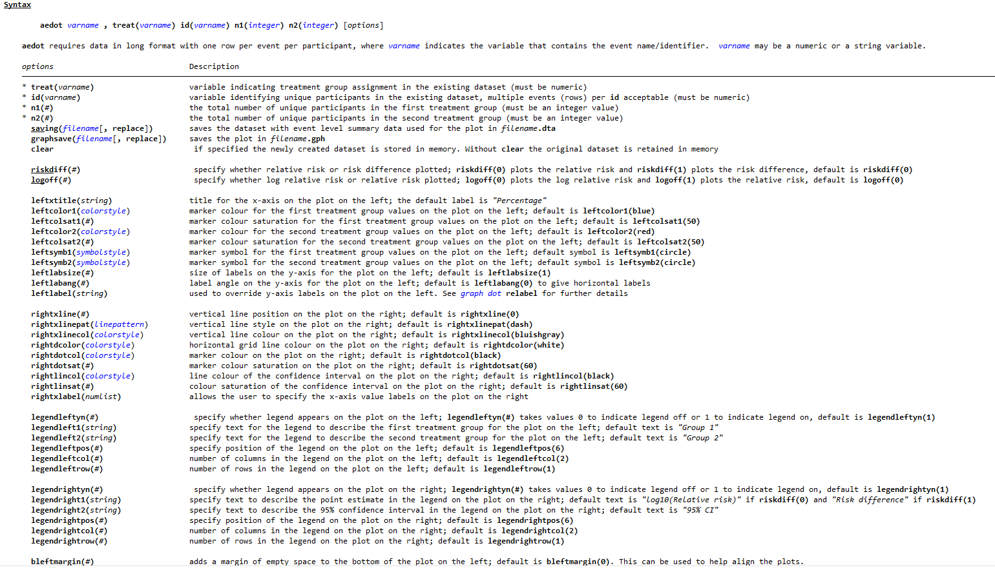
Dot plot
Individual participant data
All [options] detailed in the help file

Slide 25
Dot plot
Pros
Includes more detailed information - absolute risk by arm and relative between-arm comparison
Could replace the typical AE frequency table presented
Allows for more scrutiny
Cons/cautions
Inclusion of 95% CIs for the relative statistic strongly encourages the temptation to interpret as a test of no statistical difference

Slide 26
Summary
Visualisations provide an alternative way to communicate risk of harms
Allows assimilation of large volumes of data
Encourages informal between-arm comparisons
Provide different emphasis on inferences
Recommend trialists examine both crude numbers along with graphical displays

Slide 27
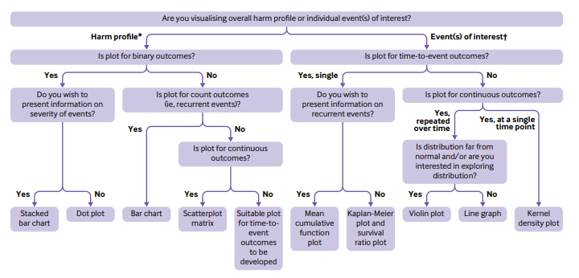
Decision tree to help researchers decide which plot(s) to use to visualise data on harm outcomes

Slide 28
Thank you
r.phillips@imperial.ac.uk

