Slide 1
Using GitHub for Collaborative Analysis
Chloe Middleton-Dalby, Liane Gillespie-Akar email: chloe.middleton-dalby@adelphigroup.com, liane.gillespie-akar@adelphigroup.com
12th September 2024 | UK Stata Conference
Notes:
Chloe, Assoc Director of Statistics at Adelphi Real World
Co-authored by Liane Gillespie-Akar
Talk about Git

Slide 2

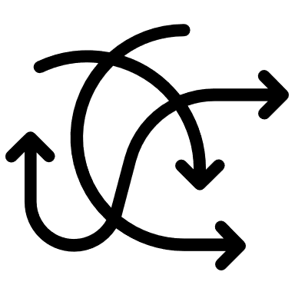

The problem
The work we do is important
The work we do is difficult
Statisticians are human
We need to implement a robust quality control process
Notes:
Two years ago, the S&DA team at ARW had a problem
Work we do is important
Analysis on medical data for pharmaceutical clients
Published and used (pharma, medical orgs, physicians)
Must be correct, can be audited/required
Work we do is difficult
Code in stata
Requests change, flexible
Need to collaborate, share knowledge, train staff
Statisticians are human
Mistakes – typos/ wrong variable
Especially when busy or complicated
We need a high-quality code review process, ideally that encourages collaboration and can support a fluid and changeable environment

Slide 3
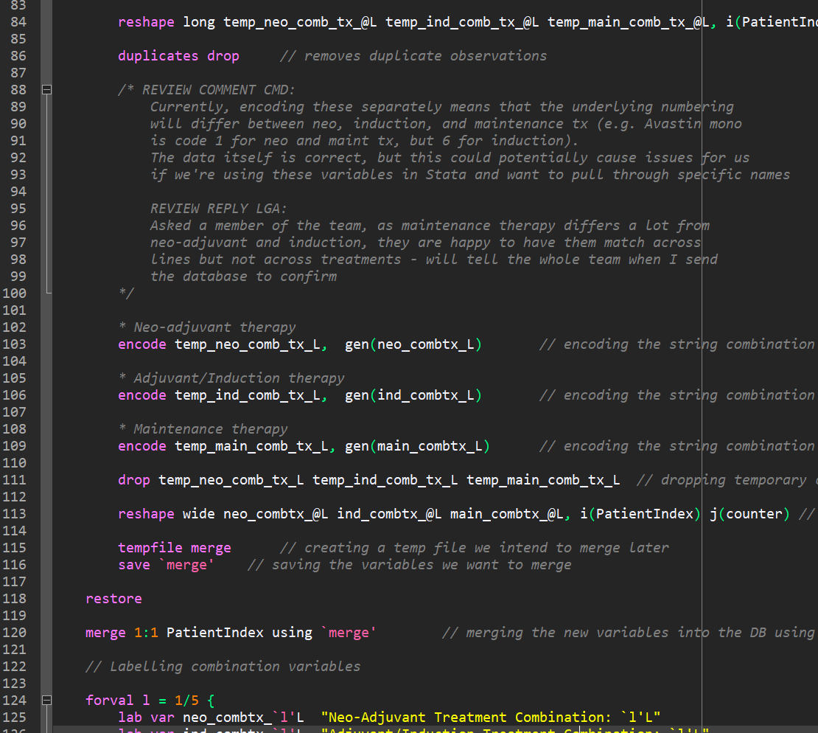
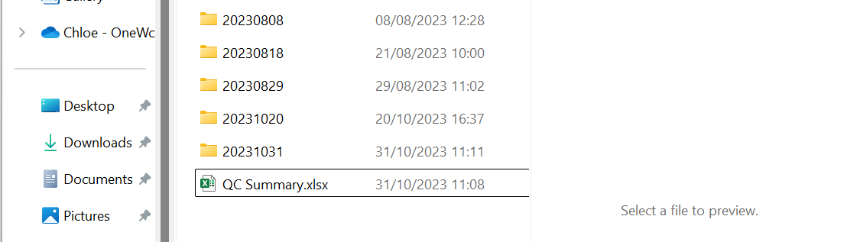
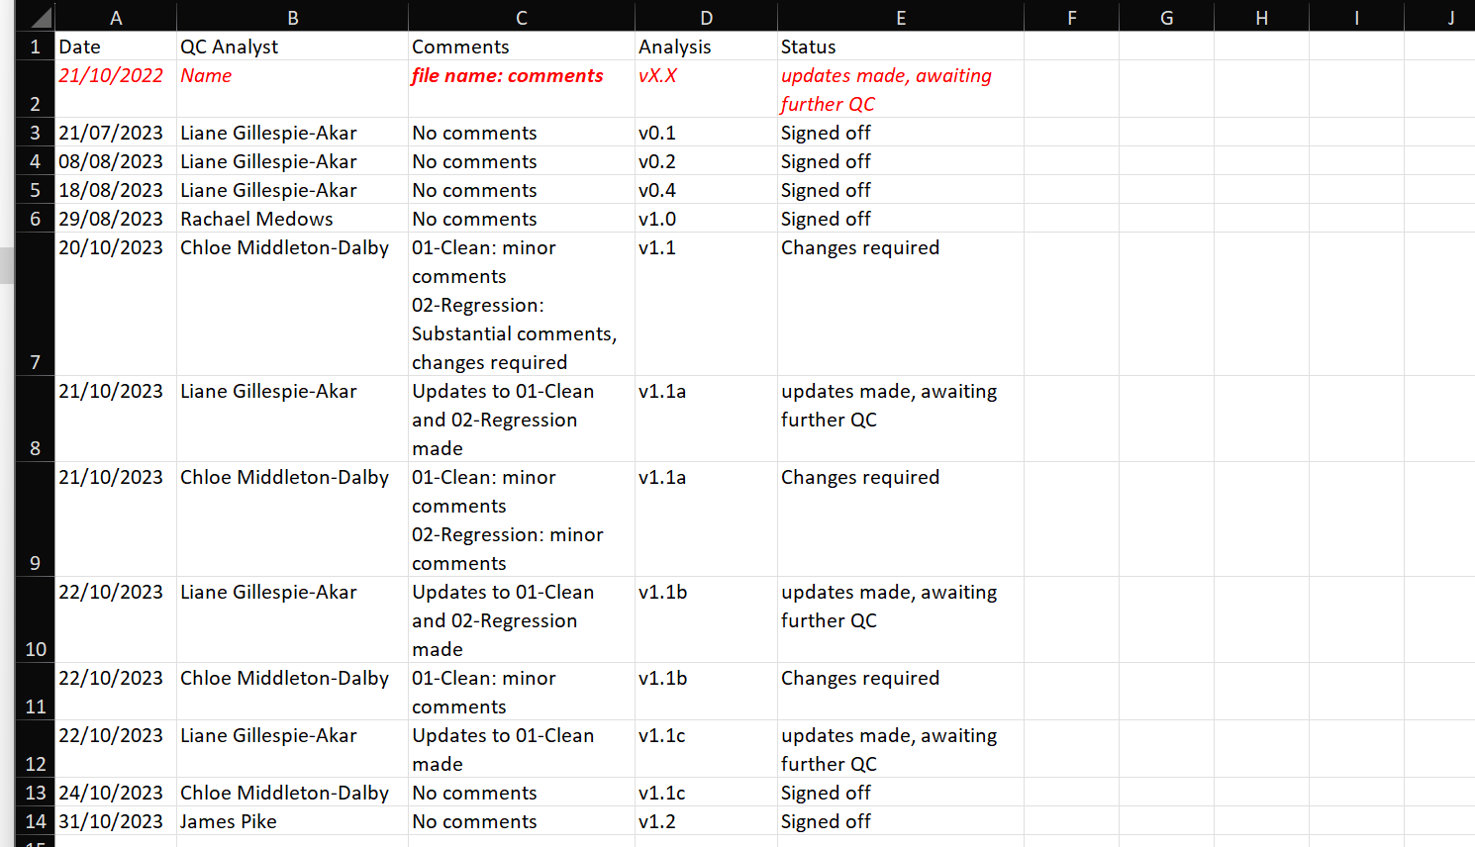
Old code review process
Manual archives
Copies of files at each review timepoint
Review comments
Directly in the do-files
Review summary log
Tracks approvals and versioning
Comment responses
Also directly in the do-files
Date
When reviews were conducted
Status
Tracks where updates are required
Comments
Whether comments were added
QC Analyst
Who conducted the review
Analysis version
For manual version control
Notes:
- Old QC process
- Comment in the do files themselves. Manually send back and forth with links to documents shared on a shared file system
- Manually fill out a QC log, with dates, who reviewed etc
- Manually archive, save whole folders when we make a change (which we would forget to do). This is a version control process, but it’s not very good

Slide 4





Problems with the old process
Time consuming, manual, & admin-heavy
Do-files clogged up with old comments
Required working in shared file system
Hard to see if errors were actually fixed
No way to know who wrote the code
Working simultaneously wasn’t possible
We weren’t the first people to have this problem
Notes:
Manual process: risks human error, forgetting, or losing things
Shared filed system: online only, slow – working locally risks losing data
Send messages “who did this” , when, and why
Do files cluttered with comments, making them less readable, easy to miss comments, and risks comment rot
Only had the new analysis, hard to tell what changes were made
Collaboration was difficult – waiting for others to be done with files, risk breaking someone else’s code
Software developers have the same problem, so we took the solution they developed 20 years ago

Slide 5





The solution:
Linus Torvalds created Git in 2005, while developing
Linux
Industry standard version control system, used by 93% of software developers¹
We use the platform GitHub to manage our Git system, like over 100 million other active users²
We started trialling Git in January 2023, switching to it full time in October
¹ Stack Overflow Development Survey, 2023
² GitHub Company News, 2023
Notes:
Linus Torvalds
Developed Linus Torvalds while creating the linux operating system.
Lightweight, scalable, and allow collaboration across large teams, and on large projects
Git
Everything is stored in the cloud and backed up
statisticians make a copy of the whole repository so they can work locally and regularly our changes up to the cloud
Text files only (although you can upload non-text files for storage).
Throughout, I’m talking about how we store do-files and ado-files
GitHub
We interact with Git via the platform GitHub
Owned by Microsoft and works with our processes, other tools exist like GitLab or BitBucket
GitHub feature is the pull request and review system, that we’ll look at shortly (and similar features are available from the alternatives to GitHub)
1- https://stackoverflow.blog/2023/01/09/beyond-git-the-other-version-control-systems-developers-use/
2- https://github.blog/news-insights/company-news/100-million-developers-and-counting/

Slide 6
Example repository
Commit
Snapshot of the project
Current status of the repo
Main branch
Source of truth
Commit Summary
Description of commit
main
Add readme
Update
fieldwork
materials
Set up folders
Add gitignore
Merge
Brings changes into main after Pull Request
Regression models
Check
diagnostics
Create
report
Clean regression
variables
New branch
Work without changing main
Notes:
Git process – timeline
Commits
Built on commits
Chunks of work, or changes, like snapshots of the project over time
Commit little and often: cleaning some variables, or model is working
Includes summary of changes, who made them, and when (git blame experience)
Branches
Multiple timelines allow for collaboration
Multiple people and multiple work items
Main
Black is “main” pathway for our codebase. It’s a source of truth
Finished, reviewed, and delivered analysis, not work in progress
We can always add or change thing
Branching
If you want to do some work, create a branch.
diversion from the main path like the branch of a tree, where you do something specific.
QoL regressions, so we branch off of main.
Commit
Importantly, at any point I (or someone else) can go back into main, where the project is at this unbranched state.
Merge
Finished branch, changes back into main, we do that by merging (white dot)
Code review happens at this stage, but it’s not required.
GitHub we submit a pull request – asking permission to pull our changes from our branch into mai
- This is an example with just one branch, but you can have as many branches as you want at once (example)

Slide 7
Example repository
Current status of the repo
Merge 2
Brings changes from dashboard branch into main
main
Merge 1
Brings changes from regression models into main
Add readme
Update
fieldwork
materials
Set up folders
Add gitignore
Regression models
More branches
Commit concurrently without affecting each other
Check
diagnostics
Create
report
Clean regression
variables
Dashboard
Clean dashboard
variables
Export dataset
Create
dashboard
Notes:
Multiple branches
Green working on one project
Purple working on another
Same codebase but at the same time
Green merge as before
Purple merges on top
If disagreements in the code, tools to easily resolve conflicts
Current status includes both regressions and dashboard

Slide 8
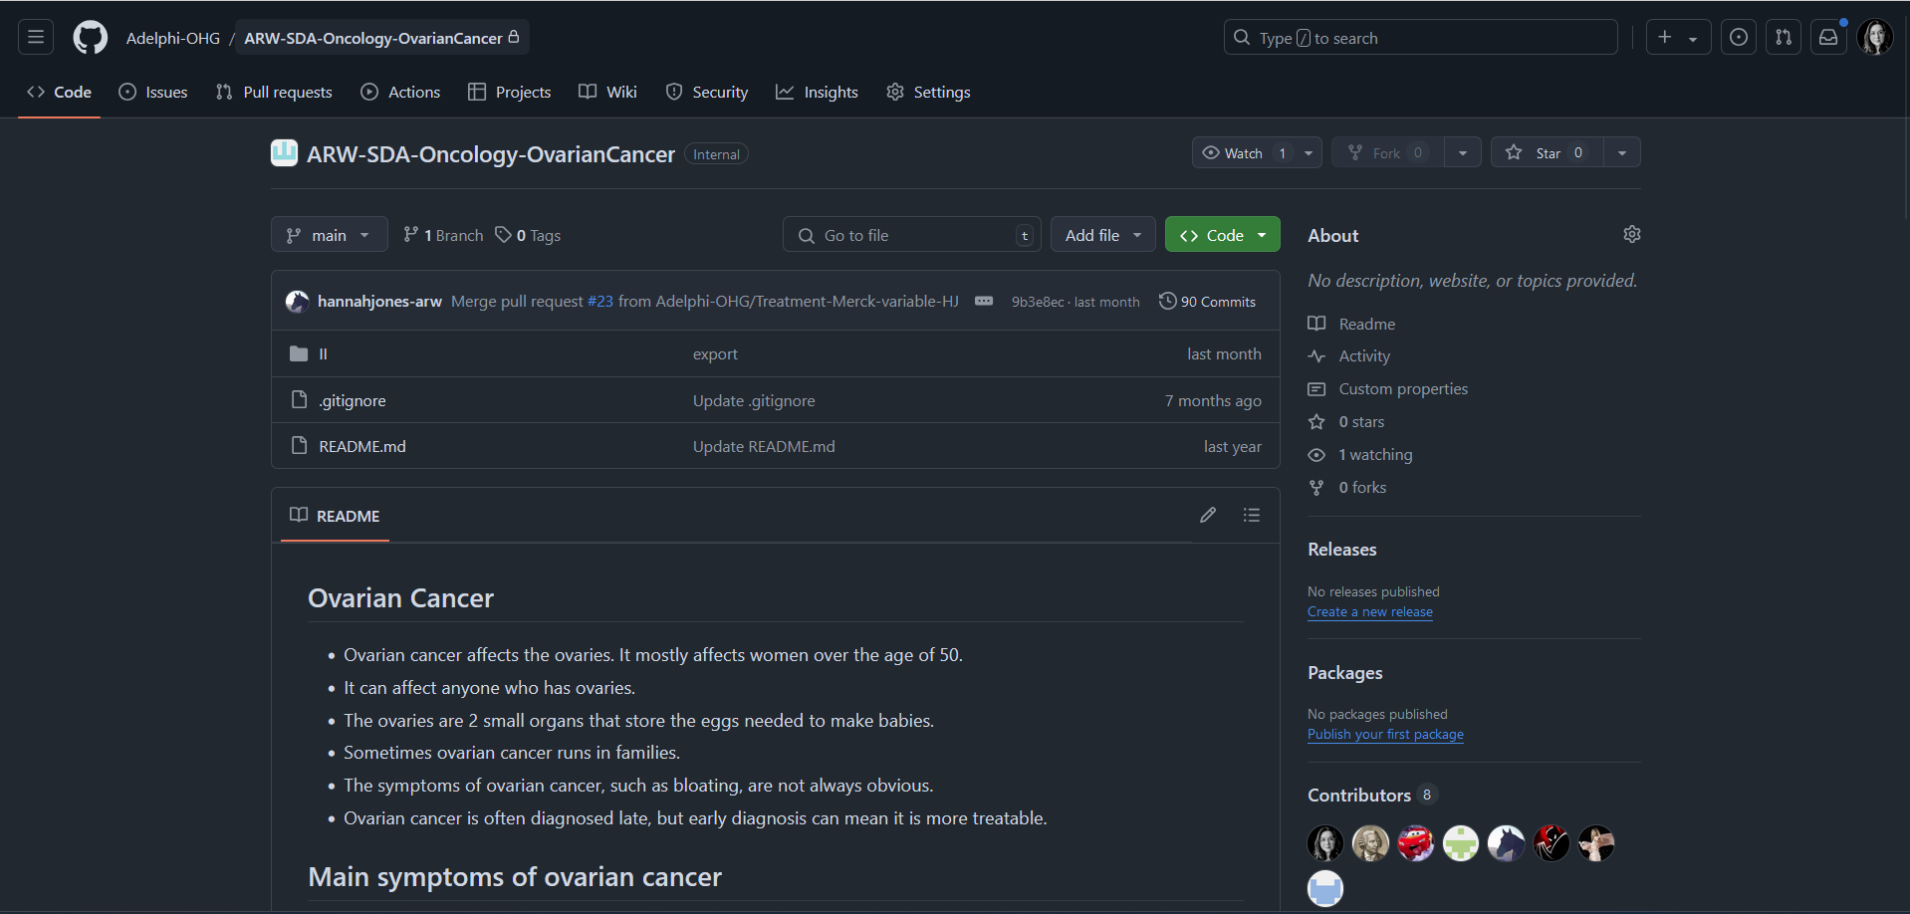
Example repository
History
See all previous commits
Files
Format similar to local file explorer
Contributors
People who have worked in the repository
Notes:
example repository on the github website (private, only we have access)
A repository is project – all analysis on our Ovarian Cancer data
No database, lots of do files
file structure here matches the file structure that you would see in finder or explorer
We include a readme for information about the project
We can see the commit history, and go back in time to previous version
- Latest changes across the top, and the contributors to the team who work on the project

Slide 9
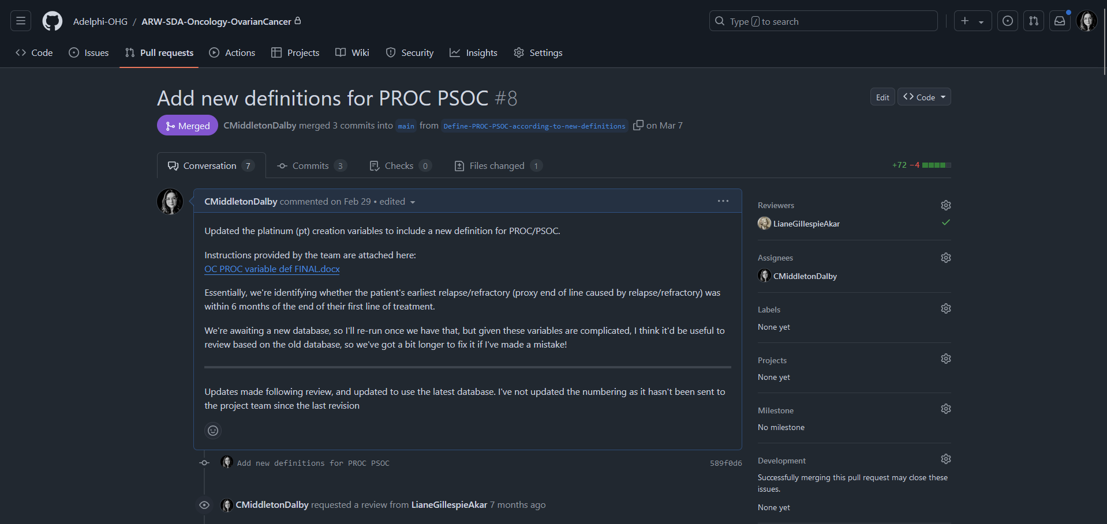
Pull requests: Conversation
Who conducts the review
Changes
74 lines added, 4 removed, compared to main
Pull request
Description of branch
Who wrote the code
Notes:
Pull request tab – this example required a review, but it looks the same for self-reviews (just without the review part!)
Description: overview of the branch, the changes, and anything that it’s important for the reviewer or collaborators to know
Changes in branch- I’ve added 72 lines of code, and removed 4
We tag the reviewer, and assign anyone who wrote the code.
Send request, automated notification
Everything is very controlled, organised, and visual – we know exactly what’s going on with the project

Slide 10
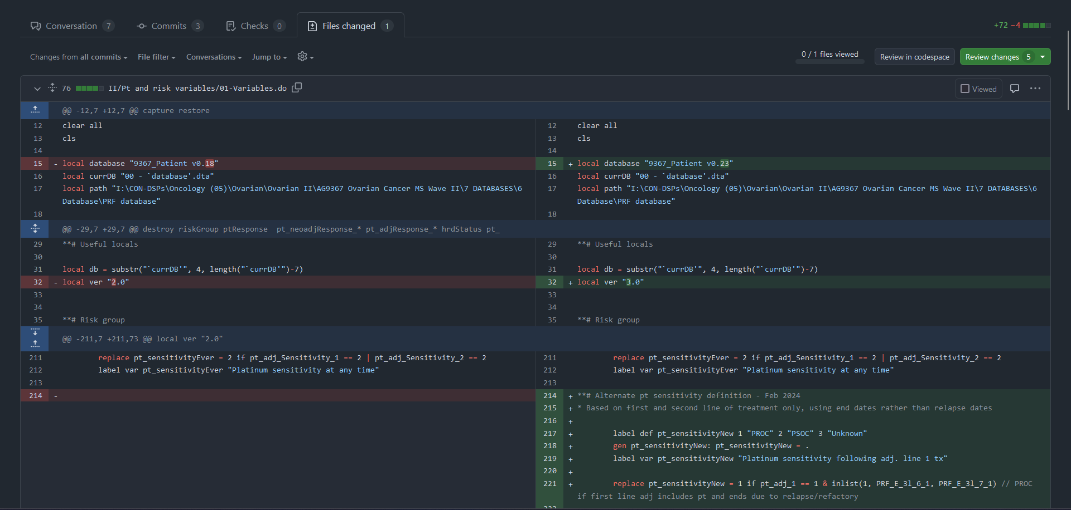
Pull requests: Files changed
New code
New analysis to add to main
Old code
File as it was before branching
Highlighted green
Where text has been added
Highlighted red
Where text has been deleted
Notes:
Reviewer looks atfiles changed tab
for each do file changed, they see the old code from main, and the new code that I want to add in
This helps the reviewer to only review the changes
The reviewer can also clone my branch down to their computer and run my do files in Stata to check everything works as expected

Slide 11
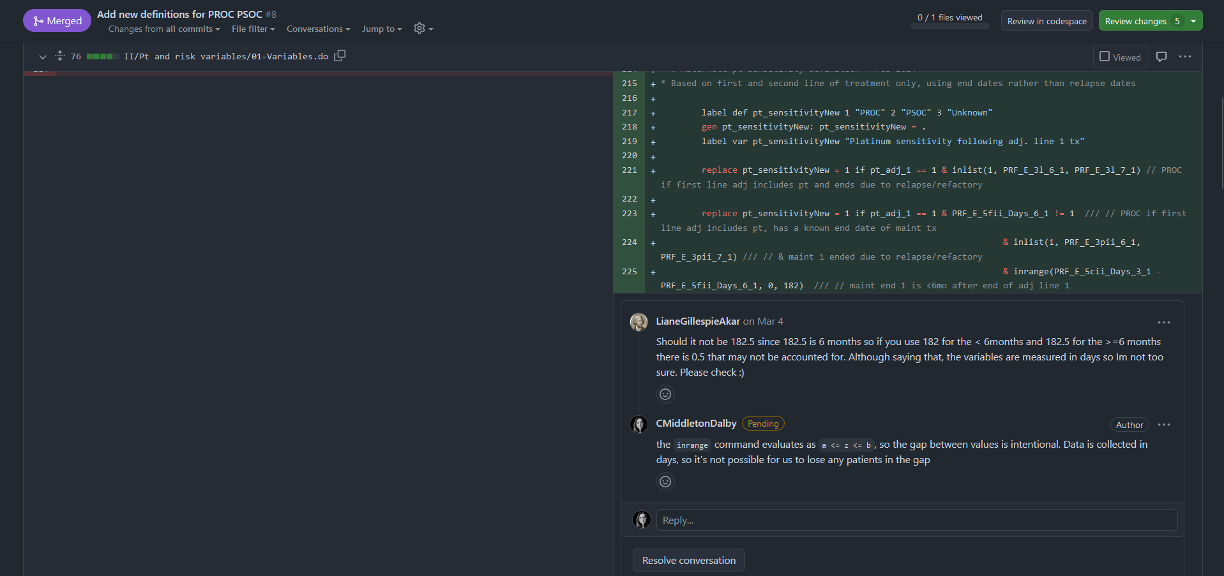
Pull requests: Reviewer comments
Review
Approve code or request changes
Comments
Reviewers and analysts add comments on top of code
Notes:
Reviewer leaves comments on the changes
Conversation style, so the first analyst can reply
Comments refer to lines – here changes are on 225
After review, either approved to merge, or requires changes
Once the reviewer submits their review, the original author gets an email or notification. They make the changes locally, run them in Stata, and commit them as normal

Slide 12
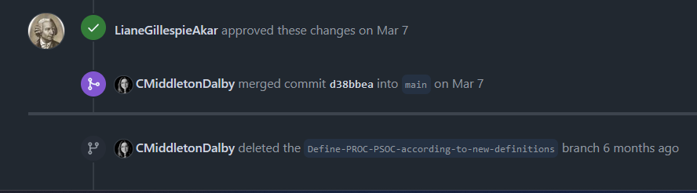
Pull requests: Resolution
Approved by reviewer!
Merged
Changes are now in main
🥳
Branch deleted
No longer required, but can be restored
Notes:
Repeat the process as needed until approved
Approved
I can merge into main, and delete the branch

Slide 13
Overview of pull request process
Submit the review as approved
Merge
No
Submit a pull request
Review the code, leaving comments on GitHub
Are changes required?
🥳
Submit the review as changes requested
Yes
Make and commit the requested changes
Notes:
Process is simple
Blue is original analyst, pink is QC
Repeat this section until everyone is happy

Slide 14
Benefits of Git
Notes:
Used for almost a year, team gave feedback
Overwhelmingly positive
High agreement with easy to use, efficient and like using it for review
Still high but slightly lower for increased accuracy and for things other than review
Concern pre-launch was Git would create unnecessary admin for non-review – generally team disagree with that
Everyone wants to continue to use it

Slide 15





Benefits of Git
Comprehensive record of changes
Secure back-ups and version control
Reduced errors, higher quality analysis
Exposure to each other’s work
Collaborative programming
Notes:
Substantial increase in recommending to friend compared to old version – mean 2.7 to 9.4 on 1-10 scale
Addition to feedback
Know exactly who made each change, when, and if it’s reviewed
Fantastic for when a client wants to know exactly what you did on a project 6 months and 10 versions ago.
Confident we won’t lose our work, even if issue with ARW servers
We find errors in work that otherwise wouldn’t be caught
Learn from each other, pick up techniques. Allows junior team members to work on more complex projects with easier reviews
Allowing multiple people to work on the same project simultaneously with branches and merge conflict support is also a game changer
Esp for user-written Stata commands

Slide 16

“It’s efficient and tidy”
“#GitHubConvert”
“GitHub has made my process a lot more organized and easier to follow when I need to go back to old code.”
“GitHub has not just dramatically improved our QC process, but enables us to have a full archive of previous work iterations - invaluable for tracking where changes have been made and why”
“GitHub is so useful for version control, and tracking contributions and amendments for old projects you haven't used in a while”
“It is so much more efficient than our original process, it highlights the specific areas where code has changed, which reduces the need to talk another analyst through the changes”
“Useful and intuitive!”
“Having an archive and a small explanation of each commit gives me a better understanding of why I coded what I did”
“GitHub has completely changed the way I think about code reviews”
Statistician responses to “How do you feel about GitHub”; ARW S&DA GitHub Survey September 2024
Notes:
If you or your team are looking to be more collaborative in your analysis, want to implement a formalised review process, or just have a really robust and safe version control system, I’d encourage you to give it a go.

