Slide 1
Optimising adverse event analysis in clinical trials when dichotomising continuous harm outcomes
using the Stata command distdicho
Victoria Cornelius
Professor in Medical Statistics and Trial Methodology
Imperial Clinical Trials Unit
Odile Sauzet
Professor in Applied Statistics
Bielefeld University

Slide 2
What’s the problem?
Dichotomisation of continuous variables!
WE DON’T DO IT! Because we lose information about the variable -
And when comparing groups -- we lose ‘power’ when we perform a hypothesis test
BUT…. Sometimes there may be reasons to want to dictomise to aid clinical interpretation e.g. proportion with abnormal test results
For these situations we can use the distribution of the outcome and retain some information and retain ‘power’ when hypothesis testing

Slide 3

Overview
The Distributional method to retain power when dictomising continuous outcome
The ADAPT trial is an example using stata command distdicho

Slide 4






Context
Data Collection
Prompted –
Questionnaires or Open Question
Patient Clinical
& Biological Samples
Spontaneous Reports
Binary/categorical data
e.g. vomiting, allergic reaction
Binary/categorical data
e.g. fatigue, rash, appetite
Continuous data
e.g. Blood pressure & Blood tests
Notes:
We collect a lot of data on harm in clinical trials – and we do that in different ways
Spontaneous reports –
Prompt patients with Questionnaires - binary/categorical data
We often in drug trials screen participant - samples and tests – clinical & biological - lots of continuous data

Slide 5
Patient Clinical & Biological Samples
BLOOD test | Omalizumab (N= 28) | Placebo (N=27)
 | Number (%) abnormal | Number (%) abnormal
White Blood Cells | 0 (0%) | 1 (4%)
Red Blood Cells | 1 (4%) | 3 (11%)
Haemoglobin | 3 (11%) | 3 (11%)
Packed Cell Volume | 8 (29%) | 4 (15%)
MCH | 5 (18%) | 4 (15%)
RDW | 1 (4%) | 0 (0%)
Neutrophils | 1 (4%) | 3 (11%)
Lymphocytes | 3 (11%) | 1 (4%)
Monocytes | 0 (0%) | 0 (0%)
Eosinophils | 20 (71%) | 24 (89%)
Sodium | 1 (4%) | 0 (0%)
Potassium | 1 (4%) | 0 (0%)
Creatinine | 6 (21%) | 5 (19%)
Albumin | 28 (100%) | 27 (100%)
Bilirubinin | 0 (0%) | 0 (0%)
Alkaline Phosphatase | 5 (18%) | 5 (19%)
Alkaline transaminase | 1 (4%) | 0 (0%)
Calcium | 0 (0%) | 1 (4%)
Corrected Calcium | 0 (0%) | 1 (4%)
Phosphate | 0 (0%) | 0 (0%)
25 Hydroxy Vitamin D | 9 (32%) | 15 (54%)
Ferritin | 5 (18%) | 6 (21%)
Dichotomise – and we have low power to flag signals of harm
Notes:
Example with blood test results – we have a distribution and references ranges – if outside that reference range we call the results abnormal
Ditcomise this continuous variable
And with saml;l sample sized we have low power to flag for signals n

Slide 6
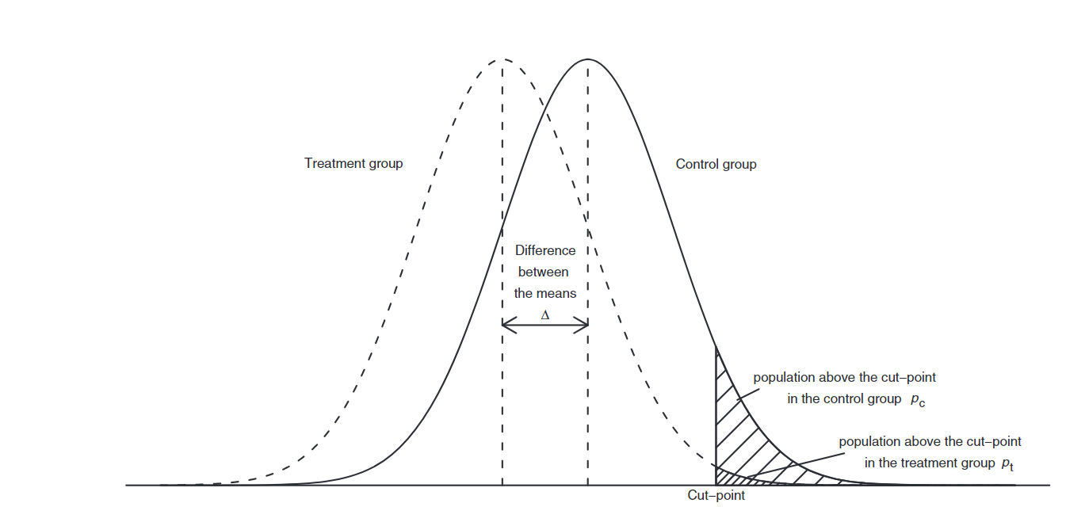
Distributional approach to retain ‘statistical power’ when dichotomizing clinical outcomes
Distributional approach calculates the between arm difference in proportions of ‘abnormal’ results based on the population distribution of the outcome rather than the observed data.
Reference: Peacock JL, Sauzet O, Ewings SM, Kerry SM. Dichotomising continuous data while retaining statistical power using a distributional approach. Stat Med. 2012;31(26):3089–103.
Notes:
Rather than dicttomise and estimate the proportion below or above a certain threshold based on the observed data – we use the underlying distribution of the continuous outcome to estimate the proportion
This method has been adopted and promoted by Odile Sauzet for a variety of situations – here is the simplest example when we can assume that the outcome in each of are treatment arms follows two normal distributions – and where these have equal variance.
So for example if we are thinking about blood pressure as an outcome, in our treatment and control group in an antihypertensive trial – it may be reasonable to assume that the treatment group follows the same normal distributions, but that has been shifted lower than the group by a mean of delta,
We then use the mean and the SD of the observed data in the treatment and control are to define the two population distributions, and we calculate the proportion above a threshold that is ‘abnormal’ say.
So the proportional estimates ar based on the assumed population distribution in each arm and NOT on the observed data
Odiele Sauzet has written a series of papers to show that if we use this approach we retain the statistical power we would have had if we have kept the variable continuous.

Slide 7
Methods by Sauzet et al with easy to implement software in R and Stata
Method 1: Assuming Normal distribution when there is equal variance
Reference: Peacock JL et al. Dichotomising continuous data while retaining statistical power using a distributional approach. Stat Med. 2012;31(26):3089–103.
Method 2: Assuming Normal distribution when there is unequal variance
Reference: Sauzet O, et al. Estimating dichotomised outcomes in two groups with unequal variances: a distributional approach. Statistics in Medicine. 2014;33(26):4547–59.
Method 3: Assuming a skew-normal distribution
Reference: Sauzet O, et al. Dichotomisation using a distributional approach when the outcome is skewed. BMC Medical Research Methodology. 2015;15(1):40.
Extension Method: A distributional approach to compare proportions between two populations — with adjustment for baseline variables
Reference: Sauzet O, et al. A distributional approach to obtain adjusted comparisons of proportions of a population at risk. Emerging Themes in Epidemiology. 2016;13(1):8.
Notes:
She has done this not just the easy case for
Normal distributions with equal varaiance,
But also for when there us unequal varaiance -
And als when the distribution cant assumes to be normal and is skewed
She has also developed a extension to that allows the between arm comparison to be adjusted for randomisation covariates and other baseline variables
These were developed for single efficacy outcome –

Slide 8
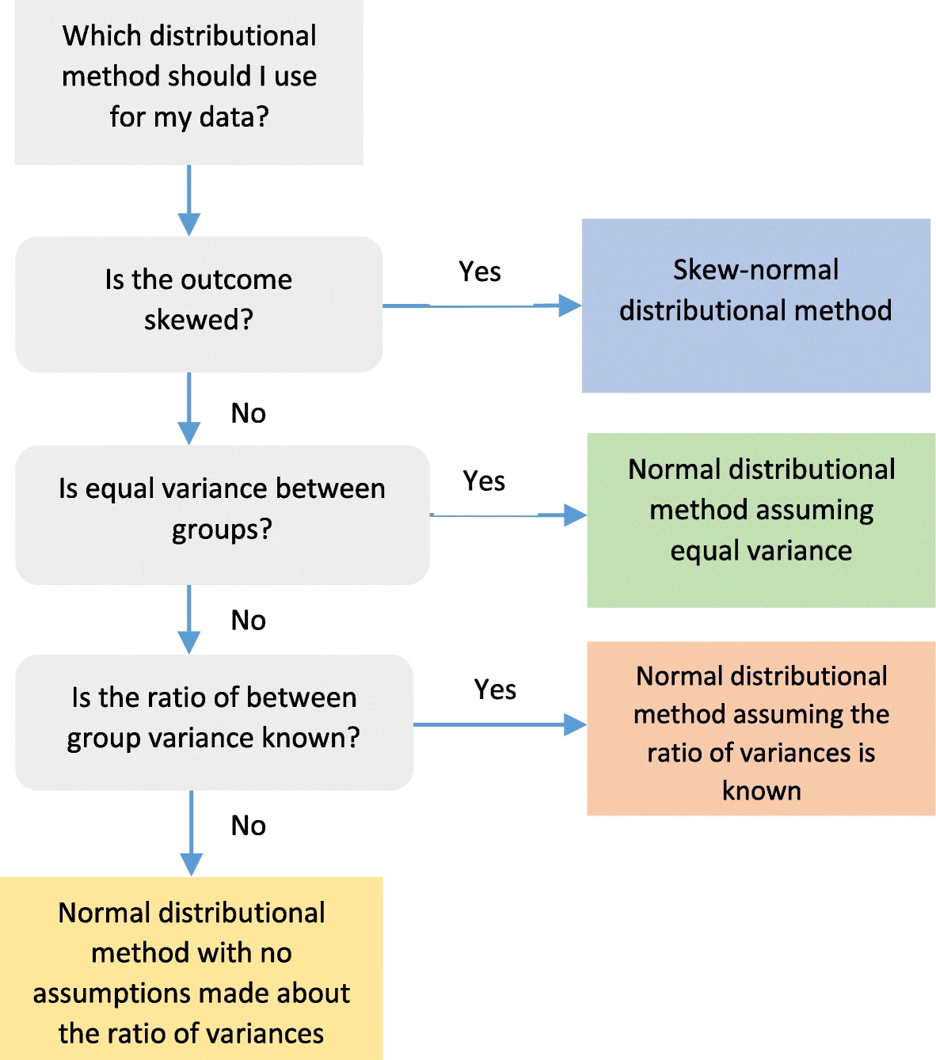
Implementing the approach in the context of harms
Where there are many outcomes
Distributional method should be chosen based on what's already known about the population distribution
Using knowledge of population distribution, select the most suitable Sauzet Distributional Method
If nothing known - we can use the observed data but not ideal
Reference: Chis Ster A, Phillips, Sauzet O, Cornelius V. Improving analysis practice of continuous adverse event outcomes in randomised controlled trials - a distributional approach. Trials. 2021
Notes:
but we can apply these to the AE setting but the consideration are different as we now have many outcomes
We need to select which of the Distrubutional approaches as best – ideally this should be
So we did some prior work to look at this

Slide 9
Implementing in Distributional Methods in Stata:
Sauzet, O., & Kleine, M. (2016). Distributional estimates for the comparison of proportions of a dichotomized continuous outcome. The Stata Journal, 16(4), 880-899
Distributional Method | Stata command
Normal with equal variance | distdicho varname1 varname2 [if] [in], cp(#) tail(lower|upper)
Normal with unequal variance | distdicho varname1 varname2 [if] [in], cp(#) tail(lower|upper)unequal
Skew-Normal distribution | sk_distdicho varname1 varname2 [if] [in], cp(#) tail(lower|upper)
Extension to include covariates | reg_distdicho varname, cp(#) tail(lower|upper) dist(sk) Use on variable after regress, mixed or xtreg
cp(#) - value of the cutpoint under or over which to compute proportions
varr(#) - specify ratio of variances OR unequal - specify for use of unequal variance assumption
tail(lower|upper)- provide the tail in which the proportions are to be computed
bootci - calculate the bootstrap bias-corrected CIs instead of distributional ones
nrep(#) specifies the number of bootstrap replications
findit distDicho
Notes:
Each command provides the distributional estimates and their standard errors for a difference in proportion, risk ratio, and odds ratio

Slide 10

The ADAPT Trial
The Atopic Dermatitis Anti-IgE Paediatric Trial (ADAPT)
Randomised, double-blind, controlled trial
Omalizumab v Placebo for the treatment of severe paediatric eczema
Population: Aged 4–19 years with SCORAD >40, (a validated eczema severity score)
N = 62 (31 per arm) – need to make most out of the data we have
https://www.ncbi.nlm.nih.gov/pmc/articles/PMC6902112/
Notes:
We will look now at an example of a typical analysis for the ADAPT trial, - which was a small population trial ( with just 62 participants in it) it was a double blind, placebo-controlled randomised trial of anti-IgE drug treatment called omalizumab, for the treatment of severe paediatric eczema
The population was children aged 4 – 19 with high score for their eczema rated over 40.on the SCORAD The participants then received 2 or 4 weekly sub-curtaneous injections for 24 weeks.

Slide 11


ADAPT Data Collection
Spontaneous Reports
Prompted –
Questionnaires or Open Question
Patient Clinical
& Biological Samples

Slide 12
ADAPT Blood Test Example - Packed Cell Volume
PCV Normal range is 0.37 to 0.45
Low PCV (<0.37) can indicate anemia, or hemodilution
High PCV (> 0.45) most common dehydration but also can
indicate lung or heart conditions, or bone marrow disorder
Examine by arm ->
reasonable to assume Normal but unequal variance
Mean = 0.38, SD 0.031
Mean = 0.40. SD 0.028
Notes:
Low WBC - It can increase your risk of getting infections. Whereas high WBC means you may have infection of cancer

Slide 13
Difference in proportion with abnormally low PCV-
Observed data
Abnormal | Trial Arm Number
PVC | Anti-IgE Placebo | Total
-----------+----------------------+----------
low | 7 4 | 11
| 25.00 14.81 | 20.00
-----------+----------------------+----------
normal | 20 23 | 43
| 71.43 85.19 | 78.18
-----------+----------------------+----------
high | 1 0 | 1
| 3.57 0.00 | 1.82
-----------+----------------------+----------
Total | 28 27 | 55
| 100.00 100.00 | 100.00
-0.10 ( 95%CI -0.11, 0.31)
or
10.1% ( 95% CI -10.7%, 31.1%)

Slide 14
Difference in proportion with abnormally low PCV-
Distributional Estimate
distdicho PCV arm, cp(0.37) tail(lower) unequal
Distributional estimates for the comparison of proportions
below the cut-point .37
Standard error computed with correction for
unknown variance ratio
--------------------------------------------------------------
Group | Obs Mean Std dev. Dist. prop.
-----------+--------------------------------------------------
Anti-IgE | 28 .3833214 .0311532 .3344675
Placebo | 27 .4001852 .02807 .1411083
-----------+--------------------------------------------------
Stat | Estimate Std error [95% Conf. Interval]
-----------+--------------------------------------------------
Diff. prop | -.1933592 .096948 -.3833738 -.0033446
Risk ratio | .4218895 .2355223 .167308 1.063851
Odds ratio | .326911 .2413025 .1059619 1.008578
--------------------------------------------------------------
-0.10 ( 95%CI -0.11, 0.31)
or
10.1% ( 95% CI -10.7%, 31.1%)
-0.19 ( 95%CI -0.38, -0.003)
or
-19.3% ( 95% CI -38.3%, -0.3%)
Notes:
Apply the distribution method – assuming normality but unequal varaiance

Slide 15
ADAPT Blood test results – comparison between empirical and distributional approach

Slide 16

In conclusion
Dichotomising continuous variables is generally a bad idea
For some clinical contexts dichotomisation can aid interpretation
If dichotomising then use the Distributional Methods to retain statistical power –
This is beneficial for:
  Harm analysis context where we are interested to flag for signals of harm
  Trials with small sample sizes

