Slide 1

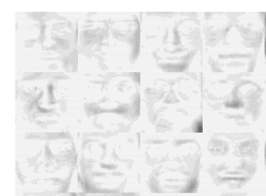
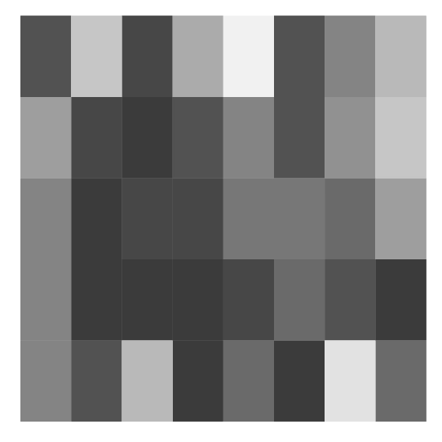
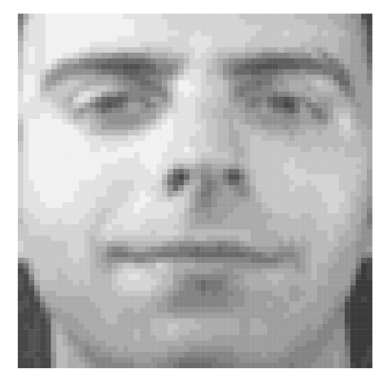
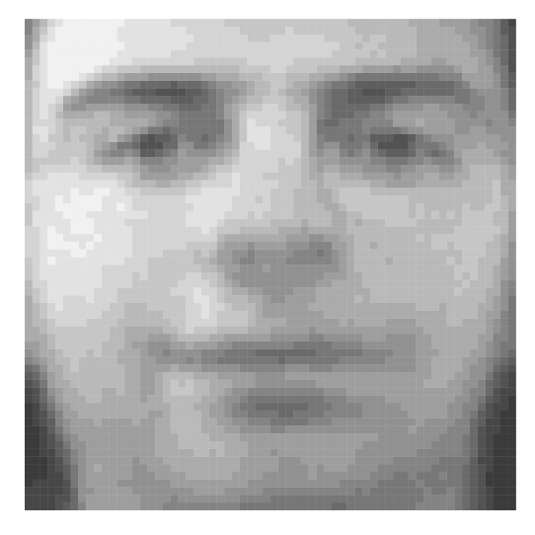










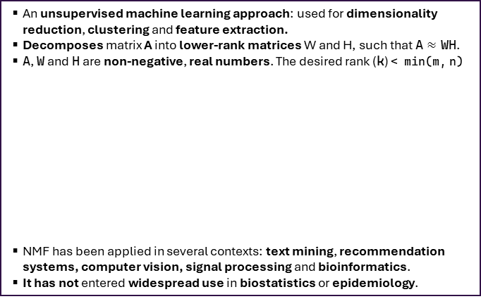








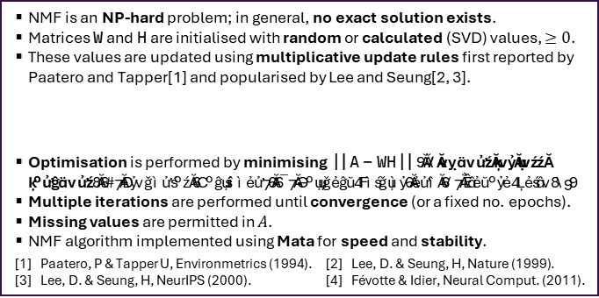





nmf: an implementation of non-negative matrix factorisation in Stata
JA Batty (Wellcome Trust Clinical PhD Fellow)^{1, 2} & M Hall (Associate Professor of Epidemiology)^{1,2}
Affiliations: ¹Leeds Institute for Data Analytics, University of Leeds, Leeds, UK, ²Leeds Institute of Cardiovascular and Metabolic Medicine, University of Leeds, Leeds, UK
Background and motivation: What is NMF?
Examples using NMF in Stata
An unsupervised machine learning approach: used for dimensionality reduction, clustering and feature extraction.
Decomposes matrix A into lower-rank matrices W and H, such that A $≈$ WH.
A, W and H are non-negative, real numbers. The desired rank (k) < min(m, n)
NMF has been applied in several contexts: text mining, recommendation systems, computer vision, signal processing and bioinformatics.
It has not entered widespread use in biostatistics or epidemiology.
1
Identification of metagenes from gene expression data (metagenes.do; nsclc.dta) → reduction of 200 genes to 5 ‘metagenes’
3
Identification of disease trajectories
(trajectories.do; disease_matrix.dta) → performing temporal clustering
Lung cancer
gene expression data ($A$)
Patient-time x
diagnosis matrix ($A$)
($W$)
($W$)
1
2
Original matrix (A)
Feature matrix
(W)
Trajectory
(k = 5)
$$×$$
3
($H$)
4
Genes,
m = 200
Genes,
m = 200
Patient-
time (y)
$$\text{≈}$$
5
Coefficient matrix
(H)
$$\text{≈}$$
$$×$$
Metagenes,
k = 5
Disease membership of endotype ($HT$)
$$\text{≈}$$
Metagene expression level for each sample,
n = 200
m
m
$$×$$
k
1
2
3
4
5
n
Samples,
n = 100
Metagenes,
k = 5
Long-term
conditions
Multimorbidity trajectory at time t (k = 5)
n
k
2
Imputation of missing data
(imputation.do; nsclc.dta) → multiplication results in ‘complete’ W and H
4
Identification of facial features from photos of faces
(imputation.do; faces.dta) → identifying lower-level features of images
Dataset with e.g. 10%
missing values ($A$)
1 x imputed
Dataset ($\overline{A}$)
Matrix of 400 64x64 pixel images of faces; each column = 1 face ($A$)
Reconstructed
matrix of
image data ($\overline{A}$)
($W$)
Implementation: how does nmf work?
m =
4096
$$\text{≈}$$
$$×$$
$$\text{=}$$
NMF is an NP-hard problem; in general, no exact solution exists.
Matrices W and H are initialised with random or calculated (SVD) values, $≥0$.
These values are updated using multiplicative update rules first reported by Paatero and Tapper[1] and popularised by Lee and Seung[2, 3].
Optimisation is performed by minimising ||A - WH||. 3 options for loss functions: (1) Frobenius (Euclidean), (2) Kullback-Leibler, and (3) Itakura-Saito[4].
Multiple iterations are performed until convergence (or a fixed no. epochs).
Missing values are permitted in $A$.
NMF algorithm implemented using Mata for speed and stability.
[1] Paatero, P & Tapper U, Environmetrics (1994). [2] Lee, D. & Seung, H, Nature (1999).
[3] Lee, D. & Seung, H, NeurIPS (2000). [4] Févotte & Idier, Neural Comput. (2011).
$$\text{≈}$$
$$×$$
($H$)
$$\text{=}$$
n = 400
Individual level
of each facial
feature (H)
Non-missing
intermediate
factorised matrices
(no direct interpretation)
Common facial
Features (H)
$$H←H∘\frac{W^{T}\frac{X}{WH} }{W^{T}}$$
$$W←W∘\frac{\frac{X}{WH}H^{T} }{H^{T}}$$
White = missing
Original face
Reconstructed face
Using NMF in Stata: quick start guide
Acknowledgements
Installation: ssc install nmf
Detailed help file: help nmf
Example syntax: nmf cols*, k(15) initial(randomu) epoch(100) /// stop(1.0e-4) loss(kl)
All examples / data: https://github.com/jonathanbatty/stata-nmf
This project was funded by:
The AI for Science and Government Fund (via The Alan Turing Institute; TU/ASG /R-SPEH-114)
The Wellcome Trust (JB: 227498/Z/23/Z, MH: 206470/Z/17/Z).

