Slide 1
Object-oriented programming in Mata
Daniel C. Schneider
UK Stata Conference, London, September 7-8, 2023

Slide 2
Preliminary Remarks
This presentation, due to time constraints,
is not a proper introduction, not rigorous.
You just get a glimpse of OOP.
Uses the -dtms- package as an illustrative example.
Assumes some knowledge of Mata.
Good resources on the topic
Official Stata doc: help [M-2] class
Bill Gould's (2018) Mata book

Slide 3
The dtms Package
"dtms": Discrete-time multistate (models / estimation)
Announcement on Stata Forum:
https://www.statalist.org/forums/forum/general-stata-discussion/general/1690703-dtms-new-stata-command-for-discrete-time-multistate-model-estimation or google "dtms Stata"
Contains location from which to -net install-.
Will be moved to SSC.
Analytical contributions in two soon-to-be-released working papers
Schneider (2023)
Schneider and Myrskylä (2023)
Package doc "Methods and formulas" has sizable chunk of it.

Slide 4
The dtms Package
dtms estimation proceeds in sequential steps:
(1) model setup
(2) regression estimation (mlogit)
(3) predict transition probabilities from (2)
(4) calculate various results from (3)
Calculated/defined objects of levels (0)-(3) can contain multiple elements of the next level => tree like structure

Slide 5
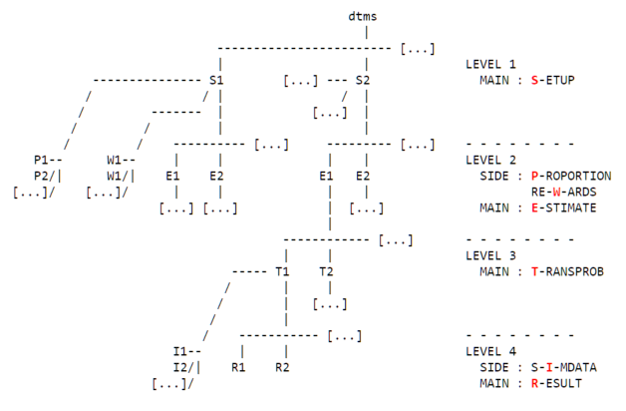
The dtms Package: The dtms Tree

Slide 6
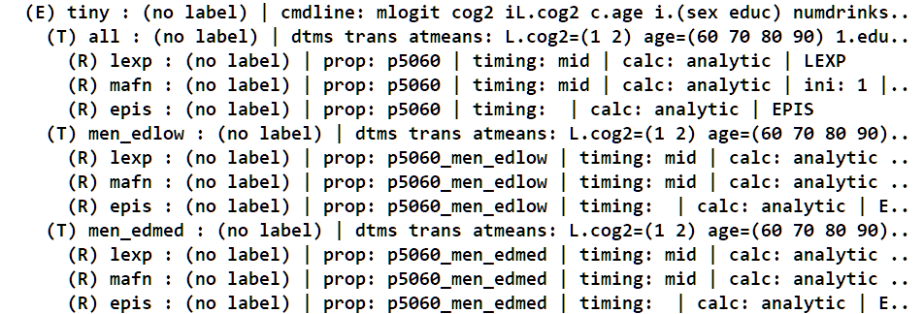
The dtms Package: The dtms Tree
[...]
[...]

Slide 7
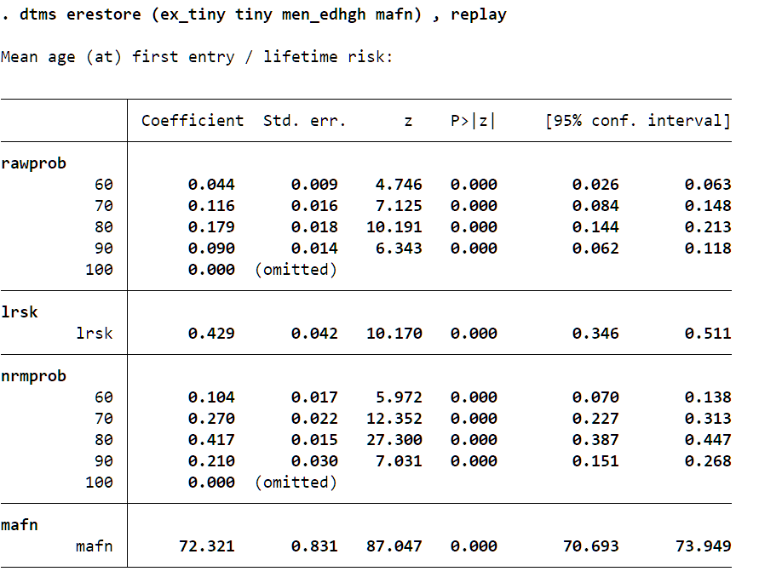
The dtms Package: Results Example
cname (composite name): uniquely identifies tree elements

Slide 8
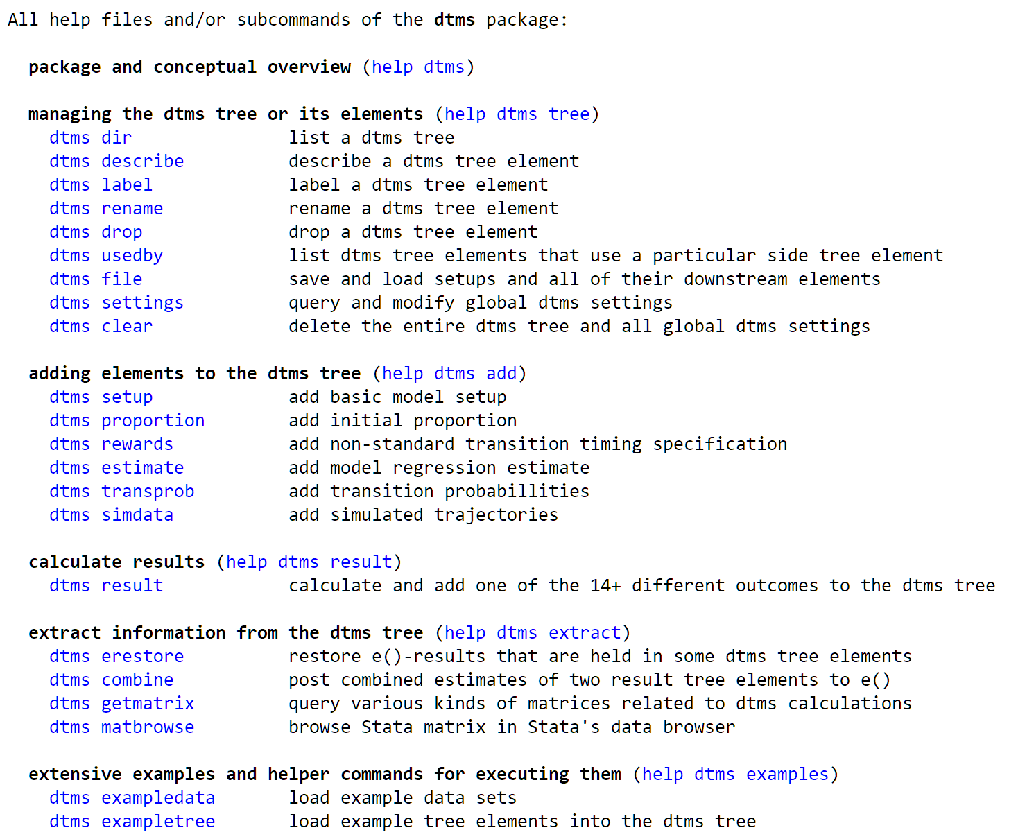
Package Highlights / Contributions

Slide 9
Object-Oriented Programming I
A class: an entity that
has members containing data
can do stuff: has functions (called methods)
defined by a class definition
code uses instances of a class (objects)
OOP section I: Simple but interrelated classes Goal: a class that holds Stata e()-results
OOP section II: Explain how the dtms tree works

Slide 10
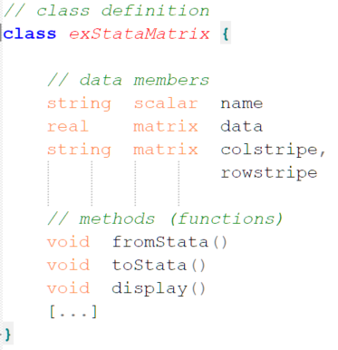
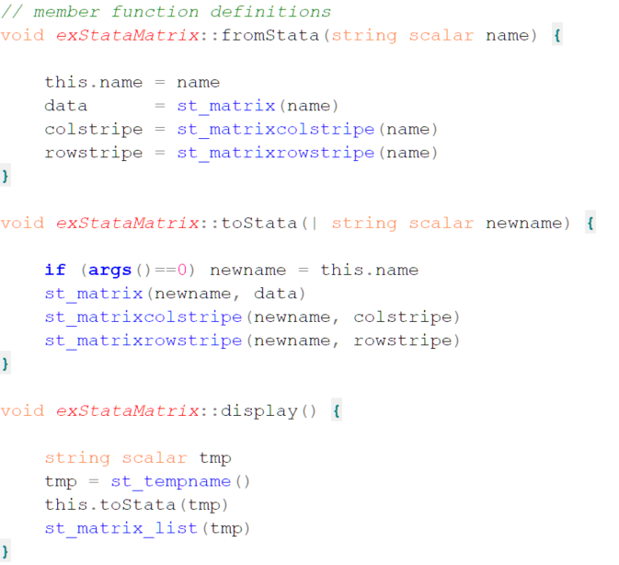
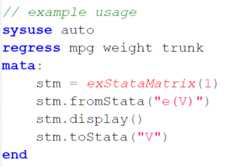
OOP I: Simple but Interrelated Classes: exStataMatrix

Slide 11
OOP I Side Note: Pointer Variables
Pointers
variables that contain the memory address of another variable
can contain addresses of (loosely speaking) anything, where "anything" includes objects
see -help [M2] pointers-

Slide 12
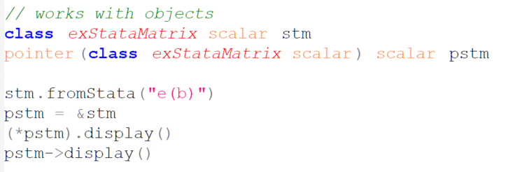
OOP I Side Note: Pointer Variables

Slide 13
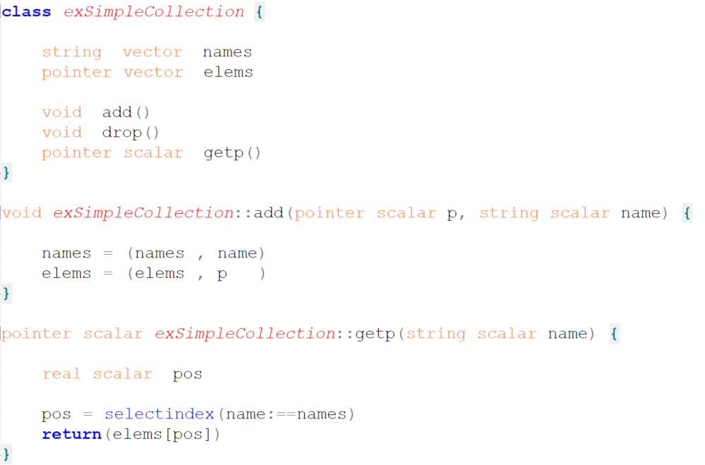
OOP I: Simple but Interrelated Classes: exSimpleCollection

Slide 14
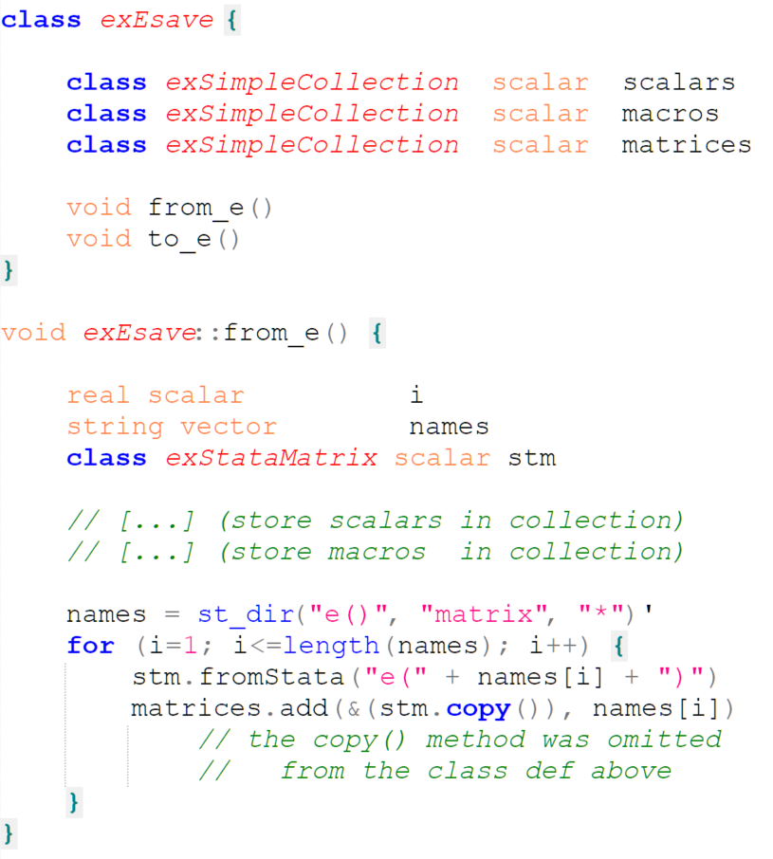
OOP I: Simple but Interrelated Classes: exEsave
many dtms tree elements have a similar class as a member

Slide 15
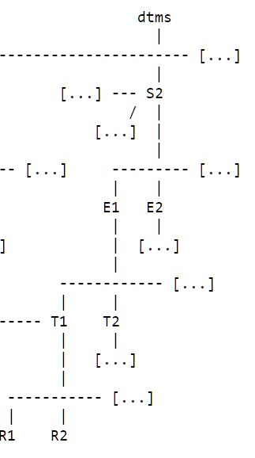
OOP II: Objects behind the dtms Tree
Four things need to be solved:
getting a pointer to a tree element
tree elements must know about upstream tree elements
iteration through all elements of a tree
idiosyncrasies of tree elements (levels) must be accounted for
Solution:
1.-3. are based on only two class definitions: exTreeColl and exTreeElem
4. makes use of OOP features: inheritance and polymorphism

Slide 16
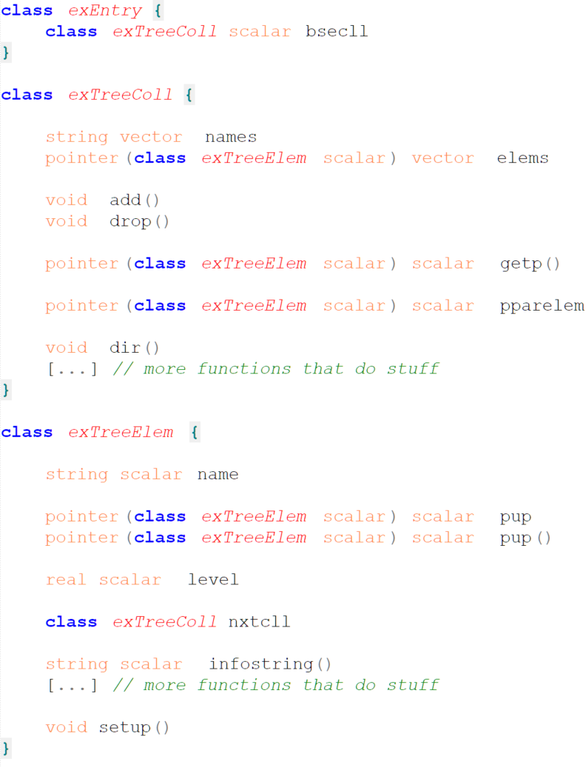
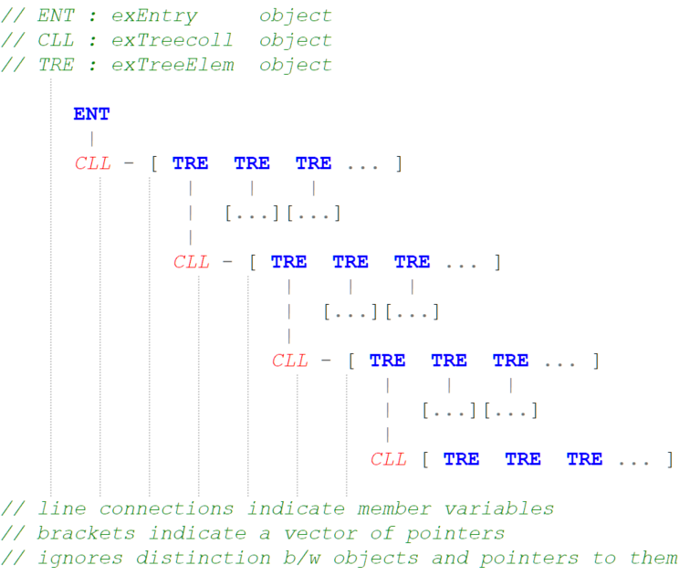
OOP II

Slide 17
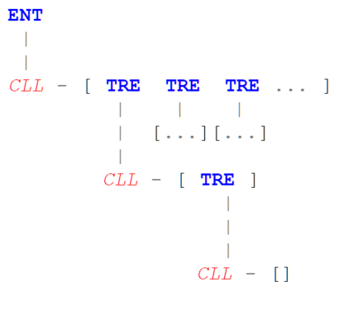
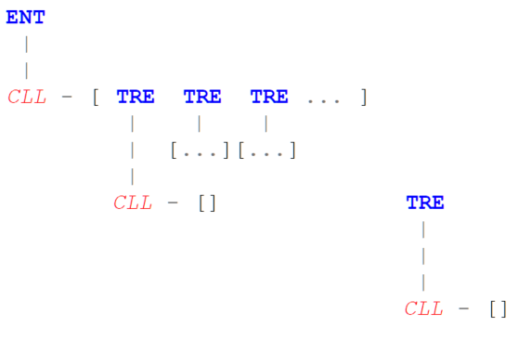
OOP II: Objects behind the dtms Tree
Step 1 An exTreeElem object gets instantiated in memory.
Its member function setup() must be called in order to pass information about its address to its member collection.
Step 2
That way, when the exTreeColl member uses its add() method to add an exTreeElem object, it can pass on that information into the exTreeElem object member.

Slide 18
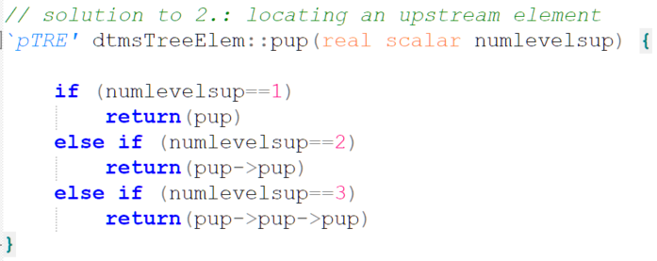
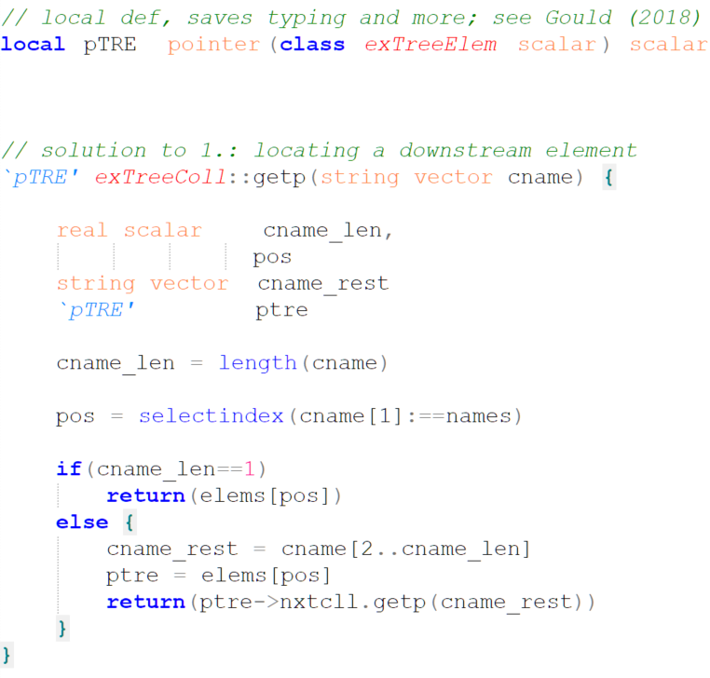
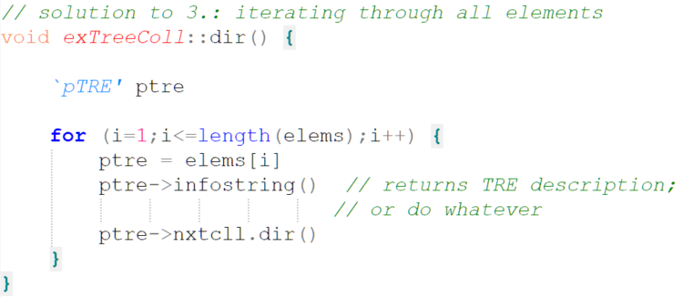
OOP II: Objects behind the dtms Tree: Solutions to 1.-3.

Slide 19
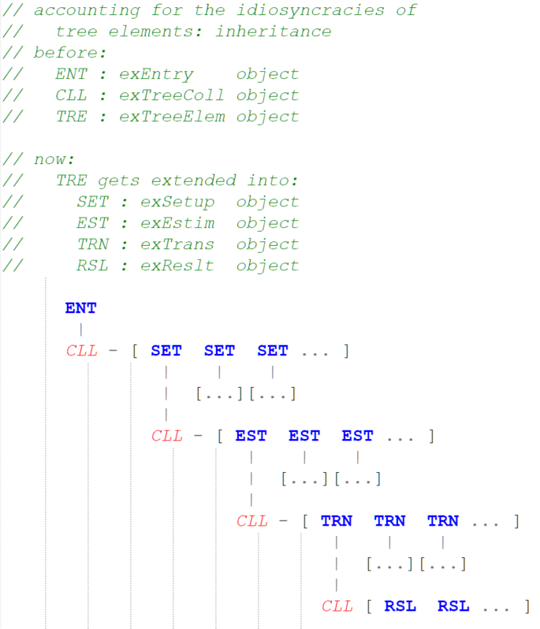
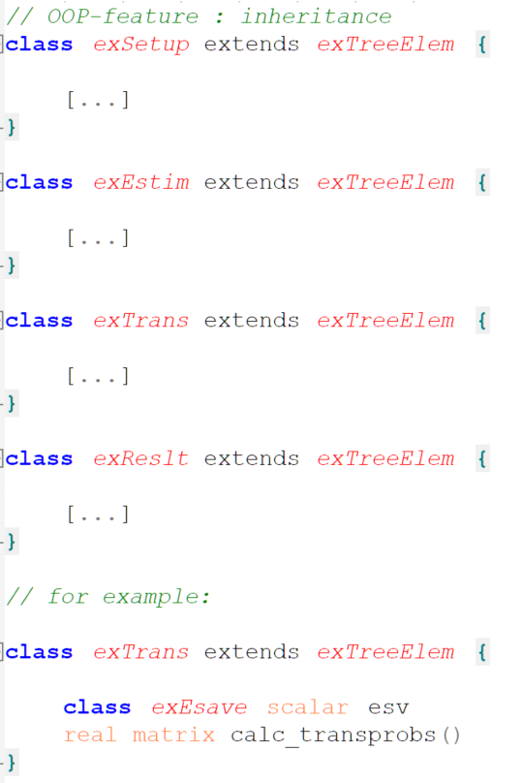
OOP II: Objects behind the dtms Tree: Solution to 4.

Slide 20
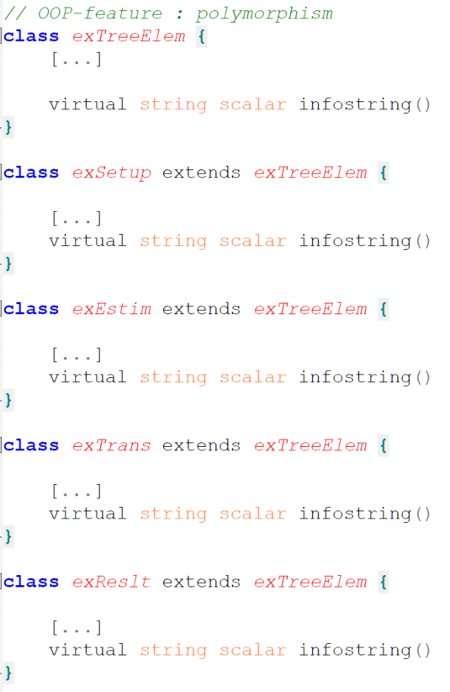
OOP II: Objects behind the dtms Tree
This technique was used in dtms dir
and coded explicitly in solution to 3.

Slide 21
Thank you
schneider@demogr.mpg.de

Slide 22
References
Gould, William W. (2018). The Mata Book: A Book for Serious Programmers and Those Who Want to Be. Stata Press.
Schneider, Daniel C. (2023). "Inference for Discrete-Time Multistate Models: Asymptotic Covariance Matrices, Partial Age Ranges, and Group Comparisons." [working title] MPDIR Working Paper, forthcoming.
Schneider, Daniel C. and Mikko Myrskylä (2023). Extending Discrete-Time Multistate Models Using Markov Chains with Rewards: New Outcome Measures and Inference Results. [working title] MPDIR Working Paper, forthcoming.

Slide 23
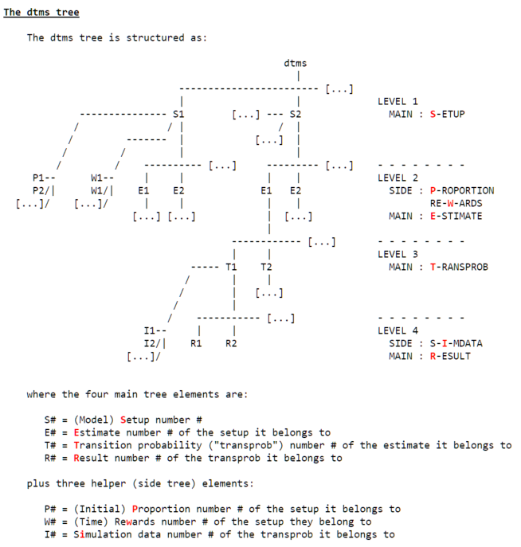
The dtms Package: The dtms Tree

Slide 24
The dtms Package: Project Size
Lines of code, counting blank lines, roughly:
Stata: 5,000
test script: 6,000
auxiliary: 3,000
Mata: 11,000, makes heavy use of OOP
Source code not (yet) online may be made available in the future

