Slide 1

USE OF STATA IN MODELING THE DETERMINANATS OF WORK ENGAGEMENT
2023 UK STATA CONFERENCE
Paulina HOJDA, University of Lodz, Doctoral School of Social Sciences
Sylwia ROSZKOWSKA, Jagiellonian University & University of Lodz

Slide 2
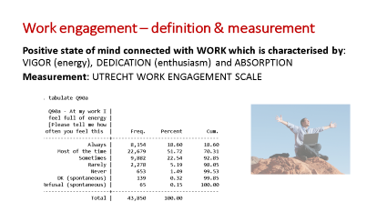
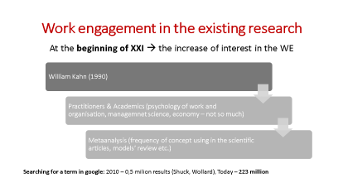
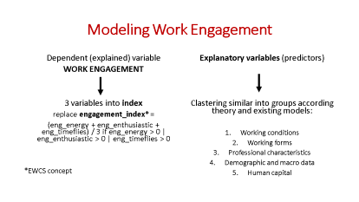
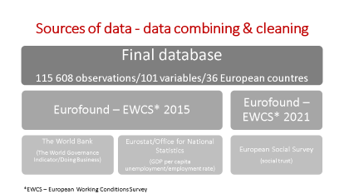

What will I talk about?

Slide 3
Work engagement in the existing research
At the beginning of XXI → the increase of interest in the WE
William Kahn (1990)
Practitioners & Academics (psychology of work and organisation, managemnet science, economy – not so much)
Metaanalysis (frequency of concept using in the scientific articles, models’ review etc.)
Searching for a term in google: 2010 – 0,5 milion results (Shuck, Wollard), Today – 223 million

Slide 4
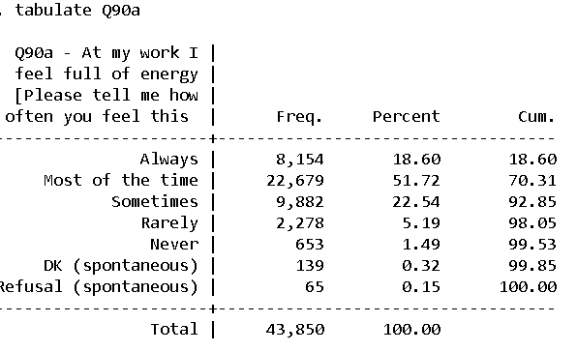

Work engagement – definition & measurement
Positive state of mind connected with WORK which is characterised by: VIGOR (energy), DEDICATION (enthusiasm) and ABSORPTION
Measurement: UTRECHT WORK ENGAGEMENT SCALE

Slide 5
Research question
In what way do working conditions, occupational characteristics, the level of human capital and some macroeconomic and macrosocial factors inluence or are correlated with the level of work engagement
in EU countries?

Slide 6
Sources of data - data combining & cleaning
Final database
115 608 observations/101 variables/36 European countres
Eurofound – EWCS* 2015
The World Bank
(The World Governance Indicator/Doing Business)
Eurostat/Office for National Statistics
(GDP per capita unemployment/employment rate)
Eurofound – EWCS* 2021
European Social Survey
(social trust)
*EWCS – European Working Conditions Survey

Slide 7
Sources of data - data combining & cleaning
Obstacles
Due to change in the interviewing mode in EWCS (telephone interview) databases were more different than similar (many questions removed or reformulated)
Only some variables: the same questions, scales, cafeteria style/response options → simple merge or append sometimes impossible
Recoding, re-labeling, generating, replacing if…

Slide 8
Modeling Work Engagement
Dependent (explained) variable
WORK ENGAGEMENT
3 variables into index
replace engagement_index* =
(eng_energy + eng_enthusiastic + eng_timeflies) / 3 if eng_energy > 0 | eng_enthusiastic > 0 | eng_timeflies > 0
*EWCS concept
Explanatory variables (predictors)
Clastering similar into groups according theory and existing models:
Working conditions
Working forms
Professional characteristics
Demographic and macro data
Human capital

Slide 9
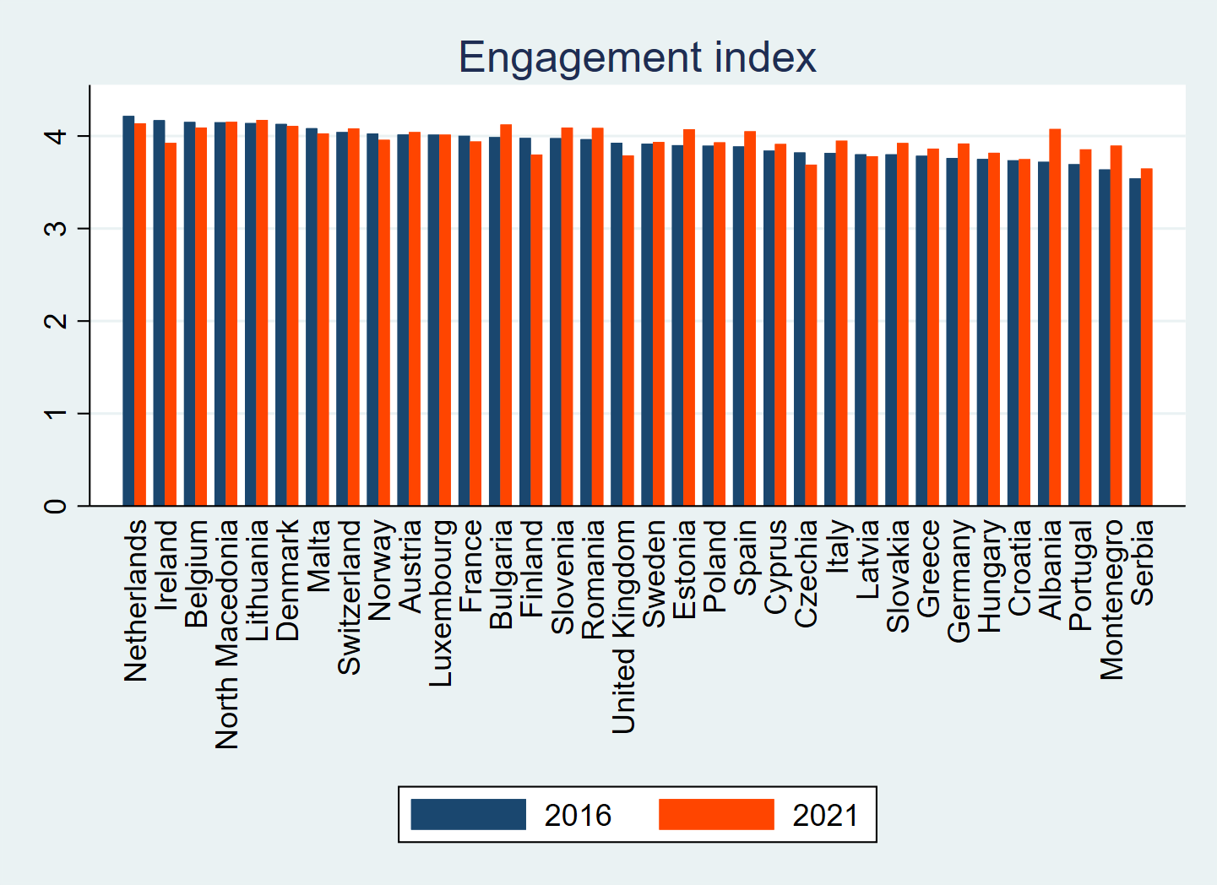

Slide 10
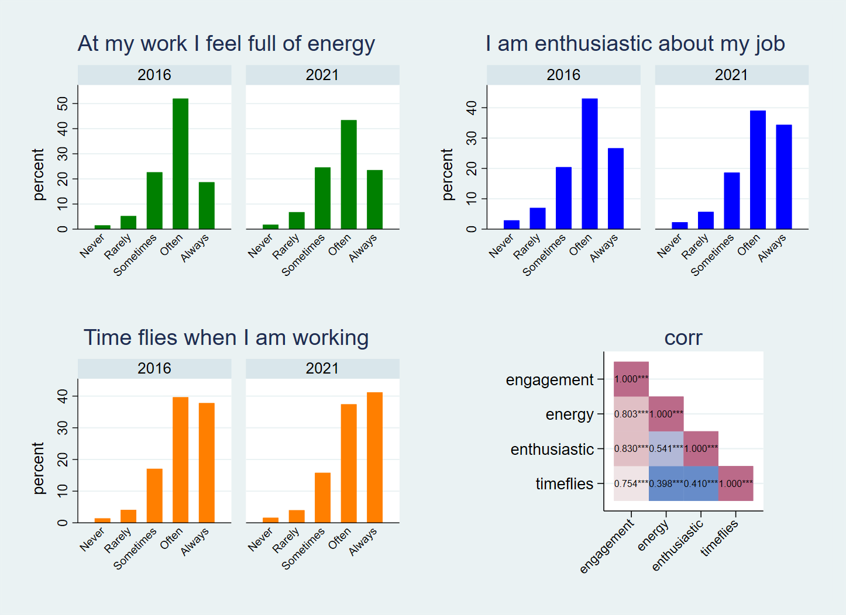

Slide 11
Engagment index values – raw data | Obs | Mean | Std. Dev. | Min | Max
 | 2016
energy | 43,646 | 3.81114 | 0.84912 | 1 | 5
enthusiastic | 43,608 | 3.834847 | 0.992722 | 1 | 5
timeflies | 43,666 | 4.083154 | 0.912188 | 1 | 5
engagement | 43,513 | 3.91054 | 0.743823 | 1 | 5
 | 2021
energy | 35,794 | 3.801559 | 0.932941 | 1 | 5
enthusiastic | 35,778 | 3.975124 | 0.980793 | 1 | 5
timeflies | 35,807 | 4.126288 | 0.926062 | 1 | 5
engagement | 35,689 | 3.967702 | 0.738489 | 1 | 5
kwallis test by country and year, p<0.001
Engagment - dummy (1 - Often/always)
 | 2016
energy | 43,646 | 0.706434 | 0.455401 | 0 | 1
enthusiastic | 43,608 | 0.696524 | 0.459764 | 0 | 1
timeflies | 43,666 | 0.774332 | 0.418026 | 0 | 1
engagement | 43,513 | 0.60529 | 0.488794 | 0 | 1
 | 2021
energy | 35,794 | 0.669135 | 0.470531 | 0 | 1
enthusiastic | 35,778 | 0.733943 | 0.441901 | 0 | 1
timeflies | 35,807 | 0.786159 | 0.410022 | 0 | 1
engagment_index | 35,689 | 0.627869 | 0.48338 | 0 | 1
kwallis test by country and year, p<0.001

Slide 12
Working forms
usual_hours_week:
1. Q24 [usual_hours_week] How many hours do you usually work per week in your main paid job?
usual_days:
1. Q26 [usual_days] How many days per week do you usually work in your main paid job?
hours_other_job_week:
1. Q28 [hours_other_job_week] How many hours a week on average do you work in job(s) other than your main paid job?
telework:
1. EU27 employees only - telework status see Eurofound (2022), "Telework during the pandemic: Prevalence, working conditions and regulations"
night:
1. Q37a [night] How often do you work at night, for a t least 2 hours between 10.00 pm and 05.00 am?

Slide 13
Working conditions
noise:
1. Q29B B.[noise] Noise so loud that you would have to raise your voice to talk to people [How often are you exposed at work to ...?]
chemicals:
1. Q29G G. [chemicals] Handling or being in skin contact with chemical products or substance [How often are you exposed at work to ...?]
infect:
1. Q29G I. [infect] Handling or being in direct contact with materials which can be infectious, such as waste, bodily fluids, laboratory materials etc. [How often are you
exposed at work to ...?]
tiring_positions:
1. Q30A [tiring_positions] Tiring or painful positions [How often does your main paid job involve...?]
lifting:
1. Q30B [lifting] Lifting or moving people [How often does your main paid job involve...?]
carrying_loads:
1. Q30C [carrying_loads] Carrying or moving heavy loads [How often does your main paid job involve...?]
repetitive_movements:
1. Q30E [repetitive_movements] Repetitive hand or arm movements [How often does your main paid job involve...?]
dealing_customers:
1. Q30F [dealing_customers] Dealing directly with people who are not employees at your workplace such as customers, passengers, pupils, patients etc. [How often does your main paid job involve...?]
computer:
1. Q30J [computer] Working with computer, laptop, tablet, smartphone [How often does your main paid job involve...?]
loc_home:
1. QM35E [loc_home] Your own home [...how often you have worked in each location during the last 12 months in your main paid job]

Slide 14
ISCO group:
employee_selfdeclared:
1. Q7 [employee_selfdeclared] Are you working as an employee or are you self-employed?
selfemp_director:
1. Q8b1 [selfemp_director] Director of own business [...Which of the following descriptions apply to your job?]
selfemp_business_partner:
1. Q8b2 [selfemp_business_partner] A partner in a business or professional practice [...Which of the following descriptions apply to your job?]
selfemp_work_yourself:
1. Q8b3 [selfemp_work_yourself] Working for yourself [...Which of the following descriptions apply to your job?]
selfemp_subcontractor:
1. Q8b4 [selfemp_subcontractor] Working as a sub-contractor / contractor [...Which of the following descriptions apply to your job?]
selfemp_freelancer:
1. Q8b5 [selfemp_freelancer] Doing freelance work [...Which of the following descriptions apply to your job?]
selfemp_paid_agency:
1. Q8b6 [selfemp_paid_agency] Paid a salary or a wage by an agency [...Which of the following descriptions apply to your job?]
selfemp_withemployees:
1. Q9aC [selfemp_withemployees] Regarding your business, do you...? - Have employees (working for you)
wp_size:
1. Q16a [wp_size] How many people in total work at your workplace that is at the local site where you work?
number_jobs_filter:
1. [number_jobs_filter] Constructed variable indicating if respondent has one or multiple jobs
Professional characteristics

Slide 15
Demographic and macro data
gender:
recoded gender to man, woman, random assignment of non binary
age:
seniority:
ISCED_11:
* Q106 [ISCED_11] What is the highest level of education or training that you have
GDPcap:
Real GDP capita
trust:
Social trust
DoingBus:
DoingBusiness
VaA
Voice and Accountability
PSAV
Political Stability and Absence of Violence/Terrorism
GE
Government Effectiveness
RQ:
Regulatory Quality:
RoL:
Rule of Law
CoC:
Control of Corruption

Slide 16
Explanatory variables
Variable | Obs | Mean | Std. Dev. | Min | Max
part_time | 111,995 | 1.82357 | 0.381185 | 1 | 2
usual_hour~k | 111,290 | 39.0136 | 12.97009 | 1 | 168
totalhour | 111,290 | 39.7282 | 13.75106 | 1 | 328
usual_days | 78,270 | 5.01069 | 0.997512 | 1 | 7
hours_othe~k | 5,407 | 15.0847 | 14.65248 | 0 | 160
telework | 62,618 | 3.1185 | 1.804509 | 1 | 6
night | 114,760 | 1.31 | 0.462493 | 1 | 2
noise | 91,233 | 1.98115 | 1.211407 | 1 | 5
chemicals | 115,311 | 1.68081 | 1.164316 | 1 | 5
infect | 115,270 | 1.51694 | 1.07451 | 1 | 5
tiring_pos~s | 91,169 | 2.40017 | 1.299172 | 1 | 5
lifting | 115,398 | 1.34891 | 0.905825 | 1 | 5
carrying_l~s | 115,452 | 1.96399 | 1.223251 | 1 | 5
repetitive~s | 91,201 | 2.69707 | 1.524617 | 1 | 5
dealing_cu~s | 115,340 | 3.2904 | 1.538028 | 1 | 5
computer | 115,425 | 3.53158 | 1.611857 | 1 | 5
loc_home | 115,056 | 2.17098 | 1.496812 | 1 | 5
commute_ti~s | 68,484 | 42.7448 | 36.96349 | 1 | 480
osh_risk | 114,349 | 1.71805 | 0.449952 | 1 | 2
ISCO_1_08 | 115,420 | 5.10121 | 2.430923 | 1 | 10
employee_s~d | 114,691 | 1.14986 | 0.356939 | 1 | 2
selfemp_di~r | 79,895 | 0.08333 | 0.276389 | 0 | 1
selfemp_bu~r | 79,895 | 0.02384 | 0.152563 | 0 | 1
selfemp_wo~f | 79,895 | 0.1114 | 0.314624 | 0 | 1
selfemp_su~r | 79,895 | 0.01351 | 0.115425 | 0 | 1
selfemp_fr~r | 79,895 | 0.0293 | 0.16865 | 0 | 1
selfemp_pa~y | 79,895 | 0.00344 | 0.058568 | 0 | 1
selfemp_wi~s | 16,927 | 1.67957 | 0.466658 | 1 | 2
NACE_broad~s | 115,315 | 5.97484 | 3.11924 | 1 | 16
private_se~r | 114,272 | 1.49184 | 0.873256 | 1 | 5
wp_size | 85,237 | 4.36867 | 1.983883 | 1 | 8
number_job~r | 115,408 | 1.07552 | 0.264235 | 1 | 2
gender_rec~d | 115,608 | 1.48459 | 0.504107 | 1 | 9
age | 115,316 | 42.4956 | 12.49371 | 15 | 89
seniority | 114,067 | 9.84273 | 10.0821 | 0 | 75
ISCED_11 | 115,082 | 5.47227 | 1.874973 | 1 | 9
PLUS MACRO VARIABLES: GDP per capita
Doing Business

Slide 17
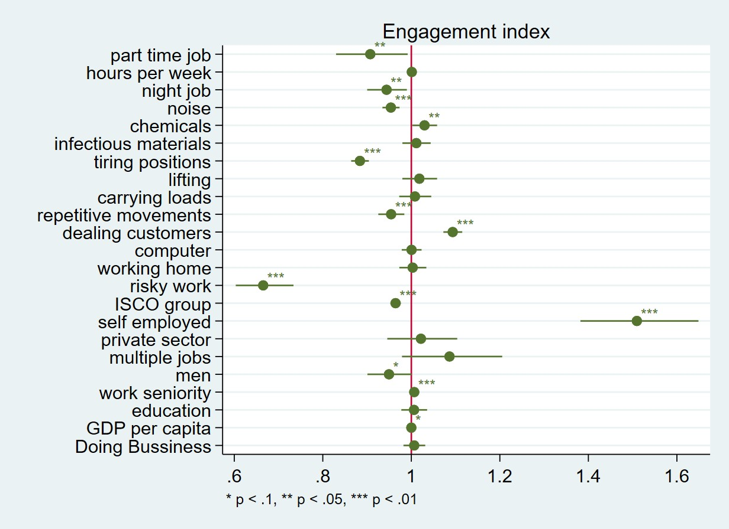
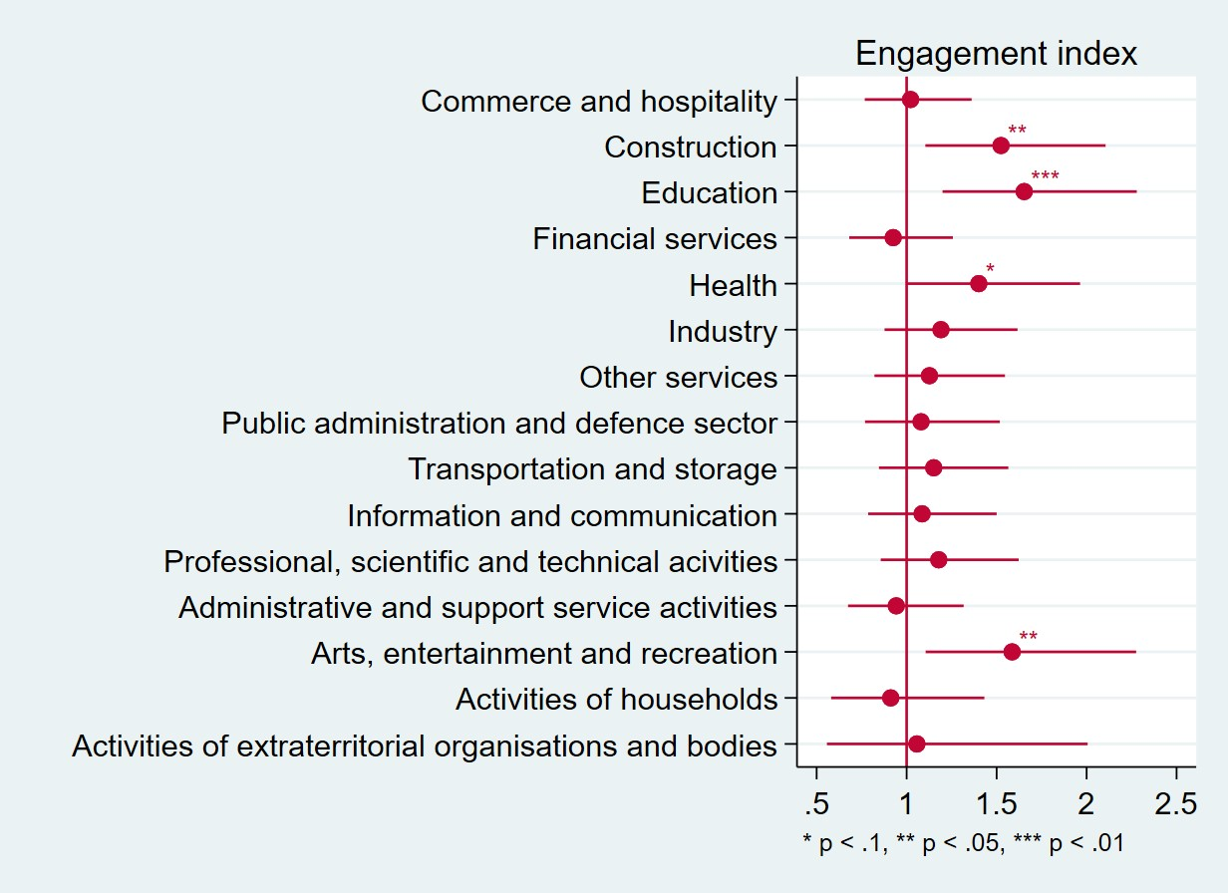
Continue Non-continue variables

Slide 18
VARIABLES | index | energy | enthusiastic | timeflies
part time job | 0.907** | 0.933 | 0.842*** | 0.969
usual hours week | 1.001 | 0.999 | 1.000 | 1.004**
night job | 0.944** | 0.946** | 0.964 | 0.917***
noise | 0.954*** | 0.957*** | 0.963*** | 0.973**
chemicals | 1.030** | 1.009 | 1.027* | 1.020
infectious materials | 1.011 | 1.000 | 1.016 | 0.994
tiring positions | 0.884*** | 0.875*** | 0.890*** | 0.922***
lifting | 1.018 | 1.041* | 1.043** | 0.944***
carrying loads | 1.008 | 1.021 | 1.006 | 1.040**
repetitive movements | 0.954*** | 0.933*** | 0.937*** | 0.955***
dealing customers | 1.093*** | 1.084*** | 1.098*** | 1.044***
computer | 1.001 | 0.966*** | 1.008 | 0.997
working home | 1.003 | 0.967** | 1.016 | 1.041**
risk work | 0.665*** | 0.575*** | 0.620*** | 0.815***
ISCO (professional group) | 0.964*** | 0.981*** | 0.948*** | 0.966***
selfemployed | 1.510*** | 1.335*** | 1.620*** | 1.312***
private sector | 1.022 | 1.096** | 0.985 | 0.988
multiple jobs | 1.086 | 1.094 | 1.020 | 1.103*
men | 0.950* | 1.075** | 1.010 | 0.865***
seniority | 1.007*** | 1.003 | 1.004** | 1.013***
ISCED (edu) | 1.006 | 1.012 | 1.016 | 1.034**
GDP per capita | 1.000* | 1.000* | 1.000** | 1.000
NACE
Doing Bus | 1.007 | 0.990 | 1.027* | 1.005
Constant | 0.922 | 5.891** | 0.292 | 2.155
Observations | 55,024 | 55,137 | 55,114 | 55,154
*** p<0.01, ** p<0.05, * p<0.1
VARIABLES | index | energy | enthusiastic | timeflies
Commerce and hospitality | 1.022 | 1.080 | 1.054 | 0.906
Construction | 1.524** | 1.425** | 1.624*** | 1.373***
Education | 1.653*** | 1.597*** | 1.969*** | 1.337**
Financial services | 0.925 | 0.966 | 0.914 | 1.043
Health | 1.401* | 1.376** | 1.586*** | 1.305**
Industry | 1.191 | 1.155 | 1.248 | 1.092
Other services | 1.127 | 1.102 | 1.293* | 0.979
Public administration and defence sector | 1.080 | 1.213 | 1.102 | 0.954
Transportation and storage | 1.151 | 1.113 | 1.170 | 1.059
Information and communication | 1.086 | 1.255* | 1.220 | 0.948
Professional, scientific and technical acivities | 1.178 | 1.165 | 1.283 | 1.048
Administrative and support service activities | 0.942 | 1.022 | 0.961 | 0.968
Arts, entertainment and recreation | 1.586** | 1.555** | 2.072*** | 1.092
Activities of households | 0.912 | 1.043 | 0.800 | 0.935
Activities of extraterritorial organisations | 1.057 | 1.286 | 1.132 | 0.941

Slide 19
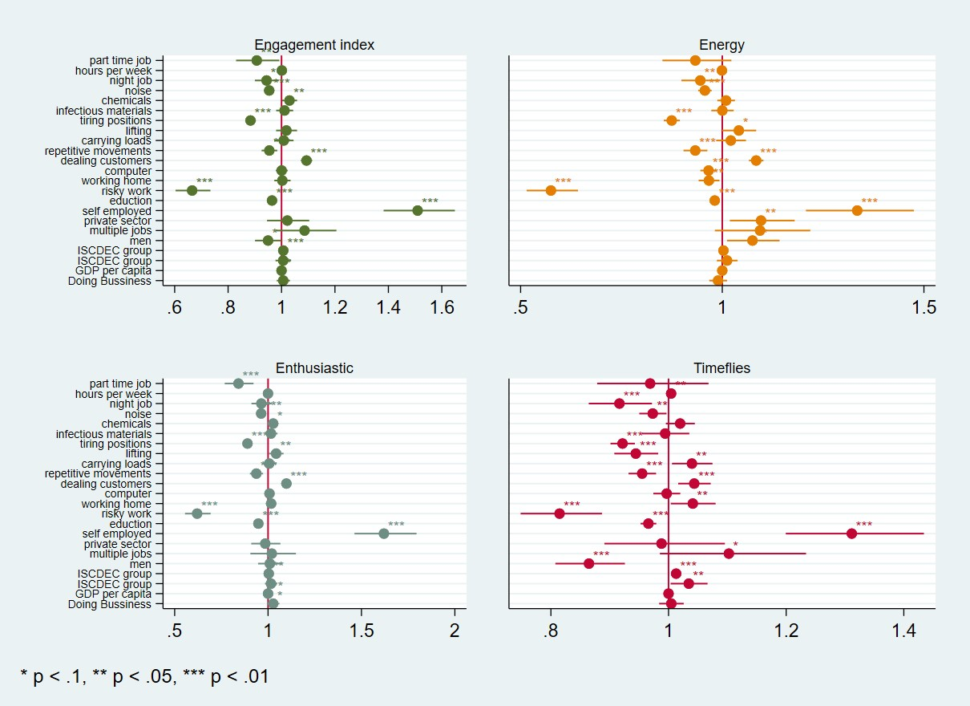

Slide 20
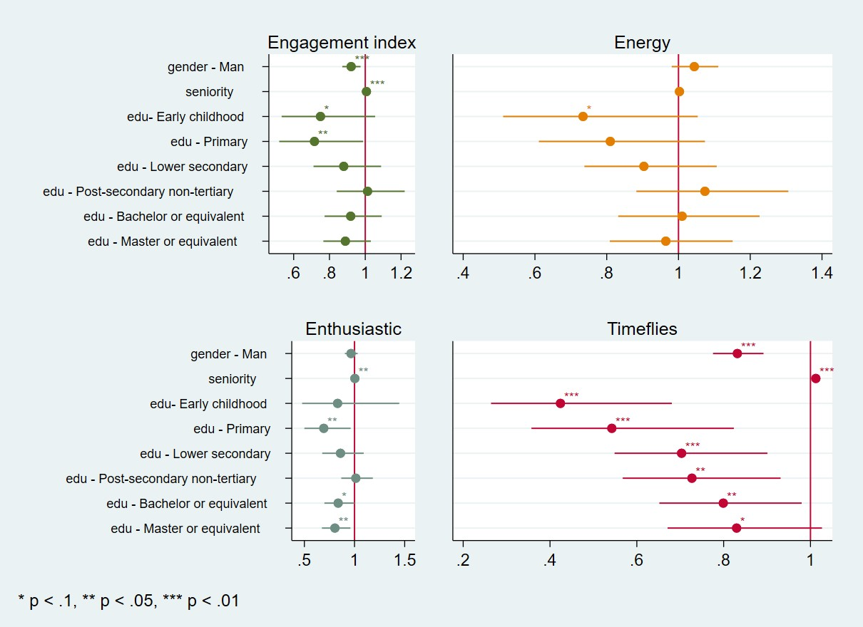
Ordinal variables

Slide 21
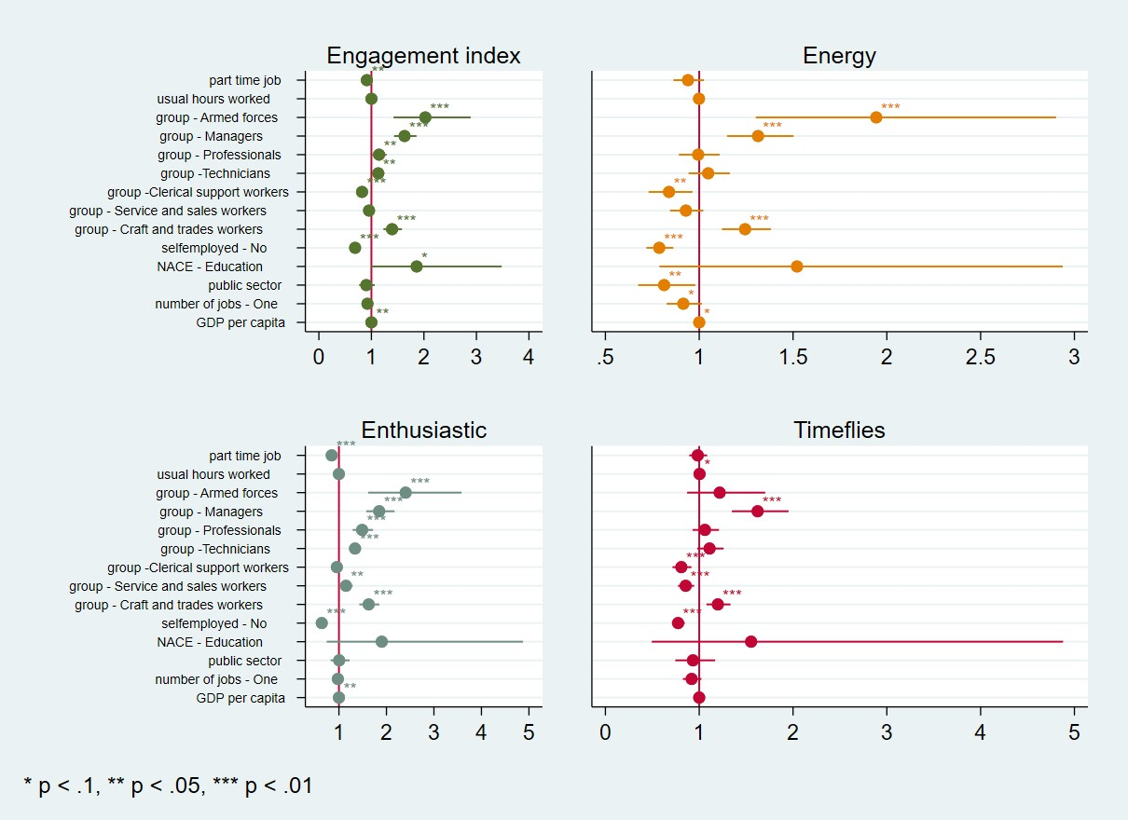

Slide 22
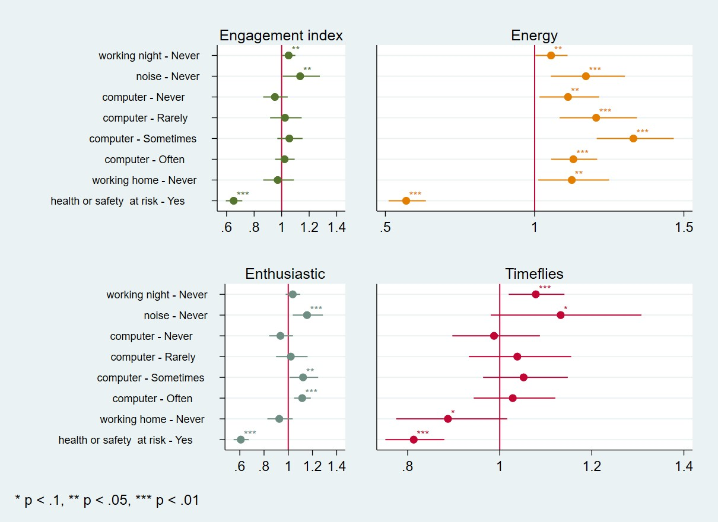

Slide 23
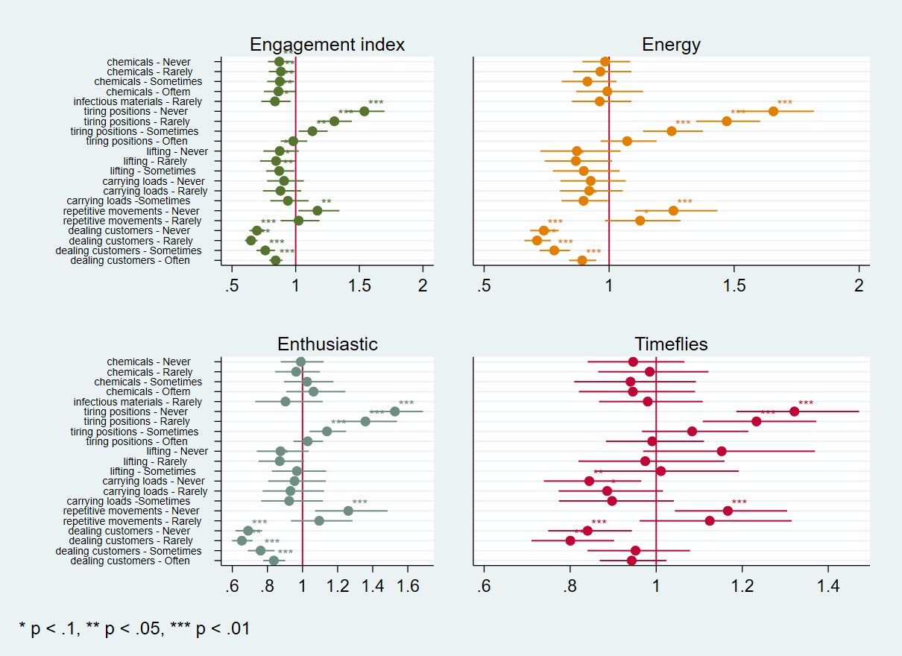

Slide 24
References
Eurofound. (2022). European Working Conditions Telephone Survey, 2021. [data collection]. UK Data Service. SN: 9026, DOI: 10.5255/UKDA-SN-9026-1
European Foundation for the Improvement of Living and Working Conditions. (2017). European Working Conditions Survey, 2015. [data collection]. 4th Edition. UK Data Service. SN: 8098, http://doi.org/10.5255/UKDA-SN-8098-4

Slide 25
Your work is going to fill a large part of your life, and the only way to be truly satisfied is to do what you believe is great work.
And the only way to do great work is to love what you do.
If you haven’t found it yet, keep looking (Steve Jobs).
Thank you for your attention!

