Slide 1


A suite of programs for clinical prediction modelling
Dr Joie Ensor
Email: j.ensor@bham.ac.uk
Twitter: @joie_ensor

Slide 2



Accurate
&
Reliable
Notes:
Imagine you have to make an important decision regarding your health, imagine you have a heart condition say,

Slide 3
Accurate
&
Reliable
Notes:
and the doctor is talking to you about whether you should have heart surgery for this condition

Slide 4
Accurate
&
Reliable
Notes:
During the conversation the doctor tells you about a risk score developed to give you an estimate of your risk of dying during or shortly after the surgery. You’re interested, in a morbid kind of way, and hell, more information can’t hurt when we’re talking life and death right?

Slide 5

Accurate
&
Reliable
Notes:
So, you fill out a short online form with the doctor and they cavalierly clack the button at the end of the form. You’re watching the doctors face, and bam, there you have it, doesn’t look like good news. The doctor tells you; your risk is quite high.

Slide 6

Accurate
&
Reliable
Notes:
You talk for a while longer, weigh up the risks, and ultimately, together decide that the surgery may be too risky, for now at least.

Slide 7



Accurate
&
Reliable
Notes:
But what if I were to tell you, that this risk score was wrong, and your true risk of dying during the surgery was significantly lower? Would you have made the same the decision? Or would you have had the potentially life-extending surgery?

Slide 8
Accurate
&
Reliable
Notes:
What if I were to tell you that this risk score had been built on an idy-biddy sample of patients?

Slide 9
Accurate
&
Reliable
Notes:
On patients that didn’t have much in common with you?

Slide 10
Accurate
&
Reliable
Notes:
That it had been built on information from years ago, and that we had improved our surgery methods since then?

Slide 11
Accurate
&
Reliable
Notes:
I tell this story because it highlights how important risk prediction models can be in influencing healthcare decisions, and therefore how important it is that such models are *accurate and reliable*.

Slide 12

pm-suite
Aid across the stages of clinical prediction modelling
Methodology & TRIPOD embedded
Useful for:
  Design
  Analysis
  Reporting
Notes:
I work a lot in prediction modelling, and developed a course on this with my colleagues. On this course we have many practical sessions in which participants work through common prediction modelling tasks. In this talk I’m going to introduce some packages I’ve written to aid in the various stages of prediction modelling, many of these coming from requests over the years from people working in prediction modelling and attending our courses.
And these packages all utilise strong methodology and best practice in reporting at their core
### BENEFIT
And if you or your colleagues want to do prediction modelling in Stata, then these packages will help you to *design, analyse and report* your studies better, and reduce the chances that your model will lead to poor healthcare decisions.

Slide 13
CPM stages
Development
&
Internal Validation
External Validation
&
Updating
Implementation
&
Impact
Notes:
There are three key stages of prediction modelling – development, external validation and impact, in this talk I will focus on the first two stages

Slide 14
CPM stages
Development
&
Internal Validation
External Validation
&
Updating
Implementation
&
Impact
Model development
Variable selection
Functional forms
Notes:
Firstly, the *development* of a model. At this stage we usually do things like:
• Deciding which variables are included & excluded from the model and,
• How we will model continuous variables, assessing non-linearity for example.

Slide 15
CPM stages
Development
&
Internal Validation
External Validation
&
Updating
Implementation
&
Impact
Internal validation of our development process
Assess model’s validity within the same population
Bootstrapping or cross-validation
Quantify optimism
Adjust our model
Notes:
It's also *essential* at this stage to do internal validation of our development process.
• This means assessing our model’s validity within the same population (using our development data)
• We do this using methods such as bootstrapping or cross-validation.
• And it allows us to quantify the optimism in our development process and to adjust our model to address this to some degree.

Slide 16
CPM stages
Development
&
Internal Validation
External Validation
&
Updating
Implementation
&
Impact
Measure the performance of the model
At development performance estimates are optimistic
After internal validation we adjust performance measures for optimism
Notes:
We also measure the performance of our model.
• At the development stage we know that any estimates of performance are optimistic – our model is fitted to our data and so should perform well.
• After internal validation we can not only adjust our model to account for optimism, but we can also adjust our performance measures for optimism, and so get a better feel for how accurate and reliable our model is.

Slide 17
CPM stages
Development
&
Internal Validation
External Validation
&
Updating
Implementation
&
Impact
External validation
Assess model’s validity in patients separate from the first stage
Models are developed to be applied in new individuals, so their value depends on their performance outside of the development sample
Notes:
In the second stage we assess the model’s external validity using data from patients separate from the first stage.
• This is crucial, because -
> [!Quote]
> As prediction models are developed to be applied in new individuals, their value depends on their performance outside of the development sample

Slide 18
CPM stages
Development
&
Internal Validation
External Validation
&
Updating
Implementation
&
Impact
Model performance
How accurate & reliable is the model?
Assess model reproducibility or transportability
Notes:
At this stage focus is mostly on the performance of the model, how accurate and reliable is it?
-
- We may be looking to assess the reproducibility (similar data, e.g. different time window) of the model OR the transportability (different case-mix, e.g. different country or clinical setting) of the model

Slide 19
CPM stages
Development
&
Internal Validation
External Validation
&
Updating
Implementation
&
Impact
Model updating
Inadequate performance could indicate updating
Adjust the model to improve accuracy & reliability in a new setting/population
Notes:
At this stage, if performance is deemed inadequate we may consider model updating. Where we adjust the model to make it more accurate and reliable in the new setting/population we're interested in deploying the model in.

Slide 20
pm-suite
Development
&
Internal Validation
External Validation
&
Updating
pmsampsize
pmintval
pmiecv
pmcstat
pmstats
pmcalplot
pmvalsampsize
pmupdate
pmsplot
pmmeta
Notes:
So here is a list of the packages I've developed or are under development, covering the first two stages. Today I'm going to briefly show some of these in action.

Slide 21
“Only nine of 119 studies (8%) reported a sample size calculation”
Dhiman et al. 2023
Notes:
If we want a useful model that can help us decide whether to have heart surgery or not, then just as with any research study, just as for trials, we need to ensure that the study is *designed* well from the start.
Sample size is one of the most crucial design elements and yet is often neglected in the prediction model literature.
I'm sure you would agree, we would never get away with this in trials!

Slide 22
Sample size considerations
We want to have a large enough sample size to develop a model that predicts as accurately as we can
Important when conducting a prospective study
  How many individuals do I need to collect?
Important when using existing data
  Is my available data large enough?
  How many predictors can I consider?
Notes:
So lets think about SS for model development - here the aim is to have a large enough SS to develop an accurate model
when we’re looking to prospectively collect data, we’re asking how many patients do I need to collect?

Slide 23
pmsampsize
Minimum sample size required for developing a prediction model
Calculates sample size that is needed to,
- minimise potential overfitting
- estimate parameters precisely (e.g., intercept)
Implements a series of closed form solutions
Notes:
`pmsampsize` allows us to calculate the minimum SS needed to develop a CPM
it calculates SS needed to meet a set of criteria which aim to:
- minimise the overfitting at model development and
- to ensure precise estimation of key parameters in the prediction model.
It implements a series of closed form expressions to do this.

Slide 24
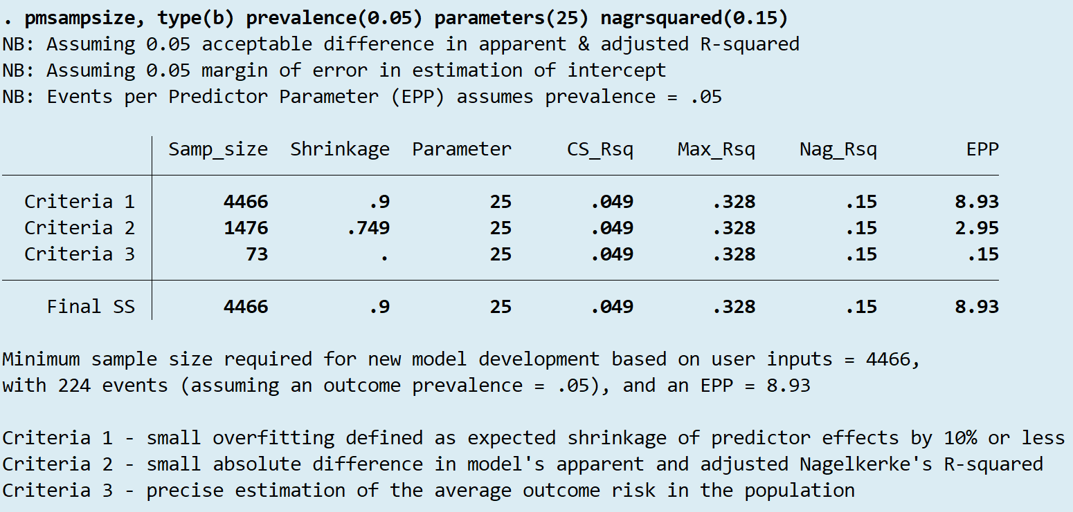
Cox-Snell R-squared
Notes:
So lets have a look at what it can do and I'll talk through each element.

Slide 25
Cox-Snell R-squared
Notes:
Talk through the following:
- type = option for model outcome
- prevalence = the anticipated outcome prevalence
- parameters = the number of candidate parameters we want to estimate
- rsquared = we need to specify a lower bound for the potential perf of the new model
- the way our calculations work, use an overall performance measure to do this, using the r-squared statistic
- now I’m assuming that most of this audience are familiar with the metric, but gives a measure of the proportion of variation in our data, explained by our model
- so here i have input a value of 15%
- this may be based on previous literature for example

Slide 26
Cox-Snell R-squared
Notes:
now lets focus on the criteria
- clearly i don’t have time to go into detail here, but the key thing is that there are a set of three criteria and the SS needed to meet each of these is calculated separately, with the maximum of these three SS’s taken as the final minimum SS needed for your new model development

Slide 27
Cox-Snell R-squared
Notes:
now lets focus on the results
- in the first column you see the SS required to meet each of the criteria and at the bottom the final SS needed for the new model developmen 4466, we also see that this means we need 224 events assuming the anticipated prevalence

Slide 28
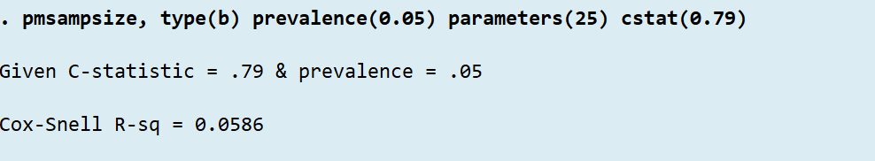
C statistic
Options to specify anticipated performance of new model include:
  Cox-Snell R-squared
  Nagelkerke’s R-squared
  C statistic
Notes:
Now as with all SS calculations the difficulties come in specifying the assumed parameters of the calculation. In this case the important one is the anticipated R-sq performance of our new model. pmsampsize can take three different inputs:
- the cs r-sq directly if its been reported in a previous study
- the nagelkerke’s r-sq - more akin to the R-sq in a linear regression setting, interpreted as a %
- or the C statistic - which is by far the most commonly reported performance statistic in the prediction modelling literature
here you can see I have replace the r-sq option with the cstat option in the command line. and uses the cstat and prevalence to calculate the cs r-sq using a quick simulation approach

Slide 29
Sample size considerations
We want to have a large enough sample size to develop a model that predicts as accurately as we can
Important when conducting a prospective study
  How many individuals do I need to collect?
Important when using existing data
  Is my available data large enough?
  How many predictors can I consider?
Notes:
However, many prediction modelling studies use an existing dataset that happens to be to hand. Then in this case the SS/events are fixed
- and rather you must decide how many parameters you can realistically assess
- `pmsampsize` can give you an estimate of this using the *n* option

Slide 30
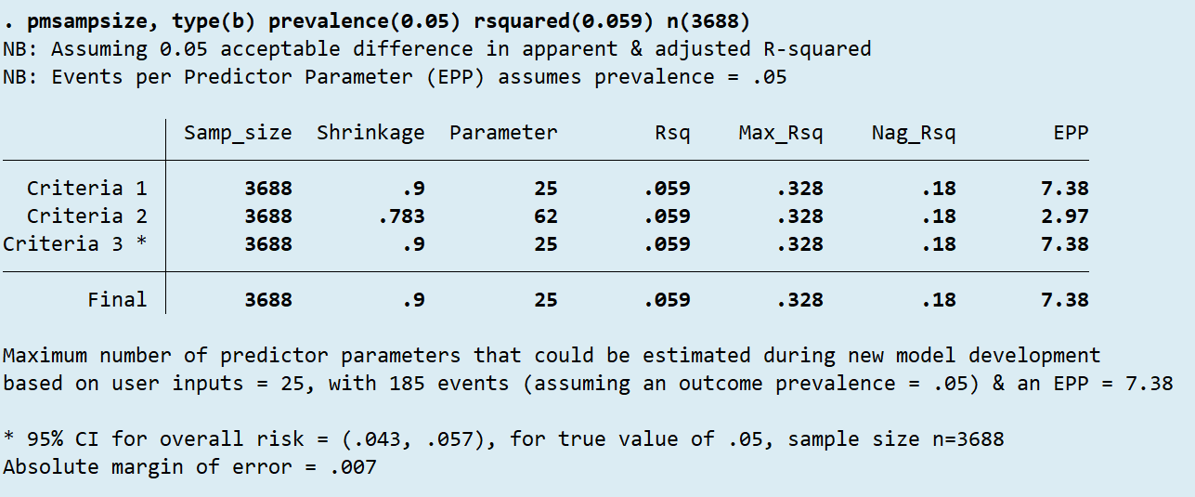
Fixed N
Notes:
so here you can see I’ve replace the parameters option with the n option, so pmsampsize works backwards if you like, to give me the number of parameters I can consider given a fixed SS of 3688 - and we can see that the number of parameters we can consider in our new model dev study is 25 in this example

Slide 31

“An explanation of sample size was reported in only 9% of validation studies”
Collins et al. 2014
Notes:
moving on to external validation - again it’s equally important to get the design right from the start, and SS is critical but again often ignored!
read out quote - that’s bad isn’t it!

Slide 32
Sample size for validation studies
Development
develop a model that predicts as accurately as we can
Validation
accurately and precisely estimate model performance
What do we want?
We want to have a large enough sample size to …
Notes:
So now we’re thinking about validation SS, the question is slightly different, we already have a fixed model now, instead we’re interested in having a large enough sample to accurately and precisely estimate the models performance in the external sample

Slide 33
pmvalsampsize
Minimum sample size required for external validation of a prediction model
Calculates sample size needed to ensure precise estimation of key measures of prediction model performance
Notes:
pmvalss calculates SS for ext val and works out the ss needed for precise estimation of performance

Slide 34
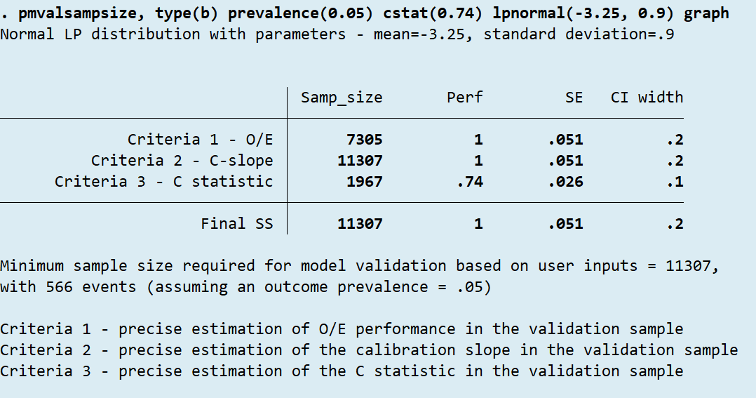
pmvalsampsize
Notes:
focus on the criteria to start

Slide 35
pmvalsampsize
Notes:
again there are 3 criteria for which SS is calculated
OE a measure of overall cal
slope a measure of optimism/shrinkage
c stat a measure of discrimination
and again i can’t go into too much detail here, but there are detailed help files for all these packages including references to methods papers that talk about these statistics in detail

Slide 36
pmvalsampsize
Notes:
similar to pmss we see options for the type of model, prevalence, c stat
c stat is often lower at validation and we recommend using a value 0.05 lower based on review evidence.
one of the critical elements of the ss calc is specifying the distribution of the LP of the model in the new sample, for criteria 2.
this is tough, and we wish there were better reporting of the LP distribution in model dev studies!

Slide 37
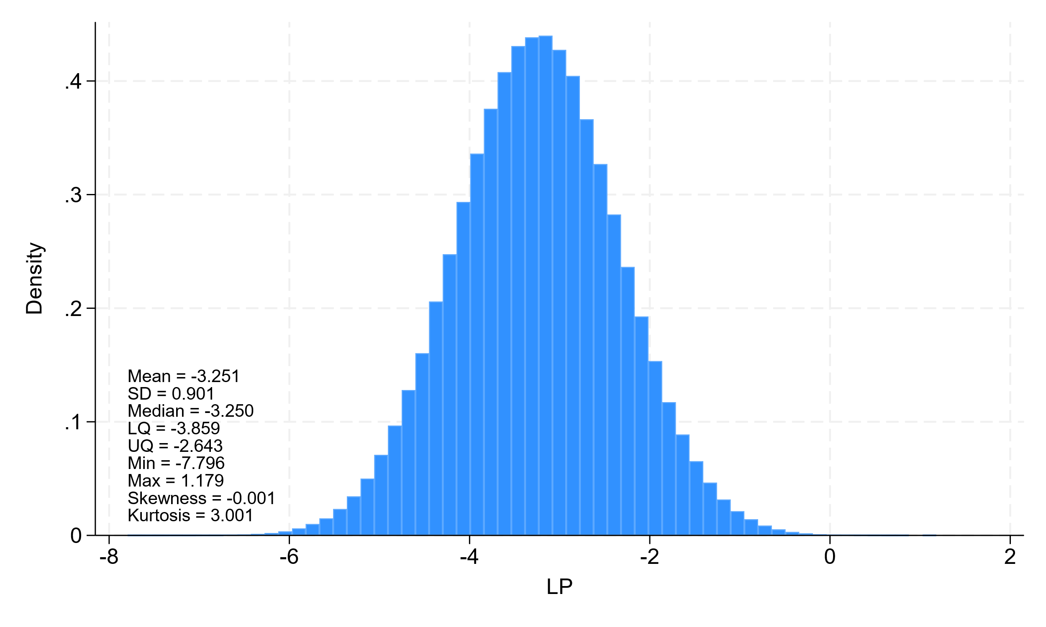
pmvalsampsize
Options to specify LP distribution include:
  Normal
  Skewed normal
  Beta – for predicted probabilities
  C statistic based normal distributions
Graph option for checking
Notes:
there are a number of options for this in pmvalss, including specifying a normal dist, skewed normal dist. you can specify a beta dist for the predicted probabilities instead, as sometimes this can be obtained from calibration plots. Or normal distributions for the event and non-event groups based on the c statistic - recall this is the most commonly reported performance statistic. In the next version of the program you’ll be able to specify separate event and non-event distribtions for the other distributional options too

Slide 38
pmvalsampsize
Notes:
we can use the graph option to check the simulated distribution against our source. it’s also useful for reporting in your study, so that future research has information on the LP distribution used! Key stats are presented here on the plot to describe the distribution.

Slide 39
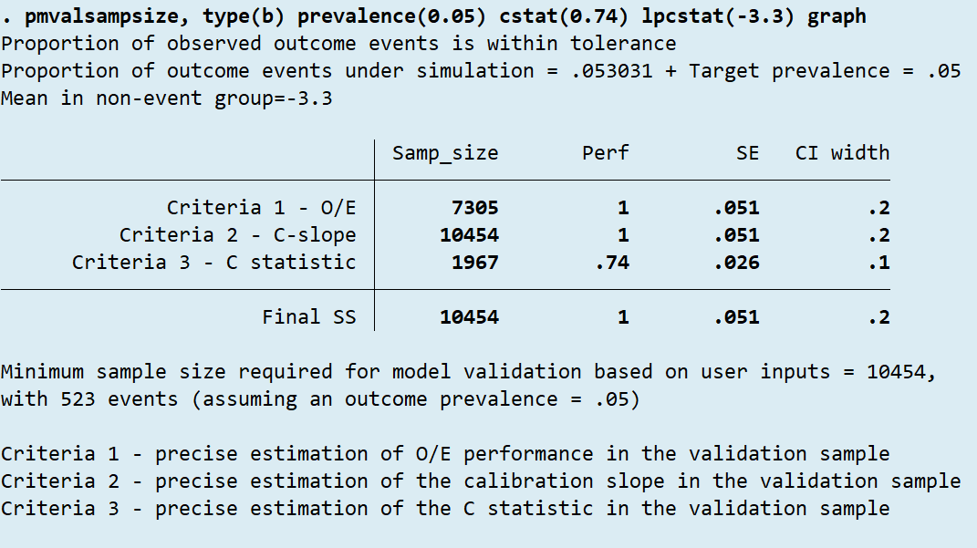
Using C statistic to derive LP distribution
Specify C statistic & non-event mean starting value
Options to aid iteration process include:
  Trace
  Tolerance
  Iteration step
Strong assumptions
Notes:
using the lpcstat() option we specify two parameters, the c stat and a starting value for the mean of the non events distribution. It then uses an iterative approach to find the appropriate parameters for the LP distributions, ensuring the simulated data has similar outcome prevalence to that specified
there are some useful options to help with this in pmvalsampsize:
- we can use a trace option to follow the iterative process and
- we can tweak it using options for tolerance and iteration step size
this one makes some strong assumptions but it may be the only option where we have nothing else to inform our LP parameters

Slide 40

“Reported model performance measures:
Discrimination = 57/78 (73%)
Calibration = 11/78 (14%)
Overall metrics = 18/78 (23%)”
Collins et al. 2014
Notes:
It’s criminal how historically poor the reporting of model performance is in the literature.
Here we can see evidence from a review of external validation studies
- Discrimination statistics like the c statistic are most commonly reported as discussed.
- Calibration was was only reported in 14% of studies! This is madness, because whether the models predicted probabilities are accurate or not is what may make the difference between you deciding to have the surgery or not!

Slide 41
pmstats
Many proposed performance statistics exist
  Time consuming & confusing
R users have rms
pmstats calculates key performance measures including:
  Discrimination
  Calibration
  Overall performance
  Reporting statistics
Notes:
When we teach on our courses, we teach how to manually derive performance statistics of interest, but for many this is time-consuming and confusing. In R Frank Harrells rms package is a popular tool for prediction modellers to quickly output an array of performance statistics. In Stata we can use pmstats.

Slide 42
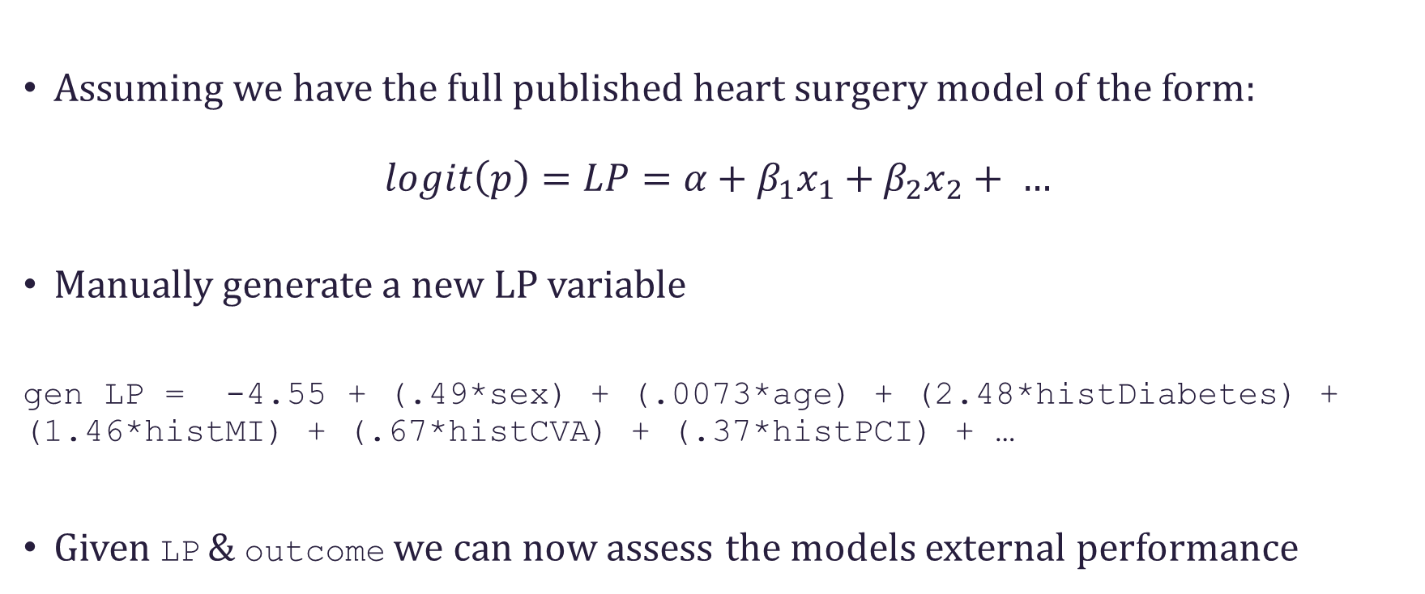
Predictions in a new sample
Assuming we have the full published heart surgery model of the form:
$$logit\left(p\right)=LP=α+β_{1}x_{1}+β_{2}x_{2}+ …$$
Manually generate a new LP variable
gen LP = -4.55 + (.49*sex) + (.0073*age) + (2.48*histDiabetes) + (1.46*histMI) + (.67*histCVA) + (.37*histPCI) + …
Given LP & outcome we can now assess the models external performance
Notes:
Assuming we have the full published model for predicting your risk of death from heart surgery - we want to validate it in new patients like you, to check it’s accuracy & reliability.
In Stata we generate a new variable as the combination of the model betas and patients characteristics, this is the linear predictor. With the linear predictor calculated for all individuals in the validation cohort and their outcomes, we have all we need to calculate model performance using `pmstats

Slide 43
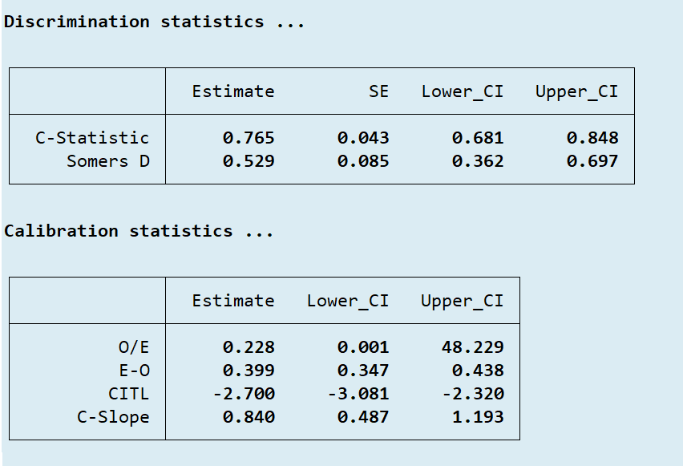
pmstats
Estimates with CI’s
Calibration model parameters
Continuous & TTE outcomes
Notes:
We can see here that it produces a range of performance statistics with confidence intervals, it produces calibration statistics including overall measures and the parameters of the so called calibration model. pmstats also works for continuous and TTE outcome models and gives appropriate performance statistics for these.

Slide 44
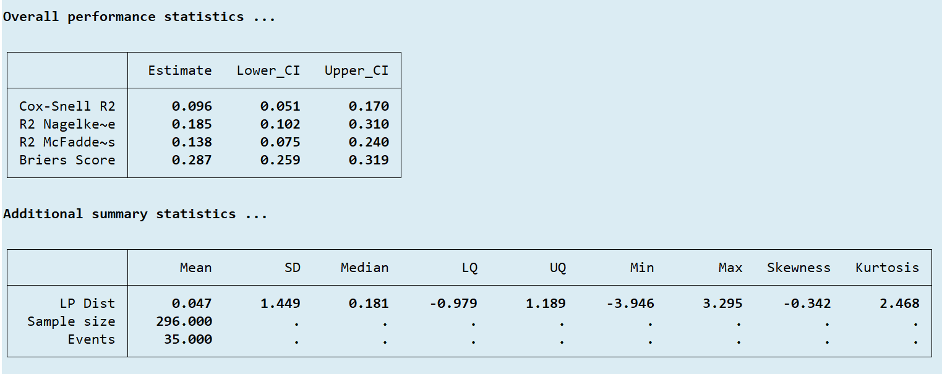
Overall performance statistics
Linear predictor distribution useful for future research
Further information
Notes:
it also outputs overall performance measures including R-sq. And summary statistics for the linear predictor as I’ve talked about how this is important for future research

Slide 45



“Only 11 studies presented a calibration plot (11/78; 14% 95% CI 8% to 24%)”
Collins et al. 2014
Notes:
We have seen how poorly performance is reported in general. But calibration is historically the most neglected element, and yet in my opinion the most important element of model performance.
In particular, a calibration plot is essential as it gives us so much information!

Slide 46

pmcalplot
Using the same validation sample
Predicted probabilities calculated using LP
$$p=\frac{e^{LP}}{1+e^{LP}}$$
Generate the predicted probabilities
gen pr = (exp(LP))/(1+exp(LP))
pmcalplot pr outcome, ci
Notes:
Using the same validation sample as before, I want to produce a calibration plot. We can use the LP variable we generated to calculate the predicted probabilities for Individuals using the logistic transformation. Then we can run pmcalplot using this simple command line

Slide 47
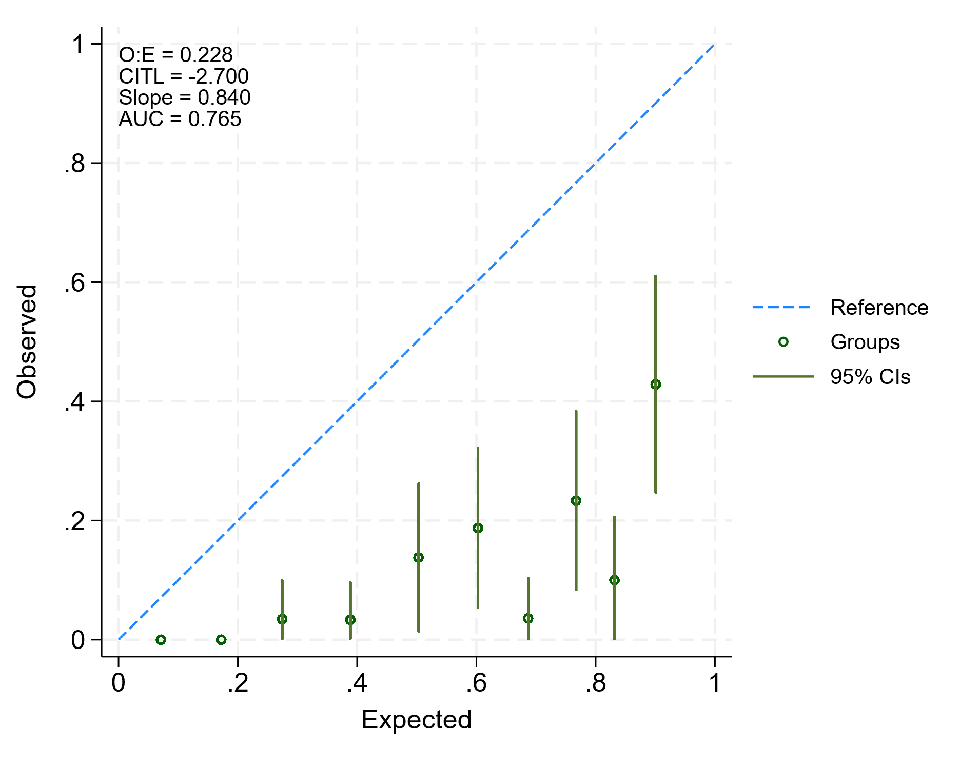
External validation
Plots observed outcomes against predictions from the model
Historically plotted in groupings
Notes:
Calibration plots visualise the agreement between the patients observed outcomes and the models predicted risk of outcome. The plot can show this agreement across the risk spectrum from those with low to high risk. Traditionally this is assessed in groupings, as shown here. We have options to increase or reduce the number of groupings, or to specify groups based on thresholds at which the model is intended for use, say high/moderate/low.

Slide 48
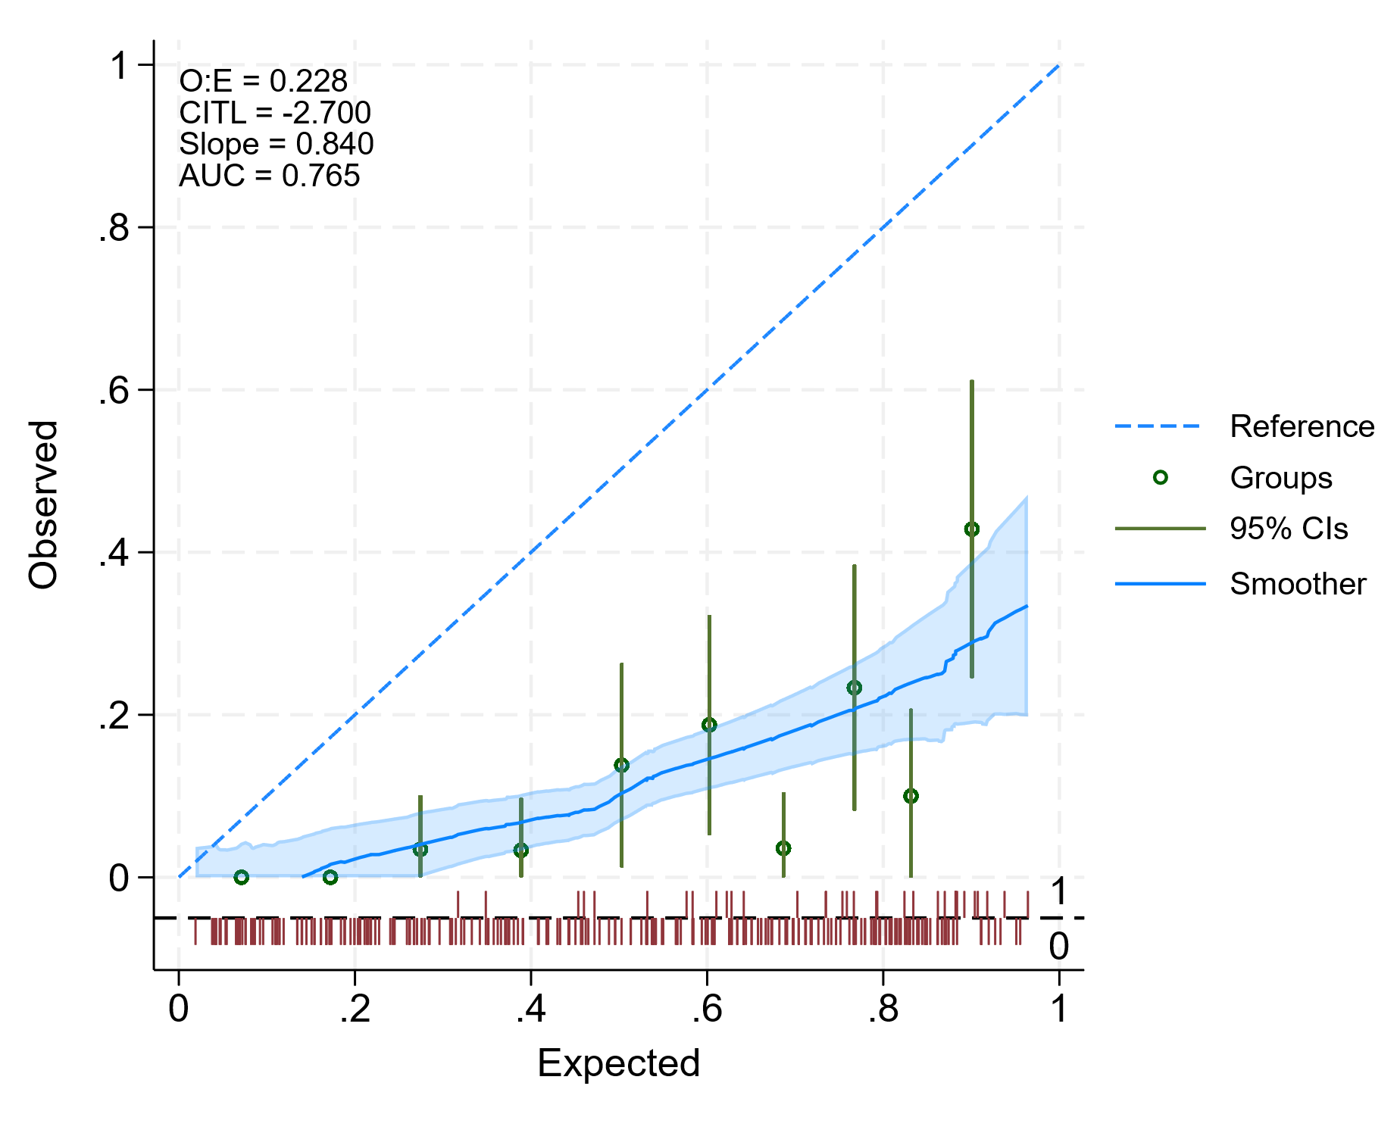
External validation
Calibration curve allows assessment of calibration at the individual patient level
Spike plot showing the spread of events/non-events across risk spectrum
Notes:
it’s common now to also use a smoother known as a calibration curve to assess this agreement at the individual level. and we also have a spike plot here at the bottom to show the spread of events/non-events across the risk spectrum.

Slide 49
External validation
Clear over-prediction
Systematic miscalibration
Evidence of overfitting
Notes:
I said the calibration plot is super useful, and a picture speaks a thousand words and all that, so lets interpret the plot a bit. we can see here the groupings and the curve show clear over prediction, for a patient predicted a 60% risk of death, their actual risk was 15%, this is akin to the example we talked about where your risk of death from heart surgery was predicted too high and influenced your decision to have the surgery .
I can see from the curve that it lies completely below the 45 degree reference line and this is something we see quite often when the prevalence in the validation sample is much lower than that seen in the development sample, again this leads to over prediction
i can also see evidence of overfitting, we have the c-slope given here, which ideally would be 1, but is lower here, indicating overfitting at model development, probably because the SS was too small and they did not do internal validation and adjust their model for optimism

Slide 50
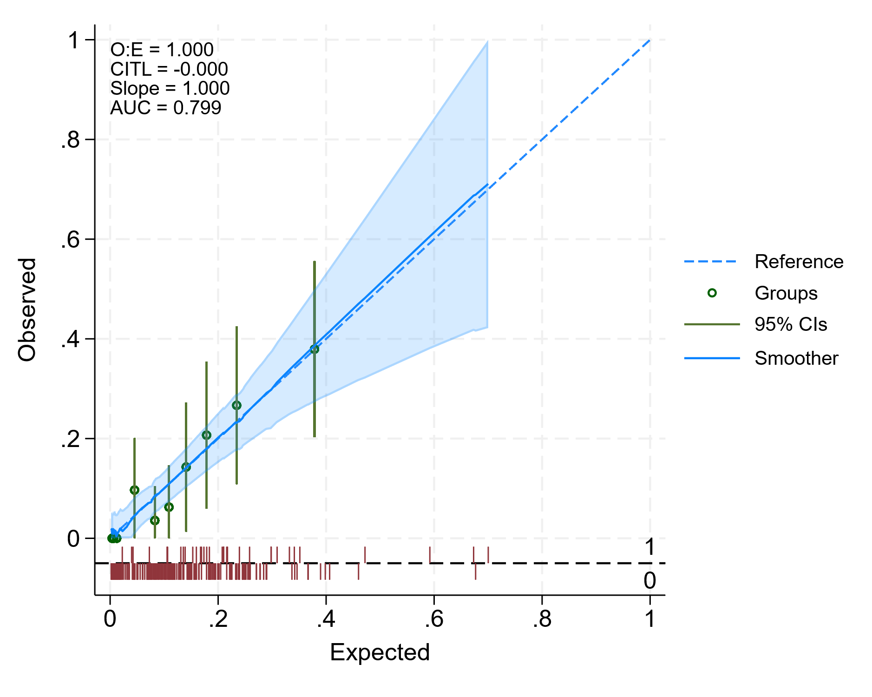
Apparent performance
Primarily for external validation
Can be used to check apparent performance!
Notes:
Both pmcalplot & pmstats are primarily for stage two, external validation, but we could use them at development too to calculate the apparent performance of our model. This is a useful check, as we expect calibration to be perfect and if it’s not then we know something has gone wrong!

Slide 51

Final thoughts
Notes:
Need a wrap up quote

Slide 52
pm-suite
Development
&
Internal Validation
External Validation
&
Updating
pmsampsize
pmintval
pmiecv
pmcstat
pmstats
pmcalplot
pmvalsampsize
pmupdate
pmsplot
pmmeta
Notes:
So I’ve just showed a few of these packages today, to mention a few of the others that are in development and testing:
- We have `pmcstat` for faster c stat computation - already using this one in some of the other packages, but will put this up as a standalone too.
- We have `pmupdate` which implements updating for your model and ranks which method is best for your population
- we `pmintval` for internal validation and optimism adjustment and reporting of the final model
- We have `pmiecv` for internal-external cross-validation when we have clustered data

Slide 53
Take home
Important to describe your sample size
  number of events
  number of candidate predictor parameters
  how you came up with your sample size
Multiple measures of model performance
Calibration plots
Baseline survival/hazard at multiple time-points
Distribution of linear predictor
Range of predictors
Notes:
a few final thoughts to take home, mostly on reporting:

Slide 54
Conclusion
Prediction modelling is hard!
  Easy to end up with inaccurate and unreliable models
Carefully consider
  Design
  Evaluation
Fully report all stages
Notes:
In conclusion, prediction modelling is hard! It's complicated and easy to fall into traps that can lead to models that are not accurate or reliable for their intended purpose or population, and could lead to bad health decisions down the line.
Hopefully, the pm packages can help!
Please carefully consider the design and evaluation of your prediction modelling studies
and fully report everything you do!

Slide 55
With thanks to Richard Riley, Gary Collins, Kym Snell, Lucy Archer …
Email: j.ensor@bham.ac.uk
Twitter: @joie_ensor

Slide 56
CPM stages
Development
&
Internal Validation
External Validation
&
Updating
Implementation
&
Impact
Model impact
Assess whether implementing a model actually improves patient outcomes
Trials assessing standard care versus using the model to inform clinical decision making
Notes:
In the third stage we look to assess how using the model impacts on patient outcomes. Ideally this would involve a trial assessing standard care versus using the model to inform clinical decision making. There have historically been very few of these studies compared to the vast number of studies covering the earlier stages. Statistically, the analyses of studies at this stage follow standard trial methodology.

