Slide 1
1. Securing Stata
2. Using characterisics for metadata
2023 UK Stata Conference
Bjarte Aagnes

Slide 2
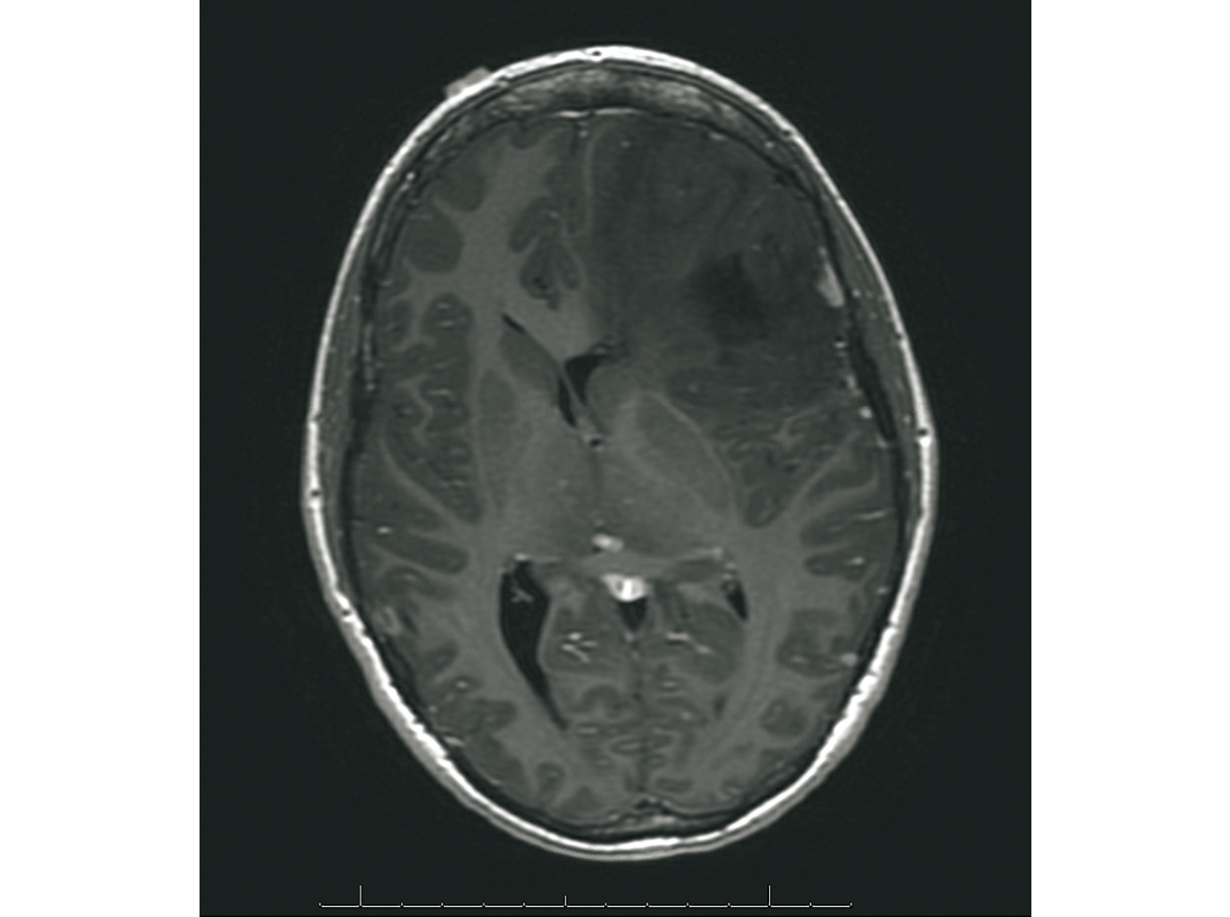
Cancer data start with cancer diagnosis
brain tumor

Slide 3
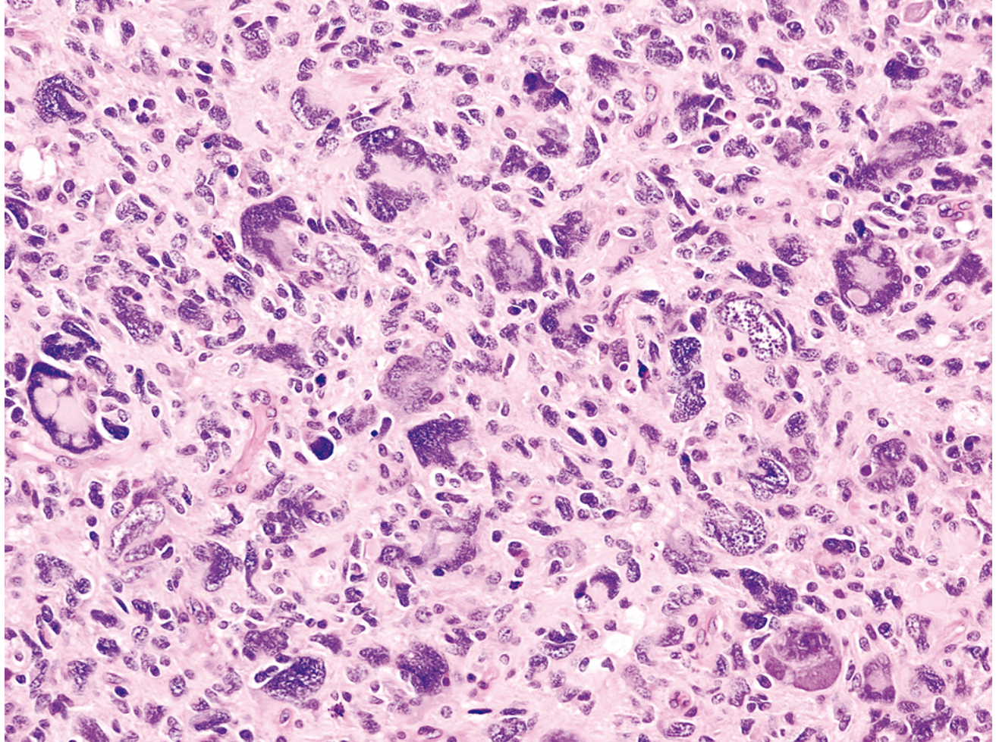
WHO classification of CNS tumors
morfology 94453 “Glioblastom, IDH-mutert”

Slide 4
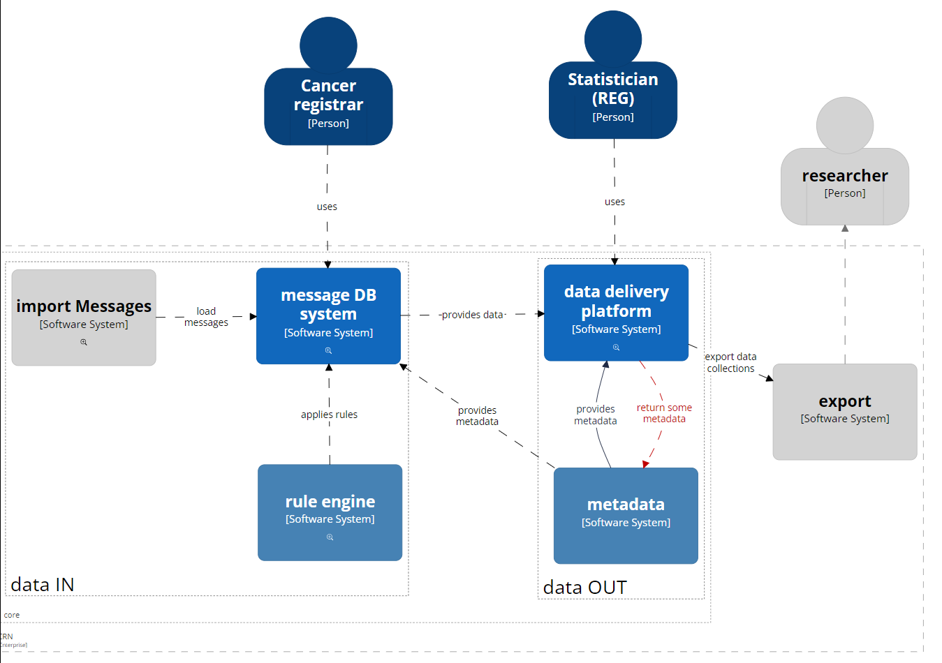
Technical context (Cancer Registry of Norway)
System landscape

Slide 5
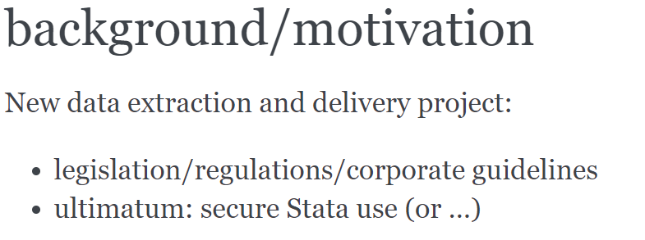

Slide 6
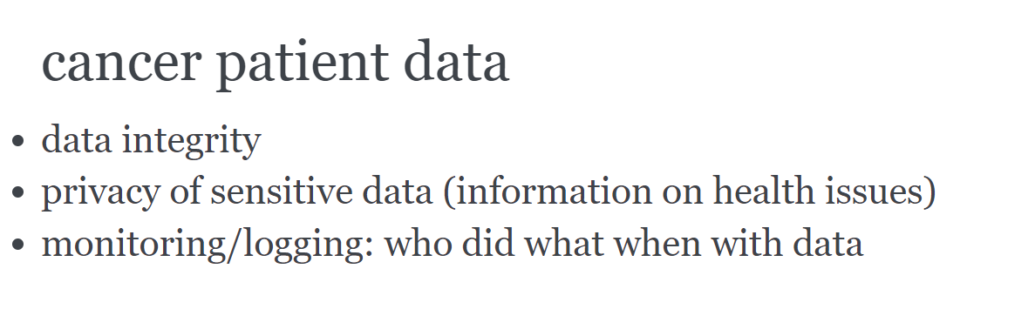

Slide 7
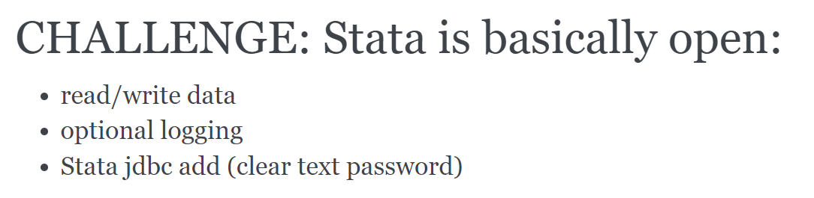

Slide 8
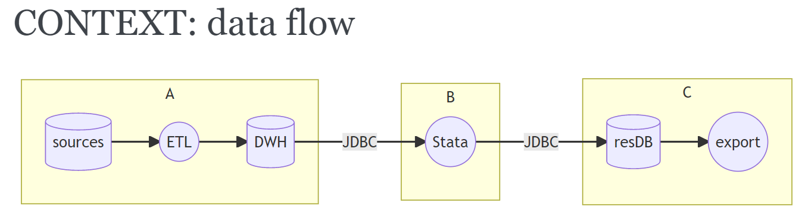

Slide 9
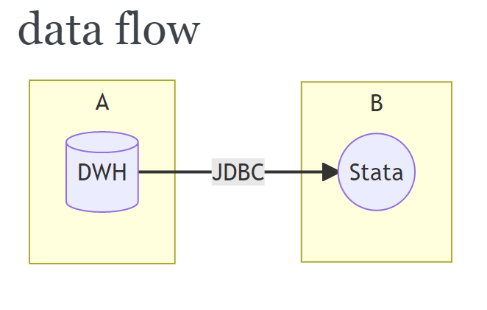

Slide 10
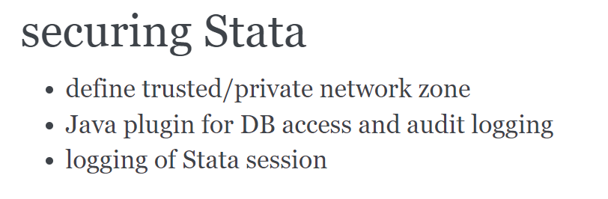

Slide 11
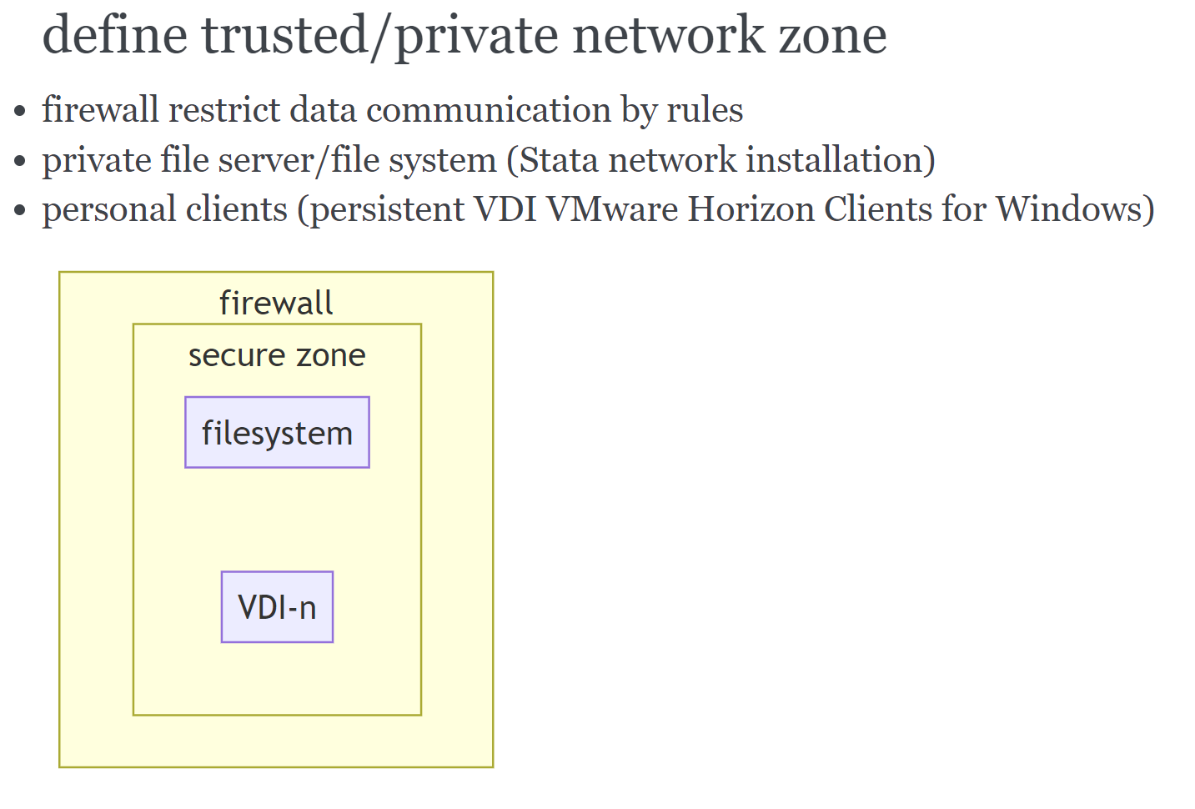

Slide 12
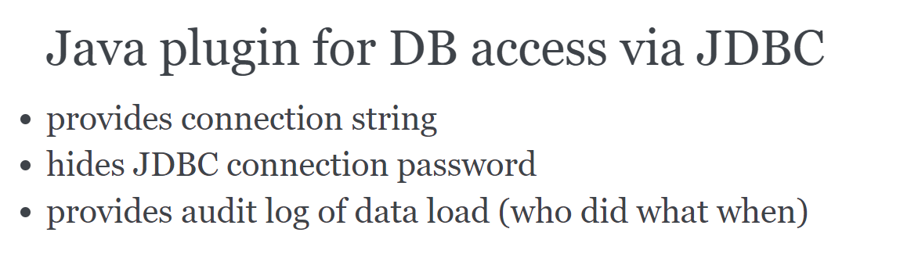

Slide 13
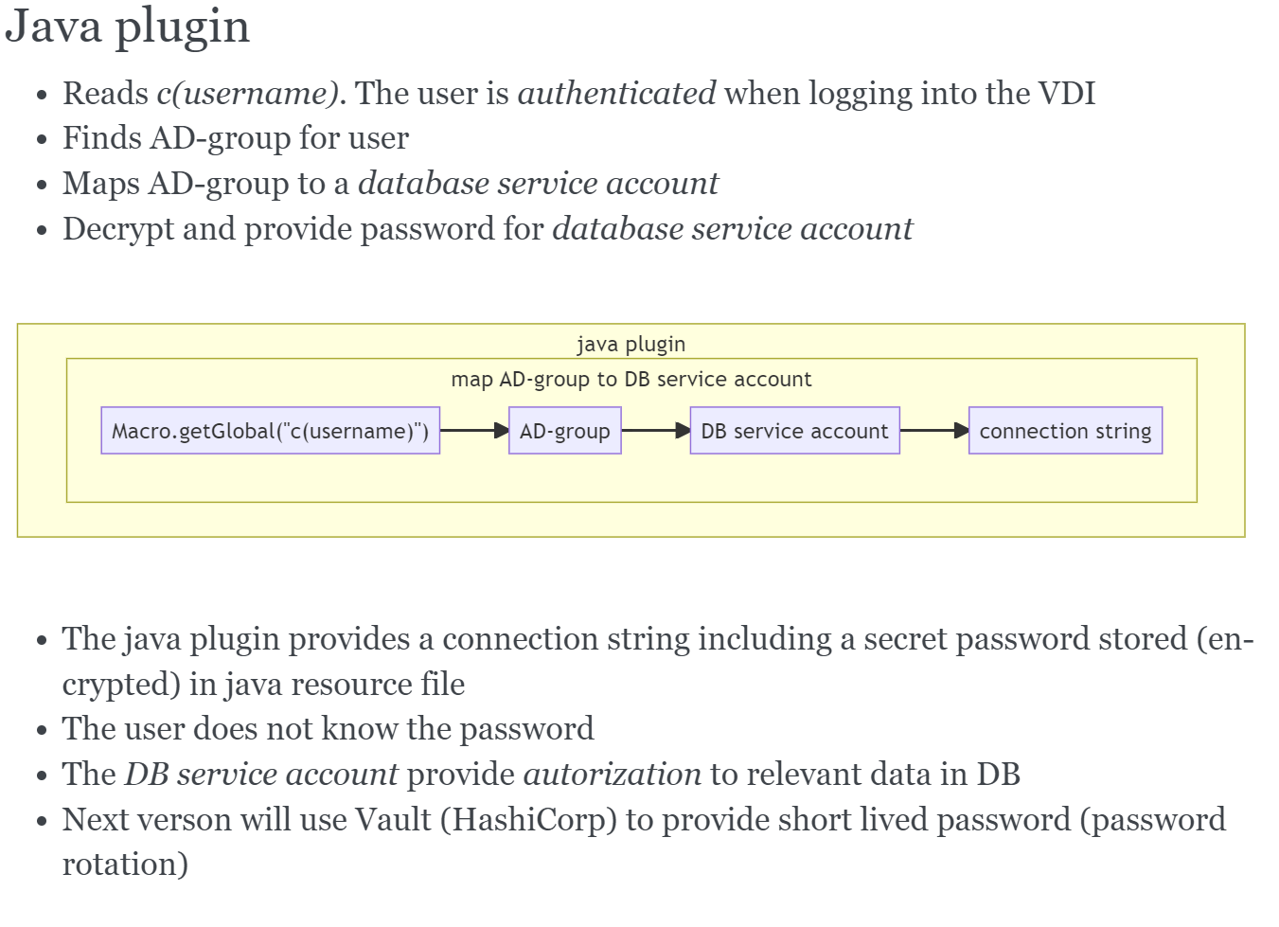

Slide 14
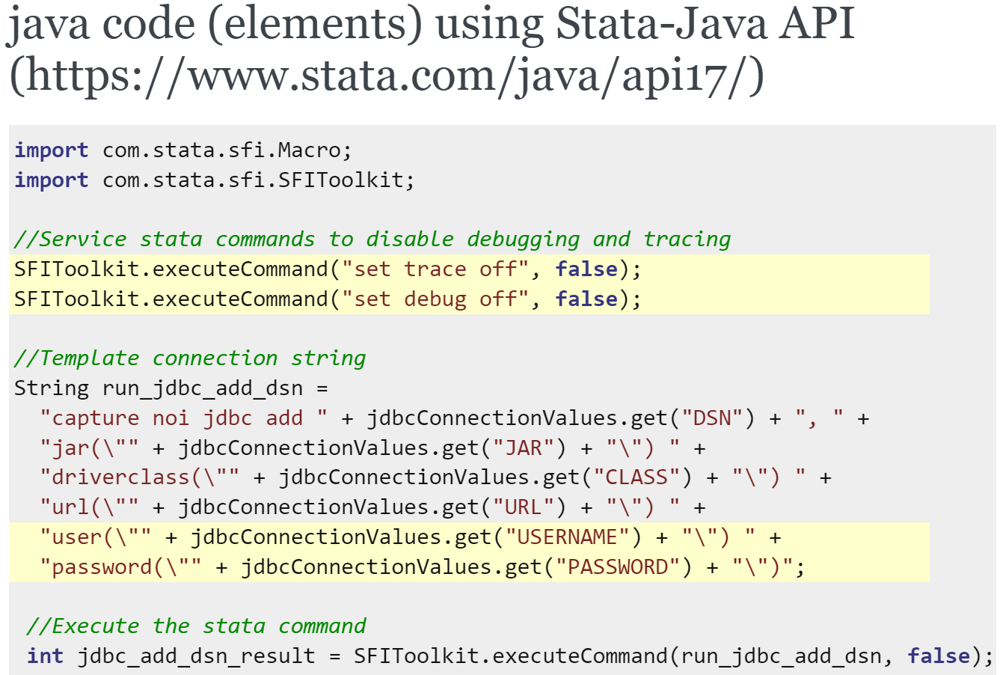

Slide 15
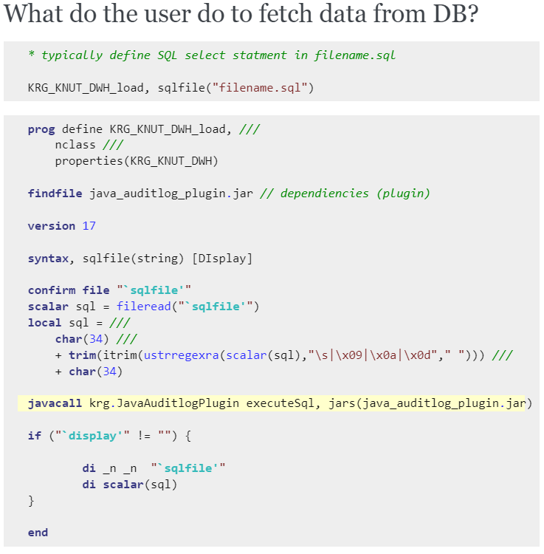

Slide 16
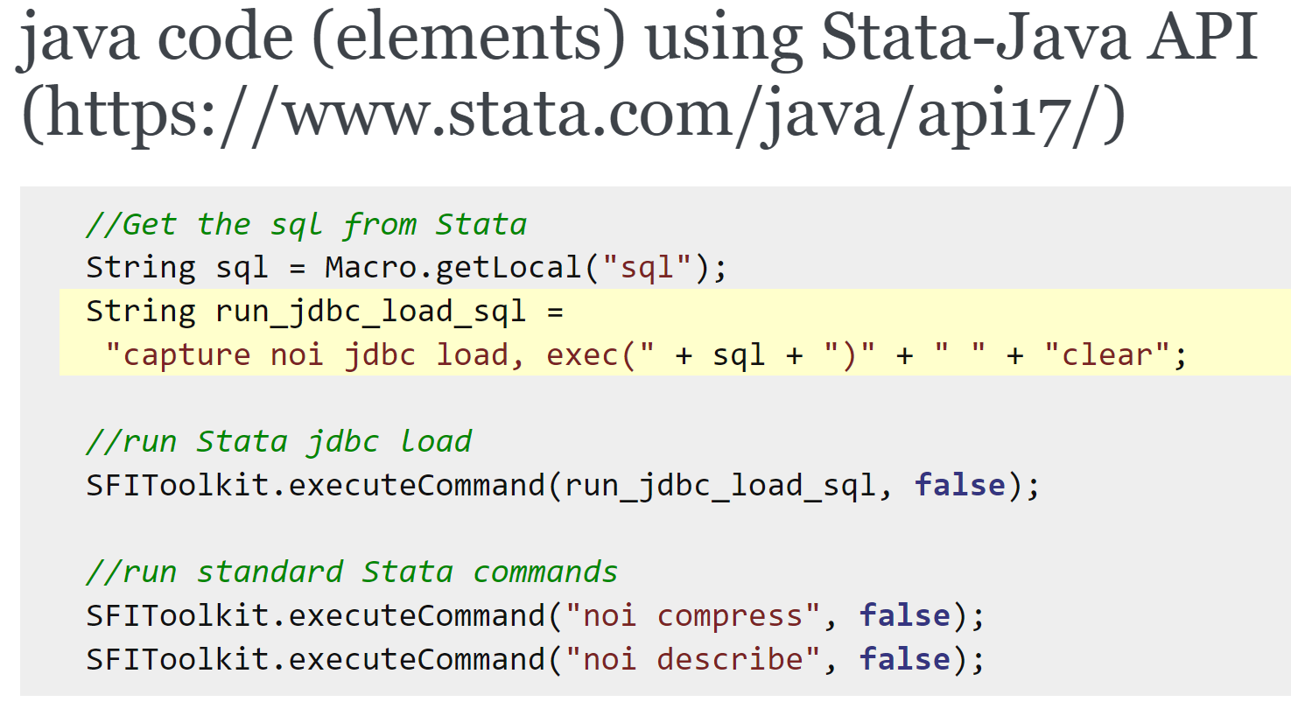

Slide 17
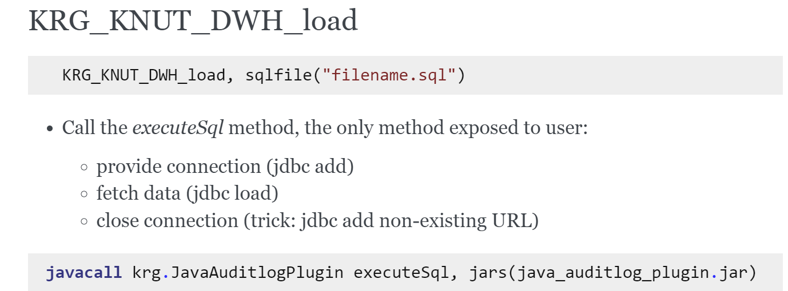

Slide 18
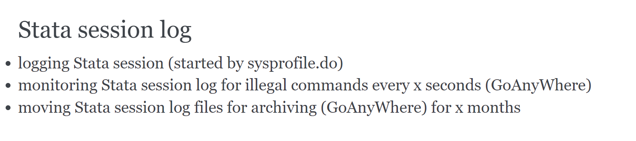

Slide 19
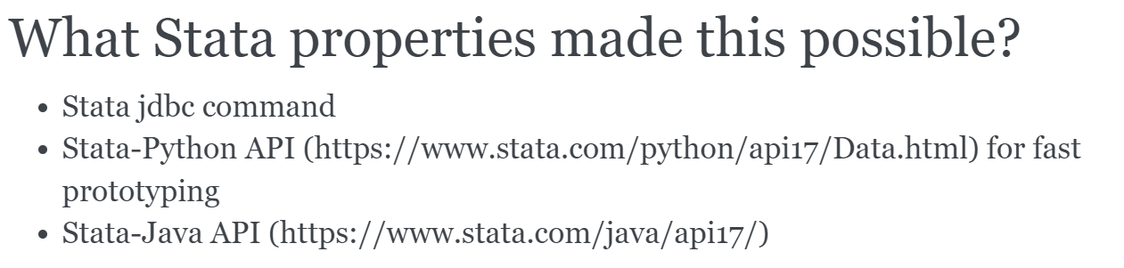

Slide 20
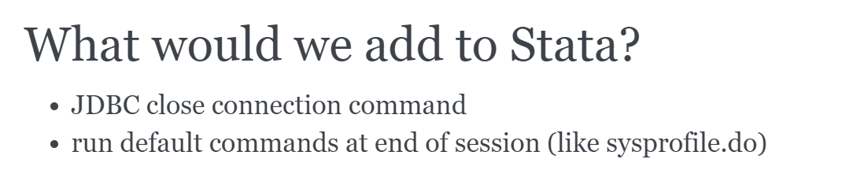

Slide 21
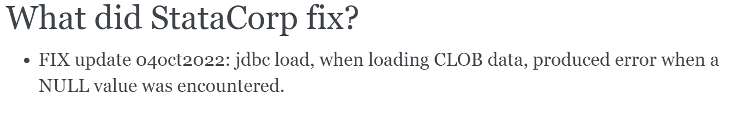

Slide 22
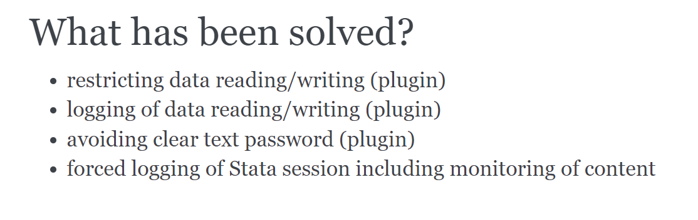

Slide 23
Meta data
  Source meta data system
  In DWH tables Variable_Dim, Variable_Value_dim
  Daily creation of dta with only metadata
  For 3500 variables 26 variable metadata elements
  For subset of variables 2 lists: value_code, value_code description
  When fetching data meta data is automatically attached
  Add variable labels
  Add value labels if metadata «Integer» and lists of value_code, value_code description

Slide 24
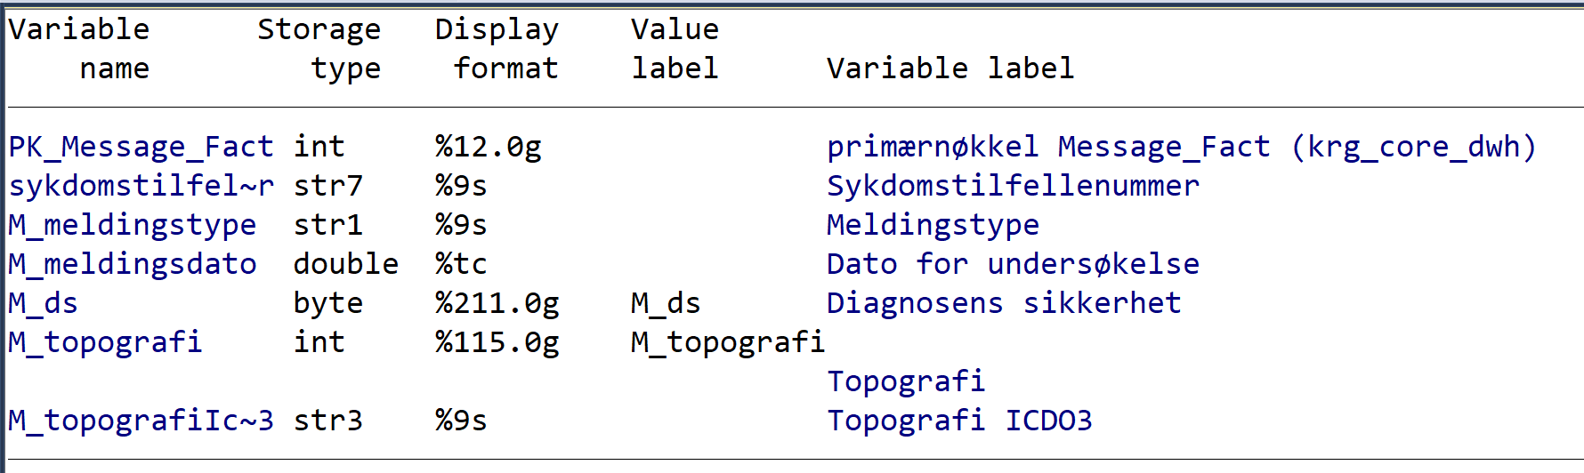
Automatic labels from meta data

Slide 25
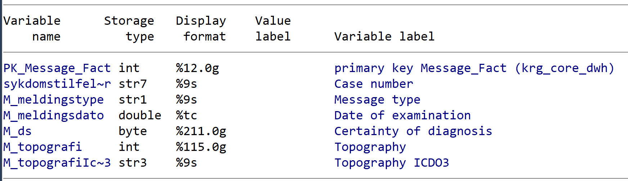
Automatic variable labels from meta data (EN)

Slide 26
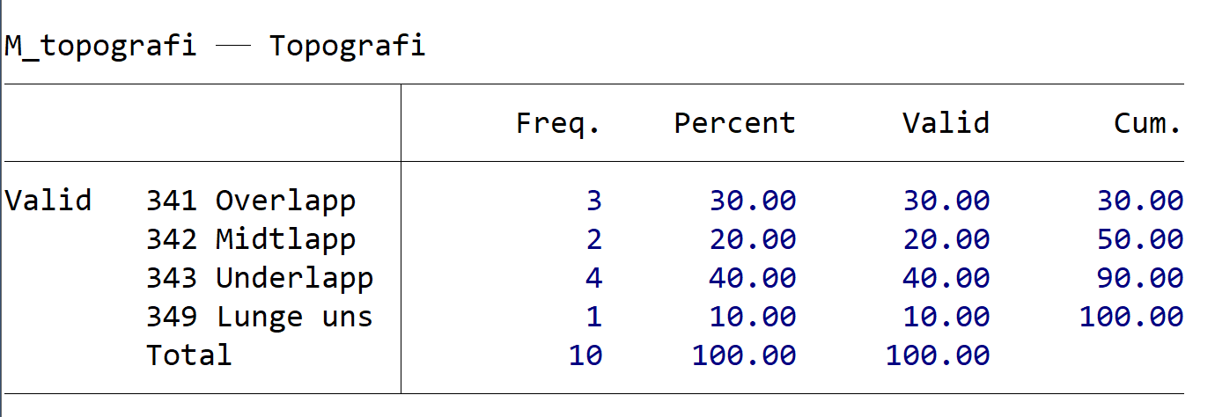
Automatic value labels from meta data

Slide 27
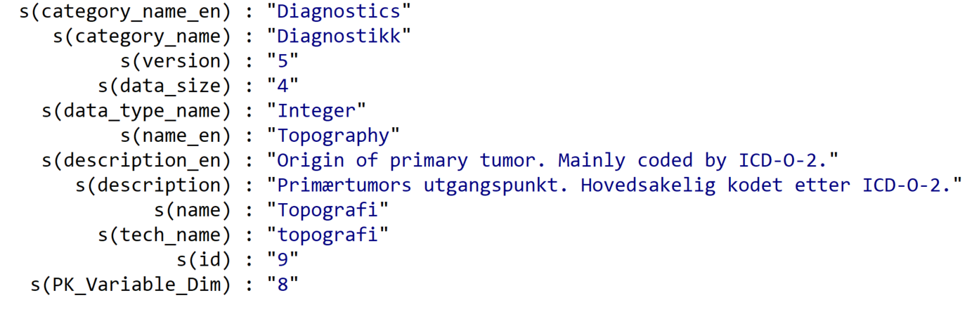
Utility: get local macros for use in programming

Slide 28


