Slide 1
Covariate adjustment in a randomised trial with time-to-event outcomes
Ian White, Tim Morris, Deborah Ford
MRC Clinical Trials Unit at UCL, London, UK
UK Stata conference (online)
9 September 2021
Notes:
20 minutes total (15+5)

Slide 2
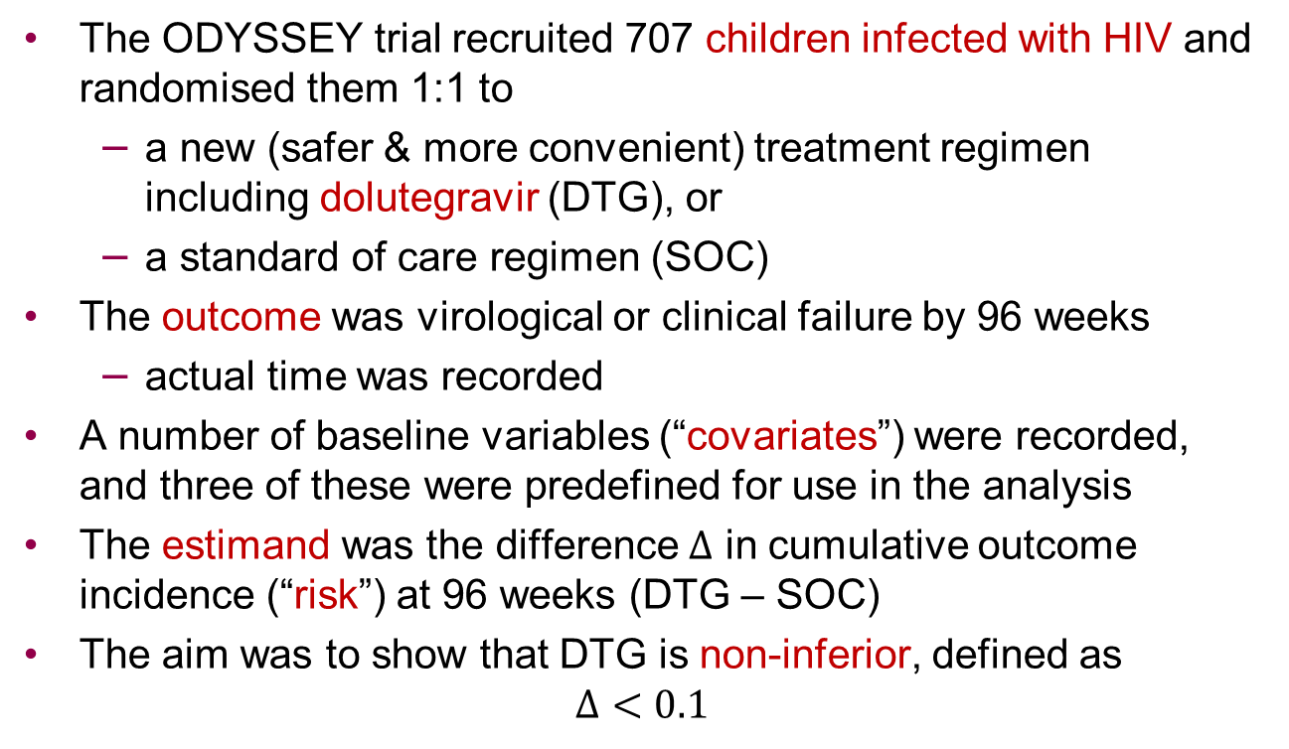
Setting
The ODYSSEY trial recruited 707 children infected with HIV and randomised them 1:1 to
  a new (safer & more convenient) treatment regimen including dolutegravir (DTG), or
  a standard of care regimen (SOC)
The outcome was virological or clinical failure by 96 weeks
  actual time was recorded
A number of baseline variables (“covariates”) were recorded, and three of these were predefined for use in the analysis
The estimand was the difference $Δ$ in cumulative outcome incidence (“risk”) at 96 weeks (DTG – SOC)
The aim was to show that DTG is non-inferior, defined as
$Δ<0.1$

Slide 3
Model-based vs. estimand-based approaches to statistical analysis
Model-based
Estimand-based
Choose model
Report model parameter
Choose outcome
Choose estimand
Choose method
Report estimand

Slide 4
Challenges here
Non-standard estimand
  difference in risk at 96 weeks
  not a parameter in a model
  could use difference between Kaplan-Meier curves if no covariate adjustment
Covariate adjustment
  not to control confounding
  to improve power
  to improve precision of estimation of the estimand

Slide 5
Methods for covariate-adjusted estimation of a chosen estimand
Regression adjustment
Find a model where the estimand is a parameter
Not always possible
Standardisation
Choose a model
Compute estimand from model fit
Inverse probability of treatment weighting
Construct weights from covariates
Use in unadjusted estimation
Broadly applicable
Broadly applicable
e.g. binary outcome: binreg, rd
logistic then margins
teffects ipw

Slide 6
Aim & plan
Aim: How should we perform covariate adjustment to estimate the risk difference in the ODYSSEY trial? We need to specify this in advance in a statistical analysis plan.
Plan:
  Describe a basic approach using margins, which almost works
  Describe three alternatives which do work
  Compare results
Paul Lambert last year, and Elisavet Syriopoulou before lunch, described covariate adjustment for time-to-event outcomes by standardisation using standsurv. This talk covers similar ground but is much less general and uses Cox, not parametric, survival models.

Slide 7
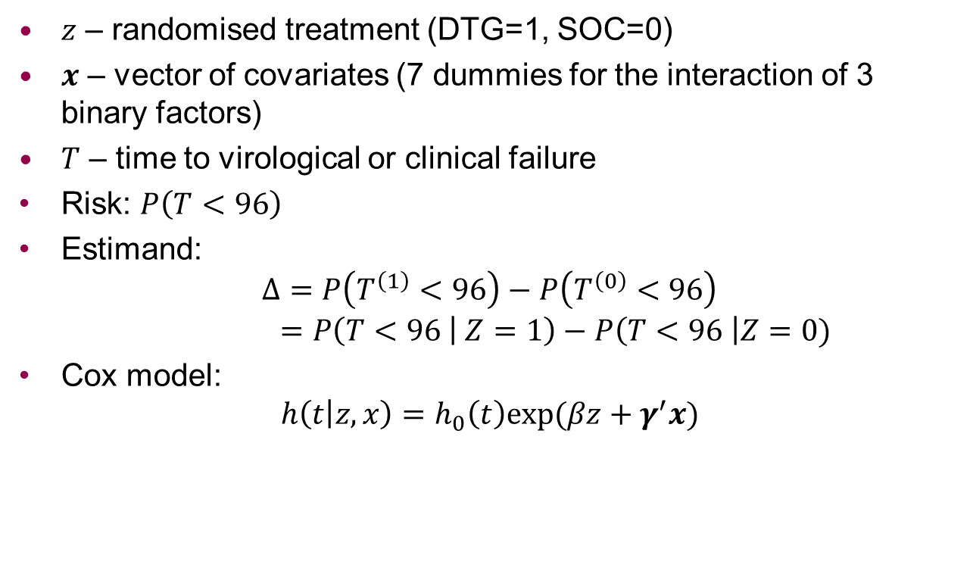
Notation
$z$ – randomised treatment (DTG=1, SOC=0)
$x$ – vector of covariates (7 dummies for the interaction of 3 binary factors)
$T$ – time to virological or clinical failure
Risk: $P\left(T<96\right)$
Estimand:
$$Δ=P\left(T^{\left(1\right)}<96\right)−P\left(T^{\left(0\right)}<96\right)$$
$$=P\left(T<96 | Z=1\right)−P\left(T<96 \right|Z=0)$$
Cox model:
$$h\left(t | z,x\right)=h_{0}\left(t\right)exp⁡(βz+γ^{′}x)$$
Notes:
The covariates were as in the primary trial analysis:
antiretroviral treatment [naïve or experienced (ODYSSEY A or ODYSSEY B)]
routine availability at site of resistance tests vs. non availability of resistance tests for children failing treatment
pre-specified NRTI backbone [ABC+3TC (± ZDV) vs. TDF(or TAF)+3TC(or FTC) vs. other]

Slide 8
Cox model result
“KMunicate” graph style: Morris et al, BMJ Open 2019
Hazard ratio, DTG vs SOC = 0.60 (0.42 to 0.86)
(unaffected by covariate adjustment to 2dp)
SOC
.2
Cumulative incidence
.1
DTG
0
Months
0
24
48
72
96
DTG
At risk
350
343
341
319
300
Censored
0
1
2
3
4
Event
0
6
7
28
46
SOC
At risk
357
347
338
295
276
Censored
0
3
8
10
12
Event
0
7
11
52
69
Notes:
Jump at 48 weeks is because most failures were due to confirmed VL>=400 after week 36 and with 12-weekly VLs a number happened at week 48
https://bmjopen.bmj.com/content/9/9/e030215.long
kmunicate by(tot_rx) ci ytitle("Cumulative incidence") title("") plotregion(margin(medsmall)) fail ylabel(#4) name(KM2,replace) ytitle(,size(medlarge)) plotopts(lwidth(*3)) ylabel(,labsize(medlarge)) legend(off) xsize(9) ysize(5) subtitle(,size(large)),
groupvar(tot_rx) timerange(0(24)96) xtitle("Months") xlabelopts(labsize(medlarge)) savecmd labsize(medsmall)
+ editing in powerpoint

Slide 9
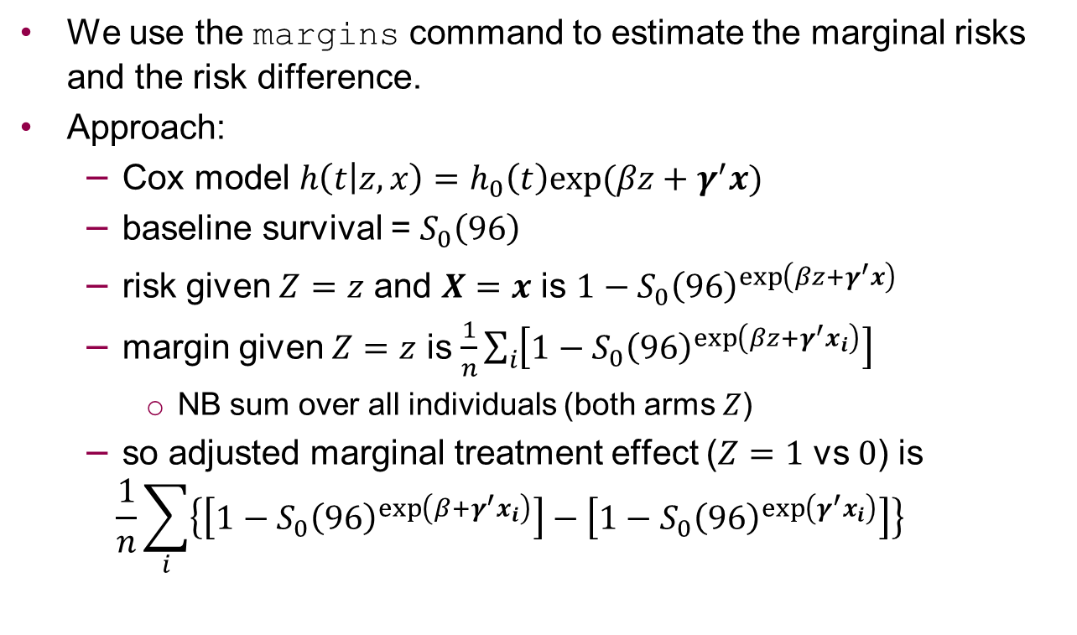
Approach 1: margins
We use the margins command to estimate the marginal risks and the risk difference.
Approach:
  Cox model $h\left(t | z,x\right)=h_{0}\left(t\right)exp⁡(βz+γ^{′}x)$
  baseline survival = $S_{0}\left(96\right)$
  risk given $Z=z$ and $X=x$ is $1−S_{0}{\left(96\right)}^{\exp\left(βz+γ^{′}x\right)}$
  margin given $Z=z$ is $\frac{1}{n}\sum_{i}{\left[1−S_{0}{\left(96\right)}^{\exp\left(βz+γ^{′}x_{i}\right)}\right]}$
    NB sum over all individuals (both arms $Z$)
  so adjusted marginal treatment effect ($Z=1$ vs $0$) is
  $$\frac{1}{n}\sum_{i}{\left\{\left[1−S_{0}{\left(96\right)}^{\exp\left(β+γ^{′}x_{i}\right)}\right]−\left[1−S_{0}{\left(96\right)}^{\exp\left(γ^{′}x_{i}\right)}\right]\right\}}$$

Slide 10
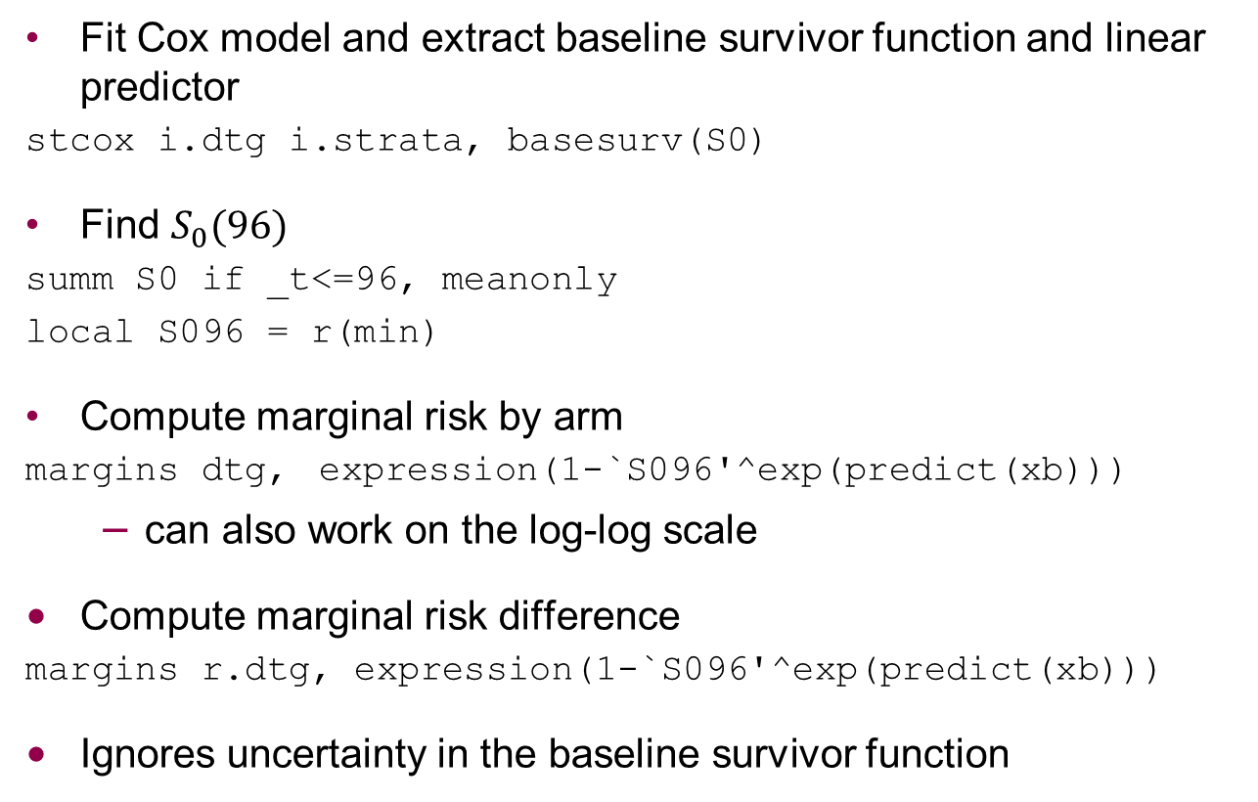
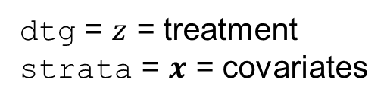
Stata method
dtg = $z$ = treatment
strata = $x$ = covariates
Fit Cox model and extract baseline survivor function and linear predictor
stcox i.dtg i.strata, basesurv(S0)
Find $S_{0}(96)$
summ S0 if _t<=96, meanonly
local S096 = r(min)
Compute marginal risk by arm
margins dtg, expression(1-`S096'^exp(predict(xb)))
  can also work on the log-log scale
Compute marginal risk difference
margins r.dtg, expression(1-`S096'^exp(predict(xb)))
Ignores uncertainty in the baseline survivor function
Notes:
Issue: whether to include f/up after 96 weeks in the Cox model fitting. We didn’t here.

Slide 11
Results
Estimand | Estimate | Scale for CI | 95% CI
DTG risk | 0.137 | probability | 0.080 | 0.193
 |  | log-log | 0.089 | 0.203
SOC risk | 0.217 | probability | 0.169 | 0.265
 |  | log-log | 0.173 | 0.269
DTG – SOC | -0.080 | probability | -0.129 | -0.032
Impact of ignoring uncertainty in the baseline survivor function?
  baseline = SOC arm & first stratum
  asymmetrical e.g. reversing coding of treatment increases SE of DTG – SOC by 50%
  definitely bad for arm-specific risks (results later)
Notes:
Why this asymmetry? Probably because SOC has larger risk, so is more uncertain on the risk scale. So ignoring uncertainty in SOC reduces SE more than ignoring uncertainty in DTG.
All results from odyssey_forest.do

Slide 12
Approach 2: margins + bootstrap
Bootstrapping the whole procedure (Cox model + margins) should correctly allow for all sources of uncertainty
We compare confidence intervals produced by normal theory and by bootstrapping, and (for the risks) using the log-log transform
  1000 bootstrap samples
  used same seed & details as in primary analysis

Slide 13
Results for treatment effect using margins +/- bootstrap
Method | Estimate | 95% CI
margins, ignore uncertain S₀ | -0.080 | -0.129 | -0.032
margins + bootstrap + Normal CI | -0.080 | -0.135 | -0.026
margins + bootstrap + percentile CI | -0.080 | -0.139 | -0.028
margins + bootstrap + bias-corrected CI | -0.080 | -0.142 | -0.031
Results reported in ODYSSEY paper
Conclusion: ignoring uncertain S₀ gives slightly too narrow CI
Note: Monte Carlo error on confidence limits is <0.001 for normal, <0.004 for percentile & BC.
Why is there no bootstrap, mcerror?
Notes:
MCSE computed by 10 replicates: <0.001 for normal, <0.004 for percentile & BC
All results from odyssey_forest.do

Slide 14
Approach 3: standsurv
We compare these methods with Paul Lambert’s standsurv, which is based on a parametric survival model
  we use streg and stpm2
This is equivalent to using margins while allowing for estimation
Code:
xi: stpm2 dtg i.strata, df(3) scale(h)
standsurv, atvars(S1 S0) at1(dtg 1) at2(dtg 0) contrast(difference) timevar(timevar) se ci contrastvar(con)
No need to bootstrap
Results later

Slide 15
Approach 4: IPTW
IPTW = Inverse probability of treatment weighting
Idea that applies for all outcome types
Can’t use stteffects which only does parametric survival models

Slide 16
Approach 4: IPTW
Regress randomised treatment on the covariates
logistic dtg i.strata
Construct inverse probability of treatment weights
predict p
gen pw = cond(dtg,1/p,1/(1-p))
Use weights in an unadjusted analysis
streset [pw = pw]
stcox i.dtg, basesurv(`S0')
summ `S0' if _t<=96, meanonly // as before
local S096 = r(min)
margins dtg, expression(1-`S096'^exp(predict(xb)))
Bootstrap for SEs and CI (code omitted)

Slide 17
ODYSSEY results: treatment effect
Apart from margins without bootstrap, all methods are very similar.
DTG is superior, not just non-inferior.
Notes:
All results from odyssey_forest.do

Slide 18
ODYSSEY results: DTG risk
Apart from margins without bootstrap, all methods are very similar
Notes:
NB prob=loglog for percentile and BC methods
All results from odyssey_forest.do

Slide 19
ODYSSEY results: SOC risk
All methods are very similar
Notes:
All results from odyssey_forest.do

Slide 20
Conclusions & discussion
Can derive covariate-adjusted survival difference after a Cox model
Need to bootstrap to get CI
All bootstrap methods were pretty similar
  in smaller samples, BC or loglog might be preferable
  useful to consider BCa
Extensions are straightforward:
  allow non-proportional hazards for treatment
  allow non-proportional hazards for covariates
  allow treatment by covariate interactions
Morris, White & Williamson. Planning a method for covariate adjustment in individually-randomised trials: a practical guide. https://arxiv.org/abs/2107.06398
Thanks to:
all the ODYSSEY team & participants
Ellen White for providing the data
Paul Lambert for invaluable advice

