Slide 1
A unified Stata package for calculating sample sizes for trials with binary outcomes (artbin)
Ella Marley-Zagar, Ian White, Mahesh Parmar, Patrick Royston, Abdel Babiker
e.marley-zagar@ucl.ac.uk
MRC Clinical Trials Unit at UCL
“London” Stata Conference
9 September 2021
Notes:
20 mins presentation slot to include questions

Slide 2
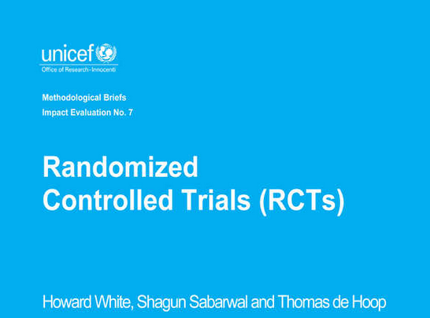
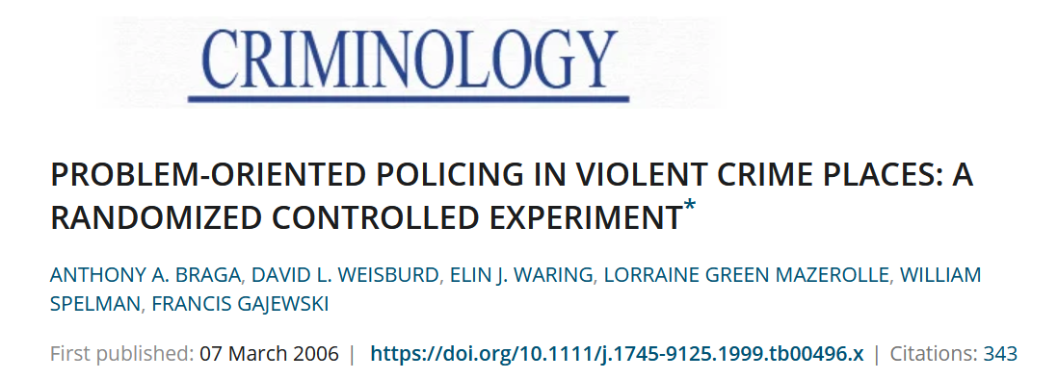
What is artbin and why do we need it?
In medicine, when designing clinical trials to test a new treatment or intervention, need to know how many patients to recruit to the trial i.e. sample size. Need a tool to calculate this. If the outcome is binary e.g. alive/dead, improved/not improved…artbin
Possible applications to other areas e.g. assessing education interventions, international development, economics, criminology….
Original artbin version available on SSC since 2004 but recently undergone a major upgrade with lots of new features added.
Why artbin? Other software available e.g. Stata’s power but the new artbin has more stats tests and options available.

Slide 3
Plan of talk
The new artbin program described here is available at https://github.com/emarleyzagar/artbin
Current sample size calculators in Stata
Types of trial
artbin command
Example in STREAM study
What’s new
Software testing
Discussion

Slide 4
Current sample size in Stata
Official power (v13).
ART suite: sample size calculations for complex time-to-event trials (artsurv)
  Includes Ian White’s artcat for ordinal outcomes (on SSC, presented last year)
  also includes binary outcome (artbin, previous version 1.1.2)
User written: ssi (Philip Jones), niss (unreleased, Patrick Phillips).

Slide 5
Sample size in Stata cont.
However, none allow variety of statistical tests available in artbin such as:
  Trend across K groups
  Wald test
  Conditional test
  Calculations under local or distant alternatives
In addition, the new artbin does not require the expected proportions to be the same in the two groups for non-inferiority/substantial-superiority trials, unlike any other software packages currently available in Stata.

Slide 6


Types of trial
Superiority
2. Non-inferiority /
Substantial-superiority

Slide 7

Superiority
When are superiority trials appropriate?
In comparisons with placebo (or no treatment).
When adding more treatment.
When using more toxic treatment.
When using more expensive treatment.
Most common type of trial.
Trials comparing treatment A with treatment B (2-arm). Used to show that one treatment is better than another.
For >2-arms, trials comparing A, B, C, D etc to test if there is any difference among the groups.

Slide 8
Superiority trial diagram
SUPERIORITY
CI wholly above 0
NOT SHOWN TO BE SUPERIOR
CI goes below / is entirely below 0
Intervention may be / is worse
Control better
0
Intervention better

Slide 9

Non-inferiority trials
2-arm trial, treatments A and B.
Used to demonstrate that a treatment is no worse than an existing treatment, by a pre-specified amount m (margin).
Used when the experimental treatment is not expected to be superior, but has other benefits.
Margin is amount of efficacy it’s acceptable to lose, given other benefits of treatment.
When are non-inferiority trials appropriate?
Cheaper treatment.
Less treatment.
Less toxic treatment.
Easier to administer treatment.
For example: Primary care treatments by a nurse practitioner vs doctor, less wait time

Slide 10
Non-inferiority trial diagram
margin
NON-INFERIOR
CI wholly above margin
NOT SHOWN TO BE NON-INFERIOR
CI goes below margin
Intervention may be / is worse by more than pre-specified amount
Control better
0
Intervention better

Slide 11
Substantial-superiority trial diagram
margin
SUBSTANTIAL-SUPERIORITY
CI wholly above margin
NOT SUBSTANTIAL-SUPERIORITY
CI goes below margin
Intervention may not be / is not better by more than pre-specified amount
SUPERIORITY, BUT NOT SUBSTANTIAL-SUPERIORITY
Control better
0
Intervention better

Slide 12
artbin – outline of syntax
Immediate command, like artsurv, artcat, power
For a 2 –arm trial, user specifies:
The anticipated probabilities in the control arm (p1) and experimental arm (p2) as pr(p1 p2)
Option to specify a margin for a non-inferiority or substantial-superiority trial as margin(m)
Either power() or n()
Various options e.g. allocation ratio aratio(1 2), wald (default score), condit, local, ccorrect.

Slide 13
artbin – outline of syntax cont.
For a 3+ arm trial, user specifies:
The anticipated outcome probabilities in the control arm (p1) and experimental arms (p2 p3 p4 etc) as pr(p1 p2 p3 p4)
No margin option as for 2-arm trials only
Either power() or n()
Various options as 2-arm trial e.g. allocation ratio aratio(1 2 3 4), wald, condit, local.
Option to specify a trend test, trend.

Slide 14
STREAM example: Non-inferiority
We reproduce the sample size calculation for the STREAM trial (Nunn et al., 2019) undertaken at MRC CTU UCL.
The need for the STREAM trial arose from the increase of multi-drug resistant strains of Tuberculosis, especially in countries without robust health care systems unable to administer and follow up treatment over long periods of time.
The STREAM trial evaluated a shorter more intensive treatment regimen for multi-drug resistant Tuberculosis compared to the lengthier treatment recommended by the World Health Organisation.
The trial used an expected 0.7 probability on control and 0.75 on treatment with a pre-specified non-inferiority margin of 0.1, with twice as many patients in treatment compared to control.
artbin, pr(0.7 0.75) margin(-0.1) power(0.8) ar(1 2) wald

Slide 15
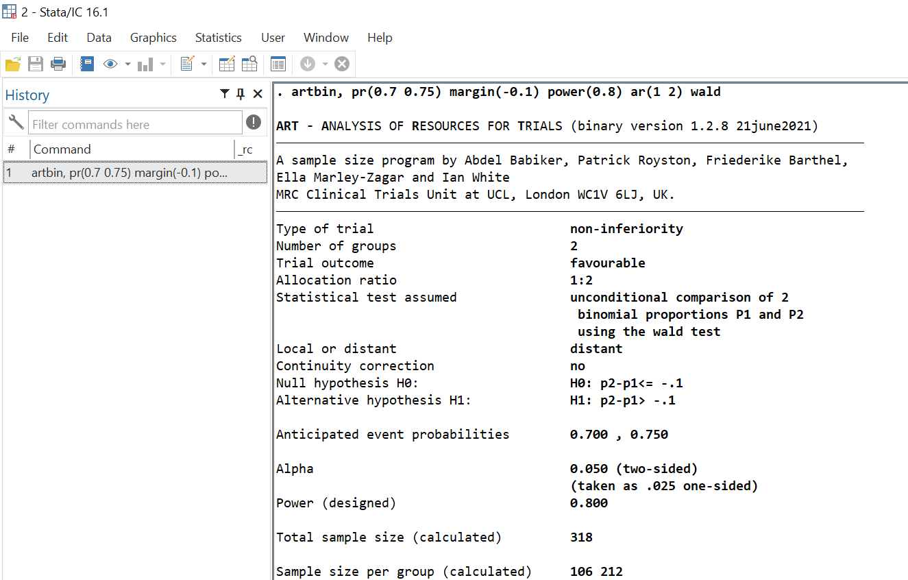
Answer

Slide 16
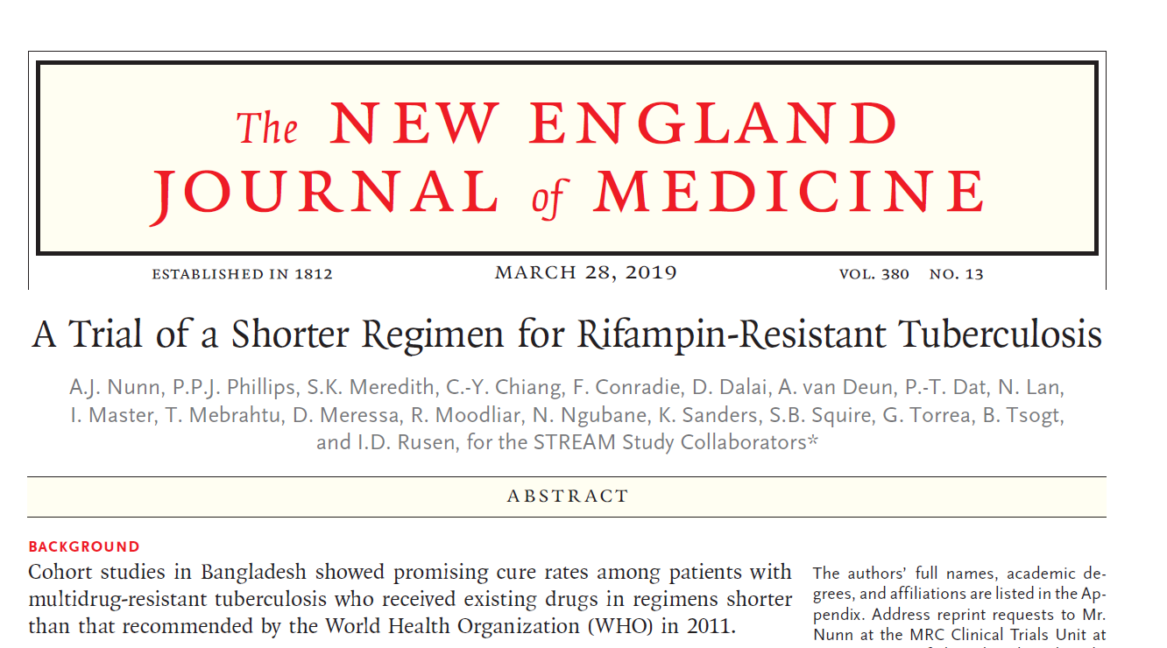
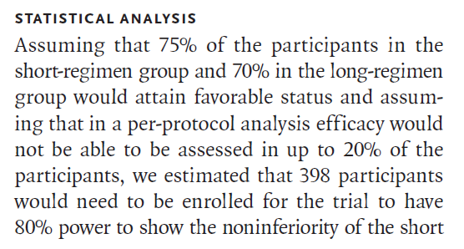

STREAM cont.
Assumed 20% of patients
were not accessible in primary analysis (318 / 0.8) = 398
398

Slide 17
What’s new
Added new options and statistical tests as previously mentioned
Old artbin syntax for non-inferiority trial:
artbin, pr(.2 .3) ni(1) distant(1)
Now:
artbin, pr(.2 .2) margin(.1)

Slide 18
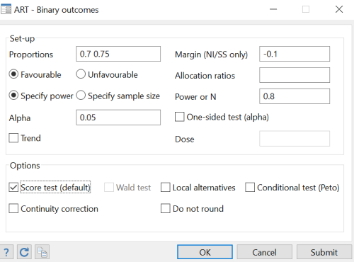
What’s new cont.
New dialogue box e.g. for STREAM trial

Slide 19
Software testing
We have a program of testing our unit’s software
artbin may be used to design randomised trials testing new medical treatments so have tested it extensively
We compared results from artbin with those given by:
  Pocock (2003)
  Julious and Owen (2011)
  Blackwelder (1982)
  Pocock (1983)
  Online calculator Sealed Envelope (2012)
  User written Stata programs ssi, niss
Exact agreement was achieved.

Slide 20
Software testing cont.
The output of artbin was compared to Cytel's software EAST which is a sophisticated package able to produce sample size and power calculations for a range of binary outcomes in clinical trial settings. We achieved perfect agreement taking into account differences in rounding.
We tested every permutation of 2-arm/more than 2-arms and non-inferiority/substantial-superiority/superiority trials with margin, local/distant, conditional/unconditional, trend and Wald test options to check that the results were as expected, and that sample size was increased/decreased accordingly.
We checked error messages in a number of impossible cases, to ensure that we obtained error messages as required.
We tested the new dialogue box menu options to verify that the results were as required.

Slide 21
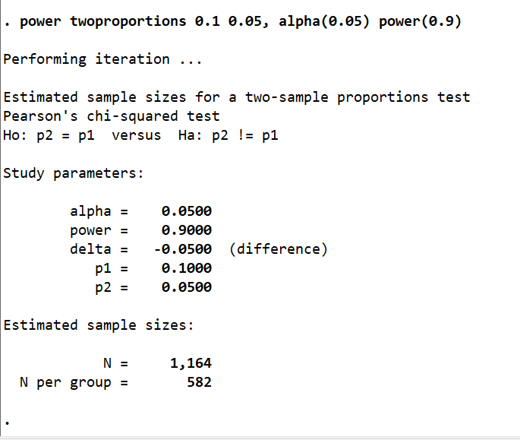
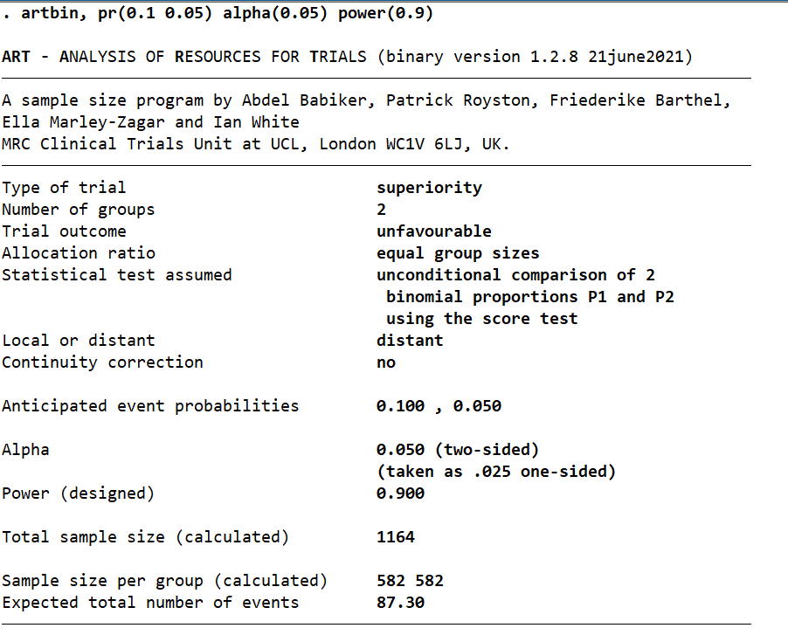
…And of course…power….

Slide 22
Discussion
User-friendly software for calculating sample size for trials with binary outcomes.
Validated against numerous other software and published sample sizes.
artbin has been created to assist the design of clinical trials, but it can also be used in the design of observational studies to explore a protective or harmful factor.
Paper is to be submitted to the SJ soon
New artbin to be released to SSC soon

Slide 23

Thank you for listening
References
Barthel, F. M. S., P. Royston, and A. Babiker. 2005. A menu-driven facility for complex sample size calculation in randomized controlled trials with a survival or a binary outcome: Update. Stata Journal 5(1): 123-129.
Blackwelder, W. C. 1982. “Proving the null hypothesis" in clinical trials. Controlled Clinical Trials 3(4): 345-353.
Julious, S. A., and R. J. Owen. 2011. A comparison of methods for sample size estimation for non-inferiority studies with binary outcomes. Statistical Methods in Medical Research 20(6): 595-612.
Nunn A.J., P.P.J. Phillips, S.K. Meredith, C.Y. Chiang, F. Conradie, D. Dalai, A. van Deun, P.T. Dat, N. Lan, I. Master, et al. A trial of a shorter regimen for rifampin-resistant tuberculosis. N Engl J Med. 2019;380(13):1201–13.
Pocock, S. J. 1983. Clinical Trials: a Practical Approach. Chichester: Wiley.
Pocock, S. 2003. The pros and cons of noninferiority trials. Fundamental and Clinical Pharmacology 17(4): 483-90.
Royston, P., and F. Barthel. 2010. Projection of power and events in clinical trials with a time-to-event outcome. Stata Journal 10(3): 386-394.
Sealed Envelope. 2012. Power calculator for binary outcome non-inferiority trial. [Online] Available from: https://www.sealedenvelope.com/power/binary-noninferior/.

