Slide 1
Sample size calculation for an ordered categorical outcome
Ian White, Ella Marley-Zagar, Tim Morris, Max Parmar, Abdel Babiker
ian.white@ucl.ac.uk
MRC Clinical Trials Unit at UCL
“London” Stata Conference
11 September 2020
Notes:
As given - 30 mins incl questions

Slide 2
Motivation
Our unit designs and runs challenging randomized controlled trials internationally in cancer and infections
  and develops related methodology
We were involved in designing trials of treatments for COVID-19
I was involved in designing a trial of treatments that could be used in an African outpatient setting
We considered a 3-level ordered categorical outcome: death; in hospital; or alive and not in hospital
Other COVID-19 trials have used other ordered categorical outcomes, typically with 6-8 levels
We needed sample size calculations for an ordered categorical outcome, and they were not available in Stata
Ideas apply beyond COVID-19 & beyond randomized trials

Slide 3
Sample size in Stata
ART suite: sample size calculations for complex time-to-event trials (artsurv)
  also includes binary outcome (artbin, currently being updated)
  Barthel FMS, Royston P, Babiker A. A menu-driven facility for complex sample size calculation in randomized controlled trials with a survival or a binary outcome: Update. Stata J 2005;5(1):123-129.
  Royston P, Barthel FMS. Projection of power and events in clinical trials with a time-to-event outcome. Stata J 2010;10(3):386-394.
Official power (v13)

Slide 4
Plan
The program described here is available by net from http://www.homepages.ucl.ac.uk/~rmjwiww/stata/ → design → artcat
Theory – sample size formulae in general, Whitehead’s method, and a new method
artcat command
Example in FLU-IVIG study
Evaluation
Software testing
Discussion

Slide 5
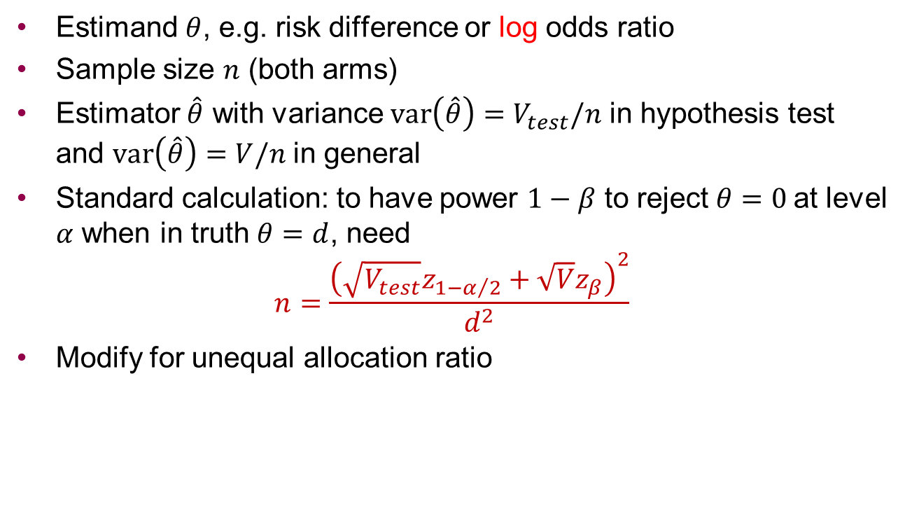
General theory for sample size calculation
Estimand $θ$, e.g. risk difference or log odds ratio
Sample size $n$ (both arms)
Estimator $\hat{θ}$ with variance $var\left(\hat{θ}\right)=V_{test}/n$ in hypothesis test and $var\left(\hat{θ}\right)=V/n$ in general
Standard calculation: to have power $1−β$ to reject $θ=0$at level $α$ when in truth $θ=d$, need
$$n=\frac{{\left(\sqrt{V_{test}}z_{1−α/2}+\sqrt{V}z_{β}\right)}^{2}}{d^{2}}$$
Modify for unequal allocation ratio

Slide 6
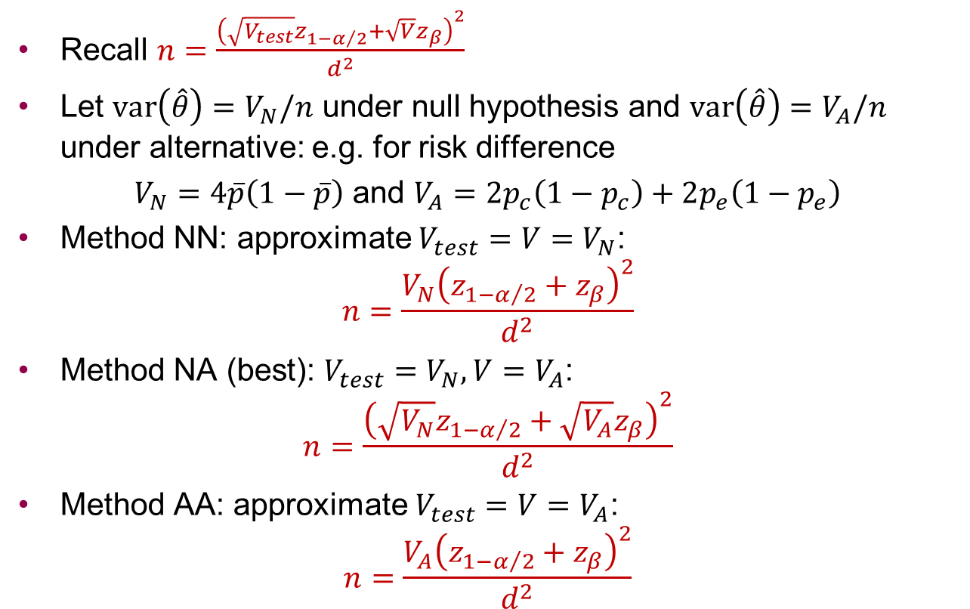
General theory for sample size calculation
Recall $n=\frac{{\left(\sqrt{V_{test}}z_{1−α/2}+\sqrt{V}z_{β}\right)}^{2}}{d^{2}}$
Let $var\left(\hat{θ}\right)=V_{N}/n$ under null hypothesis and $var\left(\hat{θ}\right)=V_{A}/n$ under alternative: e.g. for risk difference
$V_{N}=4\overline{p}\left(1−\overline{p}\right)$ and $V_{A}=2p_{c}\left(1−p_{c}\right)+2p_{e}\left(1−p_{e}\right)$
Method NN: approximate $V_{test}=V=V_{N}$:
$$n=\frac{V_{N}{\left(z_{1−α/2}+z_{β}\right)}^{2}}{d^{2}}$$
Method NA (best): $V_{test}=V_{N}, V=V_{A}$:
$$n=\frac{{\left(\sqrt{V_{N}}z_{1−α/2}+\sqrt{V_{A}}z_{β}\right)}^{2}}{d^{2}}$$
Method AA: approximate $V_{test}=V=V_{A}$:
$$n=\frac{V_{A}{\left(z_{1−α/2}+z_{β}\right)}^{2}}{d^{2}}$$

Slide 7
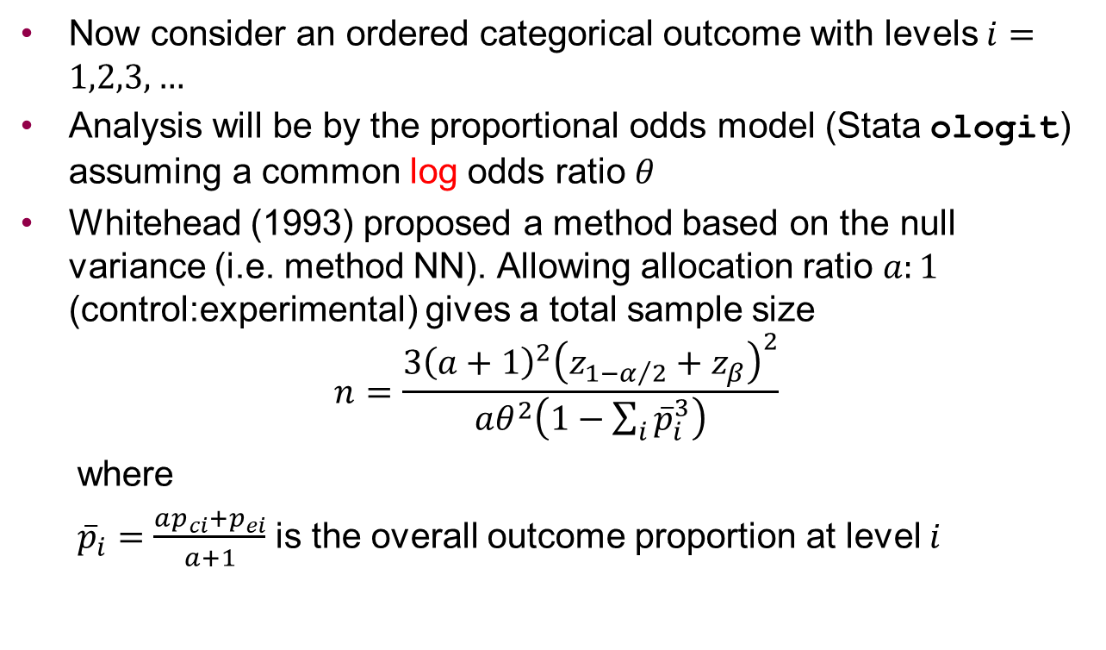
Whitehead’s method
Now consider an ordered categorical outcome with levels $i=1,2,3,…$
Analysis will be by the proportional odds model (Stata ologit) assuming a common log odds ratio $θ$
Whitehead (1993) proposed a method based on the null variance (i.e. method NN). Allowing allocation ratio $a:1$ (control:experimental) gives a total sample size
$$n=\frac{3{\left(a+1\right)}^{2}{\left(z_{1−α/2}+z_{β}\right)}^{2}}{aθ^{2}\left(1−\sum_{i}{{\overline{p}}_{i}^{3}}\right)}$$
  where
  ${\overline{p}}_{i}=\frac{ap_{ci}+p_{ei}}{a+1}$ is the overall outcome proportion at level $i$

Slide 8
Limitations of Whitehead’s method
It requires a common odds ratio at the design stage.
But e.g. in the COVID-19 trial, we considered a 3-level outcome of death / hospitalisation / OK, and assumed a common risk ratio of 0.75 for the 2 adverse outcomes.
It uses the NN method, so may be inaccurate
It doesn’t allow for non-inferiority trials

Slide 9
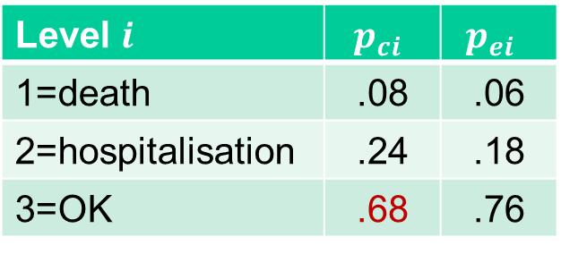
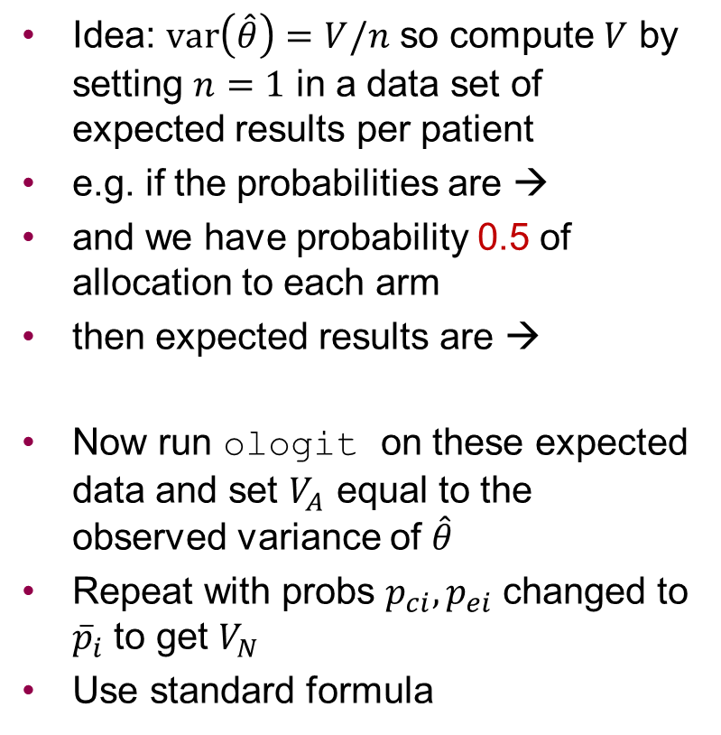
New proposal – “ologit” method
Idea: $var\left(\hat{θ}\right)=V/n$ so compute $V$ by setting $n=1$ in a data set of expected results per patient
e.g. if the probabilities are →
and we have probability 0.5 of allocation to each arm
then expected results are →
Now run ologit on these expected data and set $V_{A}$ equal to the observed variance of $\hat{θ}$
Repeat with probs $p_{ci}, p_{ei}$ changed to ${\overline{p}}_{i}$ to get $V_{N}$
Use standard formula
Level $i$ | $$p_{ci}$$ | $$p_{ei}$$
1=death | .08 | .06
2=hospitalisation | .24 | .18
3=OK | .68 | .76
Outcome | Rand | Prob
1 | c | .04
2 | c | .12
3 | c | .34
1 | e | .03
2 | e | .09
3 | e | .38

Slide 10
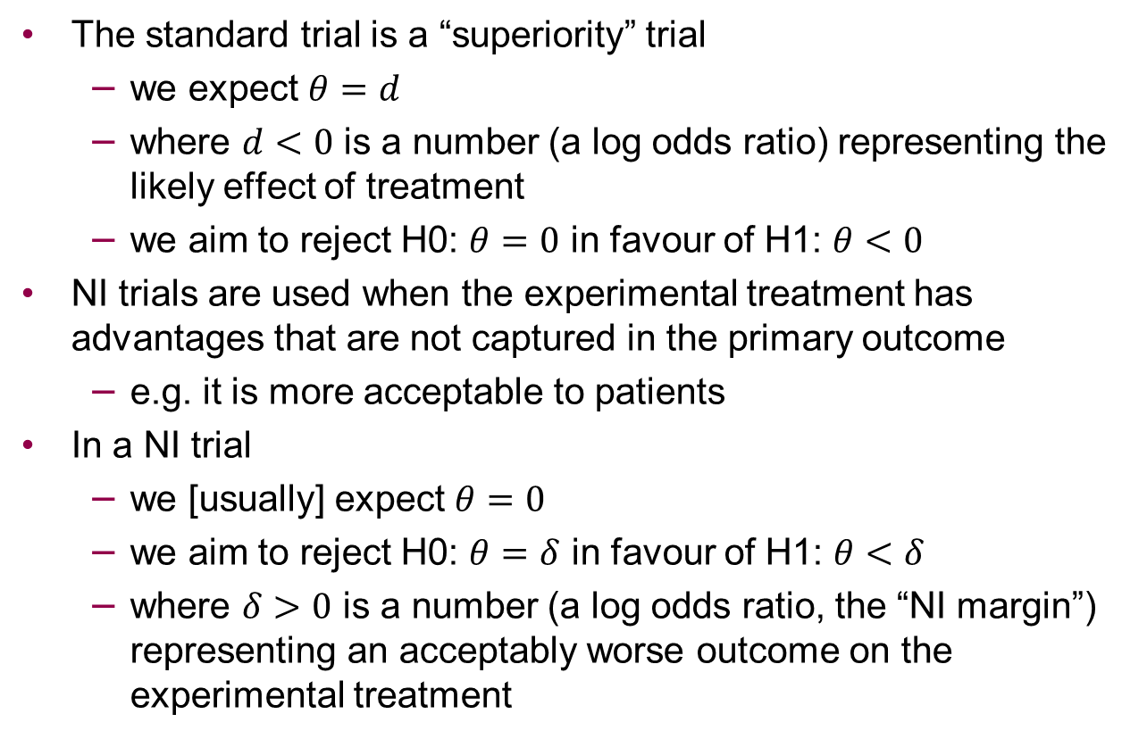
Non-inferiority trials
The standard trial is a “superiority” trial
  we expect $θ=d$
  where $d<0$ is a number (a log odds ratio) representing the likely effect of treatment
  we aim to reject H0: $θ=0$ in favour of H1: $θ<0$
NI trials are used when the experimental treatment has advantages that are not captured in the primary outcome
  e.g. it is more acceptable to patients
In a NI trial
  we [usually] expect $θ=0$
  we aim to reject H0: $θ=δ$ in favour of H1: $θ<δ$
  where $δ>0$ is a number (a log odds ratio, the “NI margin”) representing an acceptably worse outcome on the experimental treatment

Slide 11
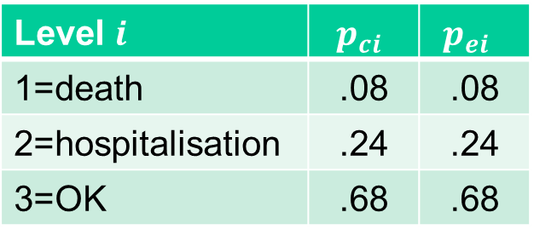
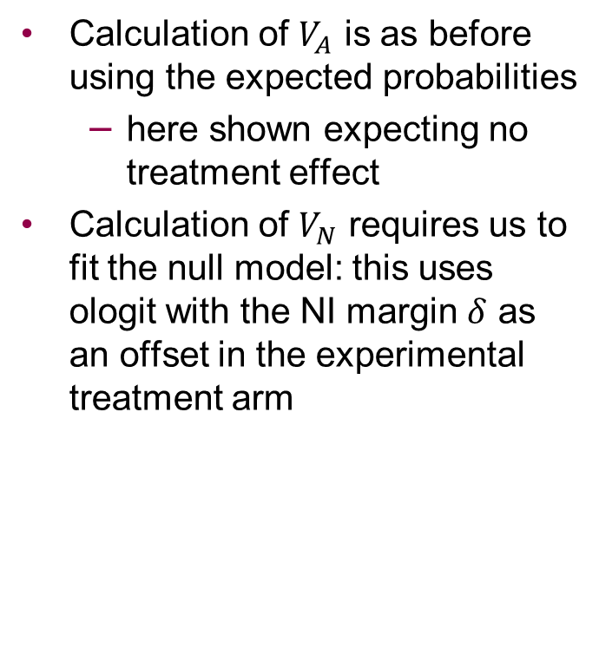
New proposal for non-inferiority trials
Calculation of $V_{A}$ is as before using the expected probabilities
  here shown expecting no treatment effect
Calculation of $V_{N}$ requires us to fit the null model: this uses ologit with the NI margin $δ$ as an offset in the experimental treatment arm
Level $i$ | $$p_{ci}$$ | $$p_{ei}$$
1=death | .08 | .08
2=hospitalisation | .24 | .24
3=OK | .68 | .68
Outcome | Rand | Prob
1 | c | .04
2 | c | .12
3 | c | .34
1 | e | .04
2 | e | .12
3 | e | .34

Slide 12
artcat – outline of syntax
Immediate command, like artbin, artsurv, power
User specifies:
The outcome probabilities in the control arm
  directly: pc(0.08 0.24)
  or as cumulative probabilities: pc(0.08 0.32) cum
The probabilities in the experimental arm
  directly: pe(0.06 0.18)
  as cumulative probabilities: pe(0.06 0.24) cum
  via a common OR or RR: or(0.7) or rr(0.75)
Either power() or n()
Various options e.g. allocation ratio aratio(2 1)
or for NI trial margin(1.2)
Effects are expressed as odds ratios (not log odds ratios).
The syntax restricts to a two-arm trial.

Slide 13
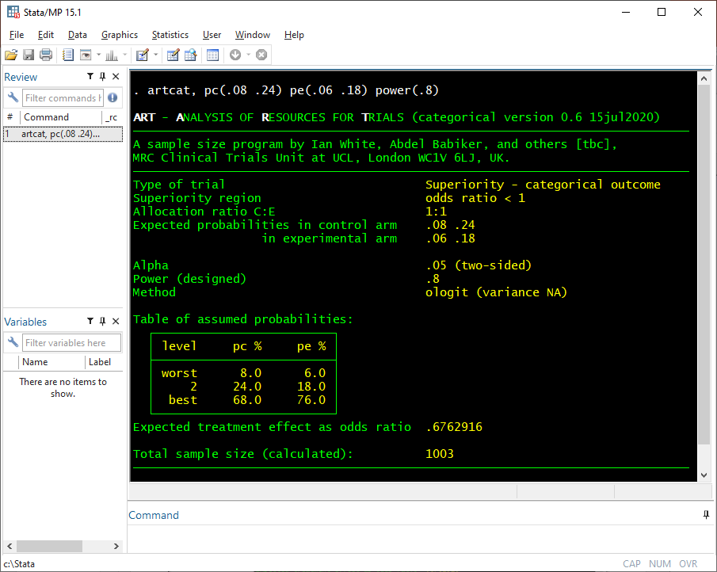
Let’s be sure we have specified the probabilities correctly
Answer

Slide 14
FLU-IVIG example
We reproduce the sample size calculation for the FLU-IVIG trial (Davey et al. 2019).
The control arm is expected to have a 1.8% probability of the worst outcome (death), a 3.6% probability of the next worst outcome (admission to an intensive care unit), and so on.
The trial is designed to have 80% power if the intervention achieves an odds ratio of 1.77 for a favourable outcome.
We invert this odds ratio because artcat is designed to focus on unfavourable outcomes.
artcat, pc(.018 .036 .156 .141 .39) or(1/1.77) power(.8) whitehead

Slide 15
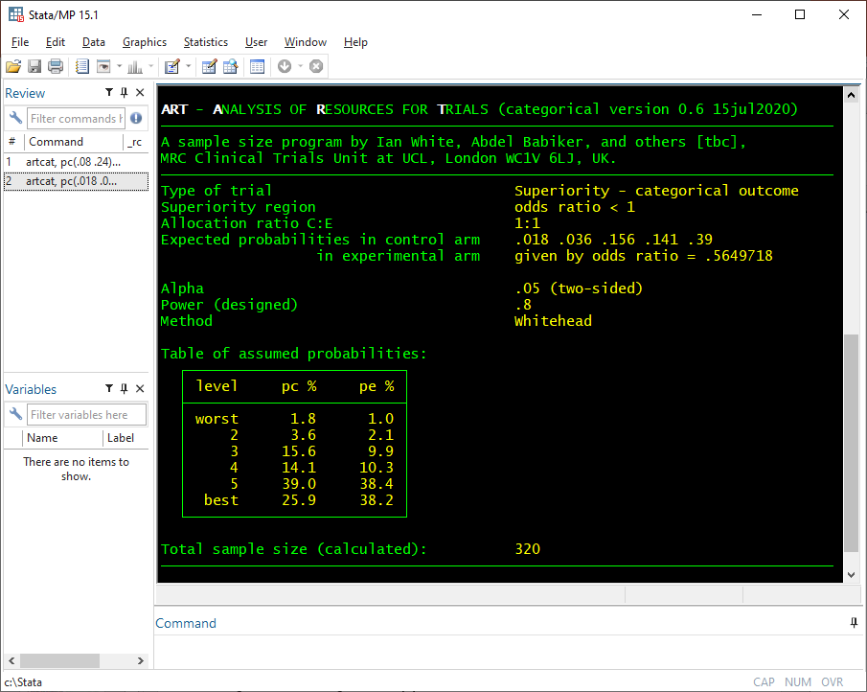
Answer

Slide 16
FLU-IVIG example (ctd)
The calculated sample size is 320 using the Whitehead method
Using the new (NA) method instead gives a very similar sample size of 322

Slide 17
Evaluations
Consider two cases:
  6-level outcome like FLU-IVIG
  binary outcome
Compare methods by computing the sample size by each method
Evaluate methods by fixing the sample size and computing power by each method and by simulation
Simulation outline:
  simulate control data as specified and experimental data with assumed odds ratio
  test H0 using ologit + Wald test (sometimes fails due to perfect prediction) or LRT
  repeat 100000 times & compute power
  all Monte Carlo errors are about 0.1%

Slide 18
Comparison 1: FLU-IVIG (6 outcome levels)
Odds ratio | Sample size for 90% power, calculated from sample size formula
 | Whitehead | New NN | New NA | New AA
0.2 | 56 | 56 | 60 | 67
0.3 | 98 | 98 | 102 | 109
0.4 | 168 | 168 | 172 | 178
0.5 | 291 | 291 | 295 | 302
0.6 | 534 | 534 | 538 | 544
0.7 | 1090 | 1090 | 1094 | 1101
0.8 | 2777 | 2777 | 2781 | 2787
Difference between methods up to 10
Whitehead = New NN (always)
Differences unimportant for moderate odds ratios (>=0.5)
Differences important for extreme odds ratios (<=0.4)

Slide 19
Evaluation 1 (6 outcome levels)
Odds Ratio | Sample size | Power %, from sample size formula or simulation
 |  | New NN | New NA | New AA | Simulation
0.2 | 56 | 90.1 | 88.1 | 84.5 | 88.4
0.3 | 98 | 90.1 | 88.9 | 86.9 | 89.2
0.4 | 168 | 90.1 | 89.4 | 88.3 | 89.5
0.5 | 291 | 90.0 | 89.6 | 89.0 | 89.6
0.6 | 534 | 90.0 | 89.8 | 89.5 | 89.7
0.7 | 1090 | 90.0 | 89.9 | 89.7 | 90.1
0.8 | 2777 | 90.0 | 90.0 | 89.9 | 90.1
All methods are accurate for moderate odds ratios (>=0.5)
New NA performs best for extreme odds ratios (<=0.4). NN (Whitehead) method is slightly anti-conservative.

Slide 20
Comparison 2: binary outcome
Control probability 0.2, power 0.9
Again all methods agree for moderate odds ratios
power and artbin agree for all odds ratios
but artcat disagrees for extreme odds ratios
OR | Sample size calculated by
 | power | artbin |  | artcat
 |  | local | distant | New NN | New NA | New AA
0.2 | 194 | 197 | 192 | 150 | 180 | 230
0.3 | 286 | 290 | 285 | 249 | 274 | 314
0.4 | 436 | 439 | 436 | 403 | 425 | 460
0.5 | 696 | 699 | 694 | 666 | 686 | 717
0.6 | 1194 | 1198 | 1198 | 1168 | 1186 | 1214
0.7 | 2318 | 2322 | 2322 | 2294 | 2311 | 2336
0.8 | 5660 | 5664 | 5664 | 5638 | 5654 | 5677

Slide 21
Evaluation 2: binary outcome
Odds Ratio | Sample size | Power %, from sample size formula or simulation
 |  | artbin |  | artcat |  |  | Simulation
 |  | local | dist. | NN | NA | AA | Wald | LRT
0.2 | 197 | 90.1 | 90.7 | 96.1 | 92.2 | 85.1 | 91.8 | 92.9
0.3 | 290 | 90.1 | 90.5 | 93.8 | 91.5 | 87.6 | 91.0 | 91.7
0.4 | 439 | 90.0 | 90.3 | 92.3 | 90.9 | 88.7 | 90.7 | 91.1
0.5 | 699 | 90.0 | 90.2 | 91.3 | 90.5 | 89.3 | 90.4 | 90.5
0.6 | 1198 | 90.0 | 90.1 | 90.7 | 90.3 | 89.6 | 90.3 | 90.3
0.7 | 2322 | 90.0 | 90.1 | 90.3 | 90.1 | 89.8 | 90.2 | 90.2
0.8 | 5664 | 90.0 | 90.0 | 90.1 | 90.1 | 89.9 | 90.0 | 90.0
All methods remain accurate for moderate odds ratios
For extreme odds ratios, new NA performs
  best of the artcat methods
  better than artbin / power?
Notes:
Wald NA (output b=se=0): 0.8% (OR=0.2), 0.002% (OR=0.3)

Slide 22
Software testing
We have started a program of testing our unit’s software
This program may be used to design randomised trials so it is crucial to get it right
We’ve decided to report how we’ve tested
so…

Slide 23
Software testing (ctd)
The program was written by IRW and tested by EMZ.
Compared results with those given by Whitehead (1993). Exact agreement was achieved.
Compared results for a binary outcome in a superiority trial with those given by artbin and power across a range of probabilities and allocation ratios. Close agreement was achieved, except in a few well understood cases.
Checked error messages in a number of impossible cases, for example negative odds ratio.
Compared results with those given by the R package dani (Quartagno 2019) for a binary outcome on the odds ratio scale for non-inferiority trials. Exact agreement was achieved for the AA method.
The simulations also test the software.
Is there other R or SAS software to compare with?

Slide 24
Discussion
User-friendly software for a niche application
Data sets of expected outcomes can be used more broadly for sample size calculations (e.g. non-PH)
Does artcat really out-perform power and artbin? Is this because the normal approximation is better on the log odds scale?
Should we / how should we report software testing?
Paper is to be submitted to the SJ soon
Thanks to the Africa COVID-19 trial team incl. Debbie Ford, Hanif Esmail, Di Gibb, Anna Turkova, Annabelle South

Slide 25
Extra slides

Slide 26
Some examples of reducing the sample size required
Control category probabilities |  |  |  |  | Sample size required
0.4 |  |  | 0.6 |  | 216
0.01 | 0.39 |  | 0.6 |  | 216
0.01 | 0.09 | 0.3 | 0.6 |  | 212
0.4 |  |  | 0.3 | 0.3 | 153
[limit] |  |  |  |  | 135
Adding small categories doesn’t help, but subdividing big ones does
Used OR=0.375, power=0.9

Slide 27
Evaluation 2: binary outcome (with type 1 error rates)
Odds Ratio | Sample size | Power %, from sample size formula or simulation
 |  | artbin |  | artcat |  |  | Simulation |  | Type 1 error
 |  | local | dist. | NN | NA | AA | Wald | LRT | Wald | LRT
0.2 | 197 | 90.1 | 90.7 | 96.1 | 92.2 | 85.1 | 91.8 | 92.9 | 4.7 | 5.2
0.3 | 290 | 90.1 | 90.5 | 93.8 | 91.5 | 87.6 | 91.0 | 91.7 | 4.9 | 5.2
0.4 | 439 | 90.0 | 90.3 | 92.3 | 90.9 | 88.7 | 90.7 | 91.1 | 4.8 | 4.9
0.5 | 699 | 90.0 | 90.2 | 91.3 | 90.5 | 89.3 | 90.4 | 90.5 | 5.0 | 5.1
0.6 | 1198 | 90.0 | 90.1 | 90.7 | 90.3 | 89.6 | 90.3 | 90.3 | 4.9 | 4.9
0.7 | 2322 | 90.0 | 90.1 | 90.3 | 90.1 | 89.8 | 90.2 | 90.2 | 5.0 | 5.1
0.8 | 5664 | 90.0 | 90.0 | 90.1 | 90.1 | 89.9 | 90.0 | 90.0 | 5.0 | 5.0

