Slide 1
A suite of community-contributed programs to produce outcome tables and graphs for demographic and survival data
Rachel Pearce
British Society of Blood and Marrow Transplantation
Guy’s Hospital
Notes:
Not theory-heavy, Stata-heavy or anything heavy.
Just going to show how I have used Stata to make my life a bit easier and to provide quick, but reasonably robust, answers to questions.

Slide 2

Background
BSBMT is an organisation for professionals with an interest in haematopoeitic stem cell transplantation
Registry of all transplants performed in UK (subject to consent) + some Republic of Ireland
Data mostly used for retrospective studies, e.g.
      Comparison of chemotherapy
      Whether the procedure is practical in certain circumstances (age / comorbidity / disease)
      Whether a second transplant is useful in the event of relapse after a first one
    These retrospective studies are methodically set up, data are checked and analyses are rigorously performed
Notes:
Used to be called bone marrow transplantation. Now peripheral blood too. Also a few umbilical cord blood.
Consent mostly (99%) given
Prospective studies handled by another body, but often informed by data we supply
NHSE commissions stem cell transplants at regional level because they are relatively rare (3800 in England, 275 in Scotland, 150 in Wales, 60 in N Ireland)

Slide 3
Requests from NHSE for summaries of data
Routine and ad hoc
e.g. How many transplants of a given type in the last 5 years?
How many of these were from sibling donors?
How many had Reduced Intensity Conditioning?
What ages were they?
How many are still alive?
How many died from non-relapse cause?
Notes:
4 Please tell me you’re not going to divide the number alive by the total to get a survival rate are you?
“Errr…”
I will do a survival curve for you
6 Quickly becomes time-consuming, but also error-prone if I am doing a lot of them in succession
E.g. easy to mislabel a graph if you are doing 20 of them

Slide 4
Two sorts of programs developed
Programs to generate datasets: take Registry data and create summary tables as Stata datasets
Programs to generate outputs: combine these datasets into datasets suitable for output to a Word file via putdocx
Notes:
Version 15 Stata

Slide 5
Programs to generate datasets
All generate values for each level of the factor and for the total
medianbyfactor : medians of e.g. age or time to discharge from hospital
binarybyfactor : numbers and percentages of a given binary variable
osbyfactor : overall survival and 95% confidence interval at various time points
nrmbyfactor : as for osbyfactor but for non-relapse mortality
fubyfactor : as for osbyfactor but for follow up
Notes:
3 By Cox model. Can be adjusted by covariates e.g. comorbidity or unadjusted
4 By competing risks regression
5 also by cox model (unadjusted)
6, 7 You can imagine how excited I was by Version 15 and “putdocx”

Slide 6
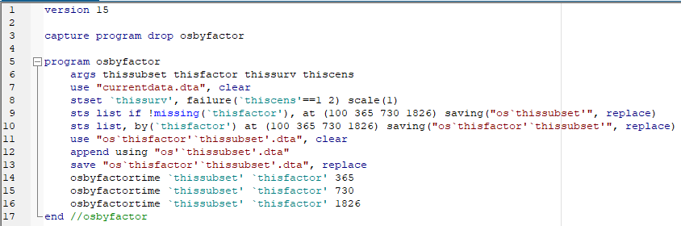
Example program: osbyfactor

Slide 7
Programs to generate output
These programs use output from osfactor etc. and combine them:
factortables : combine some of the above into a table showing demographic and outcome data
factorgraph : produces a graph comparing two levels of a factor giving Ns and P values
tablegraph : produces a table (calling factortable) and overall survival (OS) graph for the same factor, appropriately labelled
centregraphs : to produce OS curves comparing a centre with the rest of the Registry
Notes:
P values are according to Cox model with fixed covariates (age and comorbidity) and stratified by diagnosis and type of transplant, but I am looking at making the covariates arguments of the function

Slide 8
Example 1:
Prospective trial proposed to discover the prognostic value of a particular test
Specific population with a particular diagnosis
Test only recently available; presence of indicator is speculated to have poor prognosis
Trial design to establish this requires estimate of 2y OS in each case
I was able to swiftly estimate the baseline survivals in the two subpopulations and graphically illustrate them
Notes:
Recent actual request from our sister body which performs prospective trials
Obviously a third option is “test not performed or no definitive outcome” but these are not of interest to this specific request

Slide 9
Autologous transplant patients by prognostic status
Prognostic marker | Absent | Present | Total
Total | 124 | 86 | 210
Alive in CCR | 102 | 57 | 159
Alive post relapse | 15 | 16 | 31
Relapse death | 4 | 7 | 11
Non relapse death | 3 | 6 | 9
Engraftment failure | 17 | 11 | 28
% engraftment failure | 14 | 13 | 13
Median engraftment time (d) | 12 | 12 | 12
% OS at 1y | 93 | 88 | 91
95% c.i. min | 85 | 77 | 85
95% c.i. max | 97 | 94 | 95
% OS at 2y | 93 | 81 | 87
95% c.i. min | 85 | 65 | 79
95% c.i. max | 97 | 90 | 93
% NRM at 100d | 3 | 5 | 4
95% c.i. min | 1 | 2 | 2
95% c.i. max | 7 | 12 | 7
% NRM at 1y | 4 | 11 | 7
95% c.i. min | 1 | 5 | 4
95% c.i. max | 9 | 20 | 12
% NRM at 2y | 4 | 11 | 7
95% c.i. min | 1 | 5 | 4
95% c.i. max | 9 | 20 | 12
Output from tablegraph

Slide 10
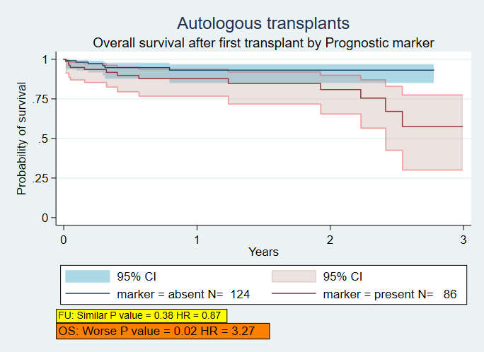
OS by prognostic marker

Slide 11
Example 2: Outcomes by centre
Asked to report numbers and outcomes by centre, by diagnosis and by type of transplant
Need to compare outcomes with UK standard
Reasonable comparisons require stratification / risk adjustment
Notes:
Recent request from NHSE / other NHS bodies
53 centres, 2 age groups, up to 20 diagnostic groups (

Slide 12
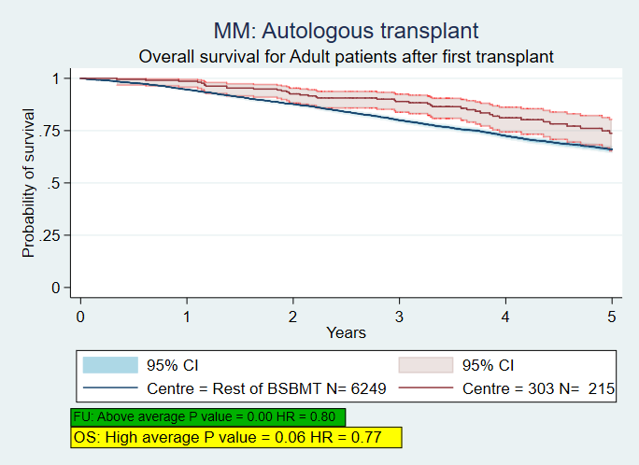
From centre report
Notes:
One centre
Specific diagnosis
Specific procedure
Outcomes of Cox regressions inform notes
Background colours for notes changed to reflect good / bad FU or OS
This sort of thing (plus the associated tables) is repeated for each diagnosis, age group (adult/paediatric) and procedure (autologous or allogeneic transplant) to give an overview of

Slide 13
Thanks
Rest of the Registry Team
Physicians and Data Managers at all the centres which contribute data
Fellow Stata users on Statalist and Twitter
Patients who consent for their data to be used
Rachel Pearce, Guy’s Hospital
rachel.pearce@kcl.ac.uk

