Slide 1
ULTIMATCH matching counterfactuals your way
Thorsten Doherr
London Stata Conference
September 6, 2019
https://github.com/ThorstenDoherr/ultimatch

Slide 2
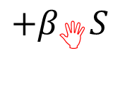

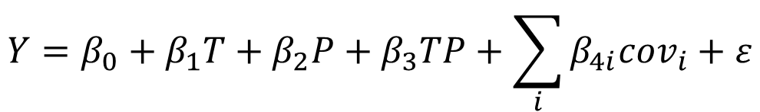



Why matching?
$$Y=β_{0}+β_{1}T+β_{2}P+β_{3}TP+\sum_{i}{β_{4i}{cov}_{i}}+ε$$
$$+β_{}S$$
exploiting the correlations:
$$cov$$
$$Y$$
$$T$$
$$S$$
matching on observables

Slide 3
ULTIMATCH
Score-based matching
ultimatch scorevar, treated(treated_dummy)
  [exact(vars_defining_cells)]
  [caliper(max_score_difference)]
  [draw(num_of_counterfactuals)]
  [copy [full]]
  [single]
  [support]
  [between]
  [radius]
  [greedy]
  [rank]
  [euclid]
  [mahalanobis]
  [report(vars_for_ttests) [unmatched]]
  [unit(vars_clustering_obs)]
  [exp(logical_exp)]
  [limit(perc_rank_limitations)]
Distance-based matching
ultimatch dvar1 dvar2…, treated(treated_dummy)
  [exact(vars_defining_cells)]
  [caliper(max_distance_difference)]
  [draw(num_of_counterfactuals)]
  [copy [full]]
  [single]
  [support]
  [between]
  [radius]
  [greedy]
  [rank]
  [euclid]
  [mahalanobis]
  [report(vars_for_ttests) [unmatched]]
  [unit(vars_clustering_obs)]
  [exp(logical_exp)]
  [limit(perc_rank_limitations)]
Coarsened exact matching
ultimatch, treated(treated_dummy)
  exact(vars_defining_cells)
  [caliper(max_diff)]
  [draw(num_of_counterfactuals)]
  [copy [full]]
  [single]
  [support]
  [between]
  [radius]
  [greedy]
  [rank]
  [euclid]
  [mahalanobis]
  [report(vars_for_ttests) [unmatched]]
  [unit(vars_clustering_obs)]
  [exp(logical_exp)]
  [limit(perc_rank_limitations)]
Transformation
. egen long coarsescore = group(cell1 cell2 cell3…)
. ultimatch coarsescore, treated(treated) caliper(0.5)

Slide 4
Score-based matching
SORT
MATCH
cell | score | treated | _distance | _match | _weight
9 | 1.079380 | 0
9 | 1.093021 | 0 | 0.002202 | 234 | 1.0
9 | 1.095223 | 1 | 0 | 234 | 1.0
9 | 1.101899 | 0 | 0.009212 | 235 | 1.0
9 | 1.111111 | 1 | 0 | 235 | 1.0
9 | 1.146180 | 1 | 0 | 236 | 1.0
9 | 1.146266 | 0 | 0.000086 | 236 | 0.5
9 | 1.146266 | 0 | 0.000086 | 236 | 0.5
10 | 0.170137 | 1 | 0 | 237 | 1.0
10 | 0.211297 | 0 | .04116 | 237 | 1.0
10 | 0.245004 | 1
10 | 0.304080 | 0
10 | 0.304764 | 0
10 | 0.330998 | 0
10 | 0.368190 | 0
10 | 0.399482 | 1
0.033707 | 238 | 2.0
0 | 238 | 1.0

Slide 5
Distance-based matching

Slide 6
Hypersphere-Leeway Algorithm

Slide 7
ultimatch y x, treated(treated) euclid

Slide 8
ultimatch y x, treated(treated) mahalanobis

Slide 9
ultimatch y x, treated(treated) caliper(0.15) radius euclid

Slide 10
Thank you
https://github.com/ThorstenDoherr/ultimatch

