Slide 1
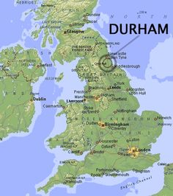
Needing a different space? Transformed scales in Stata
Nicholas J. Cox
Department of Geography

Slide 2
Transformed scales?
In teaching statistics and Stata I often have difficulty persuading people to think about working on transformed scales.
That can mean (for example)
using a transformed scale on a graph axis
transforming variables for later analysis
using a particular link function in a model.
Whatever makes that thinking easier is welcome.

Slide 3
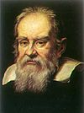
Standing on others’ shoulders
Galileo Galilei in 1627 recommended using the geometric mean of bids to decide on a fair price.
Thinking on a logarithmic scale?

Slide 4
In 1627 Galileo ‘was presented with an amiable dispute between a Florentine gentleman and a parish priest over the proper method to price a horse .... one bidder—undoubtedly the priest—had offered ten crowns and the other one thousand. In arriving at the proper value, the equestrians asked Galileo to be their arbiter. Was it better to employ an arithmetic or a geometric proportion in arriving at a fair price between divergent estimates? A geometric proportion was Galileo's answer. The real value of the horse was one hundred.’
Reston, James. 1994. Galileo: A Life. New York: HarperCollins, p.218

Slide 5
The tool kit includes
for variables y
logarithms and powers
neglog: sign(y) log(1 +|y|) and its siblings
inverse hyperbolic sine asinh()
for proportions p
logit: log [p / (1 − p)] = log p − log (1 − p)
folded roots: √ p − √ (1 − p) and its siblings
loglog(), cloglog()

Slide 6
for correlations and similar measures r
Fisher’s z: atanh(r) = (1/2) logit((1 + r)/2)

Slide 7
Some good references
Tukey, J.W. 1957.
On the comparative anatomy of transformations.
Annals of Mathematical Statistics 28: 602—632.
https://www.jstor.org/stable/2237224
Box, G.E.P. and Cox, D.R. 1964.
An analysis of transformations.
Journal of the Royal Statistical Society, Series B 26: 211—252.
https://www.jstor.org/stable/2984418
Keene, O.N. 1995.
The log transformation is special
Statistics in Medicine 14: 811—819.

Slide 8
Why do we transform?
Some goals (Grails) are
linear relationships
additive effects
equal variability
symmetric distribution (even normal distribution)
The last goal is not the most important, as many researchers seem to think….

Slide 9
Objections to transformation
Objections – not always from those new to or naïve about statistics – include
Transformation is troubling. Using an unfamiliar function just makes the analysis harder to think about.
Transformation is tricky. How do we choose a transformation without seeming arbitrary or ad hoc?
Transformation is treasonous. You are proposing changing the data. How is that allowed or even honest?

Slide 10
Theme and structure
What makes use of a transformed scale – or choice of a
transformed scale – easier to think about?
(Easy and standard.) People are always coming new to Stata, so a brisk survey of using transformed scales in graphics comes first.
(Novel and in progress.) I don’t like or use ladder, gladder or qladder. I will explain why and think aloud about what might work better.

Slide 11
Logarithmic axis scales
Graph commands in most cases allow yscale(log) and xscale(log) as option choices.
Limitation: This does not always give what you really want. For example, with histograms and box plots, working on logarithmic scale requires a fresh calculation.
Limitation: graph does not typically make good default choices of axis labels with a logarithmic scale.
If you are new to Stata, this may be the most valuable slide in the talk.

Slide 12
Better labels on logarithmic scale?
Doing better was discussed in 2018. Logarithmic binning and labelling. Stata Journal 18: 262—286
http://www.stata-journal.com/article.html?article=gr0072
niceloglabels depends on the user specifying a style.
style(1) means labels like 1 10 100.
style(13) means labels like 1 3 10 30 100.
style(125) means labels like 1 2 5 10 20 50 100.

Slide 13
More generally
Using other transformed scales (e.g. root, logit) divides into
which numbers to use on transformed scale?
which axis labels to show values on original scale?
2008. Plotting on any transformed scale. Stata Journal 8: 142—145. https://www.stata-journal.com/article.html?article=gr0032
ssc install mylabels

Slide 14
ladder, gladder, qladder
These are official commands of some vintage.
ladder and gladder were added to Stata in 1992.
qladder was added to Stata in 2000.
Does anybody use them much?
A sample script follows.

Slide 15
sysuse citytemp, clear
set scheme s1color
ladder tempjuly
gladder tempjuly, l1title("") ylabel(none) xlabel(none) name(gladder)
qladder tempjuly, ylabel(none) xlabel(none)
name(qladder)

Slide 16
ladder
This command bins transformed data and does a chi-square test for normality.
If you want such a test, other tests are surely better, e.g. Shapiro-Wilk, Doornik-Hansen.
Such a test often answers the wrong question.
For moderate or large sample sizes, it may merely detect trivial departures from normality.
For small sample sizes, it may indicate that you don’t have enough data.

Slide 17
gladder
This command transforms data and shows histograms with comparable normal distributions superimposed.

Slide 18
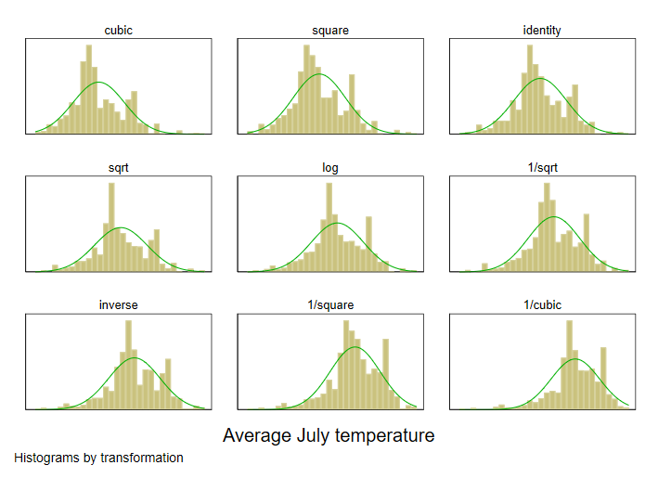

Slide 19
qladder
This command transforms data and shows normal quantile plots with comparable normal distributions as reference lines.
(a.k.a. normal probability plots, normal scores plots, probit plots)

Slide 20
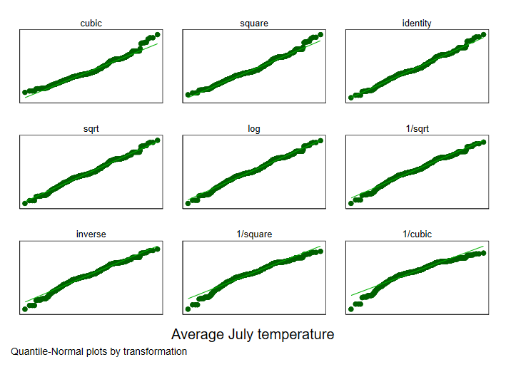

Slide 21
What is wrong
These commands offer too many transformations. It should never be true that all the transformations from cube to reciprocal cube are serious candidates.
These commands offer too few transformations. No support for cube root, neglog, asinh, logit, folded roots or anything not on the menu.
Histograms are poor for choosing a transformation.
The examples are poor. Fahrenheit temperatures are interval scale variables.

Slide 22
One variable at a time. Often you want to compare two or more variables.
No support for group comparisons. Often you want to compare two or more groups.

Slide 23
To be fair
The ladder idea is powerful (power full!) and persuasive.
Many transformations lie on a ladder (J.W. Tukey): hence choose that best suited to the data (identity?)
Bivariate and multivariate transformations are another problem.
Stata offers programmability to craft your own alternatives.
The second law of programming:
If you don’t like my program, feel free to write your own.

Slide 24
What is right
Loop:
candidate transformations
temporary variables with transforms
graph for each candidate
Combine graphs and so show a portfolio.

Slide 25
Command design
Command design means thinking through the design carefully before you write any code. That can be hard….
Commands can suffer from option creep and other conditions of complexity. The syntax becomes Baroque if not rococo, and at most only the programmer understands the command.
What the programmer thinks of as a handy Swiss army knife…

Slide 26


Slide 27
might be just a Heath Robinson machine…
William Heath Robinson 1872—1944

Slide 28
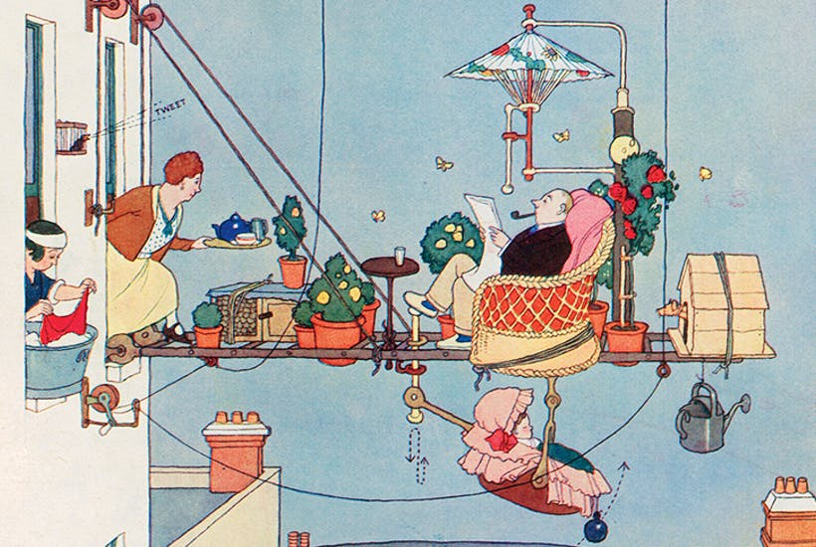

Slide 29
or a Rube Goldberg machine …
Reuben Garrett Lucius Goldberg (1883 – 1970)

Slide 30
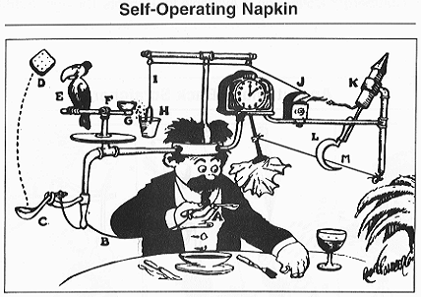

Slide 31
transplot
Work in progress…
Oneway and twoway modes are supported.

Slide 32
Oneway mode
This mode is illustrated by
transplot qnorm beans, trans(@ log10) ms(Oh)
transplot kdensity beans, trans(@ log10) combine(col(1))

Slide 35
Beans???
Spiegelhalter, D. 2019. The Art of Statistics: Learning from Data. London: Penguin
includes an example with guesses on how many jelly beans are in a jar.
The data tell you more about guessing than about jelly beans, but that is fine.
The dataset can be found on GitHub.

Slide 36
transplot syntax
Syntax starts transplot cmd varlist
cmd is any graph command for one variable
varlist specifies one or more numeric variables
if and in are supported

Slide 37
transform() option
The rules are
@ means the variable itself
A bare Stata function name such as log10 is applied to the variable
An expression such as sqrt(@) – sqrt(1 – @) is evaluated substituting the variable name for @

Slide 38
Other options
You can pass options to cmd
If cmd supports by() or over(), that is fine too
You can pass options to graph combine

Slide 39
Another example
webuse grunfeld, clear
transplot qnorm invest mvalue kstock, trans(@ log10) ms(Oh)
transplot qnorm invest mvalue kstock, trans(@ log10) ms(Oh) combine(colfirst))
transplot qnorm invest mvalue kstock, trans(@ log10) combine(colfirst) recast(line) lw(medthick)

Slide 43
qplot
The official command qnorm works fine in these examples, but qplot is much more flexible.
1999. Quantile plots, generalized.
Stata Technical Bulletin 51: 16—18.
2005. The protean quantile plot.
Stata Journal 5: 442—460.
2019. Software Update: Quantile plots, generalized.
Stata Journal 19: in press

Slide 44
Twoway mode
This mode is illustrated by
sysuse auto, clear
transplot scatter mpg weight, ytrans(@ log10 100/@) ms(Oh)
transplot scatter mpg weight, ytrans(@ log10 100/@) xtrans(@ log10) ms(Oh) combine(colfirst)

Slide 47
Twoway mode
Signal by options: use xtrans() or ytrans() or both for y and x variables of a twoway plot.
If one option is not specified, that variable is not transformed.
The same variables appear in each plot.
Syntax such as transplot twoway connected is supported.

Slide 48
In practice
transplot allows you to draw many graphs, but comparison may be difficult with more than a chosen few.
It doesn’t try to be smart about axis labels for transformed scales.
transplot is for exploratory analysis, not modelling.

Slide 49


Slide 50
All graphs use Stata scheme s1color, which I strongly recommend as a lazy but good default.
This font is Georgia.
This font is Lucida Console.

