Slide 1
admetan
A new, comprehensive meta-analysis command
David Fisher
MRC Clinical Trials Unit at UCL
2018 London Stata Conference, 6th September 2018

Slide 2
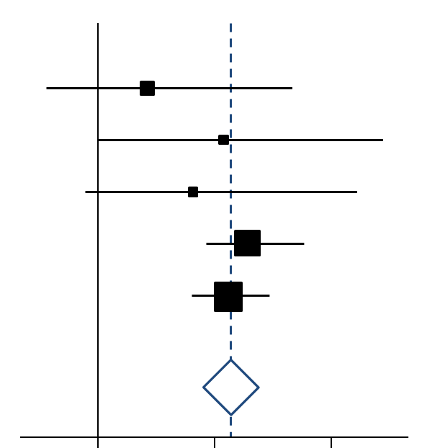
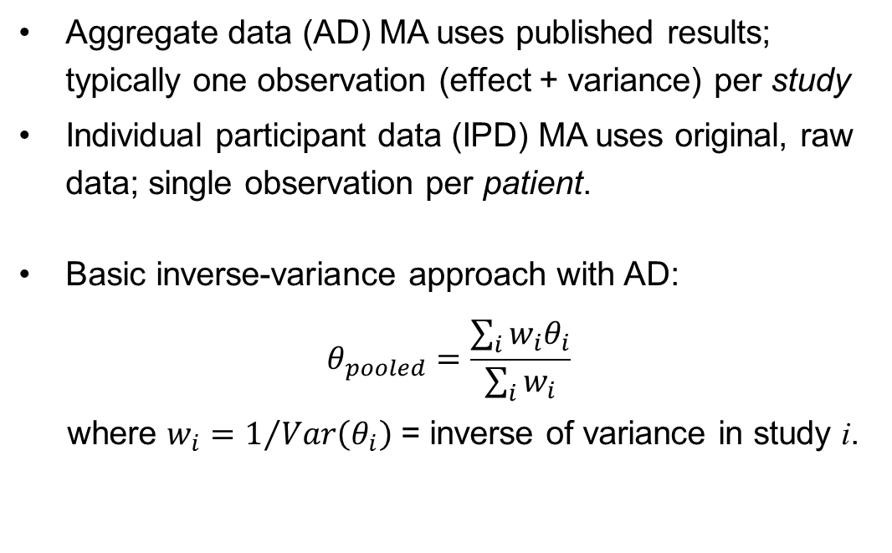
Introduction to meta-analysis (MA)
A statistical analysis which combines the results of several independent studies considered by the analyst to be ‘combinable’ (Huque 1988)
Aggregate data (AD) MA uses published results; typically one observation (effect + variance) per study
Individual participant data (IPD) MA uses original, raw data; single observation per patient.
Basic inverse-variance approach with AD:
$$θ_{pooled}=\frac{\sum_{i}{{w_{i}θ}_{i}}}{\sum_{i}{w_{i}}}$$
where $w_{i}=1/{Var\left(θ_{i}\right)}$ = inverse of variance in study i.
(Image source: Wikipedia)

Slide 3
A brief history of meta-analysis in Stata
1997: meta (Sharp & Sterne)
1998: metan (Bradburn, Deeks & Altman)
Two packages released around the same time; slightly different functionality and capabilities; pre-twoway graphics
2008: metan (Harris, Bradburn, Deeks, Harbord, Altman & Sterne) – a comprehensive update, with twoway graphics etc.
2010: last SSC update to metan
2010: metaan (Kontopantelis & Reeves) released.
Focus on random-effects models, but fewer general features than metan
2013: ipdmetan (Fisher) presented at Stata London meeting; Stata Journal article followed in 2015; admetan is an ancillary ado-file
2018: admetan presented in its own right.

Slide 4
SSC monthly downloads
Using ssccount (Choodari-Oskooei & Morris, SJ 2016)

Slide 5
A recurring theme?
“Stata should have a meta-analysis command [...] but does not” (Stata manual, c.1998?)
“Supporting it [meta] is difficult … quite a lot of [employer] time has gone into this … [in the future] I will likely not have the opportunity, save in my own time, to continue this” (Sterne, 2004)
“I’d be delighted if someone else took responsibility for metareg … I have no interest in this any more” (Sharp, c.2004)
Luckily, Ross Harris took over metan in ~2008 and pushed it into the 2010s … but he too has long since changed jobs and priorities
(N.B. I have his blessing for the admetan project)
Is admetan any different??
  While originally based heavily on metan’s code, admetan/ipdmetan has evolved to be (hopefully) more general, and more easily editable/updateable by others in the future

Slide 6
What can admetan do?
Everything that metan can do…
  caveat: some (very few) things could be done directly with metan but only indirectly with admetan
… but in many cases better …
  forest plots with improved defaults (e.g. aspect, x-axis labelling); increased flexibility
  better handling of returned values and added variables
… plus a whole lot more!
  much larger range of random-effects models
  cumulative and influence meta-analysis
  integration with forestplot and ipdmetan
  input can be a matrix instead of variables
  more continuity-correction options
  etc.

Slide 7
Syntax
Based on, and very similar to, syntax of metan:
admetan varlist [if] [in]
[, main_options forestplot(forestplot_options)]
… where varlist can be:
ES seES | effect size and std. error
ES lci uci | effect size and 95% conf. limits
event_treat noevent_treat event_ctrl noevent_ctrl | cell counts from 2x2 table
n_treat mean_treat sd_treat n_ctrl mean_ctrl sd_ctrl | N, mean and SD, by treatment group
oe v | O-E and V from log-rank/Peto analysis (with logrank option)

Slide 8
A basic example
Taken from Harris et al, SJ 2008
. use bcgtrial, clear
. metan tcases tnoncases ccases cnoncases, rr fixedi lcols(trialnam startyr) xlabel(0.1, 10) favours(BCG reduces risk of TB # BCG increases risk of TB)
. admetan tcases tnoncases ccases cnoncases, study(trialnam) iv forestplot(lcols(startyr) xlabel(0.1 10) favours(BCG reduces risk of TB # BCG increases risk of TB))

Slide 9
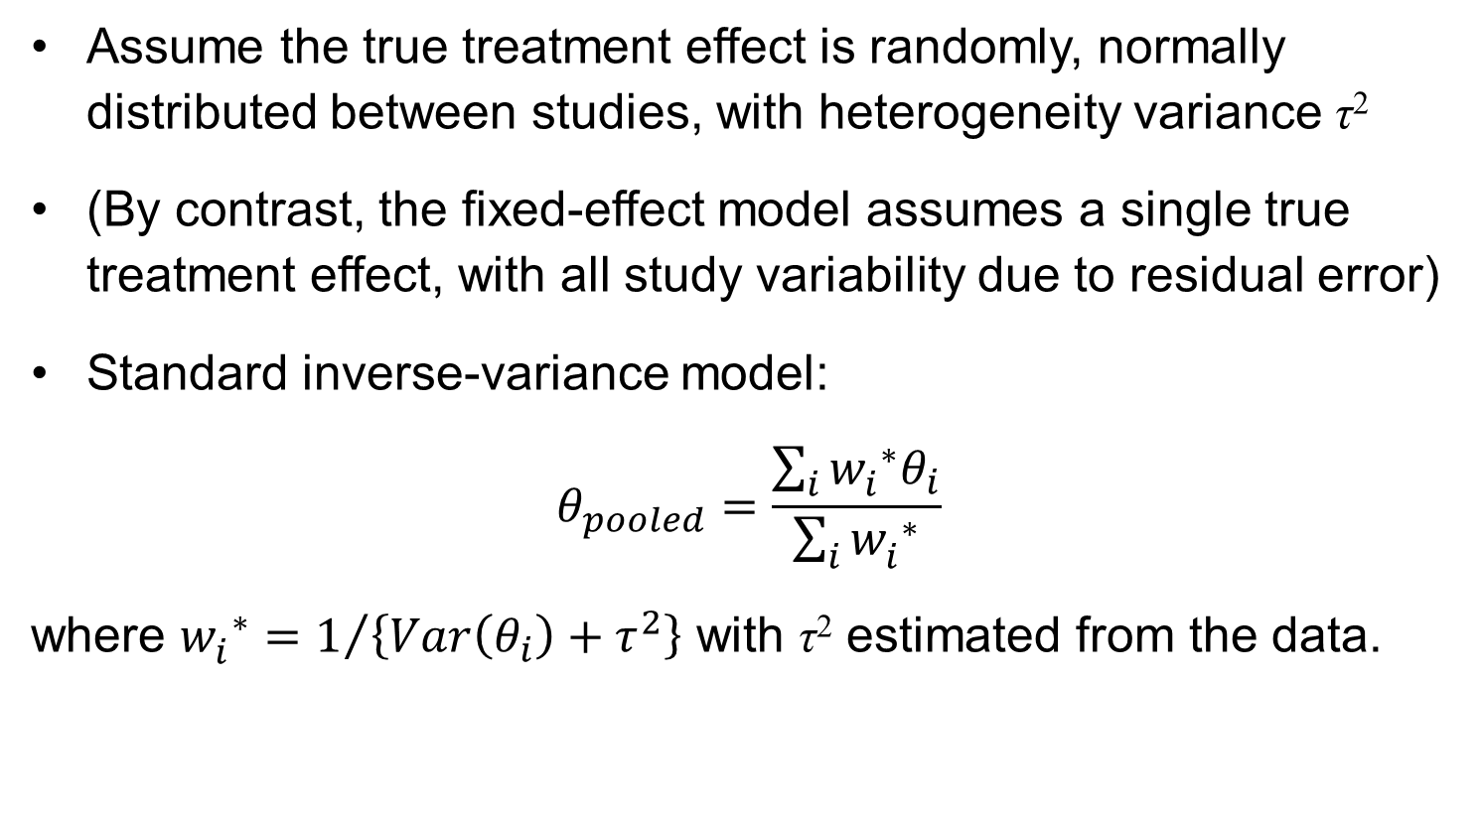
Random-effects models
Assume the true treatment effect is randomly, normally distributed between studies, with heterogeneity variance τ²
(By contrast, the fixed-effect model assumes a single true treatment effect, with all study variability due to residual error)
Standard inverse-variance model:
$$θ_{pooled}=\frac{\sum_{i}{{{w_{i}^{}}^{∗}θ}_{i}}}{\sum_{i}{{w_{i}^{}}^{∗}}}$$
where ${w_{i}^{}}^{∗}=1/{\left\{Var\left(θ_{i}\right)+τ^{2}\right\}}$ with τ² estimated from the data.

Slide 10
Random-effects models
metan only has DerSimonian-Laird estimator of τ²
ipdmetan and metaan are examples of recent commands with a range of random-effects options
admetan extends the range still further:
  All models available in ipdmetan are carried over (Fisher SJ 2015)
  More recent additions include
    Henmi and Copas’s gamma approximation method (Henmi and Copas 2010)
    Bartlett’s correction with Profile Likelihood (Huizenga et al 2011)
    Doi’s “Quality Effects” model (Doi et al 2015)
    An ADMA version of Kenward & Roger’s mixed-model variance correction for REML (Morris et al 2018)

Slide 11
Random-effects models
…with some colourful forestplot options
(same example dataset as before, from Harris et al SJ 2008)
I previously discussed how to specifying colour/pattern options for plot elements in the context of ipdmetan (Fisher SJ 2015)
  New: diamonds now constructed using twoway rarea, allowing fill colour

Slide 12
Cumulative and Influence MA
cumulative and influence options to admetan give similar functionality to existing commands metacum and metainf
  But benefit from integration with rest of admetan and forestplot!

Slide 13
Saved datasets (“results sets”)
Save data in a format from which forestplot can build a plot automatically, with no statistical modelling and minimal option-specification
  Allows huge flexibility for forest plots
  I’ve previously mentioned this in connection with ipdmetan
Example use case: recreate metan’s “second()” option (not currently available with admetan) for e.g. displaying fixed- and random-effects results on same forest plot
Psuedo-code:
  Run first (e.g. fixed-effects) analysis; save results set
  Run second (e.g. random-effects) analysis; save results set
  Load first results set; append second results set
  Apply any additional tweaks
  Run forestplot.

Slide 14
Result using metan
(taken from Harris et al, SJ 2008)
. use bcgtrial, clear
. metan tcases tnoncases ccases cnoncases, rr fixedi second(random) lcols(trialnam authors startyr alloc latitude) counts astext(70) textsize(200) boxsca(80) xlabel(0.1,10) notable xsize(10) ysize(6)

Slide 15
Code using admetan
// Run random-effects model, using "summaryonly" option
. admetan tcases tnoncases ccases cnoncases, re nograph summaryonly saving(random.dta)
// Run fixed-effects model, and create "results set"
. admetan tcases tnoncases ccases cnoncases, rr iv study(trialnam) forestplot(lcols(authors startyr alloc latitude) counts switch(counts) xlabel(.1 1 10) astext(70) leftj) nograph saving(fixed.dta, replace)
. preserve
. use fixed.dta, clear
. local lblfmt : format _LABELS
. replace _LABELS = "Fixed-effects " + _LABELS in `=_N'
. append using random.dta
. replace _LABELS = "Random-effects Overall" in `=_N'
. replace _WT = . in `=_N'
. format `lblfmt' _LABELS
. forestplot, useopts
. restore

Slide 16
Result using admetan
Note the improved defaults with admetan relative to metan for aspect ratio, text size and box scaling

Slide 17
The future?
Together, admetan and forestplot now provide a huge amount of functionality and flexibility
  ipdmetan (and ipdover) provide additional capabilities for IPD
  Results/coefficients from complex regression models can be passed to admetan or forestplot for presentational purposes (e.g. one-stage IPD MA!)
Code is (hopefully) efficient, up-to-date and clear enough (e.g. comments; subroutines) for others to modify, add to, or take over entirely in the future
  GitHub? ResearchGate?
Issues for your consideration:
  Repositories (SSC, SJ; findit) refer to ipdmetan; but admetan now arguably “core”
  Partly for this reason, admetan lags way behind metan in terms of SSC downloads
  How to resolve this? Should admetan have its own SSC page? How should forestplot, ipdmetan etc. be “bundled”?
  Contact metan authors and propose that admetan “takes over”? (with suitable acknowledgments going forward)

Slide 18
Acknowledgments
Ross Harris, Vince Wiggins, Patrick Royston for programming advice and support
Various colleagues, particularly Tim Morris, for testing
The many users who have contacted me via email or on StataList with issues or suggestions
Contact: d.fisher@ucl.ac.uk

Slide 19
References
Huque MF (1998). Experiences with meta-analysis in NDA submissions. Proceedings of the Biopharmaceutical Section of the American Statistical Association 2; 28-33
Sharp S, Sterne J (1997). sbe16: Meta-analysis. Stata Technical Bulletin 38: 9-14
Bradburn MJ, Deeks JJ, Altman DG (1998). metan—an alternative meta-analysis command. Stata Technical Bulletin 44; 4-15
Harris RJ, Bradburn MJ, Deeks JJ, Harbord RM, Altman DG, Sterne JAC (2008). metan: fixed- and random-effects meta-analysis. Stata Journal 8; 2-28
Kontopantelis E, Reeves D (2010). metaan: Random-effects meta-analysis. Stata Journal 10; 395-407
Fisher DJ (2015). Two-stage individual participant data meta-analysis and generalized forest plots. Stata Journal 15; 369-396
Choodari-Oskooei B, Morris TP (2016). Quantifying the uptake of user-written commands over time. Stata Journal 16; 88-95
Huizinga HM, Visser I, Dolan CV (2011). Testing overall and moderator effects in random effects meta-regression. British Journal of Mathematical and Statistical Psychology; 64, 1-19
Doi SAR, Barendregt JJ, Khan S, Thalib L, Williams GM (2015). Advances in the meta-analysis of heterogeneous clinical trials II: The quality effects model. Contemporary Clinical Trials 45 ; 123-129
Morris TP, Fisher DJ, Kenward MG, Carpenter JR (2018). Meta-analysis of Gaussian individual patient data: two-stage or not two-stage? Statistics in Medicine; 37:1419-1438

