Slide 1

Multi-arm, multi-stage randomised controlled trials with stopping boundaries for efficacy and lack-of-benefit:
An update to nstage
Alexandra Blenkinsop, Babak Choodari-Oskooei
8th September 2018
Institute of Clinical Trials & Methodology, University College London

Slide 2

Outline
Introduction to MAMS and nstage
Design extensions and new options
Example: STAMPEDE trial
Discussion

Slide 3




A brief history of trials
First RCT (1946)
Group sequential design
Adaptive designs
MAMS
Notes:
- We start with a brief summary of how clinical trial methods have evolved up until the present day
- First randomised trial in the 40s – parallel group design (i.e. one experimental research arm, one control arm – could be placebo, or current standard of care on the NHS)
- Not much methodological development in RCTs until the 70s when group sequential framework was implemented in trials to permit repeated looks at the data at interim stages
- showed how to maintain desirable operating characteristics
- Adaptive designs introduced to allow changes to the design at interim stages – save on resources, reduce patients being randomised to inferior/futile regimens
- As medical knowledge has advanced, we have reached a point where several drugs/regimens were becoming available for testing at the same time – how to choose which to take forward to next phase of testing?
- Platform trials – allow the comparison of multiple treatment arms (use multiple comparison procedures to control error rates)
- The concept of Multi Arm Multi Stage designs introduced in 21st Century: uses a staged approach to assess multiple research arms

Slide 4



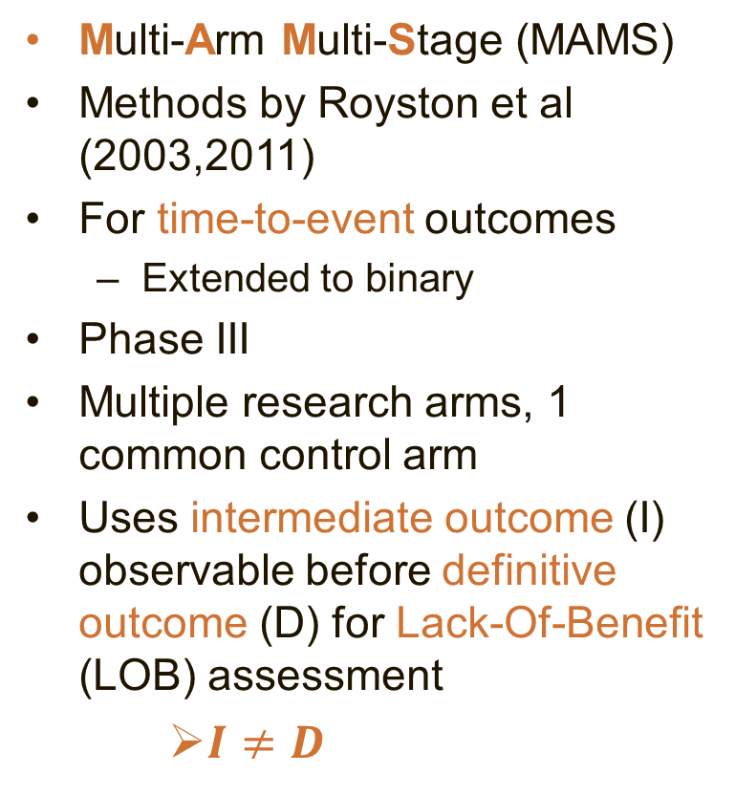
MAMS design
Multi-Arm Multi-Stage (MAMS)
Methods by Royston et al (2003,2011)
For time-to-event outcomes
  Extended to binary
Phase III
Multiple research arms, 1 common control arm
Uses intermediate outcome (I) observable before definitive outcome (D) for Lack-Of-Benefit (LOB) assessment
    $I≠D$
Control
E1
E2
E3
E4
E5
Stage 1
Stage 2
Stage 3
Notes:
- Now we focus in on the particular class of MAMS design under consideration
- Methods for a multi-arm 2-stage design were developed in the early 2000s and later extended to the multi-stage setting
- Developed for time-to-event outcomes with applications in cancer trials
- Later extended to trials with binary outcomes
- Targets late phase/confirmatory trials – most costly phase of testing
- Makes pairwise comparisons between multiple research arms and 1 common control arm – no direct head to head comparisons of research arms
- Permits the use of an intermediate outcome measure which is correlated with definitive/primary outcome but can be observed earlier to allow trigger interim analyses early on in trial
- This int/I-outcome could be composite including primary outcome e.g. FFS/PFS an intermediate outcome for OS
- Early interim analyses allow us to drop arms mid-trial if they do not demonstrate sufficient benefit against the control arm (LOB assessment)
- Such a design is denoted $I≠D$ to indicate the intermediate outcome differs from the definitive outcome
- I=D correspondingly denotes a design in which the same outcome measure is used throughout
- Benefits
Increased probability of success
See data as it accrues
Time & resource efficient
Considerations
Multiple testing impacts operating characteristics
Correlation between test statistics (due to shared control arm and shared patients across stages)

Slide 5

MAMS design
Benefits
  Increased probability of success
  See data as it accrues
  Time & resource efficient
  Considerations
  Multiple testing impacts operating characteristics
  Correlation between test statistics
E1
E2
Control
Stage 1
Stage 2
Stage 3
Notes:
Benefits:
- More arms leads to a higher prob of conclusion of efficacy on at least 1
- Staged approach allows seamless phase II/III designs and the dropping of arms which do not demonstrate sufficient benefit
- Efficient vs parallel design – fewer patients, less time, allows reallocation of resources for dropped arms
Considerations:
- Risk of multiplicity arising from repeated hypothesis testing and can affect error rates – will come on to this in more detail in a moment
- Correlation induced by:
> Common control arm leads to estimated treatment effects of different treatment arms being correlated
> Same patients being analysed at different stages leads to test statistics between stages being correlated (even if I-outcome used at interim and D-outcome used at final analysis)
- Must ensure this correlation is not ignored in analysis or may overstate strength of evidence/treatment effects

Slide 6
Operating characteristics of MAMS
Type I error:
  Pairwise error rate (PWER)
    The probability of rejecting any null hypothesis on the definitive/primary (D) outcome for a particular experimental arm
  Familywise error rate (FWER): multi-arm setting
    The probability of incorrectly rejecting any null hypothesis for the D-outcome.
Type II error rate:
  Probability of correctly concluding efficacy
  All-pairs, Per-pair, Any-pair
  Which measure of power in a multi-arm trial?
Notes:
- Type I error in the context of a MAMS trial: Prob of an incorrect conclusion of efficacy
- PWER = Prob of type I error on one research arm
- FWER = Prob of type I error on any research arm, relevant for multi-arm designs.
- It is sometimes a regulatory requirement to control the second probability for multi-arm designs – but no consensus under which circumstances, and is usually decided on a case-by-case basis
- Power: Prob of detecting a true treatment effect – 3 different measures defined in the literature for multi-arm trials. Which measure is of interest will depend on the objective of the trial.
Measures can be calculated analytically using conditional prob but simulation can be used for complex designs, taking into account the correlation between treatment effects

Slide 7
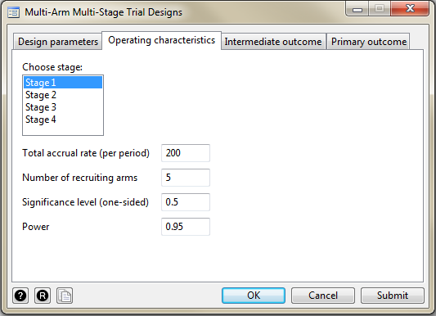
Software: nstage
Stata program developed for designing MAMS trials (Barthel & Royston, 2009; Bratton et al 2015)
Calculates:
  Sample size requirements
  Operating characteristics
  Expected timings of stages
User-friendly menu
Notes:
To help people implement the MAMS design in real trials, the nstage program was developed in Stata to perform sample size calculations, operating characteristics and the expected timings of the stages
A user-friendly point and click menu was created to guide people in specifying the design parameters
Extended in 2015 to enable some additional calculations (e.g. FWER)

Slide 8
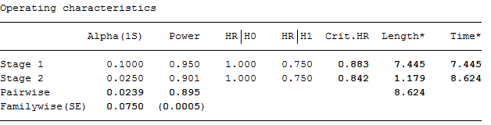
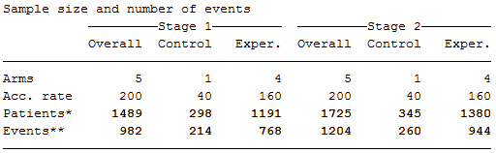
Software: nstage
Example output
Notes:
Program performs sample size calculations and produces easy-to-interpret output with sample size per stage and operating characteristics

Slide 9
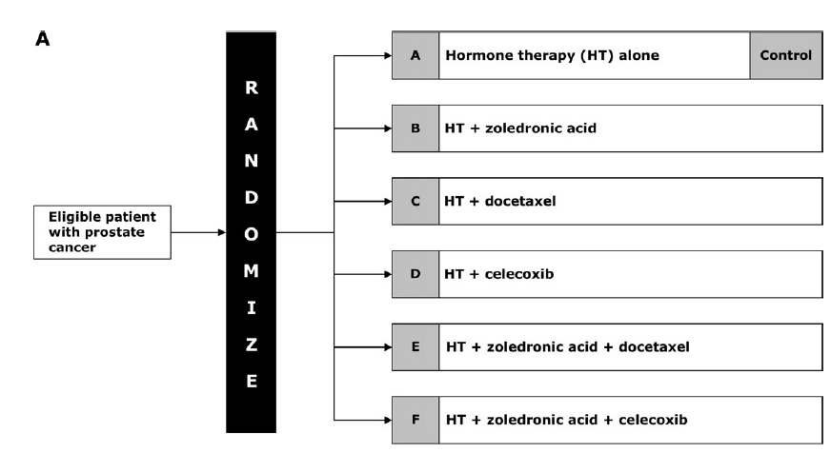
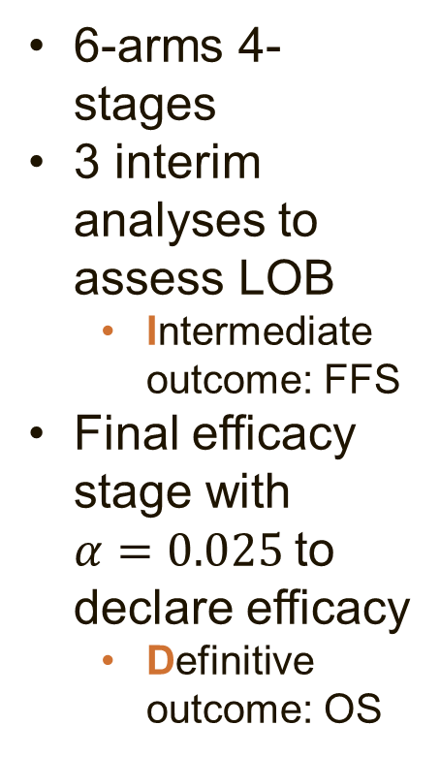
Example: STAMPEDE
6-arms 4-stages
3 interim analyses to assess LOB
  Intermediate outcome: FFS
Final efficacy stage with $α=0.025$to declare efficacy
  Definitive outcome: OS
Stop recruitment
Stop recruitment
Notes:
- Example to illustrate how MAMS design has been implemented in practice: STAMPEDE
- Started as 6-arm 4-stage design with 3 interim analyses for assessing LOB on an intermediate outcome of FFS
- The interim analyses identified 2 arms to be dropped for insufficient benefit
Final stage analysis on definitive outcome OS found one of the 3 remaining arms demonstrated a treatment effect against the control - reject $H_{0}$
Although STAMPEDE calculated and reported the FWER, the trial sought to control the PWER only, since each of the treatment arms were regarded as distinct research questions

Slide 10

MAMS design
Reject $H_{0}$
Stage
Notes:
- Illustration of how the LOB stopping boundaries work
- For time-to-event outcomes, LOB bound is an upper boundary – a reduction in hazard ratio indicates a beneficial effect
- 1-sided alphas are defined for each stage to assess LOB
- Boundaries start liberal and become stricter – ensures high power so that arms with any potential are kept in the trial (not concerned with type I errors at early stages since cannot formally reject H0 on D-outcome early)
- Pills represent treatment effect measure for treatment arm k
At each stage the alpha_j is the hurdles the treatment arms must pass in order to continue recruitment (ie. Test statistic for comparison k must be less than critical value corresponding to alpha_j
- At final stage we test for efficacy on D

Slide 11
MAMS design
Reject $H_{0}$
Stage
Notes:
- We can now introduce a formal boundary for efficacy
- Consider terminating recruitment to an arm/the trial should early evidence of efficacy be flagged
- Note that when an intermediate outcome is used for lack-of-benefit assessment, efficacy is still assessed on the primary definitive outcome (ie. There are two different test statistics for the two boundaries)

Slide 12
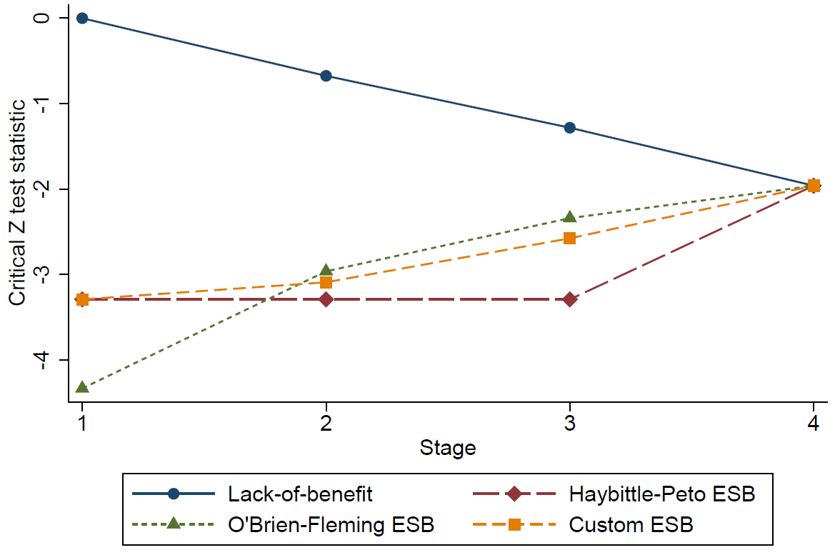
Efficacy stopping boundaries
Haybittle-Peto
O-Brien-Fleming type
Custom (e.g. function of information time)
Lack-of-benefit rejection region
Efficacy rejection region
Notes:
Implemented some popular ESBs in nstage
Graph:
- Illustrates thresholds for stopping for LOB (above) and efficacy (below) using 3 different stopping rules
- Peto, same p-value
- OBF uses alpha-spending approach to spend the type I error according to the amount of data accrued
- custom can be flexible, specify p-val at each stage. Could be generated using some function e.g. Whitehead’s triangular boundaries
- For each comparison arm, if test statistic crosses either boundary it is dropped. If not, it continues to next stage.

Slide 13
Approaches to stopping early for efficacy
If an efficacious arm is identified early:
  Terminate trial or continue with remaining research arms
  May depend on
    Research question: Whether treatment arms are distinct/related
    Ethics: Patients on an inferior control arm
    Practicality: Can efficacious treatment be added to other arms? (i.e. combination therapy)
Binding vs. non-binding lack-of-benefit boundaries
  Non-binding favoured by regulatory agencies:
    Considered more flexible
    Calculation of error rates is more conservative
Notes:
- Assumptions required for calculation of operating characteristics:
- Whether or not the trial stops should an efficacious arm be identified (simultaneous stopping) or continues with the remaining research arms (separate stopping)
- Whether lack-of-benefit boundaries are binding (i.e. if there is a possibility to continue with an arm once it has demonstrated lack-of-benefit at an interim stage). Prior to updating nstage, users didn’t have a choice, only binding boundaries were considered

Slide 14
Specifying efficacy stopping boundaries
New option esb(string[,stop])
  Haybittle-Peto
  O’Brien-Fleming
  Custom rules
Error rates are estimated via simulation
  Accounting for correlation between treatment effects
Output shows stopping boundary p-values for each stage and operating characteristics
stop option: How to proceed if an arm crosses efficacy bound
  Some trials may continue with remaining research arms (or add effective regimen to all arms and continue i.e. combination therapy trial)
  Or may be unethical to continue trial once an effective arm has been identified
Notes:
- Option esb(): HP has default value but can be specified manually, OBF uses $α_{J}$ to determine stopping boundaries, Custom rules require user to specify p-value for stages 1 to J-1 (could use some function of information time to generate these eg. Whitehead’s triangular boundaries)
- Simulation procedure:
> Feed in correlation structure to generate data (If $I≠D$, between-stage correlation is based on D-outcomes since efficacy checks are made on D – earlier in nstage where the correlation is simulated it extracts the number of D-events at the scheduled interim analysis based on I-events)
> Compare test statistics with LOB and ESBs (Assess LOB on I, efficacy on D)– flag the ones which are dropped for efficacy
> Test for efficacy on D at stage J and count type I errors
> Add the type I errors from previous stages
> Use summary statistics of simulations to obtain empirical error rates
- Stop option: User has the option to specify how to proceed should a research arm cross the efficacy boundary at an interim analysis depending on the objective of the trial
> Terminate recruitment to arm which is identified as efficacious but continue with the remaining arms to the planned end of the trial
> Terminate recruitment to all research arms and stop trial

Slide 15
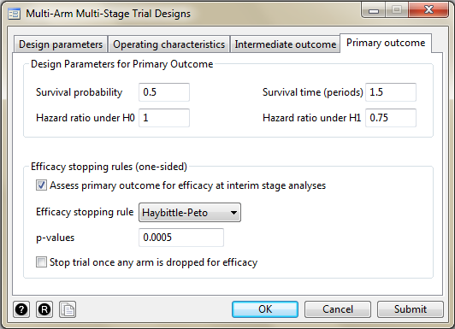
Specifying efficacy boundaries - dialog box
Notes:
Primary outcome tab now has a section for efficacy stopping rules
Tickbox to implement
Drop down list to select rule
P-value box for custom boundaries (or to modify Haybittle-Peto)
Tickbox to indicate calculations should assume trial is terminated after an effective research arm is identified

Slide 16
Controlling the FWER
Trial regulators sometimes require the overall type I error (FWER) to be controlled
  Particularly for designs which allow early termination for efficacy
Option fwercontrol(#) allows user to specify the maximum FWER permitted
nstage searches for a design which satisfies this constraint using linear interpolation
Notes:
- Strong control of the FWER: Means the FWER of the trial is controlled at a pre-specified level under any underlying treatment effects which might be observed in the trial
- It is often a requirement that the FWER is strongly controlled (ie. Controlled under any underlying treatment effects, and assuming non-binding boundaries, such that it is controlled at its maximum possible value)
- An option has been added to nstage is to specify a design which controls the FWER at the desired level
- The program uses an iterative method to search across values of $α_{J}$, until the FWER constraint is met
- Nstage then reports the design which controls the FWER

Slide 17
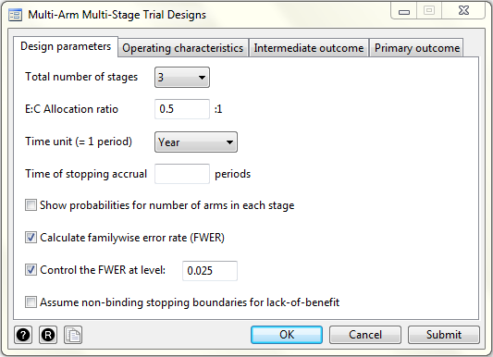
Specifying options using the dialog box
Notes:
Tickboxes have been added to the dialog box to specify:
- Control of the FWER (user inputs level desired)
- Non-binding lack-of-benefit boundaries should be assumed (nb. This is applied automatically when FWER control is specified to ensure strong control)

Slide 18
Example: STAMPEDE
Note:
Only 3 research arms reached the final stage so the actual FWER was 6.7%

Slide 19
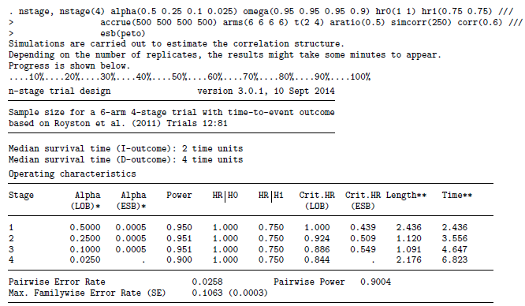
Example: STAMPEDE
Notes:
We illustrate these new features with an applied example using the STAMPEDE trial
Here we have designated the Haybittle-Peto efficacy boundary should be implemented at the design stage
The output shows the error rates for the specified design
(Sample size calculations not shown)

Slide 20
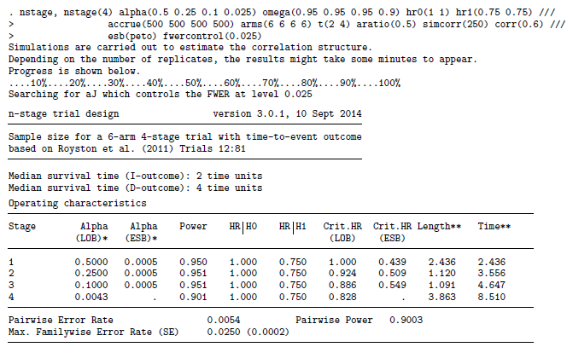
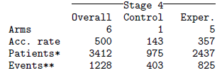
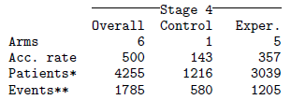
Example: STAMPEDE
Final stage significance level is adjusted
Operating characteristics meet the constraint
Length of trial increases
Number of control arm events increases
Notes:
In this second example, we implement a Haybittle-Peto efficacy boundary and specify control of the FWER at 2.5%
In the output, we can see the final stage significance level is adjusted from 0.025 to 0.0043 and the length of the trial has been increased as a result

Slide 21
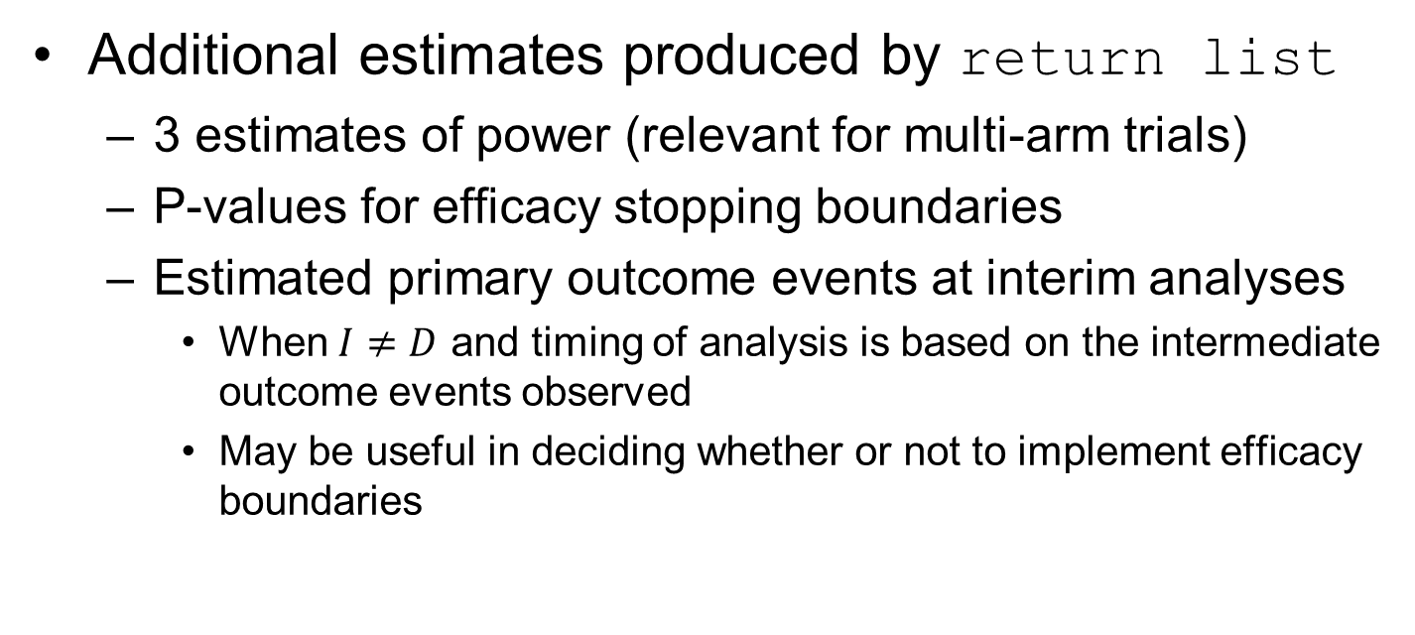
Return list
Additional estimates produced by return list
  3 estimates of power (relevant for multi-arm trials)
  P-values for efficacy stopping boundaries
  Estimated primary outcome events at interim analyses
    When $I≠D$ and timing of analysis is based on the intermediate outcome events observed
    May be useful in deciding whether or not to implement efficacy boundaries
Notes:
Running the Return list command after nstage produces some additional estimates which might be of value:
- 3 measures of power discussed before depending on aim of trial
p-values for efficacy & critical log HRs

Slide 22
Validating the new nstage
Independently coded the algorithm
Checked the simulation results against analytical solutions where possible
Re-ran the design do files of previous MAMS trials, compared the outputs/results, and checked for discrepancies
The algorithm (and nstage) has been applied to design new MAMS trials in renal cancer with time-to-event outcome.

Slide 23
Discussion
nstage can design a MAMS trial assessing lack-of-benefit on I-outcome and efficacy on D-outcome for time-to-event outcome measures
  To our knowledge the only software that does such a complex design
  We use it for all of our MAMS designs, i.e. STAMPEDE, RAMPART, RUSSINI2, TB MAMS Trial, …
Choosing an efficacy boundary
  Depends on design parameters
  We have developed practical guidelines (Blenkinsop, Parmar, Choodari-Oskooei, 2018)
Control of the FWER
  Not always required, but our approach is fast, easy to apply and ensures high power early in trial
Notes:
- Nstage is the only software we are aware of which can calculate sample sizes and operating characteristics for trials utilising an intermediate outcome measure for lack-of-benefit analysis at interim stages and a different primary outcome for efficacy for time-to-event outcomes
- Some consideration should go into choosing ESBs, we have provided guidelines on how to implement these (see paper, under review)
- Enabling the design which strongly controls the FWER is desirable, may increase uptake of the design and software

Slide 24
Discussion
Binding vs. non-binding a useful addition
  Often a regulatory requirement to assume non-binding boundaries
  nstage allows users to compare both approaches
Stopping vs. continuing with trial
  Depends on trial, ethical considerations, practicality
  nstage allows flexibility
Speed
  Favourable compared to alternative freely available software
The article to be submitted to Stata journal
Notes:
- The option to assume binding or non-binding boundaries is a useful addition, most alternative software are fixed in the approach they take
- The option to choose the planned course of action should an efficacious arm be identified adds flexibility to the design depending on the aims and the treatment arms
- The speed of nstage compares favourably with alternative freely available software, particularly in achieving control of the FWER
- The methods here could be easily applied to alternative outcome measures (e.g. to the version of nstage for binary outcomes). This is an area for future work

Slide 25
References
Blenkinsop, A., Parmar, M. K. B., Choodari-Oskooei, B. (2018), Assessing the impact of efficacy stopping rules on the error rates under the MAMS framework, Clinical Trials (under review)
Blenkinsop, A., Choodari-Oskooei, B. (2018), Multi-arm, multi-stage randomized controlled trials with stopping boundaries for efficacy and lack-of-benefit: An update to nstage, Stata Journal (to be submitted)
Royston, P., Barthel, F. M.-S., Parmar, M. K. B., Choodari-Oskooei, B., & Isham, V. (2011). Designs for clinical trials with time-to-event outcomes based on stopping guidelines for lack of benefit. Trials, 12(1), 81.
Barthel, F. M.-S., & Royston, P. (2009). A menu-driven facility for sample-size calculation in novel multiarm, multistage randomized controlled trials with a time-to-event outcome. Stata Journal, 9(4), 505–523. https://doi.org/The Stata Journal
Bratton, D. J., & Choodari-Oskooei, B. (2015). A menu-driven facility for sample-size calculation in multiarm, multistage randomized controlled trials with time-to-event outcomes: Update. Stata Journal, 15(2), 350–368.
Sydes, M. R., Parmar, M. K. B., Mason, M. D., Clarke, N. W., Amos, C., Anderson, J., … James, N. D. (2012). Flexible trial design in practice - stopping arms for lack-of-benefit and adding research arms mid-trial in STAMPEDE: a multi-arm multi-stage randomized controlled trial. Trials, 13(1), 1.

