Slide 1
Scheme scheme, plot plot: crafting graph schemes in Stata
Tim Morris MRC Clinical Trials Unit at UCL
7 Sep 2017

Slide 2
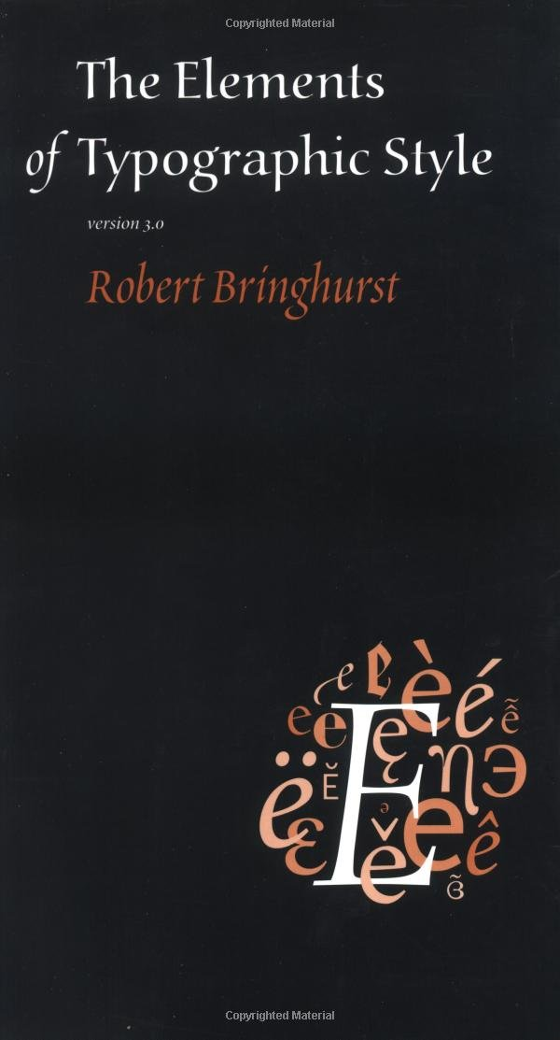
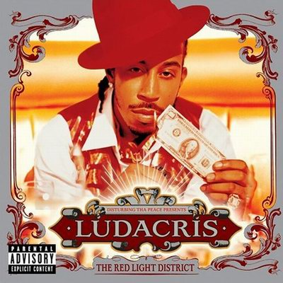
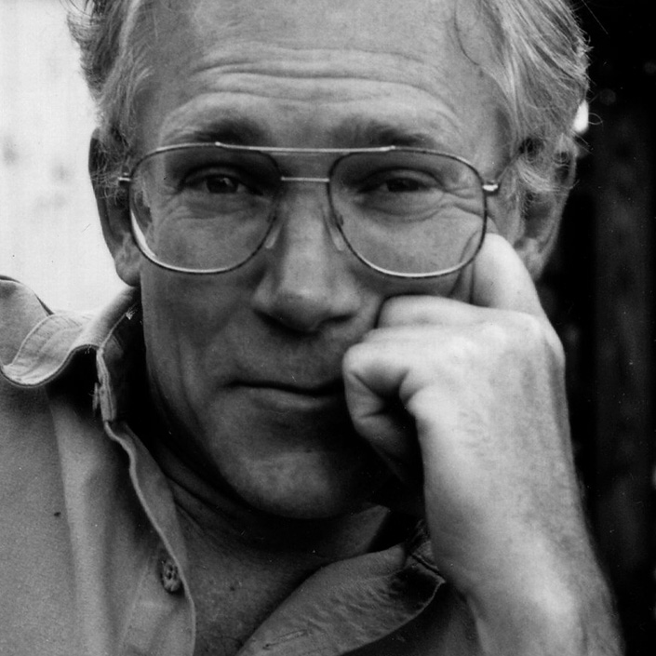
Two poets

Slide 3
By all means break the rules, and break them beautifully, deliberately and well.
– Robert Bringhurst
The Elements of Typographic Style

Slide 4
Removing the ‘typo’s
Typography should honour the text data for its own sake – always assuming that the text data is worth a typographer’s trouble – and it should honour and contribute to its own tradition: that of typography itself.
– Robert Bringhurst
The Elements of Typographic Style

Slide 5
. tw (scatter price weight if foreign)
> (scatter price weight if !foreign)
0
0
0
,
5
1
0
0
0
,
0
e
1
c
i
r
P
0
0
0
,
5
0
2,000
3,000
4,000
5,000
Weight (lbs.)
Price
Price
Wow, ggp%*t default also looks this bad!

Slide 6
Legibility, in practice, amounts simply to what one is accustomed to.
– Eric Gill
An essay on typography, 1936

Slide 7
… , scheme(s1mono)
0
0
0
,
5
1
0
0
0
,
0
e
1
c
i
r
P
0
0
0
,
5
0
2,000
3,000
4,000
5,000
Weight (lbs.)
Price
Price

Slide 8
… , … ylabel(,angle(0))
15,000
10,000
e
c
i
r
P
5,000
0
2,000
3,000
4,000
5,000
Weight (lbs.)
Price
Price

Slide 9
Why? Let’s recode $ to ¢
0
0
0
,
0
0
5
0
,
0
1
0
,
0
5
2
0
,
0
1
0
,
0
)
0
¢
0
,
(
0
1
e
0
c
0
i
,
r
0
P
5
7
0
0
0
,
0
0
5
0
0
0
,
0
5
2
0
2,000
3,000
4,000
5,000
Weight (lbs.)
Price (¢)
Price (¢)

Slide 10
Why? Let’s recode $ to ¢
1,500,000
1,250,000
)
1,000,000
¢
(
e
c
i
750,000
r
P
500,000
250,000
0
2,000
3,000
4,000
5,000
Weight (lbs.)
Price (¢)
Price (¢)

Slide 11
. tw (scatter …, msymbol(Oh))
> (scatter …, msymbol(Oh)), …
15,000
10,000
e
c
i
r
P
5,000
0
2,000
3,000
4,000
5,000
Weight (lbs.)
Price
Price

Slide 12
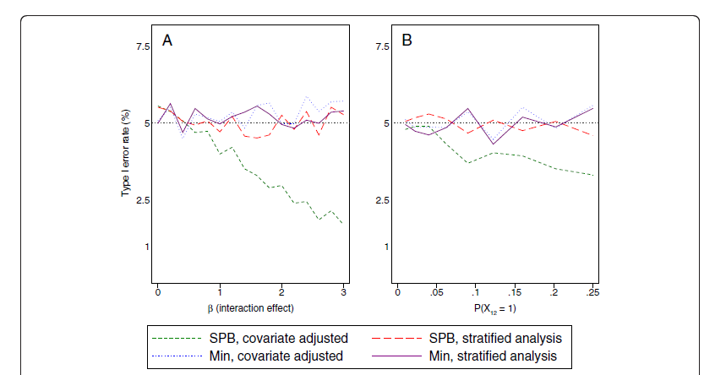
… ytitle(,orientation(0))
> plotregion(style(none))
> ylabel(,angle(0) noticks grid gmin)
> xlabel(,noticks)
> yscale(noline) xscale(noline)
15,000
10,000
Price
5,000
0
2,000
3,000
4,000
5,000
Weight (lbs.)
Price
Price

Slide 13
Every. Single. Time. (almost)
. tw (scatter price weight if foreign,
msymbol(Oh) mcolor("33 103 126"))
(scatter price weight if !foreign,
msymbol(Oh) mcolor("106 59 119"))
,
ytitle(,orientation(0))
ylabel(,angle(0) noticks grid gmin)
xlabel(,noticks)
yscale(noline)
xscale(noline)
plotregion(style(none))

Slide 14
Discovering scheme files
Several years ago, Rachel Jinks and I were looking through our adopaths, as you do, and stumbled across the base\style directory
Opened something like color-blue.style and saw that it contains
. set rgb "0 0 255"
I set-to writing my own to match MRC’s branding

Slide 15
Discovering scheme files
Not yet content, we stumbled across scheme-s2color.scheme
It was easy enough to read, so I started tinkering…
Within a few hours, had done all of the every-single-time changes so I had to do them No. More. Times.

Slide 16
Help: scheme entries
At the time, I wasn’t aware of the ‘scheme entries’ help
It’s helpful
Importantly: you don’t have to write a full scheme file. Of Stata’s base schemes, only s2color is ‘full’
To write your own scheme, start file with:
#include s2color
Inherits everything that you don’t change

Slide 17
Example: scheme-my.scheme
(goes in adopath at personal\s)
#include s2color
color background white
anglestyle vertical_tick horizontal
symbol p circle_hollow
color plotregion_line none
yesno draw_major_vgrid yes
yesno extend_axes_full_low no
yesno extend_axes_full_high no
15,000
10,000
e
c
i
r
P
5,000
0
2,000
3,000
4,000
5,000
Weight (lbs.)
Price
Price

Slide 18
Writing your own scheme
Work cautiously when writing a scheme
Nice effects on one plot type may have unintended consequences on others
Build scheme with a primary plot but have a battery of others to check against
Can spend a long time on a scheme then suddenly realise you’ve broken something and can’t get back

Slide 19
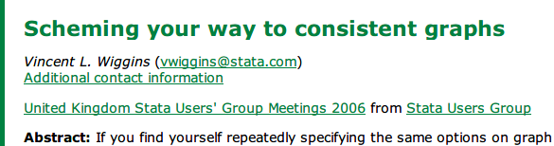
Why don’t many people know?
It’s mostly because Vince didn’t use a Ludacris lyric as his presentation title…

Slide 20


Why don’t many people know?
A lot of scheme-changing is about colour. I wrote a brief how-to paper. Then realised:
doesn’t do colour

Slide 21
Finally
In the spirit of keeping Wishes and Grumbles to time:
Grumble: The Stata Journal doesn’t allow colour
Wish: That The Stata Journal would allow colour
(and put my paper in the first issue)

