Slide 1
Handling treatment changes in randomised trials with survival outcomes
UK Stata Users' Group, 11-12 September 2014
Ian White
MRC Biostatistics Unit, Cambridge, UK
ian.white@mrc-bsu.cam.ac.uk

Slide 2
Motivation 1: Sunitinib trial
RCT evaluating sunitinib for patients with advanced gastrointestinal stromal tumour after failure of imatinib
  Demetri GD et al. Efficacy and safety of sunitinib in patients with advanced gastrointestinal stromal tumour after failure of imatinib: a randomised controlled trial. Lancet 2006; 368: 1329–1338.
Interim analysis found big treatment effect on progression-free survival
All patients were then allowed to switch to open-label sunitinib
Next slides are from Xin Huang (Pfizer)

Slide 3
Time to Tumor Progression
(Interim Analysis Based on IRC, 2005)
with thanks to Xin Huang (Pfizer)

Slide 4
Overall Survival (NDA, 2005)
Total deaths
29
27
with thanks to Xin Huang (Pfizer)

Slide 5
Overall Survival (ASCO, 2006)
Total deaths
89
53
with thanks to Xin Huang (Pfizer)

Slide 6
Overall Survival (Final, 2008)
Total deaths
176
90
with thanks to Xin Huang (Pfizer)

Slide 7
Sunintinib: explanation?
The decay of the treatment effect is probably due to treatment switching
Of 118 patients randomized to placebo:
  19 switched to sunitinib before disease progression
  84 switched to sunitinib after disease progression
  15 did not switch to sunitinib
Hence we aim to answer the "causal question":
what would the treatment effect be if (counterfactually) no-one in the placebo arm received treatment?

Slide 8
Motivation 2: Concorde trial
Zidovudine (ZDV) in asymptomatic HIV infection
1749 individuals randomised to immediate ZDV (Imm) or deferred ZDV (Def)
  Lancet, 1994
Outcome here: time to ARC/AIDS/death

Slide 9
Concorde: ITT results for progression
1.00
0.75
0.50
HR (Imm vs. Def):
0.89 (0.75-1.05)
0.25
0.00
0
1
2
3
4
Years
Number at risk
Def
871
755
617
391
29
Imm
874
799
645
426
26
Def
Imm
Notes:
from ConcordeEVR.do

Slide 10
Treatment changes in Concorde
1
575 participants stopped taking their blinded capsules because of adverse events or personal reasons
283 Def participants started ZDV before progression
Causal question: What would the HR between randomised groups be if none of the Def arm took ZDV?
p(ZDV | imm, t)
.8
.6
.4
.2
p(ZDV | def, t)
0
0
1
2
3
4
Time

Slide 11
Plan
Methods to adjust for treatment switching
  the rank-preserving structural nested failure time model (RPSFTM)
strbee (2002)
Improvements needed
  sensitivity analysis
  weighted log rank test
strbee2 (2014)

Slide 12
Plan
Methods to adjust for treatment switching
  the rank-preserving structural nested failure time model (RPSFTM)
strbee (2002)
Improvements needed
  sensitivity analysis
  weighted log rank test
strbee2 (2014)

Slide 13
Statistical methods to adjust for switching in survival data
Intention-to-treat analysis
  ignores the switching problem
  compares treatment policies as implemented
Per-protocol analysis
  censors at treatment switch
  likely selection bias
Inverse-probability-of-censoring weighting (IPCW)
  adjusts for selection bias assuming no unmeasured confounders
  Robins JM, Finkelstein DM. Biometrics 2000; 56: 779–788.
Rank-preserving structural nested failure time model (RPSFTM)
  an instrumental variable method: allows for unmeasured confounders
  Robins JM, Tsiatis AA. Comm Stats Theory Meth 1991; 20(8): 2609–2631.

Slide 14
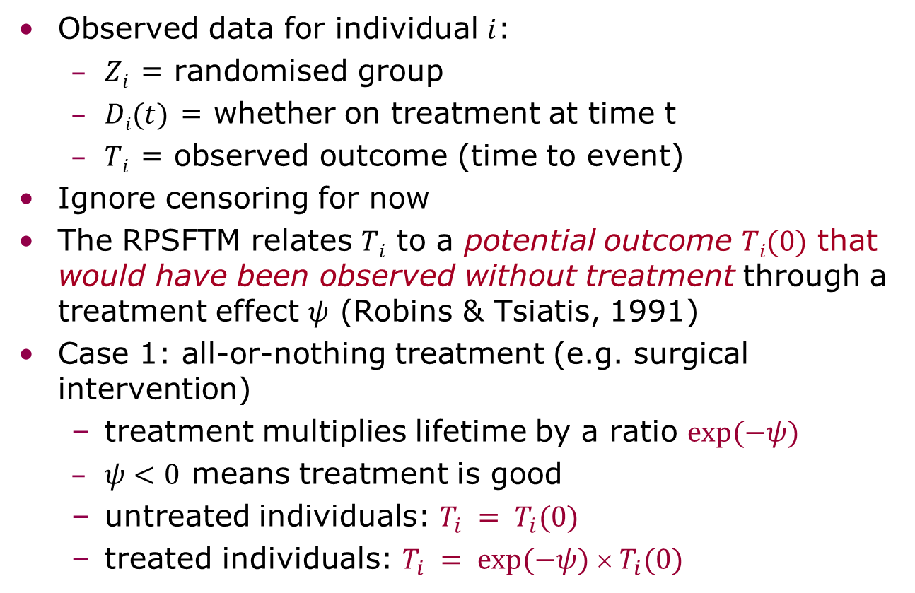
Rank-preserving structural failure time model (1)
Observed data for individual $i$:
  $Zi$ = randomised group
  $Di(t)$ = whether on treatment at time t
  $Ti$ = observed outcome (time to event)
Ignore censoring for now
The RPSFTM relates $Ti$ to a potential outcome $Ti(0)$ that would have been observed without treatment through a treatment effect $ψ$ (Robins & Tsiatis, 1991)
Case 1: all-or-nothing treatment (e.g. surgical intervention)
  treatment multiplies lifetime by a ratio $exp⁡(−ψ)$
  $ψ<0$ means treatment is good
  untreated individuals: $T_{i} = T_{i}(0)$
  treated individuals: $T_{i} = exp⁡(−ψ)  T_{i}(0)$

Slide 15
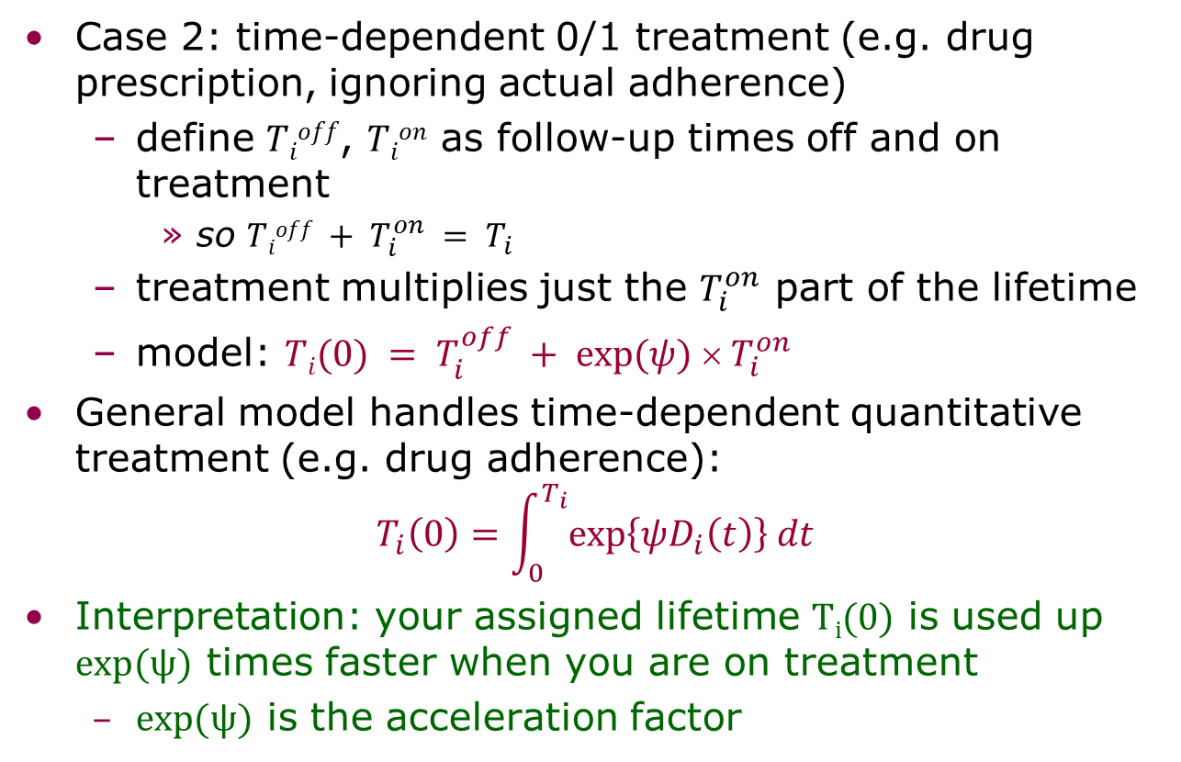
Rank-preserving structural failure time model (2)
Case 2: time-dependent 0/1 treatment (e.g. drug prescription, ignoring actual adherence)
  define $Tioff$, $Tion$ as follow-up times off and on treatment
    so $Tioff + T_{i}^{on} = T_{i}$
  treatment multiplies just the $T_{i}^{on}$ part of the lifetime
  model: $Ti(0) = T_{i}^{off} + exp⁡(ψ)  T_{i}^{on}$
General model handles time-dependent quantitative treatment (e.g. drug adherence):
$$T_{i}\left(0\right)=\int_{0}^{T_{i}}{exp\left\{ψD_{i}\left(t\right)\right\} dt}$$
Interpretation: your assigned lifetime $Ti(0)$ is used up $exp⁡(ψ)$ times faster when you are on treatment
  $exp⁡(ψ)$ is the acceleration factor

Slide 16

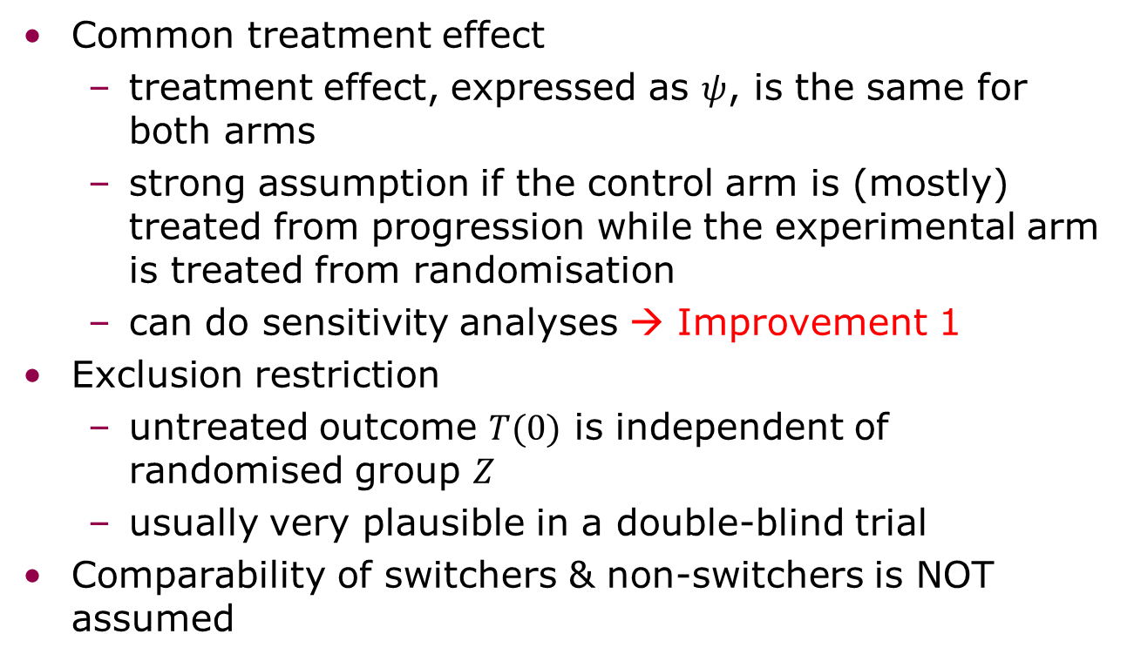
RPSFTM: identifying assumptions
Model: $Ti(0) = T_{i}^{off}+ exp⁡(ψ)  T_{i}^{on}$
Common treatment effect
  treatment effect, expressed as $ψ$, is the same for both arms
  strong assumption if the control arm is (mostly) treated from progression while the experimental arm is treated from randomisation
  can do sensitivity analyses → Improvement 1
Exclusion restriction
  untreated outcome $T(0)$ is independent of randomised group $Z$
  usually very plausible in a double-blind trial
Comparability of switchers & non-switchers is NOT assumed

Slide 17
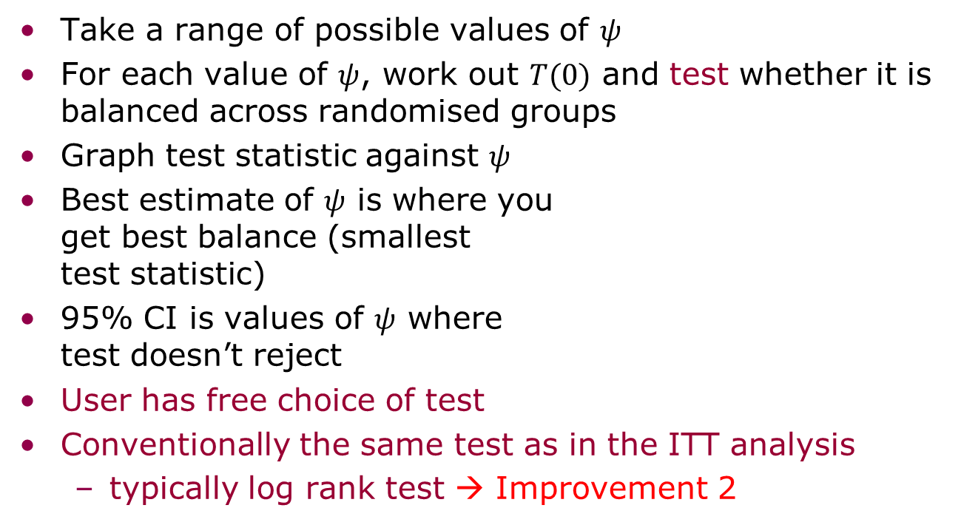

G-estimation: an unusual estimation procedure
Model: $Ti(0) = T_{i}^{off}+ exp⁡(ψ)  T_{i}^{on}$
Take a range of possible values of $ψ$
For each value of $ψ$, work out $T(0)$ and test whether it is balanced across randomised groups
Graph test statistic against $ψ$
Best estimate of $ψ$ is where you
get best balance (smallest
test statistic)
95% CI is values of $ψ$ where
test doesn’t reject
User has free choice of test
Conventionally the same test as in the ITT analysis
  typically log rank test → Improvement 2
2
0
Test statistic
-2
-.4
-.2
0
$$ψ$$

Slide 18
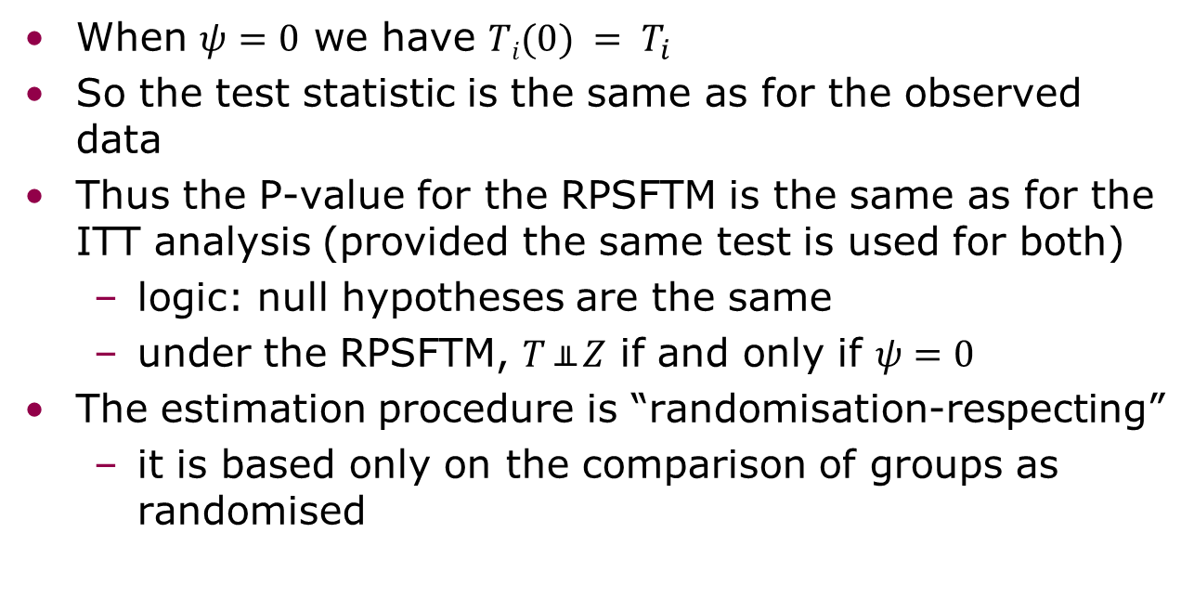
RPSFTM: P-value
Model: $Ti(0) = T_{i}^{off}+ exp⁡(ψ)  T_{i}^{on}$
When $ψ=0$ we have $Ti(0) = T_{i}$
So the test statistic is the same as for the observed data
Thus the P-value for the RPSFTM is the same as for the ITT analysis (provided the same test is used for both)
  logic: null hypotheses are the same
  under the RPSFTM, $T ╨ Z$ if and only if $ψ=0$
The estimation procedure is “randomisation-respecting”
  it is based only on the comparison of groups as randomised

Slide 19
RPSFTM: Censoring
Censoring introduces complications in RPSFTM estimation
  censoring on the T(0) scale is informative
  requires re-censoring which can lead to strange results
White IR, Babiker AG, Walker S, Darbyshire JH. Randomisation-based methods for correcting for treatment changes: examples from the Concorde trial. Statistics in Medicine 1999; 18: 2617–2634.

Slide 20
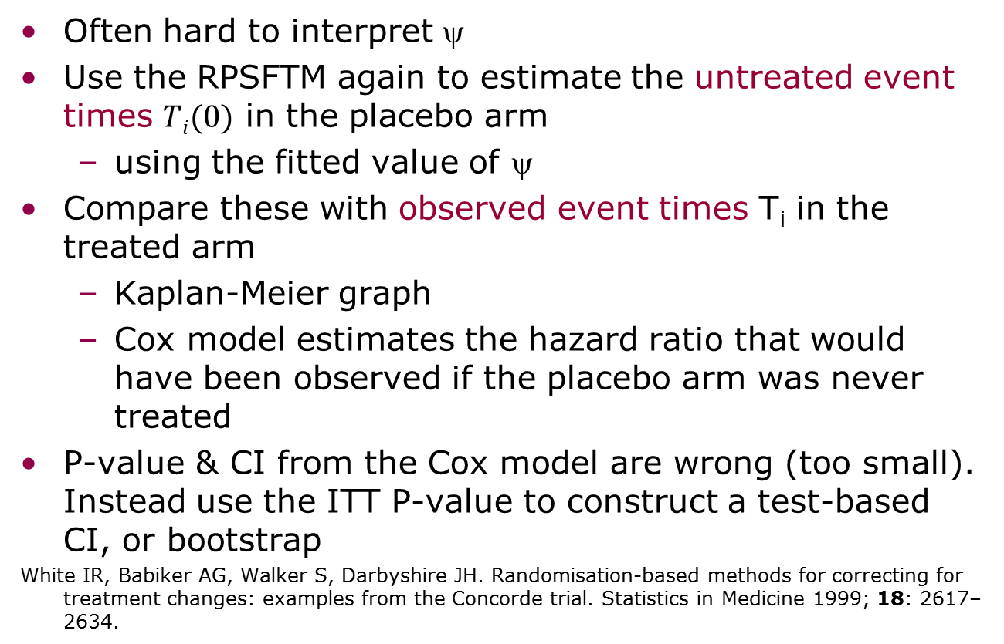
Estimating a causal hazard ratio
Often hard to interpret ψ
Use the RPSFTM again to estimate the untreated event times $Ti(0)$ in the placebo arm
  using the fitted value of ψ
Compare these with observed event times T_{i} in the treated arm
  Kaplan-Meier graph
  Cox model estimates the hazard ratio that would have been observed if the placebo arm was never treated
P-value & CI from the Cox model are wrong (too small). Instead use the ITT P-value to construct a test-based CI, or bootstrap
White IR, Babiker AG, Walker S, Darbyshire JH. Randomisation-based methods for correcting for treatment changes: examples from the Concorde trial. Statistics in Medicine 1999; 18: 2617–2634.
Notes:
Demetri abstract: http://annonc.oxfordjournals.org/content/19/suppl_8/viii266.full.pdf

Slide 21
Sunitinib overall survival again
Total deaths
176
90
with thanks to Xin Huang (Pfizer)

Slide 22
Sunitinib overall survival with RPSFTM
*Estimated by RPSFT model
**Empirical 95% CI obtained using bootstrap samples.
with thanks to Xin Huang (Pfizer)

Slide 23
Plan
Methods to adjust for treatment switching
  the rank-preserving structural nested failure time model (RPSFTM)
strbee (2002)
Improvements needed
  sensitivity analysis
  weighted log rank test
strbee2 (2014)

Slide 24
strbee: "randomisation-based efficacy estimator"
. l in 1/10, noo clean // Concorde-like data
id def imm xoyrs xo progyrs prog entry censyrs
1 0 1 0.00 0 3.00 0 0 3
2 1 0 2.65 1 3.00 0 0 3
3 0 1 0.00 0 1.74 1 0 3
4 0 1 0.00 0 2.17 1 0 3
5 1 0 2.12 1 2.88 1 0 3
6 1 0 0.56 1 3.00 0 0 3
7 1 0 2.19 0 2.19 1 0 3
8 0 1 0.00 0 0.92 1 0 3
9 0 1 0.00 0 3.00 0 0 3
10 0 1 0.00 0 3.00 0 0 3
. stset progyrs prog
. strbee imm, xo0(xoyrs xo) endstudy(censyrs)
time to switch in imm=0 arm
time to end of study (for re-censoring)
instrument (randomised group)

Slide 25
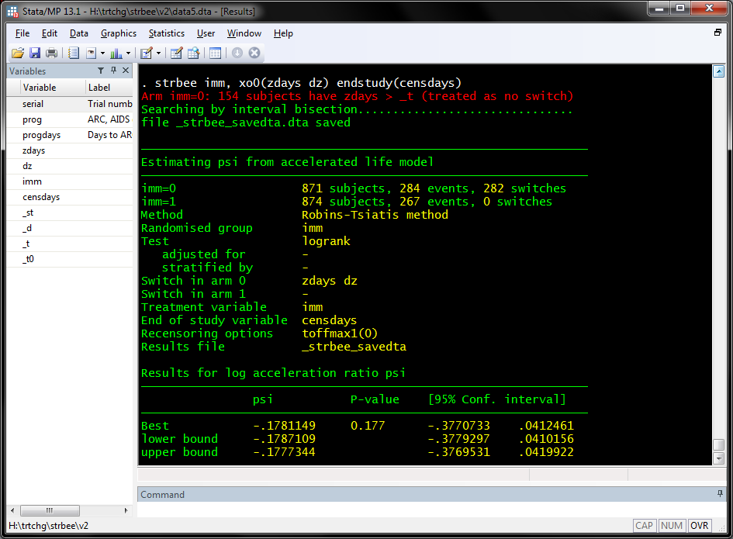
strbee in action
strbee results in Concorde data

Slide 26
Concorde: results as KM & hazard ratios
Kaplan-Meier survival estimates
1.00
0.75
0.50
HR (Imm vs. Def):
0.80 (0.58-1.11)
HR (Imm vs. Def):
0.89 (0.75-1.05)
0.25
0.00
0
500
1000
1500
analysis time
def observed
imm observed
def if untreated
Counterfactual for psi=-.1781149

Slide 27
Plan
Methods to adjust for treatment switching
  the rank-preserving structural nested failure time model (RPSFTM)
strbee (2002)
Improvements needed
  sensitivity analysis
  weighted log rank test
strbee2 (2014)

Slide 28
Improvements needed
A crucial assumption of the RPSFTM is that the effect of treatment is the same whether
  taken on progression in the placebo arm; or
  taken from randomisation in the experimental arm
  Want to do sensitivity analyses allowing (a) to be a defined fraction of (b)
Want to improve the power of the log rank test and the precision of the RPSFTM procedure
Want to allow for other treatments with known effect
These become easy with a change of data format …

Slide 29
Plan
Methods to adjust for treatment switching
  the rank-preserving structural nested failure time model (RPSFTM)
strbee (2002)
Improvements needed
  sensitivity analysis
  weighted log rank test
strbee2 (2014)

Slide 30
strbee formats
. * data in old format
. l if inlist(id,1,2,7), noo clean
id def imm xoyrs xo _st _d _t _t0
1 0 1 0.00 0 1 0 3.00 0.00
2 1 0 2.65 1 1 0 3.00 0.00
7 1 0 2.19 0 1 1 2.19 0.00
. * data in new format
. l if inlist(id,1,2,7), noo clean
id def imm _st _d _t _t0 treat
1 0 1 1 0 3.00 0.00 1
2 1 0 1 0 2.65 0.00 0
2 1 0 1 0 3.00 2.65 1
7 1 0 1 1 2.19 0.00 0
Notes:
use immdef, clear
stset progyrs prog
format xoyrs progyrs _t _t0 %6.2f
l id def imm xoyrs xo progyrs prog entry censyrs in 1/10, noo clean
l id def imm xoyrs xo progyrs prog _st _d _t _t0 if inlist(id,1,2,7), noo clean
use immdef2, clear
format progyrs _t _t0 %6.2f
l id def imm _st _d _t _t0 treat if inlist(id,1,2,7), sepby(id) noo clean

Slide 31
strbee syntax
Old syntax
  . strbee imm, xo0(xoyrs xo) endstudy(censyrs)
  New syntax (cf ivregress)
  . strbee2 (treat=imm), endstudy(censyrs)
  treat no longer needs to be 0/1
Can also adjust for baseline covariates
Screen shot next …

Slide 32
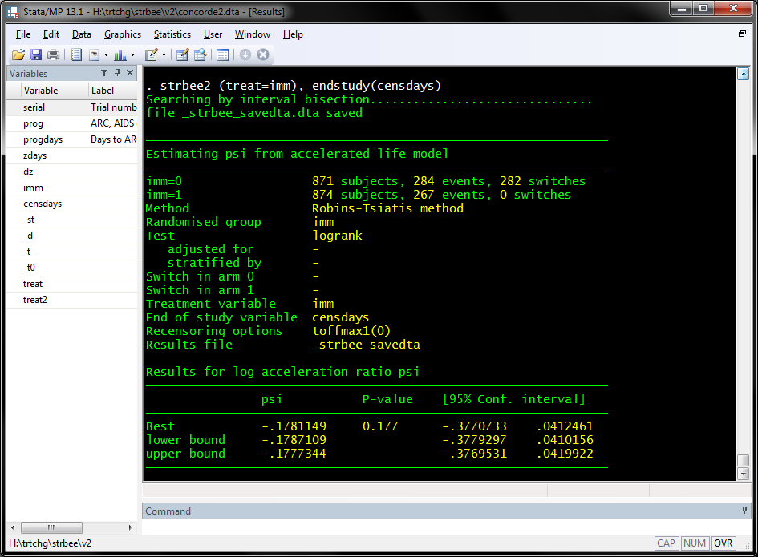
strbee2 results in Concorde data

Slide 33
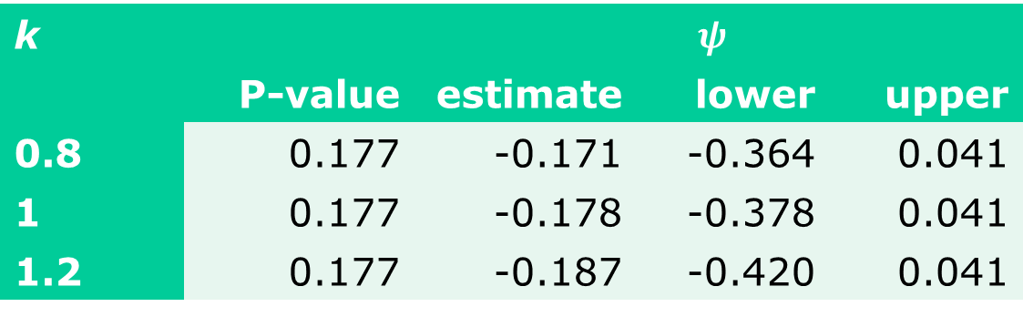

Improvement 1: sensitivity analyses
  Aim: to estimate $ψ$ in Concorde assuming
  treatment effect in Imm arm is $ψ$
  treatment effect in Def arm is $kψ$
  sensitivity parameter $k$ is assumed known
gen treat2 = treat * cond(imm,1,k)
strbee2 (treat2=imm), endstudy(censyrs)
k |  | $$ψ$$
 | P-value | estimate | lower | upper
0.8 | 0.177 | -0.171 | -0.364 | 0.041
1 | 0.177 | -0.178 | -0.378 | 0.041
1.2 | 0.177 | -0.187 | -0.420 | 0.041

Slide 34
Improvement 2: more powerful test
RPSFTM preserves the ITT P-value
Usually comes from the log rank test
Can we devise a better (more powerful) test, to be used both in the ITT and RPSFTM analyses?
Work with Jack Bowden and Shaun Seaman
Recall sunitinib: P=0.007, 0.107, 0.306 at 1, 2, 4 years.
Power is lost because the treatments received by the arms converge over time

Slide 35
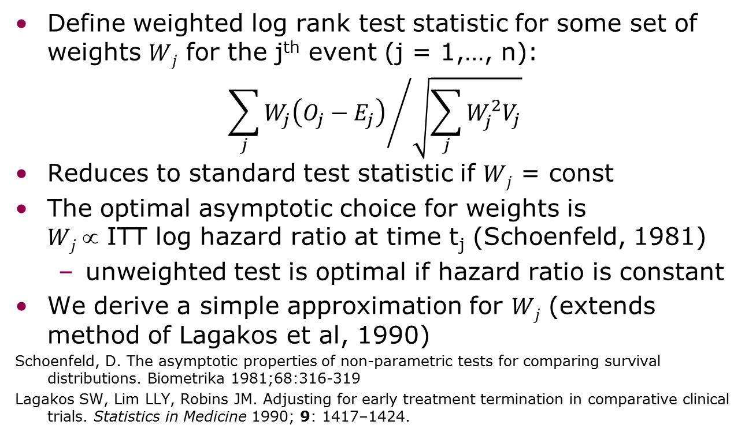
Weighted log rank test
Define weighted log rank test statistic for some set of weights $Wj$ for the j^{th} event (j = 1,…, n):
$${\sum_{j}{W_{j}\left(O_{j}−E_{j}\right)}}/{\sqrt{\sum_{j}{W_{j}^{2}V_{j}}}}$$
Reduces to standard test statistic if $Wj$ = const
The optimal asymptotic choice for weights is
$Wj $ ITT log hazard ratio at time t_{j} (Schoenfeld, 1981)
  unweighted test is optimal if hazard ratio is constant
We derive a simple approximation for $Wj$ (extends method of Lagakos et al, 1990)
Schoenfeld, D. The asymptotic properties of non-parametric tests for comparing survival distributions. Biometrika 1981;68:316-319
Lagakos SW, Lim LLY, Robins JM. Adjusting for early treatment termination in comparative clinical trials. Statistics in Medicine 1990; 9: 1417–1424.

Slide 36
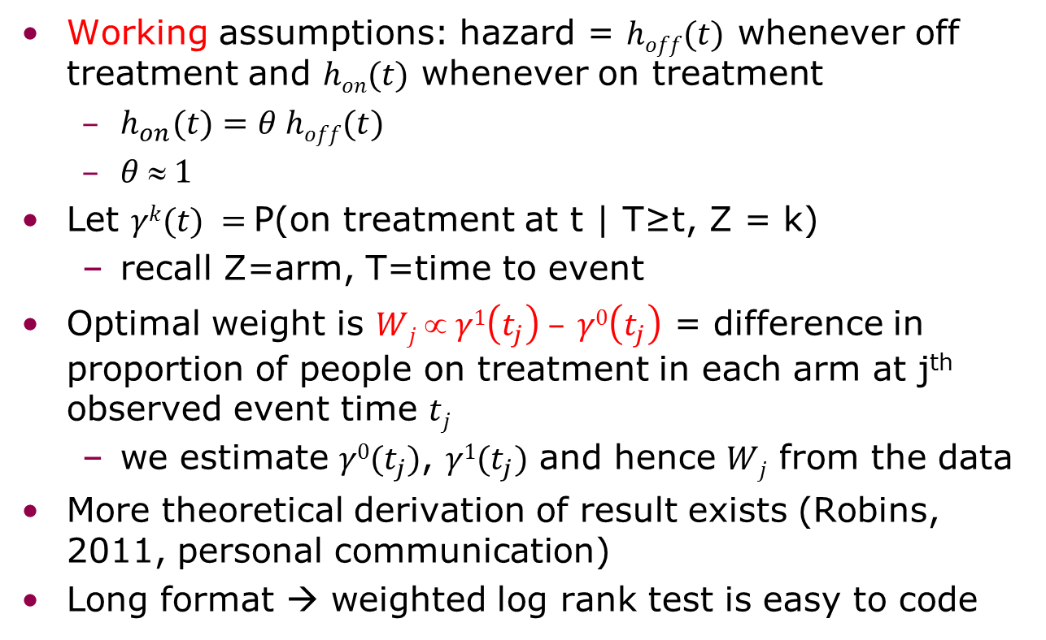
Simple approximation for optimal weights
Working assumptions: hazard = $hoff(t)$ whenever off treatment and $hon(t)$ whenever on treatment
  $h_{on}(t)=θ hoff(t)$
  $θ  1$
Let $γk(t) =$P(on treatment at t | T≥t, Z = k)
  recall Z=arm, T=time to event
Optimal weight is $Wj ∝ γ1\left(t_{j}\right) – γ0\left(t_{j}\right)$ = difference in proportion of people on treatment in each arm at j^{th} observed event time $tj$
  we estimate $γ0(t_{j})$, $γ1(t_{j})$ and hence $Wj$ from the data
More theoretical derivation of result exists (Robins, 2011, personal communication)
Long format → weighted log rank test is easy to code

Slide 37

strbee2 results in Concorde data with weighted log rank test

Slide 38

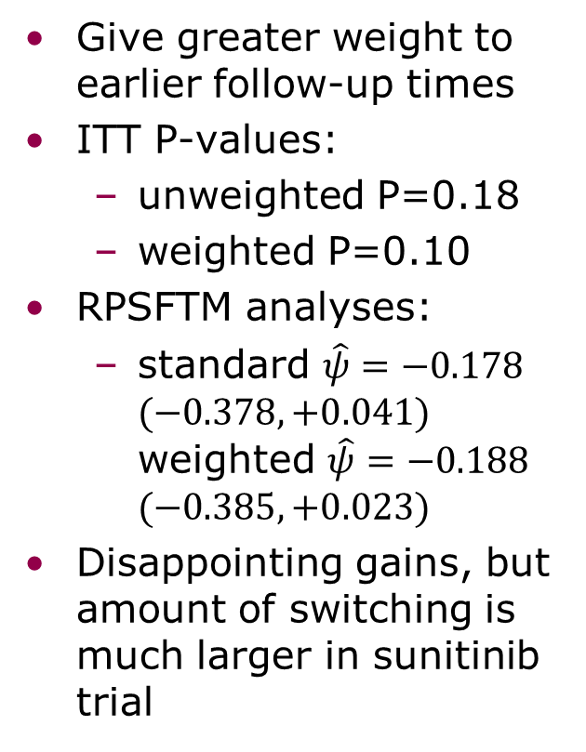


Concorde: weights and results
Give greater weight to earlier follow-up times
ITT P-values:
  unweighted P=0.18
  weighted P=0.10
RPSFTM analyses:
  standard $\hat{ψ}=−0.178$ $(−0.378,+0.041)$ weighted $\hat{ψ}=−0.188$ $(−0.385,+0.023)$
Disappointing gains, but amount of switching is much larger in sunitinib trial
$γ^{1}\left(t\right)=$ p(ZDV | imm, t)
weight = $γ^{1}\left(t\right)−γ^{0}(t)$
$γ^{0}\left(t\right)=$p(ZDV | def, t)

Slide 39
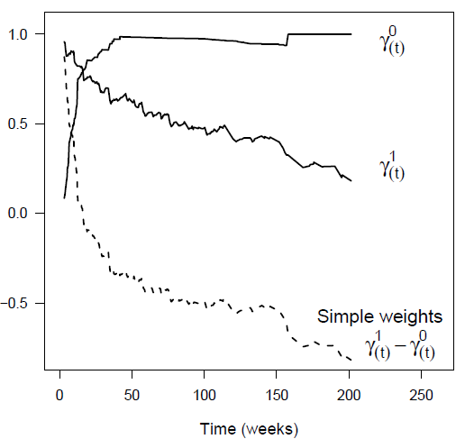
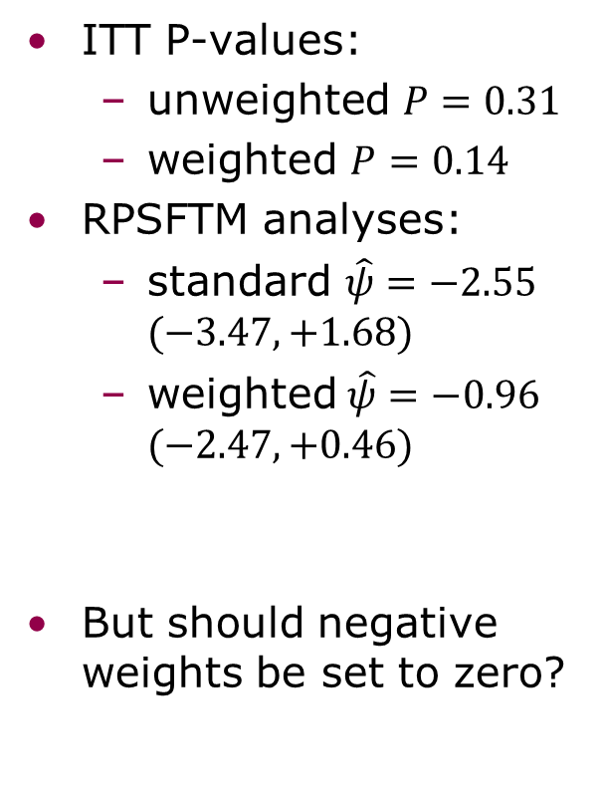
Sunitinib trial: weights and results
ITT P-values:
  unweighted $P=0.31$
  weighted $P=0.14$
RPSFTM analyses:
  standard $\hat{ψ}=−2.55$ $(−3.47, +1.68)$
  weighted$\hat{ψ}=−0.96$ $(−2.47, +0.46)$
But should negative weights be set to zero?

Slide 40
A small simulation study
Setting | Log rank method | ITT |  | RPSFTM
 |  | mean ψ | p(reject NH) | mean ψ | MSE
ψ=0 | unweighted | 0.000 | 0.04 | -0.071 | 0.232
 | weighted | -0.008 | 0.04 | -0.018 | 0.088
ψ=-0.693 | unweighted | -0.126 | 0.45 | -0.761 | 0.206
 | weighted | -0.435 | 0.70 | -0.725 | 0.078
Both methods preserve type I error when ψ=0
Both methods estimate ψ with small bias
Weighted log rank test is more powerful
and more accurate
Notes:
MC errors? Meaning of θ₂?

Slide 41
Summary
RPSFTM is increasingly used to tackle treatment switches in late-stage cancer trials
  e.g. advocated by NICE (National Institute for Health and Care Excellence)
strbee2 updates the Stata provision to
  handle sensitivity analyses
  to give more powerful tests
  allow for 3rd treatments with known effects (as offset - not yet done)
Work in progress

