Slide 1
A suite of Stata programs for network meta-analysis
UK Stata users’ Group
London, 13th September 2013
Ian White
MRC Biostatistics Unit, Cambridge, UK
Notes:
20 mins talk + 10 mins discussion
Abstract: Network meta-analysis involves synthesising the scientific literature comparing several treatments. Typically, two-arm and three-arm randomised trials are synthesised, and the aim is to compare treatments that have not been directly compared, and often to rank the treatments. A difficulty is that the network may be inconsistent, and ways to assess this are required.
In the past, network meta-analysis models have been fitted using Bayesian methods, typically in WinBUGS. I have recently shown how they may be expressed as multivariate meta-analysis models and hence fitted using mvmeta. However, various challenges remain, including getting the data set up in the correct format; parameterising the inconsistency model; and making good graphical displays of complex data and results. I will show how a new suite of Stata programs, network, meets these challenges, and I will illustrate its use with examples.

Slide 2
Plan
Ordinary (pairwise) meta-analysis
Multiple treatments: indirect comparisons, consistency, inconsistency
Network meta-analysis: models
Fitting network meta-analysis: WinBUGS and Stata
Data formats
network: its aims and scope; fitting models in different formats; graphical displays
My difficulties

Slide 3
Pairwise meta-analysis: data from randomised trials
study | dA | nA | dC | nC
1 | 9 | 140 | 23 | 140
6 | 75 | 731 | 363 | 714
7 | 2 | 106 | 9 | 205
8 | 58 | 549 | 237 | 1561
9 | 0.5 | 34 | 9.5 | 49
10 | 3 | 100 | 31 | 98
11 | 1 | 31 | 26 | 95
12 | 6 | 39 | 17 | 77
13 | 95 | 1107 | 134 | 1031
14 | 15 | 187 | 35 | 504
15 | 78 | 584 | 73 | 675
16 | 69 | 1177 | 54 | 888
17 | 64 | 642 | 107 | 761
18 | 5 | 62 | 8 | 90
19 | 20 | 234 | 34 | 237
Aim is to compare individual counselling (“C”) with no contact (“A”).
In arm A, C:
dA, dC = # who quit smoking
nA, nC = # randomised

Slide 4
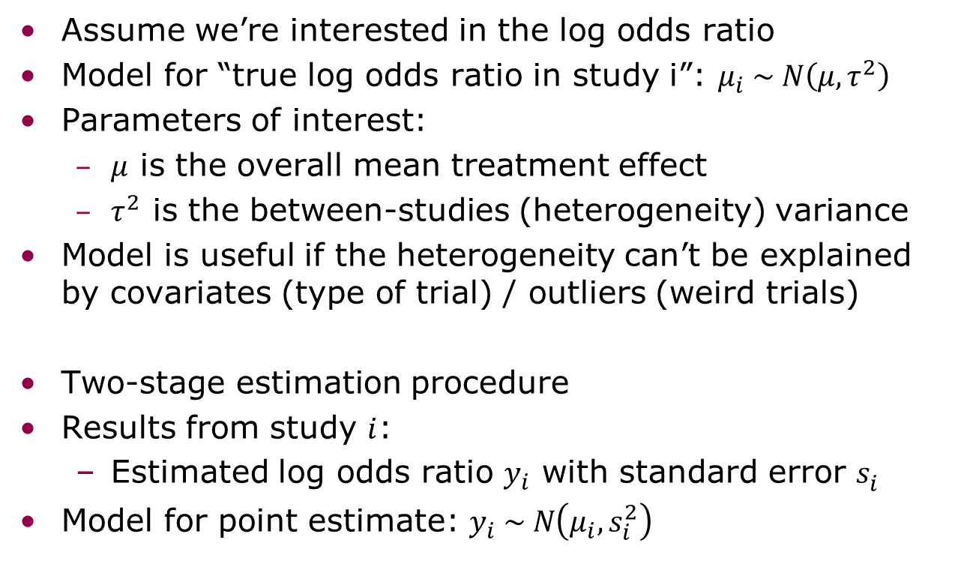
Pairwise meta-analysis: random-effects model
Assume we’re interested in the log odds ratio
Model for “true log odds ratio in study i”: $μ_{i} \sim N\left(μ,τ^{2}\right)$
Parameters of interest:
  $μ$ is the overall mean treatment effect
  $τ^{2}$ is the between-studies (heterogeneity) variance
Model is useful if the heterogeneity can’t be explained by covariates (type of trial) / outliers (weird trials)
Two-stage estimation procedure
Results from study $i$:
  Estimated log odds ratio $y_{i}$ with standard error $s_{i}^{}$
Model for point estimate: $y_{i} \sim N\left(μ_{i},s_{i}^{2}\right)$

Slide 5
Pairwise meta-analysis: forest plot (metan)
Study-specific results: here the odds ratio for quitting smoking with intervention C (individual counselling) vs. A (no contact)
The random-effects analysis gives a pooled estimate allowing for heterogeneity.

Slide 6
But actually the data are more complicated …
study | dA | nA | dB | nB | dC | nC | dD | nD
1 | 9 | 140 |  |  | 23 | 140 | 10 | 138
2 |  |  | 11 | 78 | 12 | 85 | 29 | 170
3 | 79 | 702 | 77 | 694
4 | 18 | 671 | 21 | 535
5 | 8 | 116 | 19 | 146
6 | 75 | 731 |  |  | 363 | 714
7 | 2 | 106 |  |  | 9 | 205
8 | 58 | 549 |  |  | 237 | 1561
9 | 0 | 33 |  |  | 9 | 48
10 | 3 | 100 |  |  | 31 | 98
11 | 1 | 31 |  |  | 26 | 95
12 | 6 | 39 |  |  | 17 | 77
13 | 95 | 1107 |  |  | 134 | 1031
14 | 15 | 187 |  |  | 35 | 504
15 | 78 | 584 |  |  | 73 | 675
16 | 69 | 1177 |  |  | 54 | 888
17 | 64 | 642 |  |  | 107 | 761
18 | 5 | 62 |  |  | 8 | 90
19 | 20 | 234 |  |  | 34 | 237
20 | 0 | 20 |  |  |  |  | 9 | 20
21 |  |  | 20 | 49 | 16 | 43
22 |  |  | 7 | 66 |  |  | 32 | 127
23 |  |  |  |  | 12 | 76 | 20 | 74
24 |  |  |  |  | 9 | 55 | 3 | 26
Trials compared 4 different interventions to help smokers quit:
A="No contact"
B="Self help"
C="Individual counselling"
D="Group counselling"

Slide 7
Indirect comparisons
We have trials of different designs:
  A vs B
  A vs C
  A vs D
  B vs C
  B vs D
  C vs D
  A vs C vs D
  B vs C vs D
  We can use indirect evidence: e.g. combining A vs B trials with B vs C trials gives us more evidence about A vs C (we call the A vs C and A vs C vs D trials “direct evidence”)

Slide 8
Network meta-analysis
  If we want to make best use of the evidence, we need to analyse all the evidence jointly
  May enable us to identify the best treatment
  A potential problem is inconsistency: what if the indirect evidence disagrees with the direct evidence?
  The main statistical challenges are:
  formulating and fitting models that allow for heterogeneity and inconsistency
  assessing inconsistency and (if found) finding ways to handle it
Less-statistical challenges include
  defining the scope of the problem (which treatments to include, what patient groups, what outcomes)

Slide 9
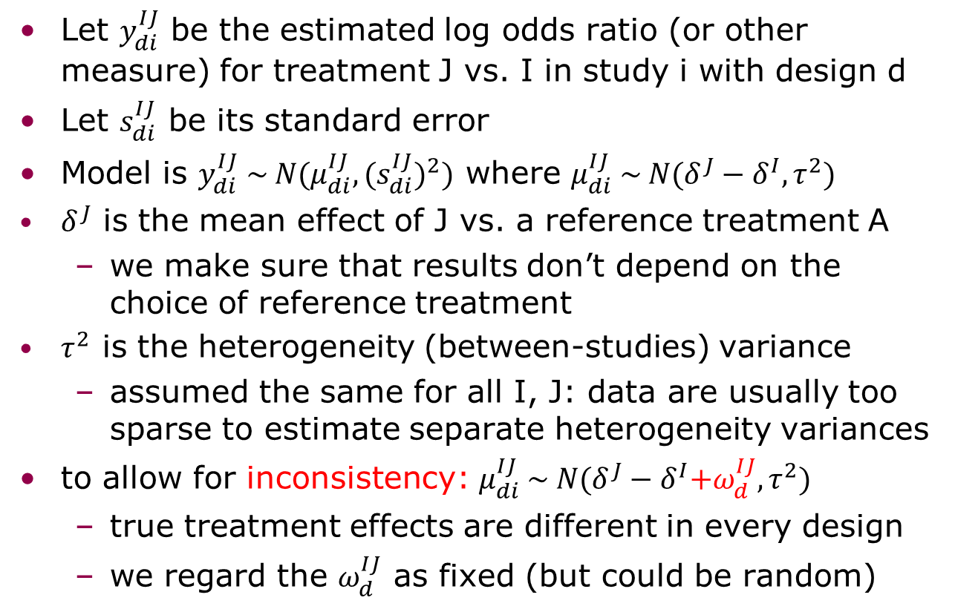
Network meta-analysis: the standard model, assuming consistency
Let $y_{di}^{IJ}$ be the estimated log odds ratio (or other measure) for treatment J vs. I in study i with design d
Let $s_{di}^{IJ}$ be its standard error
Model is $y_{di}^{IJ} \sim N(μ_{di}^{IJ},{{(s}_{di}^{IJ})}^{2})$ where $μ_{di}^{IJ} \sim N(δ^{J}−δ^{I},τ^{2})$
$δ^{J}$ is the mean effect of J vs. a reference treatment A
  we make sure that results don’t depend on the choice of reference treatment
$τ^{2}$ is the heterogeneity (between-studies) variance
  assumed the same for all I, J: data are usually too sparse to estimate separate heterogeneity variances
to allow for inconsistency: $μ_{di}^{IJ} \sim N(δ^{J}−δ^{I}{+ω}_{d}^{IJ},τ^{2})$
  true treatment effects are different in every design
  we regard the $ω_{d}^{IJ}$ as fixed (but could be random)

Slide 10
Network meta-analysis: multi-arm trials
Multi-arm trials contribute >1 log odds ratio
  need to allow for their covariance
  mathematically straightforward but complicates programming
With only 2-arm trials, we can fit models using standard meta-regression (Stata metareg)
Multi-arm trials complicate this – need suitable data formats and multivariate analysis

Slide 11
Data format 1: Standard
Study | Contrast 1 | Contrast 2 | y1 | y2 | var(y1) | var(y2) | cov(y1,y2)
1 | C - A | D - A | 1.051 | 0.129 | 0.171 | 0.119 | 0.227
2 | C - B | D - B | 0.001 | 0.225 | 0.203 | 0.106 | 0.147
3 | B - A | . | -0.016 | . | 0.029 | . | .
4 | B - A | . | 0.394 | . | 0.107 | . | .
5 | B - A | . | 0.703 | . | 0.195 | . | .
6 | C - A | . | 2.202 | . | 0.020 | . | .
different reference treatments in different designs
y1 (log OR for contrast 1) has different meanings in different designs
need to (meta-)regress it on treatment covariates: e.g. (xB, xC, xD) = (0,1,0) for y1 in study 1, (0,0,1) for y2 in study 1, (-1,1,0) for y1 in study 2, etc.

Slide 12
Data format 2: Augmented
study | design | yB | yC | yD | SBB | SBC | SBD | SCC | SCD | SDD
1 | ACD | . | 1.051 | 0.129 | . | . | . | 0.171 | 0.119 | 0.227
3 | AB | -0.016 | . | . | 0.029 | . | . | . | . | .
4 | AB | 0.394 | . | . | 0.107 | . | . | . | . | .
5 | AB | 0.703 | . | . | 0.195 | . | . | . | . | .
6 | AC | . | 2.202 | . | . | . | . | 0.020 | . | .
same reference treatment (A) in all designs
simplifies modelling: just need the means of yB, yC, yD
problems arise for studies with no arm A: I “augment” by giving them a very small amount of data in arm A:
study | design | yB | yC | yD | SBB | SBC | SBD | SCC | SCD | SDD
2 | BCD | 0 | 0.001 | 0.225 | 3000.00 | 3000.00 | 3000.00 | 3000.20 | 3000.11 | 3000.15
21 | BC | 0 | -0.152 | . | 3000.00 | 3000.00 | . | 3000.18 | . | .
22 | BD | 0 | . | 1.043 | 3000.00 | . | 3000.00 | . | . | 3000.20
23 | CD | . | 0 | 0.681 | . | . | . | 3000.00 | 3000.00 | 3000.17
24 | CD | . | 0 | -0.405 | . | . | . | 3000.00 | 3000.00 | 3000.51

Slide 13
Fitting network meta-analyses
In the past, the models have been fitted using WinBUGS
  because frequentist alternatives have not been available
  has made network meta-analysis inaccessible to non-statisticians
Now, consistency and inconsistency models can be fitted for both data formats using multivariate meta-analysis or multivariate meta-regression
  using my mvmeta
Parameterising the consistency model for “augmented” format is easy
Allowing for inconsistency and “standard” format is trickier …

Slide 14
Aims of the network suite
Automatically convert network data to the correct format for multivariate meta-analysis
Automatically set up mvmeta models for consistency and inconsistency, and run them
Provide graphical displays to aid understanding of data and results
Handle both standard and augmented formats, and convert between them, in order to demonstrate their equivalence
Interface with other Stata software for network meta-analysis

Slide 15
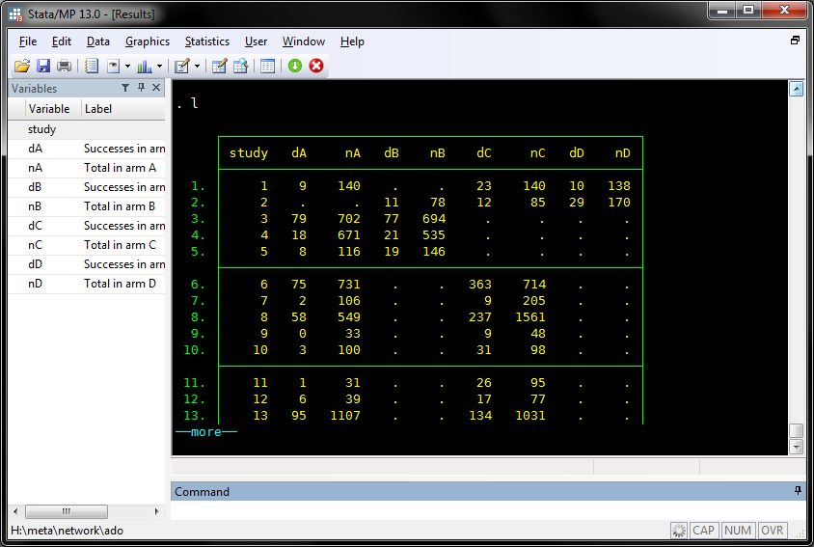
Initial data
Notes:
cd H:\meta\network\ado
use H:\meta\network\examples\smoking, clear
keep study treat d n
reshape wide d n, i(study) j(treat) string
foreach trt in A B C D {
label var d`trt' "Successes in arm `trt'"
label var n`trt' "Total in arm `trt'"
}
save H:\meta\network\examples\smokingwide, replace
network setup d n, studyvar(study)
network meta, c
network meta, i
network forest, name(smoke_forest, replace) msize(*0.2) ///
title(Smoking network) xsize(9.8) ysize(7.3)

Slide 16
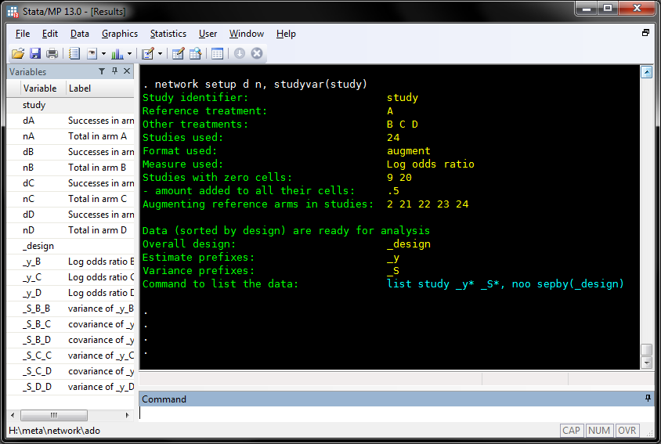
Set up data in correct format

Slide 17
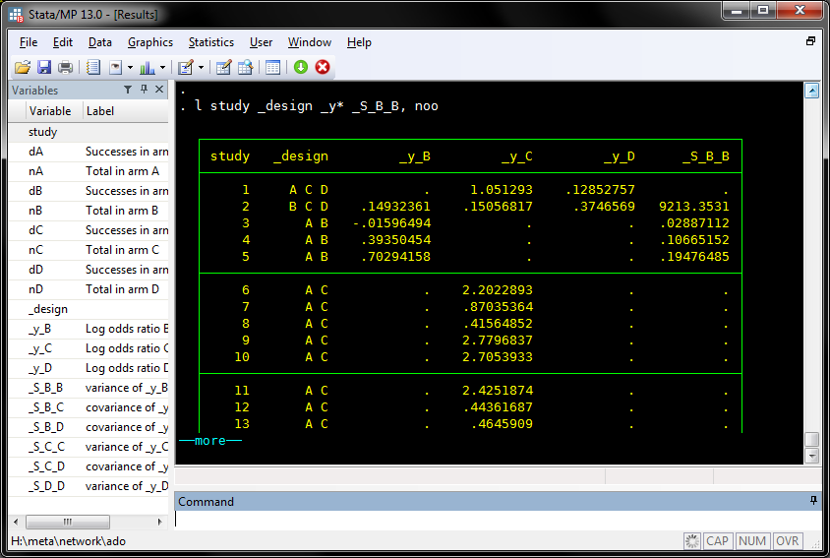
Notes:
l study _design _y* _S_B_B, noo

Slide 18
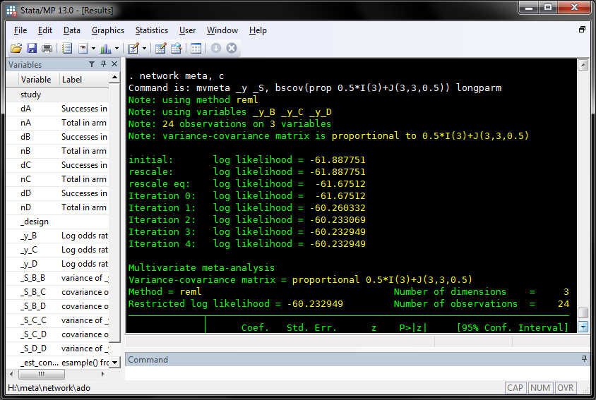
Fit consistency model (1)

Slide 19
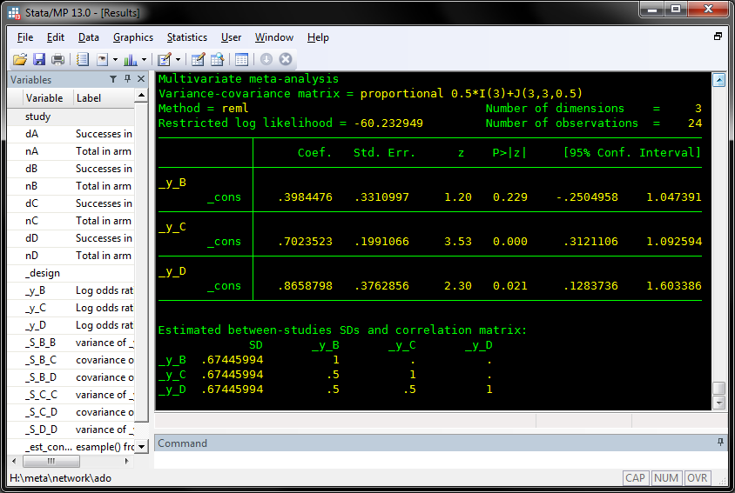
Fit consistency model (2)
estimated treatment effects vs. A
estimated heterogeneity SD (τ)

Slide 20
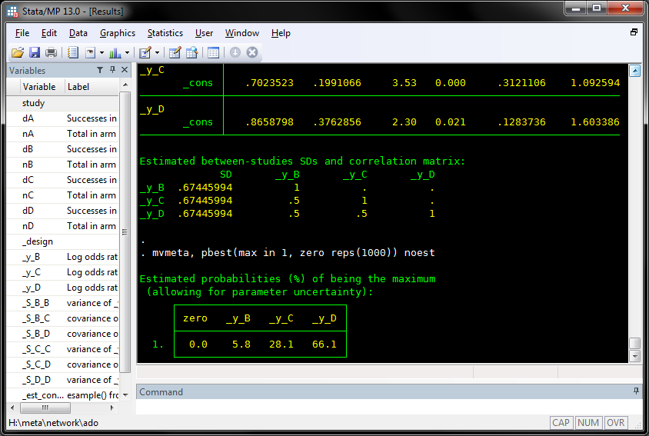
Which treatment is best?
66% chance that D is the best (approx Bayes)

Slide 21
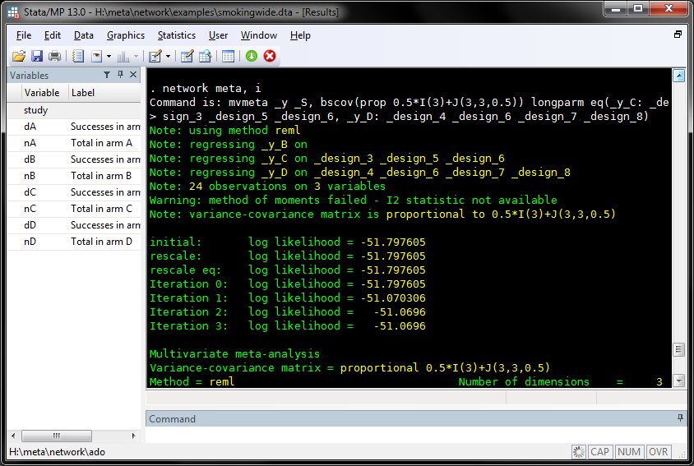
Fit inconsistency model (1)

Slide 22
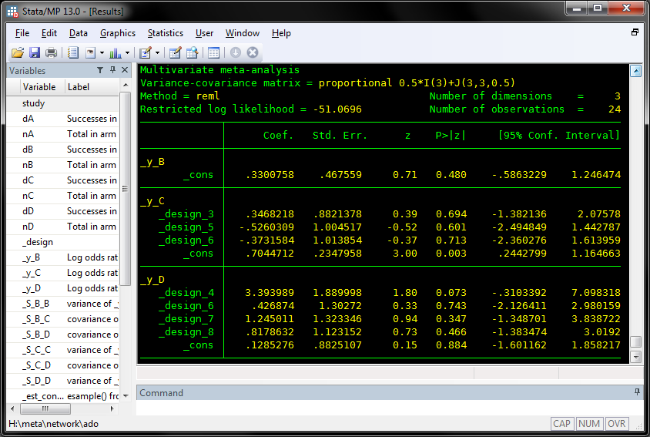
Fit inconsistency model (2)

Slide 23
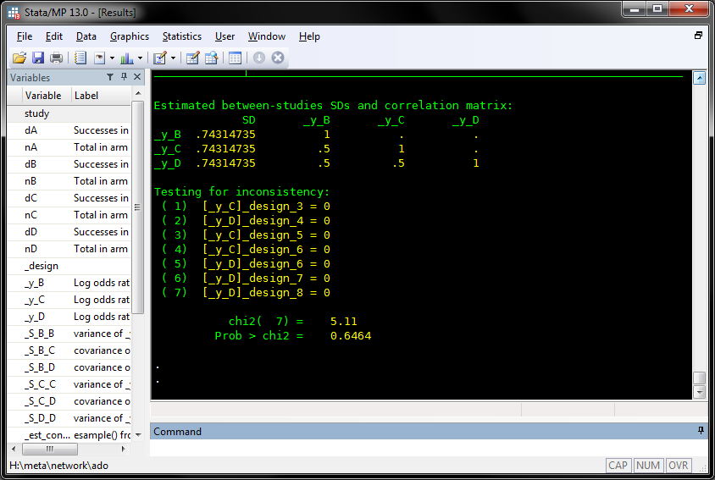
- including a test for inconsistency
no evidence of inconsistency

Slide 24
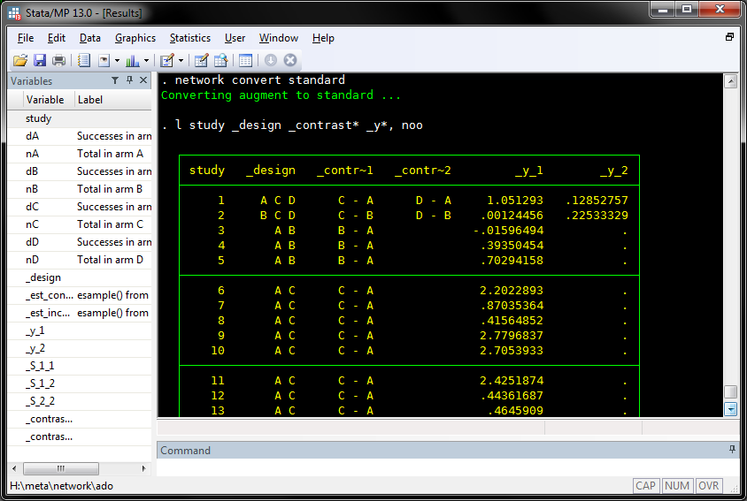
Now in standard format …
Notes:
network convert standard
l study _design _contrast* _y*, noo

Slide 25
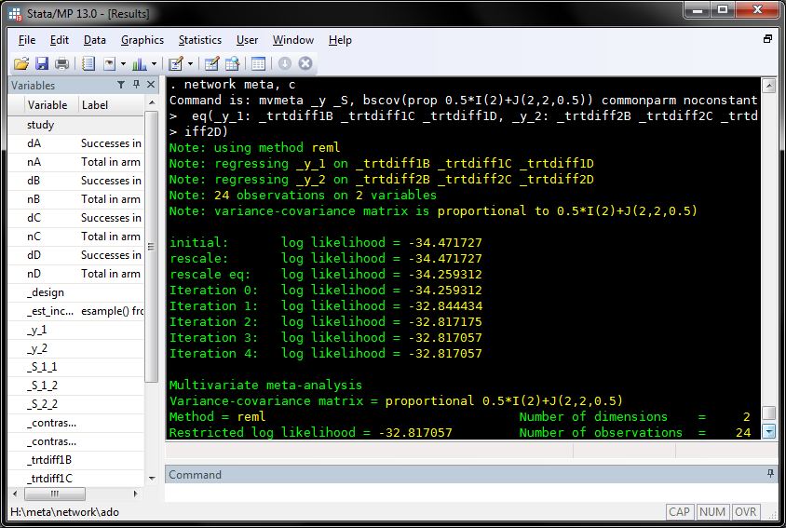

Slide 26
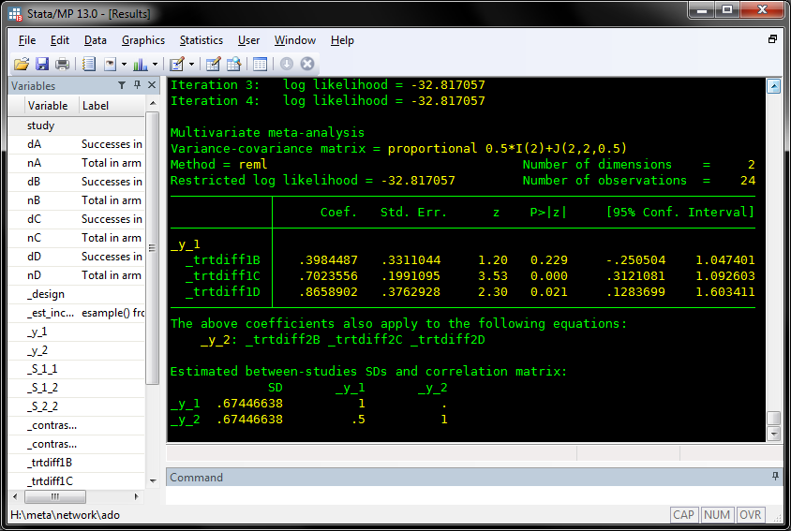
estimated treatment effects vs. A
estimated heterogeneity SD (τ)

Slide 27
Graphics
can convert to “pairs” format (one record per contrast per study) and access the routines by Anna Chaimani & Georgia Salanti (http://www.mtm.uoi.gr/STATA.html)
e.g. networkplot graphs the network showing which treatments and contrasts are represented in more trials
Next: my extension of the standard forest plot …

Slide 28
Notes:
use H:\meta\network\examples\smoking, clear
keep study treat d n
network setup d n, studyvar(stud) trtvar(treat) augment(0.0001) format(aug)
network meta, c
network meta, i
network forest, name(smoke_forest, replace) msize(*0.2) ///
title(Smoking network) xsize(9.8) ysize(7.3)

Slide 29
Another data set: 8 thrombolytics for treating acute myocardial infarction

Slide 30
Notes:
use H:\meta\network\examples\thrombolytics, clear
drop treat2
network setup r n, studyvar(study) trtvar(treat)
network meta, c
network meta, i
network forest, name(throm_forest, replace) msize(*0.2) ///
title(Thrombolytics network) xsize(9.8) ysize(7.3)

Slide 31
A difficulty
In network forest: I need to make the symbol sizes proportional to 1/se²
(using [aweight=1/se^2])
  across all panels
  across all plots (i.e. the different colours)
This doesn’t happen automatically
  I think scatter makes the largest symbol in each panel the same size
I’m still not sure I have got it right …

Slide 32
Difficulty in scaling symbols (continued)
clear
input x y size group
1 1 10 1
2 2 100 1
1 1 100 2
2 2 1000 2
end
scatter y x [aw=size], ///
by(group) ms(square) ///
xscale(range(0.5 2.5)) ///
yscale(range(0.5 2.5))
Sizes don’t scale correctly across by-groups.

Slide 33
Difficulty in scaling symbols (continued)
clear
input x y ysize z zsize
1 1 10 2 50
2 2 100 1 500
end
twoway (scatter y x [aw=ysize], ms(square)) (scatter z x [aw=zsize], ms(square)), xscale(range(0.5 2.5)) yscale(range(0.5 2.5)) xsize(4) ysize(4)
Sizes don’t scale correctly across variables.

Slide 34
Future work (1)
SK + tPA
Ten
Better automated “network plot”?
SK
AtPA
Ret
UK
tPA
ASPAC
Single study (three arms)
Single study (two arms)
Multiple studies (two arms)

Slide 35
Future work (2)
Release to users
Allow more complex variance structures for the heterogeneity terms
Random inconsistency model
Thanks to Julian Higgins, Dan Jackson and Jessica Barrett who worked with me on this.
Key references:
Lu G, Ades AE. Assessing evidence inconsistency in mixed treatment comparisons. Journal of the American Statistical Association 2006; 101: 447–459.
White IR, Barrett JK, Jackson D, Higgins JPT. Consistency and inconsistency in network meta-analysis: model estimation using multivariate meta-regression. Research Synthesis Methods 2012; 3: 111–125.

Slide 36
Underlying code for forest plot
graph twoway
(rspike low upp row if type=="study", horizontal lcol(blue))
(scatter row diff if type=="study" [aw=1/se^2], mcol(blue) msymbol(S))
(rspike low upp row if type=="inco", horizontal lcol(green))
(scatter row diff if type=="inco" [aw=1/se^2], mcol(green) msymbol(S))
(rspike low upp row if type=="cons", horizontal lcol(red))
(scatter row diff if type=="cons" [aw=1/se^2], mcol(red) msymbol(S))
(scatter row zero, mlabel(label2) mlabpos(0) ms(none) mlabcol(black))
,
ylabel(#44, valuelabel angle(0) labsize(vsmall) nogrid )
yscale(reverse)
plotregion(margin(t=0))
ytitle("")
subtitle("")
by(column, row(1) yrescale noiytick
note(`"Test of consistency: chi2=5.11, df=7, P=0.646"', size(vsmall)))
legend(order(1 3 5) label(1 "Studies") label(3 "Pooled within design")
label(5 "Pooled overall") row(1) size(small))
xlabel(,labsize(small))
xtitle(,size(small))
xtitle(Log odds ratio)
;

