Slide 1

Multiple Imputation of missing data in longitudinal health records
Irene Petersen and Cathy Welch
Primary Care & Population Health

Slide 2
Today
Issues with missing data and multiple imputation of longitudinal records
Twofold algorithm

Slide 3
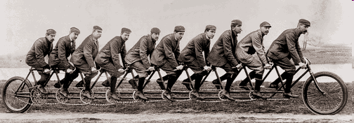
Funding and Acknowledgement
James Carpenter
Jonathan Bartlett
Sarah Hardoon
Louise Marston
Richard Morris
Irwin Nazareth
Kate Walters
Ian White
Funded by Medical Research Council (MRC), UK

Slide 4
The Health Improvement Network (THIN)
One of the UK’s largest primary care databases
Anonymised records 11 million patients in over 550 practices, broadly representative for UK population
Dynamic and variable
length of records (individuals
come and go at different time)

Slide 5

Missing data in primary care records
Health indicators
Blood pressure
Weight
Height
Smoking
Alcohol
Cholesterol

Slide 6
How much data is missing 1 year after registration?
488 384 patients registered with General Practitioner (GP) in 2004-06
Missing data
  Smoking 22%
  Blood pressure 30%
  Weight 34%
  Alcohol 37%
  Height 38%
Marston et al. Pharmacoepidemiology and drug safety 2010; 19: 618e–626

Slide 7
Recording of weight in diabetics and non-diabetics

Slide 8
Recording of weight by age and gender

Slide 9
Longitudinal health data
ID | Variable | 2000 | 2001 | 2002 | 2003
A | Smoking | Yes | Yes | Yes
A | Weight | 75
A | Height |  | 170
A | SBP | 120
A | D |  | 1
B | Smoking | No | No | Yes | No
B | Weight | 61 |  | 58
B | Height |  | 160
B | SBP | 140 |  | 155 | 120
B | D
C | Smoking |  |  | No
C | Weight |  | 85 | 90
C | Height
C | SBP |  | 140
C | D |  |  | 1

Slide 10
Cohort study
Is disease x is associated with y?
Longitudinal data
  Define baseline (year)
Simple study - just interested in the effect of x at baseline
Account for potential confounders (also at baseline)
Time-to-event model

Slide 11
Cohort study
Baseline
How should we deal with the missing data?

Slide 12
  Complete case analysis
  Exclude variables with incomplete records
  Create missing data category
  Use any info available (before and after baseline)
  Multiple Imputation ☺

Slide 13
Different options…
MI just at baseline
MI model with several time blocks
Do something else…

Slide 14
MI just at baseline
Many individuals don’t have information in that year, but may have info in later or earlier year
Loose information ☹

Slide 15
Cohort study
Calendar Time
2000 2001 2002 2003 2004 2005 2006 2007 2008

Slide 16
Multiple Imputation including a variable for each time point
Instead of using just data from baseline we could include a variable from each time point in MI
mi impute chained (reg) sbp2000-sbp2011 height2000-height2011 weight2001-weight2011 (logit) smok2001-smok2011 = age2001-age2011 d na, chaindots add(40)
Would this work?

Slide 17
Yes, sometimes it does
But….

Slide 18
Multiple Imputation including variables for each time points
Many time points -> dataset becomes very large (wide)
Co-lineariaty, perfect predictions and overfitting, regression may break down ☹
A priori, give equal weight to all time points
  do not exploit that data may be temporally ordered

Slide 19
Do something else – Two-fold FCS Multiple Imputation
Mix between option 1 and option 2

Slide 20
Longitudinal multiple imputation – Twofold FCS algorithm
Impute data at a given time block
Use information available +/- one time block
Move on to next time block
Repeat procedure x times
Within-time iteration
Among-time iteration
Nevalainen J, Kenward MG, Virtanen SM. Stat Med 2009; 28(29):3657-3669.

Slide 21
Break the data into smaller (time) blocks (t)
Calendar time or time since registration or time since date of birth
Select width of time blocks
  Year, month, data collection points….or
Here we use calendar time and years as width of our blocks

Slide 22
Cohort study
Calendar Time
2000 2001 2002 2003 2004 2005 2006 2007 2008
t – 1 t t + 1

Slide 23
Cohort study
Calendar Time
2000 2001 2002 2003 2004 2005 2006 2007 2008
t – 1 t t + 1
Within time imputation

Slide 24
Cohort study
Calendar Time
2000 2001 2002 2003 2004 2005 2006 2007 2008 2009

Slide 25
Cohort study
Calendar Time
2000 2001 2002 2003 2004 2005 2006 2007 2008 2009

Slide 26
Cohort study
Calendar Time
2000 2001 2002 2003 2004 2005 2006 2007 2008 2009
End of first Among time iteration

Slide 27
twofold command
twofold, timein(varname) timeout(varname)
[ clear saving(string) depmis(varlist) indmis(varlist) base(varname) indobs(varlist) depobs(varlist) outcome(varlist) cat(varlist) m(#) ba(#) bw(#) width(#) table keepoutside trace(varlist) im condvar(varlist) conditionon(varlist) condval(string) ]

Slide 28
Cohort study
Calendar Time
2000 2001 2002 2003 2004 2005 2006 2007 2008

Slide 29
Implementation details
Time-independent variables with missing values
Data is in wide form so each subject has one observation and separate variables for measurements at each time point
All subjects in the dataset are imputed
twofold uses mi impute suite
Use mi estimate to combine estimates using Rubin`s rules

Slide 30
Issues when using twofold in practice
Number of imputations
Number of among-time and within-time iterations
Window width

Slide 31
Example
0.852
0.960
Fit survival model to predict risk of coronary heart disease conditional on age, height and weight and systolic blood pressure measured in a baseline year (2000)
Systolic blood pressure has missing values

Slide 32
Example
New variables
  firstyear - Calendar year the patient entered the study
  lastyear - Calendar year the patient exited the study
Command
  twofold, timein(firstyear) timeout(lastyear) clear depmis(sys) indobs(age height) outcome(chd chdtime) depobs(weight) cat(age chd) m(5) ba(20) bw(5)

Slide 33
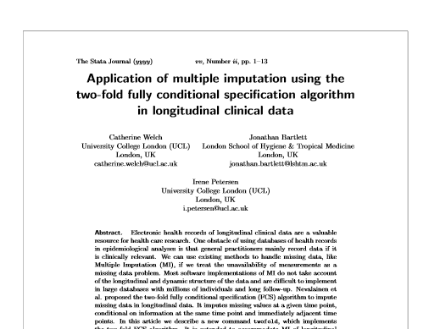
Two-fold FCS algorithm implemented in Stata
http://www.ucl.ac.uk/pcph/research-groups-themes/thin-pub/missing_data

Slide 34
Strength of the Twofold FCS algorithm
Handle categorical variables on a longitudinal scale (reduced risk of co-linearity, perfect prediction)
Large data sets
More weight on observations near each other (in time) – other observations are independent
Correlation structure over time is preserved (provided measurements outside time window are conditional independent)
Missing At Random (MAR) assumption more plausible with repeated measurements

Slide 35
Implications for research
Twofold provides better use of the information available in longitudinal datasets
Simulation studies suggest two-fold FCS algorithm increase the precision of the estimates ~ double the sample size in some situations
New opportunities for research!
  Time dependent covariates

Slide 36
Other MI options
May be feasible in some situations:
Small amount of missing data at baseline
If correlations between variables are stronger than within variables
  Blood pressure stronger correlated to weight than future and past blood pressure measurements?
If you only have a few data points e.g. 3 time points

Slide 37
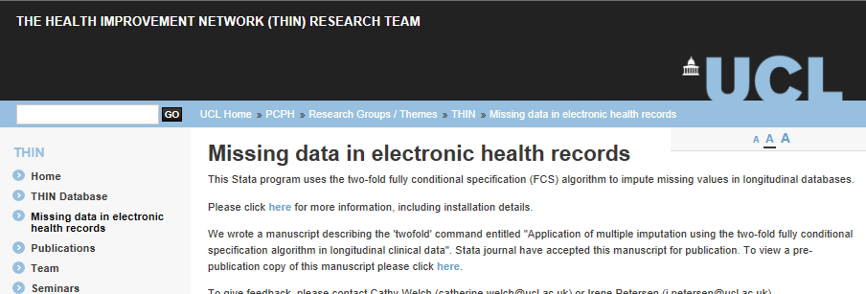
Want to know more
Short course on missing data 14 -15 November 2013, UCL London
Stata programme twofold available from the SSC Archive
http://www.ucl.ac.uk/pcph/research-groups-themes/thin-pub/missing_data

Slide 38
Further information:
http://missingdata.lshtm.ac.uk/
http://www.ucl.ac.uk/pcph/research-groups-themes/thin-pub/missing_data
i.petersen@ucl.ac.uk
Marston, L. et al. Issues in multiple imputation of missing data for large general practice clinical databases. Pharmacoepidemiol Drug Saf. 2010 Jun;19(6):618-26.
D B Rubin. Inference and missing data. Biometrika, 63:581–592, 1976.
Nevalainen J. et al. Missing Values in Longitudinal Dietary Data: a Multiple Imputation Approach Based on a Fully Conditional Specification. Stat. Med. 2009 28 3657-69.
Sterne et al. Multiple imputation for missing data in epidemiological and clinical research: potential and pitfalls BMJ 2009 339, b2393
van Buuren, S. Multiple imputation of discrete and continuous data by fully conditional specification. Statistical Methods in Medical Research, 16:219–242, 2007
Carpenter and Kenward Multiple Imputation and its Application 2013

