Slide 1

Producing animated graphs from Stata without having to learn any other software
Robert Grant
Senior Research Fellow
St George’s, University of London
& Kingston University

Slide 2
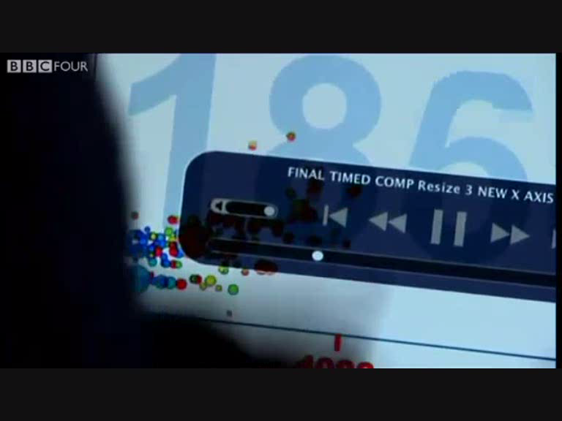
The objective
I have seen some cool graphs made into videos like Hans Rosling’s 200 Countries
and I thought “I want to do that!”

Slide 3
The objective
I analyse data all day long
    I am (if I say so myself) pretty good using stats software
    but I know nothing about video software
    and in fact I don't have the time/money/energy to learn

Slide 4
The objective
I analyse data all day long
    I am (if I say so myself) pretty good using stats software
    but I know nothing about video software
    and in fact I don't have the time/money/energy to learn
I want to make animations from inside Stata
I want the process to be simple but totally flexible so I am not restricted in the look of my animations and the effects I can build into them.

Slide 5
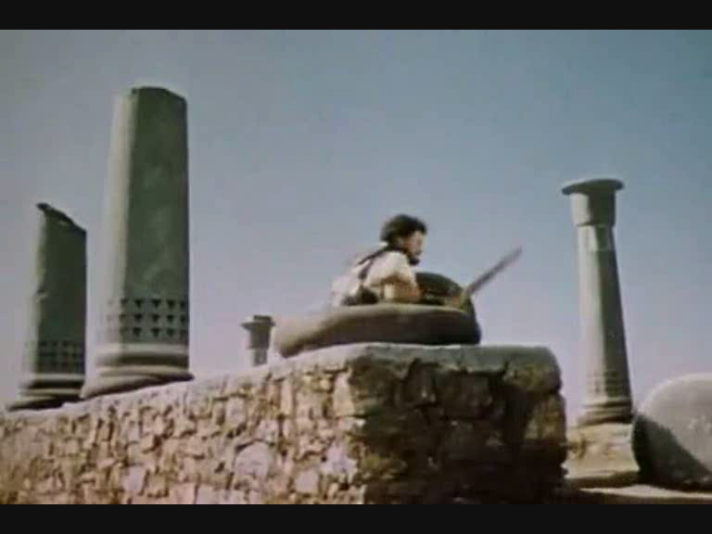
Stop frame animation
Movies are made up of a series of still images
If you can control the images, you can make anything happen
You already know how to control Stata graphs

Slide 6

Stop frame animation
For Ray Harryhausen or Nick Park and their talented animators, this was (and still is) very hard work
But you have Stata programming at your disposal to make lots of images quickly

Slide 7
The basic do-file
Set up macros with the graph options
Loop over the number of frames
    Advance / interpolate the data one step
    Draw the graph
    Export the graph
Use -winexec- to call the free open source software FFMPEG and make the images into a video file
    FFMPEG runs “behind the scenes” (no GUI)

Slide 8
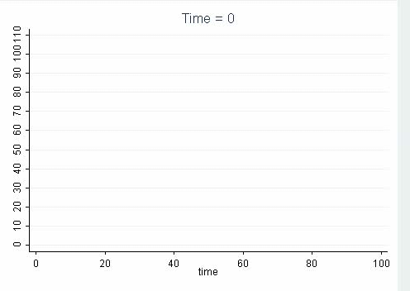
Example 1:
Line filling from left to right

Slide 9
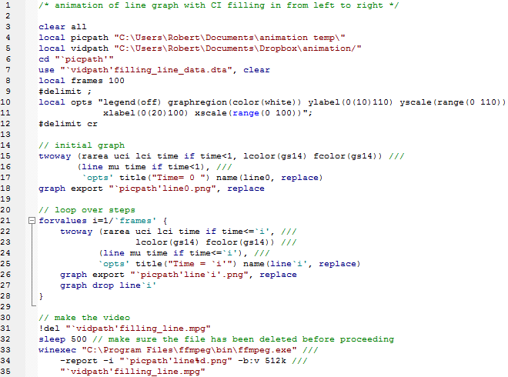
Example 1:
Line filling from left to right

Slide 10
Example 2:
Line scrolling from left to right

Slide 11
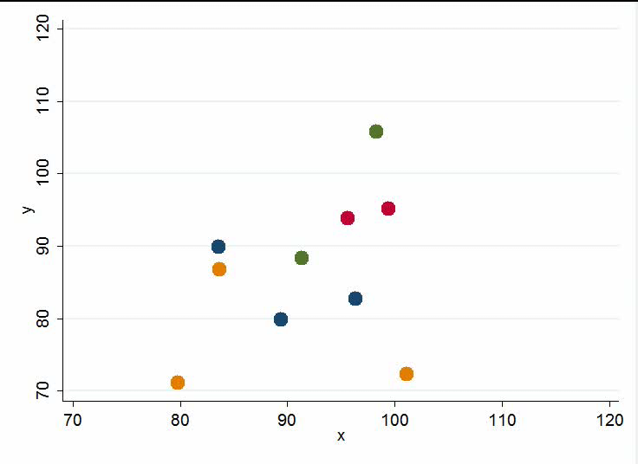
Example 3:
Interpolated scatterplot

Slide 12
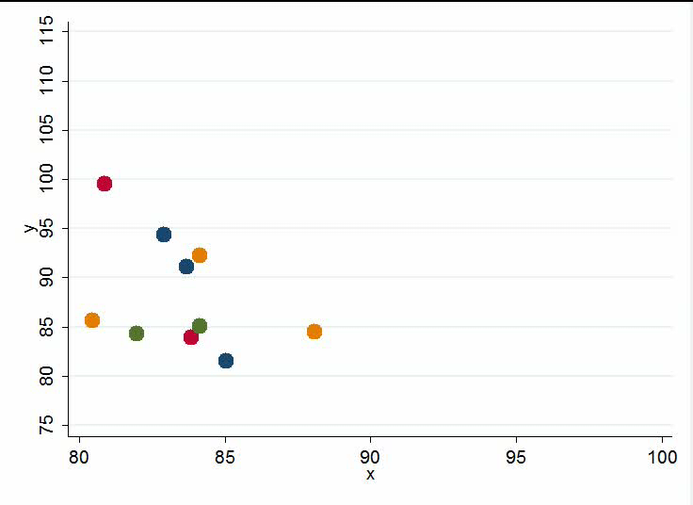
Example 4:
Trails made with phantom data

Slide 13
Use or abuse?
It is possible to draw the eye to one aspect of the animation through your aesthetic choices
    “My voice is a powerful gift. It can be used for good or it can be used for evil.” - Barry White
Some points might move faster than others; should data start and stop moving together?
Be careful to control axes so they don’t creep
Colour, light, emphasis, sound

Slide 14
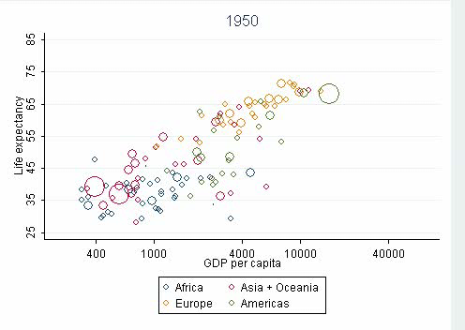
Example 5:
Hans recreated

Slide 15
Stata strengths and weaknesses
The ease and flexibility of macros
Having a direct link to the operating system
Powerful graphics
Having to display each graph slows it down
Having to split into multiple -graph twoway- commands to change size and colour

Slide 16
www.animatedgraphs.co.uk
All these examples, and some more
All the do-files
Tips on achieving particular aesthetics
User contributions
Expanding into R, SPSS, and maybe Excel VBA
Consultancy: I can do bespoke graphs but would rather teach you how to catch the fish

