Slide 1
Cure models within the framework of flexible parametric survival models
T.M-L. Andersson¹,
S. Eloranta¹,
P.W. Dickman¹,
P.C. Lambert^{1,2}
¹ Medical Epidemiology and Biostatistics, Karolinska Institutet, Stockholm, Sweden
² Department of Health Sciences, University of Leicester, UK

Slide 2
Relative survival
Cancer patient survival is often measured as 5-year relative survival,
Expected survival, , obtained from national population life tables stratified by age, sex, calendar year and possibly other covariates.
Estimate mortality associated with a disease without requiring information on cause of death.

Slide 3
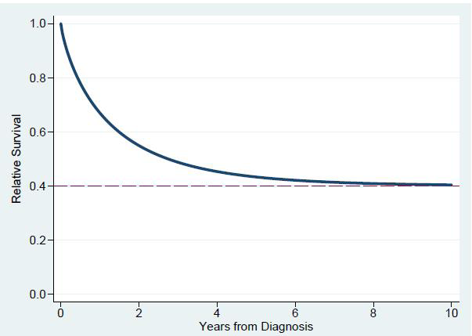
Definition of statistical cure
When the mortality rate observed in the patients eventually returns to the same level as that in the general population

Slide 4
Cure models
Mixture cure model
Non-mixture cure model
As well as the cure proportion, the survival of the “uncured” can be estimated
The commands strsmix and strsnmix in Stata¹
1. P.C. Lambert. 2007. Modeling of the cure fraction in survival studies. Stata Journal 7:351-375.

Slide 5
Cure models
We need to choose a parametric form for or . For many scenarios the Weibull distribution provides a good fit.
Hard to fit survival functions flexible enough to capture high excess hazard within a few months from diagnosis.
Hard to fit high cure proportion.
Flexible parametric approach for cure models would enable inclusion of these patient groups.

Slide 6
Flexible parametric survival model
First introduced by Royston and Parmar², stpm in Stata³
Consider a Weibull survival curve
Transforming to the log cumulative hazard scale gives
Rather than assuming linearity with flexible parametric models use restricted cubic splines
2. P. Royston and M. K. B. Parmar. 2002. Flexible proportional-hazards and proportional-odds models for censored survival data, with application to prognostic modelling and estimation of treatment effects. Statistics in Medicine 21:2175-2197.
3. P. Royston. 2001. Flexible alternatives to the Cox model, and more. The Stata Journal 1:1-28.

Slide 7
Flexible parametric survival model
Why model on log cumulative hazard scale?
    a generally stable function, easy to capture the shape
    easy to transform to the survival and hazard functions
    under the proportional hazards assumption covariate effects are interpreted as hazard ratios
Restricted cubic splines with k number of knots are used to model the log baseline cumulative hazard
where is a function of

Slide 8
Flexible parametric survival model
When introducing covariates
Possible to include time-dependant effects (non-proportional hazards)
Extended to relative survival⁴, stpm2 in Stata⁵
4. C. P. Nelson, P. C. Lambert, I. B. Squire and D. R. Jones. 2007. Flexible parametric models for relative survival, with application in coronary heart disease. Statistics in Medicine 26:5486–5498.
5. P. C. Lambert and P. Royston. 2009. Further development of flexible parametric models for survival analysis. Stata Journal 9: 265-290.

Slide 9
Flexible parametric cure model
When cure is reached the excess hazard rate is zero, and the cumulative excess hazard is constant.
By incorporating an extra constraint on the log cumulative excess hazard after the last knot, so that we force it not only to be linear but also to have zero slope, we are able to estimate the cure proportion.
This is done by calculating the splines backwards and introduce a constraint on the linear spline parameter in the regression model.

Slide 10
Flexible parametric cure model

Slide 11
Comparing non-mixture and flexible parametric cure model
The FPCM looks like this:
which is a special case of a non-mixture model where

Slide 12
Comparing non-mixture and flexible cure model
If we introduce covariates:
This means that the constant parameters are used to model the cure proportion and the time-dependent parameters are used to model the distribution function.

Slide 13
Flexible parametric cure model

Slide 14
Comparing non-mixture and flexible cure model

Slide 15
Comparing non-mixture and flexible cure model

Slide 16
Comparing non-mixture and flexible cure model

Slide 17
Thank you for listening!
.ssc install stpm2

