Slide 1


The 2023 Spanish STATA Conference
Madrid
19th October 2023
Prisons service quality: a study of Data Envelopment Analysis Visualisation
Dr Ane Elixabete Ripoll-Zarraga
Universitat Autònoma de Barcelona (UAB)

Slide 2
Outline
Revise Efficiency Methodological Approaches: parametric versus non-parametric.
Methodology DEA-Visualisation:
Estimation of Prisons and Youth Offender Institutions (England and Wales, 2020): DEA specifications (one specification is a model with a specific combination of inputs and outputs)
Multivariate statistical analysis to identify special performance features, i.e., specialisation, outliers & mavericks: Factor Analysis, Cluster and Pro-Fit.
Results
Conclusions

Slide 3
Methodological Efficiency Approaches
Benchmarking Techniques (Source: based on Von Hirschhausen and Cullmann, 2005)
Frontier
Average
Multi-Dimensional
Non-Parametric
Parametric
Data Envelopment Analysis (DEA)
Stochastic DEA (SFEA)
Efficiency/Productivity Analysis
One Dimensional
Performance Indicators
Induced Approaches (Index-based numbers)
Parametric (deterministic)
Ordinary Least Squares (OLS)
Total Factor Productivity (TFP)
Stochastic Frontier Analysis (SFA)
Corrected Ordinary Least Squares (COLS)
Modified Ordinary Least Squares (MOLS)

Slide 4
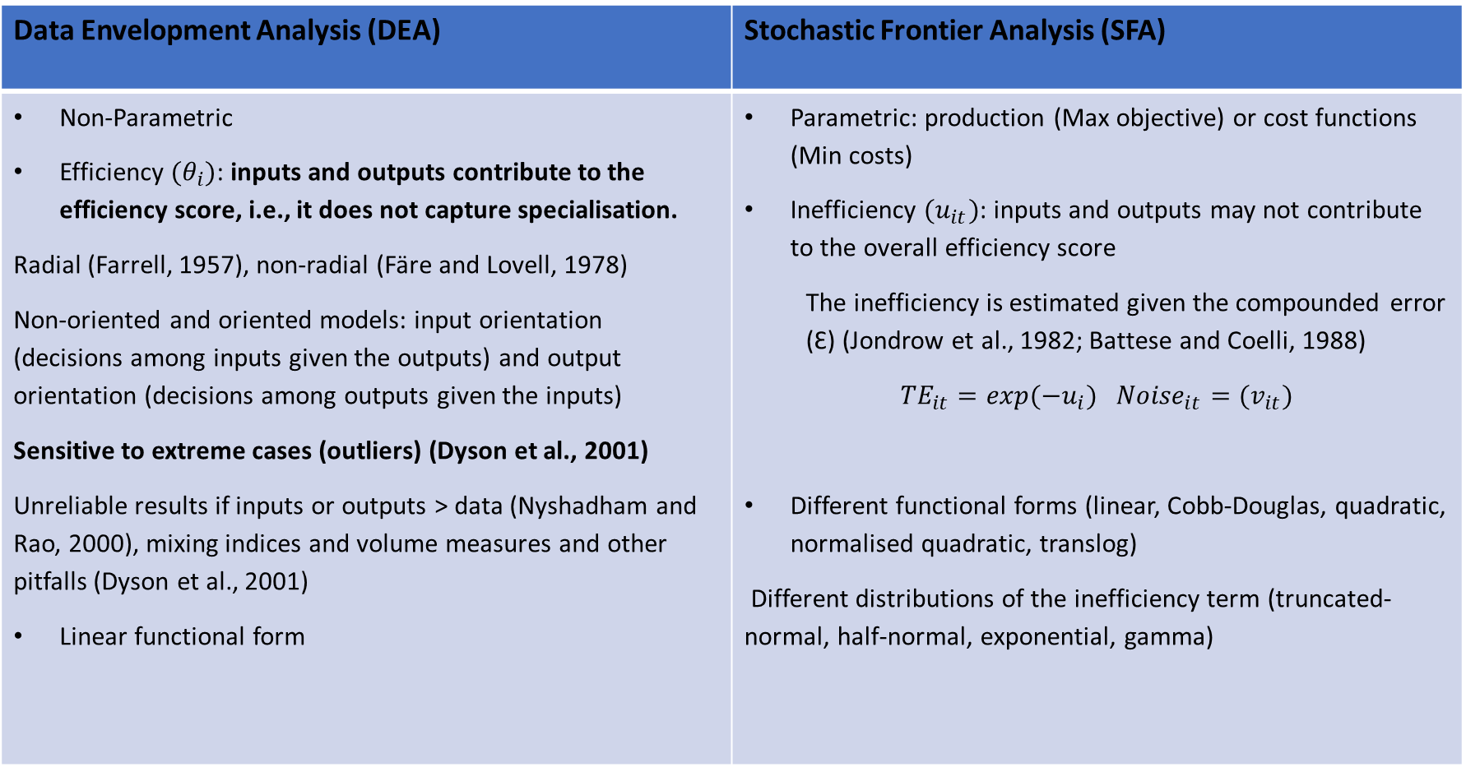
Methodological Efficiency Approaches
Data Envelopment Analysis (DEA) | Stochastic Frontier Analysis (SFA)
Non-Parametric Efficiency ${(θ}_{i})$: inputs and outputs contribute to the efficiency score, i.e., it does not capture specialisation. Radial (Farrell, 1957), non-radial (Färe and Lovell, 1978) Non-oriented and oriented models: input orientation (decisions among inputs given the outputs) and output orientation (decisions among outputs given the inputs) Sensitive to extreme cases (outliers) (Dyson et al., 2001) Unreliable results if inputs or outputs > data (Nyshadham and Rao, 2000), mixing indices and volume measures and other pitfalls (Dyson et al., 2001) Linear functional form | Parametric: production (Max objective) or cost functions (Min costs) Inefficiency ${(u}_{it})$: inputs and outputs may not contribute to the overall efficiency score The inefficiency is estimated given the compounded error (Ɛ) (Jondrow et al., 1982; Battese and Coelli, 1988) ${TE}_{it}=\exp{(−u_{i}})$ ${{Noise}_{it}=(v}_{it})$ Different functional forms (linear, Cobb-Douglas, quadratic, normalised quadratic, translog) Different distributions of the inefficiency term (truncated-normal, half-normal, exponential, gamma)

Slide 5
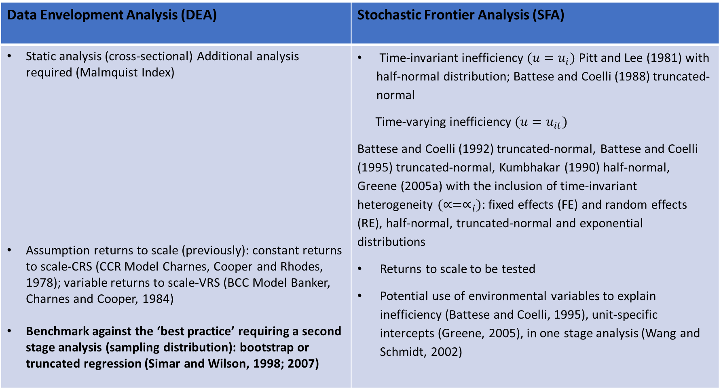
Methodological Efficiency Approaches
Data Envelopment Analysis (DEA) | Stochastic Frontier Analysis (SFA)
Static analysis (cross-sectional) Additional analysis required (Malmquist Index) Assumption returns to scale (previously): constant returns to scale-CRS (CCR Model Charnes, Cooper and Rhodes, 1978); variable returns to scale-VRS (BCC Model Banker, Charnes and Cooper, 1984) Benchmark against the ‘best practice’ requiring a second stage analysis (sampling distribution): bootstrap or truncated regression (Simar and Wilson, 1998; 2007) | Time-invariant inefficiency $(u=u_{i})$ Pitt and Lee (1981) with half-normal distribution; Battese and Coelli (1988) truncated-normal Time-varying inefficiency ${(u=u}_{it})$ Battese and Coelli (1992) truncated-normal, Battese and Coelli (1995) truncated-normal, Kumbhakar (1990) half-normal, Greene (2005a) with the inclusion of time-invariant heterogeneity $(∝=∝_{i})$: fixed effects (FE) and random effects (RE), half-normal, truncated-normal and exponential distributions Returns to scale to be tested Potential use of environmental variables to explain inefficiency (Battese and Coelli, 1995), unit-specific intercepts (Greene, 2005), in one stage analysis (Wang and Schmidt, 2002)

Slide 6
DEA Visualisation: DEA & Multivariate Statistical Techniques
Aim estimation of efficiencies of UK and Wales Prisons & YOI (publicly and privately managed) 2020
To confirm the consistency of the structural characteristics of the efficiency scores, i.e., sources of inefficiencies
Methodology Serrano-Cinca and Mar- Molinero (2004, 2005)
DEA combined with multivariate statistical techniques (visualisation)
Advantages:
i) The efficiency scores can be ranked even for efficient units
ii) The weights-zero problem is overcome
iii) Identify sources of inefficiency (consistent)
iv) Identify outliers (and mavericks) without removing them
Previous applications:
Transport Ripoll-Zarraga, A.E. & Mar-Molinero, C. (2020). Exploring the reasons for efficiency in Spanish airports. Transport Policy, 99, 186-202. https://doi.org/10.1016/j.tranpol.2020.08.021
Ripoll-Zarraga, A.E., Portillo, F., and Mar-Molinero, C. (2023). The impact of the Economic Crisis on the efficiency of Spanish airports: A DEA Visualisation analysis. Research in Transportation Business & Management, 100689. https://doi.org/10.1016/j.rtbm.2021.100689
Water Ripoll-Zarraga, A.E. (Forthcoming December 2023). Water provision service: a Visual Study of Data Envelopment Analysis. In (Eds.) Boubaker, S. & Ngo T., Handbook on Data Envelopment Analysis: Applications in Business, Finance, and Sustainability World Scientific.

Slide 7
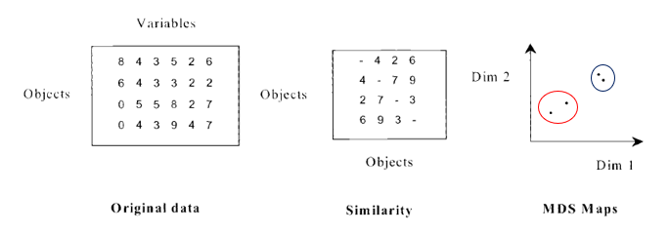
Multidimensional Scaling (MDS)
Kruskai (1960) develops the algorithm (Kruskai & Vish, 1978)
Variables=DEA Specifications (n x 1 year)
Objects=DMUs (m x 1 year)
Mar-Molinero and Serrano-Cinca (2000; 2004; 2005)
MDS approach overcomes data inefficiency or lack of relevant information
(not disclosures; confidentiality, etc.)

Slide 8
Analysis: Inputs and Outputs
Descriptive Statistics (March, 2020)* Source: Minister of Justice (UK)
*Except Capacity (December 2020), Investment (2020-2021)
Zero values are substituted by 0.0009
Type of Prisons (2020)
Variable | Obs. | Mean | Std. Dev. | Min | Max
Releases (Number) | 117 | 448.97 | 365.19 | 1.00 | 1,553.00
Negative Drug Tests (Number) | 118 | 12.35 | 14.87 | 0.00 | 102.00
Prison Population (Number) | 117 | 700.86 | 366.98 | 101.00 | 2,073.00
Staff (Number of public employees) | 102 | 357.95 | 150.79 | 75.00 | 861.00
Capacity (Number prisoners) | 118 | 705.81 | 370.90 | 96.00 | 2,106.00
Investment (£) | 118 | 21,900,000 | 11,300,000 | 4,280,909 | 71,800,000
Inputs | Outputs
A Prison Population | 1 Releases
B Staff | 2 Negative Drug Tests
C Capacity
D Investment
Prison Function | Categories | Male | Female | YOI
Local | N/A | 32 | 6 | 0
Open Prisons | D, Female Open, Male YOI Young People | 13 | 2 | 3
Closed Prisons | B, C, Female Closed, Male Closed YOI | 50 (B 8, C 42) | 3 | 4
High-Security Prisons | A, Dispersal | 5 | 0 | 0
Total | 118 | 100 | 11 | 7

Slide 9
Analysis: Inputs and Outputs
DEA Specifications | Inputs | Outputs
ABCD12 Traditional DEA model | ABCD (Prison Population, Staff, Operational Capacity, Investment) | 12 (Releases, Negative Drug Tests)
A1, A2, B1, B2, C1, C2,D1, D2, A12, B12, C12, D12 AB1, AB2, AB12 AC1, AC2, AC12 AD1, AD2, AD12 BC1, BC2, BC12 BD1, BD2, BD12 CD1, CD2, CD12 ABC1, ABC2, ABC12 ABD1, ABD2, ABD12 ACD1, ACD2, ACD12 BCD1, BCD2, BCD12 ABCD1, ABCD2 | A (Prison Population), B (Staff), C (Operational Capacity), D (Investment) AB (Prison Population & Staff) AC (Prison Population & Operational Capacity) AD (Prison Population & Investment) BC (Staff & Operational Capacity BD (Staff & Investment) CD (Operational Capacity & Investment) ABC (Prison Population, Staff & Operational Capacity) ABD (Prison Population, Staff & Investment) ACD (Prison Population, Operational Capacity & Investment) BCD (Staff, Operational Capacity & Investment) ABCD (Prison Population, Staff, Operational Capacity & Investment) | 1 (Releases) 2 (Negative Drug Tests) 12 (Releases & Negative Drug Tests)

Slide 10
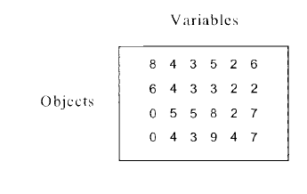
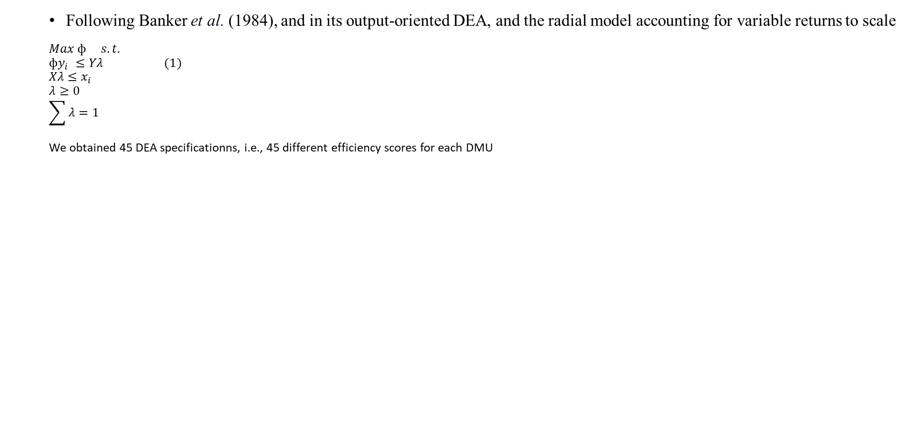
Methodology: 1st Stage DEA-BCC Model
Following Banker et al. (1984), and in its output-oriented DEA, and the radial model accounting for variable returns to scale
$$Max ф s.t.$$
$$фy_{i} ≤Yλ (1)$$
$$Xλ≤x_{i}$$
$$λ≥0$$
$$\sum{λ}=1$$
We obtained 45 DEA specificationns, i.e., 45 different efficiency scores for each DMU
If zero values to be substituted by 0.0009
DMU Prisons | ABCD12 | ABCD1 | ABCD2 | ABC12 | ABC1 | ABC2 | ABD12 | ABD1 | ABD2 | ACD12
Altcourse | 100.00% | 100.00% | 216.57% | 100.00% | 100.00% | 216.57% | 100.00% | 100.00% | 216.57% | 100.00%
Ashfield | 100.00% | 100.00% | 100.00% | 169.84% | 448.18% | 174.25% | 100.00% | 100.00% | 100.00% | 596.75%
Askham Grange | 100.00% | 100.00% | 100.00% | 100.00% | 103.30% | 100.00% | 100.00% | 100.00% | 100.00% | 100.00%
Aylesbury | 909.87% | 1134.20% | 1134.01% | 909.87% | 1134.20% | 1134.01% | 909.87% | 1134.20% | 1134.01% | 909.87%
Bedford | 166.68% | 238.91% | 167.02% | 166.68% | 238.91% | 167.02% | 166.68% | 238.91% | 167.02% | 175.24%
Belmarsh | 221.52% | 449.42% | 251.42% | 221.52% | 449.42% | 251.42% | 221.52% | 456.28% | 251.42% | 221.52%
Berwyn | 100.00% | 158.63% | 100.00% | 100.00% | 170.66% | 100.00% | 100.00% | 158.86% | 100.00% | 100.00%
Birmingham | 109.84% | 173.49% | 126.89% | 110.41% | 186.14% | 126.89% | 109.84% | 173.49% | 126.89% | 109.84%
Brinsford | 172.69% | 178.84% | 631.33% | 172.69% | 178.84% | 652.78% | 172.69% | 178.84% | 631.33% | 172.76%
Bristol | 117.50% | 177.00% | 124.62% | 117.61% | 177.00% | 124.62% | 117.50% | 177.00% | 124.62% | 117.50%
Brixton | 145.74% | 145.74% | 2018.12% | 163.02% | 163.02% | 2018.12% | 148.41% | 148.41% | 2027.58% | 169.05%
Bronzefield | 100.00% | 100.00% | 215.46% | 100.00% | 100.00% | 215.46% | 100.00% | 100.00% | 215.46% | 136.45%
…
Spring Hill | 100.00% | 100.00% | 100.00% | 100.00% | 100.00% | 100.00% | 100.00% | 100.00% | 100.00% | 632.51%
Warren Hill | 1026.59% | 1230.67% | 1355.39% | 1026.59% | 1230.67% | 1388.13% | 1026.59% | 1230.67% | 1356.43% | 1026.59%

Slide 11
Methodology: 2nd Stage i. Factor Analysis (Unrotated & Rotated)
Component | Initial Solution |  |  | Rotated Solution
 | Eigenvalue | % of Variance | Cumulative % | Eigenvalue | % of Variance | Cumulative %
1 | 15.75 | 35.00 | 35.00 | 14.39 | 31.97 | 31.97
2 | 13.03 | 28.96 | 63.96 | 14.01 | 31.13 | 63.10
3 | 9.10 | 20.22 | 84.17 | 9.13 | 20.28 | 83.38
4 | 5.64 | 12.54 | 96.71 | 6.00 | 13.33 | 96.71
5 | 0.54 | 1.21 | 97.92
DEA Specifications (45): Variables
Prisons (118x1=118): Cases
Factor Analysis Extraction (PCA): Factors 1 to 4
Eigenvalue > 0.70 (criterion applied)
Eigenvalue > 1 (Kaiser’s criterion)
Factor1 < 60% Variability (previous studies>)*
Factor1 to 4 = 97% Variability
Unrotated: to assess the dimensionality of the data
Rotated Component Matrix
*Gutierrez-Nieto et al (2007); Serrano-Cinca et al. (2016); Sagarra et al. (2017) & Ripoll-Zarraga and Mar-Molinero (2020, 2023)
DEA Specifications | PC1 | PC2 | PC3 | PC4
ABCD12 | -0.050 | 0.982 | -0.080 | 0.075
ABCD1 | -0.026 | 0.108 | -0.012 | 0.994
ABCD2 | 0.991 | -0.045 | -0.009 | -0.018
ABC12 | -0.030 | 0.981 | -0.086 | 0.060
BD1 | -0.011 | 0.028 | 0.999 | -0.005
CD12 | -0.057 | 0.984 | 0.089 | 0.055
CD2 | 0.976 | -0.039 | -0.006 | -0.010

Slide 12
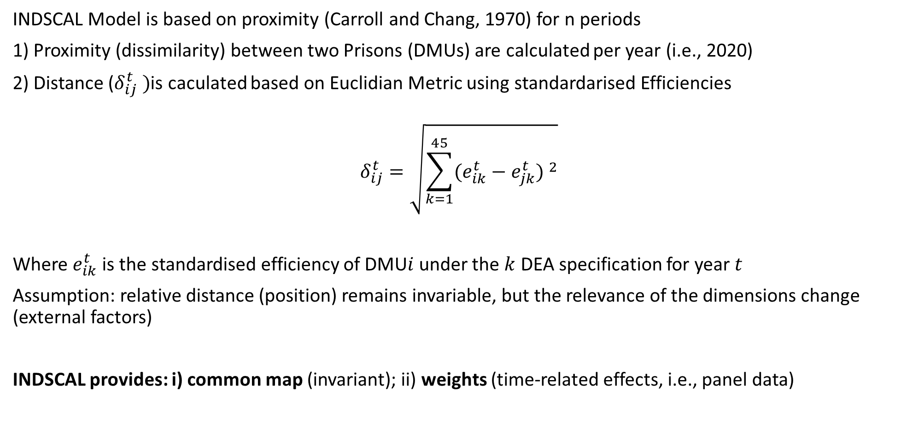
Methodology: 3rd Mapping Individual Differences Scaling (INDSCAL)
INDSCAL Model is based on proximity (Carroll and Chang, 1970) for n periods
1) Proximity (dissimilarity) between two Prisons (DMUs) are calculated per year (i.e., 2020)
2) Distance ($δ_{ij}^{t} )$is caculated based on Euclidian Metric using standardarised Efficiencies
$$δ_{ij}^{t}=\sqrt{\sum_{k=1}^{45}{{(e_{ik}^{t}−e_{jk}^{t}) }^{2}}}$$
Where $e_{ik}^{t}$ is the standardised efficiency of DMU$i$ under the $k$ DEA specification for year $t$
Assumption: relative distance (position) remains invariable, but the relevance of the dimensions change (external factors)
INDSCAL provides: i) common map (invariant); ii) weights (time-related effects, i.e., panel data)

Slide 13
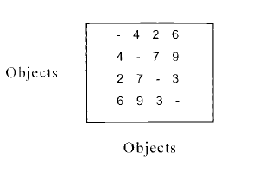
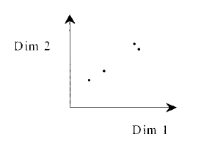
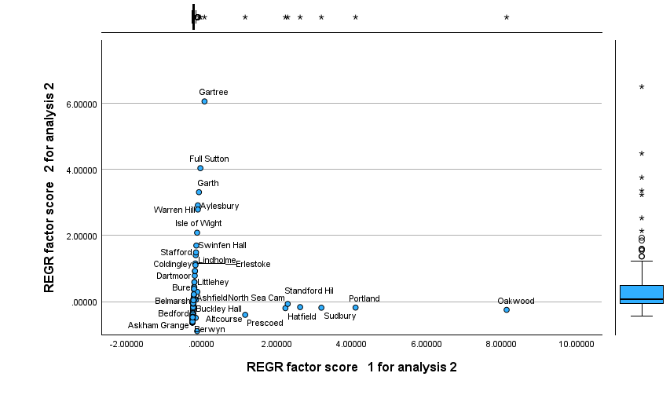
Methodology: 3rd Mapping Individual Differences Scaling (INDSCAL)

Slide 14
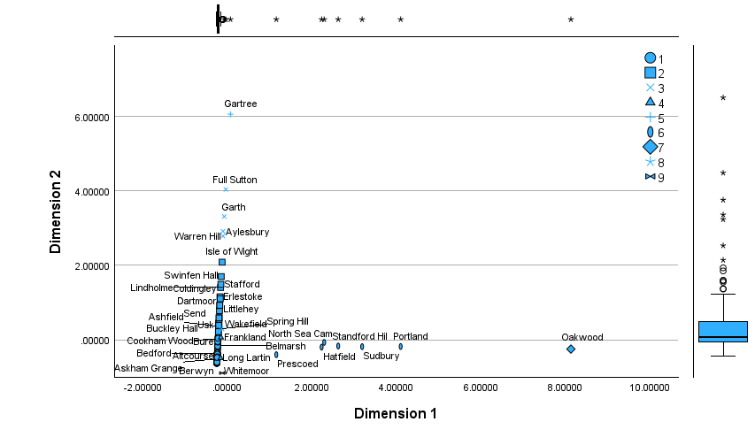
Methodology: 3rd Mapping Individual Differences Scaling (INDSCAL) Cluster Analysis Stand.

Slide 15
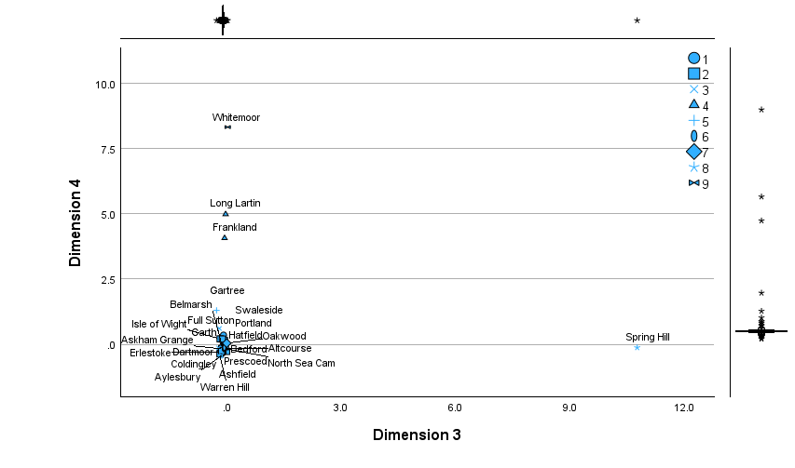
Methodology: 3rd Mapping Individual Differences Scaling (INDSCAL) Cluster Analysis

Slide 16
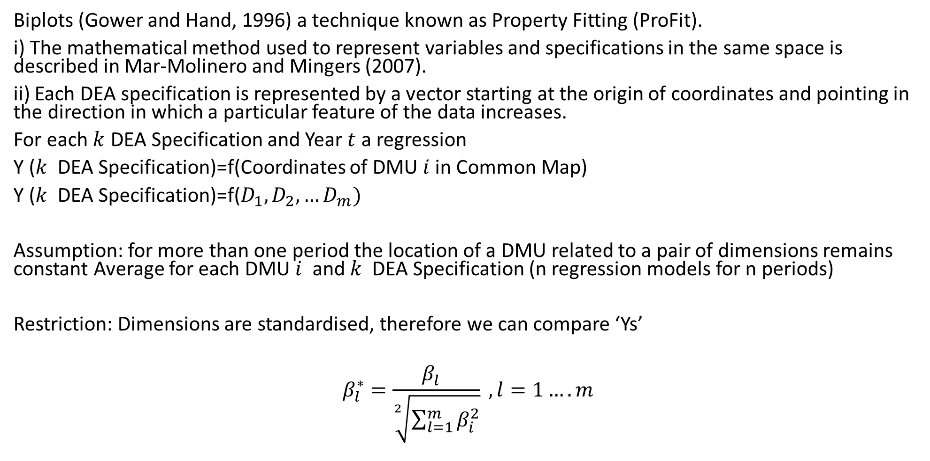
Methodology: 4th Stage ProFit
Biplots (Gower and Hand, 1996) a technique known as Property Fitting (ProFit).
i) The mathematical method used to represent variables and specifications in the same space is described in Mar-Molinero and Mingers (2007).
ii) Each DEA specification is represented by a vector starting at the origin of coordinates and pointing in the direction in which a particular feature of the data increases.
For each $k$ DEA Specification and Year $t$ a regression
Y ($k$ DEA Specification)=f(Coordinates of DMU $i$ in Common Map)
Y ($k$ DEA Specification)=f($D_{1}, D_{2},…D_{m})$
Assumption: for more than one period the location of a DMU related to a pair of dimensions remains constant Average for each DMU $i$ and $k$ DEA Specification (n regression models for n periods)
Restriction: Dimensions are standardised, therefore we can compare ‘Ys’
$$β_{l}^{∗}=\frac{β_{l}^{}}{\sqrt[2]{\sum_{l=1}^{m}{β_{i}^{2}}}} , l=1….m$$

Slide 17

Methodology: ProFit
Y ($k=45$ DEA Specification)=f($D_{1}, D_{2},…D_{m=7})$
45 regressions
DEASpecifications | Beta1* | Beta2* | Beta3* | Beta4* | R2
ABCD12 | -0.37 | 7.24 | -0.59 | 0.55 | 0.978
ABCD1 | -275.31 | 1,137.30 | -128.70 | 10,427.22 | 1.000
ABCD2 | 39,531,277.38 | -1,795,474.39 | -373,404.74 | -734,727.66 | 0.984
ABC12 | -0.23 | 7.50 | -0.65 | 0.46 | 0.975
ABC1 | -279.98 | 1,183.50 | -134.44 | 10,429.61 | 1.000
ABC2 | 57,537,084.97 | -2,566,206.75 | -508,886.15 | -990,098.05 | 0.997
D2 | 101,306,734.18 | -4,084,018.14 | -623,525.32 | -1,107,618.22 | 0.963

Slide 18
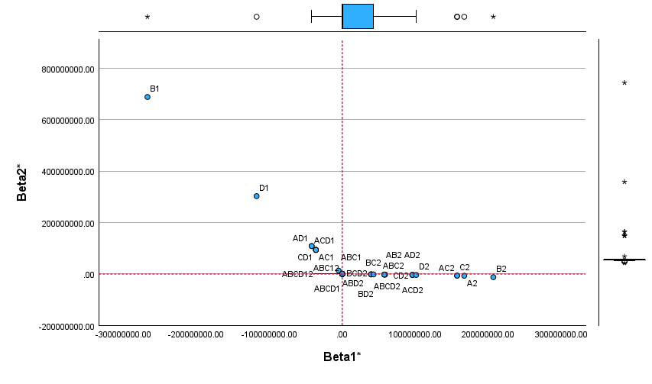
Methodology: ProFit
End point vectors

Slide 19
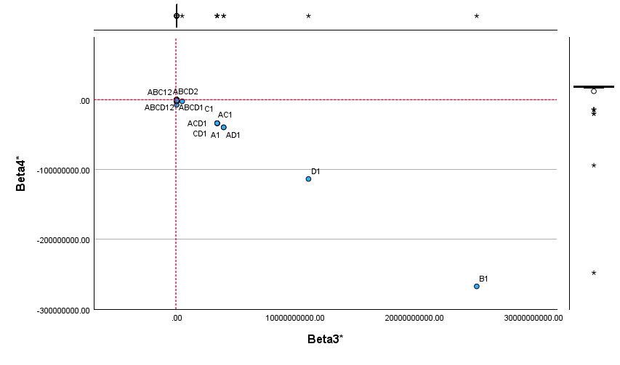
Methodology: ProFit
End point vectors

Slide 20
Conclusions
The in-efficiency depends on the Inputs-Outputs used by the researcher, but is this a true and fair view?
DEA Visualisation helps to identify intrinsic characteristics of the database, not visible at human-eye, by using Pro-Fit the results of the analysis can be presented graphically
Identification of a similar group of DMUs (good/bad practices)
To identify weak/strengths of DMUs activity: potential diversification/specialisation
To visualise mavericks/outliers without having to remove them from the sample
Overcomes weight-zero problem
It can be use with panel data (Ripoll-Zarraga et al. 2023)
Limitations
Production frontier shifts are not mathematically considered
Use of rations in DEA (Dyson et al. 2001): work in progress

Slide 21
Thank you for your attention
Dr Ane Elixabete Ripoll-Zarraga
Senior Lecturer Operations & Audit
Auditor-Consultant
Linkedin
ResearchGate https://www.researchgate.net/profile/Ane-Ripoll-Zarraga

