Slide 1

12th Spanish Stata User Conference
Madrid, 17 de octubre de 2019
On the cost of uncertainties in product-mix decisions: A simulation study built upon Goldratt’s PQ problem
José Costas. Continuous Improvement director. Plastic7A, S.L.

Slide 2
A3 thinking / the overall picture
CONTEXT
Product mix problem
Case study: Goldratt’s PQ problem
“The Haystack Syndrome”
BASELINE
Deterministic scenario
T: $6,300 / week
NP: $300 / week
OBJECTIVE / TARGET CONDITION
Understand effects of internal system noise
Six bog losses, Nakajima
And seek what can be done to minimize undesirable economic effects driven by noise conditions
APPROACH
Agent based modeling and simulation
Petri nets
Heuristics
APICS inventory management policy
Designed experiments
TEAM CHARTER
Research work organization
Architect role
Test engineer role
Scribe role
Internal reviewer

Slide 3
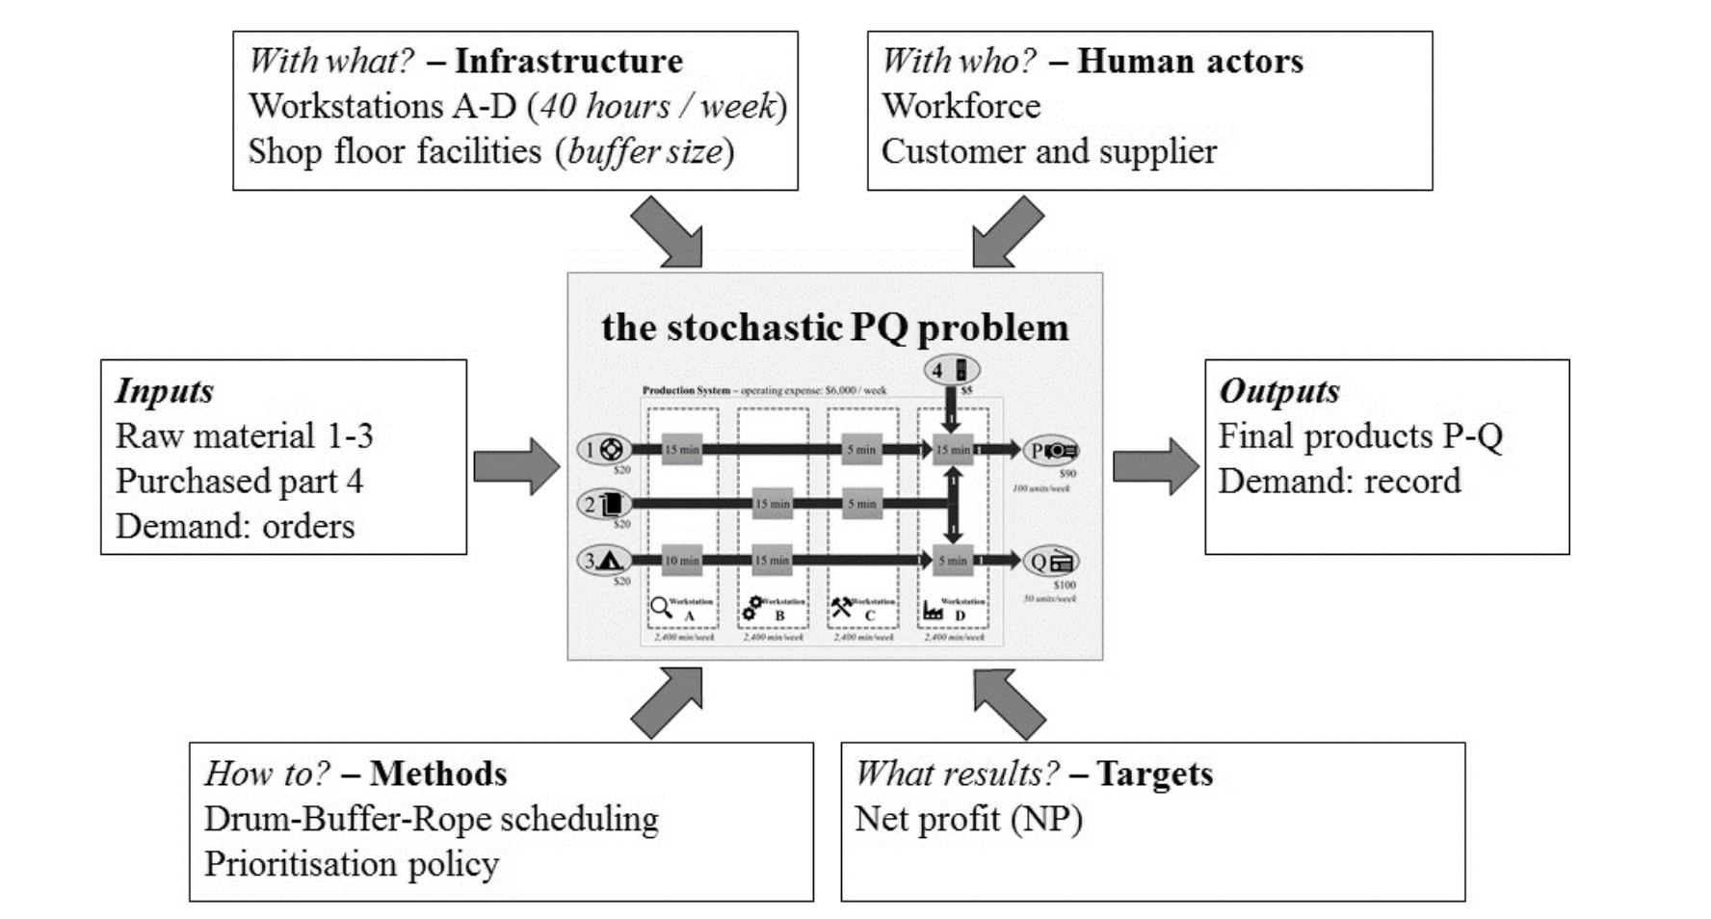
Turtle diagram / process domain

Slide 4
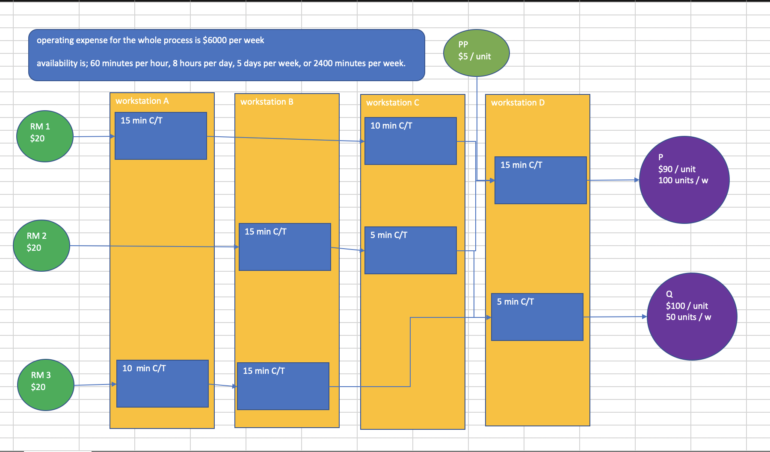
PQ problem / parameters

Slide 5
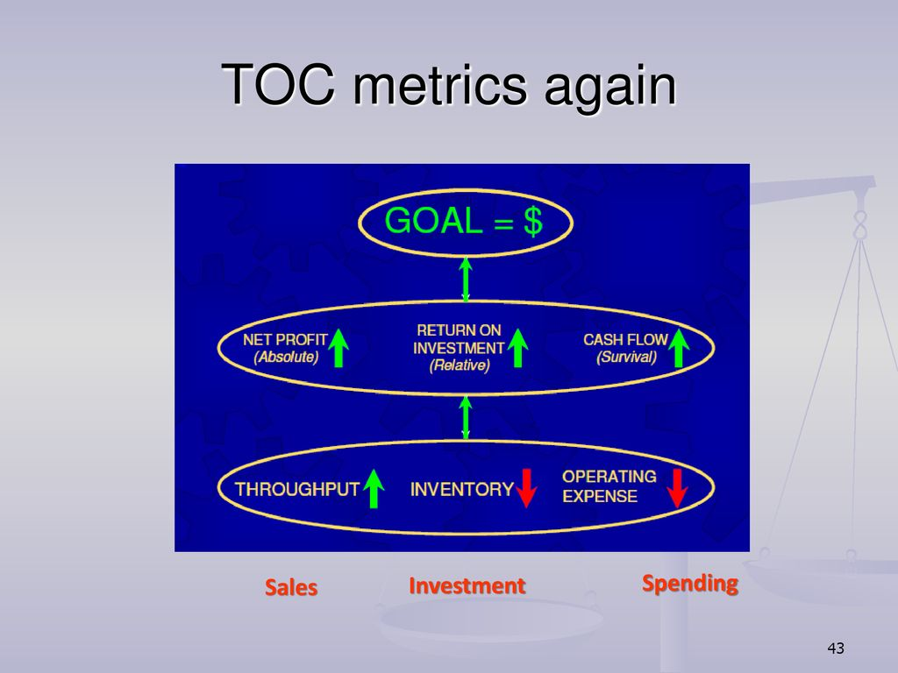
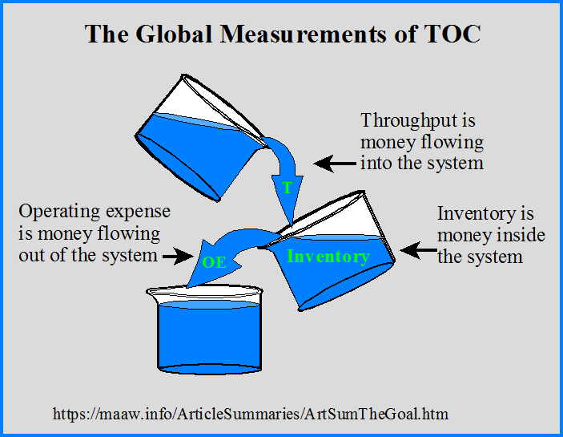
Process evaluation / TOC metrics

Slide 6

Perturbations
Noise conditions

Slide 7
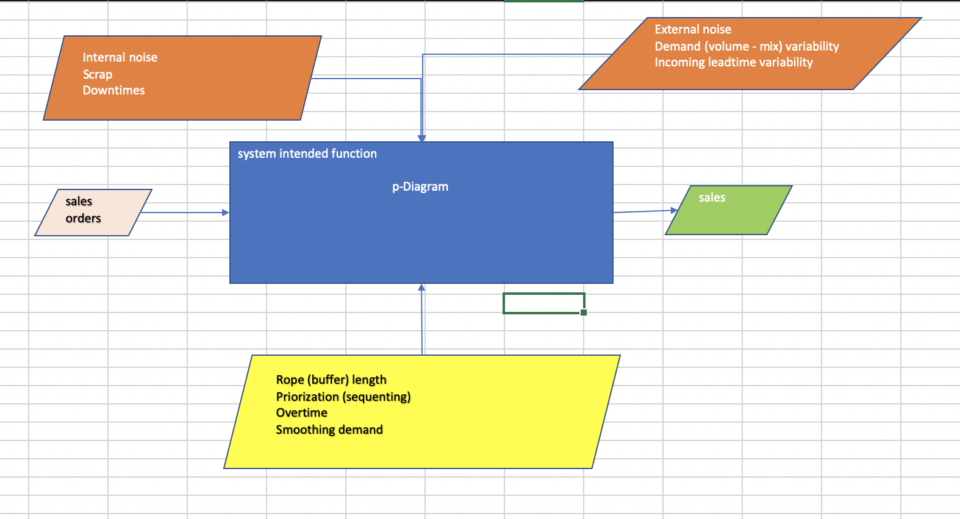
p-Diagram

Slide 8
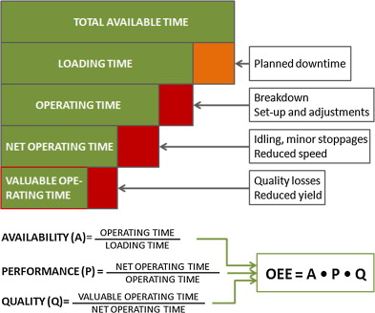
Six big losses – Internal noise
Internal noise effects
  Downtimes (machine breakdowns, change over, operator availability issues, …) in workstations erode available time.
  Speed perturbations reduce performance
  Scrap (and other quality losses) reduce yield

Slide 9
System model
Shipping loop, manufacturing loop, incoming loop

Slide 10
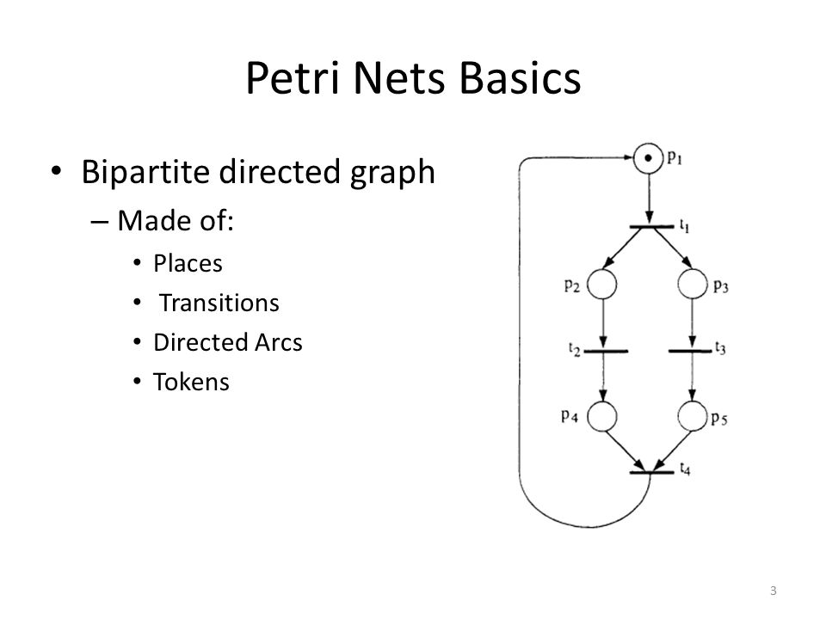
Key points about Petri nets
Carl Adam Petri, 1962
Application here: flexible manufacturing
Places may hold tokens.
A transition is enabled when the number of tokens in each of its input places is at least equal to the arc weight going from the place to the transition.
When a transition fires, it takes the tokens that enabled it from the input places; it then distributes tokens to output places according to arc weights.

Slide 11
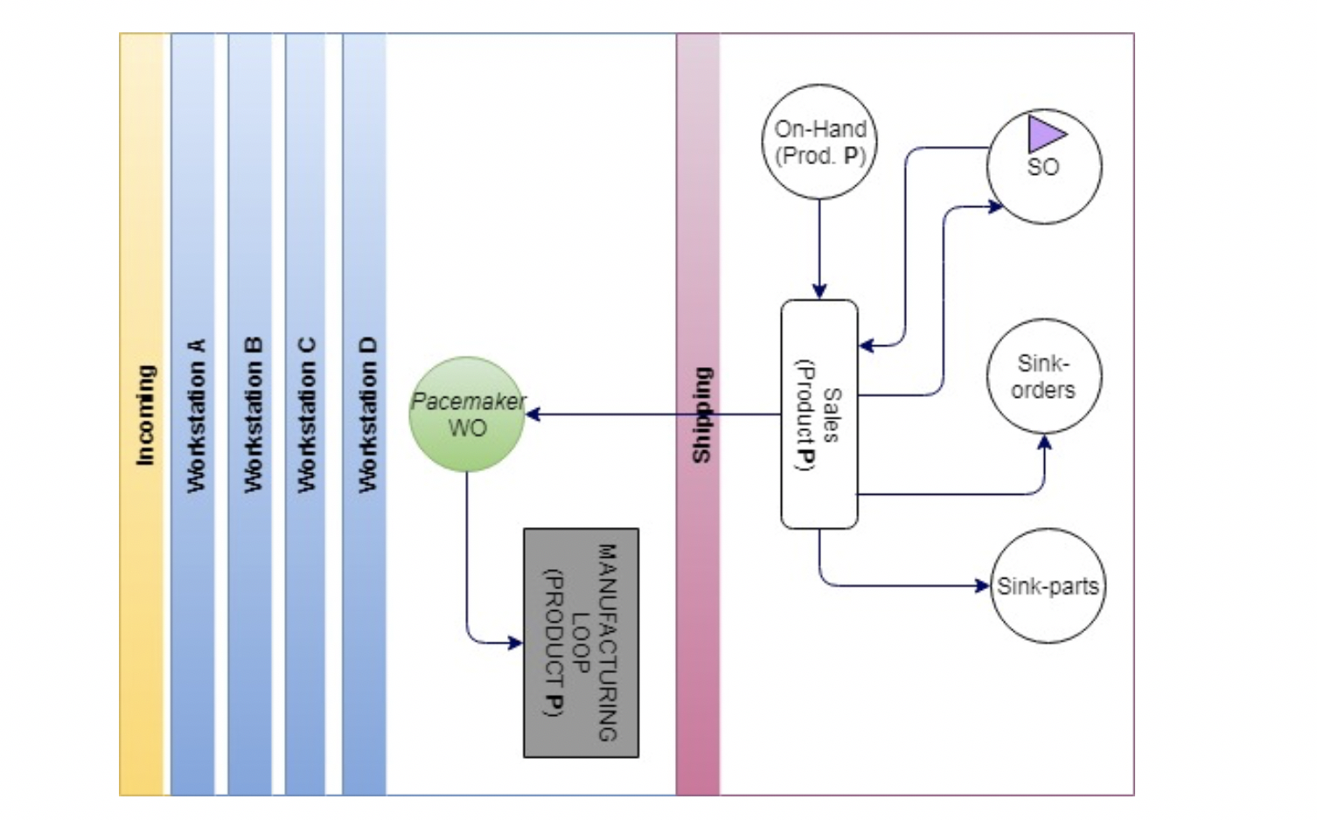
Simplified representation shipping loop
Tokens at sales order place (for P, Q) delay 1 week.
They enable Sales transition.
Once sales transition fires, it burns part tokens (color P) from On hand place.
Orders and parts burnt are sent to “sink-..” places for statistical analysis.

Slide 12
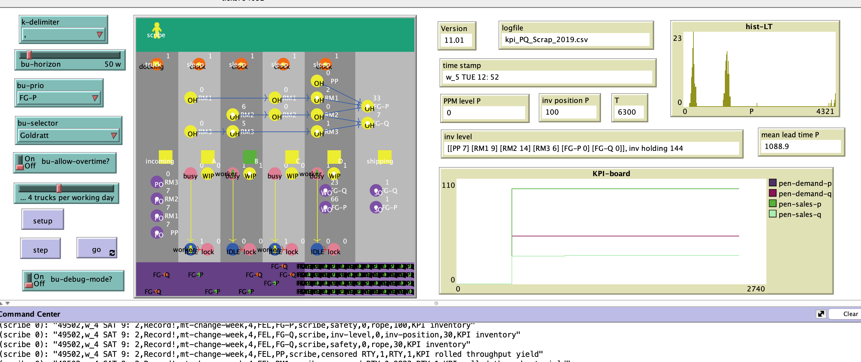
Netlogo model

Slide 13
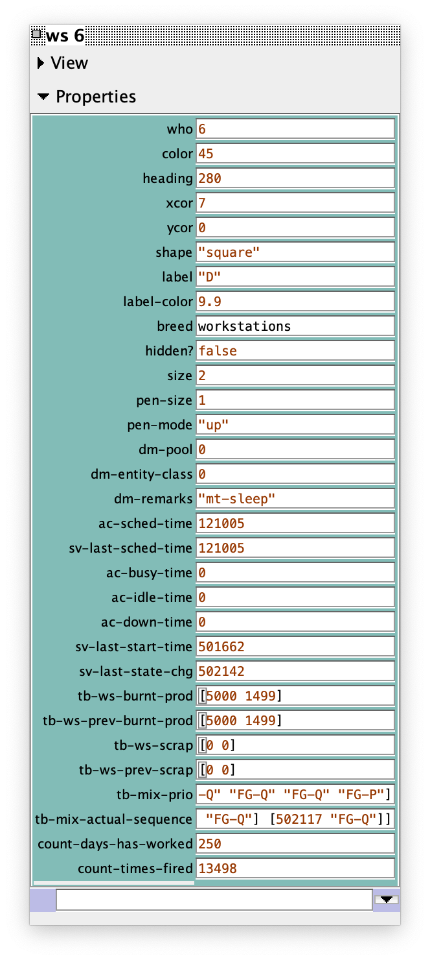
Inspecting Netlogo model agents
Agents have attributes (properties) to describe themselves and their current state, and have also behavior, according to their beliefs, desires and intentions (BDI).

Slide 14
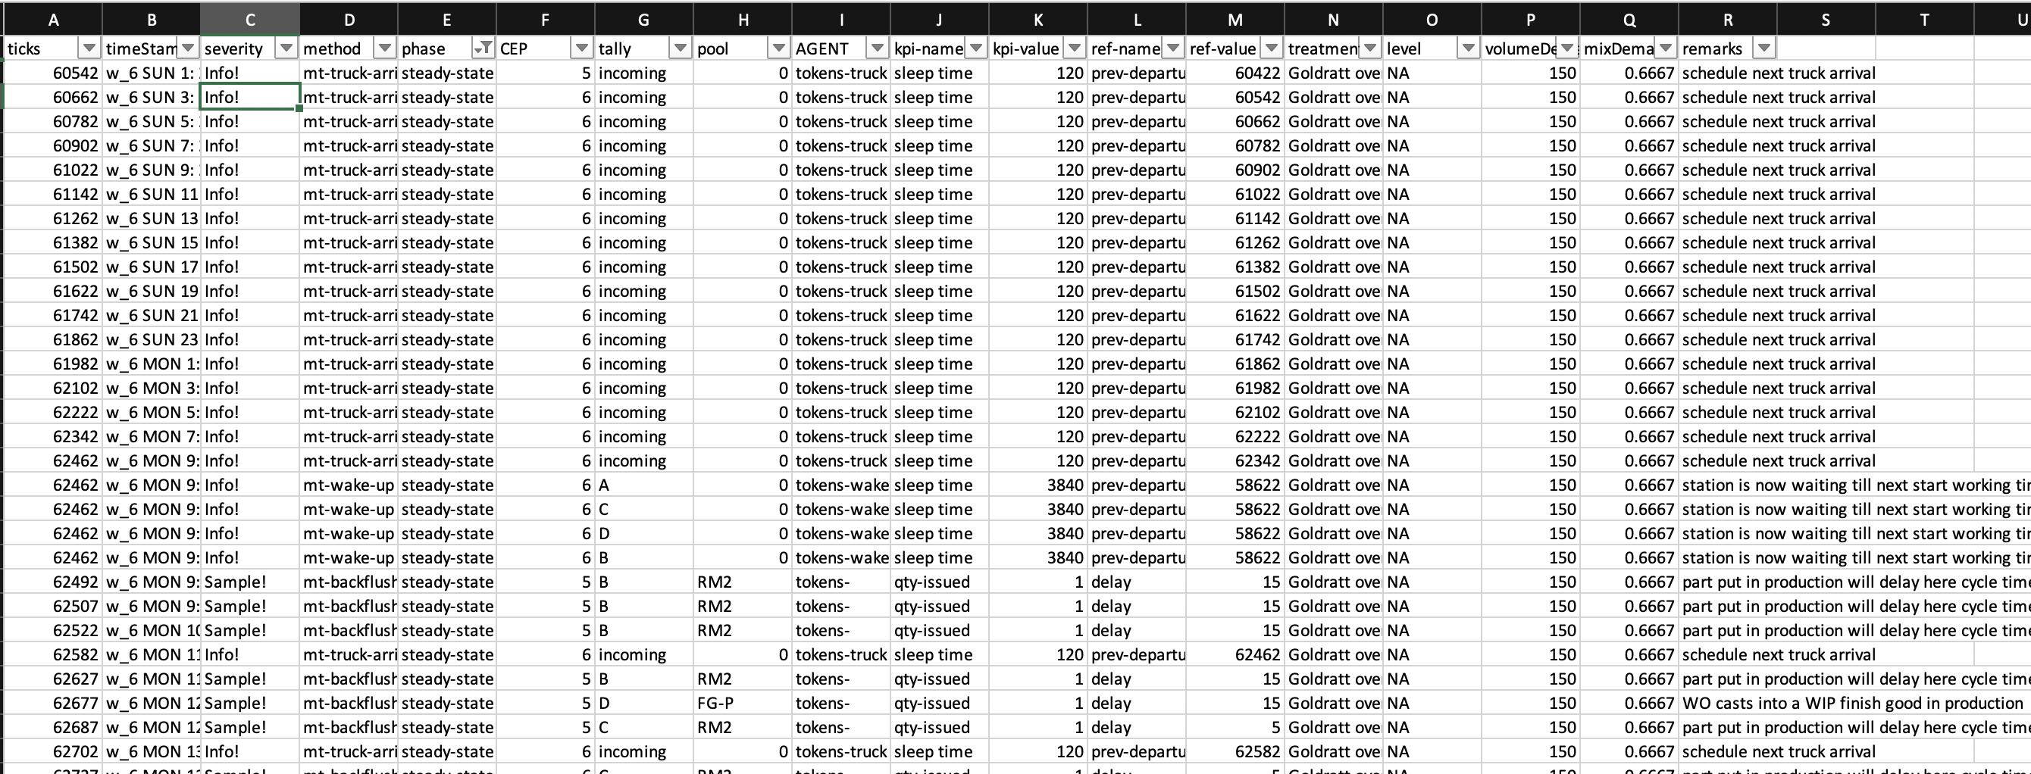
Logfile (csv) for data analysis

Slide 15
Model verification
SAT / site acceptance tests

Slide 16
SITE ACCEPTANCE TESTS
SAT# | DESC | Goal | Details | Exit criteria (DoD)
1 | Analysis of Goldratt’s setting in the deterministic scenario | the system performs as intended in the traditional PQ problem (matches simplex calculations) | Prio in P | T: $6,300.- NP: $300 Sales : [100, 30]
2 | Same as 1 |  | But now, Prio in Q | T: $5,700.- NP: -$300. Sales [60, 50]
3 | Low PPM rate on workstation A, material 3. Before the bottleneck | We expect the system to be able to preserve sales, with some increase in operational expense and some erosion in T | Prio automatic | T ~ $6,300 - $31 NP < $300, because Some more inv level Some disposal cost Sales [100, 30]

Slide 17
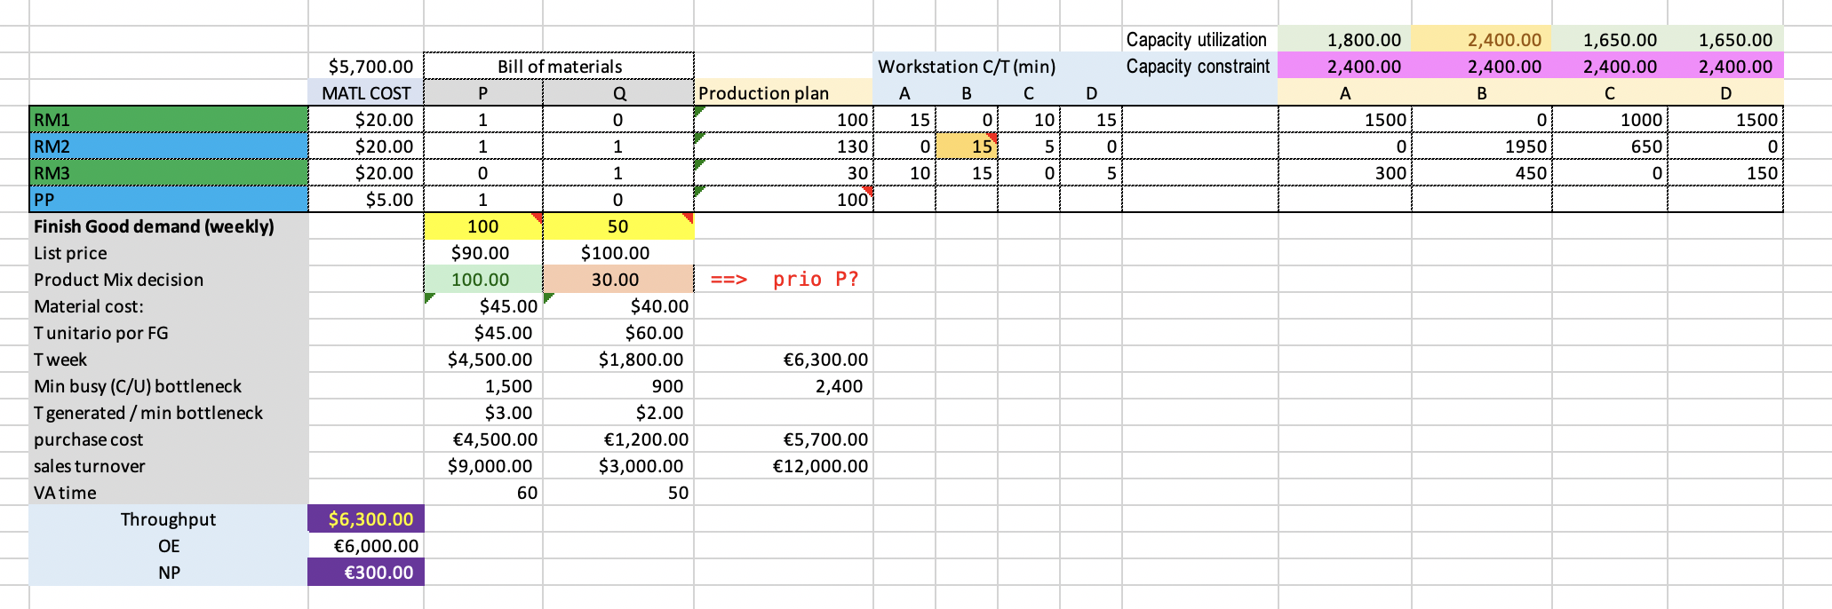
Baseline – simplex solution / SAT #1 – DoD

Slide 18

Critical questions
For research

Slide 19
Some basic considerations – about scrap effects
Scrap implies to increment OE due to disposal cost, extra inv holding cost, and the use of overtime to catch up target production
Scrap implies loss of T, even if you can protect sales
Clerical MUDA o tackle scrap
Risk of defects escaping controls, hence, customer claims.
MUDA (MUV, LEV, …) due to loss of parts, labor, capacity of assets, …

Slide 20
Now … critical questions for research
CQ1: (critical question number 1) a 5% scrap level in raw-1 has the same effect than in raw-3 in workstation A?
CQ2: same scrap level in a workstation before the bottleneck hast the same effect than after the bottleneck?
CQ3: is the effect of scrap linear or do we expect an abrupt change once we cross the saturation point of the workstation? Say, once we get rid of idle time.
CQ4: same RTY generate same effects or not?
CQ5: what can agents in workstations do to schedule overtime with anticipation?
CQ6: the bottleneck is sensitive to scrap allocations in the value stream; so what?
CQ7: what can agents do to redefine priority depending of scrap distribution across the value stream?
CQ8: what about sensitivity (prices, overtime cost, disposal cost, inv holding cost, ..?)
CQ9: what about lead time? Time between two consecutive good parts in workstation D.
CQ10: variance absorbe variance; linearly?

Slide 21
Experimenting with the model
DoE

Slide 22
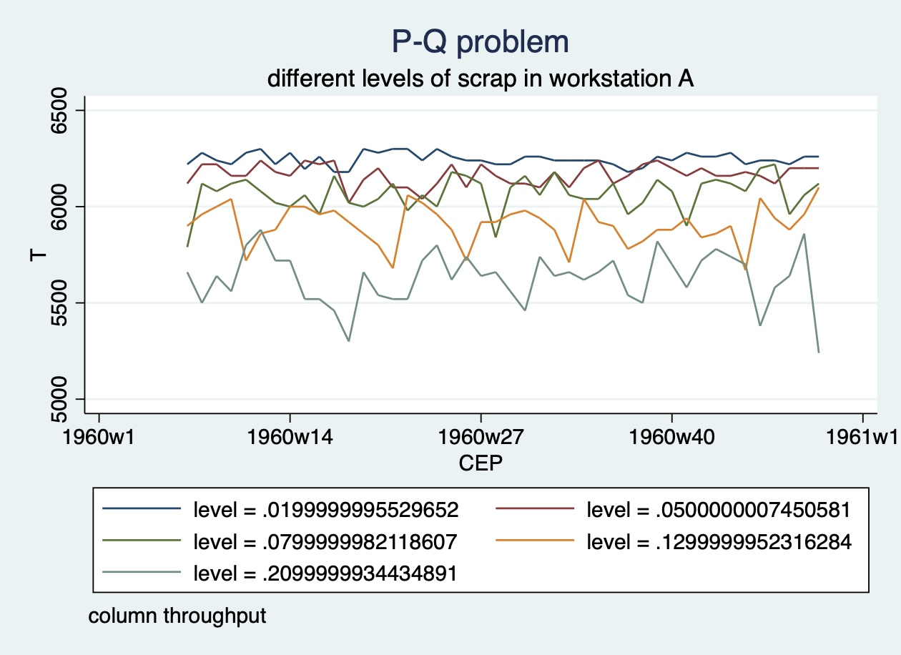
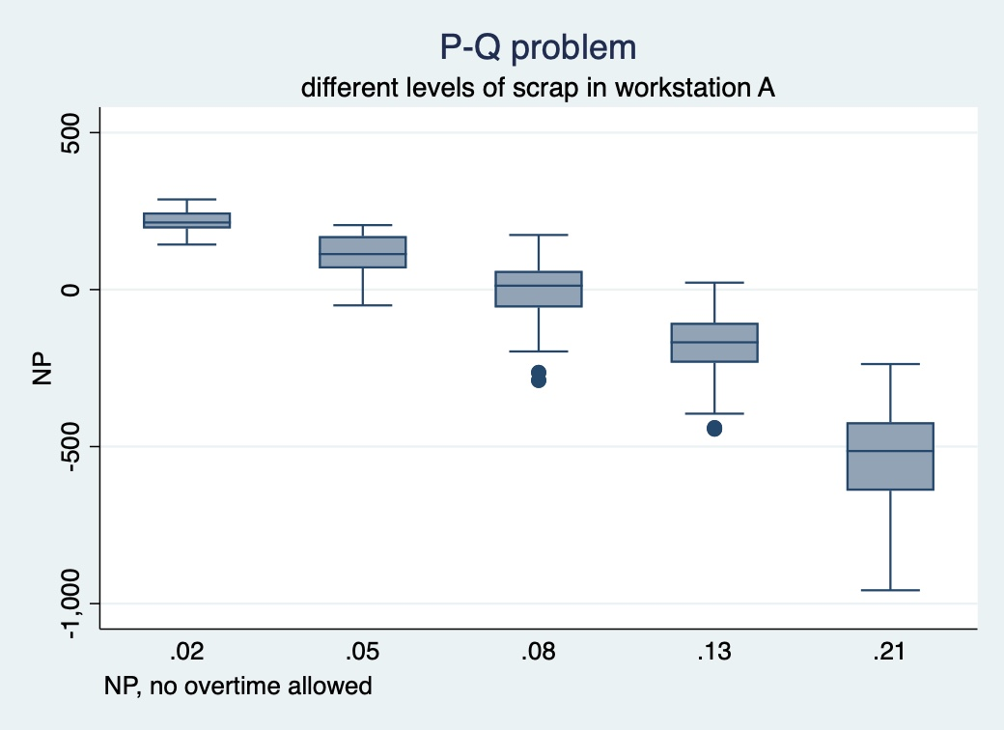
Effects of scrap in workstation A, wo overtime

Slide 23
Scrap in A, no overtime
regress throughput level, ///
> vce(robust) /* trying linear regression */
Linear regression Number of obs = 220
F(1, 218) = 898.31
Prob > F = 0.0000
R-squared = 0.8545
Root MSE = 91.095
------------------------------------------------------------------------------
| Robust
throughput | Coef. Std. Err. t P>|t| [95% Conf. Interval]
-------------+----------------------------------------------------------------
level | -3291.405 109.8168 -29.97 0.000 -3507.844 -3074.966
_cons | 6324.876 8.445666 748.89 0.000 6308.23 6341.521
------------------------------------------------------------------------------
NB: Linktest reveals no issues for this linear model
robvar throughput, by(level) /* Levene's test */
| Summary of T
level | Mean Std. Dev. Freq.
------------+------------------------------------
.02 | 6246.7045 33.007103 44
.05 | 6166.3636 54.178469 44
.08 | 6066.5909 90.655063 44
.13 | 5906.0227 102.25697 44
.21 | 5625.9091 137.86273 44
------------+------------------------------------
Total | 6002.3182 238.23138 220
W0 = 13.698391 df(4, 215) Pr > F = 0.00000000

Slide 24
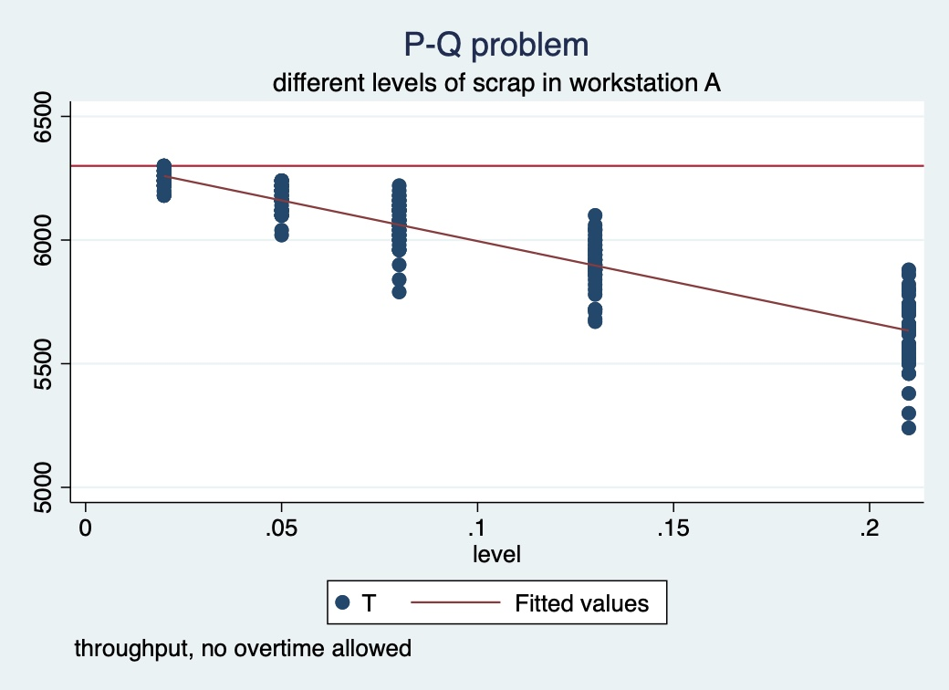
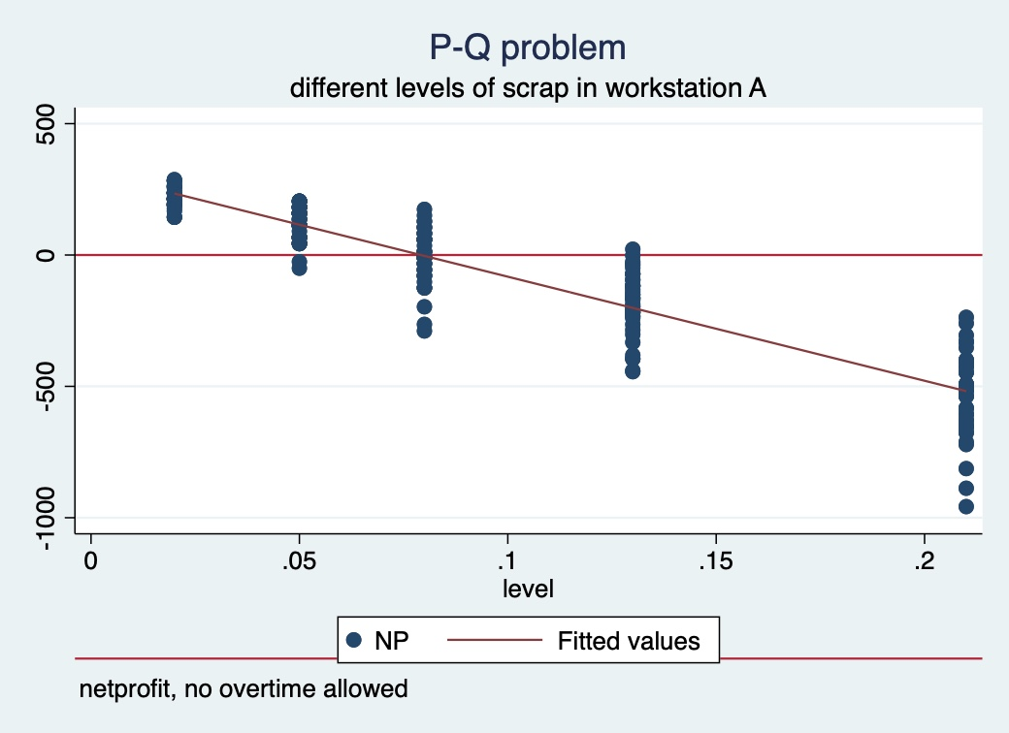
Predictions – scrap at workstation A

Slide 25
Scrap in A: Agents deciding to allocate overtime
regress netprofit level i.overtime_flag, ///
> vce(robust) /* trying linear regression */
Linear regression Number of obs = 440
F(2, 437) = 1174.14
Prob > F = 0.0000
R-squared = 0.8805
Root MSE = 100.77
-------------------------------------------------------------------------------
| Robust
netprofit | Coef. Std. Err. t P>|t| [95% Conf. Interval]
--------------+----------------------------------------------------------------
level | -4082.374 84.59097 -48.26 0.000 -4248.629 -3916.118
|
overtime_flag |
TRUE | -11.44091 9.608013 -1.19 0.234 -30.32457 7.44275
_cons | 325.5834 8.082171 40.28 0.000 309.6986 341.4681
-------------------------------------------------------------------------------
Agents may decide
  To allocate a different amount of overtime each week in each workstation depending on the scrap distributions for workstation and parts
    NB: Scrap downstream may provoke need of overtime
  To adjust the rope (hence buffer) length depending on historical performance analysis
  Prioritize the intended sequence of parts in each workstation
Overtime trade off
  Cost of overtime
  Versus ability to prevent loss of sales of finish goods
Prioritize heuristics
  Burndown curves, debt
  Every product each X (interval of time)

Slide 26
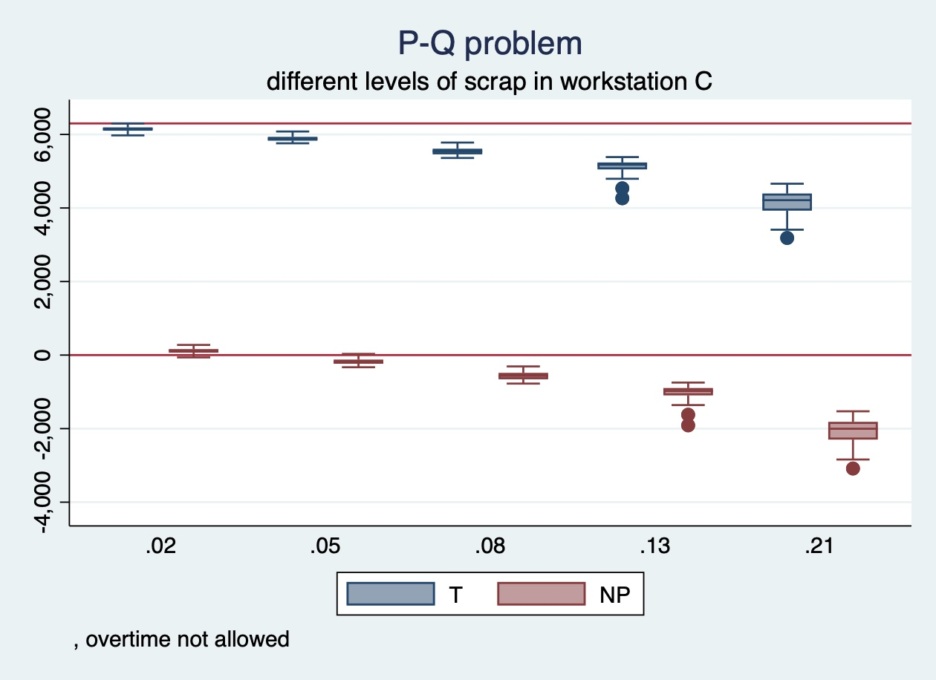
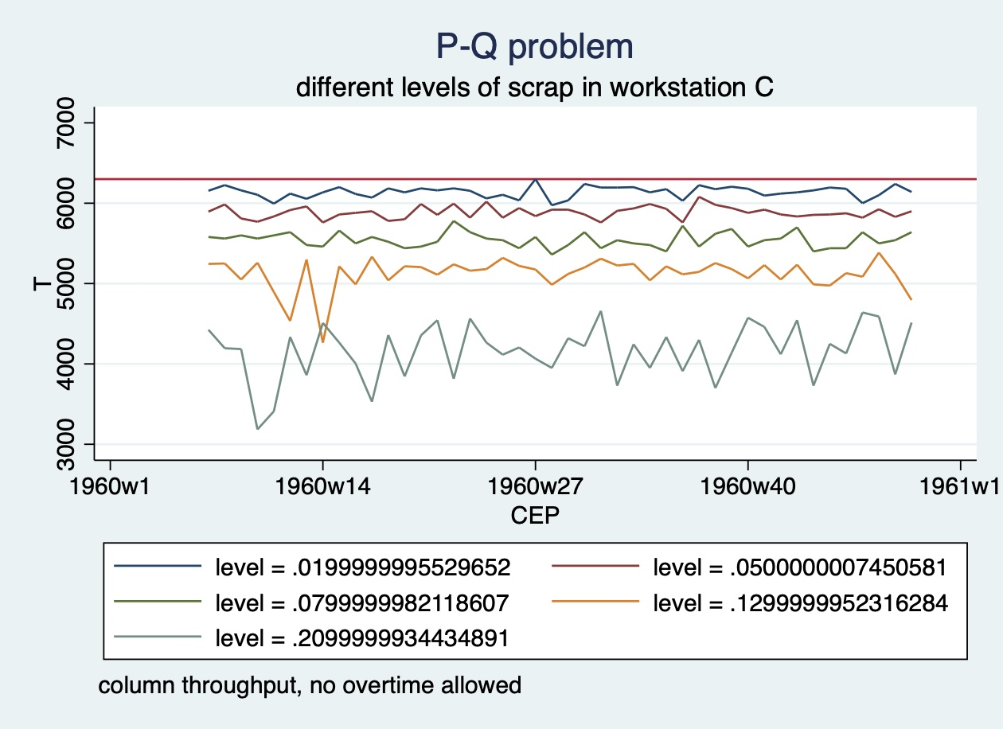
Scrap after the bottleneck.

Slide 27
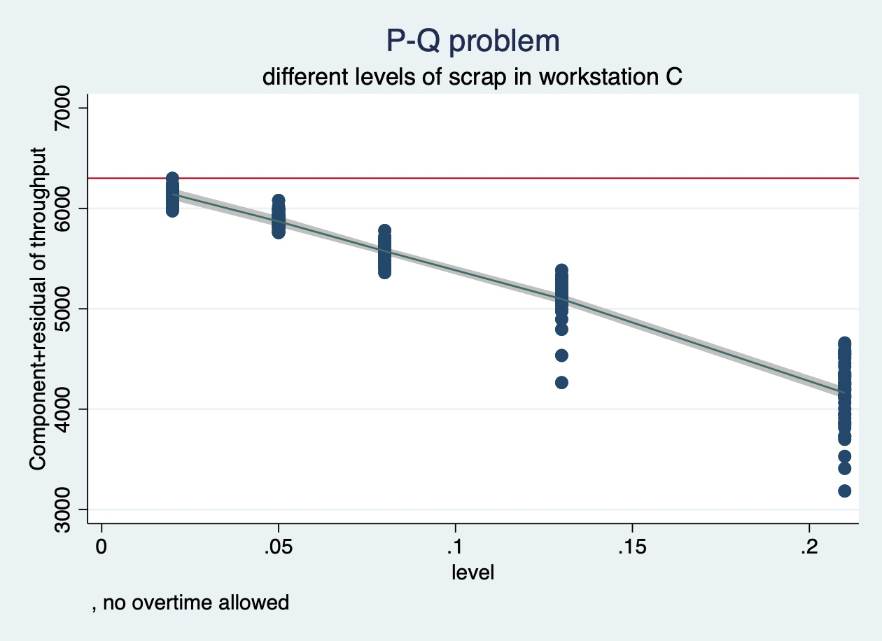
Predicting throughput / non-linear – scrap in “C”
fp <level>, power(-1 -.5 1 2) dimension(3) replace: regress throughput <level>
(fitting 34 models)
(....10%....20%....30%....40%....50%....60%....70%....80%....90%....100%)
Fractional polynomial comparisons:
(*) P = sig. level of model with m = 3 based on F with 213 denominator dof.
m = 3 | 6 2925.976 188.705 0.000 -- -1 -1 2
Source | SS df MS Number of obs = 220
-------------+---------------------------------- F(3, 216) = 996.70
Model | 106475286 3 35491762.1 Prob > F = 0.0000
Residual | 7691629.58 216 35609.3962 R-squared = 0.9326
-------------+---------------------------------- Adj R-squared = 0.9317
Total | 114166916 219 521310.118 Root MSE = 188.7
------------------------------------------------------------------------------
throughput | Coef. Std. Err. t P>|t| [95% Conf. Interval]
-------------+----------------------------------------------------------------
level_1 | 110.8113 29.38085 3.77 0.000 52.90147 168.7212
level_2 | 22.95592 6.647391 3.45 0.001 9.853867 36.05798
level_3 | -29424.31 2281.403 -12.90 0.000 -33920.97 -24927.65
_cons | 5102.846 176.9565 28.84 0.000 4754.063 5451.629
------------------------------------------------------------------------------

Slide 28
SUMMARY TABLES OF STATISTICS
SCRAP IN WORKSTATION “A”
  Not a huge drop in throughput between levels of scrap
  No relevant differences in T using overtime or not.
tabulate overtime_flag level, summarize(throughput)
Means, Standard Deviations and Frequencies of T
| level
overtime? | .02 .05 .08 .13 .21 | Total
-----------+-------------------------------------------------------+----------
FALSE | 6,246.70 6,166.36 6,066.59 5,906.02 5,625.91 | 6,002.32
| 33.01 54.18 90.66 102.26 137.86 | 238.23
| 44 44 44 44 44 | 220
-----------+-------------------------------------------------------+----------
TRUE | 6,244.55 6,156.59 6,068.18 5,898.98 5,583.07 | 5,990.27
| 39.50 67.44 68.79 101.59 121.10 | 248.58
| 44 44 44 44 44 | 220
SCRAP IN WORKSTATION “C”
  A huge drop in throughput between levels of scrap
  Relevant differences in T using overtime or not.
tabulate overtime_flag level, summarize(throughput)
| level
overtime? | .02 .05 .08 .13 .21 | Total
-----------+-------------------------------------------------------+----------
FALSE | 6,140.23 5,885.68 5,542.73 5,120.45 4,157.39 | 5,369.30
| 71.86 75.31 94.36 201.99 341.28 | 722.02
| 44 44 44 44 44 | 220
-----------+-------------------------------------------------------+----------
TRUE | 6,285.91 6,127.73 5,948.64 5,651.36 5,075.45 | 5,817.82
| 37.50 90.27 125.32 160.38 225.20 | 450.57
| 44 44 44 44 44 | 220

Slide 29
End of file
Sentinel

