Slide 1
Do the rich save more in Brazil?
Pedro Henrique Sant’Anna Universidad Carlos III
Fábio Gomes Insper
Márcio Salvato Ibmec - MG

Slide 2
Introduction
Motivation: understanding savings heterogeneity
Wellbeing = f(consumption)
Consumtpion/GDP > 50%, in general
Our main goal:
How savings rate is related to current income?
How savings rate is related to lifetime (permanent) income?

Slide 3
Introduction
Dynan, Skinner e Zeldes (2004)
In the U.S.A., the rich save more.
Alan, Atalay e Crossley (2006)
In Canada, savings rate is constant.
Nothing has been done for a developing country , as Brazil

Slide 4
Introduction
Heterogeneous Savings rate in respect to wealth (Permanent Income)
Tax Policy
Crisis policy
Public policy Evaluation

Slide 5
Literature Review

Slide 6
Literature Review
Keynes (1936) – Savings rate are decreasing with income
It’s not the only theory who has this implication
Friedman (1957)
Savings rate is constant with respect to permanent income
Higher Income
Positive Temporary shock on Income
Higher transitory Income
Higher Savings

Slide 7
Dynan, Skinner e Zeldes(2004)
Planned Bequest
Different discount factor
Heterogeneous Savings Rate
Precautionary savings
Heterogeneous Benefits from Social Security

Slide 8
Empirical Evidence
Regressors | Expected sign | Empirical Results
 |  | Wang (1995) | Dynan, Skinner e Zeldes (2004) | Sameroynina (2005) | Alan, Atalay e Crossley (2006)
Current Income | + |  | + | Inconclusive | +
Permanent Income | Undetermined | + | + |  | Constant
Age 30-39 | + |  | Not different from 40-49 |  | Not different from 40-49
Age 40-49 | + |  | + |  | +
Age 50-59 | + |  | Not different from 40-49 |  | Not different from 40-49
Retirees | - |  | +
Incomplete High School (IHS) | Undetermined |  | +
Complete High School (CHS) | > IHS |  | > IHS
Higher education | > CHS |  | > CHS

Slide 9
Database

Slide 10
Database
Brazilian Household Budget Surveys 2002-2003.
Data on the main features of the house and the residents, the collective and individual cost structure and individual income.
48.568 interviewed families.
We have to merge 13 different files
Create the identificator
Joinby command

Slide 11
Database
Three measures of Savings:
Net Income – Total Expenditure
Net Income – Expenditure with non-durable goods.
Net Income – Expenditure with non-durable goods excluding social security, vehicles leasing, health insurance and mortgage

Slide 12
Methodology and Results

Slide 13
Methodology
We estimate the following regression via Least Absolute Deviations:
Qreg command
qreg dep_var regressors [aweight = fator_set], quantile(50)

Slide 14
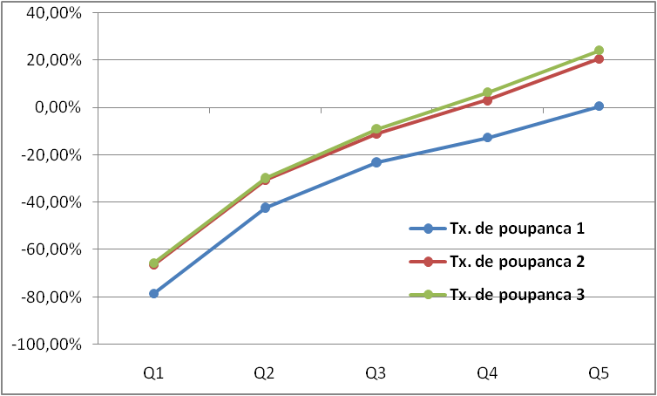
Result - LAD for current income
Table 2

Slide 15
Methodology
Relation between lifetime income and savings rate
Lifetime income need to be estimated
Measurement erros
Alternative: instruments for permanent income.
Food Consumption
Non-Durable Consumption
Education of the household.
All previous together

Slide 16
Methodology
(7)
2 stages regressions

Slide 17
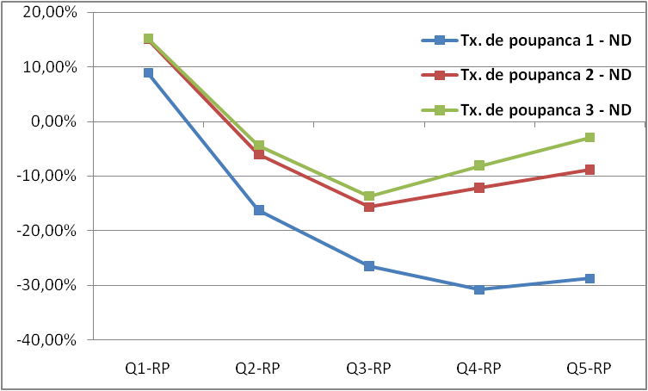
Results - LAD for permanent Income
Instruments – Non-Durable Consumption
Tabela 3

Slide 18
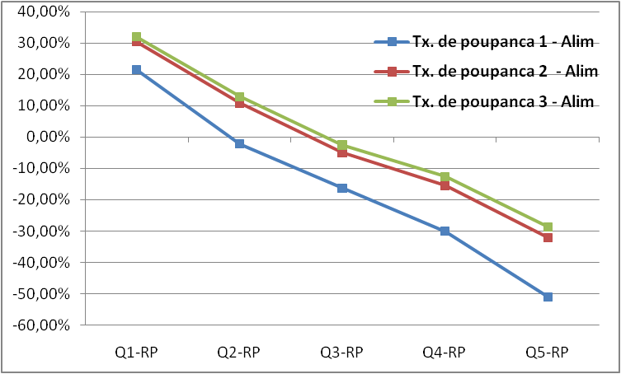
Result - LAD for Permanent Income
Instrument – Food Consumption
Tabela 3

Slide 19
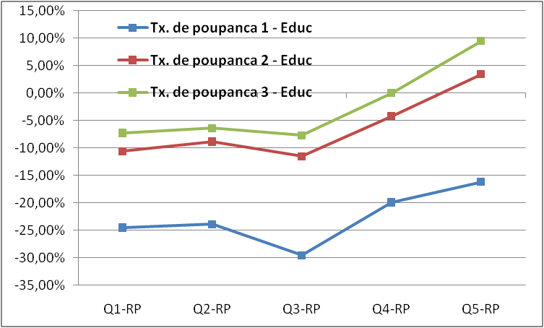
Results - LAD for Permanent Income
Instruments – Education
Tabela 3

Slide 20
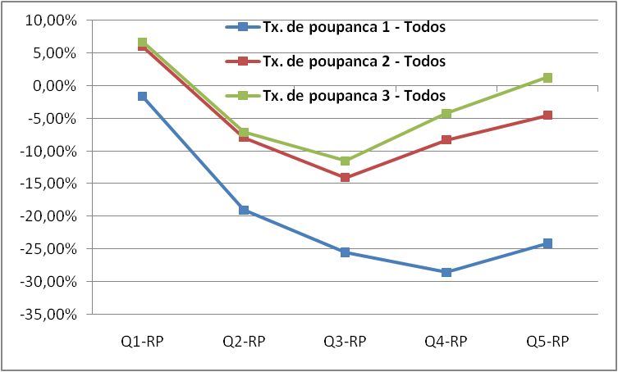
Results - LAD for Permanent Income
Instruments – All together
Tabela 3

Slide 21
Results
The results are sensible with respect the instrument used.
Education migth be correlated with preference for savings, which is a error component. (ALAN; ATALAY; CROSSLEY, 2006).
Verify this hyphoteses:
Covariates for preferences for savings (education, religion, gender, color).

Slide 22
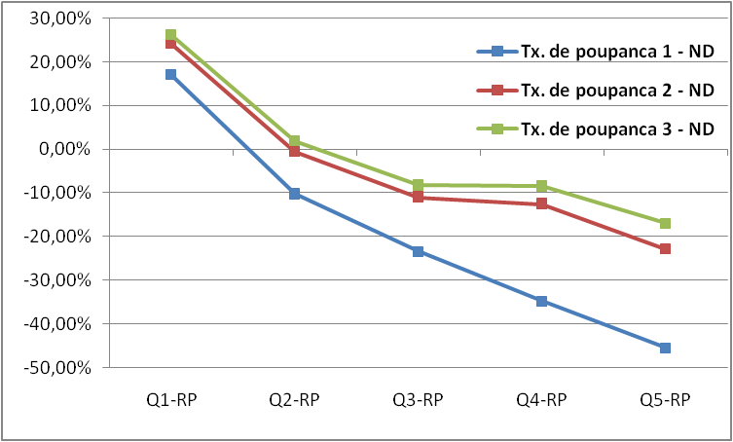
Results - LAD for Permanent Income with controls
Instruments – Non-durable goods consumption
Tabela 5

Slide 23
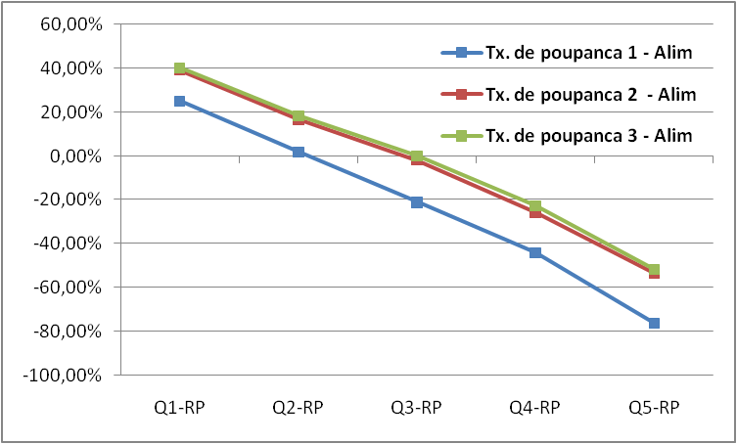
Results - LAD for Permanent Income with controls
Instruments – Food Consumption
Tabela 5

Slide 24
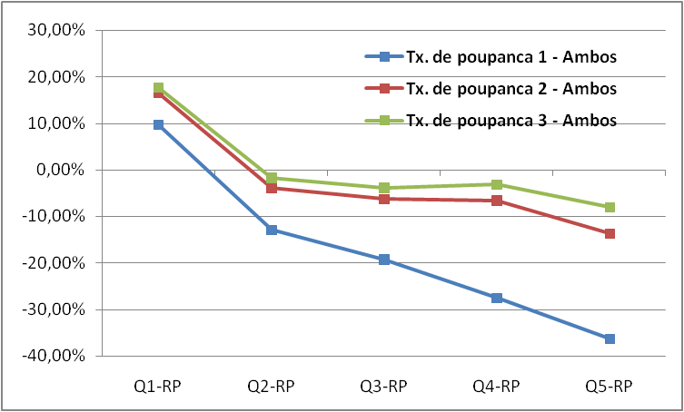
Results - LAD for Permanent Income with controls
Instruments – Both
Tabela 5

Slide 25
Results
Poor families save more
Covariates
Education : More educated people save more.
Religion: In general, does not matter
Color: not conclusive
Gender: Woman save less
Age: Younger save less.

Slide 26
Final Remarks

Slide 27
Conclusion
In 2002-2003, the poor saved more than the rich in Brazil.
Possible Explanations:
Precautionary Savings

Slide 28
Conclusion
Limitations:
Permanetn Income is still not well estimated
Inclusions of other variables correlated to the permanent income
Location;
Employment – sector and activity ;
Possible Extensions:
Include variables related to income uncertainty (Employment variables, in example);
Use a Pseudo-Panel date analysys using the other Household Surveys Available.

Slide 29
Backup

Slide 30
Tabela 2 – LAD para renda corrente
 | Tx. de poupanca 1 | Tx. de poupanca 2 | Tx. de poupanca 3
Renda Corrente - Q1 | -0.7838 | -0.6620 | -0.6544
 | 0.0373 | 0.0223 | 0.0214
Renda Corrente - Q2 | -0.4224* | -0.3051* | -0.2965*
 | 0.0316 | 0.0262 | 0.0198
Renda Corrente - Q3 | -0.2309* | -0.1092* | -0.0894*
 | 0.0273 | 0.0264 | 0.0204
Renda Corrente - Q4 | -0.1268* | 0.0311* | 0.0650*
 | 0.0280 | 0.0249 | 0.0160
Renda Corrente - Q5 | 0.0049* | 0.2054* | 0.2412*
 | 0.0250 | 0.0107 | 0.0166
Idade - entre 30 e 39 | 0.0299 | 0.0410 | 0.0569
 | 0.0255 | 0.0223 | 0.0155
Idade - entre 50 e 59 | 0.0498 | 0.0030 | 0.0007
 | 0.0252 | 0.0161 | 0.0192
Pseudo R2 | 0.0620 | 0.1032 | 0.1152
Coeficiente da Renda/10000 | 0.0480 | 0.0583 | 0.0622
 | 0.0065 | 0.0043 | 0.0074
Número de observações | 22121 | 22121 | 22121
1. Erros-Padrão são calculados pelo algoritmo de Huber Sandwich e apresentados em parênteses.
2. * significa que o coeficiente do quintil da renda é estatisticamente diferente que o imediatamente anterior, a 5% de significância.
3. Todas as regressões são ponderadas pelos pesos disponibilizados pela POF.
Voltar

Slide 31
Tabela 3 – LAD para renda permanente
Instrumento para Renda Permanente | Educação do Chefe de família |  |  | Despesa com bens não-duráveis |  |  | Despesa com alimentos |  |  | Todos os anteriores
R2 do Primeiro Estágio | 0.1066 |  |  | 0.2901 |  |  | 0.0319 |  |  | 0.2995
Teste F - Primeiro Estágio | 527.6403 |  |  | 3012.6240 |  |  | 242.9934 |  |  | 1350.7830
 | Tx. de poupança 1 | Tx. de poupança 2 | Tx. de poupança 3 | Tx. de poupança 1 | Tx. de poupança 2 | Tx. de poupança 3 | Tx. de poupança 1 | Tx. de poupança 2 | Tx. de poupança 3 | Tx. de poupança 1 | Tx. de poupança 2 | Tx. de poupança 3
Renda Permanente - Q1 | -0.2452 | -0.1063 | -0.0727 | 0.0883 | 0.1502 | 0.1519 | 0.2152 | 0.3044 | 0.3188 | -0.0168 | 0.0595 | 0.0667
 | (0.0510) | (0.0327) | (0.0322) | (0.0210) | (0.0180) | (0.0216) | (0.0327) | (0.0251) | (0.0205) | (0.0233) | (0.0197) | (0.0197)
Renda Permanente - Q2 | -0.2394 | -0.0884 | -0.0641 | -0.1631* | -0.0606* | -0.0438* | -0.0215* | 0.1090* | 0.1282* | -0.1903* | -0.0787* | -0.0717*
 | (0.0197) | (0.0181) | (0.0193) | (0.0281) | (0.0148) | (0.0254) | (0.0224) | (0.0159) | (0.0143) | (0.0275) | (0.0191) | (0.0205)
Renda Permanente - Q3 | -0.2958 | -0.1150 | -0.0773 | -0.2651* | -0.1564* | -0.1369* | -0.1630* | -0.0490* | -0.0258* | -0.2548 | -0.1403* | -0.1150
 | (0.0425) | (0.0335) | (0.0430) | (0.0233) | (0.0182) | (0.0271) | (0.0243) | (0.0123) | (0.0160) | (0.0364) | (0.0199) | (0.0177)
Renda Permanente - Q4 | -0.1995 | -0.0423 | -0.0001 | -0.3083 | -0.1210 | -0.0813 | -0.3012* | -0.1530* | -0.1273* | -0.2850 | -0.0828 | -0.0422*
 | (0.0387) | (0.0177) | (0.0207) | (0.0190) | (0.0190) | (0.0344) | (0.0335) | (0.0331) | (0.0208) | (0.0334) | (0.0299) | (0.0269)
Renda Permanente - Q5 | -0.1622 | 0.0337* | 0.0947* | -0.2884 | -0.0884 | -0.0300 | -0.5106* | -0.3196* | -0.2866* | -0.2408 | -0.0453 | 0.0124
 | (0.0162) | (0.0215) | (0.0313) | (0.0195) | (0.0138) | (0.0248) | (0.0298) | (0.0264) | (0.0263) | (0.0183) | (0.0133) | (0.0203)
Idade - entre 30 e 39 | -0.0214 | -0.0007 | -0.0204 | -0.0550 | -0.0275 | -0.0211 | -0.2659 | -0.2157 | -0.2151 | -0.0327 | -0.0116 | -0.0088
 | (0.0436) | (0.0221) | (0.0272) | (0.0236) | (0.0156) | (0.0241) | (0.0248) | (0.0223) | (0.0182) | (0.0260) | (0.0189) | (0.0199)
Idade - entre 50 e 59 | 0.1162 | 0.0457 | 0.0274 | 0.0870 | 0.0658 | 0.0575 | 0.1810 | 0.1612 | 0.1498 | 0.0890 | 0.0609 | 0.0466
 | (0.0392) | (0.0268) | (0.0366) | (0.0230) | (0.0195) | (0.0239) | (0.0303) | (0.0209) | (0.0199) | (0.0272) | (0.0160) | (0.0217)
Pseudo R2 | 0.0033 | 0.0045 | 0.0068 | 0.0216 | 0.0148 | 0.0124 | 0.0401 | 0.0432 | 0.0420 | 0.0094 | 0.0056 | 0.0056
Coeficiente da Renda/10000 | 0.0241 | 0.0336 | 0.0407 | -0.0283 | -0.0116 | -0.0027 | -0.2828 | -0.2465 | -0.2414 | -0.0146 | -0.0026 | 0.0050
 | (0.0082) | (0.0048) | (0.0057) | (0.0046) | (0.0009) | (0.0007) | (0.0306) | (0.0369) | (0.0149) | (0.0053) | (0.0022) | (0.0013)
Número de observações | 22.121
Notas: 1. Erros-Padrão são calculados pelo algoritmo de Huber Sandwich e apresentados em parênteses. 2. * significa que o coeficiente do quintil da renda é estatisticamente diferente que o imediatamente anterior, a 5% de significância. 3. Todas as regressões são ponderadas pelos pesos disponibilizados pela POF.
Voltar

Slide 32
Tabela 4 – LAD para renda corrente com controles
 | Tx. de poupança 1 | Tx. de poupança 2 | Tx. de poupança 3
Renda Corrente - Q1 | -0.8047 | -0.6783 | -0.6619
 | (0.0446) | (0.0256) | (0.0285)
Renda Corrente - Q2 | -0.4246* | -0.3065* | -0.2872*
 | (0.0339) | (0.0321) | (0.0347)
Renda Corrente - Q3 | -0.2260* | -0.0891* | -0.0709*
 | (0.0443) | (0.0281) | (0.0311)
Renda Corrente - Q4 | -0.0725* | 0.0821* | 0.1122*
 | (0.0357) | (0.0244) | (0.0221)
Renda Corrente - Q5 | 0.1408* | 0.3262* | 0.3487*
 | (0.0401) | (0.0272) | (0.0319)
Idade - entre 30 e 39 | 0.0473 | 0.0770 | 0.0656
 | (0.0259) | (0.0168) | (0.0155)
Idade - entre 50 e 59 | 0.0373 | 0.0013 | -0.0016
 | (0.0246) | (0.0181) | (0.0186)
Ensino médio completo | -0.1340 | -0.1442 | -0.1190
 | (0.0241) | (0.0191) | (0.0163)
Ensino Superior incompleto | -0.2385 | -0.2470 | -0.2160
 | (0.0534) | (0.0533) | (0.0311)
Ensino superior completo ou mais | -0.2546 | -0.2152 | -0.1688
 | (0.0376) | (0.0243) | (0.0300)
Católico | -0.0248 | -0.0182 | -0.0152
 | (0.0281) | (0.0191) | (0.0204)
Evangélico | -0.0168 | -0.0292 | -0.0322
 | (0.0378) | (0.0251) | (0.0259)
Mulher | 0.0385 | -0.0042 | -0.0002
 | (0.0265) | (0.0179) | (0.0144)
Negro | 0.0688 | 0.0666 | 0.0563
 | (0.0391) | (0.0235) | (0.0423)
Amarelo | -0.0236 | -0.1717 | -0.1451
 | (0.0587) | (0.0379) | (0.2955)
Pardo | 0.0633 | 0.0520 | 0.0440
 | (0.0211) | (0.0145) | (0.0158)
Índio | 0.1333 | 0.2235 | 0.2255
 | (0.0589) | (0.2007) | (0.2001)
Pseudo R2 | 0.0707 | 0.1153 | 0.1245
Coeficiente da Renda/10000 | 0.0614 | 0.0736 | 0.0729
 | (0.0048) | (0.0052) | (0.0044)
Número de observações |  | 22121
Notas: 1. Erros-Padrão são calculados pelo algoritmo de Huber Sandwich e apresentados em parênteses. 2. * significa que o coeficiente do quintil da renda é estatisticamente diferente que o imediatamente anterior, a 5% de significância. 3. Todas as regressões são ponderadas pelos pesos disponibilizados pela POF.
Voltar

Slide 33
Tabela 5 - LAD para renda permanente com controles
Instrumento para Renda Permanente | Despesa com bens não-duráveis |  |  | Despesa com alimentos
R2 do Primeiro Estágio | 0.2915 |  |  | 0.1246
Teste F - Primeiro Estágio | 699.5616 |  |  | 242.0534
 | Tx. de poupança 1 | Tx. de poupança 2 | Tx. de poupança 3 | Tx. de poupança 1 | Tx. de poupança 2 | Tx. de poupança 3
Renda Permanente - Q1 | 0.1707 | 0.2419 | 0.2610 | 0.2500 | 0.3887 | 0.4012
 | (0.0364) | (0.0361) | (0.0272) | (0.0394) | (0.0362) | (0.0447)
Renda Permanente - Q2 | -0.1017* | -0.0048* | 0.0191* | 0.0177* | 0.1641* | 0.1827*
 | (0.0446) | (0.0362) | (0.0248) | (0.0268) | (0.0222) | (0.0335)
Renda Permanente - Q3 | -0.2335* | -0.1090* | -0.0817* | -0.2106* | -0.0200* | -0.0008*
 | (0.0383) | (0.0395) | (0.0369) | (0.0362) | (0.0291) | (0.0352)
Renda Permanente - Q4 | -0.3469* | -0.1246 | -0.0839 | -0.4419* | -0.2571* | -0.2272*
 | (0.0479) | (0.0355) | (0.0337) | (0.0523) | (0.0278) | (0.0369)
Renda Permanente - Q5 | -0.4537* | -0.2280* | -0.1690* | -0.7615* | -0.5346* | -0.5169*
 | (0.0411) | (0.0391) | (0.0278) | (0.0629) | (0.0460) | (0.0550)
Idade - entre 30 e 39 | -0.0786 | -0.0475 | -0.0493 | -0.1882 | -0.1572 | -0.1523
 | (0.0216) | (0.0224) | (0.0197) | (0.0178) | (0.0202) | (0.0188)
Idade - entre 50 e 59 | 0.1135 | 0.0709 | 0.0577 | 0.2165 | 0.1688 | 0.1648
 | (0.0227) | (0.0205) | (0.0206) | (0.0252) | (0.0197) | (0.0236)
Ensino médio completo | 0.1992 | 0.1726 | 0.1784 | 0.5366 | 0.5049 | 0.5160
 | (0.0237) | (0.0268) | (0.0253) | (0.0472) | (0.0343) | (0.0379)
Ensino Superior incompleto | 0.3576 | 0.3035 | 0.3101 | 0.7538 | 0.7757 | 0.8139
 | (0.0368) | (0.0368) | (0.0347) | (0.0603) | (0.0658) | (0.0583)
Ensino superior completo ou mais | 0.3465 | 0.3265 | 0.3443 | 0.7445 | 0.7640 | 0.8116
 | (0.0402) | (0.0369) | (0.0283) | (0.0569) | (0.0589) | (0.0556)
Católico | -0.0414 | -0.0407 | -0.0425 | -0.0525 | -0.0686 | -0.0715
 | (0.0323) | (0.0235) | (0.0223) | (0.0278) | (0.0214) | (0.0259)
Evangélico | -0.0358 | -0.0601 | -0.0501 | -0.1218 | -0.1405 | -0.1491
 | (0.0367) | (0.0301) | (0.0445) | (0.0442) | (0.0288) | (0.0363)
Mulher | -0.0474 | -0.0726 | -0.0677 | -0.1976 | -0.2215 | -0.2125
 | (0.0196) | (0.0208) | (0.0199) | (0.0301) | (0.0177) | (0.0232)
Negro | -0.0103 | -0.0015 | -0.0276 | -0.1487 | -0.1755 | -0.1649
 | (0.0378) | (0.0339) | (0.0251) | (0.0415) | (0.0242) | (0.0446)
Amarelo | -0.0566 | -0.1603 | -0.2354 | -0.1357 | -0.2634 | -0.2705
 | (0.0371) | (0.0299) | (0.0346) | (0.0185) | (0.0355) | (0.0391)
Pardo | -0.1076 | -0.0932 | -0.1051 | -0.1713 | -0.1735 | -0.1821
 | (0.0195) | (0.0205) | (0.0191) | (0.0181) | (0.0158) | (0.0191)
Índio | 0.2741 | 0.1602 | 0.1829 | 0.3064 | 0.1149 | 0.1013
 | (0.0317) | (0.1083) | (0.1291) | (0.0139) | (0.2260) | (0.2062)
Pseudo R2 | 0.0379 | 0.0323 | 0.0319 | 0.0355 | 0.0414 | 0.0441
Coeficiente da Renda/10000 | -0.0726 | -0.0408 | -0.0308 | -0.2511 | -0.1864 | -0.1667
 | (0.0084) | (0.0042) | (0.0050) | (0.0091) | (0.0176) | (0.0155)
Número de observações |  |  |  | 22121
Notas: 1. Erros-Padrão são calculados pelo algoritmo de Huber Sandwich e apresentados em parênteses. 2. * significa que o coeficiente do quintil da renda é estatisticamente diferente que o imediatamente anterior, a 5% de significância. 3. Todas as regressões são ponderadas pelos pesos disponibilizados pela POF
Voltar

Slide 34
Tabela 5 - LAD para renda permanente com controles
Instrumento para Renda Permanente | Ambos os anteriores
R2 do Primeiro Estágio | 0.3002
Teste F - Primeiro Estágio | 677.2930
 | Tx. de poupança 1 | Tx. de poupança 2 | Tx. de poupança 3
Renda Permanente - Q1 | 0.0959 | 0.1634 | 0.1762
 | (0.0348) | (0.0432) | (0.0367)
Renda Permanente - Q2 | -0.1292* | -0.0391* | -0.0170*
 | (0.0335) | (0.0467) | (0.0370)
Renda Permanente - Q3 | -0.1929* | -0.0636 | -0.0391
 | (0.0286) | (0.0434) | (0.0355)
Renda Permanente - Q4 | -0.2755* | -0.0667 | -0.0317
 | (0.0368) | (0.0473) | (0.0367)
Renda Permanente - Q5 | -0.3627* | -0.1368* | -0.0802
 | (0.0378) | (0.0500) | (0.0440)
Idade - entre 30 e 39 | -0.0699 | -0.0435 | -0.0493
 | (0.0215) | (0.0233) | (0.0221)
Idade - entre 50 e 59 | 0.1113 | 0.0504 | 0.0410
 | (0.0189) | (0.0249) | (0.0250)
Ensino médio completo | 0.1465 | 0.1332 | 0.1329
 | (0.0191) | (0.0261) | (0.0257)
Ensino Superior incompleto | 0.2695 | 0.2102 | 0.2341
 | (0.0424) | (0.0420) | (0.0498)
Ensino superior completo ou mais | 0.2864 | 0.2571 | 0.2720
 | (0.0311) | (0.0489) | (0.0362)
Católico | -0.0387 | -0.0296 | -0.0283
 | (0.0251) | (0.0294) | (0.0235)
Evangélico | -0.0423 | -0.0627 | -0.0413
 | (0.0333) | (0.0401) | (0.0326)
Mulher | -0.0770 | -0.0881 | -0.0873
 | (0.0202) | (0.0218) | (0.0246)
Negro | -0.0176 | -0.0092 | -0.0207
 | (0.0340) | (0.0312) | (0.0384)
Amarelo | -0.0901 | -0.1933 | -0.2586
 | (0.0188) | (0.0527) | (0.4816)
Pardo | -0.0974 | -0.0780 | -0.0817
 | (0.0200) | (0.0208) | (0.0192)
Índio | 0.2599 | 0.1376 | 0.1795
 | (0.0386) | (0.1318) | (0.1008)
Pseudo R2 | 0.0205 | 0.0162 | 0.0171
Coeficiente da Renda/10000 | -0.0535 | -0.0259 | -0.0172
 | (0.0094) | (0.0032) | (0.0059)
Número de observações |  | 22.121
Notas: 1. Erros-Padrão são calculados pelo algoritmo de Huber Sandwich e apresentados em parênteses. 2. * significa que o coeficiente do quintil da renda é estatisticamente diferente que o imediatamente anterior, a 5% de significância. 3. Todas as regressões são ponderadas pelos pesos disponibilizados pela POF
Voltar

