Slide 1

Issues for analyzing competing-risks data with missing or misclassification in causes
Dr. Ronny Westerman
Institute of Medical Sociology and Social Medicine
Medical School & University Hospital
July 27, 2012

Slide 2
Introduction
Background
Data and Methods
Results
Discussion
Reference
Outline
Introduction/Background
Data
Methods
Discussion
Perspectives

Slide 3
Introduction
Background
Data and Methods
Results
Discussion
Reference
Introduction
Limited Failure Models (Immortal)
Competing Risks
Missing and Misclassification of causes (Masked causes)

Slide 4
Introduction
Background
Data and Methods
Results
Discussion
Reference
Limited Failure Model (Cure Survival Models)
Examples: Infant Mortality
Curability of cancer and decreasing mortality risk since diagnosis of cancer
None defective units are not expected to fail from risk

Slide 5
Introduction
Background
Data and Methods
Results
Discussion
Reference
The Competing Risk Problem:
Each subject being exposed to many competing risks, but only one will be caused the failure
Subject ist still right-censored if it do not fail within the follow-up duration

Slide 6
Introduction
Background
Data and Methods
Results
Discussion
Reference
Competing Risks
Non-parametic, semi-parametric and full-parametric models
Cause-spezific hazard function
Problem: Assumption of independence through cause often violated?
Failure Time for all risks are operatively the same, in that case, all risks being removed except the risk under consideration

Slide 7
Introduction
Background
Data and Methods
Results
Discussion
Reference
Missclassification and Missing of causes
Cause of event for some of units or individuals not exactly identified or recored
Partial masking: Cause is narrowed down but not exactely identified
Reason for missclassification:
documentation containing the information needed for attributing the cause of failure may be not collected, or the cause of diseases for some patients may be difficult to determine

Slide 8
Introduction
Background
Data and Methods
Results
Discussion
Reference
Difficulties for determination: (aetiological problems)
Example: Cardioembolic stroke (Leary and Caplan, 2008)
Cardioembolic stroke occurs when the heart pumps unwanted materials into the brain circulation, resulting in the occlusion of a brain blood vessel and damage to the brain tissue.
CS diagnosed in 3-8% stroke patients, but in various current stroke registries, approximately 10-20% patients with CS have not maximal symptoms at the onset of their stroke Exclusion

Slide 9
Introduction
Background
Data and Methods
Results
Discussion
Reference
Missclassification:
Example: Breast Cancer
TNM Staging vs . I-IV Staging
Stage migration: improved detection of illness leads to movement of people from the set of healthy people to the set of unhealthy people
Will Rogers phenomen:
„When the Okies left Oklahoma and moved to California, they raised
the average intelligence level in both states“

Slide 10
Introduction
Background
Data and Methods
Results
Discussion
Reference
Methods for treating masked cause data
1) Mutiple Imputations
Should be used, when Baseline are not proportional
Works good in case of Missing at Random (for cause)
Problem: High-Mortality-Risks, Multiple-Specific and High-
Potential-Risks often not Missing at Random
False classification or misinterpretation of cause-specific
mortality

Slide 11
Introduction
Background
Data and Methods
Results
Discussion
Reference
Methods for treating masked cause data
2) Second Stage Analysis
Models with non-proportional cause-specific hazard
3) EM for grouped Survival data
Bayesian Methods
Assumptions for masked causes:
Right censoring, if causes not exactly identified
Masking probabilty is constant over time

Slide 12
Introduction
Background
Data and Methods
Results
Discussion
Reference
SEER Cancer Statistic Data Base National Cancer Institute,
DCCPS, Surveillance Research Program, Cancer Statistics Branch
(released April 2012)
Incidence by Race, Gender and Age (different periods of time)
Cause-Specific Mortality including all specific cancer
SEER public use dataset on survival of breast cancer patients
from 1992-2009 (n=69,990 in Situ)

Slide 13
Introduction
Background
Data and Methods
Results
Discussion
Reference
Leading Cause of Death in the U.S. 1975 vs. 2009
Source: US Moratlity Files, National Center of Health Statistics, Centers of Disease Control and Prevention

Slide 14
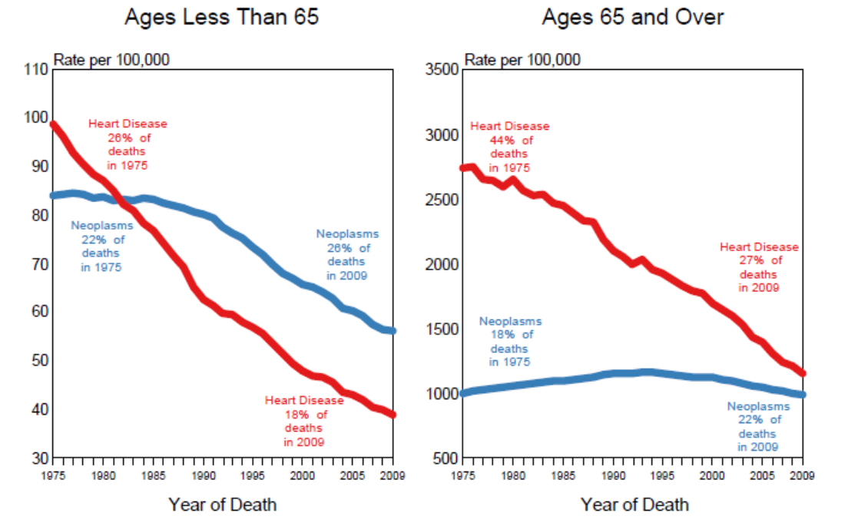
Introduction
Background
Data and Methods
Results
Discussion
Reference
US Death Rates, 1975-2009 Heart Disease compared to Neoplasms, by age at death
Source: US Moratlity Files, National Center of Health Statistics, Centers of Disease Control and Prevention
Rates are per 100,000 and age-adjusted to the 2000 US Std Population (19 age groups - Census P25-1103).

Slide 15
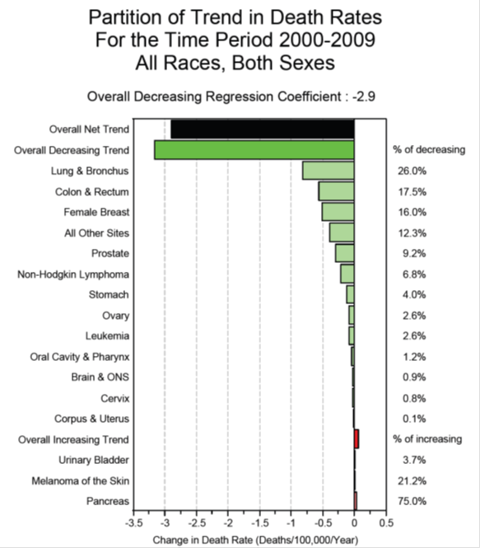
Introduction
Background
Data and Methods
Results
Discussion
Reference
Source: US Moratlity Files, National Center of Health Statistics, Centers of Disease Control and Prevention

Slide 16
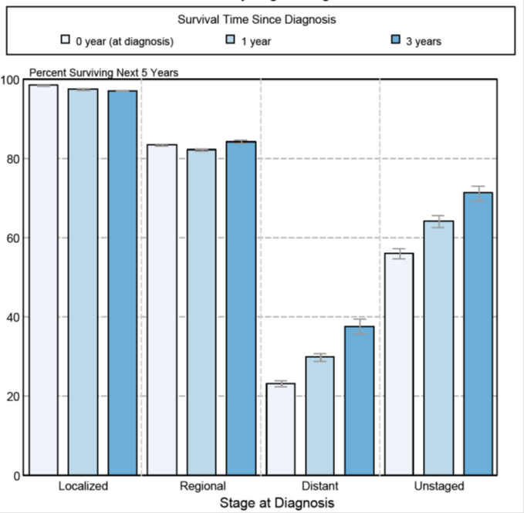
Introduction
Background
Data and Methods
Results
Discussion
Reference
5-year Conditional Relative Survival for Cancer of female Breast
SEER, 2012

Slide 17
Introduction
Background
Data and Methods
Results
Discussion
Reference
And now, what‘s the problem?
Preliminary Analysis with SEER- DATA (Sen et al. 2010)
Over-sampling the masked cases
46 % of the women died during follow-up
Specific mortality related to breast cancer, other cancer or non-cancer related causes
for 56 % the exact cause of death was known
for 35 % partial information available
30 % with missing cause of death: false classification (breast cancer to other or multiples cancer)
65 % missing causes were complety masked

Slide 18
Introduction
Background
Data and Methods
Results
Discussion
Reference
How do deal with masked causes ?
Motivation to use Two-Component-Model for masked causes
Risks are latent: no specific information about the cause of the component failure
Only some individuals may susceptible to the event of interest
(curability or the recessive risk for the disease)

Slide 19
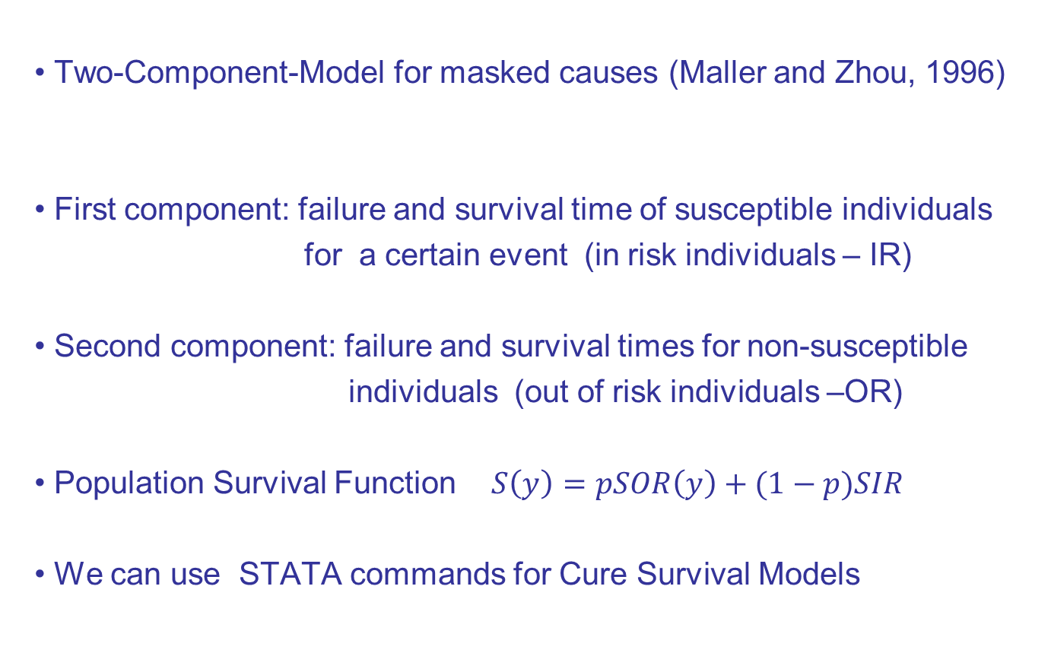
Introduction
Background
Data and Methods
Results
Discussion
Referenc
Two-Component-Model for masked causes (Maller and Zhou, 1996)
First component: failure and survival time of susceptible individuals
for a certain event (in risk individuals – IR)
Second component: failure and survival times for non-susceptible
individuals (out of risk individuals –OR)
Population Survival Function $S\left(y\right)=pSOR\left(y\right)+(1−p)SIR$
We can use STATA commands for Cure Survival Models

Slide 20
Introduction
Background
Data and Methods
Results
Discussion
Reference
Useful Stata commands for cure models: lncure, spsurv, and
cureregr (Lambert, 2007)
the advances of cureregr: fits both mixture and nonmixture cure models
parametric distributions: exponential, Weibull, lognormal, and
gamma parametric distributions available
Optional: strsmix allowing more flexible parametric distributions

Slide 21
Introduction
Background
Data and Methods
Results
Discussion
Reference
Data Analysis with SEER Breast Cancer Data
Survival of breast cancer patients
from 1992-2009 (n=69,990 in Situ)
cause of death: breast cancer and other causes
other causes as competing risks
We used a non-mixture cure fraction model with Weibull and Exponential specification

Slide 22
Introduction
Background
Data and Methods
Results
Discussion
Reference
Results from Data Analysis (Estimates for the Long-Term Survival Function)
Λ-scale parameter, φ- shape parameter, p- long-term parameter

Slide 23
Introduction
Background
Data and Methods
Results
Discussion
Reference
Results
no evidence that Weibull provides a better fitting than the Exponential
for Seer Breast Cancer Data at 5% significance
corrobate the empirical Kaplan-Meier Survival

Slide 24
Introduction
Background
Data and Methods
Results
Discussion
Reference

Slide 25
Introduction
Background
Data and Methods
Results
Discussion
Reference
Thrills and Tears with Cure Survival Models
Thrills: less assumptions and minor computation problems
Tears: to overcome the naïve assumption for infinite failure time of
the nonsusceptiple units

Slide 26
Introduction
Background
Data and Methods
Results
Discussion
Reference
Limitations for parametric hazard functions
The complexity of the baseline hazard function (Crowther and Lambert, 2011)
beyond standard and sometimes biologically and implausible shapes
a turning point in the hazard function is observed
2-component mixture distribution e.g. Weibull-Weibull-distribution
other distribution families also available

Slide 27
Introduction
Background
Data and Methods
Results
Discussion
Reference
Options in STATA
STPM2: Stata module to estimate flexible parametric survival models (Royston-Parmar models) (updated by Lampert, 2012)
STPM2 also used with single- or multiple- record (more generalized)
STMIX: 2-component parametric mixture survival models (Crowther and Lambert, 2011)
distribution choices includes Weibull-Weibull or Weibull-exponential
STMIX can be used with single- or multiple-record

Slide 28
Introduction
Background
Data and Methods
Results
Discussion
Reference
References
Craiu and Lee (2005): Model Selection for the Competing-Risks Model with and without masking. Technometrics, Vol.25, No.4, 457-467
Leary MC, Caplan LR (2008): Cardioembolic stroke: An updated on etiology, diagnosis and management. Annuals Indian Academic Neurology , 11, 52-63
Lu and Liang (2008): Analysis of competing risks data with missing cause of failure under additive hazard model. Statistica Sinica 18, 219-234.
Crowther and Lampert (2011): Simulating complex survival data. Stata Nordic and Baltic Users‘ Group Meeting
National Cancer Institute DCCPS Surveillance Research Programme, Surveillance, Epidemiology and End Results (SEER) Programme (www.cancer.seer.gov) Research Data (1973-2009) (Released April 2012)
Louzda et al. (2012): The Long-Term Bivariate Survival FGM Copula Model: An
Application to a Brazilian HIV Data. Journal of Data Science 10, 515-535
Roman et al. (2012): A New Long-Term Survival Distribution for Cancer Data. Journal of Data Science 10, 242-258
Sen et al. (2010): A Bayesian approach to competing risks analysis with masked cause of death. Statistics in Medicine, 29, 1681-1695

Slide 29

Thank you for your attention

Slide 30

Mon, 7/30/2012, 8:30 AM - 10:20 AM | CC-Room 24C
Biometrics Section
Advances in Modeling Competing Risks — Contributed Papers

