Slide 1

An Empirical Analysis Comparing
Public Self-Selecting Elementary Schools to Traditional Based Elementary Schools
Within the Anchorage School District by
Matthew McCauley
Sponsored by
College of Business and Public Policy and
University of Alaska Anchorage Honors College

Slide 2
Introduction
Current Alaskan Elementary Achievement
  Alaskan 4th Graders at or Above Basic Proficiency
    Reading: 56% (66% National Average)
      Only five states are below Alaska (California, Louisiana, Mississippi, Alabama, and D.C.)
    Math: 78% (82% National Average)
Notes:
According to National center for Educational Statistics, Alaskan 4th graders are 56% proficient at or above basic reading standards set by National Assessment of Educational Progress (NAEP) compared to the national average of 66%.
Only five states are below Alaska. California, Louisiana, Mississippi, Alabama, and DC.
In math Alaskan 4th graders are just slightly below the national average for basic math proficiency with 78% compared to the national average of 82%.

Slide 3
A Possible Solution
More Charter/Lottery (“Self-Selecting”)
  High Achievement: Five of the nine Anchorage School District (ASD) publically funded self-selecting schools are consistently in the top ten for highest achieving elementary schools in all subjects
  High Parental Demand: The top three ASD public elementary schools are self-selecting schools with 400-600 students per school on waitlists
Notes:
- Currently five of the nine self-selecting schools are consistently in the top ten for test scores for all subjects (reading, writing, math, and science.)
- There is a large demand for high achieving schools top schools in Anchorage.

Slide 4
SBA: Percentage School Proficient
Notes:
A graphical representation on how these self-selecting schools compare to Traditional Schools
The SBA is a state norm assessment that measures overall school proficiency. Beginning in 3rd grade students take these assessments every spring.
On average self-selecting schools are 10 -13% more proficient compared to the traditional base schools

Slide 5
TerraNova Above Average Scores
Notes:
But where you really see the gap start to widen between these school types is at the highest percentiles.
The TerraNova 5th grade nationally norm achievement scores in the highest centile range show students who attend a self-selecting school score 24-25% higher than traditional based schools in the top range for test scores.

Slide 6
My Question
  What is most likely driving the differences in test scores between self-selecting K-6 elementary schools and traditional based schools?
Notes:
My question is mainly what is the baseline for how these different types of schools compared to one another and what is driving the differences of test scores?

Slide 7
Presentation Outline
Related Literature
Data Summary and Sources
Econometric Framework
Discussion of Results

Slide 8
Related Literature
  In Michigan self-selecting schools test scores were lower or average to traditional public schools (Eberts and Hollenbeck 2001)
Milwaukee, Wisconsin self-selecting school’s test score were lower or average to traditional public schools (Hiren Nisar 2010)
  In New York self-selecting schools had higher test scores compared to traditional public schools. (Hoxby et. al 2009)
  Authors controlled for parent, student, and teacher characteristics such as income, educational attainment of parents, teacher quality, students who were limited in English proficiency, F/R lunch, etc.
  My model controls for similar characteristics
Notes:
As far as past research goes there are some mixed results.
In an earlier study in Michigan:
MICHIGAN
Some earliest literature on comparing self-selecting schools to traditional based schools was a study done by Eberts and Hollenbeck comparing publically funded Michigan Charter schools to traditional based schools for the entire state.
Their results show 4th grade students in self-selecting schools scored 2-4% less in math and reading compared to traditional based public schools.
MILWAUKEE
In the second study by Nisar, self-selecting schools in Milwaukee were compared to their traditional based counterparts. Nisar also concluded that self-selecting schools on average scored lower to equal to traditional based schools within the same area.
NEW YORK
In the study by Hoxby, New York City Charter schools effect on achievement was assess by comparing students that were lotteried into a New City Charter school and those that did not lottery in into a charter school.
- Overall results showed that students who attended particular charters schools did better than the non-lotteried students. However most results were not immediate and required the student to have attended the school for over 6 years.
- Methods include controlling for student and parented characteristics such as student previous test scores, race, gender, F/R lunch, etc.
- This study was a very robust study and more about comparing student outcomes.

Slide 9
My Research Methods
Compare Self-Selecting Schools to Traditional Based Schools By:
  Using least squares regression, random effects model, and a panel data set
  Controlling for parental, teacher, and student characteristics

Slide 10
Data Summary and Sources
Anchorage School District Elementary School Data.
  “Profile of Performance”- School Years 2007-2010
  Number of Students for Each School By Home Zip Code Including Self-Selecting Schools
2010 Census and American Community Survey (2006-2010)
  Average household income by census tract matched to zip code
  Average household educational attainment by census tract matched to zip code
Notes:
Just lay out data source. Don’t take too much time…
To obtain test score data for all elementary schools, I requested from ASD to provide Profile of performance data for each elementary school.
Also by request, home zip codes for all students was provided for each school. This data was especially important to get a better idea where these self-selecting students are coming from to control for parental characteristics such as parental income and educational attainment.
I was not able to get specific parental data from ASD so I tried to recreate this data using census tract and zip code data.
Supporting data for number of households by zip code was collected using the 2010 Census. Average household income and average household educational attainment for each zip code was calculated by Census tract using ACS data.

Slide 11
Data Summary and Sources
2008-2009 ASD ranked 94th out of the 100 largest school districts
  ASD area covers 1,900 Square miles (Size of Delaware)
  42% of Alaska’s population lives in Anchorage
  50,000 students
  Diversity: 50.8 percent non-white, 49.2 white
  Over 90 different languages are spoken within the ASD
  $14,193 per student
  2,839 full time teachers
Notes:
Number of Languages spoken at home

Slide 12
Econometric Framework
Two Competing Hypotheses
  H₀: The methods and teachers in self-selecting schools drive the differences in outcomes; therefore, replicating a self-selecting school and its methods would increase test scores across the district.
  H₁: A second hypothesis is that it is primarily the characteristics of parents or students that are driving differences in self-selecting school outcomes; that is, parents with a higher than average educational attainment, higher earnings, etc. (things that are highly correlated with student achievement) are more likely to send a child to a self-selecting school.
Notes:
Two competing hypotheses are:

Slide 13



Random Effects Model
Random Effects Model
  and subscript i = schools and subscript t = time
  that change over time
  fixed school effects that are constant over time
Notes:
Get rid of General Random effects model

Slide 14
Variables and Descriptions
Dependent Variables
  SBA Subject (Reading, Writing, Math, and Science)
  TerraNova Subject (Reading, Language, and Math)
Independent Variables
  (1) Parental Effects
    Lnwkvolhrs: Nat. log of parental volunteers hours
    Lnincome: Nat. log of average household income by zip
    Pctbach: Average household educational attainment by zip
  (2) Teacher Quality Effects
    Peraddegree: Percentage of teachers with masters or higher
    Nbacert: National Board Certified teachers per school
  (3) Student Effects
    Classstr: Classroom teacher to student ratio by school
    Pctlep: Percentage of limited English proficient students
    Pcteds: Percentage of free or reduced lunch students
Notes:
Dependent Variables are:
- SBA: are standards based assessments State norm tests which starting at 3rd grade students take every spring which measure grade proficiency for subjects such as reading, math, writing, and science
TerraNovas are Nationally norm test which only 5th graders take each spring.
My Independent Variables are
Consist of three separates groups variables. The first set of control variables includes parental effects these are

Slide 15
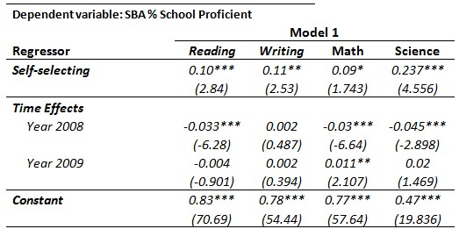
Model 1: SBA Results
Notes:
Interpret the coefficient on Self-Selecting
The first regression is the random school effects along with time variables. No independent variables are added at this point in the regression.
Self-selecting is a dummy compared to a traditional school. You see that the coefficients for all subjects are positive and significant. Not all are large.
Essentially the coefficient on self-selecting says that self-selecting schools are about 10% more proficient in reading, writing, and math. And 28% more proficient in science.
Conclusion: Self-selecting schools better and it is significant

Slide 16
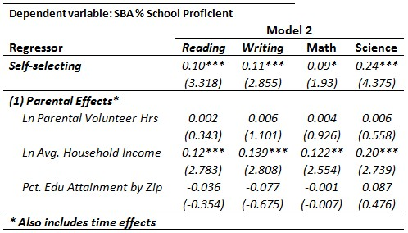
Model 2 Results: Parental Effects

Slide 17
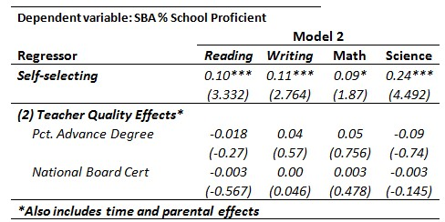
Model 2 Results: Teacher Effects

Slide 18
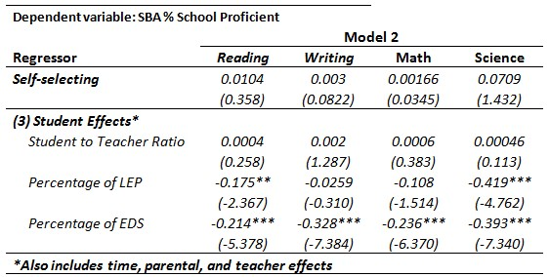
Model 2 Results: Student Effects
Notes:
KEY take home point: After controlling for all variables the coefficient a self-selecting school is zero or the advantage of a self-selecting schools is
At bottom * Includes all variables
Briefly describe eds and LEP
After adding the student controls we see that essentially that the coefficient on self-selecting is essentially zero.

Slide 19
Notes:
Greatest impact on achievement scores is student effect of EDS
Self-selecting schools have about 24% less of EDS enrollment when compared to traditional based schools.
LEP enrollment is about 40 percent less in self-selecting schools compared to traditional based schools.

Slide 20
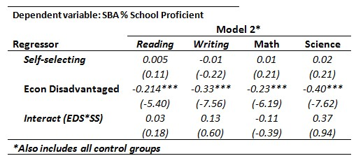
Interact: Self-Selecting and EDS
Notes:
Another way to look at the effect of Selecting schools on the EDS population is to interact the EDS variable with the top five self-selecting schools to see if there any significance. Base on the Interaction variable, there is not.

Slide 21
Conclusion
Two Competing Hypotheses
  H₀: The methods and teachers in self-selecting schools drive the differences in outcomes; therefore, replicating a self-selecting school and its methods would increase test scores across the district.
  H₁: A second hypothesis is that it is primarily the characteristics of parents or students that are driving differences in self-selecting school outcomes; that is, parents with a higher than average educational attainment, higher earnings, etc. (things that are highly correlated with student achievement) are more likely to send a child to a self-selecting school.
Notes:
What can we conclude? Based on results we can say that is predominantly the student and parental characteristics that are driving these differences within these self-selecting schools.

Slide 22
Questions?

Slide 23
Top Five Self-Selecting Schools
Notes:
What if I drop the lowest performing self-selecting schools and redo the last regression with all the control variables added what would be the result. This purpose is to see if these top five self-selecting schools are significant even when controlling for this EDS population.
The results show a small statistical significance in school proficiency when only these top five schools are regressed in subjects of reading, writing, and math. For science it is not significant.

Slide 24
Notes:
However it is important to note the average EDS enrollment for the top five self-selecting schools compared to all other traditional based elementary schools. Self-selecting schools are lower but the top five schools they are dramatically lower.

Slide 25
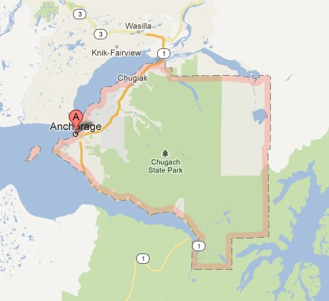

Slide 26
Overview/Definitions
All Anchorage publically funded K-6 schools
  66 elementary schools for school years 2007-2010
  No private schools were included in this study.
“Self-Selecting School” - A school in which a parent chooses (self-selects) to enroll his/her child into.
  Nine K-6 self-selecting schools TABLE HERE (Charter, Waldorf, ABC, and Optional)
  Parents must provide transportation
“Traditional Based School” - All other schools Transportation is provided by school district
Notes:
Expound on school types what is TABLE on Self-selecting school types

Slide 27
Table Self-selecting schools type
Category name
Number of Kids
Waitlist

Slide 28
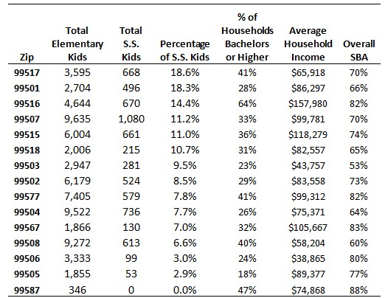
Summary and Sources

