Slide 1

Analyzing large-scale achievement surveys in Stata using
PISATOOLS and PIAACTOOLS
Dr Maciej Jakubowski
Evidence Institute and Warsaw University
November 2017

Slide 2
Agenda for today
What are large-scale achievement surveys?
Complex survey design(s)
Estimation without plausible values
  Point estimates
  Interval estimates with replicate weights
Estimation with plausible values
  Point estimates
  Estimating sampling and measurement errors
PISATOOLS
PIAACTOOLS

Slide 3
before 1990:
FIMS 1964
FISS 1970
SIMS 1980
SISS 1983
2000s:
PIRLS 2001 PIRLS 2006
TIMSS 2003 TIMSS 2007
TALIS 2008
TED S-M
ICCS 2009
PISA 2000 PISA 2003
PISA 2006 PISA 2009
2010+
TALIS 2013 TALIS 2018
ESLC 2012
ICILS 2013 ICILS 2018
TIMSS 2011 TIMSS 2015
PIRLS 2011 PIRLS 2016
PISA 2012 PISA 2015 PISA 2018
1990s:
Reading L
TIMSS 1995
IALS
CIVIC

Slide 4
Where to find information?
Survey technical reports
Data guides (TIMSS, PIRLS)
Data analysis manual (PISA – last version published in 2009)
SVY documentation in Stata

Slide 5
Sources of error
Measurement error
Model-related errors
Sampling schools and classrooms – different probability of sampling a single school/classroom
Sampling students – different probability of sampling a student (related mainly to school size)
Non-response adjustments
For trends: linking error

Slide 6
How to account for these errors?
The most important errors are:
  measurement error
  sampling errors
Plausible values reflect measurement error
Survey weight (main weight) to obtain unbiased point estimates for population
Replicate weights to derive confidence intervals (interval estimates) reflecting sampling and non-response errors

Slide 7
Survey weights
Rural
Urban
Student1
School1
School2
SchoolA
SchoolB
SchoolC
Student2
Student1
Student2
Student1
Student2
Stratum
PSU
Students

Slide 8
Replicate weights in Stata
Jackknife, BRR, bootstrap: re-sampling PSU units
In Jackknife and BRR units are dropped by design and not randomly like in bootstrap
PISA or PIAAC datasets contain sets of replicate weights
BRR for PISA
two different jackknife methods for PIAAC
These weights usually contain additional information (often confidential), e.g. strata, non-response
Easy to use by specifying svyset but…
Sometimes unclear how to specify svyset
Some commands do not work with all replicate methods, e.g. qreg does not allow BRR

Slide 9
How to do it in Stata?
Example: regression with without plausible values

Slide 16
Estimation with plausible values
Plausible values are draws from posterior distribution of student latent achievement
Usually 5, 10 or more plausible values are estimated
With each plausible value we can obtain unbiased estimates of student achievement
Using one plausible values works well in initial analysis or for graphs
However, only with five plausible values one can estimate measurement error

Slide 17
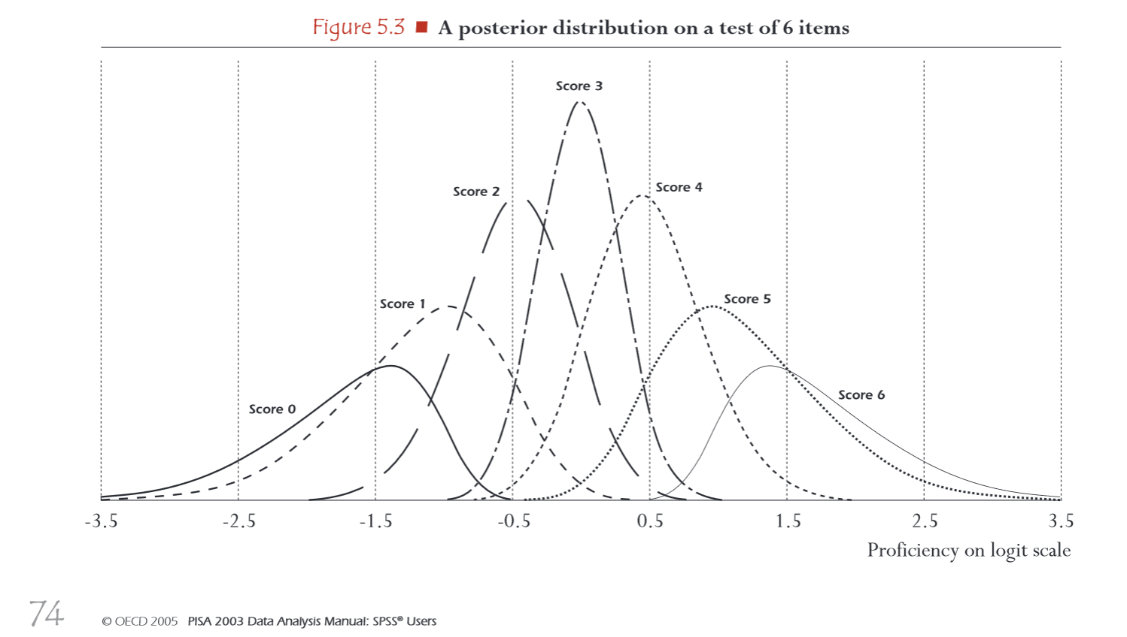

Slide 19
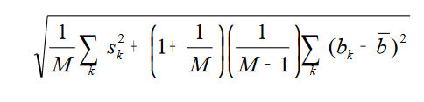
Plausible values
Point estimates: average of plausible value estimates
Interval estimates obtained using Rubin’s formula for multiple imputation (Rubin, 1987; Allison, 2000)
NEVER use average of plausible values as your variable

Slide 20
Example in Stata
Regression with plausible values – point estimates
Regression with plausible values using PISAREG
Estimation algorithm with five plausible values:
Estimate your regression model with each plausible value and BRR replicate weights
Calculate regression coefficients by taking average of five coefficients
Your sampling variance is the average sampling variance from these regressions
Your measurement error is the variation of single plausible value regression coefficients around their average (point estimate).
Calculate S.E. using Rubin’s formula
It means you have to estimate each regression model with 405 regressions (5*(80+1))

Slide 21
Using forvalues loop to get a single coefficient
use int_stu09_jan27.dta if oecd==1, clear
svyset schoolid [pw=w_fstuwt], brrweight(w_fstr1-w_fstr80) vce(brr) fay(0.5) mse
recode st04q01 (2=0) (1=1), gen(female)
local b=0
forvalues i=1(1)5 {
svy: reg pv`i'read joyread female if cnt=="POL"
local b=`b'+_b[joyread]
}
display "joyread coefficient: " %9.5f `b'/5

Slide 22
pisareg example
pisareg depvar [indepvars] [if] [in] [,options]
As depvar you can use „math”, „scie”, „read” and pisareg will know to use plausible values
You can also use „proflevel”
You should specify:
  cnt(string)
  save(filename, ...)
You can specify
  pvindep*(string).
  over(var)
  round(int)
  cycle(int)
  fast
  cons
  r2()
pisareg read joyread female, cnt(OECD) cycle(2009) save(example_regOECD)

Slide 23
Variable | joyread |  | female |  | r2
Country | Coef. | S.E. | Coef. | S.E.
Australia | 43.75 | 1.12 | 8.65 | 2.88 | 0.26
Austria | 35.42 | 1.56 | 12.24 | 4.95 | 0.2
Belgium | 40.27 | 1.29 | 5.02 | 3.99 | 0.17
Canada | 34.94 | 0.85 | 4.67 | 1.87 | 0.2
Chile | 27.5 | 1.6 | 9.29 | 4.1 | 0.09
Czech Republic | 42.09 | 1.73 | 19.46 | 3.92 | 0.22
Denmark | 42.06 | 1.51 | 7.16 | 2.79 | 0.22
Estonia | 39.68 | 1.92 | 15.57 | 2.8 | 0.21
Finland | 39.04 | 1.24 | 20.36 | 2.5 | 0.28
France | 45.05 | 2.35 | 17.99 | 3.51 | 0.21
Germany | 35.35 | 1.38 | 7.88 | 3.6 | 0.21
Greece | 42.22 | 2.15 | 21.51 | 3.69 | 0.18
Hungary | 42.68 | 2.03 | 13.35 | 3.25 | 0.21
Iceland | 40.65 | 1.46 | 18.6 | 2.87 | 0.23
Ireland | 42.83 | 1.57 | 20.45 | 4.27 | 0.25
Israel | 27.05 | 1.93 | 20.41 | 4.98 | 0.09
Italy | 36.64 | 1.01 | 19.63 | 2.58 | 0.17
Japan | 33.81 | 1.71 | 25.18 | 5.89 | 0.17
Korea | 37.93 | 2.1 | 24.37 | 5.01 | 0.2
Luxembourg | 38.16 | 1.51 | 11.57 | 2.88 | 0.18
Mexico | 19.05 | 1.15 | 17.87 | 1.62 | 0.05
Netherlands | 38.58 | 2.07 | -0.55 | 2.65 | 0.17
New Zealand | 45.65 | 1.63 | 16.48 | 4.03 | 0.23
Norway | 38.74 | 1.5 | 22.41 | 2.66 | 0.24
Poland | 31.21 | 1.44 | 24.81 | 2.65 | 0.2
Portugal | 32.55 | 1.69 | 14.18 | 2.51 | 0.15
Slovak Republic | 34.08 | 2.22 | 32.69 | 3.4 | 0.17
Slovenia | 33.29 | 1.46 | 31.47 | 2.37 | 0.2
Spain | 37.29 | 1.1 | 7.69 | 2.23 | 0.18
Sweden | 43.95 | 1.7 | 14.67 | 2.87 | 0.22
Switzerland | 36.39 | 1.32 | 9.04 | 2.53 | 0.23
Turkey | 17.02 | 2.17 | 31.62 | 3.86 | 0.1
United Kingdom | 44.66 | 1.53 | 2.52 | 4.08 | 0.22
United States | 38.15 | 1.98 | 1.32 | 3.6 | 0.17
OECD Average | 36.99 | 0.28 | 15.58 | 0.6 | 0.19

Slide 24
Other commands in the PISATOOLS package
https://www.evidenceinstitute.pl/skorzystaj-z-danych/
https://www.evidenceinstitute.eu/pisa-data-and-tools/
pisastats for basic statistics
pisareg for linear regression
pisaqreg for quantiles regression
pisacmd for different regression and estimation commands
pisadeco and pisaoaxaca for decomposition analysis
Output saved as HTML tables and in matrices
Check also:
pv
repest

Slide 25
PIAACTOOLS
ssc install piaactools
piaacdes – descriptive statistics including plausible values
piaacreg – different regression models
piaactab – tabulation with proficiency levels

Slide 26
Examples PIAAC data
Example: Gender distribution by proficiency levels
recode pvlit1 (.=.) (0/175.9999=0) /// (176/225.9999=1) (226/275.9999=2) /// (276/325.9999=3) (326/375.9999=4) /// (376/999=5), gen(proflevel1)
tabstat male, by(proflevel)
piaacdes male, over(pvlit) save(test)
Example: Regression with plausible values as an independent variable.
piaacreg readytolearn gender_r, /// pvindep1(pvnum) round(5) cons save(example3)
mat list r(b)
mat list r(se)
Example 4. Logistic regression with plausible values as an independent variable.
recode computerexperience (1=1) (2=0), /// gen(compexp)
piaacreg compexp readytolearn gender_r, /// pvindep1(pvnum) cmd("logit") save(example4)

Slide 27

Zapraszamy do kontaktu!
mj@evidenceinstitute.pl
www.facebook.com/EvidenceInstitutePL
@JakubowskiEvid
www.evidenceinstitute.pl

