Slide 1
Machine Learning and Artificial
Intelligence Using Stata
Chuck Huber
StataCorp
chuber@stata.com
17th Northern European Stata Conference
September 24, 2026

Slide 2
Download Website
You can download all of the slides, datasets and do-files here:
https://tinyurl.com/StataAIML

Slide 3
Outline
The Dataset and The Question
Download and Setup H2O and Graphviz
Modeling Drug Treatment With Random Forests and Gradient Boosting Machines
Stata Commands for ChatGPT, Claude, Gemini, and Grok
References

Slide 4
The Dataset and The Question
This dataset is completely fictious but loosely based on a 2016 paper by Janowczyk and Madabhushi.
A large sample of breast tumor CT scans were screened using Convolutional Neural Networks which identified 279 women with malignant tumors.
Genetic sequence data from the tumors were submitted to the NCBI sequence database using BioPython to identify the presence or absence of BRCA1 and BRCA2 genes.
The women were then treated with two new, experimental chemotherapy drugs and monitored for remission after one year.
Paper: https://pmc.ncbi.nlm.nih.gov/articles/PMC4977982/pdf/JPI-7-29.pdf

Slide 5
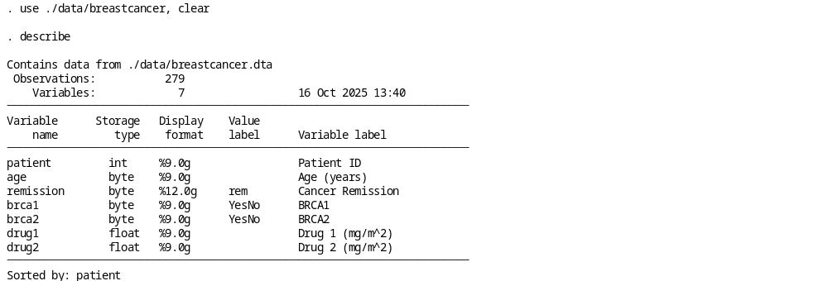
The Dataset and The Question

Slide 6
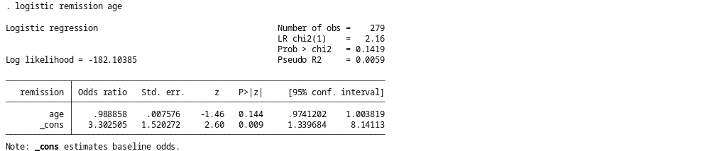
The Dataset and The Question

Slide 7
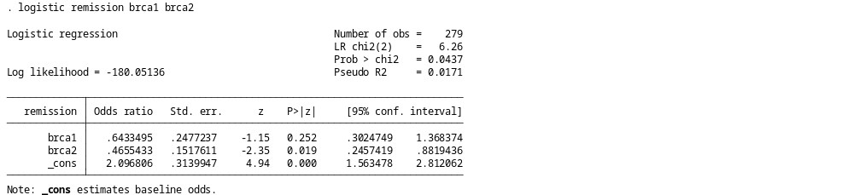
The Dataset and The Question

Slide 8
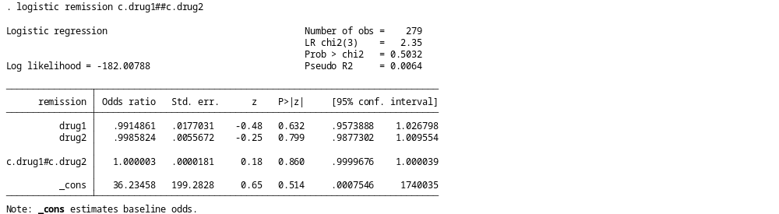
The Dataset and The Question

Slide 9
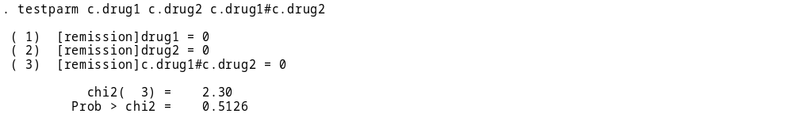
The Dataset and The Question

Slide 10

The Dataset and The Question

Slide 11
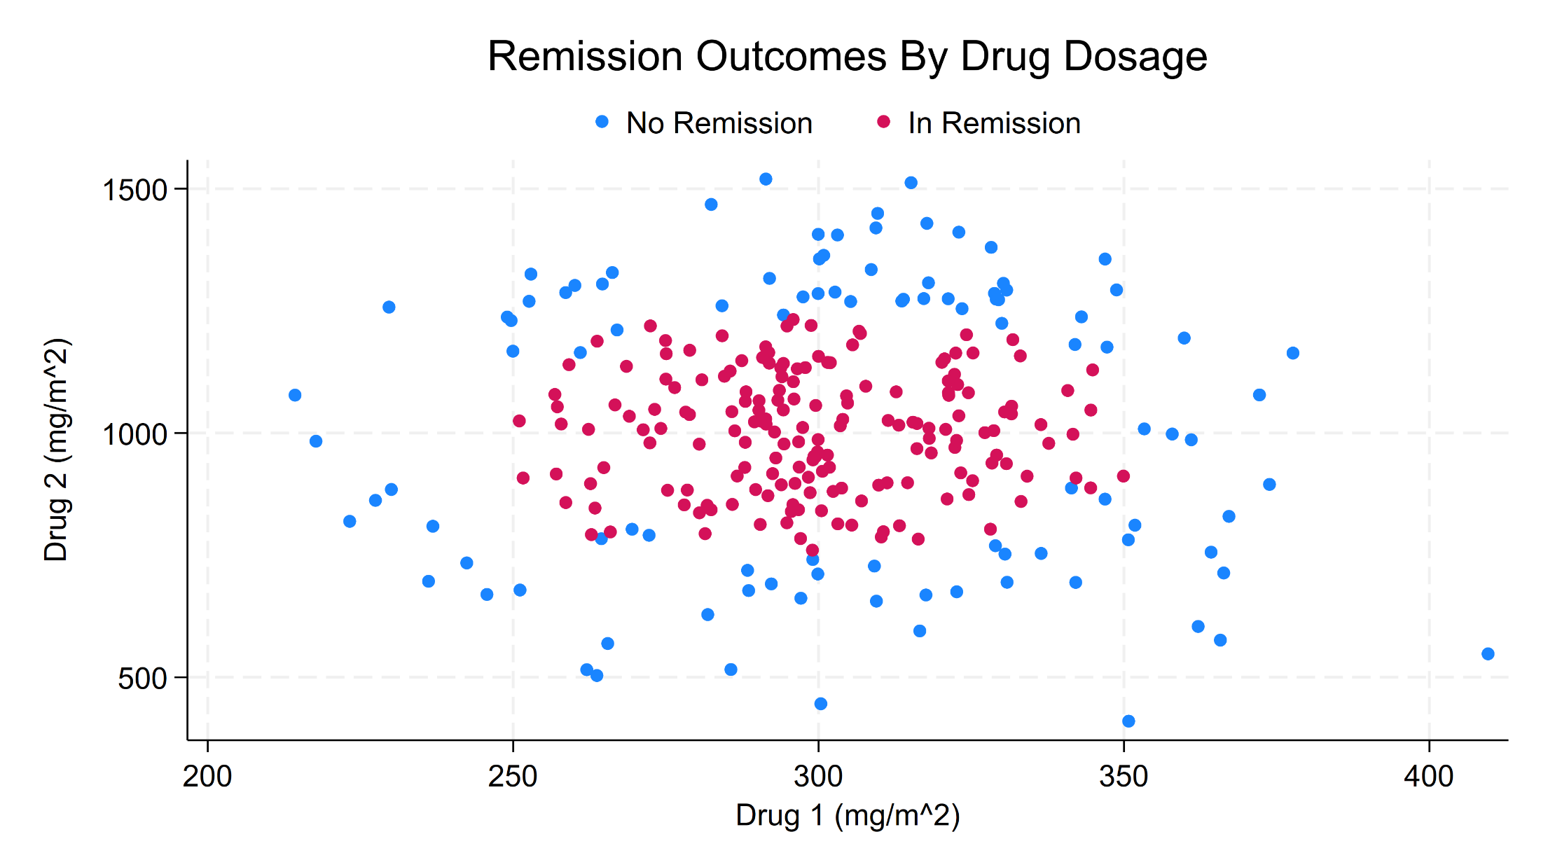
The Dataset and The Question

Slide 12

Outline
The Dataset and The Question
Download and Setup H2O and Graphviz
Modeling Drug Treatment With Random Forests and Gradient Boosting Machines
Stata Commands for ChatGPT, Claude, Gemini, and Grok
References

Slide 13
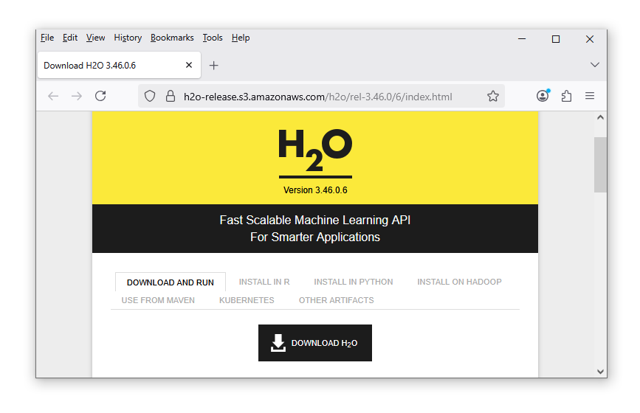
Download H2O
Be sure to download Version 3.46.06!!!
https://h2o-release.s3.amazonaws.com/h2o/rel-3.46.0/6/index.html

Slide 14
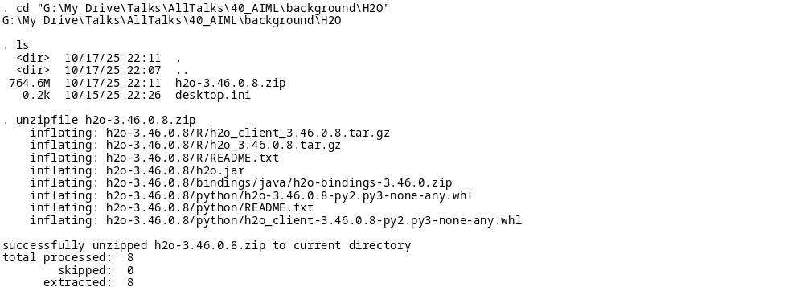
Download H2O

Slide 15
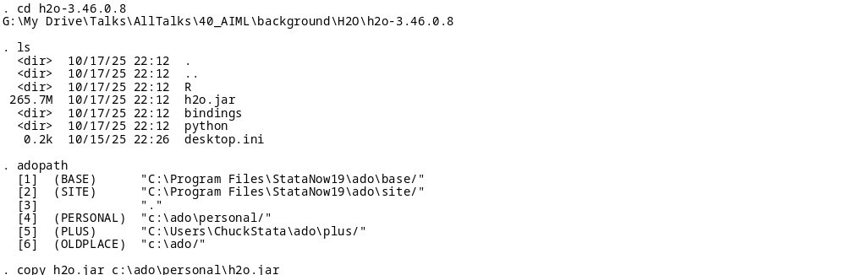
Download H2O

Slide 16
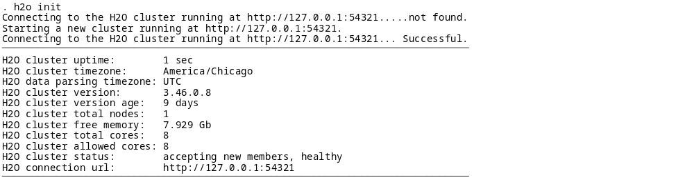
Download H2O

Slide 17
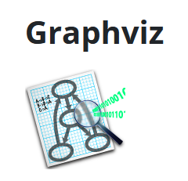
Download Graphviz
Download: https://graphviz.org/download/

Slide 18
Download Graphviz
h2omltree, id(1) dotsaving(.\graphs\tree.dot, replace)
shell "C:\Program Files\Graphviz\bin\dot.exe" -Tpng ///
.\graphs\tree.dot -o ///
.\graphs\MyDecisionTree.png
Download: https://graphviz.org/download/

Slide 19
Outline
The Dataset and The Question
Download and Setup H2O and Graphviz
Modeling Drug Treatment With Random Forests and Gradient Boosting Machines
Stata Commands for ChatGPT, Claude, Gemini, and Grok
References

Slide 20
From Testing To Prediction

Slide 21
The Dataset and The Question

Slide 22
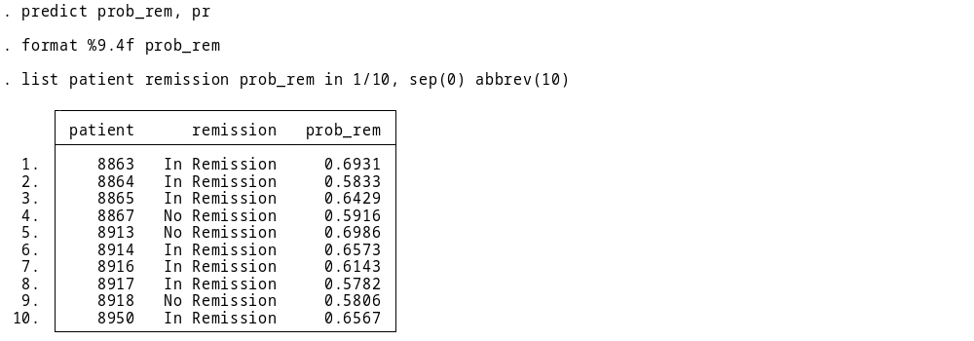
From Testing To Prediction

Slide 23
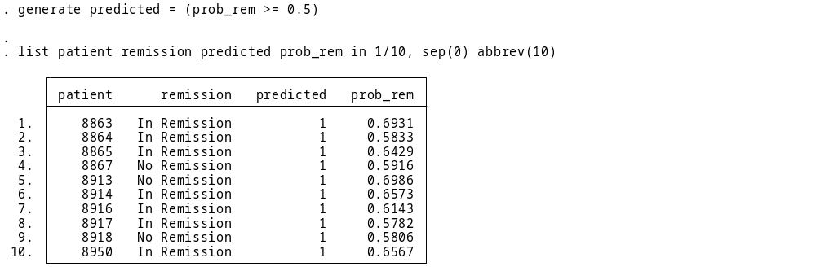
From Testing To Prediction

Slide 24
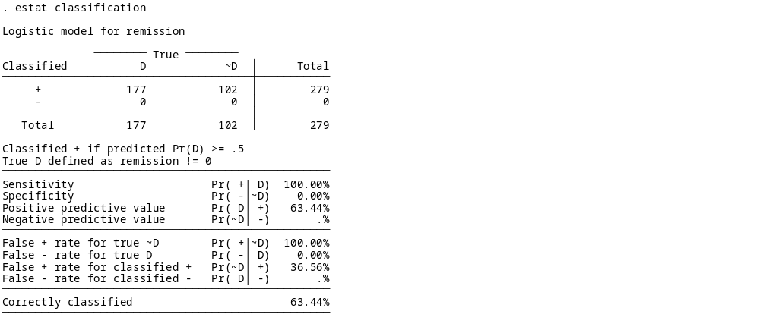
From Testing To Prediction

Slide 25
From Testing To Prediction

Slide 26
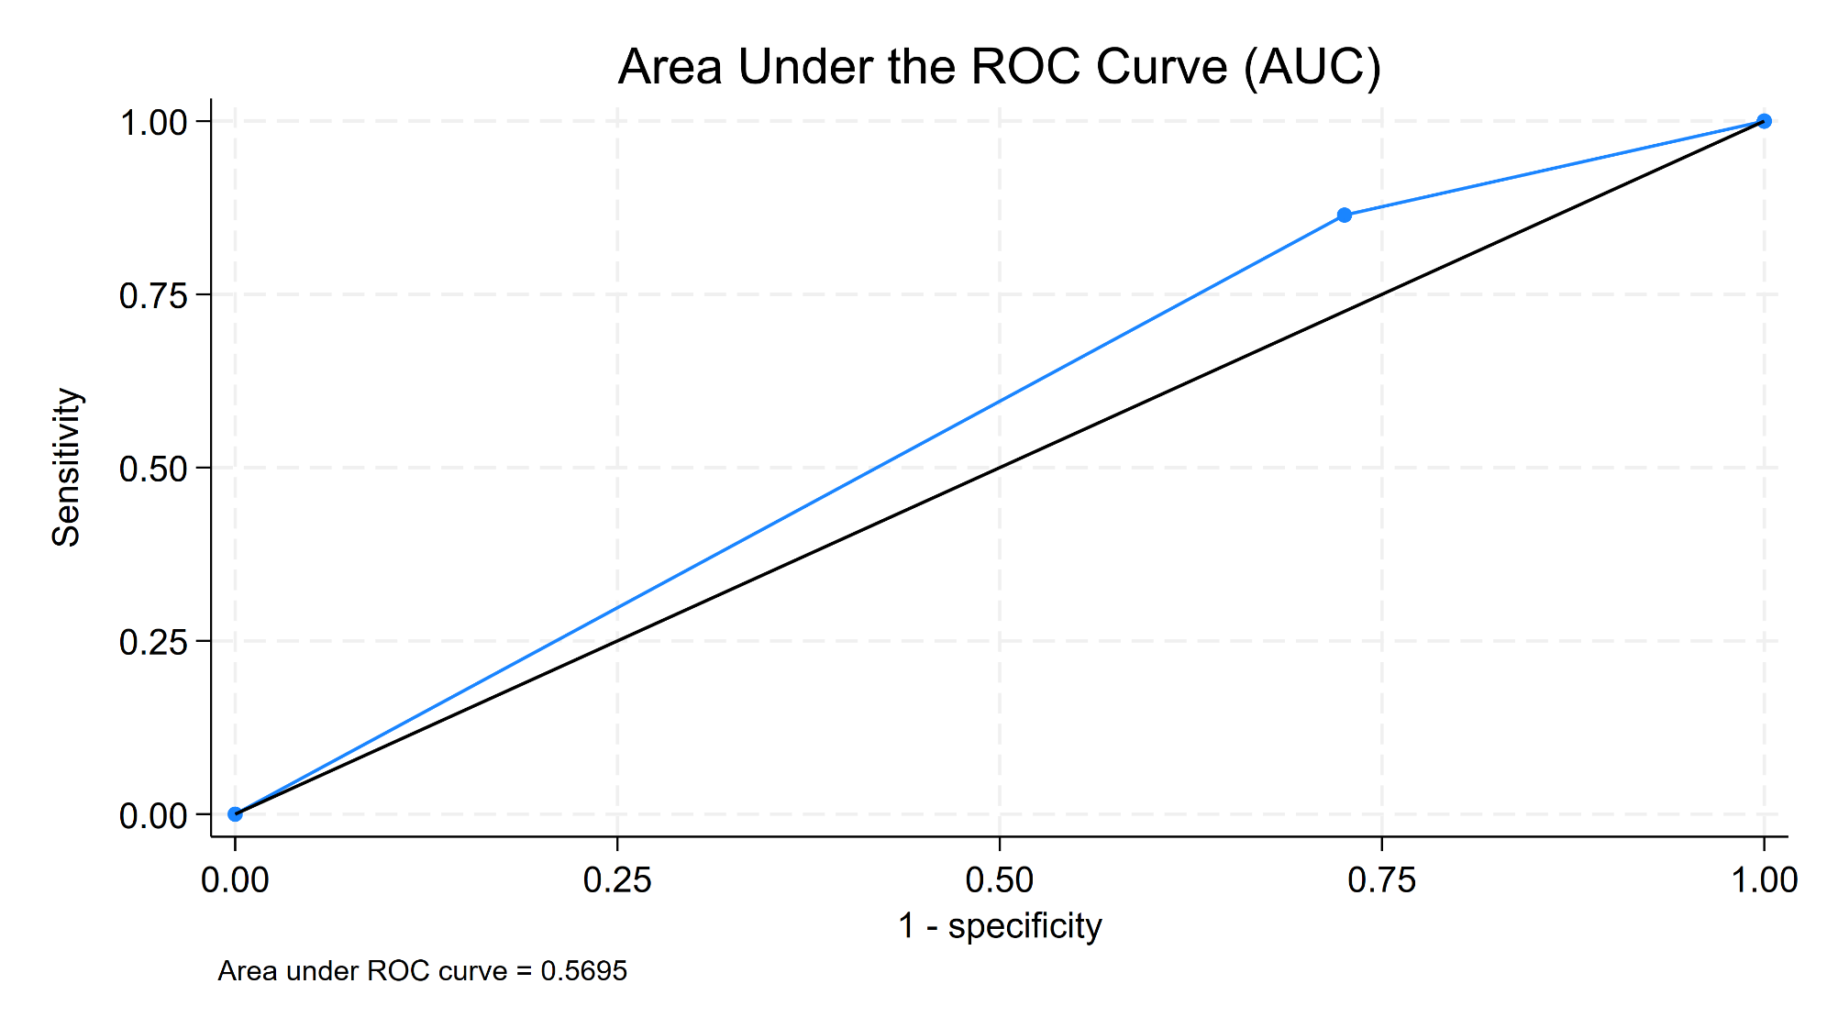
From Testing To Prediction
. lroc

Slide 27
Decision Trees

Slide 28
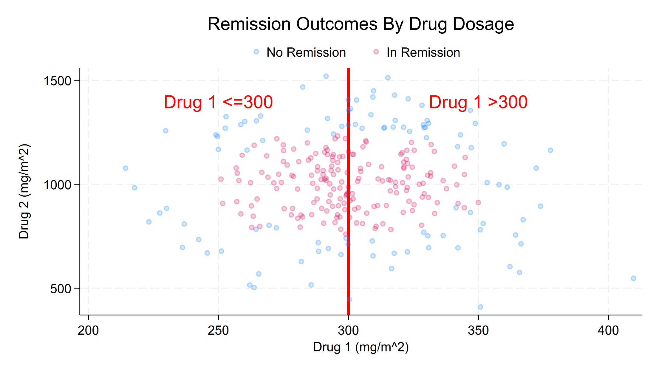
Decision Trees

Slide 29
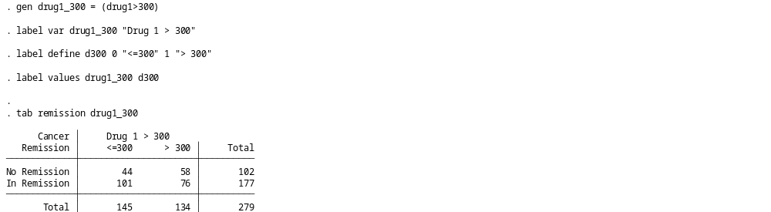
Decision Trees

Slide 30
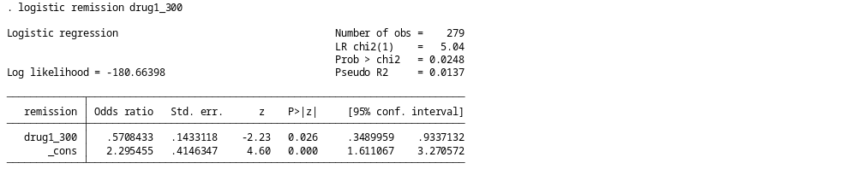
Decision Trees

Slide 31
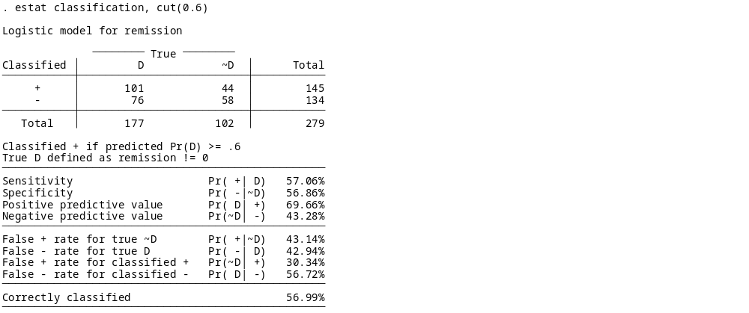
Decision Trees

Slide 32
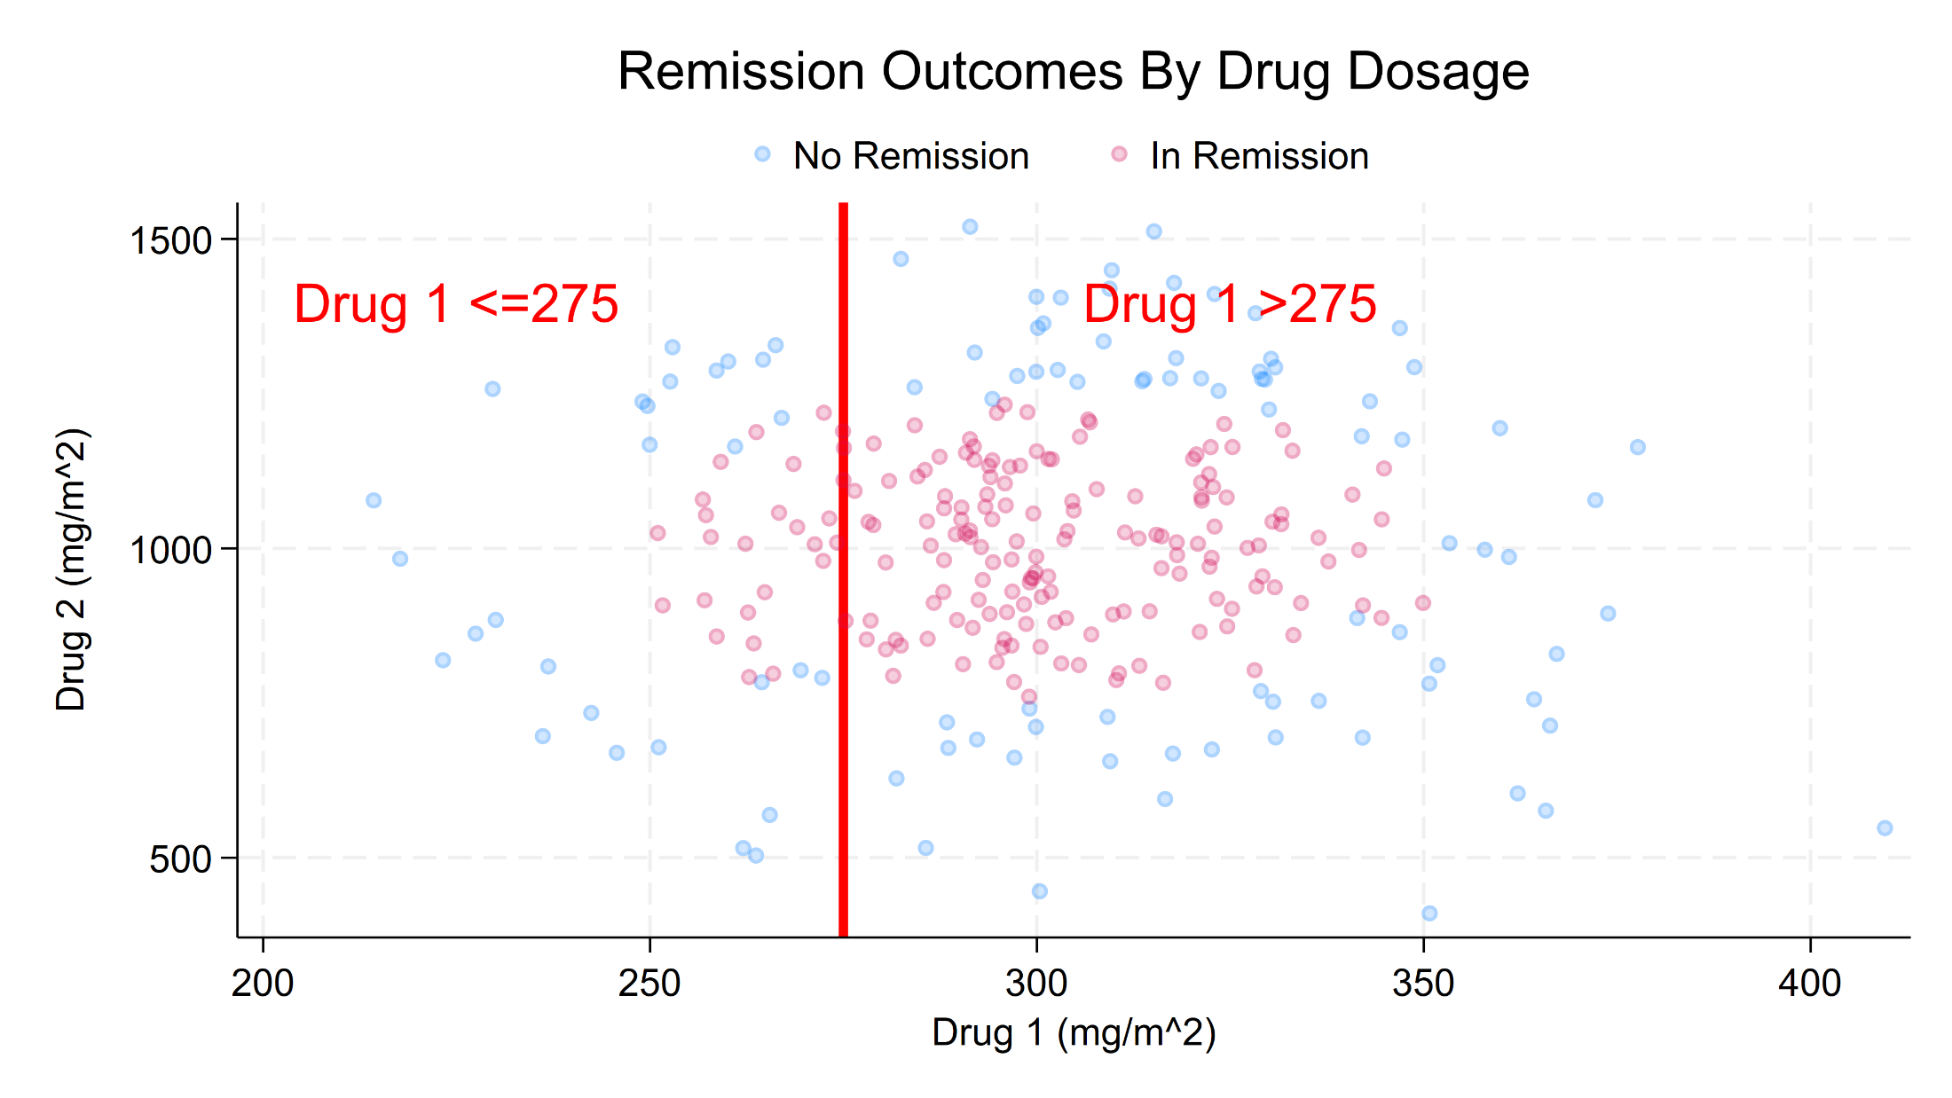
Decision Trees

Slide 33
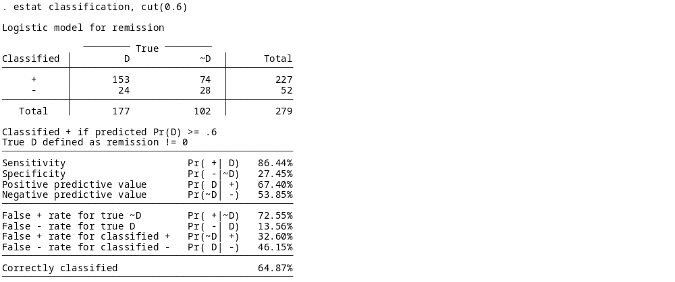
Decision Trees

Slide 34
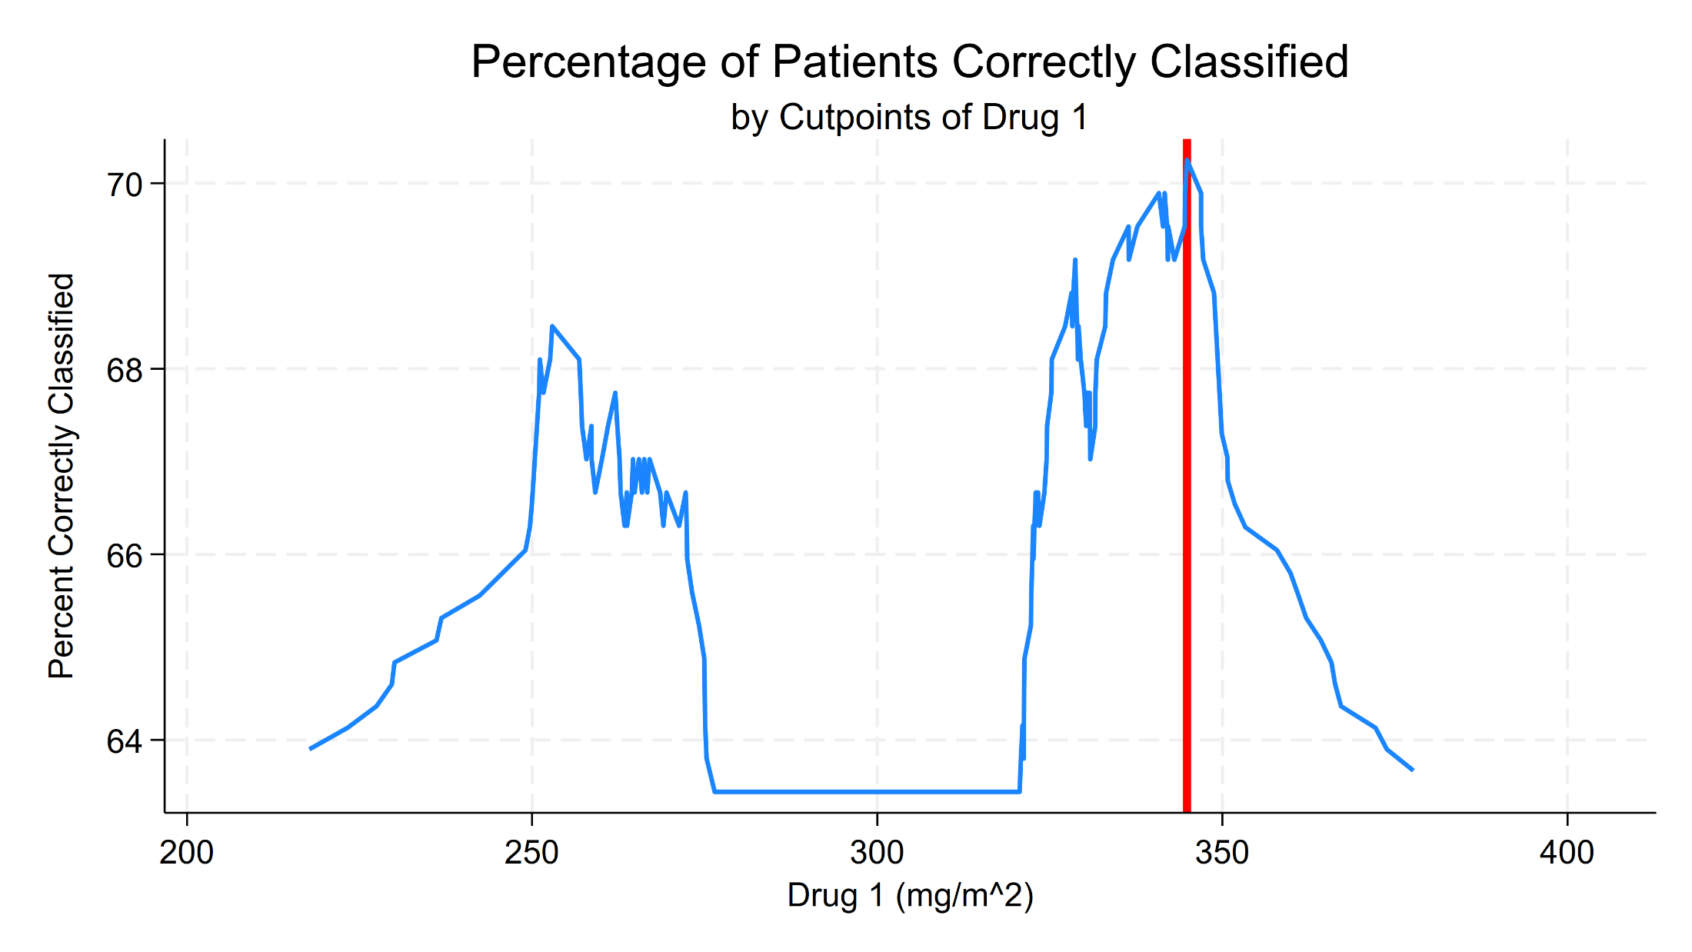
Decision Trees
Drug 1 <= 345

Slide 35
Decision Trees
Drug 1 <= 345
Yes
No

Slide 36
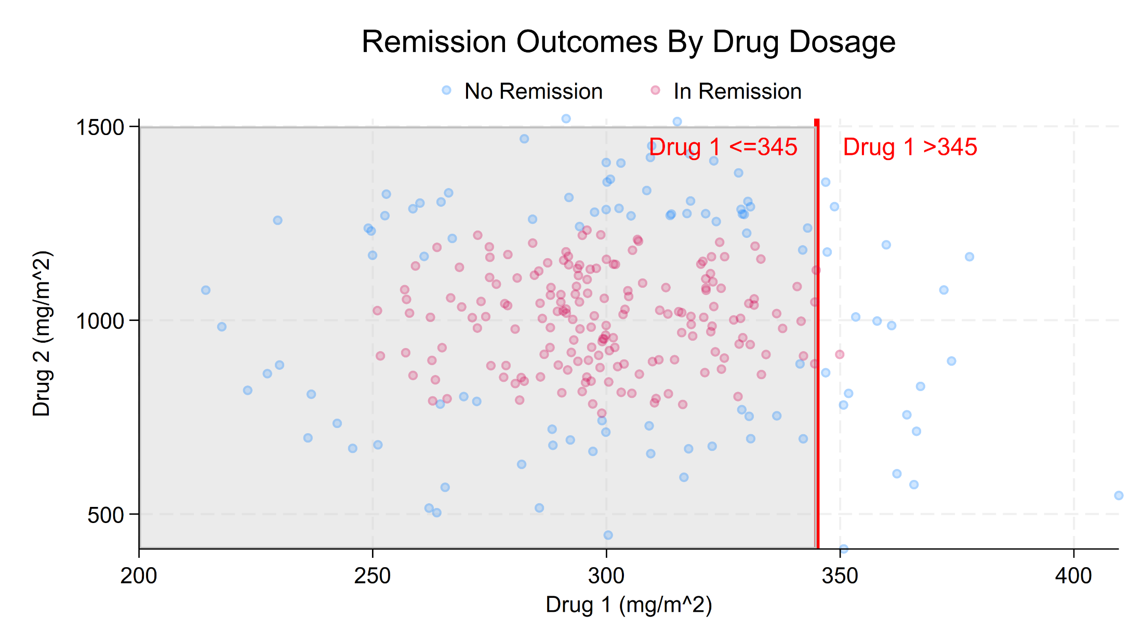
Decision Trees

Slide 37
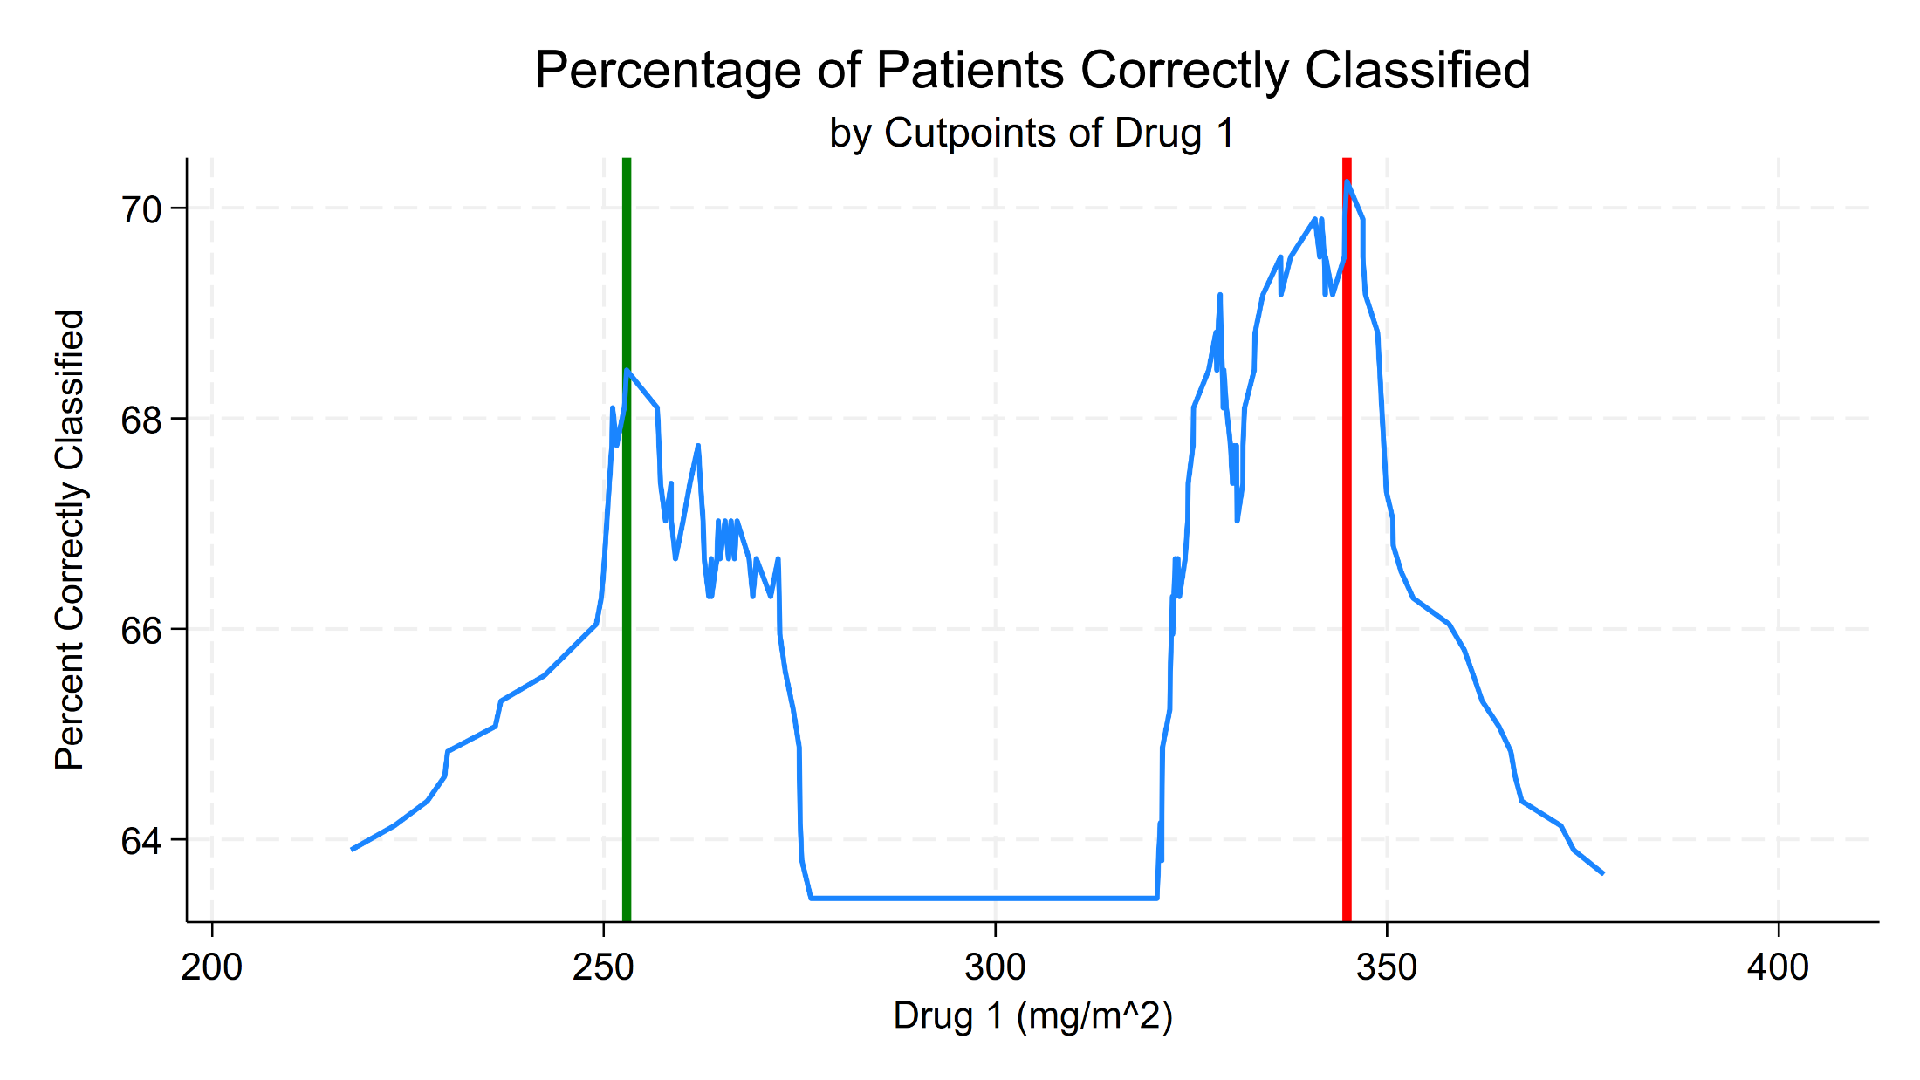
Decision Trees
Drug 1 > 255

Slide 38
Decision Trees
Drug 1 <= 345
Yes
No
Drug 1 > 255

Slide 39
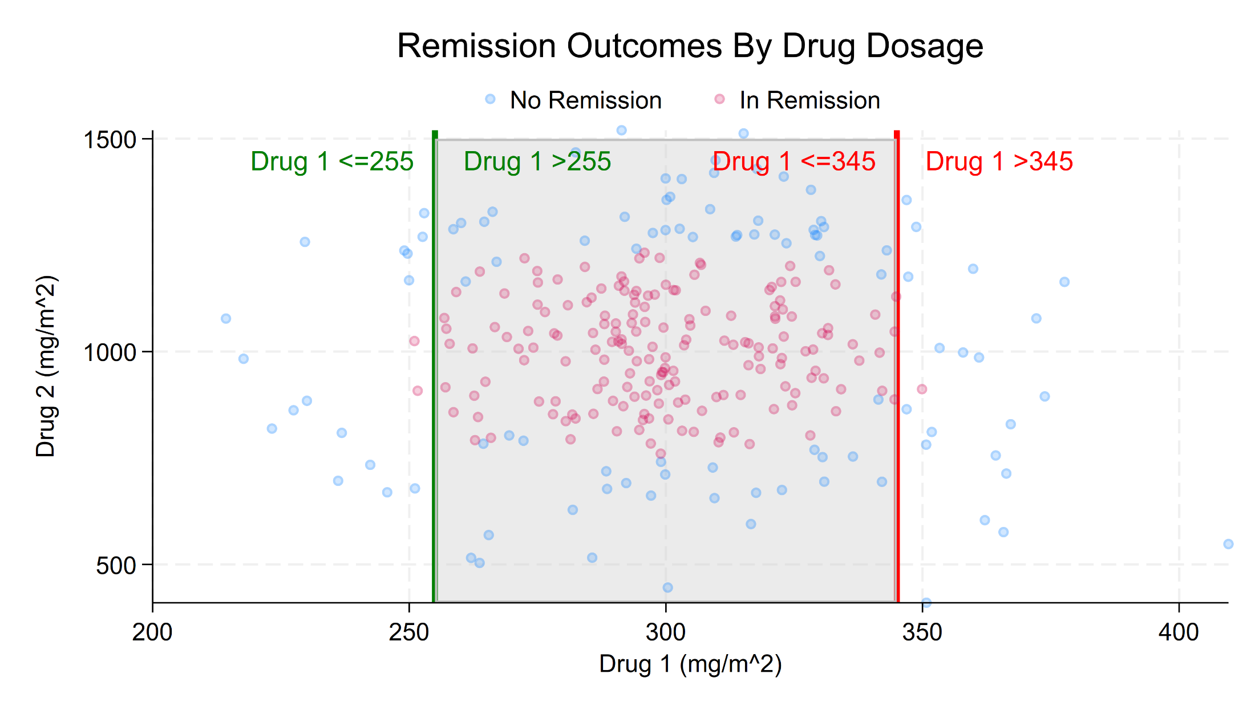
Identifying Breast Cancer

Slide 40
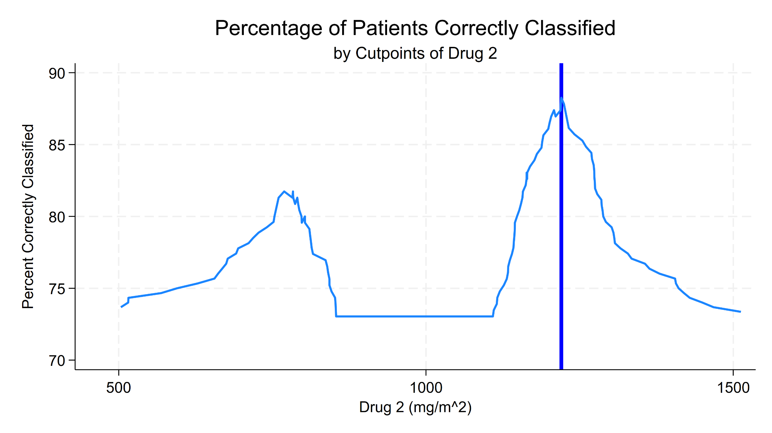
Decision Trees
Drug 2 <= 1220

Slide 41
Decision Trees
Drug 1 <= 345
Yes
No
Drug 1 > 255
Yes
No
Drug 2 <= 1220

Slide 42
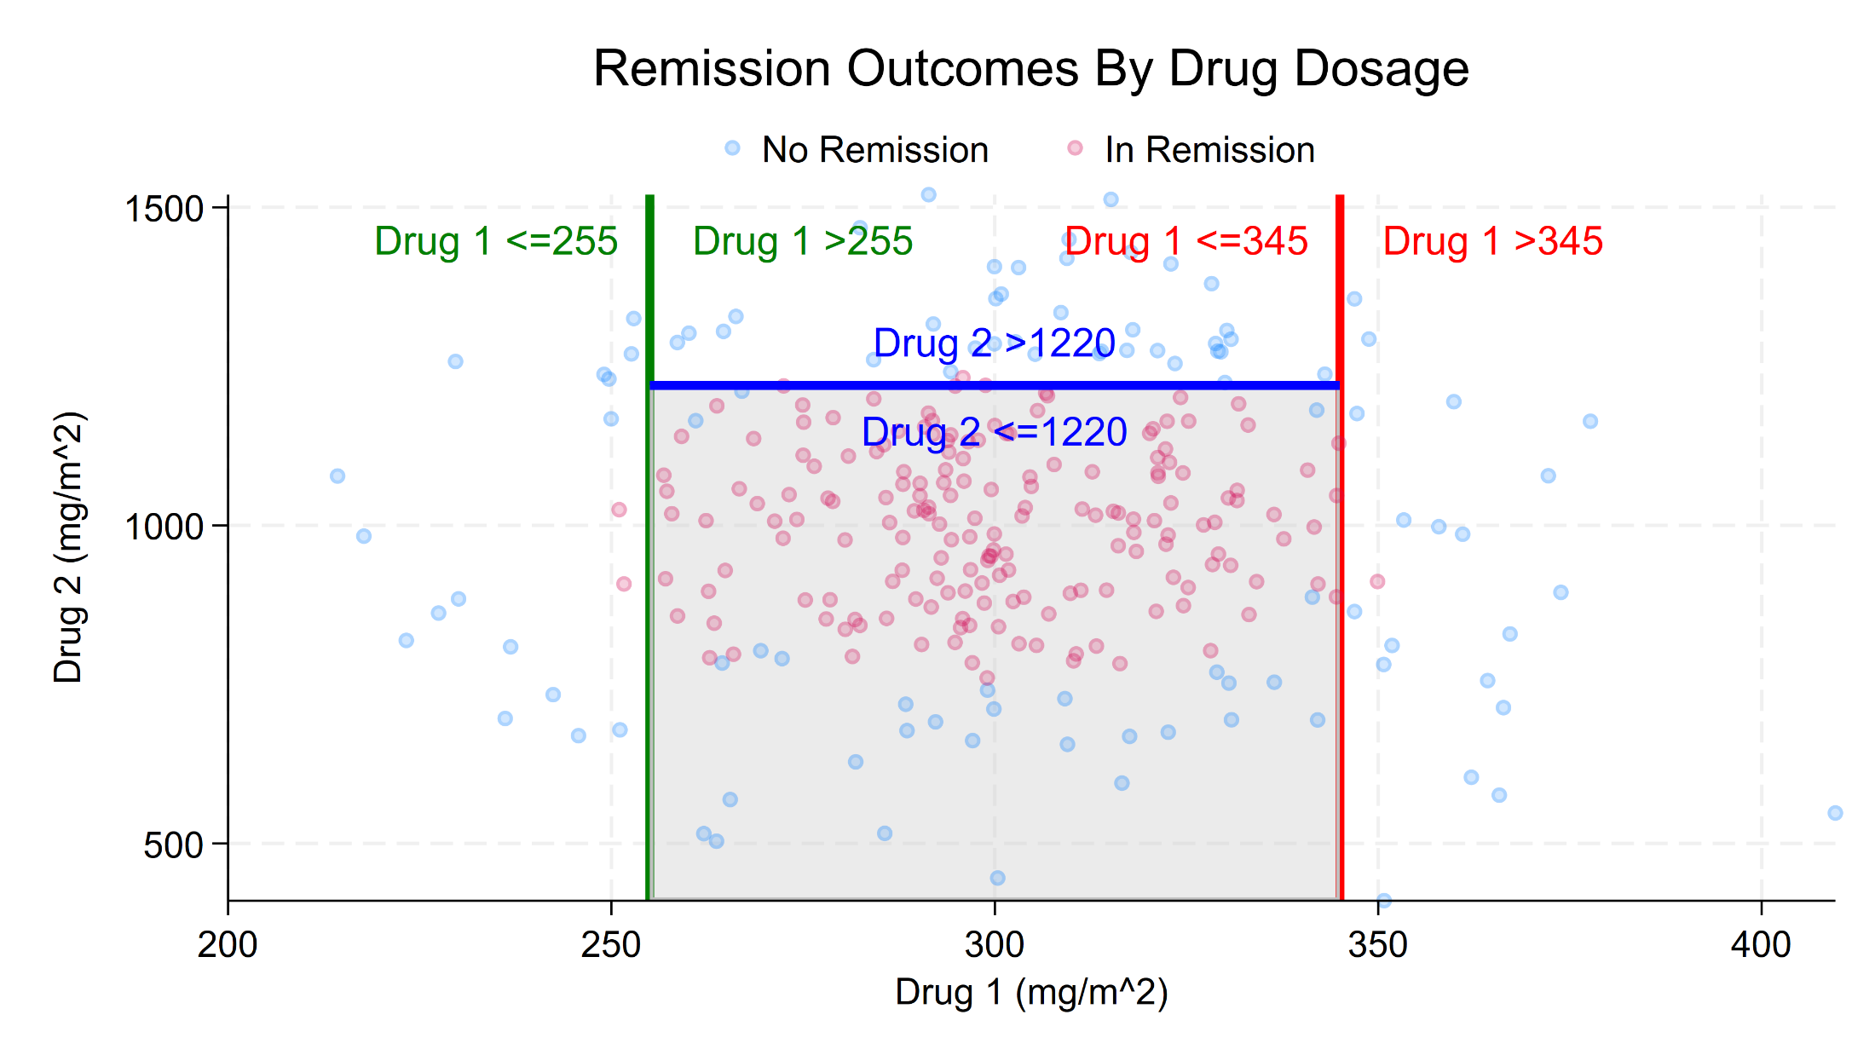
Decision Trees

Slide 43
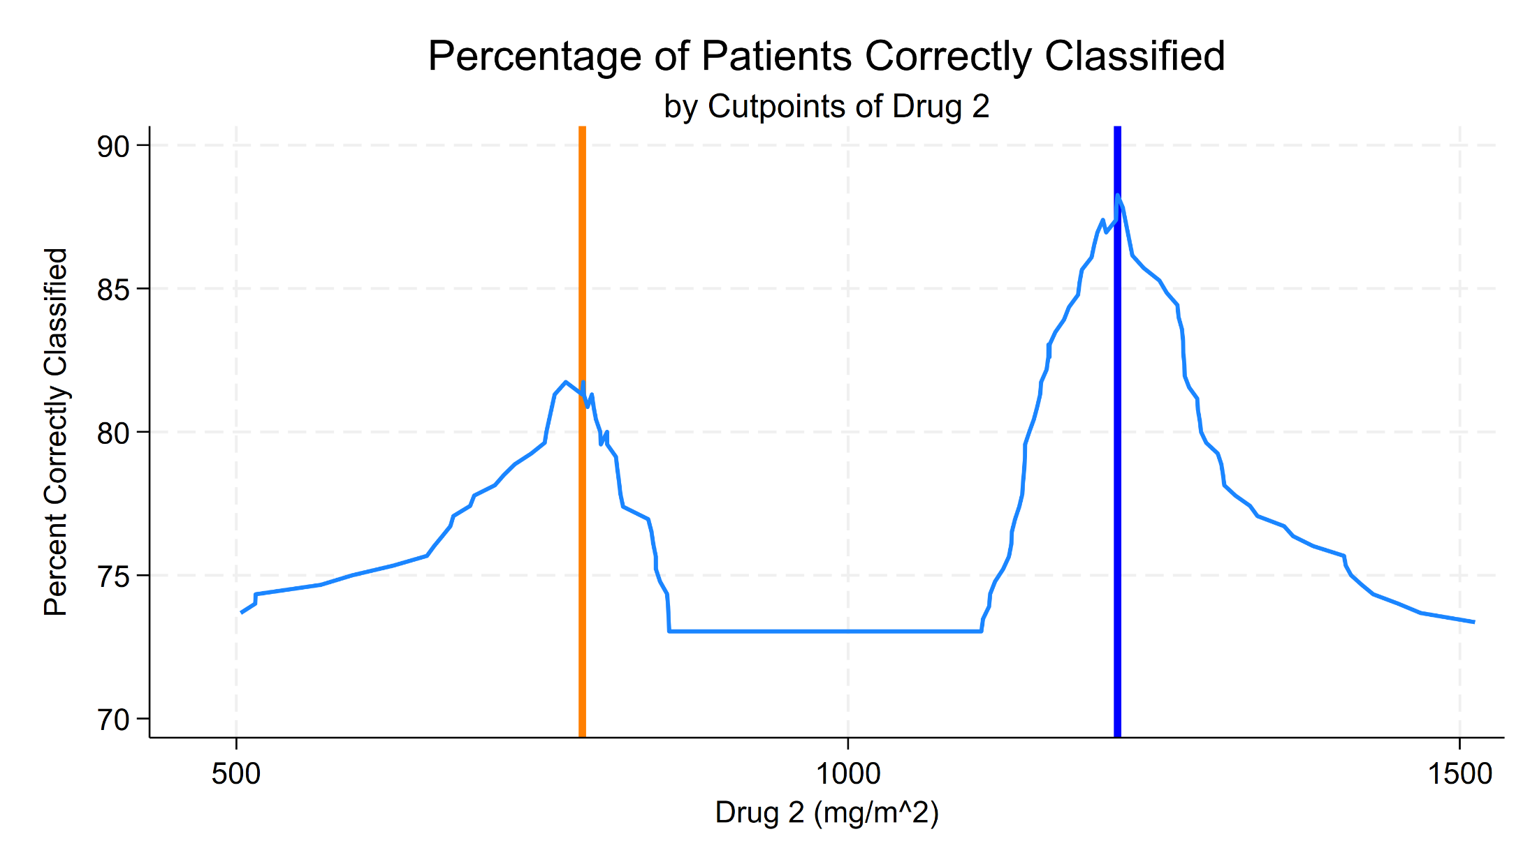
Decision Trees
Drug 2 > 783

Slide 44
Decision Trees
Drug 1 <= 345
Yes
No
Drug 1 > 255
Yes
No
Drug 2 <= 1220
Yes
No
Drug 2 > 783

Slide 45
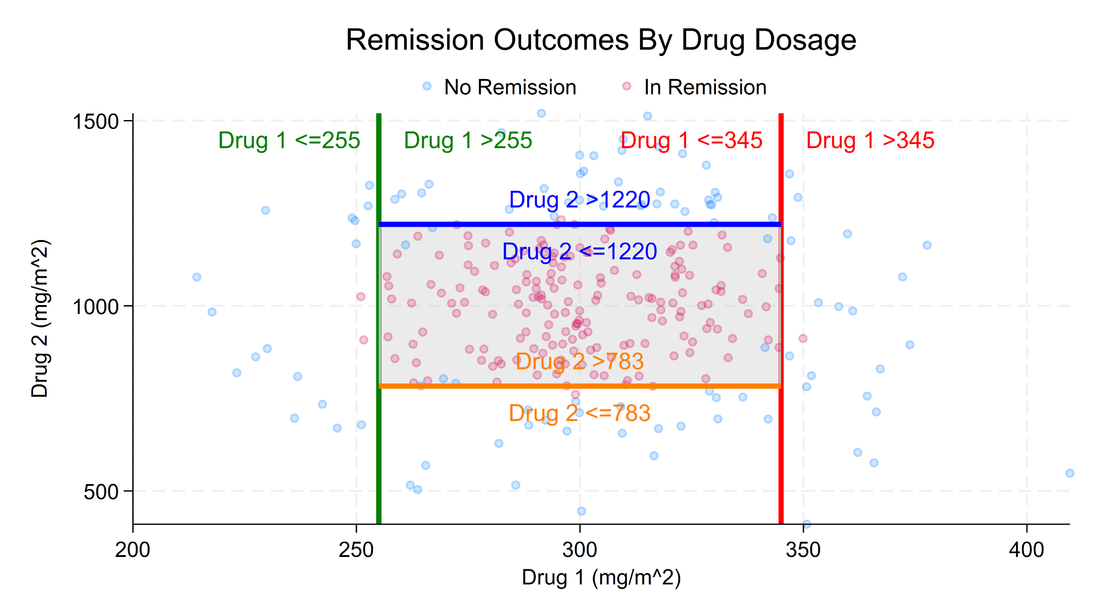
Decision Trees

Slide 46
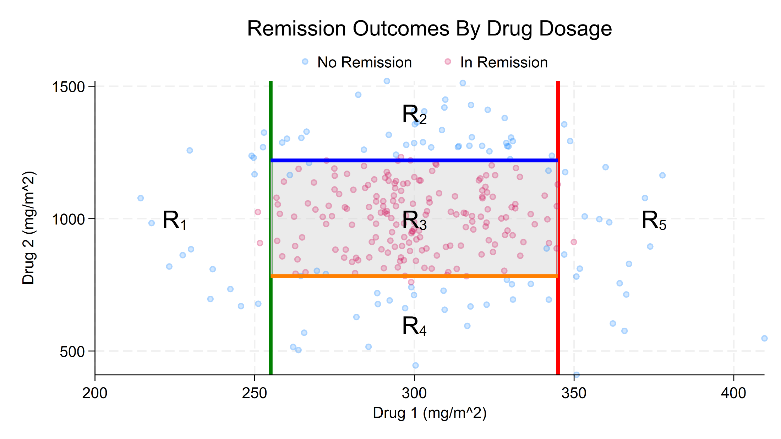
Decision Trees

Slide 47
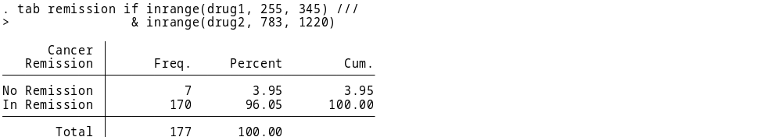
Decision Trees
New observations can be classified as being “in
Remission” or “not in remission” by following their
covariate values through the tree and placing them in
a region. The observation is assigned the value of the
most frequent category in that region.
A person in Region 3 would be classified as “in remission”.

Slide 48
Decision Trees
Drug 1 <= 345
Yes
No
Drug 1 > 255
Yes
No
Drug 2 <= 1220
Yes
No
Drug 2 > 783
0.96

Slide 49
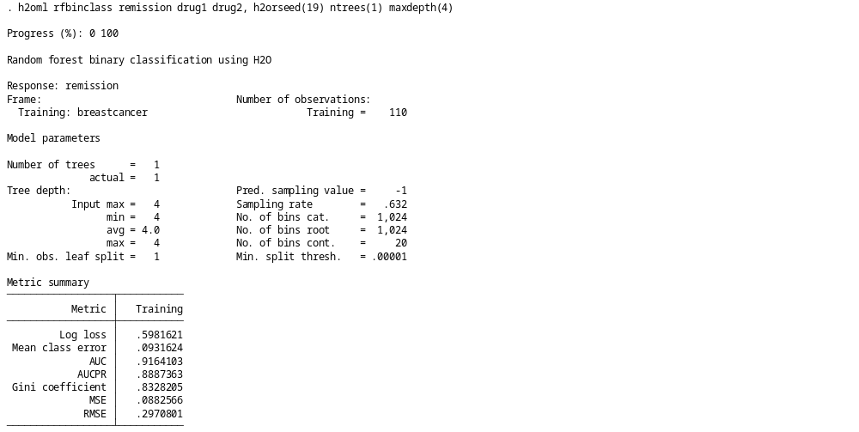
Decision Trees

Slide 50
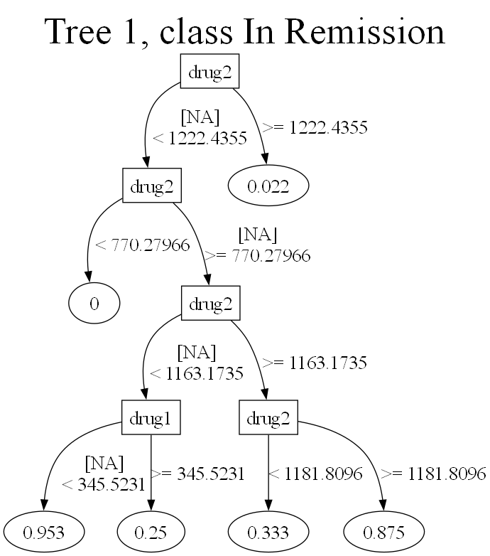
Decision Trees

Slide 51
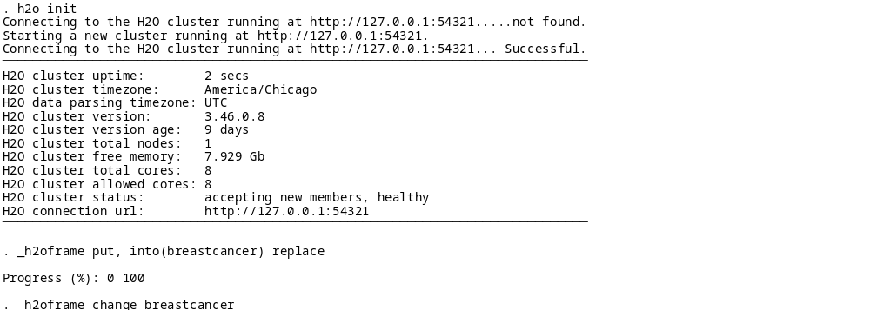
Random Forests and Gradient Boosting Machines

Slide 52
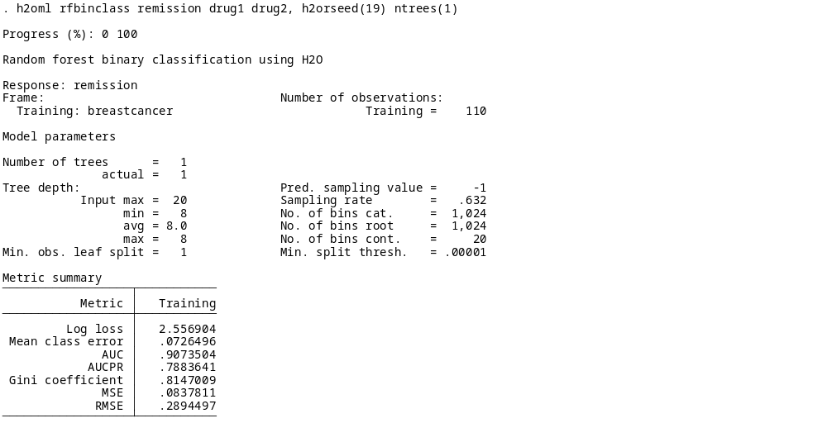
Random Forests and Gradient Boosting Machines

Slide 53
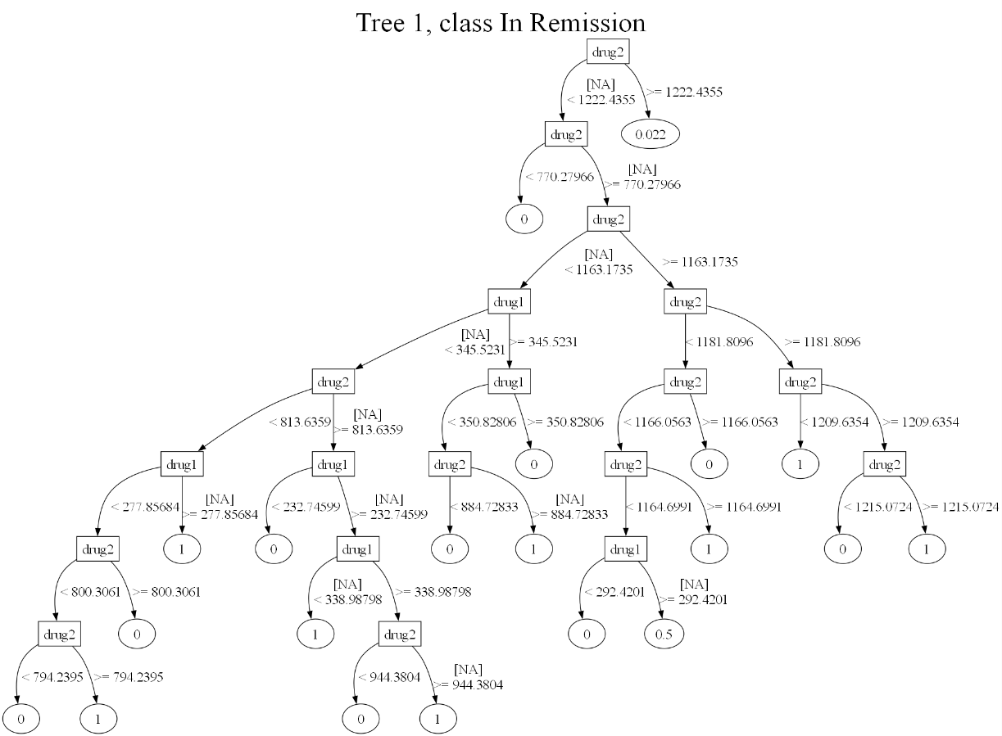
Random Forests and Gradient Boosting Machines
Notes:
Compared with the classification tree in
Example 1: Plotting a classification tree after random forest,
the terminal nodes of the classification tree after GBM contain negative values. This may be surprising
because the expected values should be between [0, 1]. However, as we explain below, this is the expected
behavior.
As discussed in the
Introduction of [H2OML] h2oml gbm, GBM relies on link functions to determine
the loss function. For instance, in binary classification, GBM uses the logit link function. Consequently,
for certain postestimation commands, such as h2omltree and h2omlgraph shapvalues, probabilities
are obtained by applying the inverse link function, in this case, the inverse logit function

Slide 54
Random Forests and Gradient Boosting Machines

Slide 55
Random Forests and Gradient Boosting Machines

Slide 56
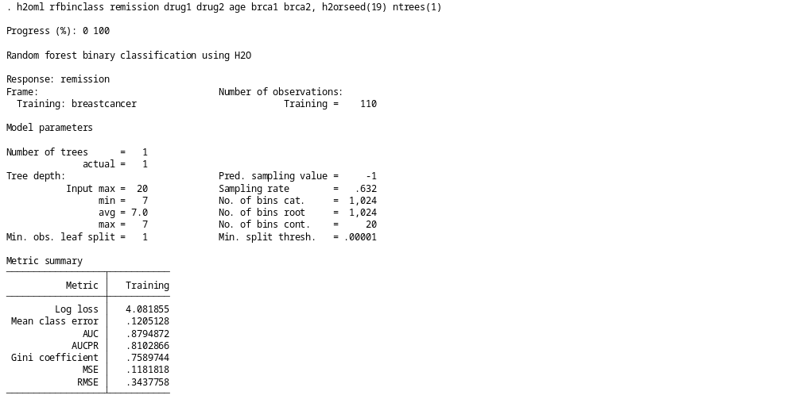
Random Forests and Gradient Boosting Machines

Slide 57
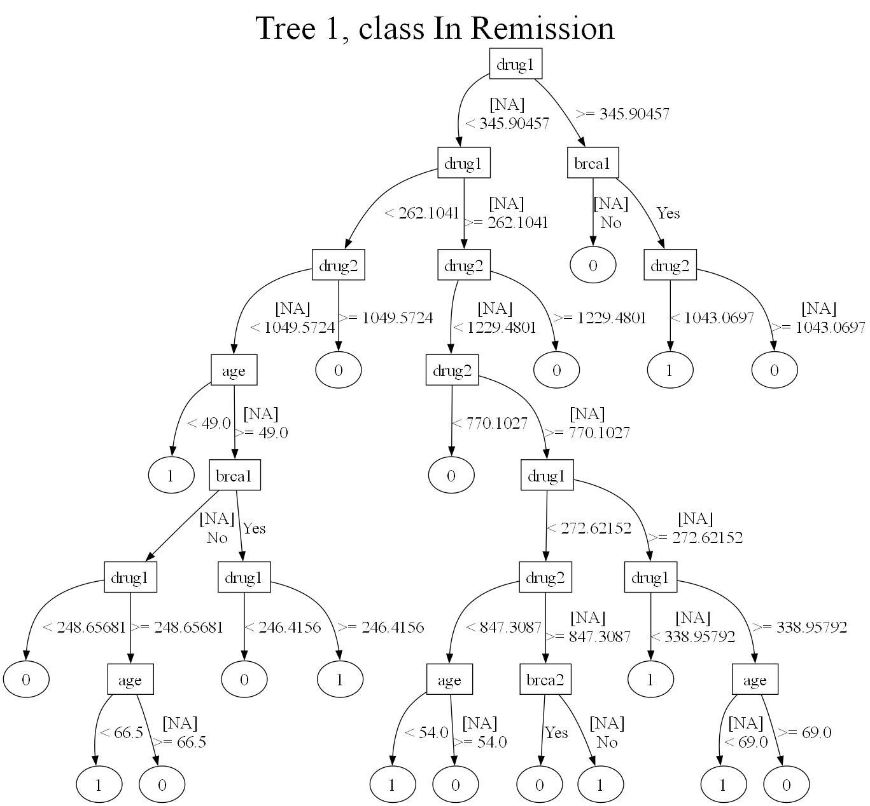

Slide 58
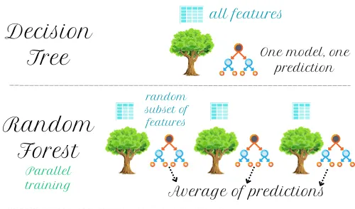
Ensemble Methods
Source: https://medium.com/@mlaniefouesnard/decision-tree-random-forest-xgboost-understand-and-tune-them-easily-b1fa25501af0

Slide 59
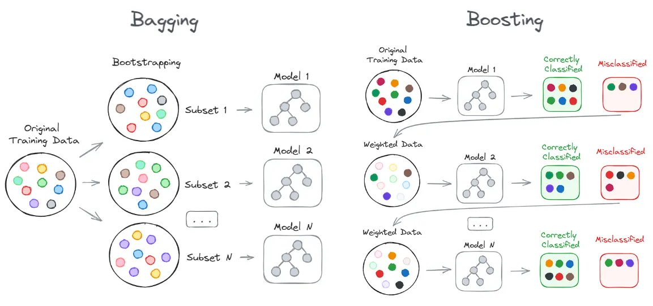
Boosting and Bagging
Reduces Variance
Reduces Bias
Source: https://pub.towardsai.net/bagging-vs-boosting-the-power-of-ensemble-methods-in-machine-learning-6404e33524e6
Notes:
The main difference between bagging and boosting is in how they perturb and generate new datasets.
Bagging, which was first introduced in Breiman (1996), generates the perturbations by random and inde-
pendent drawings (bootstrap samples) from the training data. In contrast, boosting, introduced by Freund
and Schapire (1997) to solve classification problems, has a deterministic approach and generates pertur-
bations by sequentially reweighting the dataset. In particular, at any step, the weights of the observations
that were misclassified in the previous step increase, whereas the weights for the correctly classified
observations decrease. Thus, boosting forces each successive classifier to focus on those observations
that were missed by the previous ones in the sequence. By design, bagging reduces variance, whereas
boosting tends to control the generalization error by reducing bias. The difference is summarized in the
figure below.

Slide 60
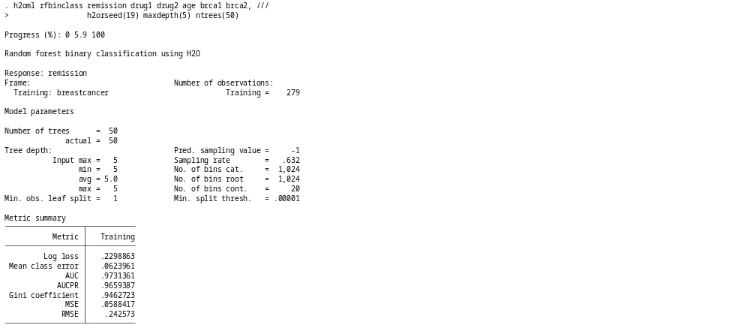
Random Forests (Bagging)
Notes:
The main difference between bagging and boosting is in how they perturb and generate new datasets.
Bagging, which was first introduced in Breiman (1996), generates the perturbations by random and inde-
pendent drawings (bootstrap samples) from the training data. In contrast, boosting, introduced by Freund
and Schapire (1997) to solve classification problems, has a deterministic approach and generates pertur-
bations by sequentially reweighting the dataset. In particular, at any step, the weights of the observations
that were misclassified in the previous step increase, whereas the weights for the correctly classified
observations decrease. Thus, boosting forces each successive classifier to focus on those observations
that were missed by the previous ones in the sequence. By design, bagging reduces variance, whereas
boosting tends to control the generalization error by reducing bias. The difference is summarized in the
figure below.

Slide 61
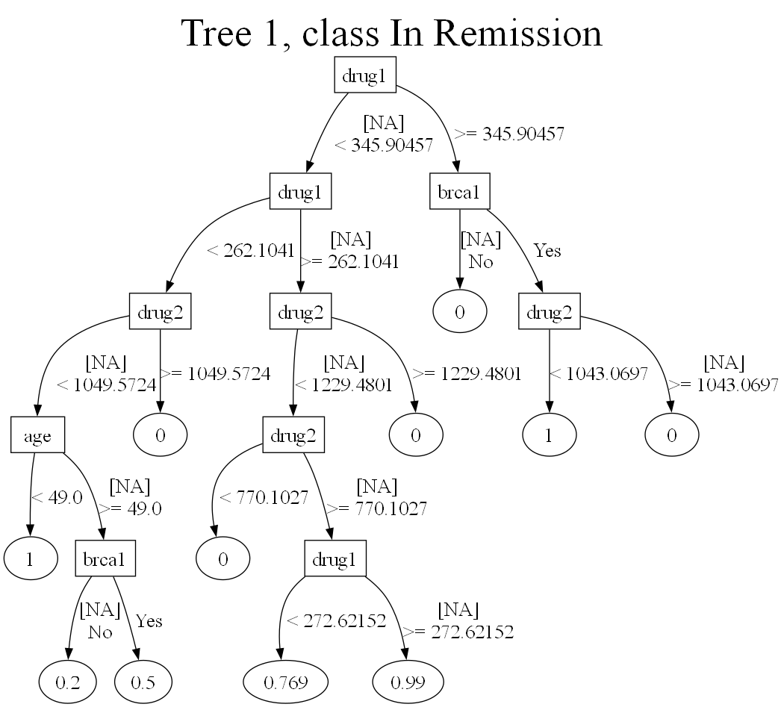
Random Forest (Bagging)
Notes:
The main difference between bagging and boosting is in how they perturb and generate new datasets.
Bagging, which was first introduced in Breiman (1996), generates the perturbations by random and inde-
pendent drawings (bootstrap samples) from the training data. In contrast, boosting, introduced by Freund
and Schapire (1997) to solve classification problems, has a deterministic approach and generates pertur-
bations by sequentially reweighting the dataset. In particular, at any step, the weights of the observations
that were misclassified in the previous step increase, whereas the weights for the correctly classified
observations decrease. Thus, boosting forces each successive classifier to focus on those observations
that were missed by the previous ones in the sequence. By design, bagging reduces variance, whereas
boosting tends to control the generalization error by reducing bias. The difference is summarized in the
figure below.

Slide 62
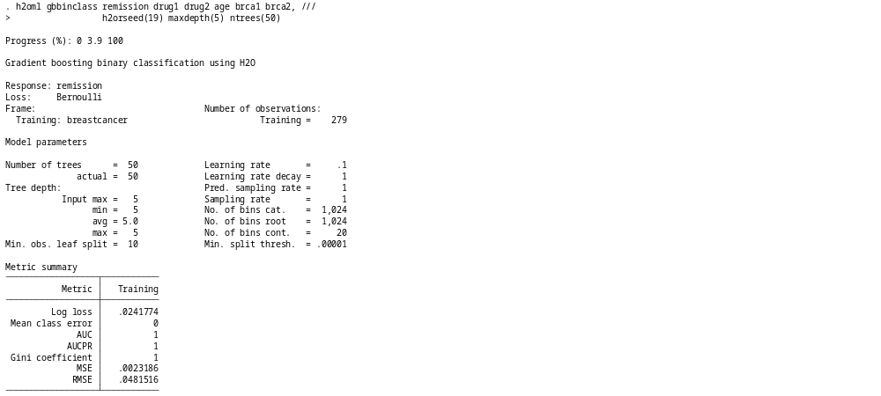
Gradient Boosting Machine
Notes:
The main difference between bagging and boosting is in how they perturb and generate new datasets.
Bagging, which was first introduced in Breiman (1996), generates the perturbations by random and inde-
pendent drawings (bootstrap samples) from the training data. In contrast, boosting, introduced by Freund
and Schapire (1997) to solve classification problems, has a deterministic approach and generates pertur-
bations by sequentially reweighting the dataset. In particular, at any step, the weights of the observations
that were misclassified in the previous step increase, whereas the weights for the correctly classified
observations decrease. Thus, boosting forces each successive classifier to focus on those observations
that were missed by the previous ones in the sequence. By design, bagging reduces variance, whereas
boosting tends to control the generalization error by reducing bias. The difference is summarized in the
figure below.

Slide 63
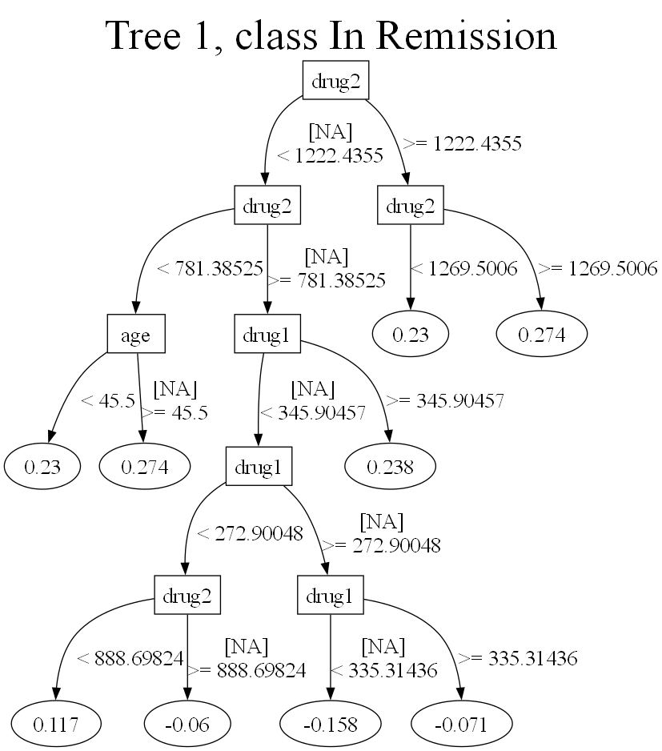

Gradient Boosting Machine
Notes:
The main difference between bagging and boosting is in how they perturb and generate new datasets.
Bagging, which was first introduced in Breiman (1996), generates the perturbations by random and inde-
pendent drawings (bootstrap samples) from the training data. In contrast, boosting, introduced by Freund
and Schapire (1997) to solve classification problems, has a deterministic approach and generates pertur-
bations by sequentially reweighting the dataset. In particular, at any step, the weights of the observations
that were misclassified in the previous step increase, whereas the weights for the correctly classified
observations decrease. Thus, boosting forces each successive classifier to focus on those observations
that were missed by the previous ones in the sequence. By design, bagging reduces variance, whereas
boosting tends to control the generalization error by reducing bias. The difference is summarized in the
figure below.

Slide 64
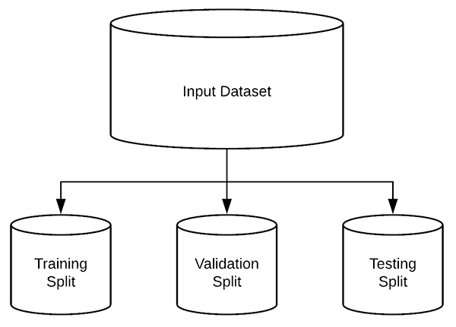
Two-way & Three-way Holdout

Slide 65
Two-way Holdout
Notes:
The main difference between bagging and boosting is in how they perturb and generate new datasets.
Bagging, which was first introduced in Breiman (1996), generates the perturbations by random and inde-
pendent drawings (bootstrap samples) from the training data. In contrast, boosting, introduced by Freund
and Schapire (1997) to solve classification problems, has a deterministic approach and generates pertur-
bations by sequentially reweighting the dataset. In particular, at any step, the weights of the observations
that were misclassified in the previous step increase, whereas the weights for the correctly classified
observations decrease. Thus, boosting forces each successive classifier to focus on those observations
that were missed by the previous ones in the sequence. By design, bagging reduces variance, whereas
boosting tends to control the generalization error by reducing bias. The difference is summarized in the
figure below.

Slide 66
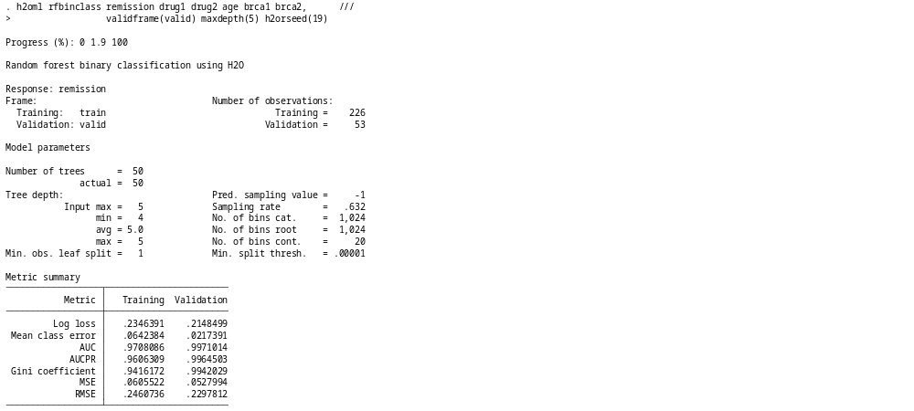
Two-way Holdout
Notes:
The main difference between bagging and boosting is in how they perturb and generate new datasets.
Bagging, which was first introduced in Breiman (1996), generates the perturbations by random and inde-
pendent drawings (bootstrap samples) from the training data. In contrast, boosting, introduced by Freund
and Schapire (1997) to solve classification problems, has a deterministic approach and generates pertur-
bations by sequentially reweighting the dataset. In particular, at any step, the weights of the observations
that were misclassified in the previous step increase, whereas the weights for the correctly classified
observations decrease. Thus, boosting forces each successive classifier to focus on those observations
that were missed by the previous ones in the sequence. By design, bagging reduces variance, whereas
boosting tends to control the generalization error by reducing bias. The difference is summarized in the
figure below.

Slide 67
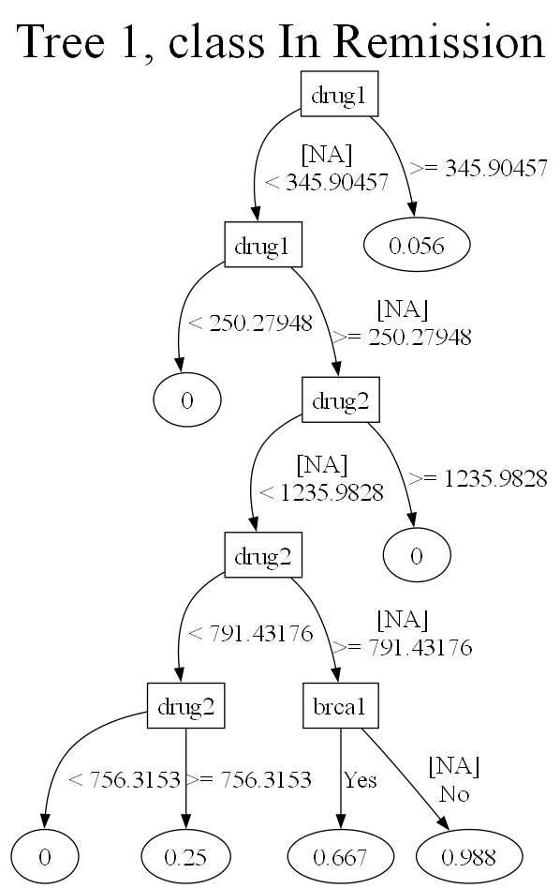
Decision Trees

Slide 68
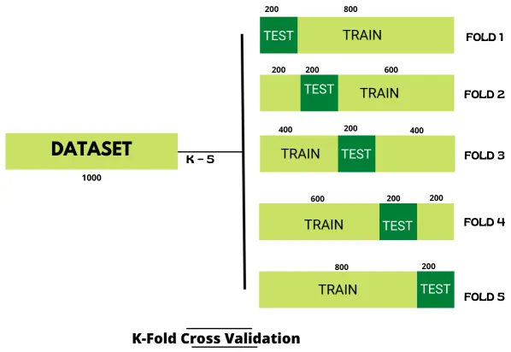
K-Fold Cross Validation
Source: https://heartbeat.comet.ml/the-best-way-of-splitting-data-for-machine-learning-54c2f44cf409

Slide 69
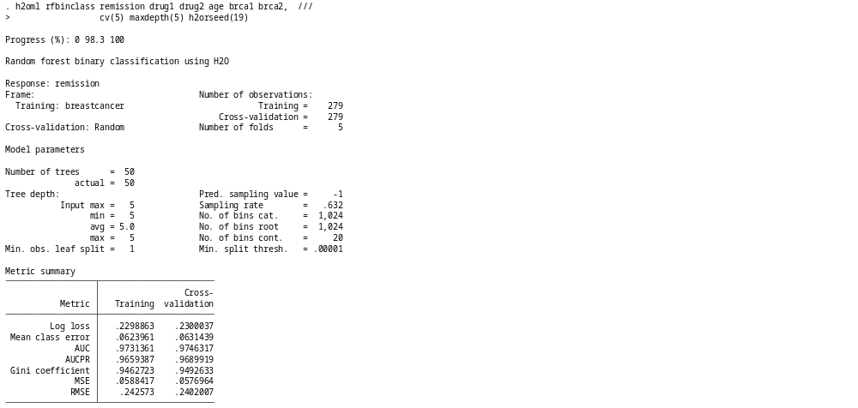
K-Fold Cross Validation

Slide 70
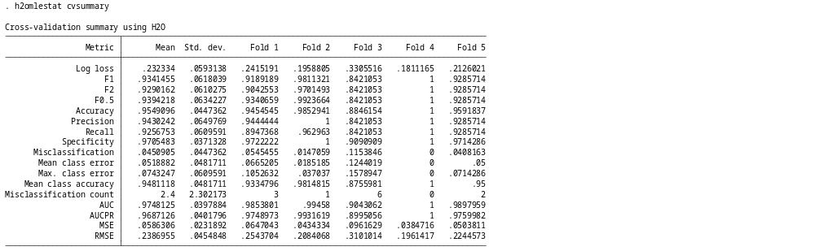
K-Fold Cross Validation

Slide 71
K-Fold Cross Validation

Slide 72
K-Fold Cross Validation

Slide 73
Hyperparameter Tuning
h2oml rfbinclass remission drug1 drug2 age brca1 brca2, ///
validframe(valid) h2orseed(19) ///
ntrees(25(25)200) ///
maxdepth(3(3)12) ///
tune(metric(auc))

Slide 74


Slide 75

Hyperparameter Tuning

Slide 76

Hyperparameter Tuning

Slide 77
Compare Models
h2oml rfbinclass remission drug1 drug2 age brca1 brca2, ///
cv(5) maxdepth(3) ntrees(25) h2orseed(19)
h2omlest store RF
h2oml gbbinclass remission drug1 drug2 age brca1 brca2, ///
cv(5) maxdepth(3) ntrees(25) h2orseed(19)
h2omlest store GBM
h2omlgraph roc, models(RF GBM)

Slide 78

ROC Curves
. h2omlgraph roc, models(RF GBM)

Slide 79

Goodness of Fit

Slide 80

Confusion Matrix

Slide 81
Explaining Predictions
Global models describe the average behavior of a machine learning model
  Variable importance
  Global surrogate models (simple interpretable models approximating machine learning predictions)
  PDPs
Local models explain individual predictions by approximating the model's behavior for a single observation.
  ICE curves
  SHAP values

Slide 82

Variable Importance
. h2omlgraph varimp

Slide 83

Global Surrogate Model
h2oml rfbinclass remission drug1 drug2 age brca1 brca2, ///
ntrees(1) maxdepth(3) h2orseed(19)

Slide 84

Partial Dependence Plot (PDP)

Slide 85

SHAP Plot for Observation 1
Notes:
SHAP values are used to explain the predictions of a model by measuring the contribution of each
predictor to those predictions. Specifically, for a given prediction, the SHAP value measures the contribution
of a predictor to the deviation of that prediction from a base prediction, typically from the average
prediction our model makes (Štrumbelj and Kononenko 2010, 2013; Lundberg and Lee 2017).
In a traditional linear regression with no interaction terms, the computation of SHAP has a simple
closed-form solution. For example, the contribution of predictor 𝑋1 to the prediction is simply the estimated
coefficient on 𝑋1 multiplied by the observed value 𝑥1𝑖. However, for a typical machine learning
model, no such coefficients are available, so computing the contributions requires an alternative approach.
Finally, suppose the predicted price for the
car is $32,000 and the average predicted price for all cars is $29,000. Our goal then is to measure the
contribution of each predictor (M, A, and F) to the $32,000 − $29,000 = $3,000 by which the predicted
price of the new car deviates from the average predicted price.

Slide 86

SHAP Summary Plot

Slide 87
Outline
The Dataset and The Question
Download and Setup H2O and Graphviz
Modeling Drug Treatment With Random Forests and Gradient Boosting Machines
Stata Commands for ChatGPT, Claude, Gemini, and Grok
References

Slide 88

Stata and Artificial Intelligence
https://blog.stata.com/2025/10/07/stata-commands-to-run-chatgpt-claude-gemini-and-grok/

Slide 89
chatgpt.ado
program chatgpt, rclass
version 19.5 // (or version 19 if you do not have StataNow)
args InputText
display ""
python: query_openai("`InputText'", "gpt-4.1-mini")
return local OutputText = `"`OutputText'"'
end
python:
import os
from openai import OpenAI
from sfi import Macro
def query_openai(prompt: str, model: str = "gpt-4.1-mini") -> str:
inputtext = Macro.getLocal('InputText')
client = OpenAI(api_key="PASTE YOUR API KEY HERE")
response = client.chat.completions.create(
model= model,
messages=[
{"role": "user", "content": inputtext}
]
)
print(response.choices[0].message.content)
f = open("chatgpt_output.txt", "w")
f.write(response.choices[0].message.content)
f.close()
Macro.setLocal("OutputText", response.choices[0].message.content)
end

Slide 90
claude.ado
program claude, rclass
version 19.5 // (or version 19 if you do not have StataNow)
args InputText
display ""
python: query_claude()
return local OutputText = `"`OutputText'"'
end
python:
import os
from sfi import Macro
from anthropic import Anthropic
def query_claude():
inputtext = Macro.getLocal('InputText')
client = Anthropic(
api_key='PASTE YOUR API KEY HERE'
)
response = client.messages.create(
model="claude-3-haiku-20240307",
max_tokens=1000,
messages=[
{"role": "user", "content": inputtext}
]
)
print(response.content[0].text)
f = open("claude_output.txt", "w")
f.write(response.content[0].text)
f.close()
Macro.setLocal("OutputText", response.content[0].text)
end

Slide 91
gemini.ado
program gemini, rclass
version 19.5 // (or version 19 if you do not have StataNow)
args InputText
display ""
python: query_gemini()
return local OutputText = `"`OutputText'"'
end
python:
import os
from sfi import Macro
from google import genai
def query_gemini():
inputtext = Macro.getLocal('InputText')
client = genai.Client(api_key="PASTE YOUR API KEY HERE")
response = client.models.generate_content(
model="gemini-2.5-flash", contents=inputtext
)
print(response.text)
f = open("gemini_output.txt", "w")
f.write(response.text)
f.close()
Macro.setLocal("OutputText", response.text)
end

Slide 92
grok.ado
program grok, rclass
version 19.5 // (or version 19 if you do not have StataNow)
args InputText
display ""
python: query_grok("`InputText'", "grok-4")
return local OutputText = `"`OutputText'"'
end
python:
import os
from sfi import Macro
from xai_sdk import Client
from xai_sdk.chat import user, system
def query_grok(prompt: str, model: str = "grok-4") -> str:
inputtext = Macro.getLocal('InputText')
client = Client(api_key="PASTE YOUR API KEY HERE")
chat = client.chat.create(model=model)
chat.append(user(inputtext))
response = chat.sample()
print(response.content)
f = open("grok_output.txt", "w")
f.write(response.content)
f.close()
Macro.setLocal("OutputText", response.content)
end

Slide 93
chatgpt Output

Slide 94

chatgpt Output
. chatgpt "Write a haiku about Stata"

Slide 95
Outline
The Dataset and The Question
Download and Setup H2O and Graphviz
Modeling Drug Treatment With Random Forests and Gradient Boosting Machines
Stata Commands for ChatGPT, Claude, Gemini, and Grok
References

Slide 96

Machine Learning and Artificial Intelligence
Michael Droste’s GitHub Repository: https://github.com/mdroste/stata-pylearn

Slide 97
Stata/Python Blog Posts
Stata/Python integration part 1: Setting up Stata to use Python
Stata/Python integration part 2: Three ways to use Python in Stata
Stata/Python integration part 3: How to install Python packages
Stata/Python integration part 4: How to use Python packages
Stata/Python integration part 5: Three-dimensional surface plots of marginal predictions
Stata/Python integration part 6: Working with APIs and JSON data
Stata/Python integration part 7: Machine learning with support vector machines
Stata/Python integration part 8: Using the Stata Function Interface to copy data from Stata to Python
Stata/Python integration part 9: Using the Stata Function Interface to copy data from Python to Stata
A Stata Command To Run ChatGPT
Stata commands to run ChatGPT, Claude, Gemini, and Grok

Slide 98
References
Hastie, T. J., R. J. Tibshirani, and J. H. Friedman. 2009.
The Elements of Statistical Learning: Data Mining, Inference, and
Prediction. 2nd ed. New York: Springer. https://doi.org/10.1007/978-0-387-84858-7
James, G., D. Witten, T. J. Hastie, and R. J. Tibshirani. 2021.
An Introduction to Statistical Learning: With Applications in
R. 2nd ed. New York: Springer. https://doi.org/10.1007/978-1-0716-1418-1
Stata H2O Manual Introduction

Slide 99
Thank you!
Questions?
You can download the slides, datasets, and do-files here:
https://tinyurl.com/StataAIML
You can contact me anytime at chuber@stata.com

