Slide 1
Introduction to Bayesian analysis using Stata 15
Chuck Huber
StataCorp
chuber@stata.com
2018 Nordic and Baltic Stata Users Group Meeting
Oslo, Norway
September 12, 2018

Slide 2
Outline
Introduction to Bayesian Analysis
Coin Toss Example
Priors, Likelihoods, and Posteriors
Markov Chain Monte Carlo (MCMC)
Bayesian Linear Regression
Advantages and Disadvantages of Bayes

Slide 3
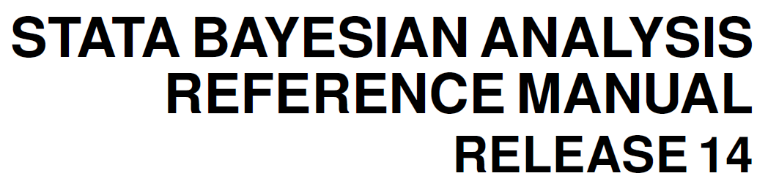
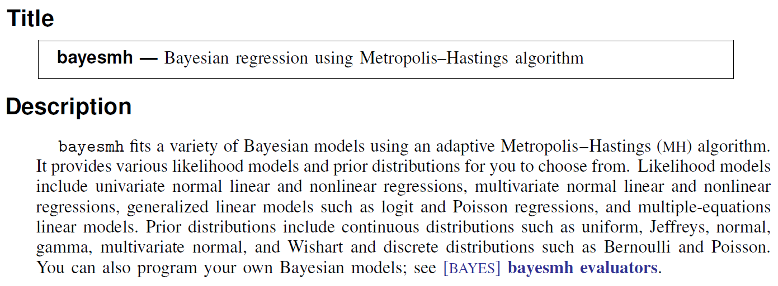

Slide 4
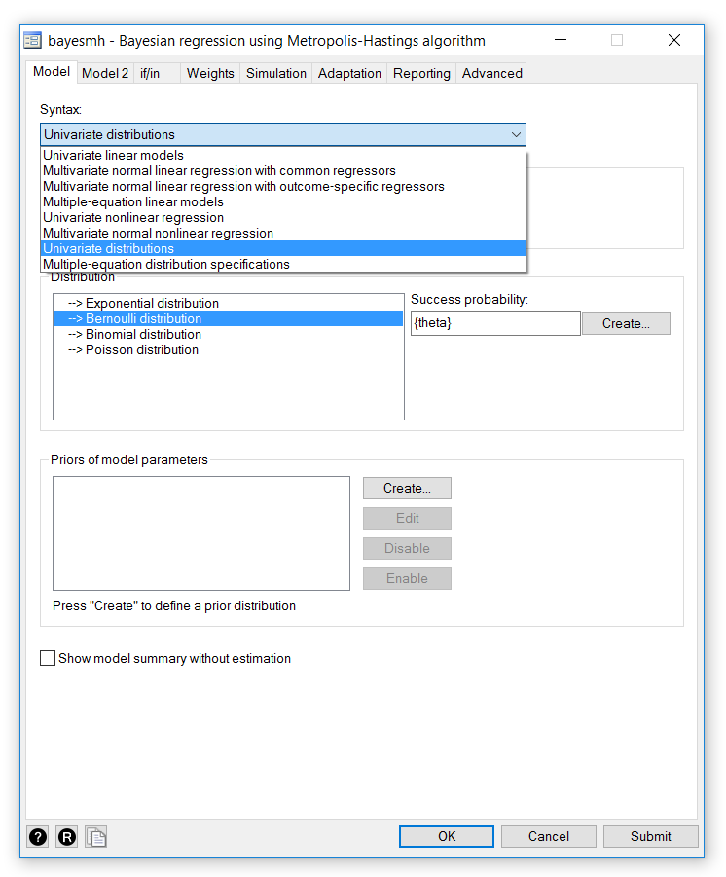

Slide 5
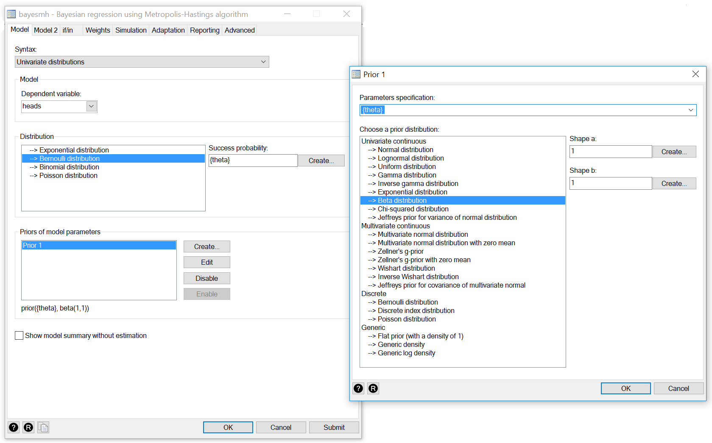

Slide 6
The bayesmh Command
bayesmh sbp age sex bmi, ///
likelihood(normal({sigma2})) ///
prior({sbp: _cons}, normal(0,100)) ///
prior({sbp: age}, normal(0,100)) ///
prior({sbp: sex}, normal(0,100)) ///
prior({sbp: bmi}, normal(0,100)) ///
prior({sigma2}, igamma(1,1))

Slide 7
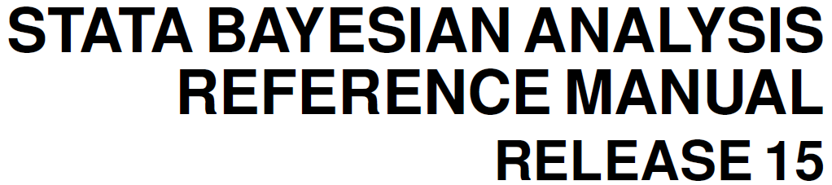
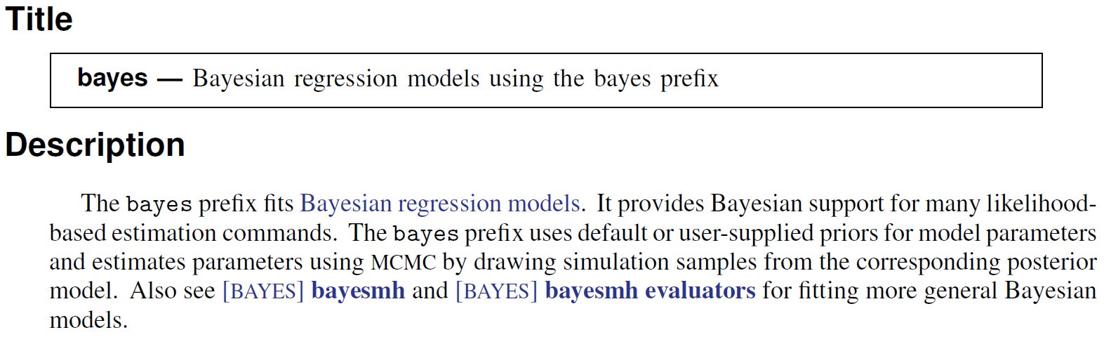

Slide 8
The bayes Prefix
regress sbp age sex
bayes: regress sbp age sex
logistic highbp age sex
bayes: logistic highbp age sex

Slide 9
Two Paradigms
Frequentist Statistics
Model parameters are considered to be unknown but fixed constants and the observed data are viewed as a repeatable random sample.
Bayesian Statistics
Model parameters are random quantities which have a posterior distribution formed by combining prior knowledge about parameters with the evidence from the observed data sample.

Slide 10
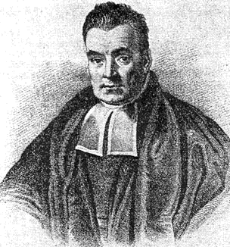
Reverend Thomas Bayes
1701 – born in London
Presbyterian Minister
Amateur Mathematician
Published one paper on theology and one on mathematics
1761 – died in Kent
1763 - “Bayes Theorem” paper published by friend Richard Price
https://bayesian.org/bayes

Slide 11
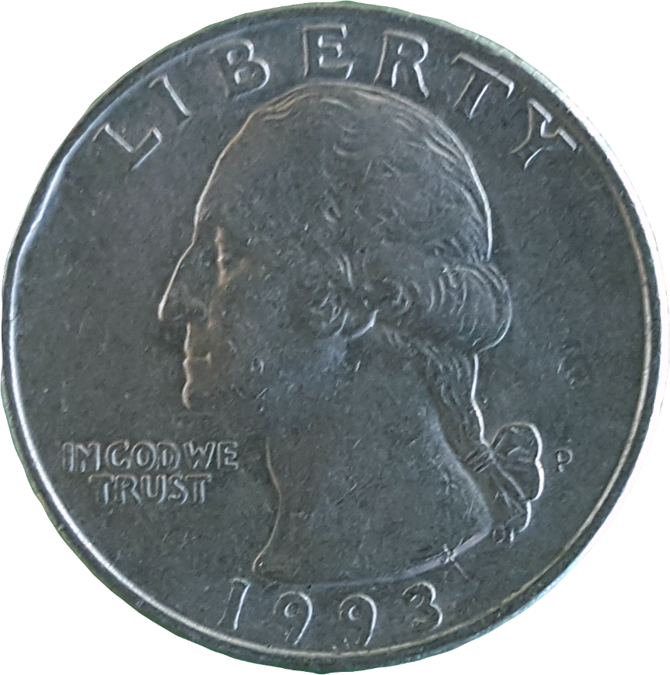
Coin Toss Example
What is the probability of heads (θ)?

Slide 12
Prior Distribution
Prior distributions are probability distributions of model parameters based on some a priori knowledge about the parameters.
Prior distributions are independent of the observed data.

Slide 13
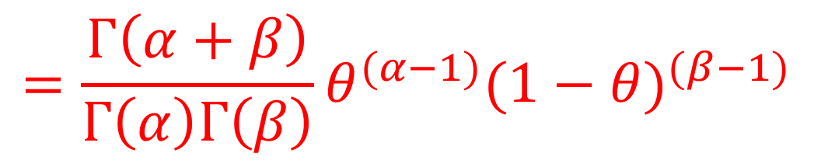
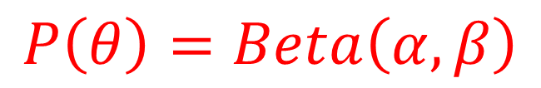
Beta Prior for θ
$$P\left(θ\right)=Beta\left(α,β\right)$$
$$=\frac{Γ\left(α+β\right)}{Γ\left(α\right)Γ\left(β\right)}θ^{(α−1)}{(1−θ)}^{(β−1)}$$

Slide 14
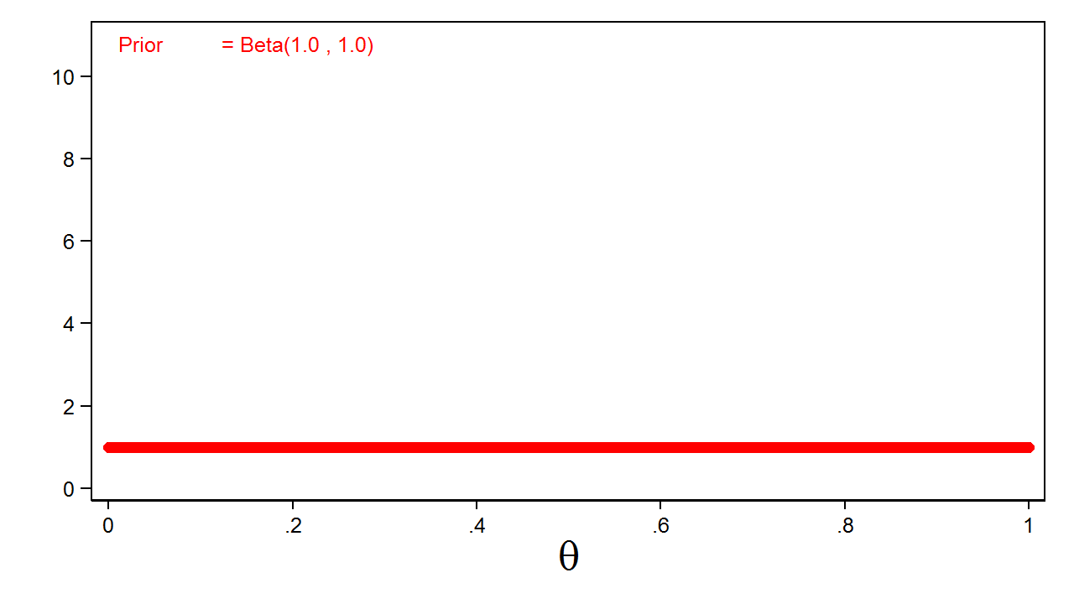
Uninformative Prior

Slide 15
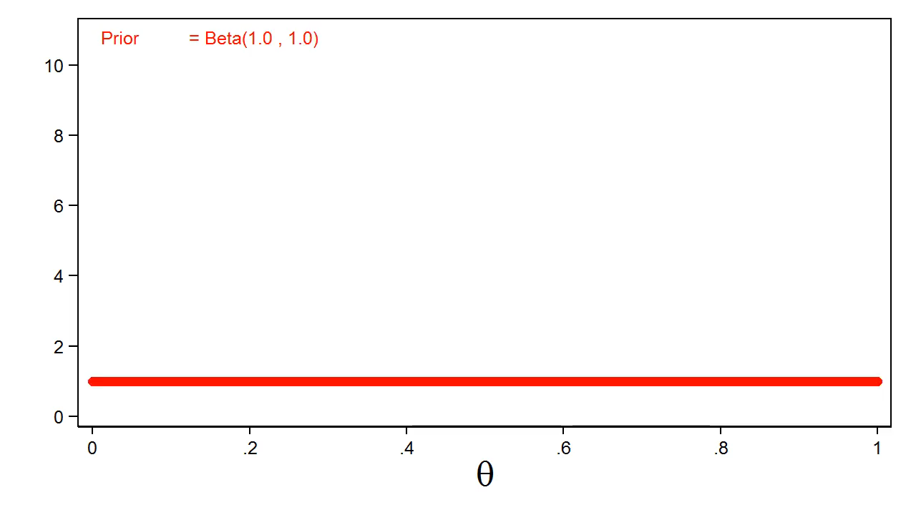
Different Priors

Slide 16
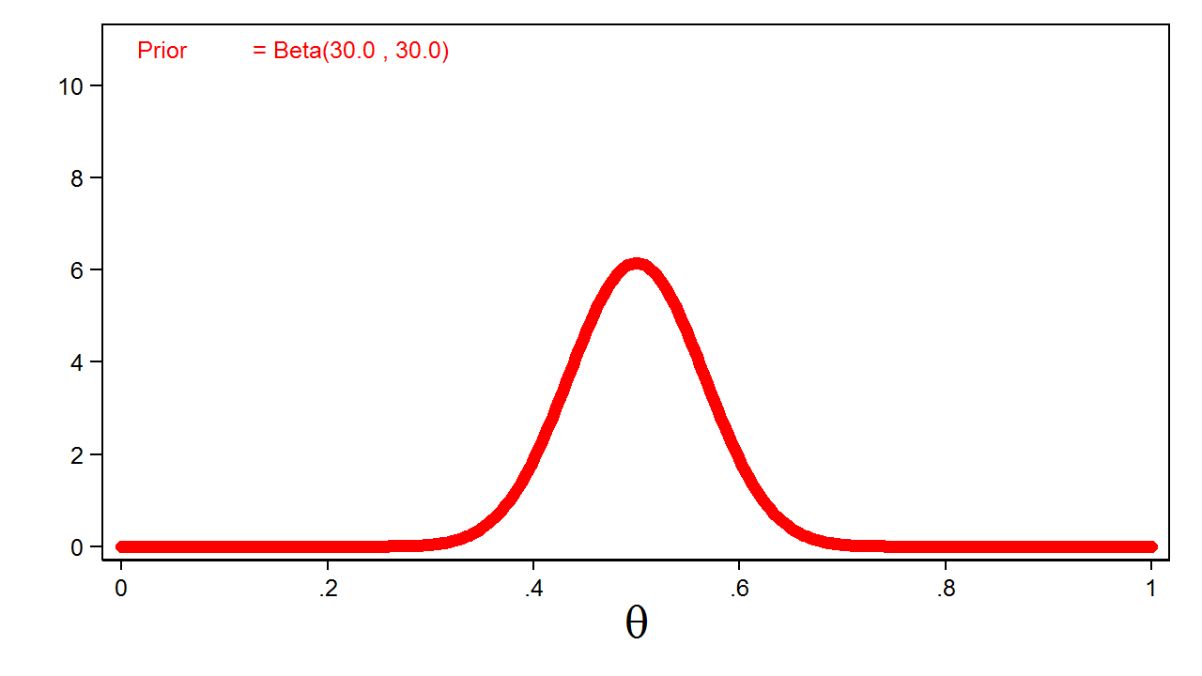
Informative Prior

Slide 17
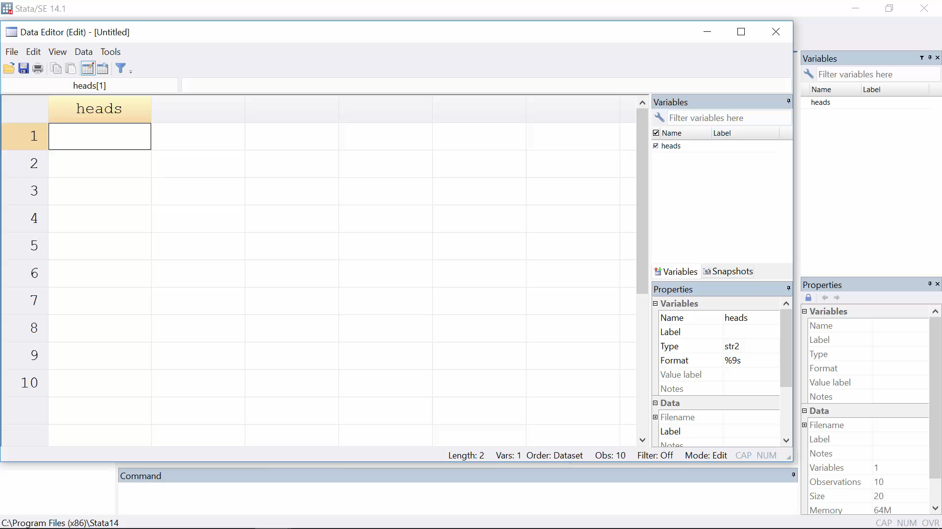
Coin Toss Experiment

Slide 18
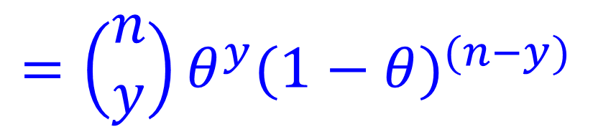
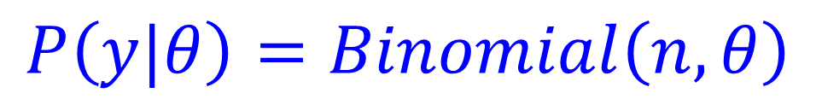
Likelihood Function for the Data
$$P\left(y|θ\right)=Binomial\left(n,θ\right)$$
$$=\left(\begin{matrix}n \\ y\end{matrix}\right)θ^{y}{(1−θ)}^{(n−y)}$$

Slide 19
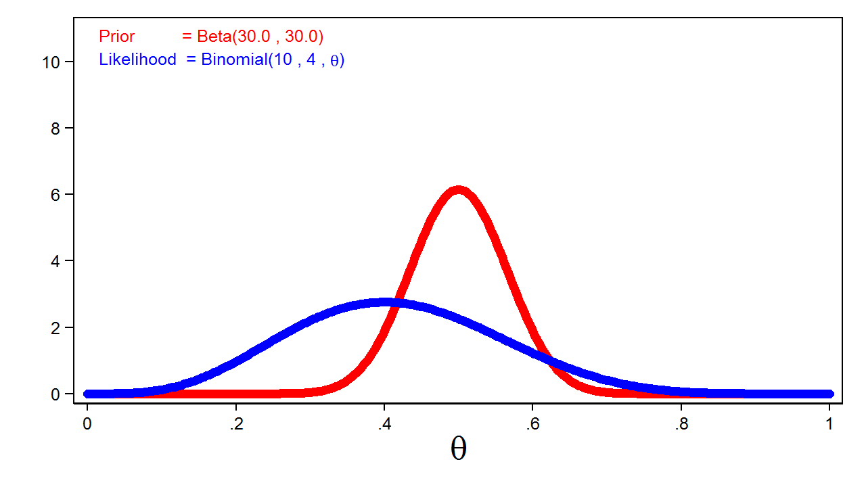
Prior and Likelihood

Slide 20


Posterior Distribution
$$Posterior=Prior×Likelihood$$
$$P\left(θ|y\right)=P\left(θ\right)P\left(y|θ\right)$$
$$P\left(θ|y\right)=Beta\left(α,β\right)×Binomial\left(n,θ\right)$$
$$=Beta\left(y+α,n−y+β\right)$$

Slide 21
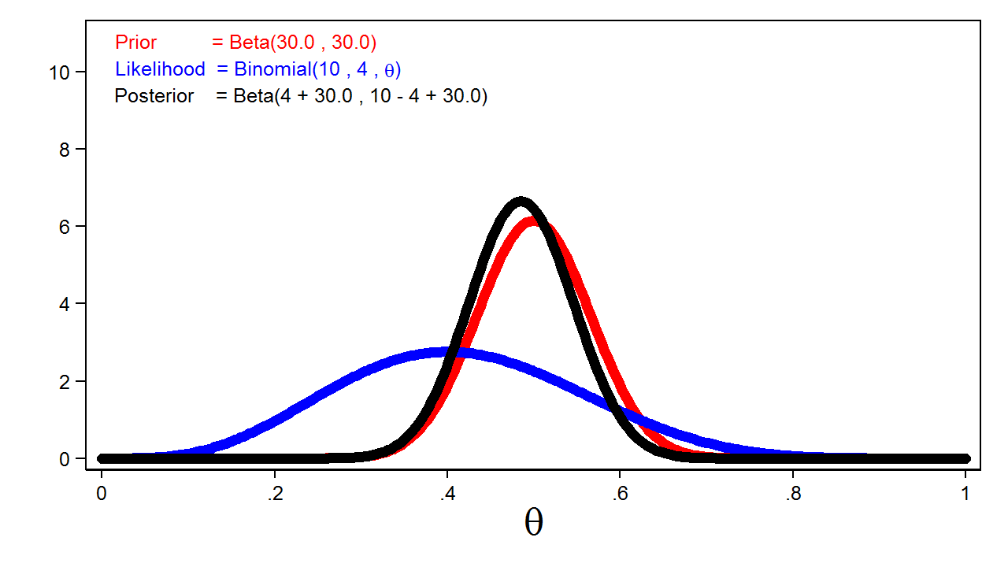
Posterior Distribution

Slide 22
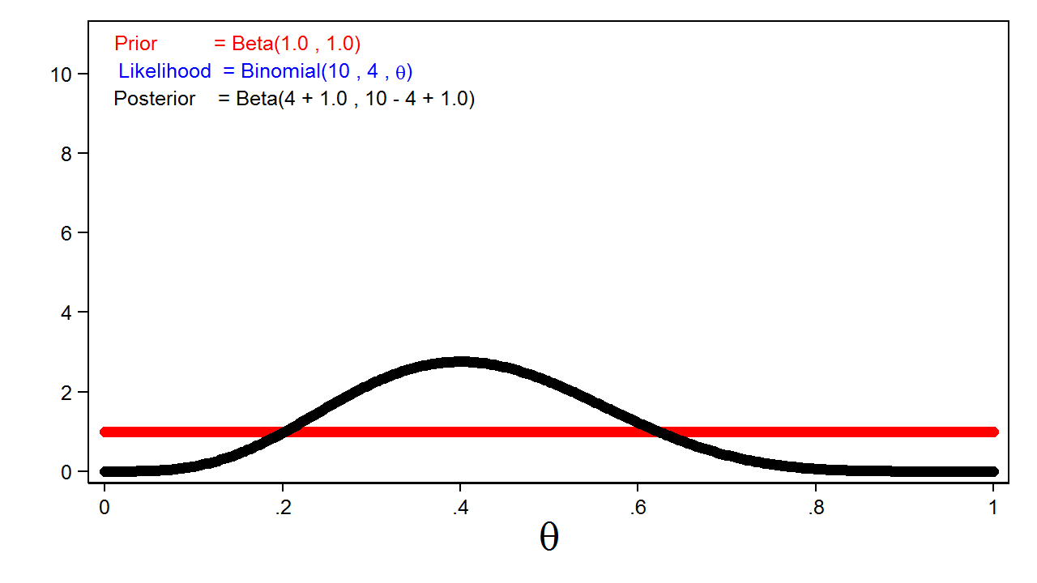
Effect of Uninformative Prior

Slide 23
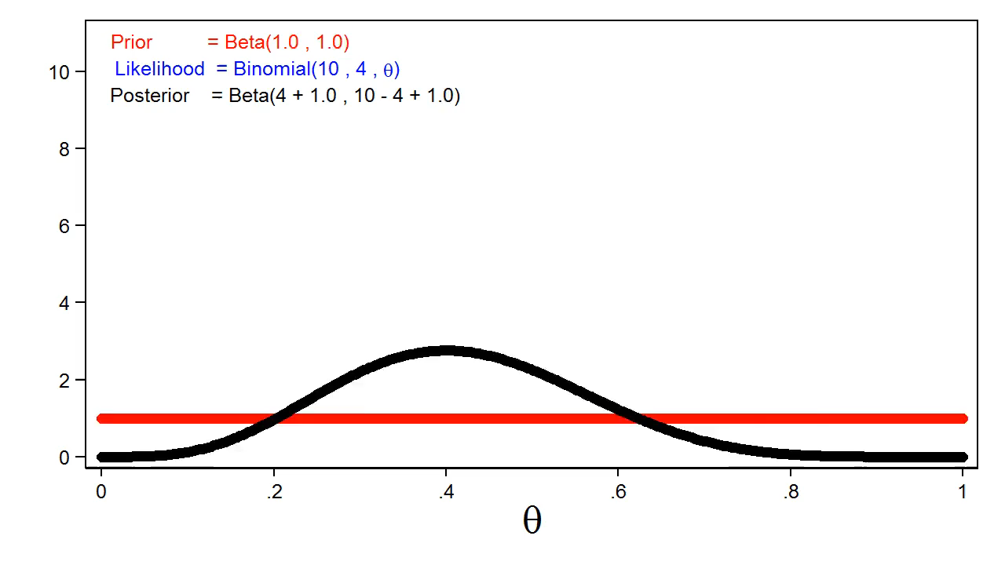
Effect of Informative Prior

Slide 24
Markov Chain Monte Carlo
Often the posterior distribution does not have a simple form. We can use Markov Chain Monte Carlo (MCMC) with the Metropolis-Hastings algorithm to generate a sample from the posterior distribution.

Slide 25
MCMC and Metropolis-Hastings
Monte Carlo
Markov Chains
Metropolis-Hastings

Slide 26
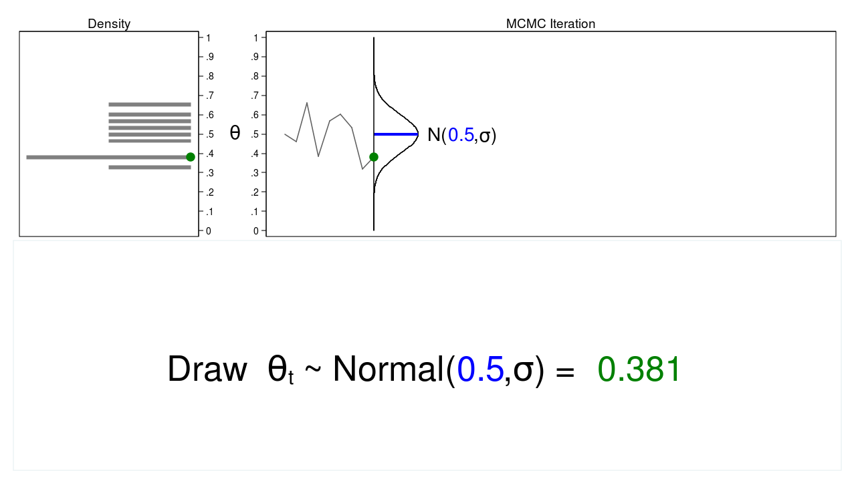
Monte Carlo
←Proposal Distribution

Slide 27
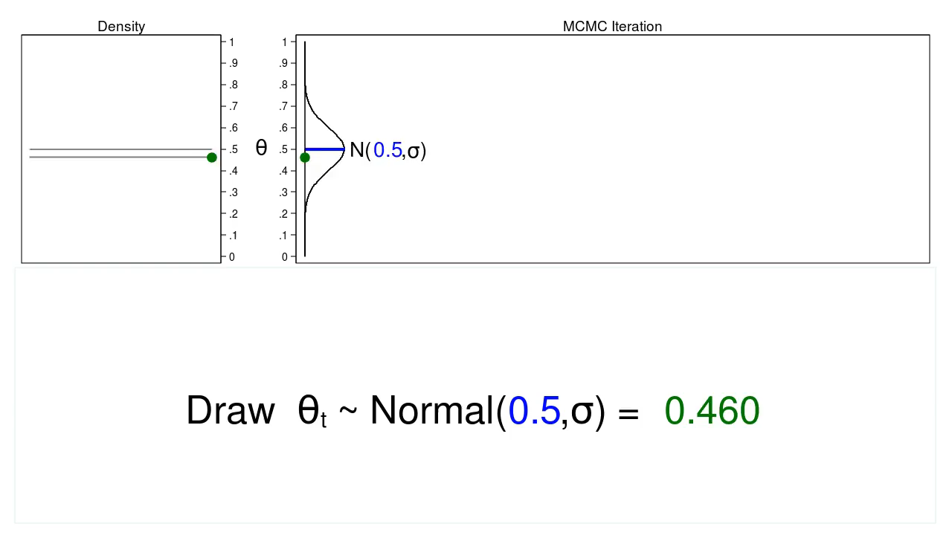
Monte Carlo

Slide 28
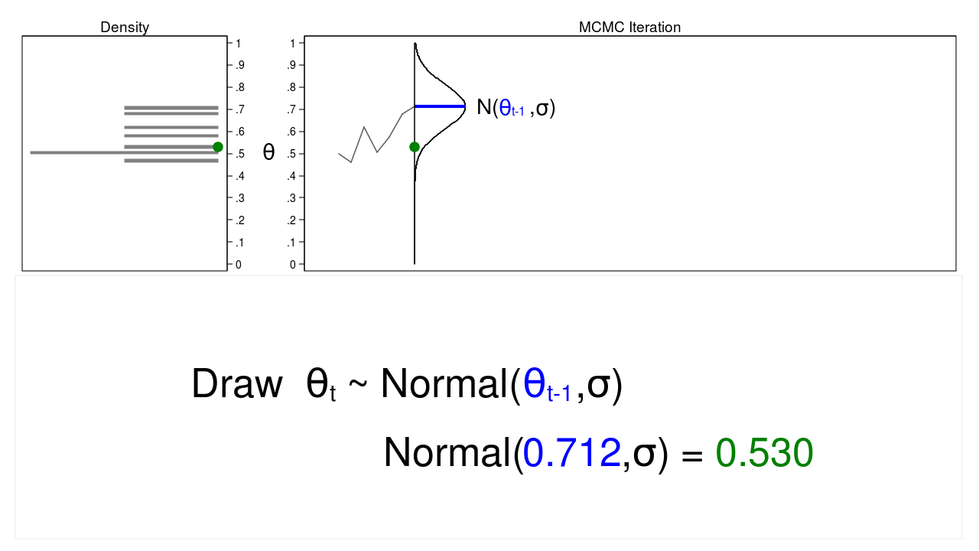
Markov Chain Monte Carlo

Slide 29
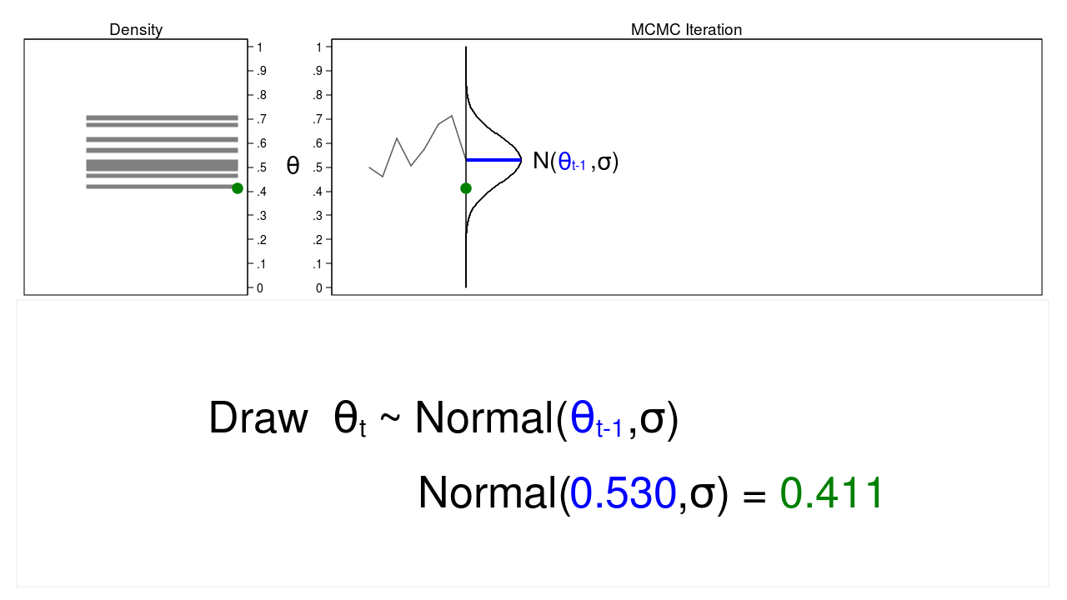
Markov Chain Monte Carlo

Slide 30
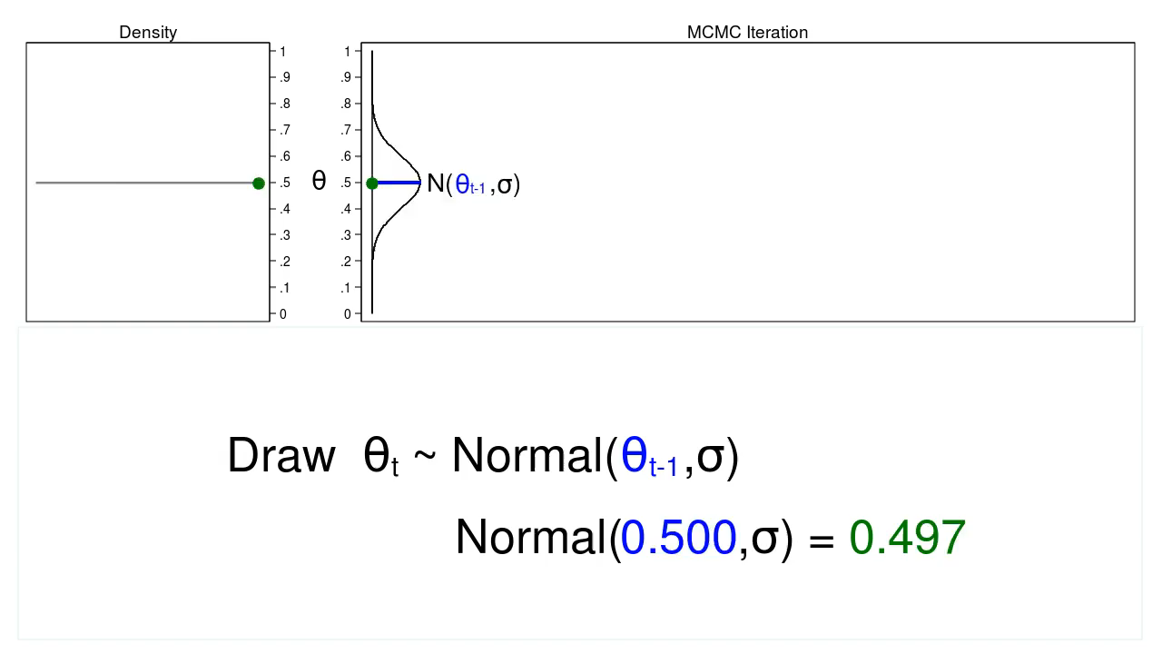
Markov Chain Monte Carlo

Slide 31
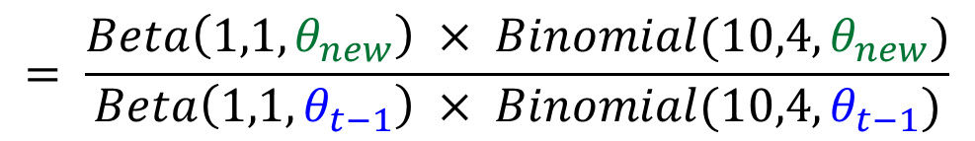
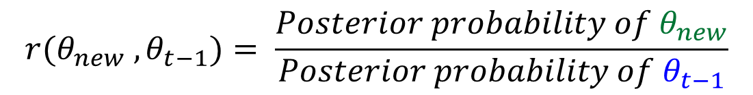
MCMC with Metropolis-Hastings
$$r(θ_{new} ,θ_{t−1})= \frac{Posterior probability of θ_{new}}{Posterior probability of θ_{t−1}}$$
$$= \frac{Beta\left(1,1,θ_{new}\right) × Binomial(10,4,θ_{new})}{Beta\left(1,1,θ_{t−1}\right) × Binomial(10,4,θ_{t−1})}$$

Slide 32

MCMC with Metropolis-Hastings
$$acceptance probability=α(θ_{new} ,θ_{t−1})$$
$$=min\left[ r(θ_{new},θ_{t−1}) , 1 \right]$$

Slide 33


MCMC with Metropolis-Hastings
$$Draw u \sim Uniform(0,1)$$
$$If u<α\left(θ_{new} ,θ_{t−1}\right) Then θ_{t}=θ_{new}$$
$$Otherwise θ_{t}=θ_{t−1}$$

Slide 34
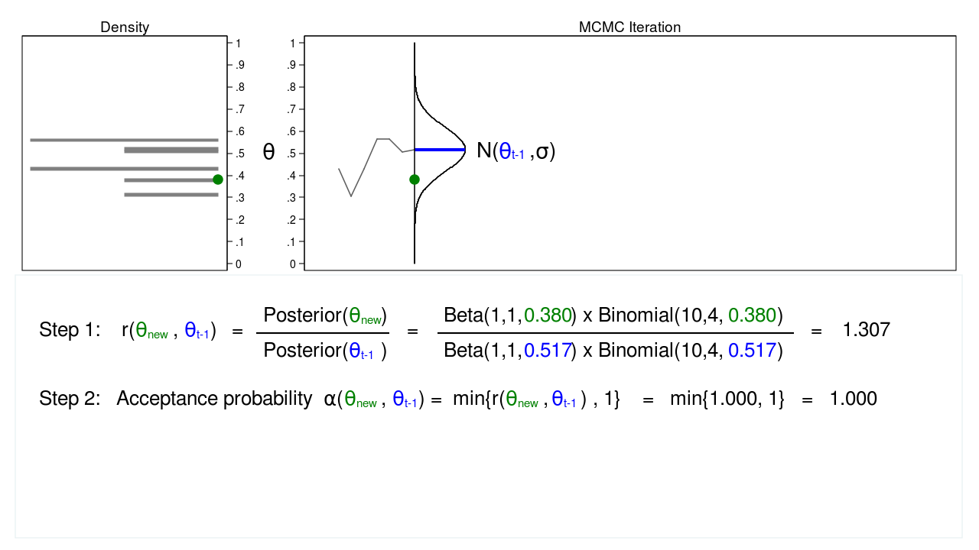
MCMC with Metropolis-Hastings

Slide 35
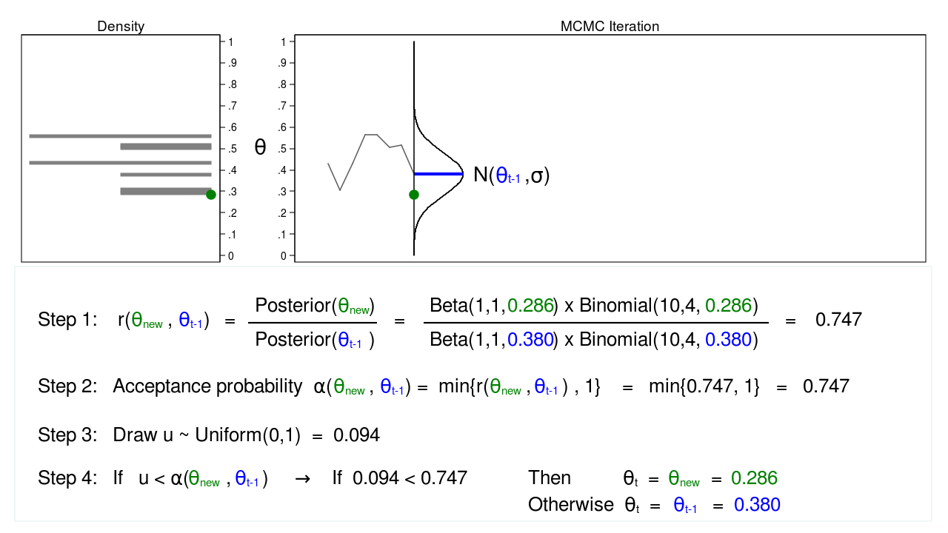
MCMC with Metropolis-Hastings

Slide 36
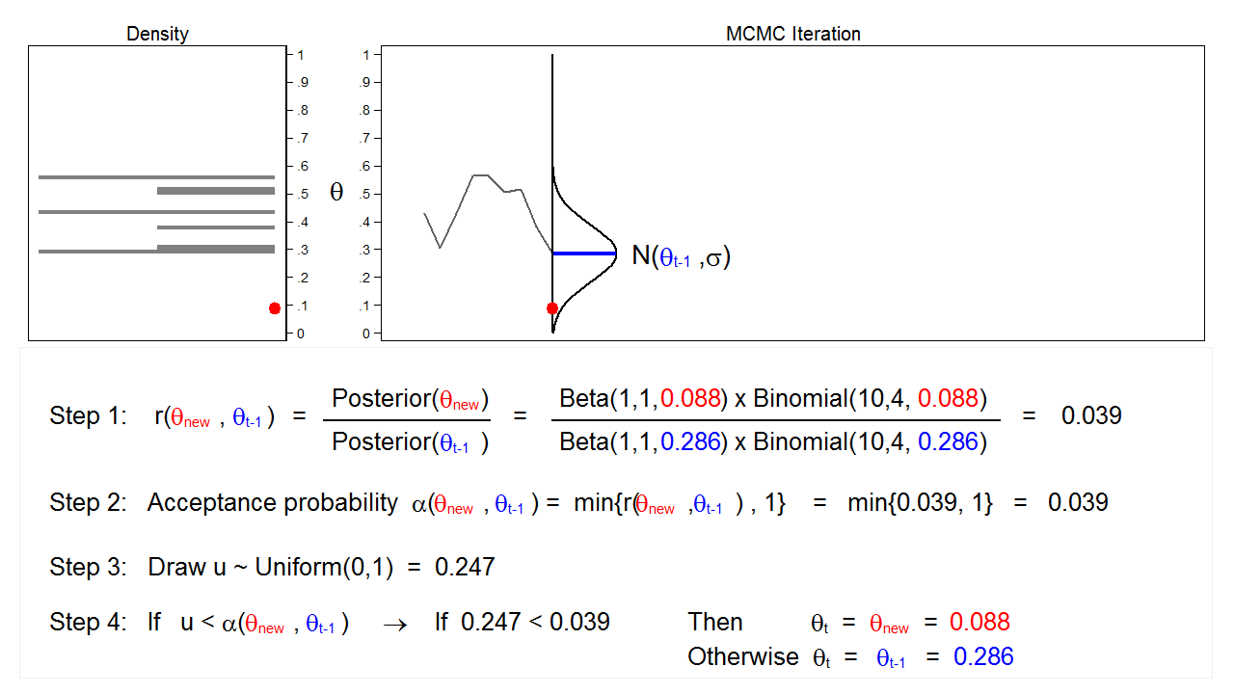
MCMC with Metropolis-Hastings

Slide 37
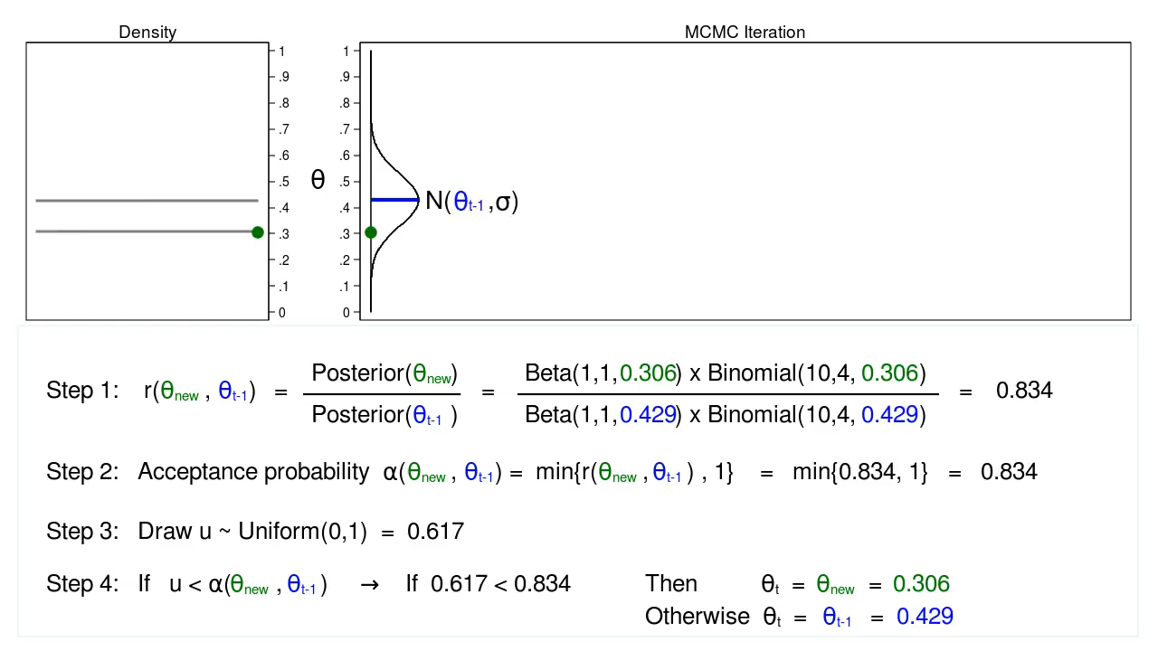
MCMC with Metropolis-Hastings

Slide 38
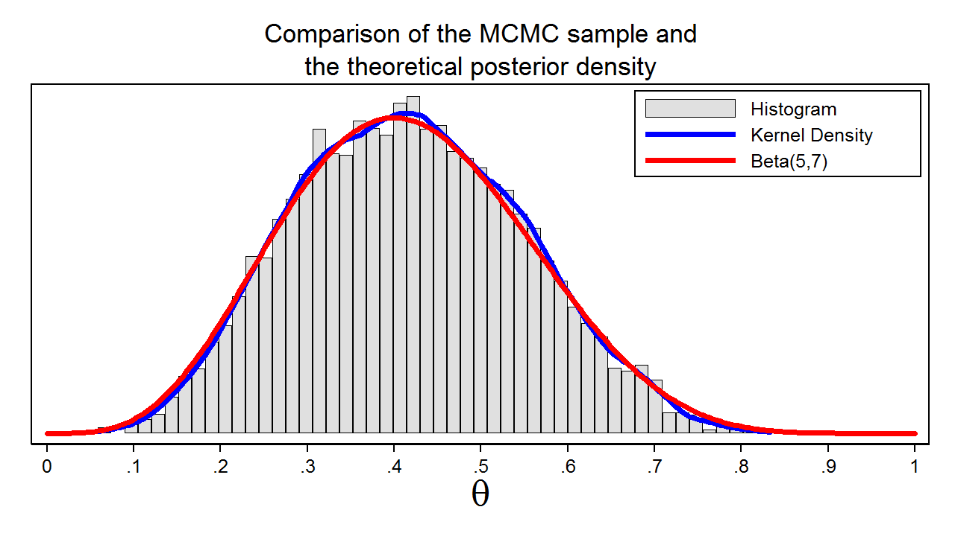
MCMC with Metropolis-Hastings

Slide 39
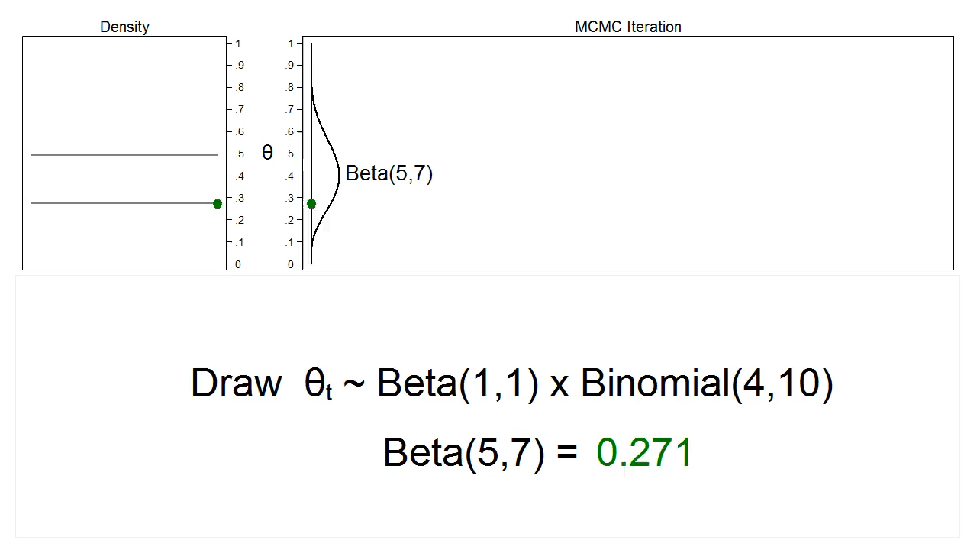
MCMC with Gibbs Sampling

Slide 40
The bayesmh command
bayesmh heads, ///
likelihood(dbernoulli({theta})) ///
prior({theta}, beta(1,1))

Slide 41
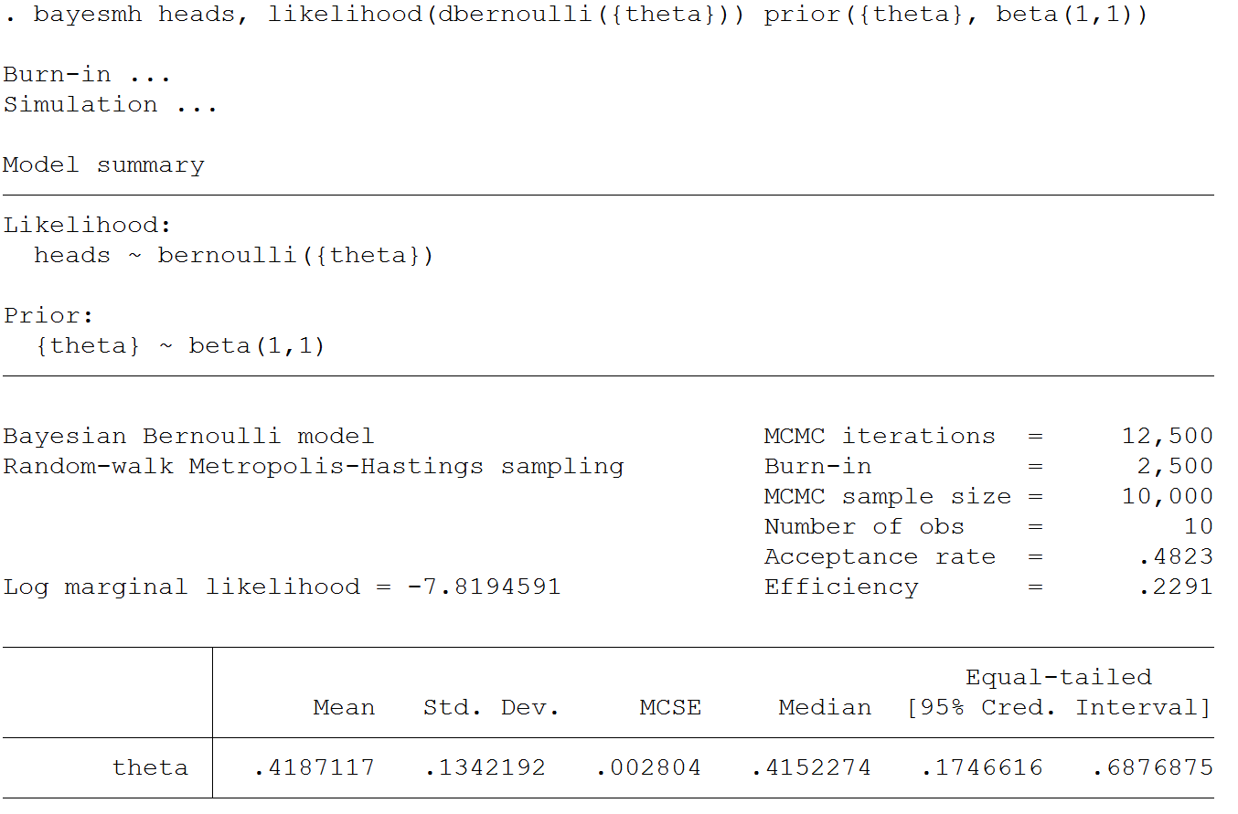

Slide 42
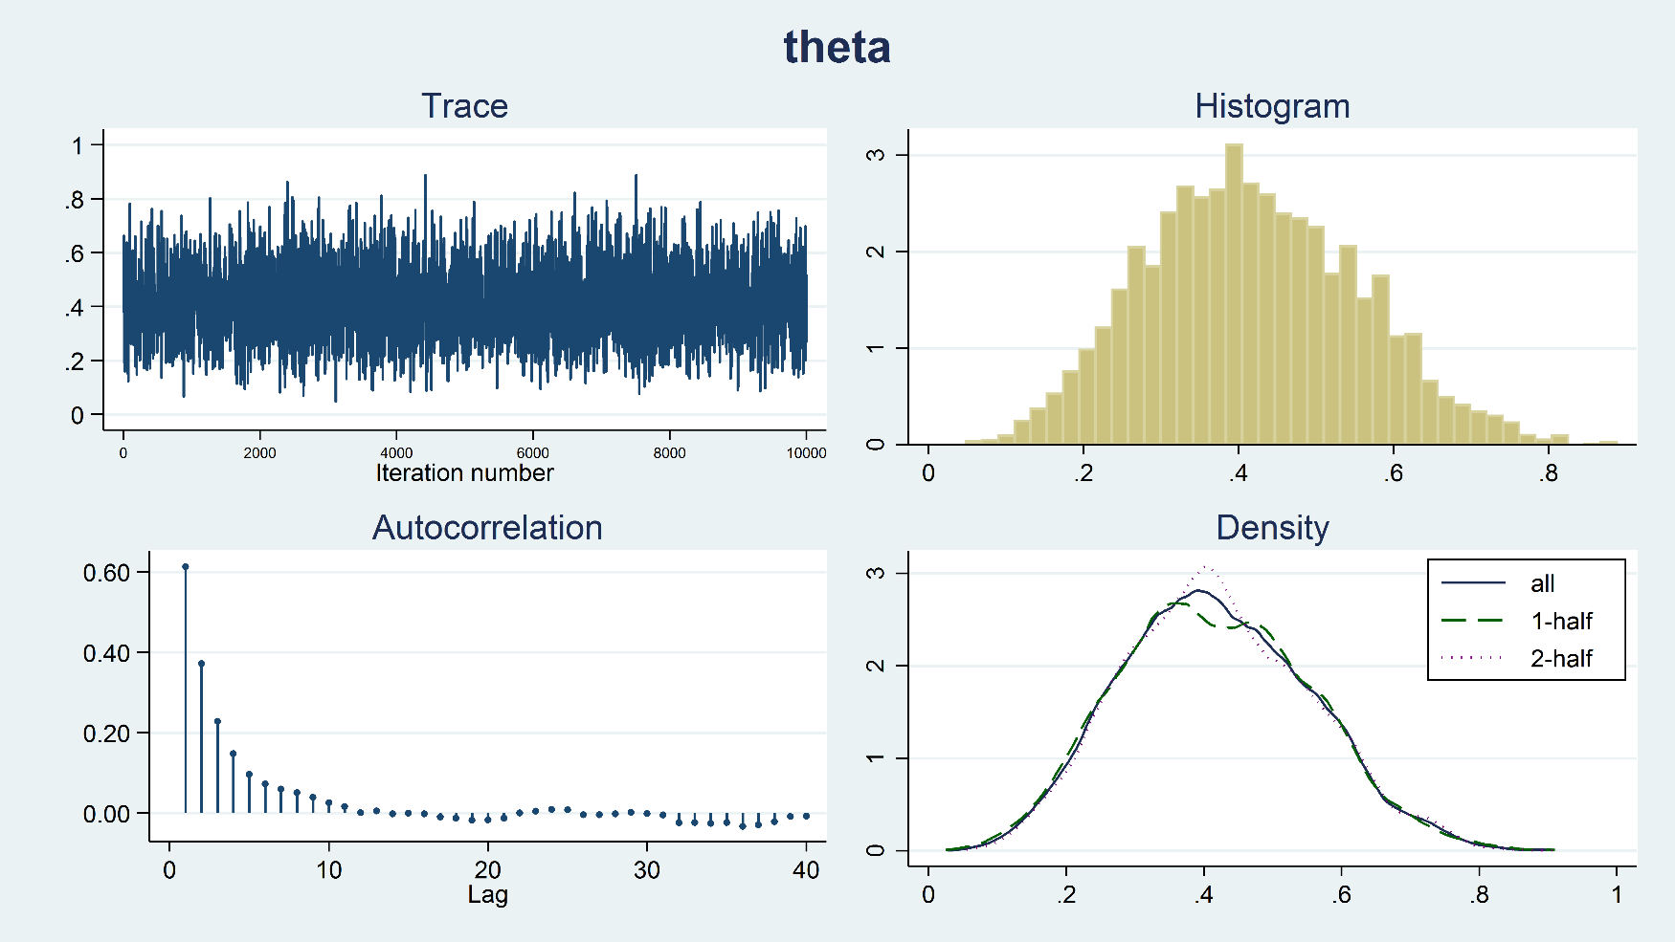
Diagnostic Plots
bayesgraph diagnostics {theta}

Slide 43
Outline
Introduction to Bayesian Analysis
Coin Toss Example
Priors, Likelihoods, and Posteriors
Markov Chain Monte Carlo (MCMC)
Bayesian Linear Regression
Advantages and Disadvantages of Bayes

Slide 44
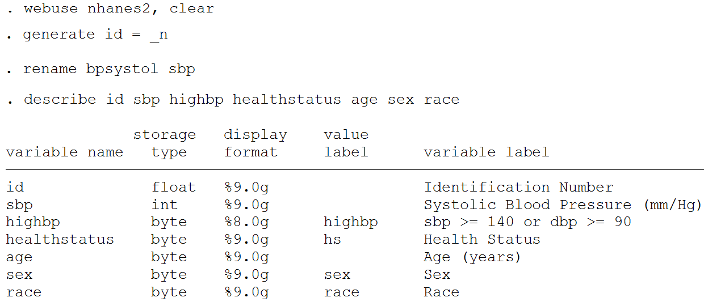
Bayesian Linear Regression
We will ignore the sample weights to keep things simple.

Slide 45
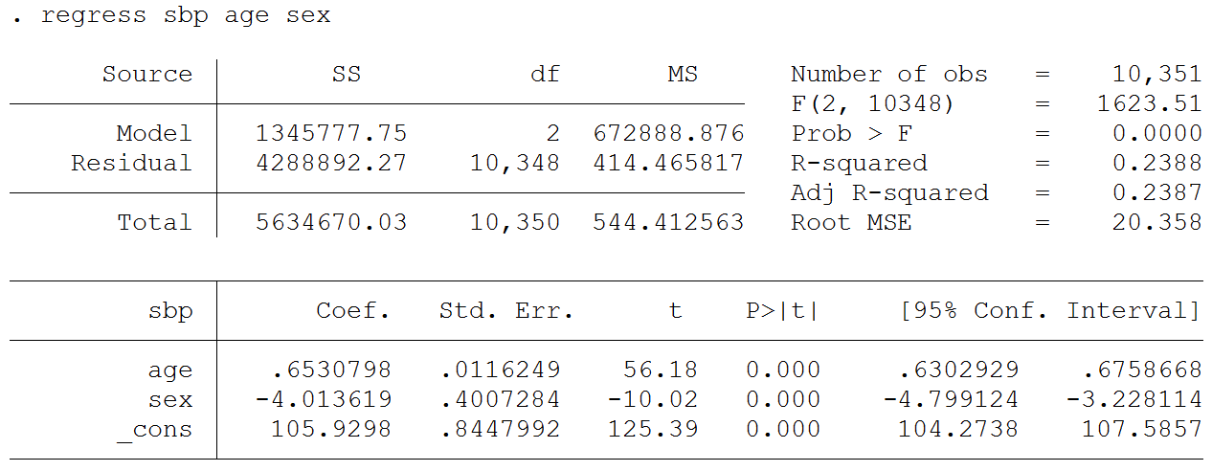
$${sbp}_{i}=β_{0}+β_{1}{age}_{i}+β_{2}{sex}_{i}+e_{i}$$

Slide 46
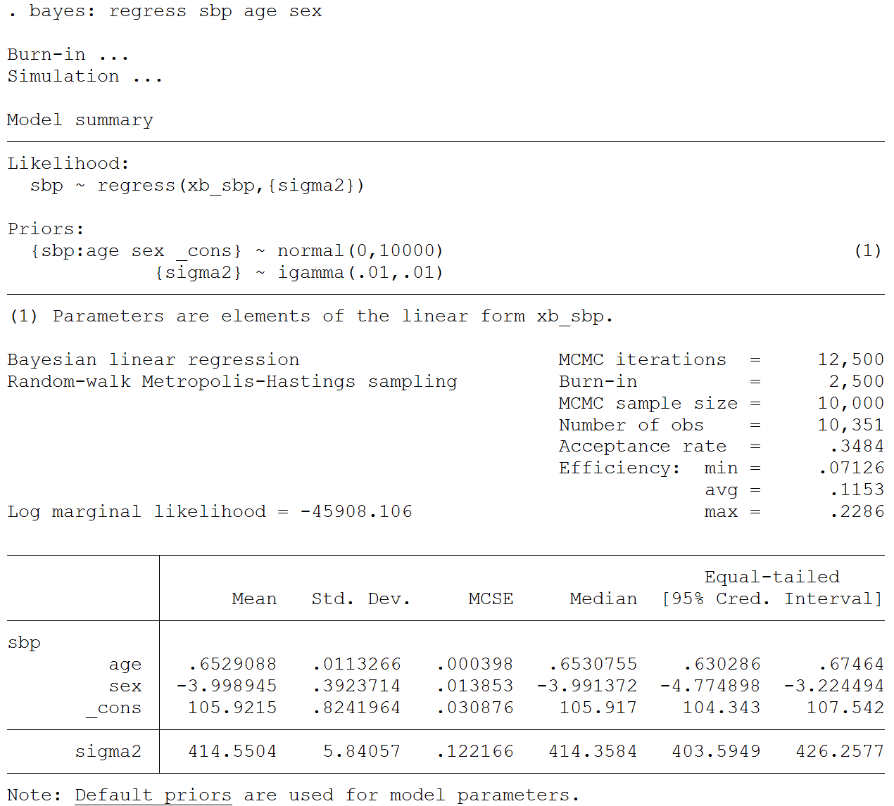

Slide 47
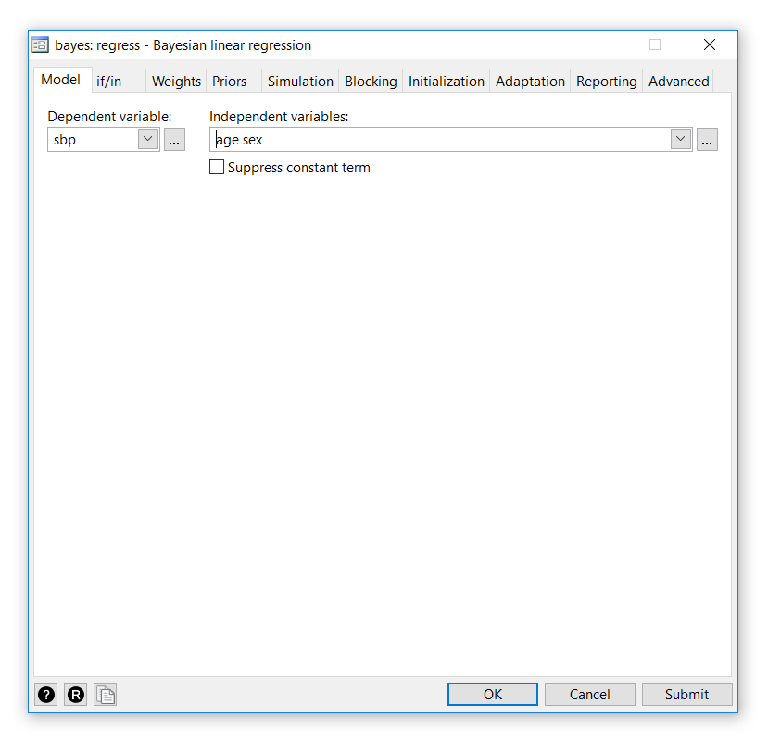

Slide 48
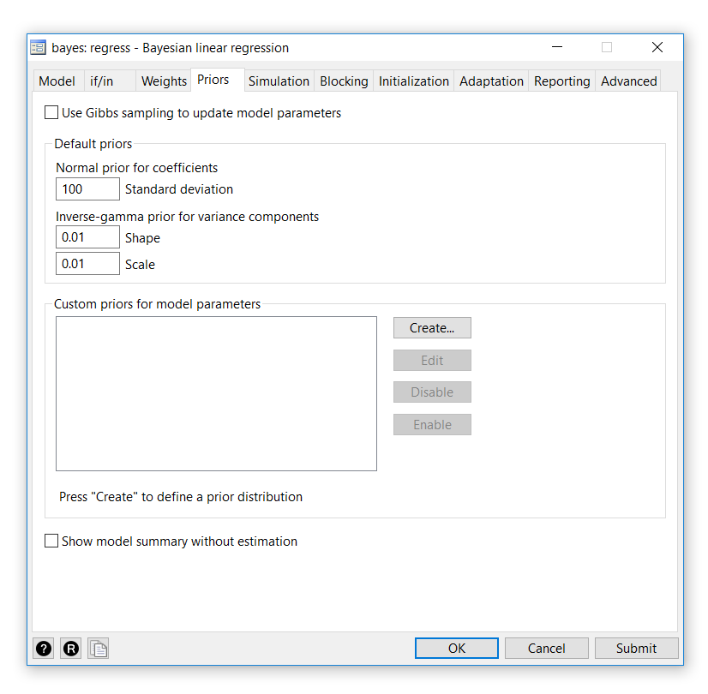

Slide 49
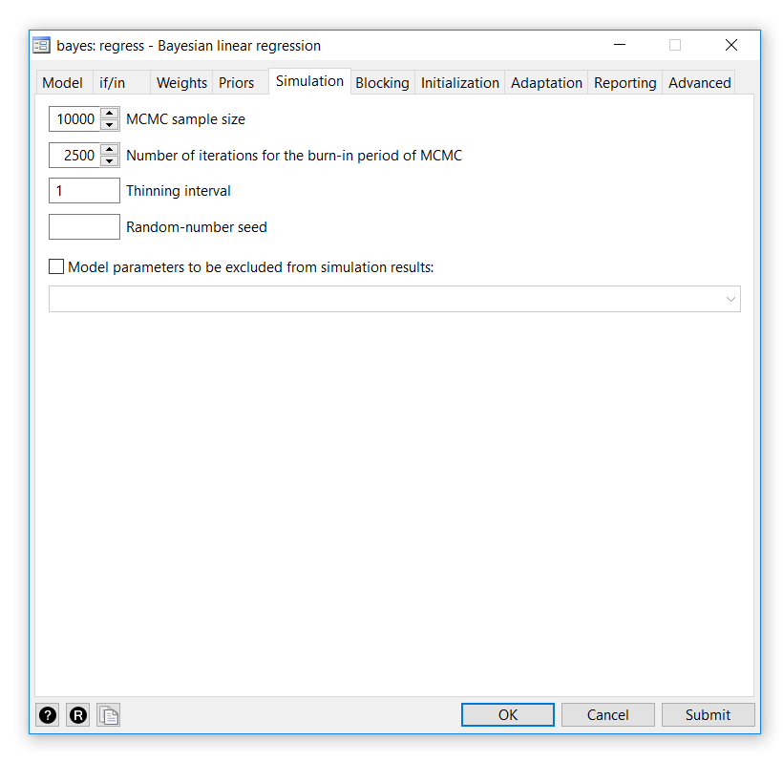

Slide 50
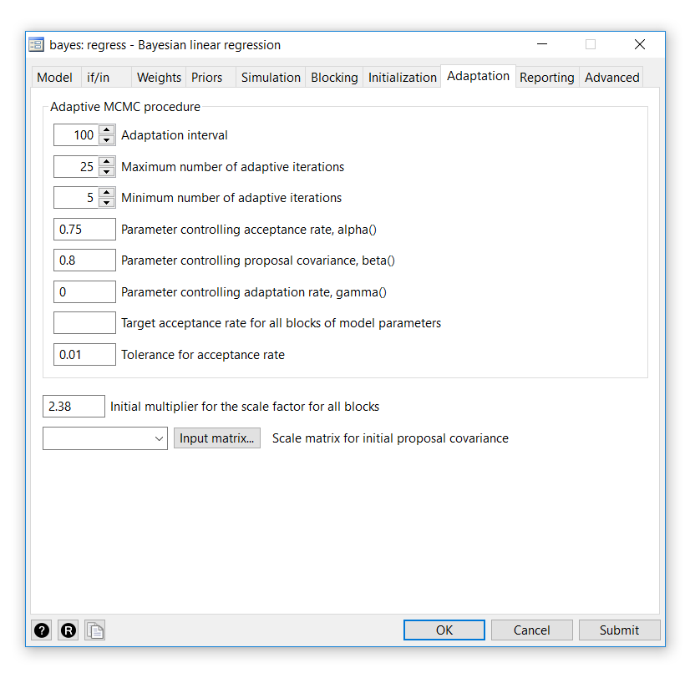

Slide 51
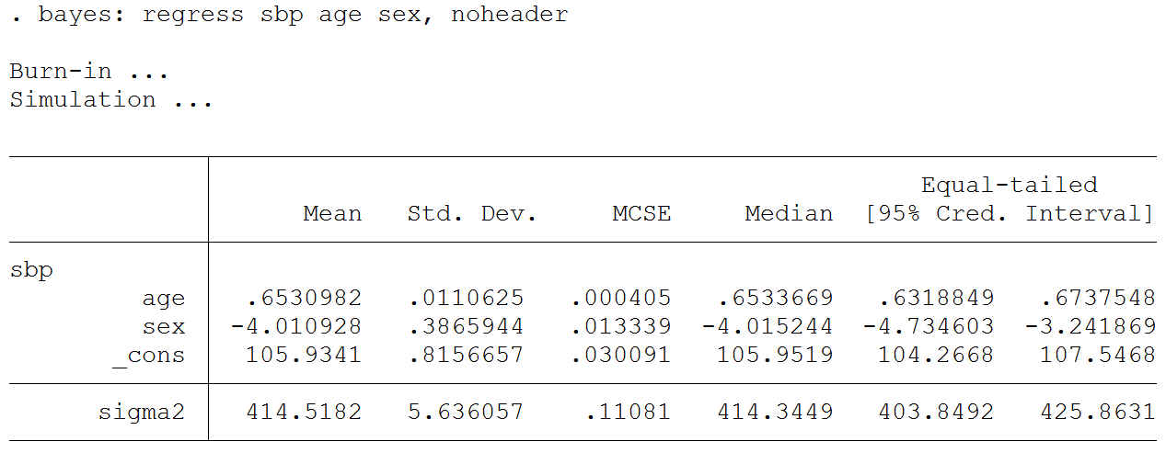
bayes options

Slide 52
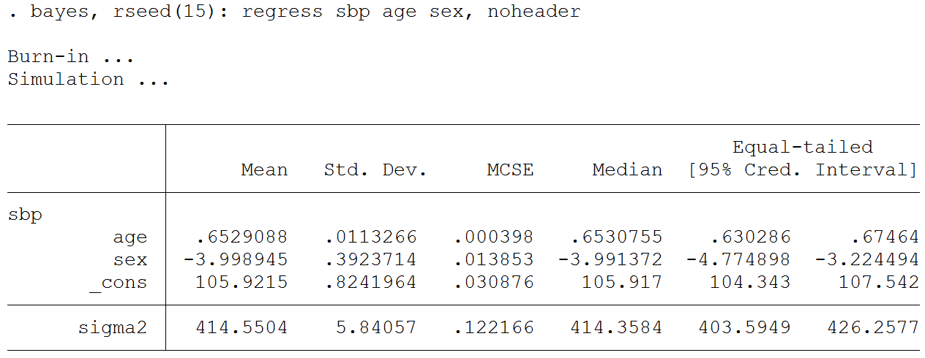
bayes options

Slide 53
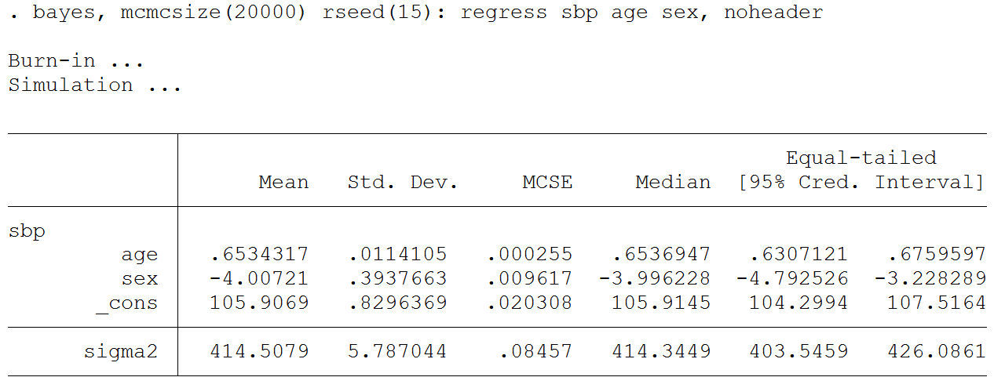
bayes options

Slide 54
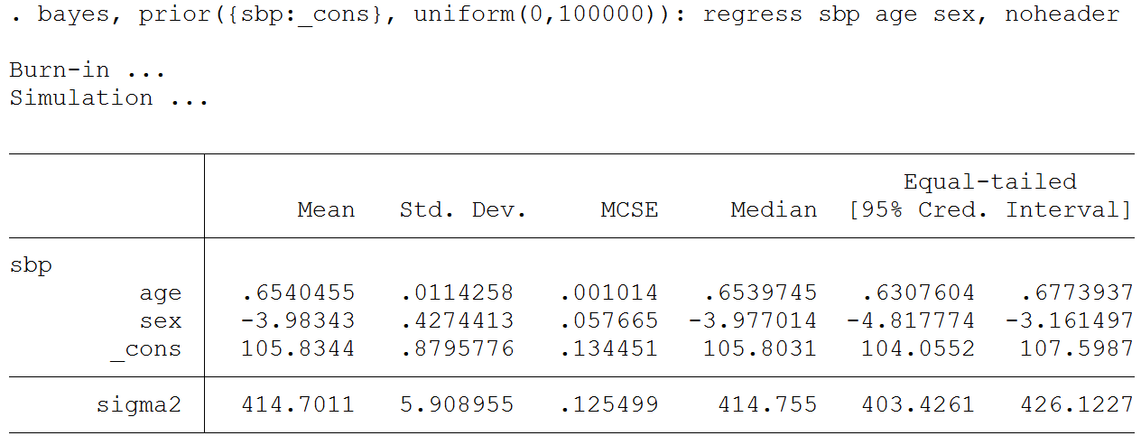
bayes options

Slide 55
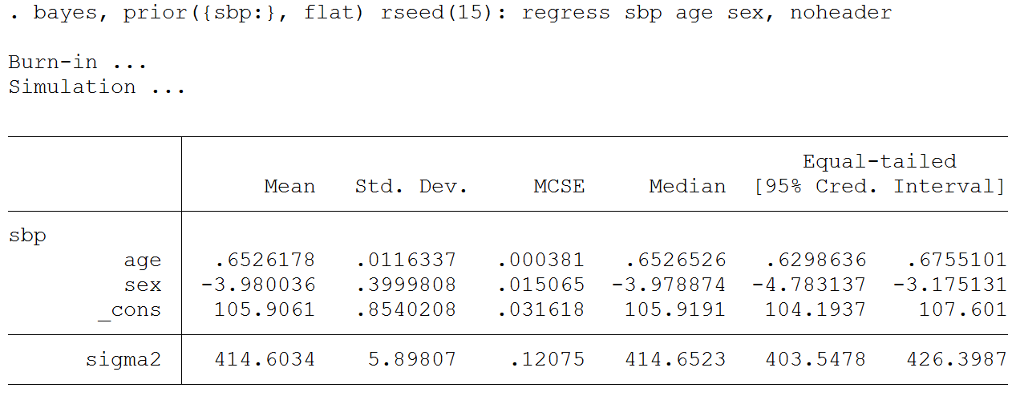
bayes options

Slide 56
Checking “Convergence” of the Chain
Effective Sample Size
Trace Plots
Histograms
Correlegrams
Scatterplot Matrices

Slide 57
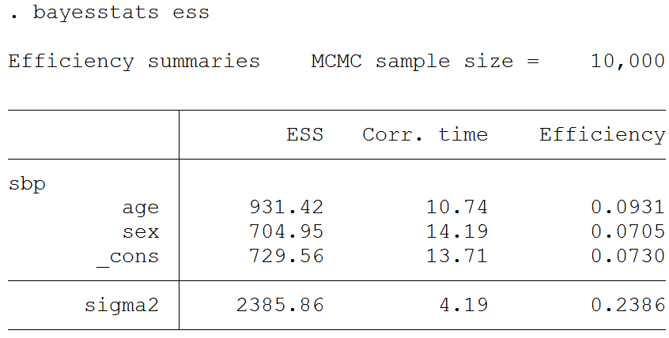
Checking “Convergence” of the Chain

Slide 58
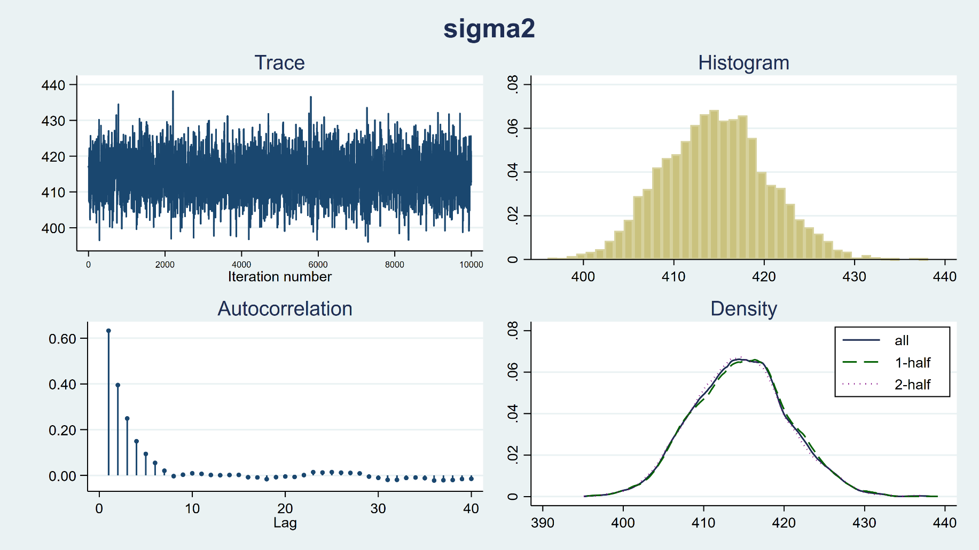
Checking “Convergence” of the Chain
bayesgraph diagnostics {sigma2}

Slide 59
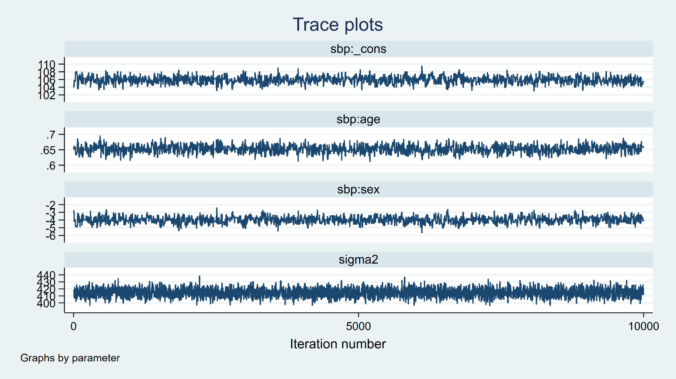
Checking “Convergence” of the Chain
bayesgraph trace {sbp: _cons age sex} {sigma2}, byparm

Slide 60

Checking “Convergence” of the Chain
bayesgraph ac {sbp: _cons age sex} {sigma2}, byparm

Slide 61

Checking “Convergence” of the Chain
bayesgraph histogram {sbp: _cons age sex} {sigma2}, byparm

Slide 62

Checking “Convergence” of the Chain
bayesgraph matrix _all

Slide 63
Bayesian Model Selection
quietly {
bayes, rseed(15): regress sbp age
estimates store age
bayes, rseed(15): regress sbp sex
estimates store sex
bayes, rseed(15): regress sbp age sex
estimates store full
}

Slide 64

Bayesian Model Selection

Slide 65

Bayesian Model Selection

Slide 66

Tests

Slide 67


Predictions
Frequentist
Bayesian

Slide 68

Predictions

Slide 69


Slide 70

Predictions

Slide 71

Predictions

Slide 72
Convert the Matrix to a Dataset
matrix pred = r(summary)
clear
svmat pred /* convert matrix to dataset */
rename pred1 mean
rename pred2 stddev
rename pred3 mcse
rename pred4 median
rename pred5 lower
rename pred6 upper
gen sex = _n<6
label define sex 0 "Female" 1 "Male"
label values sex sex
gen age = (_n+1)*10 if _n<6
replace age = (_n-4)*10 if _n>5

Slide 73

Predictions

Slide 74


The bayes Prefix

Slide 75

The bayes Prefix

Slide 76


The bayes Prefix

Slide 77

The bayes Prefix

Slide 78
Outline
Introduction to Bayesian Analysis
Coin Toss Example
Priors, Likelihoods, and Posteriors
Markov Chain Monte Carlo (MCMC)
Bayesian Linear Regression
Advantages and Disadvantages of Bayes

Slide 79
Advantages of Bayesian Statistics
Formally incorporate prior information into studies
Works when maximum likelihood estimation (MLE) fails or is not identified
Does not rely on asymptotic normality like MLE
Works with small sample sizes
Intuitive interpretation of results such as credible intervals

Slide 80


US Food and Drug Administration (FDA)
Quote from page 22
https://www.fda.gov/downloads/MedicalDevices/DeviceRegulationandGuidance/GuidanceDocuments/ucm071121.pdf

Slide 81
Disadvantages of Bayesian Statistics
Subjectivity in the selection of prior distributions
Computational complexity

Slide 82
Outline
Introduction to Bayesian Analysis
Coin Toss Example
Priors, Likelihoods, and Posteriors
Markov Chain Monte Carlo (MCMC)
Bayesian Linear Regression
Advantages and Disadvantages of Bayes

Slide 83
Thank you!
Questions?
chuber@stata.com

