Slide 1
Using monte carlo simulation for non-standard sample size/power calculation
Prof Michael Jones
13 September, 2016

Slide 2
Aims of the presentation
Lay out some context for when sample size/power calculations are important
Describe some simple cases
Describe some more complex problems
Propose a somewhat general solution using monte carlo facilities in Stata

Slide 3
Context

Slide 4
Purpose of sample size/power
Prospective
Design stage
Maximize probability of rejecting H₀ when false
Ethical considerations
How large a sample should I recruit ?
Other design considerations, such as measurement choice
Retrospective
Analysis stage
What was the probability of rejecting H₀ if false
Qualification of interpretation of a non-sig hypothesis test
What was the power of my test ?
Fixed sample size available

Slide 5
Let’s revisit hypothesis test principles
 |  | State of H₀ in population
 |  | True | False
State of H₀ in sample | True | Correct | Type II error
 | False | Type I error | Correct
We accept or reject an hypothesis based on what we know from a sample but want to make inference about the state of play in a population
If our conclusion (accept or reject H₀) agrees with the (unseen) population then we are correct but otherwise we have made an error
Psychology

Slide 6
A hypothetical example: influence of emotional intelligence on Psych QoL
From a larger sample of individuals on whom we had emotional intelligence scores (TeiQue) we randomly selected n=10 with low EI scores and n=10 with high EI scores and asked them to complete a psychological QoL scale (WHO)
We then compared QoL-Psych between the EI groups with low and high scores
Psychology

Slide 7
Our findings
. ttest psychqol, by(group)
Two-sample t test with equal variances
------------------------------------------------------------------------------
Group | Obs Mean Std. Err. Std. Dev. [95% Conf. Interval]
---------+--------------------------------------------------------------------
Low | 10 119.3839 7.70726 24.3725 101.9488 136.8189
High | 10 136.4704 6.525548 20.63559 121.7086 151.2322
---------+--------------------------------------------------------------------
combined | 20 127.9271 5.291095 23.6625 116.8527 139.0015
---------+--------------------------------------------------------------------
diff | -17.08651 10.09874 -38.30319 4.130162
------------------------------------------------------------------------------
diff = mean(Low) - mean(High) t = -1.6919
Ho: diff = 0 degrees of freedom = 18
Ha: diff < 0 Ha: diff != 0 Ha: diff > 0
Pr(T < t) = 0.0539 Pr(|T| > |t|) = 0.1079 Pr(T > t) = 0.9461
p=0.1 therefore accept H₀ and conclude that psych QoL does not differ between individuals with high and low EI scores
Psychology

Slide 8
But …
Cohen’s d is defined as:
d =-17.1/23.7=-0.72
d >0.8 is considered a large effect size and >0.6 is medium but we have accepted H₀
Psychology

Slide 9
The p-value deconstructed
An unstandardized
effect size
The t-statistic:
SD of the difference
in means
So what the p-value measures is how likely we are to observe a t-statistic as large as we have if H₀ is true in the population.
Our t-value will be large if the unstandardized effect size is large, the pooled SD is small or n_{H} and/or n_{L} are large
If the unstandardized effect size is large enough to be scientifically or clinically interesting then we can enhance the probability of rejecting H₀ by decreasing the pooled SD and/or increasing our sample size
The probability of rejecting H₀ is the ‘power’ of the test
Psychology

Slide 10
Power functions - general
Generally involve 5 parameters
Effect size (δ)
Variance (σ)
Sample size (n)
Type I rate (α)
Type II rate (β) or power (1- β)
And we calculate either:
n = f(δ, σ, α, (1- β)), or
(1- β) = f(δ, σ, α, n)

Slide 11
Simple cases

Slide 12
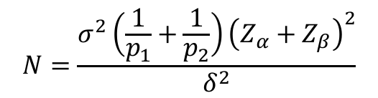
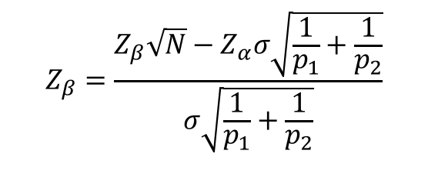
. power twomeans 125 140, sd(20)
Performing iteration ...
Estimated sample sizes for a two-sample means test
t test assuming sd1 = sd2 = sd
Ho: m2 = m1 versus Ha: m2 != m1
Study parameters:
alpha = 0.0500
power = 0.8000
delta = 15.0000
m1 = 125.0000
m2 = 140.0000
sd = 20.0000
Estimated sample sizes:
N = 58
N per group = 29
$$N=\frac{σ^{2}\left(\frac{1}{p_{1}}+\frac{1}{p_{2}}\right){\left(Z_{α}+Z_{β}\right)}^{2}}{δ^{2}}$$
$$Z_{β}=\frac{Z_{β}\sqrt{N}−Z_{α}σ\sqrt{\frac{1}{p_{1}}+\frac{1}{p_{2}}}}{σ\sqrt{\frac{1}{p_{1}}+\frac{1}{p_{2}}}}$$

Slide 13
. power twocorr 0.5 0.3, power(0.8)
Performing iteration ...
Estimated sample sizes for a two-sample correlations test
Fisher's z test
Ho: r2 = r1 versus Ha: r2 != r1
Study parameters:
alpha = 0.0500
power = 0.8000
delta = -0.2000
r1 = 0.5000
r2 = 0.3000
Estimated sample sizes:
N = 554
N per group = 277

Slide 14
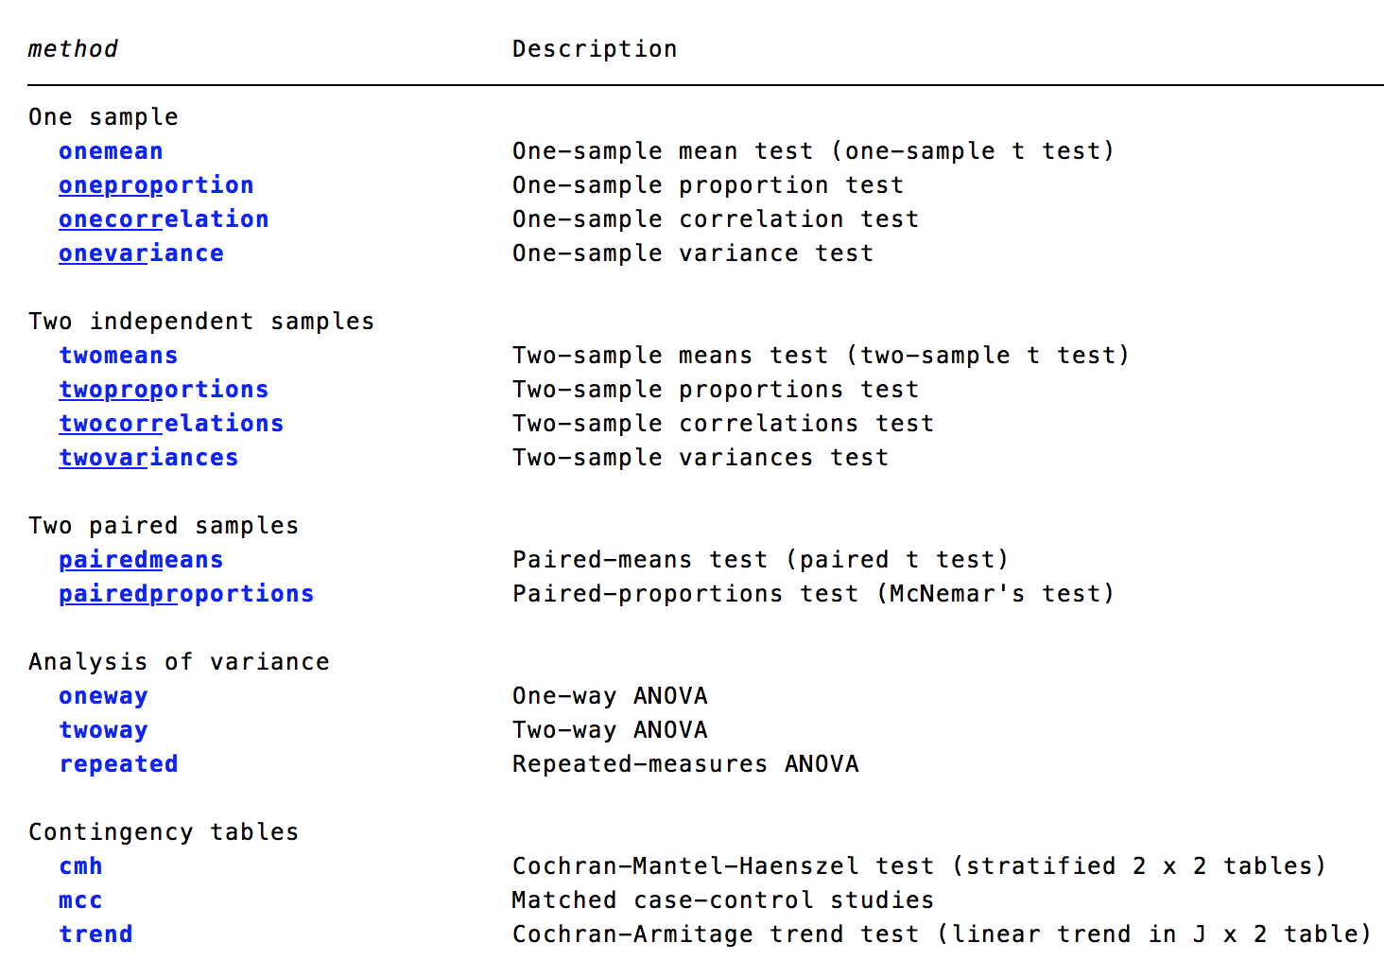

Slide 15
Less simple cases

Slide 16
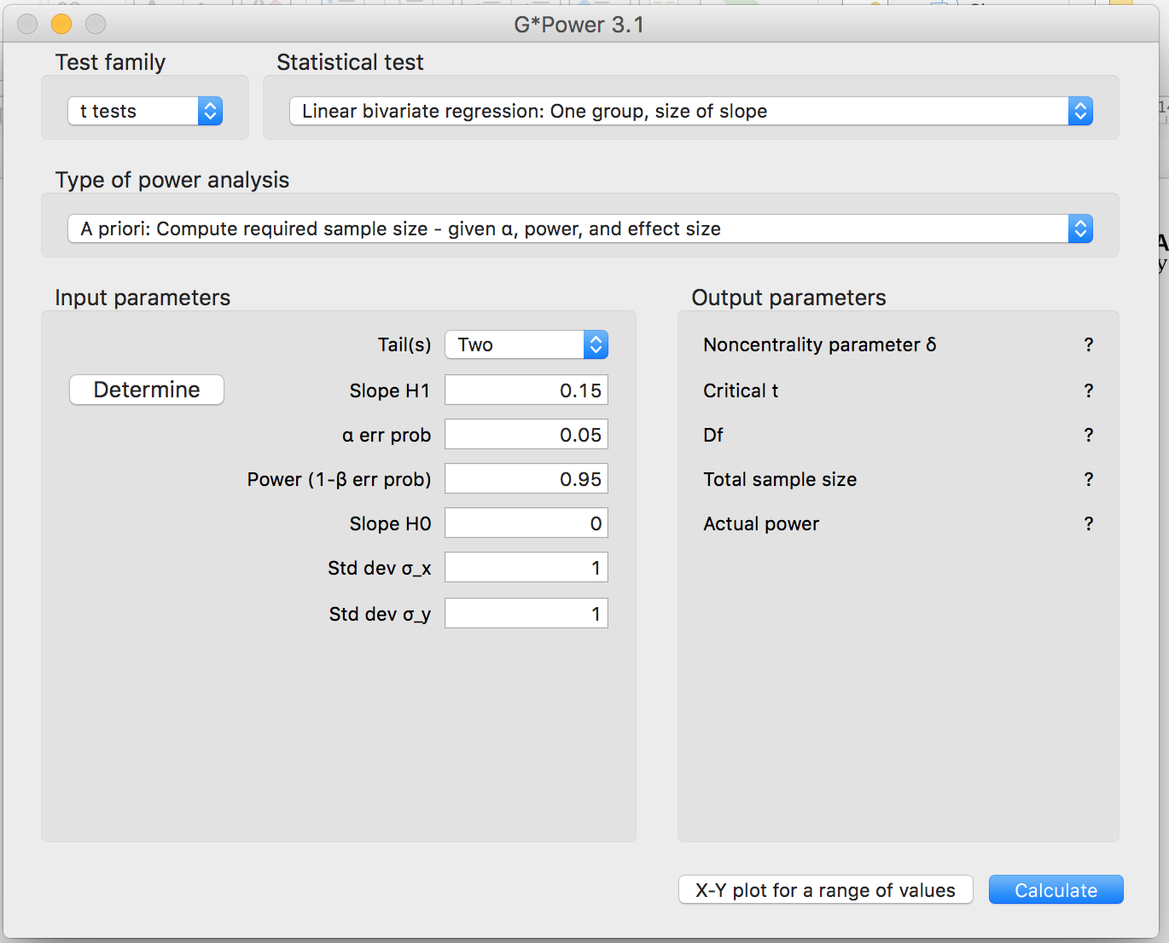
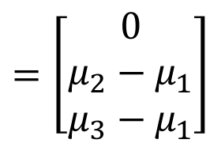
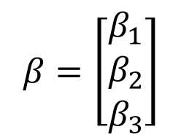
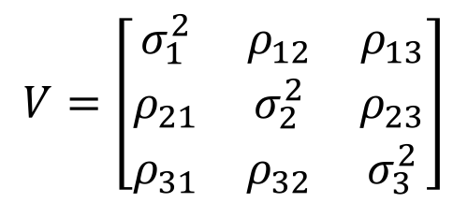
$$y_{i}=β_{0}+β_{1}{X1}_{i}+β_{2}{X2}_{i}+β_{3}{X3}_{i}+ε_{i}$$
$$β=\left[\begin{matrix}β_{1} \\ β_{2} \\ β_{3}\end{matrix}\right]$$
$$=\left[\begin{matrix}0 \\ μ_{2}−μ_{1} \\ μ_{3}−μ_{1}\end{matrix}\right]$$
$$V=\left[\begin{matrix}σ_{1}^{2} & ρ_{12} & ρ_{13} \\ ρ_{21} & σ_{2}^{2} & ρ_{23} \\ ρ_{31} & ρ_{32} & σ_{3}^{2}\end{matrix}\right]$$

Slide 17
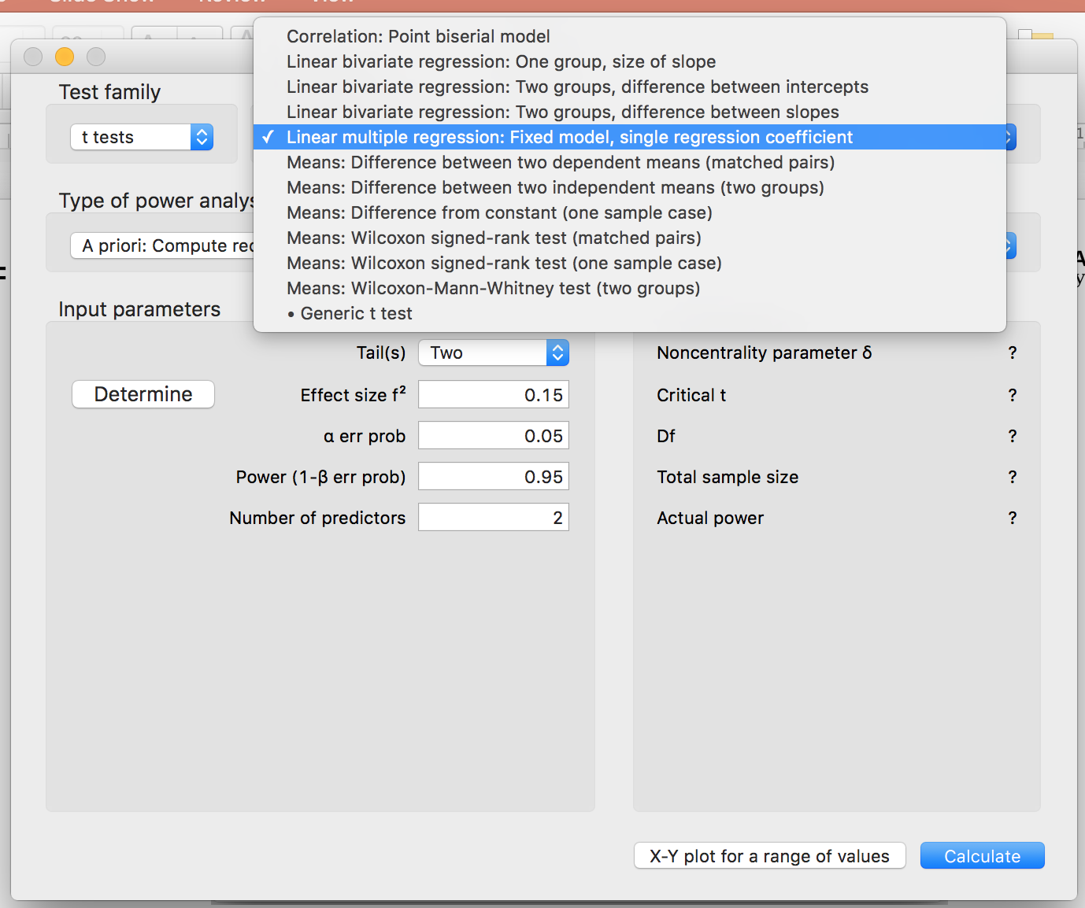

Slide 18
Another approach
Define a model which specifies H₀
Define a model which specifies H₁
Generate a sample from a population where H₁ applies
Calculate test statistic/p-value and determine whether H₀ accepted/rejected
Repeat a large number of times
Calculate percentage where H₀ rejected (=1-β )
$$y_{i}=β_{0}+β_{1}(=0){X1}_{i}+β_{1}{(=0)X2}_{i}+β_{1}{(=0)X3}_{i}+ε_{i}$$
$$y_{i}=β_{0}+β_{1}(>0){X1}_{i}+β_{1}{(>0)X2}_{i}+β_{1}{(>0)X3}_{i}+ε_{i}$$

Slide 19
clear
drop _all
set obs 50
matrix M = 0, 0, 0
matrix V = (1, .2, .2 \ .2, 1, .2 \ .2, .2, 1)
matrix list M
matrix list V
drawnorm x1-x3, n(200) cov(V) means(M) clear
gen err=rnormal(0,5)
gen y=1.5+1*x1+1.5*x2+2.0*x3+err
regr y x1 x2 x3
M[1,3]
c1 c2 c3
r1 0 0 0
. matrix list V
symmetric V[3,3]
c1 c2 c3
r1 1
r2 .2 1
r3 .2 .2 1

Slide 20
Source | SS df MS Number of obs = 50
-------------+---------------------------------- F(3, 46) = 15.00
Model | 834.631175 3 278.210392 Prob > F = 0.0000
Residual | 853.241807 46 18.5487349 R-squared = 0.4945
-------------+---------------------------------- Adj R-squared = 0.4615
Total | 1687.87298 49 34.4463874 Root MSE = 4.3068
------------------------------------------------------------------------------
y | Coef. Std. Err. t P>|t| [95% Conf. Interval]
-------------+----------------------------------------------------------------
x1 | -.3935259 .6908725 -0.57 0.572 -1.78418 .9971283
x2 | 3.696434 .6629891 5.58 0.000 2.361906 5.030961
x3 | 2.687594 .7566116 3.55 0.001 1.164614 4.210574
_cons | .4632275 .6132948 0.76 0.454 -.771271 1.697726
------------------------------------------------------------------------------

Slide 21
Repeat 1,000 times
capture program drop regsim11
sca def n=50
program regsim11, rclass
version 13
drop _all
set obs 50
matrix M = 0, 0, 0
matrix V = (1, .2, .2 \ .2, 1, .2 \ .2, .2, 1)
matrix list M
matrix list V
drawnorm x1-x3, n(50) cov(V) means(M)
gen err=rnormal(0,5)
gen y=1.5+1*x1+1.5*x2+2.0*x3+err
regr y x1 x2 x3
return scalar r2 = e(r2)
end
set seed 1234
simulate _b _se r2=e(r2), reps(1000) nodots: regsim11
gen tb1=_b_x1/_se_x1
gen tb2=_b_x2/_se_x2
gen tb3=_b_x3/_se_x3
gen pb1=tden(1,tb1)<0.05
gen pb2=tden(1,tb2)<0.05
gen pb3=tden(1,tb3)<0.05
su pb1 pb2 pb3
Variable | Obs Mean Std. Dev. Min Max
-------------+---------------------------------------------------------
pb1 | 1,000 .653 .4762539 0 1
pb2 | 1,000 .949 .2201078 0 1
pb3 | 1,000 1 0 1 1

Slide 22
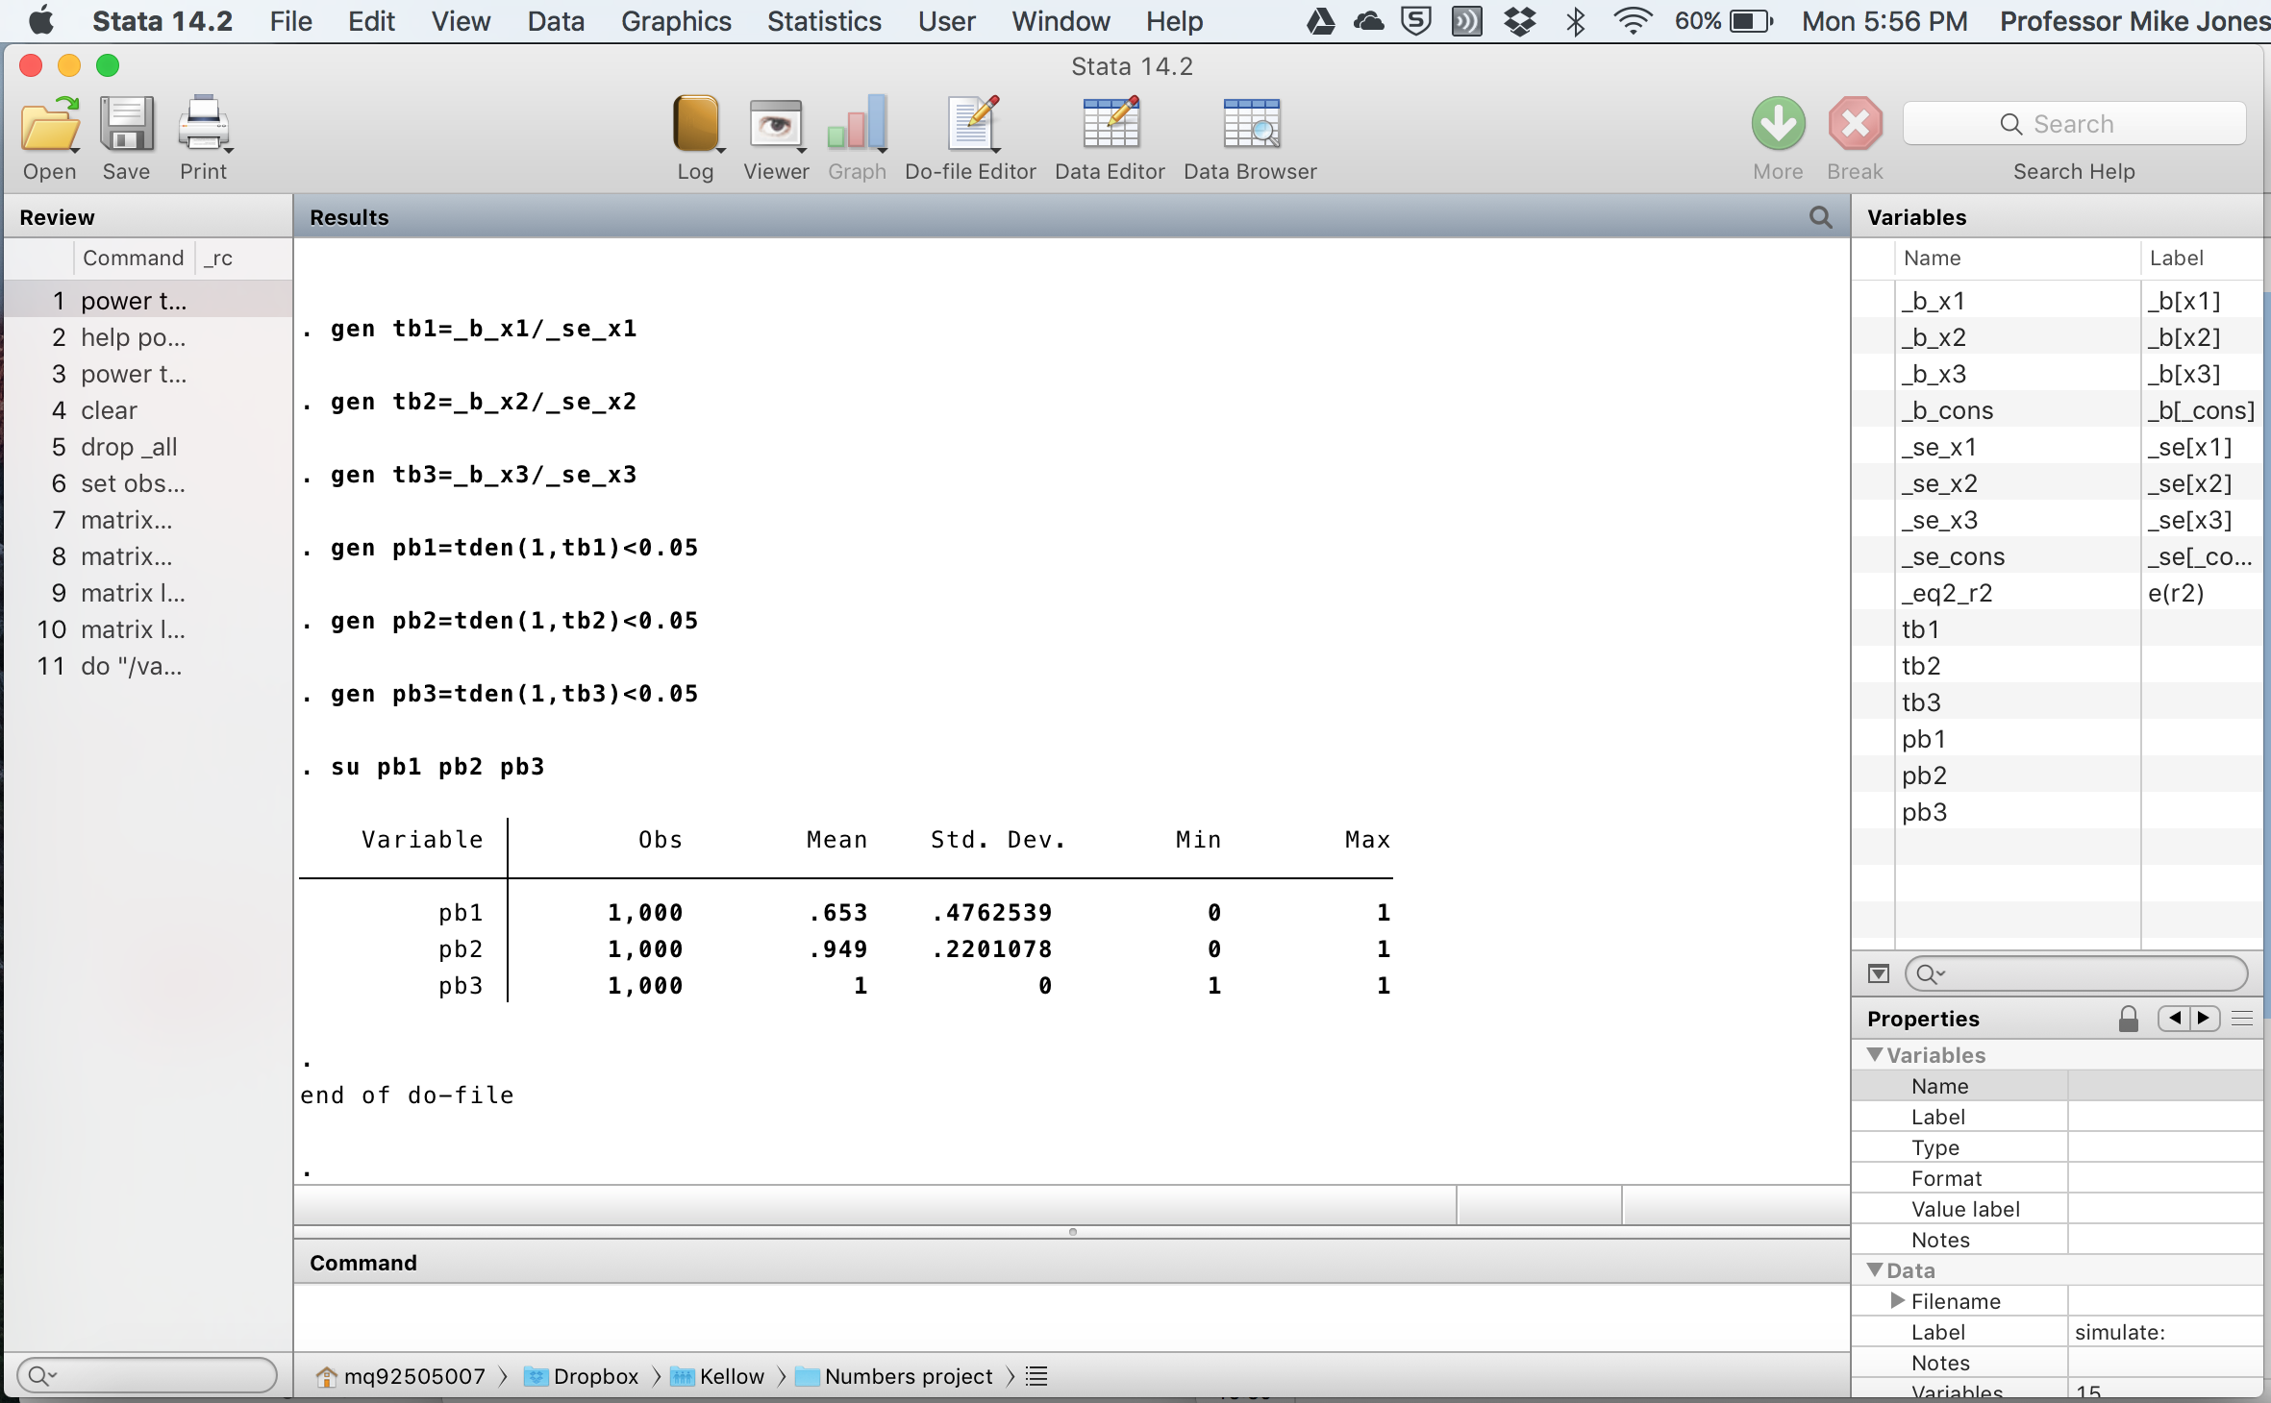

Slide 23
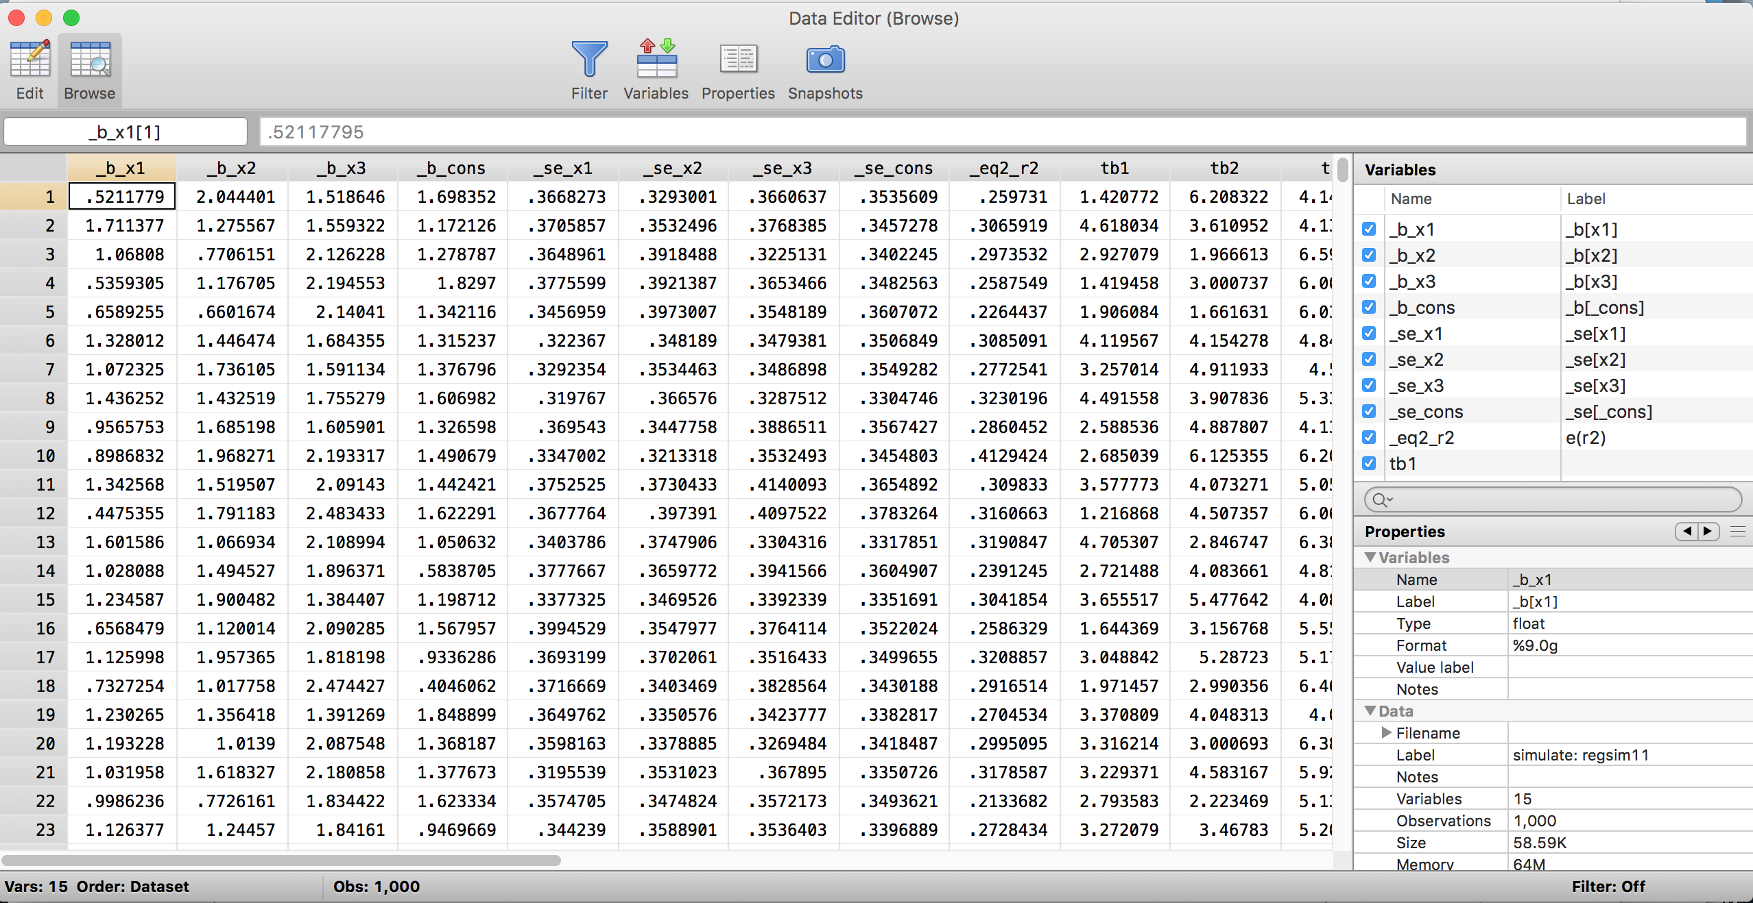

Slide 25

Factorial designed (independent groups) experiment
 | Factor B
Factor A | 1 | 2 | 3
1 | μ₁₁ | μ₁₂ | μ₁₃
2 | μ₂₁ | μ₂₂ | μ₂₃
$$y_{ijk}=α+θ_{i}+β_{j}+{θβ}_{ij}+ε_{ijk}$$

Slide 26
Examples: Computing sample size
Compute sample size for testing the row effect for a 5%-level test with 80% power
. power twoway 134 143 91 \ 106 173 145, varerror(1417)
Compute the required sample size for the test of a column effect
. power twoway 134 143 91 \ 106 173 145, varerror(1417) factor(column)
Compute the required sample size for the test of a row-by-column effect
. power twoway 134 143 91 \ 106 173 145, varerror(1417) factor(rowcol)

Slide 27
capture program drop facanovasim1
program facanovasim1, rclass
version 13
drop _all
set obs 30
gen id=_n
gen y1=rnormal(10,2)
gen y2=rnormal(11,2)
gen y3=rnormal(12,2)
gen y4=rnormal(10,2)
gen y5=rnormal(10,2)
gen y6=rnormal(10,2)
reshape long y, i(id) j(g)
recode g 1/3=0 4/6=1, gen(gender)
recode g 1 4=1 2 5=2 3 6=3, gen(group)
anova y gender group gender#group
return scalar f = e(F)
return scalar f_int = e(F_3)
return scalar df_int = e(df_3)
return scalar dfm = e(df_m)
return scalar dfe = e(df_r)
end
set seed 1234
simulate f_int=e(F_3) df_int=e(df_3) f=e(F) dfm=e(df_m) dfe=e(df_r) r2=e(r2), reps(1000) nodots: facanovasim1
pintsig | Freq. Percent Cum.
------------+-----------------------------------
0 | 44 4.40 4.40
1 | 956 95.60 100.00
------------+-----------------------------------
Total | 1,000 100.00

Slide 28
Power curves

Slide 29

Repeated measures experiment
Factor A
1 | 2 | 3
μ₁₁ | μ₁₂ | μ₁₃
$$y_{ik}=α+θ_{i}+ε_{ik}$$

Slide 30
Examples: Computing sample size
Calculate the sample size necessary to reject the null hypothesis that there is no main effect of
treatment and no interaction between treatment and time
. power repeated 145 135 130\145 130 120, covmat(225 158 158\158 225 158\158 158 225)
Specify the data of the last analysis as matrices; compute the sample size required to detect an
interaction between treatment and time
. matrix M = (145,135,130\145,130,120)
. matrix cov = (225,158,158\158,225,158\158,158,225)
. power repeated M, covmat(cov) factor(bwithin)
Repeat the last example specifying the error variance and repeated measures correlation
. power repeated M, varerr(225) corr(0.7) factor(bwithin)

Slide 31
capture program drop regsim11
sca def n=10
program regsim11, rclass
version 13
drop _all
set obs 10
matrix M = 0, 0.25, 0.5
matrix V = (1, .2, .2 \ .2, 1, .2 \ .2, .2, 1)
matrix list M
matrix list V
gen id=_n
drawnorm y1-y3, n(10) cov(V) means(M)
reshape long y, i(id) j(group)
anova y group id, repeated(group)
return scalar f = e(F_1)
return scalar dfm = e(df_1)
return scalar dfe = e(df_r)
end
set seed 1234
simulate f=e(F_1) dfm=e(df_1) dfe=e(df_r) r2=e(r2), reps(1000) nodots: regsim11
pintsig | Freq. Percent Cum.
------------+-----------------------------------
0 | 799 79.90 79.90
1 | 201 20.10 100.00
------------+-----------------------------------
Total | 1,000 100.00

Slide 32
Power curves

Slide 33
Conclusion
There are numerous approaches to prospective sample size determination, analytic and simulation
Some make more sense than others in particular situations
In more complex cases simulation that specifies a model satisfying the null hypothesis offers a tangible, readily specified approach

