Slide 1
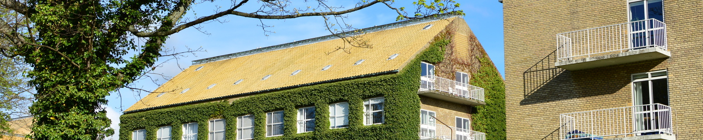

Stata as a numerical tool for
scientific thought experiments:
A tutorial with worked examples
September 5, 2014 - Aarhus
Henrik Støvring

Slide 2
Acknowledgments
Joint work with
    Theresa Wimberley-Böttger
    PhD-candidate, Department of Economics, AU
    Erik Parner
    Professor, Department of Public Health, AU
The Lifestyle During Pregnancy Study research group,
in particular Ulrik Kesmodel and Erik Lykke Mortensen
Full paper: http://www.stata-journal.com/article.html?article=st0281

Slide 3
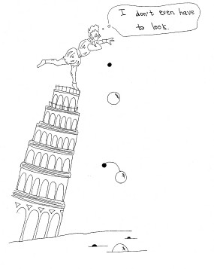
Thought experiments
Brown JR, Fehige Y. Thought Experiments. In: Zalta EN, editor. The Stanford Encyclopedia of Philosophy [Internet]. 2014 Available from: http://plato.stanford.edu/entries/thought-experiment/

Slide 4
Outline
Setting
Two cases
Perspectives and possibilities

Slide 5
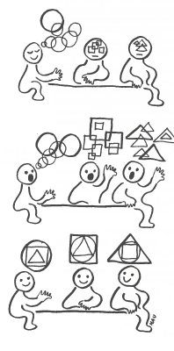
The challenge of cross-disciplinary research
Different professions
Different terminology
Different levels of
mathematical understanding
Different strategies
for validation of claims
How can we arrive at
common decisions?
Taken from Metode i projektarbejdet,
Algreen-Ussing & Fruensgaard, 1990, p112

Slide 6
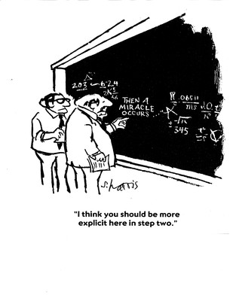
What makes a good
argument?
Transparent
Provides an example
Use simple tools
Involve empiric observation
...

Slide 7
The Lifestyle During Pregnancy Study (LDPS)
Subsample of the Danish National Birth Cohort (DNBC):
101,402 pregnancies with questionnaire info on mothers
- lifestyle
- living conditions
- medications
- etc
For access to data visit http://www.ssi.dk/English/RandD/Research%20areas/Epidemiology/DNBC/

Slide 8
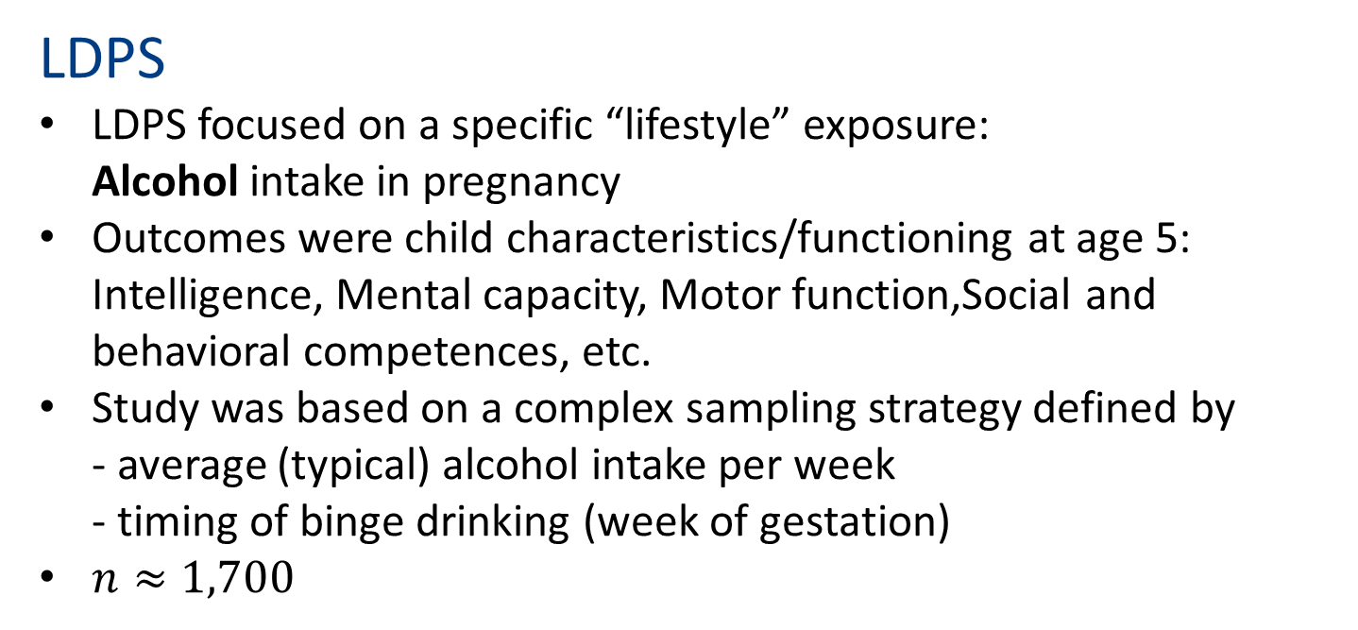
LDPS
LDPS focused on a specific “lifestyle” exposure:
Alcohol intake in pregnancy
Outcomes were child characteristics/functioning at age 5:
Intelligence, Mental capacity, Motor function,Social and behavioral competences, etc.
Study was based on a complex sampling strategy defined by
- average (typical) alcohol intake per week
- timing of binge drinking (week of gestation)
$n≈1,700$

Slide 9
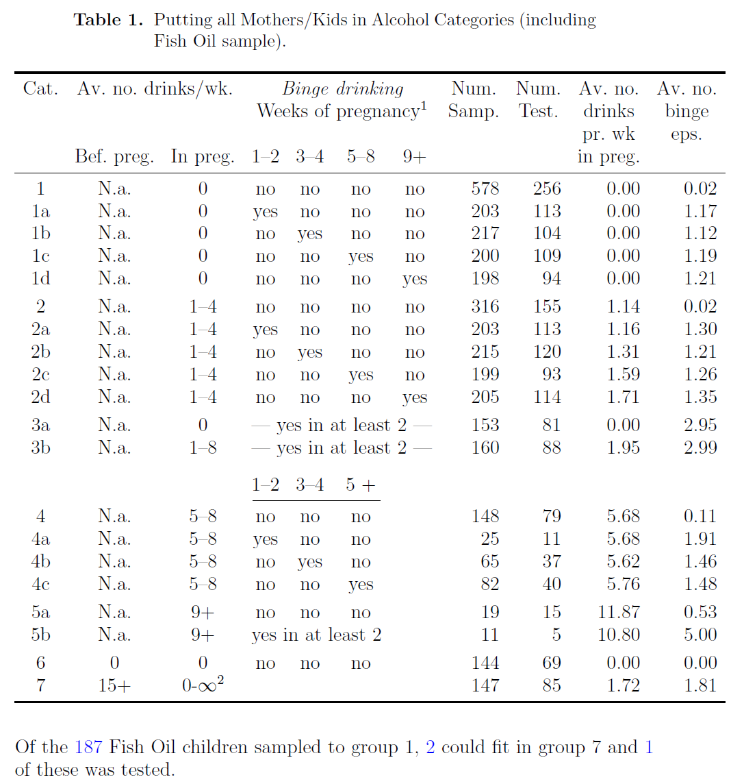
Sampling
strategy –
overview

Slide 10
Case I: Does dichotomizing an exposure at higher values always lead to higher effect estimates?
Background:
- Binge drinking defined in LDPS as 5+ drinks at a single occasion
- Monotone decrease in child IQ with higher intake
-> If only binge drinking had been defined as 8+ drinks, then a larger effect size would have been observed?!
Mathematical auto-pilot answer:
Of course not!
... But how would you demonstrate it?

Slide 11
Case II: Is it really necessary to apply the sampling weights in statistical analyses of LDPS?
Background:
- Statistical standard analysis incorporates sampling weights
- But this apparently took a hefty toll on precision...
-> Did weighting only maintain good temper of the statistician – or did it contribute actual value to the analyses?!
Mathematical-statistical auto-pilot answer:
Of course you need it!
... But how would you demonstrate it?

Slide 12
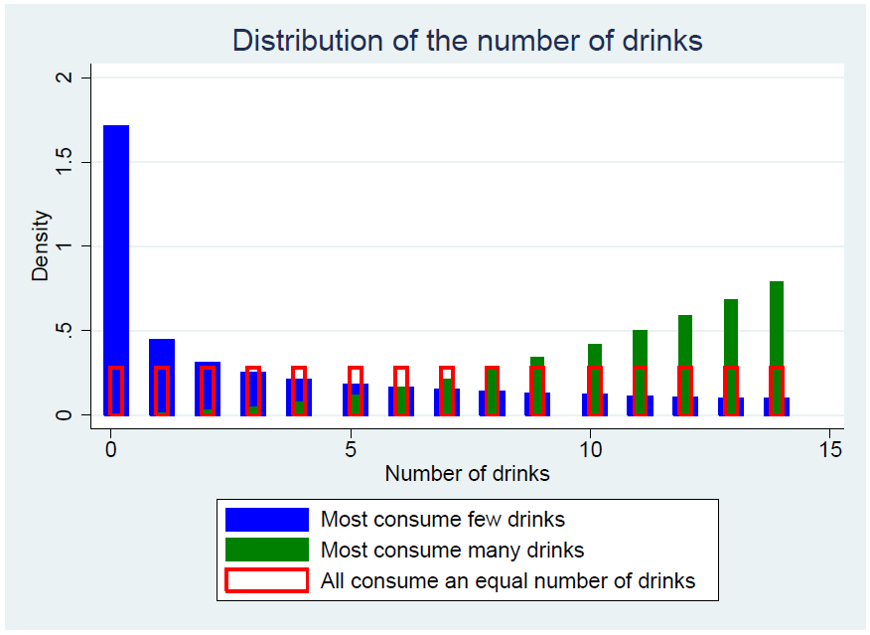
Binge drinking: higher cut-point – higher effect?
. set obs 1000000
obs was 0, now 1000000
. generate ndrinks = ///
int(runiform()^3*15)
. generate binge5 = ///
ndrinks >=5
. generate binge8 = ///
ndrinks >=8

Slide 13
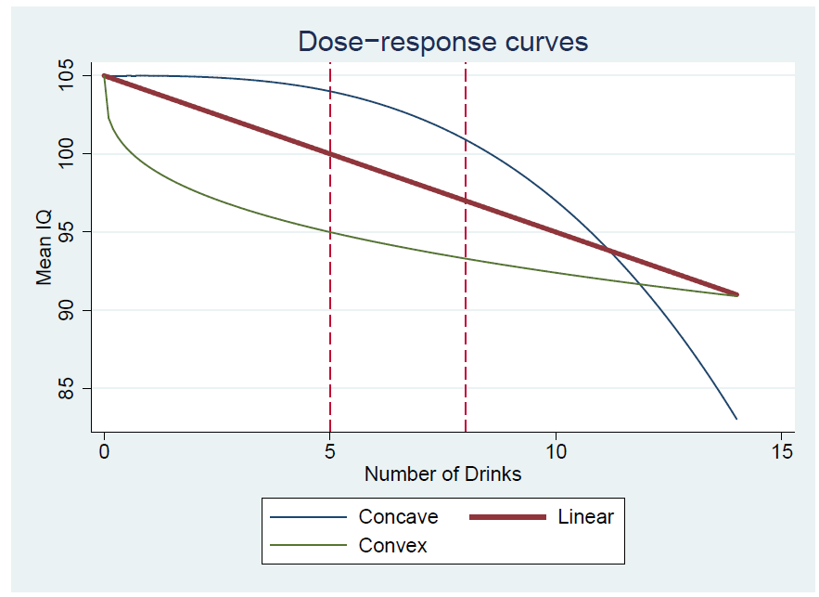

Binge drinking: higher cut-point – higher effect?
Concave (blue):
IQ = $105 − {\left(\frac{x}{5}\right)}^{3}$
Linear (red):
IQ =$105 − x$
Convex (green):
IQ =$105 −\sqrt[3]{200x}$

Slide 14
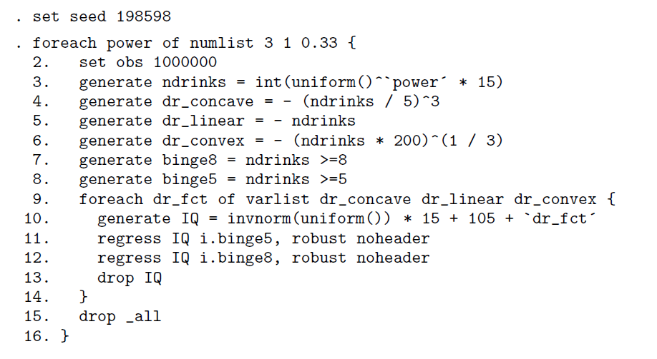
Binge drinking: higher cut-point – higher effect?

Slide 15
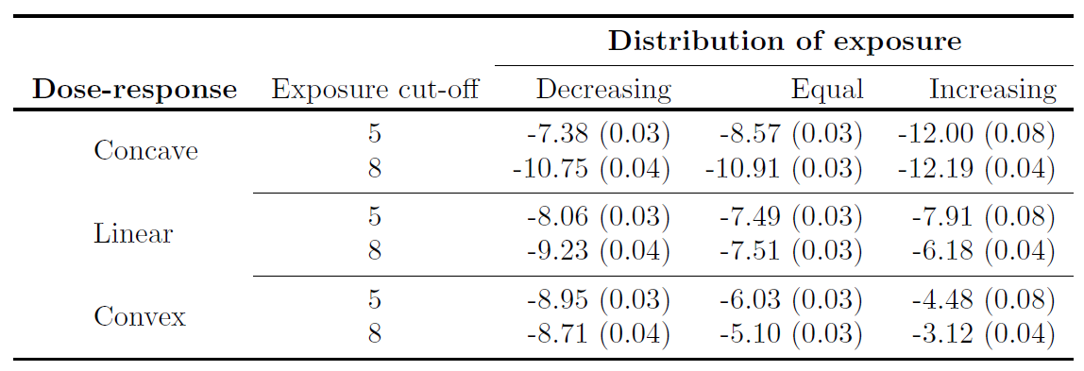
Binge drinking: higher cut-point – higher effect?

Slide 16
Sampling weights – nice to have or need to have?
First step: Simplification!
Generate a “synthetic” Danish National Birth Cohort of 100,000
Only consider binge vs. no binge and average alcohol intake in 4 categories
. set seed 1508776
. set obs 100000
obs was 0, now 100000
. generate avalco = int(runiform()^3 * 15)
. generate binge = runiform() < (.2 + avalco/(14*2))
. recode avalco (0 = 1) (1/4 = 2) (5/8 = 3) ///
(9/20 = 4), generate(alcocat)

Slide 17
Sampling weights – nice to have or need to have?
Child IQ depends on average alcohol intake and binge drinking:
. generate IQ = rnormal()*15 + 105 - (avalco/7)ˆ3 ///
- 4 * binge - .4 * (avalco/7)ˆ3 * binge
Sampling fractions:
        RECODE of binge
        avalco 0 1
        1 0.005 0.030
        2 0.010 0.035
        3 0.015 0.040
        4 0.020 0.045

Slide 18
Sampling weights – nice to have or need to have?
How to use -simulate- command:
. program define alcopw, eclass
. preserve
. keep if runiform() < sampfrac
. regress IQ avalco [pw = 1/sampfrac]
. restore
. end
. simulate _b _se, ///
reps(2500) saving(pwres, replace): ///
alcopw

Slide 19
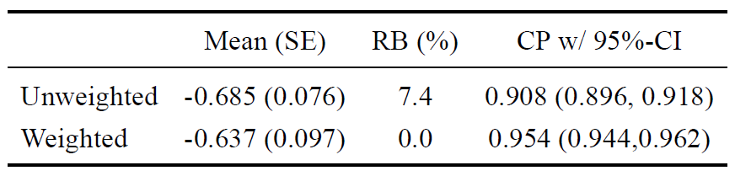
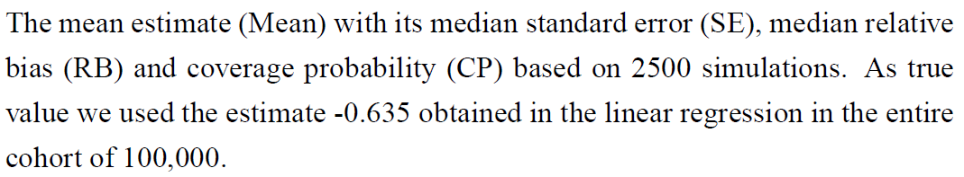
Sampling weights – nice to have or need to have?

Slide 20
Perspectives
Forces reconsideration of study design and sampling mechanism
Simple implementation (in particular due to -simulate-)
Very flexible tool
Based on experience: It may facilitate communication in cross-disciplinary research groups

Slide 21
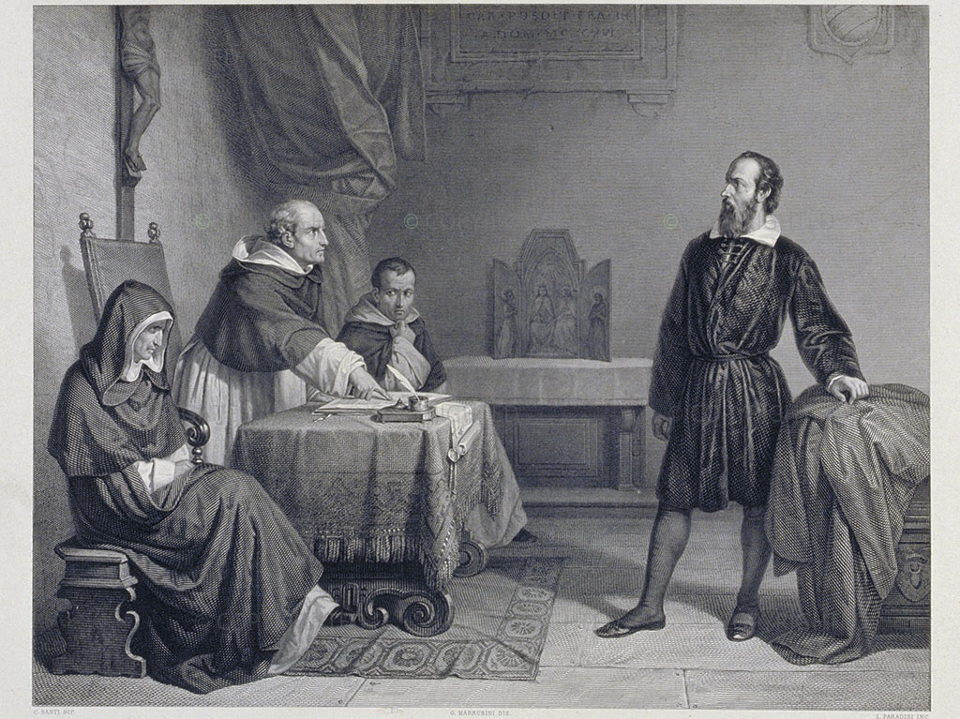
Cautionary advice:
Make sure your scenarios are sufficiently general
Do not provoke the inquisition!!

Slide 22

Give it a try and jump in!

